Slide 1
Product Lifecycle Management
By
Lewis Stalbird

Slide 2
What is PLM?
“The process of managing the entire lifecycle of a product from its conception, through design and manufacture, to service and disposal.”
“PLM integrates people, data, processes, and business systems and provides a product information backbone for companies and their extended enterprise.”

Slide 3
Product Lifecycle Management (PLM) != Product Life Cycle Management (PLCM)
“PLM describes the engineering aspect of a product, from managing description and properties of a product through its development and useful life.”
“PLCM refers to the commercial management of a product in the business market with respect to costs and sales measures.”

Slide 4
The Benefits of PLM
Reduced time to market
Improved product quality
Reduced prototyping costs
More accurate and timely Request For Quote generation
Ability to quickly identify potential sales opportunities and revenue contributions
Savings through the reuse of original data
A framework for product optimization

Slide 5
Even More Benefits of PLM
Reduced waste
Savings through the complete integration of engineering workflows
Documentation that can assist in proving Compliance for Restriction of Hazardous Substances (RoHS) or Title 21 CFR Part 11
Ability to provide Contract Manufacturers with access to a centralized product record

Slide 6
The Five Primary Areas of PLM
Systems Engineering (SE) – meets all requirements, primary meets customers needs, and coordinates the Systems Design process by involving all relevant disciplines
Product and Portfolio Management (PPM) – manages resource allocation, tracks progress vs. plan for projects in the new product development projects that are in process (or in a holding status)
Product Design (CAx)
Manufacturing Process Management (MPM)
Product Data Management (PDM) – captures and maintains information on products and/or services through their development and useful life

Slide 7
On the Idea of Software Integration
“While application software is not required for PLM processes, the business complexity and rate of change requires organizations to execute as rapidly as possible.”

Slide 8
Some PLM Software

Slide 9
Some Hyperlinks to the Software Information
Aras Innovator
Enovia MatrixOne
Oracle Agile e6

Slide 10
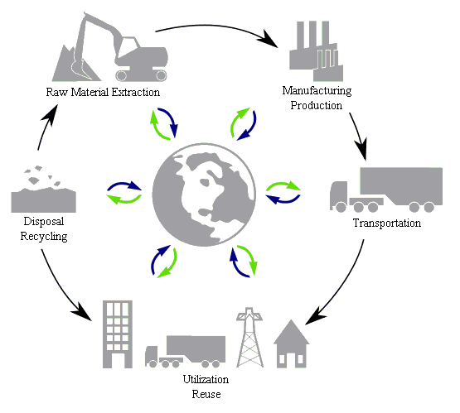
A Typical Lifecycle of Products

Slide 11
Phases of PLM
Conceive
Imagine, specify, plan, innovate
Design
Describe, define, develop, test, analyze and validate
Realize
Manufacture, make, build, procure, produce, sell and deliver
Service
Use, operate, maintain, support, sustain, phase-out, retire, recycle and disposal

Slide 12
Methodologies that PLM Adopted
Concurrent engineering workflow
Industrial Design
Bottom-up design
Top-down design
Front loading design workflow
Design in context
Modular design
NPD New product development
DFSS Design for Six Sigma
DFMA Design for manufacture / assembly
Digital simulation engineering
Requirement driven design
Specification managed validation
Configuration Management

Slide 13
The information provided throughout the PowerPoint was obtained from WikiPedia unless otherwise specified (http://en.wikipedia.org/wiki/Product_lifecycle_management)

