Slide 1
OAuth Tutorial
Hannes Tschofenig, Blaine Cook
(Similar material was used for the OAuth IETF#78 tutorial.)

Slide 2

Entities
User Agent
Authorization Request
User
Resource Consumer
Token request
Authorization Server
Access Request
(incl. Token)
Resource Server

Slide 3
Web Server Flow

Slide 4
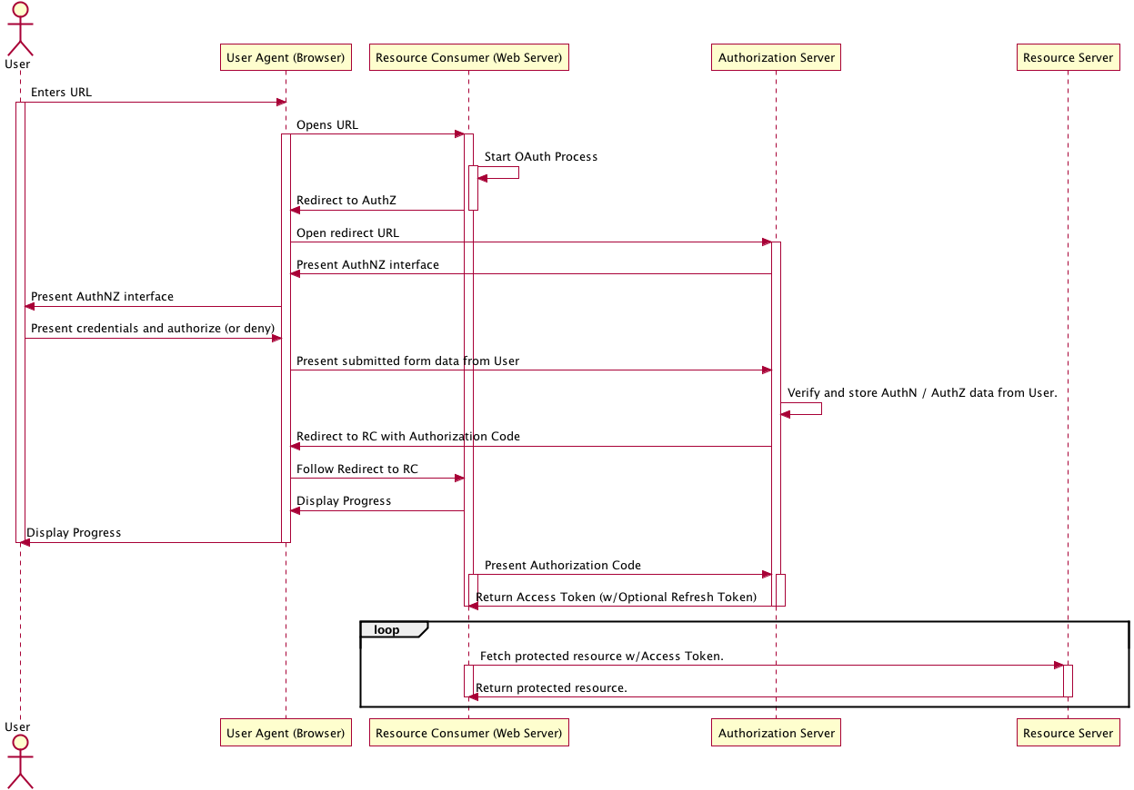

Slide 5
JavaScript Flow (User Agent Flow in Draft)

Slide 6
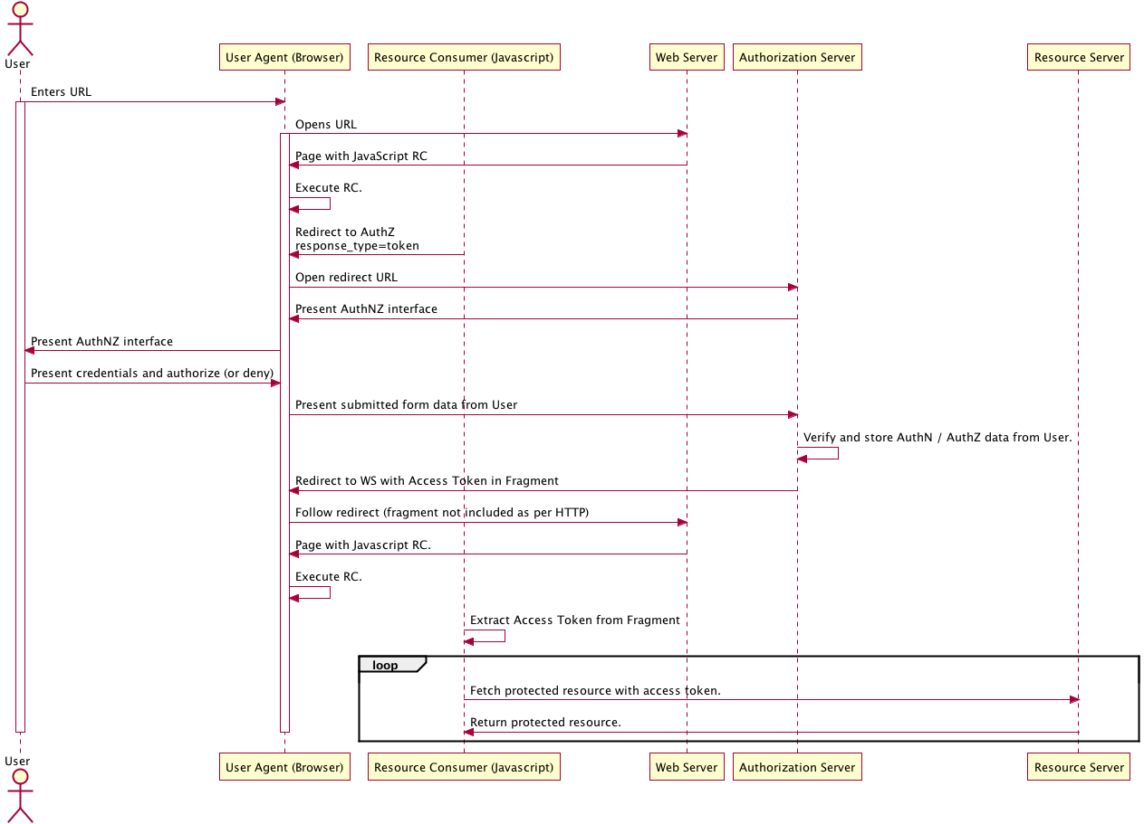

Slide 7
Native Application Flow

Slide 8
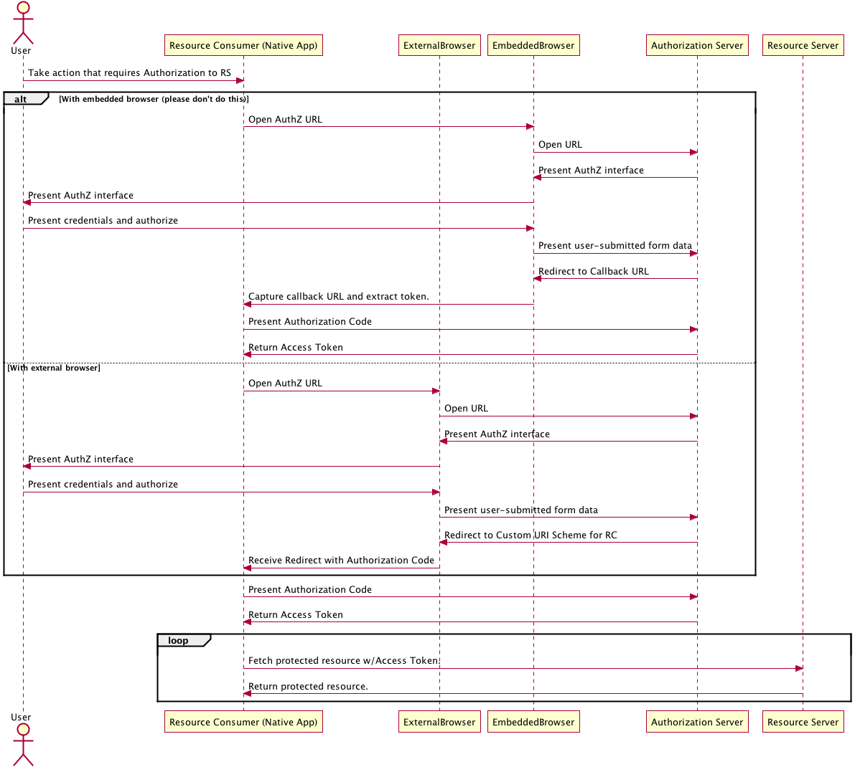

Slide 9
Autonomous Flow

Slide 10
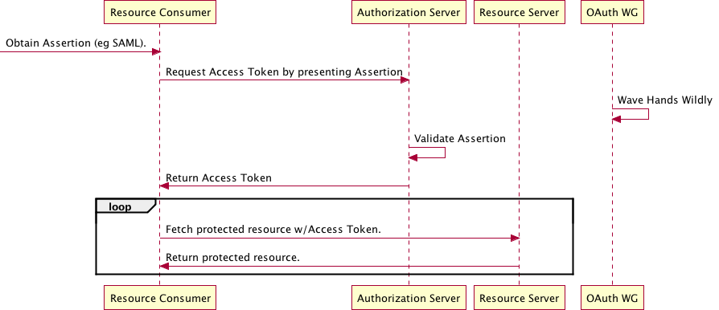

Slide 11
Device Flow

Slide 12
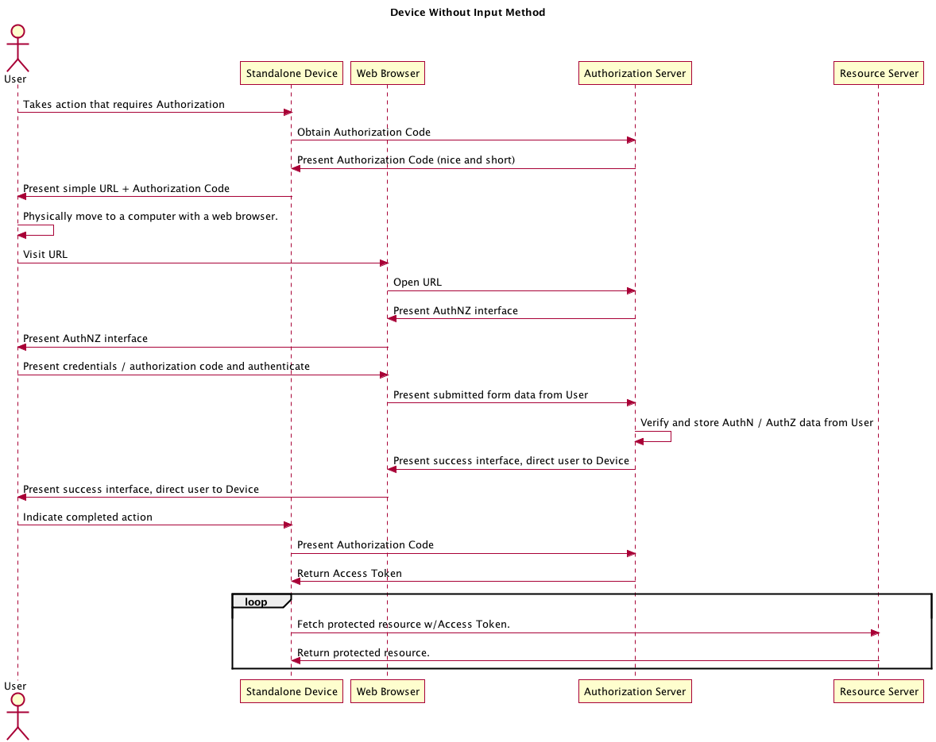

Slide 13
