Slide 1
WiFi, Bluetooth, ZigBee and NFC

Slide 2
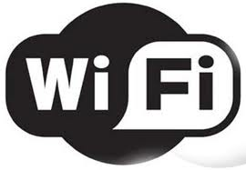
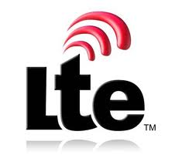

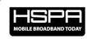
Wireless Broadband Technologies
802.11n
Throughput
4G
802.11 a/b/g
3.5G
Coverage Range

Slide 3
Wireless Technology Differences
Standard | Family | Downlink (Mbps) | Uplink (Mbps) | Coverage
WiFi | 802.11 | 11/54/150/300 |  | 100m
WiMAX | 802.16e | 144 | 35 | 10km
UMTS (3G) /HSPA (3.5G) | 3GPP | 14.4 | 5.76 | 30km
LTE (4G) | 3GPP | 360 | 80 | 30km

Slide 4
Wireless Technology Trends
WiFi
More hotspots, higher speed (802.11 a/b/g -> 802.11 n)
WiMAX
Bill Payne (CTO, Motorolla), said WiMAX will finally evolve into LTE.
LTE
Good coverage and high throughput (with offloading)

Slide 5
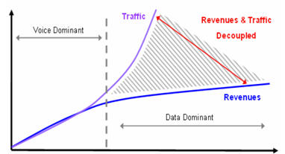
Why Offloading?

Slide 6
How to offload?
WiFi
Opportunistically use WiFi hotspots once they are available

Slide 7
WiFi
What is WiFi
Short for “Wireless Fidelity”
A trademark of the Wi-Fi Alliance
The brand name for products using the IEEE 802.11 family of standards
Commonly used for “wireless local area network” (WLAN)

Slide 8
IEEE 802.11 Family
Protocol | Release | Freq. (GHz) | Data Rate (Mbit/s) (Typical / Max) | Range (m) (Indoor/outdoor)
A | Sep 1999 | 5 / 3.7 | 20 / 54 | 35 / 120
B | Sep 1999 | 2.4 | 5.5 / 11 | 35 / 140
G | Jun 2003 | 2.4 | 22 / 54 | 38 / 140
N | Oct 2009 | 2.4 / 5 | 110+ / 300+ | 70 / 250

Slide 9
WiFi Network Topology
Point-to-Multipoint (Access Point)
Point-to-Point (Ad hoc)
Multipoint-to-Multipoint (Mesh Network)

Slide 10
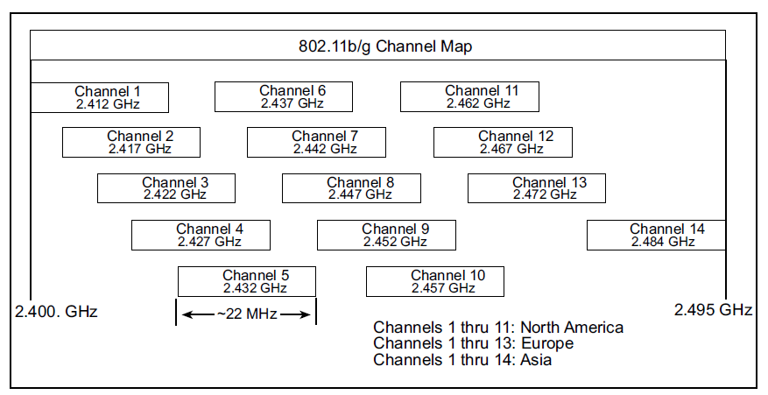
WiFi Channels

Slide 11
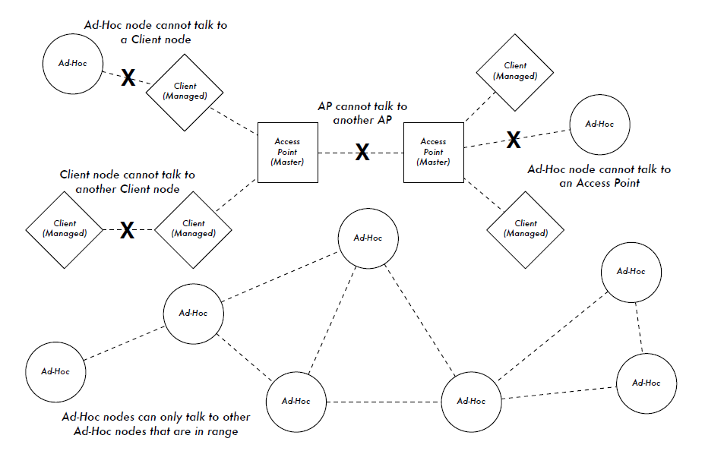
WiFi radio modes in action

Slide 12

WiFi Direct

Slide 13
WiFi Direct Features
Connects devices directly, with or without a Wi-Fi network or hotspot available
Makes the connection to open a world of applications, including content sharing, synch, printing, gaming and more
Connects with almost any Wi-Fi CERTIFIED device
Designed for portable and stationary devices

Slide 14
Bluetooth
Wireless Personal Area Networks (WPAN)
Design goal
Cable replacement
Low cost
Low power
Small size
For mobile devices
Standard: IEEE 802.15.1

Slide 15
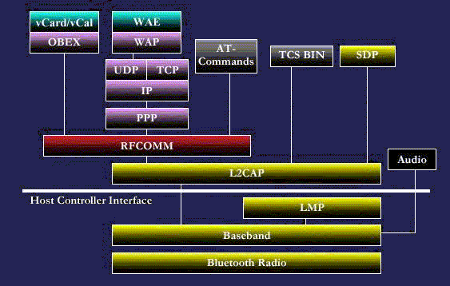
Bluetooth Protocol Stack

Slide 16
Technical Specification
Classes
Class 1 (100mW, 100m range)
Class 2 (2.5mW, 10m range)
Class 3 (1mW, 1m range)
RF
ISM band between 2.4-2.485GHz
Frequency hopping over 79 channels, 1600 hops/second

Slide 17
Bluetooth Version
Version | Data rate | Feature
1.2 | 721 kb/s
2.0 + EDR | 3 Mb/s | Enhanced Data Rate (EDR)
3.0 + HS | 24 Mb/s | High-Speed
4.0 | 1 Mb/s (BLE) | Bluetooth Low Energy (BLE)

Slide 18
WiFi vs. Bluetooth
 | Bluetooth | Wifi
Specifications authority | Bluetooth SIG | IEEE, WECA
Year of development | 1994 | 1991
Bandwidth | Low ( 800 Kbps ) | High (11 Mbps )
Hardware requirement | Bluetooth adaptor on all the devices connecting with each other | Wireless adaptors on all the devices of the network, a wireless router and/or wireless access points
Cost | Low | High
Power Consumption | Low | High
Frequency | 2.4 GHz | 2.4 GHz
Security | It is less secure | It is more secure
Range | 10 meters | 100 meters
Primary Devices | Mobile phones, mouse, keyboards,office and industrial automation devices | Notebook computers, desktopcomputers, servers
Ease of Use | Fairly simple to use. Can be used to connect upto seven devices at a time. It is easy to switch between devices or find and connect to any device. | It is more complex and requires configuration of hardware and software.

Slide 19
ZigBee
Design goal
Low power consumption
Simple Design
Few costs
History
ZigBee-style networks began in around 1998
IEEE 802.15.4 was first completed in 2003
ZigBee Alliance was established in 2002

Slide 20
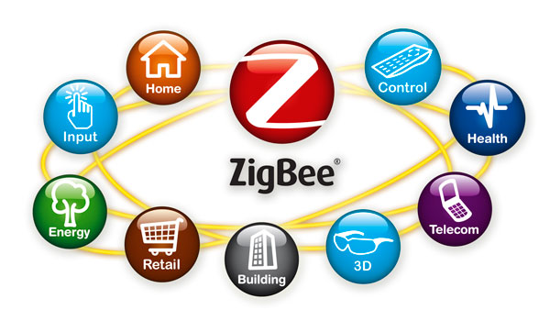
ZigBee Core Market
Industrial and Commercial
Monitors
Movement Sensors
Automation
Personal Healthcare
Patient monitors
Remote Diagnosis
Data loggers
Building Automation
Security
Lighting
Fire and Safety systems
Automotive
Service controls
Inventory tracking

Slide 21
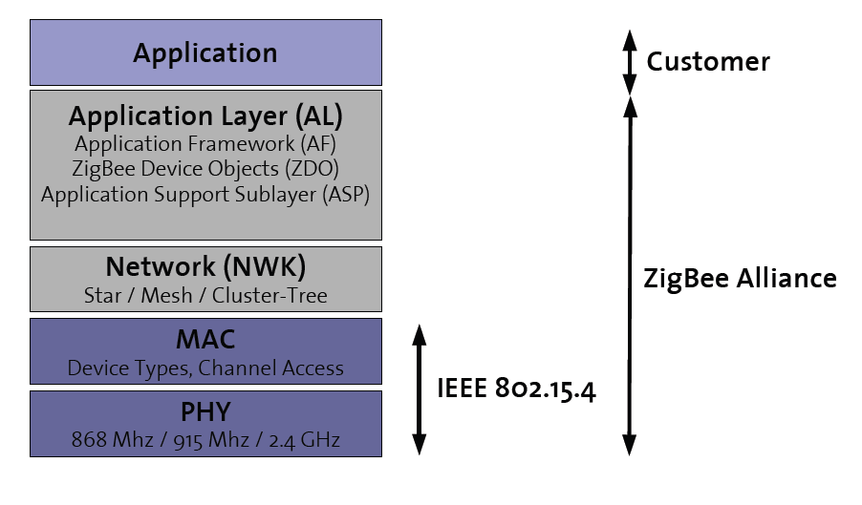
ZigBee Protocol Stack

Slide 22
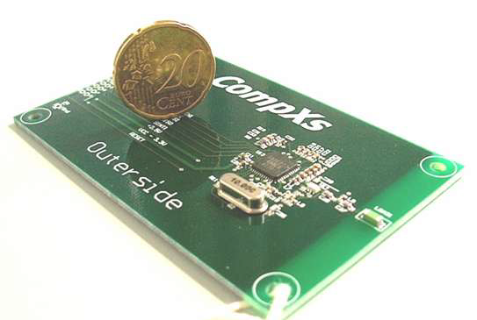
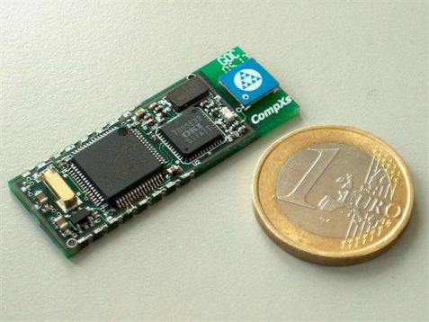
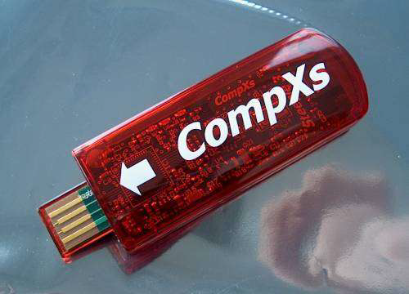
Device Type
Full Function Device (FFD)
Network router function
Any Topology
Reduced Function Device (RFD)
Easy and cheap to implement
Limited to star topology
Personal Area Network (PAN) Coordinator
Maintains overall network knowledge
Needs most memory and computing
power

Slide 23
Bluetooth vs. ZigBee
 | Bluetooth (v1) | ZigBee
Protocol Stack | 250 kb | < 32 kb (4kb)
Range | 10 - 100 meters | 30 - 100 meters
Link Rate | 1 Mbps | 250 kbps
Battery | rechargeable | non-rechargeable
Devices | 8 | 2^16
Air Interface | FHSS | DSSS
Usage | frequently | infrequently
Network Join Time | long | short
Extendibility | no | yes
Security | PIN, 64 bit, 128 Bit | 128 bit, AES

Slide 24
What is NFC?
Short range radio communication
Builds on specifications laid out for earlier RFID (Radio Frequency Identification) technology²
Usually operates within a 4 cm range, but specifications allow for a range up to 20 cm²
Uses a frequency of 13.56 MHz²
Possible transfer rates are 106, 212, 424kbps¹⁵

Slide 25
Comparison Between Similar Technologies ¹⁴
 | NFC | RFID | Bluetooth | Wi-Fi
Maximum Operating Range | 10 cm | 3 m | 100 m | 100 m
Operating Frequency | 13.56 MHz | Varies¹ | 2.4 GHz | 2.4/5 GHz (802.11n)
Directional Communication | Two way | One way | Two way | Two way
Bit Rate | 106/212/ 424 Kbps | Varies¹³ | 22 Mbps | 144 Mbps
Potential Uses | e-Tickets, Credit card payment, Membership card | Tracking items, EZ-Pass | Communicate between phones, peripheral devices | Wireless internet

Slide 26
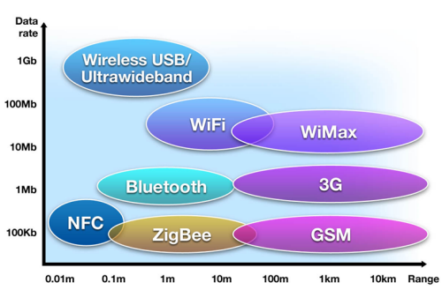
Comparison Between Similar Technologies³

Slide 27
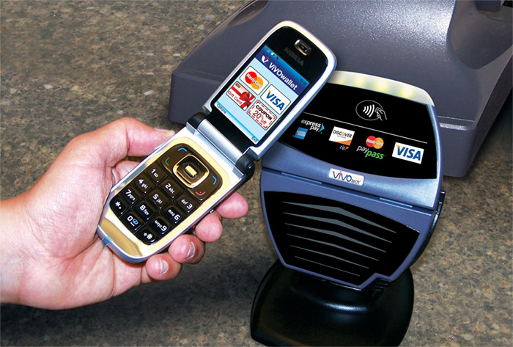
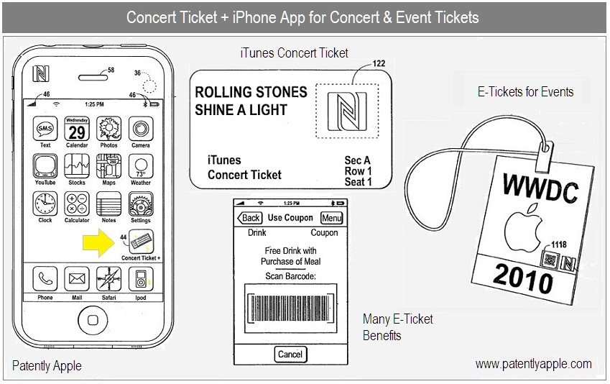
Applications for NFC
Use phone like a contactless credit card ¹¹
Also could work as a coupon or gift card
Apple patent (lower image) shows ideas for digital concert tickets, coupons ¹⁰
Can download tickets to phone with NFC enabled computer

Slide 28
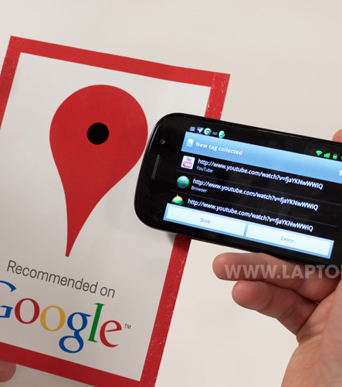
Applications for NFC
Smart posters/tags ¹²
These tags can link to relevant websites
Can be used to perform actions in applications that are NFC enabled
Could be used to download and run a guide program in a museum

Slide 29
Applications for NFC⁹
 | Bus/Train Station, Airport | Vehicle | Office | Store, Restaurant | Theater, Stadium | Anywhere
Usage of NFC Mobile Phone | Ticketing Get information from smart poster Get information from info kiosk Pay bus/taxi fare | Adjust seat position Open door Pay parking fees | Enter/exit office building Exchange business cards Log into PC Print using copier machine | Pay by credit card Get loyalty points Get and use coupons Share information and coupon among users | Electronic ticket Get event information | Download and personalize application Check usage history Download ticket Lock phone remotely
Service Industries | Mass transport Advertising | Public transport | Security | Banking Retail Credit Card | Entertainment | Any
Notes:
(From http://www.nfc-forum.org/aboutnfc/nfc_in_action/)
7:30 - Eric gets on a train to go to his office, using his NFC-enabled phone to tap a reader and easily open the turnstile.
7:32 - He sees a poster announcing a free concert that evening. He touches his NFC-enabled phone to the N-Mark on the poster, which transfers the detailed information onto his phone. He reserves seats for the concert with his mobile phone, using mobile communications (e.g., SMS, internet, packet-based connections), and the complimentary tickets are sent to his mobile phone. He sends a text message to his wife to invite her to the concert and dinner.
8:15 - When he arrives at his office, Eric touches his NFC-enabled phone to the office gate to unlock the security mechanism.
Noon - At lunch time, he pays for his meal using one of the credit cards stored in his phone.
13:00 - After lunch, Eric visits the office of his new business partner for a meeting. Those attending the meeting exchange electronic business cards, stored in their NFC-enabled phones, by touching their phones together.
18:00 - Eric meets his wife and they go to the concert venue. He touches his NFC-enabled phone to a turnstile at the entrance to the venue, their reservations are confirmed, and they are admitted.
20:00 - After the concert, they visit a shopping center, where they make a few purchases and have dinner, using their NFC-enabled phones to pay for everything.
22:00 - When they arrive home, Eric realizes that he left his NFC-enabled phone on the train. He immediately calls the mobile network operator and makes a request to disable all active NFC services in the phone. If his phone is later found and returned to him, he will be able to reactivate these services.

Slide 30
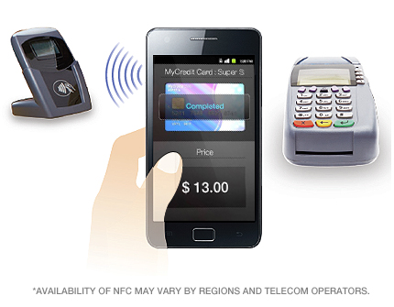
NFC Enabled Devices
Samsung Nexus S¹⁶
Samsung Galaxy II¹⁷
Nokia expects all phones to have NFC this year⁴
iPhone 5 expected to have NFC⁵

Slide 31
NFC in the Future
In Turkey, Visa has started a contactless payment trial for the iPhone (using an peripheral device) ⁸
AT&T, Verizon, and T-Mobile have formed a group, Isis, promoting NFC in cell phones for payment⁶
London has announced it intends to fully support NFC payments on all busses, subway, and light rail transportation systems before the 2012 Olympic Games⁷

Slide 32
How NFC Works
There are two types of NFC devices, active and passive.
Passive | Active
No power source | Has own power source
Stores data to be read by another NFC device | Creates RF field to power passive devices

Slide 33
NFC Interaction
Based on a message/reply system¹⁸
Device that begins the interaction process is called the “initiator” and the other called the “target”
Device X send a message to Device Y. Device Y then responds. Device Y cannot send data without being contacted first
Possible combinations of Active/Passive devices¹⁸
 | Initiator | Target
Active | Possible | Possible
Passive | Not Possible | Possible

Slide 34
Inductive Coupling¹⁵
Induction is the production of electric current by passing a wire through a magnetic field
NFC devices have coils built into them. A magnetic field from a NFC device generates power in these coils, which initiates the transmission of data into radio waves²²
Both devices share this power

Slide 35
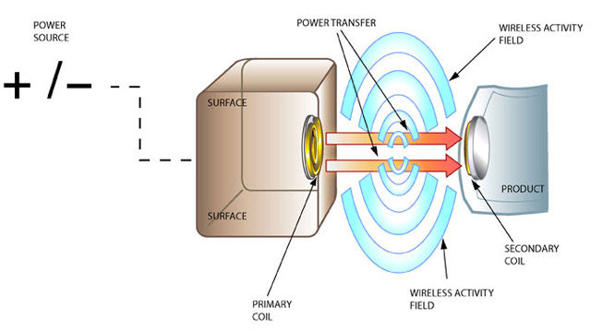
Inductive Coupling²¹

Slide 36
References
[1] “20101020_Wi-Fi_Direct_Media_Presentation_FINAL”.
[2] Ramiro Liscano. “Introduction to Bluetooth Networking ”.
[3] Patrice Oehen. “ZigBee: An Overview of the Upcoming Standard”.
[4] Rabbit.com. “An Introduction to ZigBee”.

Slide 37
Reference (Cont’d)
1 - www.scansource.eu/es/education.htm?eid=8&elang=en
2 - http://arstechnica.com/gadgets/guides/2011/02/near-field-communications-a-technology-primer.ars
3 - http://www.nfc-forum.org/aboutnfc/nfc_and_contactless/
4 - http://www.theregister.co.uk/2010/06/17/nokia_nfc_commitment/
5 - http://www.nearfieldcommunicationsworld.com/2011/03/02/36293/e-wallet-icon-sparks-more-apple-nfc-speculation/
6 - http://news.cnet.com/8301-1035_3-20022912-94.html
7 - http://www.nearfieldcommunicationsworld.com/2011/02/27/36204/transport-for-london-confirms-plans-to-accept-contactless-cards-in-time-for-olympics/
8 - http://www.wired.co.uk/news/archive/2011-02/01/visa-iphone-nfc
9 - http://www.nfc-forum.org/aboutnfc/nfc_in_action/
10 - http://www.patentlyapple.com/patently-apple/2010/04/apple-introduces-us-to-a-new-itunes-concert-ticket-system.html
11 - http://www.mobilemag.com/2010/08/20/visa-announces-mobile-payment-trials-in-nyc-this-year/
12 - http://www.laptopmag.com/review/cellphones/samsung-nexus-s.aspx?page=2
13 - http://www.hightechaid.com/standards/18000.htm
14 - http://java.sun.com/developer/technicalArticles/javame/nfc_bluetooth/
15 - http://www.nfc-forum.org/resources/faqs/
16 - http://www.nearfieldcommunicationsworld.com/2010/12/07/35385/google-unveils-first-android-nfc-phone-but-nexus-s-is-limited-to-tag-reading-only-for-now/
17 - http://galaxys2.samsungmobile.com/html/feature.html
18 - http://events.iaik.tugraz.at/RFIDSec06/Program/papers/002%20-%20Security%20in%20NFC.pdf
19 - http://intrepidusgroup.com/insight/2010/12/nfc-rfid-enabled-smartphones-and-mobile-devices-are-coming/
20 - http://www.crypto.rub.de/imperia/md/content/seminare/itsss07/near_field_communication_in_cell_phones.pdf
21 - http://www.gamberjohnson.com/assets/images/concept-illustration.jpg
22 - http://electronics.howstuffworks.com/nfc-phone.htm

