Slide 1
Azure IoT and Bluetooth LE
Jared Rhodes
MCSD, Xamarin Certified Developer
Senior Consultant
Magenic Technologies
Marshall Stewart
Power Engineer
Mangan Inc.

Slide 2
Outline
Internet of Things
Bluetooth Low energy
Azure IoT offerings

Slide 3
What’s Driving the IOT trend
Costs are falling. The costs of the Internet of Things components such as microchips, cloud services, GPS devices, accelerometers, connectivity, and other technologies have fallen and are now within reach for most organizations. In addition, processing power is becoming more affordable, and cloud computing services are increasingly available, vastly expanding the capability to crunch very large data sets.
Connected device demand is accelerating. As more companies and consumers realize the value of connected things, the market is swelling into the billions and beyond.

Slide 4
What’s Driving the IOT trend
Device options are expanding. Everything from light bulbs and washing machines to point-of-sale terminals is becoming connected, and that connectivity is also greatly improved, whether it’s wired, wireless, Wi-Fi, Bluetooth, cellular, or something else. And components are becoming more powerful—tiny microchips are now capable not only of connectivity but also of running much more advanced software than ever before.
More machines are talking to each other. Machine-to-machine (M2M) solutions are going mainstream. Vodafone forecasts that 50 percent of companies will have adopted M2M communications technologies by 2020.

Slide 5
What’s Driving the IOT trend
Software is more advanced than ever. Today’s rich, dynamic business software is putting high-level data analysis capabilities into the hands of companies around the globe.
The economic benefits are enormous. The Internet of Things has the potential to create economic impact of $2.7 trillion to $6.2 trillion annually by 2025, according to McKinsey Global Institute.
Microsoft’s Internet of Things White Paper

Slide 6
What’s Driving the IOT trend - Jared’s take
Cost of Hardware
Cost of Data
Cost of Operations
Sunk cost end of life

Slide 7
What is Bluetooth LE
AKA Bluetooth Smart / Bluetooth 4.0
Bit rate is 1Mbit/s, and the maximum transmit power is 10 mW
Max Range <100 m
Number of Children restrictions removed
New GAP and GATT Layers
Notes:
The major benefits have been due to timing and restructuring the way data is transmitted. Prior BT devices took 22mS to transmit while BT Smart takes 3. Bluetooth LE started off as a small subset of version 4.0 of the Bluetooth Core specification. Because of the popularity of it though, the Bluetooth Smart standard was created to more properly address the industry uses. Bluetooth SIG is currently on version 4.2 (adopted Dec, 02, 2014)
Another added advantage is a CCCD which can save information about difference connections from peripherals to central units and vice versa.
Bluetooth Smart bridged the gap between the old, BT Basic Rate and Enhanced Data Rate, with the Bluetooth Low Energy devices.

Slide 8
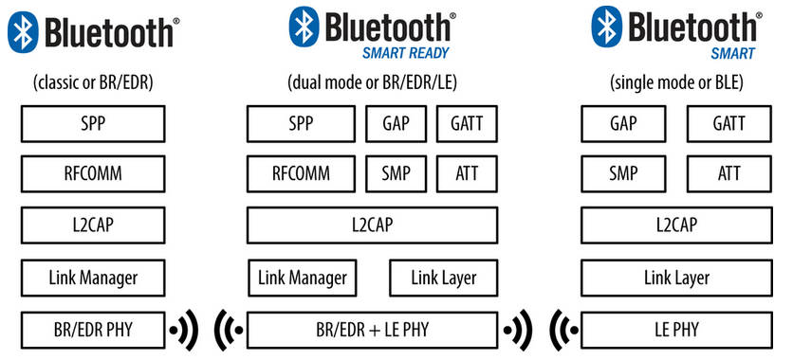
Introduction to Bluetooth Smart
Notes:
Image from “Getting Started with Bluetooth Low Energy” by Kevin Townsend, Carles Cufi, Akiba, and Robert Davidson
http://shop.oreilly.com/product/0636920033011.do

Slide 9
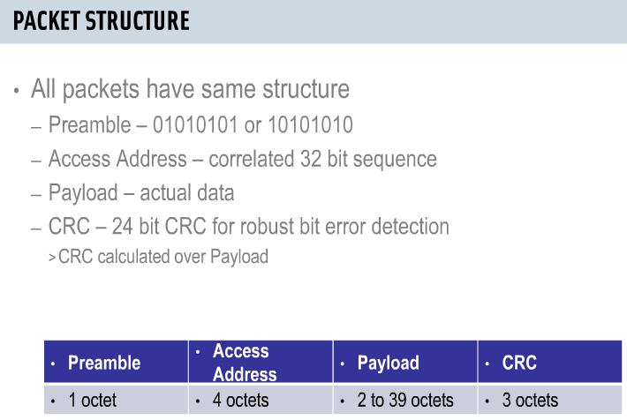
Packet Structure changes
Notes:
The payload is in Octets because of the communication standard, but in this case, it’s the same as “byte”. In practice, the chip we’re using will get around 10 kbits/sec, because of the lowered transmission intervals and structure of our packets.
16bit CRC on most all other networking types
24bit CRC on BT Smart to cut down on noise since they developed this to be massively deployed.
1.5ms is the maximum amount of time any operation takes, the device goes to sleep or turns off after each portion of an operation.
Added CRC size allows to calculate many more errors. Made for noisy environments.
Also, as opposed to BT Basic Rate, the CRC is generated after the data is encrypted so transmitting no longer requires the slave device to use energy to encrypt this. Also, encryption methods are now determined by the host/server/master device. After that encryption method is determined. The slave can use the desired method. But, while this flow of Data Encryption before CRC generation is required. Encryption isn’t required by the standard. Encryption and some other controls to determine the way the devices communicate is done with Link Layer Control Messages.
Connection intervals – between 7.5ms and 4s. One of the primary factors to allow for longer battery life. Is adjustable after initial setting.

Slide 10
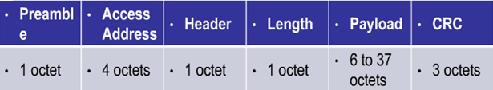
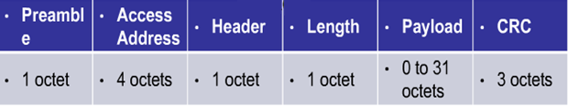
Packet Structure Design
Advertising Packet
Data Packet
Notes:
This is to highlight the similarities between the way advertisers and peripherals send information.
This makes it easier to configure a device to be a peripheral and means that for BT Smart devices, that can be a peripheral and Central units, the packet doesn’t change much.
Now that Centrals can connect to multiple Peripherals and Peripherals can connect to multiple centrals, we can take advantage of this using more protocol layers. This makes the GATT and standards more important.

Slide 11
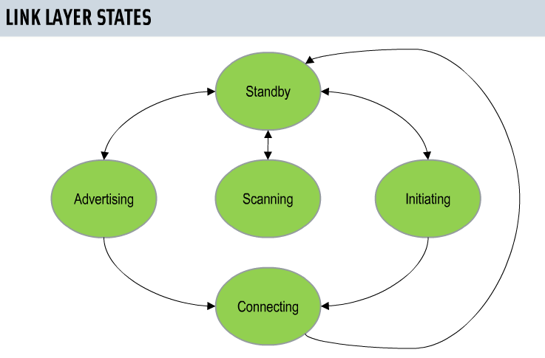
Link Layer
3 Advertising channels
37 Data channels
Notes:
The Advertising channels are sectioned around typical Wi-Fi frequencies, to avoid interface. The addition of data channels was made because BT Smart was designed to work in noisier environments. 37 Channels ensures that data will be transmitted
The Link Layer has been made more efficient by only having 5 states it can be in. If a device is Broadcasting/Advertising, it will be the slave/client in the match. The device Initiating the connection will be the master/server. Once this exchange has taken place, and the devices have exchanged their information. They both go back to standby.
The Advertiser sends information to the Initiator. The Initiator can then request information from the Advertiser with a Scan Request. The Scan Response is then sent by the Advertiser with that relevant information. That’s another reason BT Smart is being adopted. This feature improves security, since the Advertising device now has to have the relevant information the Initiator wants each time there re-establish connection. It also means that the Advertising device can store multiple “user profiles” so that different actions can be done depending on that extra information that was requested.
It’s important to know this, because it’s backwards from BT Basic Rate/classic/legacy/prior devices. There, the device that scanned for devices would become the master. That forced all the end devices to use battery power just broadcasting their state, or turn off. Standby, also allows the device to come out of that state.
Another big shift in what BT can starting in BT LE, the Master can poll a list of devices for information. It no longer has to be actively connected to one end device. This opens the standard to allow a seamless connection with many devices. From a headset at the office, to the entertainment system on a car, to a mesh of devices at home. The user experience travels with the user.

Slide 12
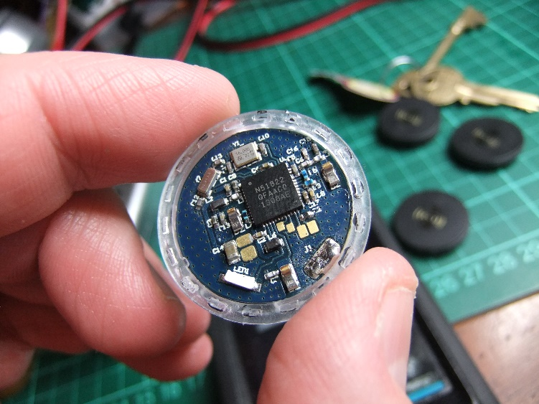
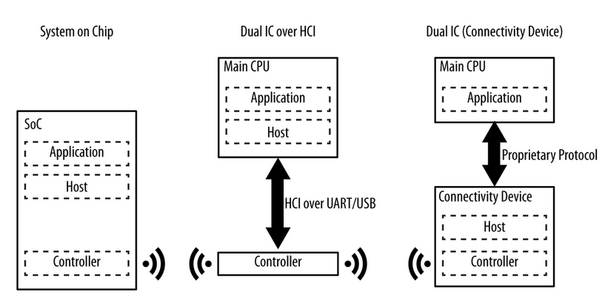
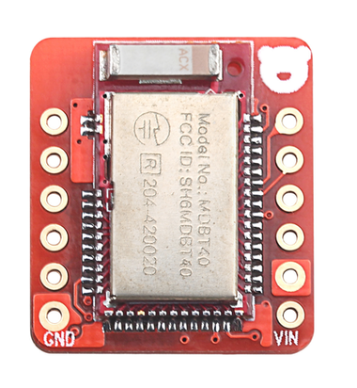
Hardware Configurations

Slide 13
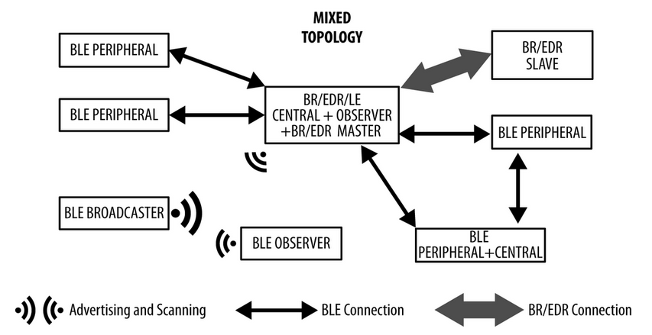

Slide 14
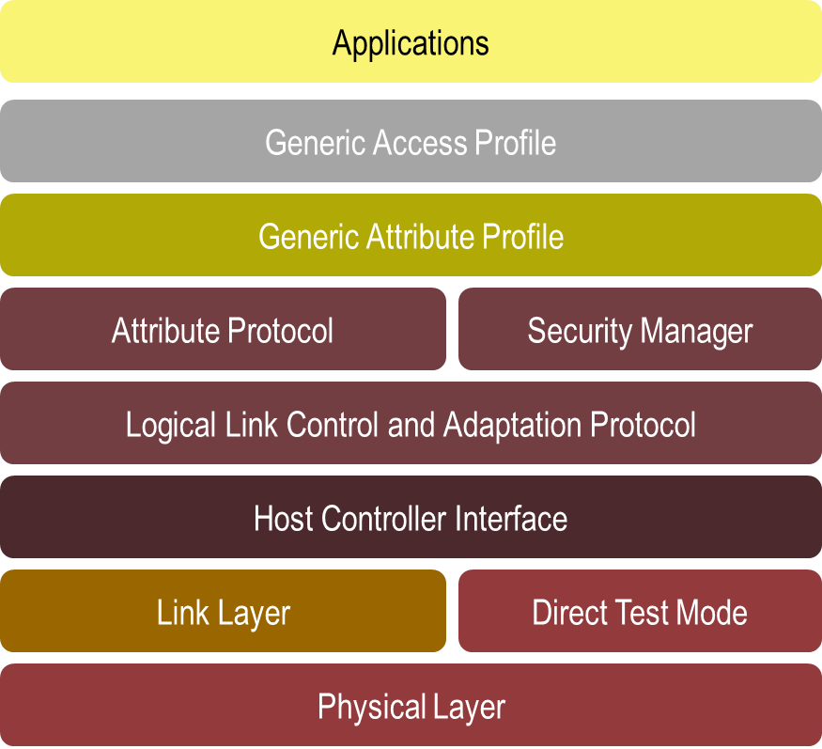
Notes:
Bluetooth Profiles are standard methods for establishing certain types of communication.
The GAP defines the basis for all other profiles.
The GATT provides profile discovery and description services. It also defines how other ATT attributes are grouped together. GATT is built on top of ATT.
Security manager is optional but can comprise how the ATT operates.
HCI is really just the communication from the Host to the controlled device. It is not bidirectional.

Slide 15
What is GAP
Generic Access Profile
Roles –
Broadcaster – an advertiser that is non-connectable
Observer – scans for advertisements, but cannot initiate connections
Central – scans for advertisements and initiates connections; operates as a master in a single or multiple link-layer connections. Currently, the BLE central stack supports up to three simultaneous connections.
Peripheral – an advertiser that is connectable, and operates as a slave in a single link-layer connection.
Notes:
The differences between the way Broadcasters and Observers work vs Peripherals and Central units.
The Scan Response is what the Advertiser sends to send further information to the Broadcaster
The note here about 3 simultaneous connections is because the of the advertising channels. In practice, many devices can be communicated with, just alternating which peripheral device has the “ear” of the central unit.
Connections make the difference
When the connection is established, the security used and personal information is exchanged which “bonds” the units together. The connection method is established by the Central unit for the amount of data to send, the way it’s sent, how often and the peripheral follows the orders. Peripherals usually fall within certain roles to better develop for these types of communications.
Peripherals Can still connect to other central units.
Multiple roles can be defined

Slide 16
What is GATT
Generic Attribute Profile (GATT)
Terminology:
Client - A device that initiates GATT commands and requests, and accepts responses, for example a computer or smartphone.
Server - A device that receives GATT commands and requests, and returns responses, for example a temperature sensor.
Characteristic - A data value transferred between client and server, for example the current battery voltage.

Slide 17
What is GATT
Terminology (cont)
Service - A collection of related characteristics, which operate together to perform a particular function. For instance, the Health Thermometer service includes characteristics for a temperature measurement value, and a time interval between measurements.
Descriptor - A descriptor provides additional information about a characteristic. For instance, a temperature value characteristic may have an indication of its units (e.g. Celsius), and the maximum and minimum values which the sensor can measure. Descriptors are optional - each characteristic can have any number of descriptors.
Notes:
Primary services are the for the main functionality for the GATT server. The GATT server can also run secondary services which don’t do much on their own, but support the main service. These aren’t used in practice much, but are available.
You can also add references to other services within a service.
Standard services like the “Health Thermometer” can be found at
https://developer.bluetooth.org/gatt/services/Pages/ServicesHome.aspx
You can also create your own to function with your own sensors or apps.

Slide 18
What is GATT
Terminology (cont)
Identifiers - Services, characteristics, and descriptors are collectively referred to as attributes, and identified by UUIDs. Any implementer may pick a random or pseudorandom UUID for proprietary uses, but the Bluetooth SIG have reserved a range of UUIDs (of the form xxxxxxxx-0000-1000-8000-00805F9B34FB) for standard attributes. For efficiency, these identifiers are represented as 16-bit or 32-bit values in the protocol, rather than the 128 bits required for a full UUID. For example, the Device Information service has the short code 0x180A, rather than 0000180A-1000-... . The full list is kept in the Bluetooth Assigned Numbers document online.
Notes:
https://www.bluetooth.org/en-us/specification/assigned-numbers
The reduction in size from 128 bit to 16 or 32 is simply to reduce power consumption.
If you have a function that isn’t listed on the Bluetooth SIG, you can generate a UUID from here
http://www.itu.int/en/ITU-T/asn1/Pages/UUID/uuids.aspx but they don’t offer to find one that meets the Bluetooth shortened form. You can still use a generated UUID, just expect to use the full UUID and don’t expect the BT SIG to recognize the device.

Slide 19
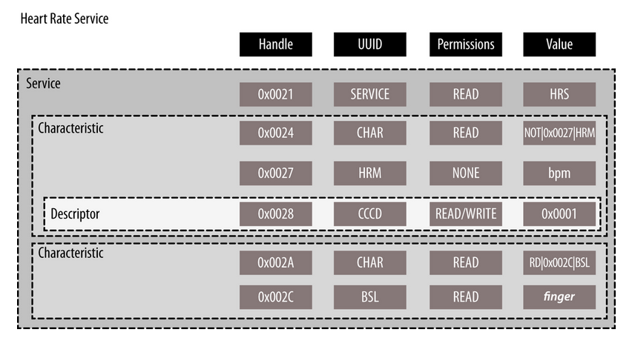
Example of a service
Notes:
The Services, Characteristic and Descriptors are all running on the Server/Master device and can be written to the peripheral device/slave when they establish their connection. This is through Service Discovery.
The service can be thought of as similar to a Class in OOP, (0x2800 for primary and 0x2801 for secondary services)
The first attribute of the Service must be the Service Declaration, where the UUID of the service is given.
Inside the Service, include definitions can be used similarly to pointers to reference other services.
The first attribute of a Characteristic must be it’s Characteristic declaration (0x2803)
A combination of services and characteristics can be layered to create security protocols or the evaluate data and how best to transmit it. These can arranged to give certain information higher priority to be sent first, or parse up data and hold it to wait for the device to reconnect. These arrangements are called Protocols.
Profiles are standard methods the that have been recognized as a proper arrangement of Protocols to achieve a certain task. Heart Rate Monitoring, UART, iBeacon

Slide 20
Bluetooth LE Hardware
Energy efficiency is the primary design concern
4 second connection interval draws 4μA
2μA standby current between connection events
500nA deep sleep mode
11mA Tx and 12.5mA Rx current at peak 0dBm output

Slide 21
Manufacturers of the BT technology
BlueRadios
Broadcom
Cambridge Silicon Radio (CSR)
connectBlue
Dialog Semiconductor
ISSC Technologies
Nordic Semiconductor
Stollmann
Texas Instruments
Cypress Semiconductor
Notes:
Who offers Software?
Texas Instruments
IAR Embedded Workbench for 8051 Compiler
BlackBerry
Broadcom
WIDCOMM Software → http://www.broadcom.com/support/bluetooth/update.php
SDK from Broadcom →http://www.broadcom.com/support/bluetooth/sdk.php
Cambridge Silicon Radio (CSR)
http://www.csr.com/products/technology/bluetooth
connectBlue
Laird Technologies
Stollmann
App works with iOS http://www.stollmann.de/en/software/bluetooth-bluetooth-low-energy/terminal-io-profile.html
Bluetooth Stack http://www.stollmann.de/en/software/bluetooth-bluetooth-low-energy/bluecode-protocol-stack.html
Apple
→ Under Core OS Layer → Core Bluetooth → https://developer.apple.com/library/ios/navigation/#section=Frameworks&topic=CoreBluetooth
LightBlue
Cypress Semiconductor
http://www.cypress.com/?rid=102636&utm_source=PSoC_BLE_PioneerKit_Banner&utm_medium=Cypress_Homepage_Banner&utm_campaign=BLELaunch
RedBearLabs
Nordic Semiconductor Google Apps
http://www.nordicsemi.com/eng/Products/nRFready-Demo-Apps/nRF-Toolbox-App
nRF Master Control Panel
nRF Toolbox

Slide 22


Used for this demo
Notes:
ARM’s mbed in browser development suite
The n51822 SoC from Nordic Semiconductor, Cortex M0, packaged in the StickNFind sensor
RedBear Labs BLE Nano boards.

Slide 23
Azure IoT Offerings
Azure Event Hubs
Azure DocumentDB
Azure Stream Analytics
Azure Notification Hubs
Azure Machine Learning
Azure HDInsight
Microsoft Power BI

Slide 24
Azure Event Hubs
Stream millions of events per second into multiple applications
Enable applications to process events with variable load profiles
Connect millions of devices across platforms

Slide 25
Azure DocumentDB
Rich query over a schema-free JSON data model
Transactional execution of JavaScript logic
Enables rapid development

Slide 26
Azure Stream Analytics
Stream millions of events per second
Perform real-time analytics
Correlate across multiple streams of data
Rapid development with familiar SQL-like language

Slide 27
Azure Notification Hubs
Target millions of devices with single API call
Tailor notifications by audience, language, location
Use with any backend, cloud or on-premises

Slide 28
Azure HDInsight
100% Apache Hadoop-based service in the cloud
Develop in Java, .NET, and more
Visualize your Hadoop data in Excel
Easily integrate on-premises Hadoop clusters

Slide 29
Contact Info
Blog
http://qimata.com/
Email
JRhodes@QiMata.com
MarshallCStewart@gmail.com

