Slide 1

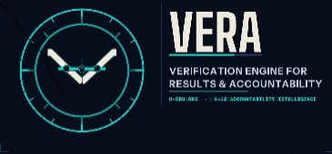
H-EDU.SOLUTIONS
Presentation to The CSBA
March 23, 2026
Verification Engine for Results & Accountability

Slide 2
The Problem, as Defined by CSBA
California has no coherent state-level plan to close the achievement gap — and the state itself is accountable to no one for that failure. Local schools are measured constantly. Sacramento is not. The result is a fragmented, reactive system where one-off grants and disconnected reforms substitute for a durable strategy, and the state's most vulnerable students — with proficiency rates as low as 20–30% — fall further behind with each passing generation.
H-EDU.solutions | VERA | Presented to CSBA | March 2026

Slide 3
CSBA's Six Point Plan
1
Clear, measurable state goals for CDE, the State Board, and CCEE.
4
Budget alignment — money follows purpose, not politics.
2
Annual benchmarks and transparent reporting — the state assesses its own efforts.
5
Legislative Analyst's Office (LAO) reports and hearings — regular, independent, nonpartisan analysis.
3
A public "State of the Gap" dashboard — easy-to-use visual tools tracking state performance.
6
A shift from compliance to customer service — the state supports districts according to their specific local needs.
H-EDU.solutions | VERA | Presented to CSBA | March 2026

Slide 4
VERA — Response to CSBA's Six Point Plan
Verification Engine for Results & Accountability
1
Clear, measurable state goals
4
Budget alignment
VERA produces district-level measurements of whether LCAP interventions are closing the oral-written gap, giving CDE, the State Board, and CCEE a concrete, verifiable metric to anchor state goals against.
VERA identifies which districts have the highest-need Type 4 students and the widest gaps, giving state budget allocations a data-driven target rather than a political one.
2
Annual benchmarks and transparent reporting
5
LAO reports and hearings
VERA runs on publicly available CAASPP and ELPAC data updated annually, generating match-rate reports that benchmark district performance year over year.
VERA's match-rate reports provide the independent, verifiable data the LAO would need to conduct nonpartisan analysis of whether state education programs are working.
3
A public "State of the Gap" dashboard
6
A shift from compliance to customer service
VERA is the data engine that powers exactly this. Its output is a district-by-district accountability report that can be surfaced as a public-facing dashboard.
VERA does not add reporting burden to districts. It pulls public data and returns a report. Districts receive intelligence, not a mandate.
H-EDU.solutions | VERA | Presented to CSBA | March 2026

Slide 5
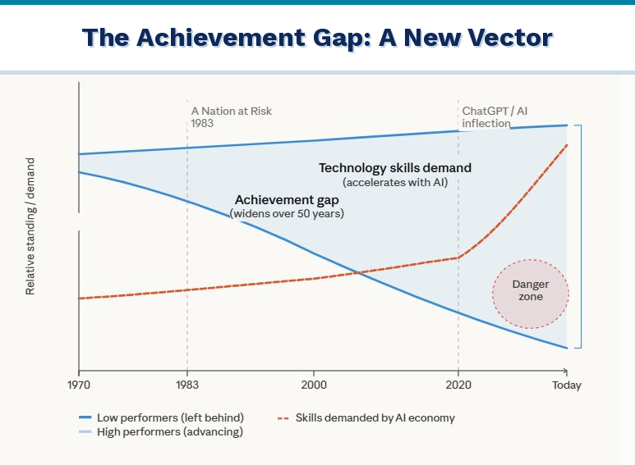
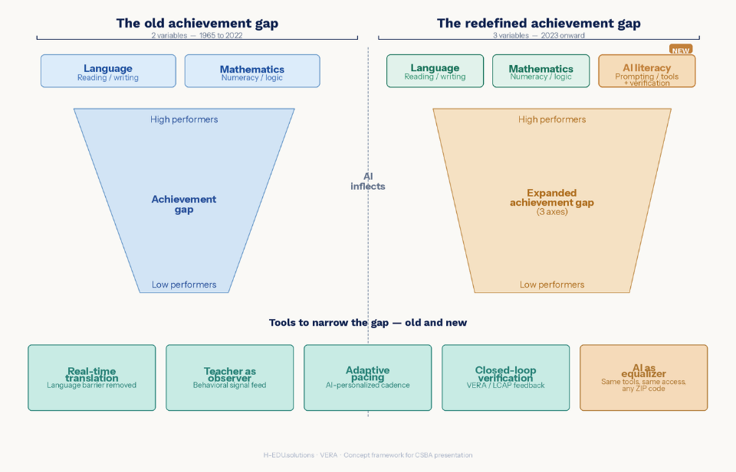
AI & The Achievement Gap
AI exacerbates the problem ....
And, AI accelerates the solution ....
The achievement gap was a moral problem for fifty years. AI just turned it into an economic emergency — and the students we can still reach are in 3rd and 4th grade right now.

Slide 6
Model Context Protocol
MODEL
CONTEXT
PROTOCOL
The AI model
(Claude, GPT, Gemini)
The external data and tools
the model needs to do useful work
The standardized rules
governing how that connection is made
MCP was announced by Anthropic in November 2024 — an open standard for connecting AI assistants to data systems such as content repositories, business management tools, and development environments. Before MCP, developers often had to build custom connectors for each data source or tool, resulting in what Anthropic described as an "N×M" data integration problem.
H-EDU.solutions | VERA | Presented to CSBA | March 2026

Slide 7
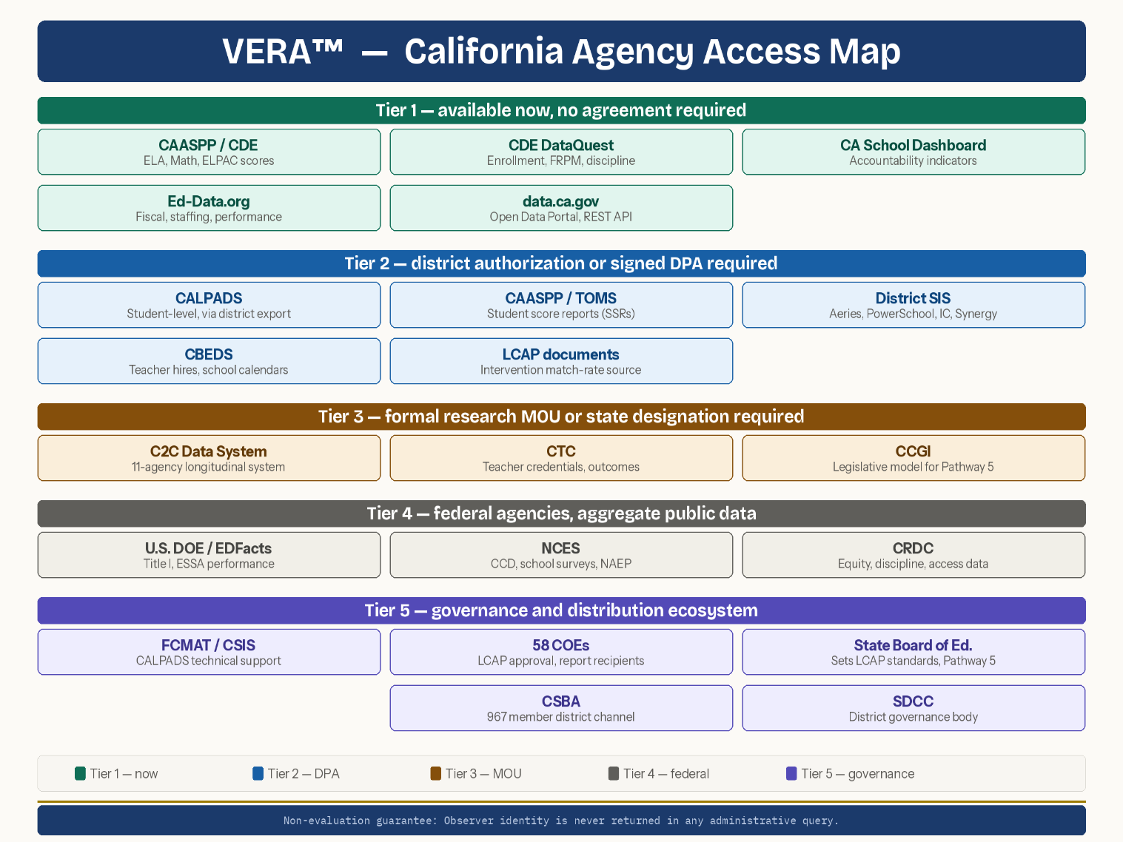
VERA™ — Verification Engine for Results & Accountability
VERA is a California K-12 education intelligence system that answers the question no current accountability tool can answer:
Were the interventions funded by a district's LCAP actually matched to the verified learning needs of the students who received them?
An MCP server that connects Claude Desktop to California education assessment data. COE reviewers and district administrators type questions in plain English and receive formatted, submission-ready reports automatically.
The data is available from:
Key Differentiator — Type 4 Gap Detection
H-EDU's proprietary classification identifies students who speak well but write poorly — the "oral-written delta." This classification does not exist anywhere in the California state accountability system.
H-EDU.solutions | VERA | Presented to CSBA | March 2026

Slide 8
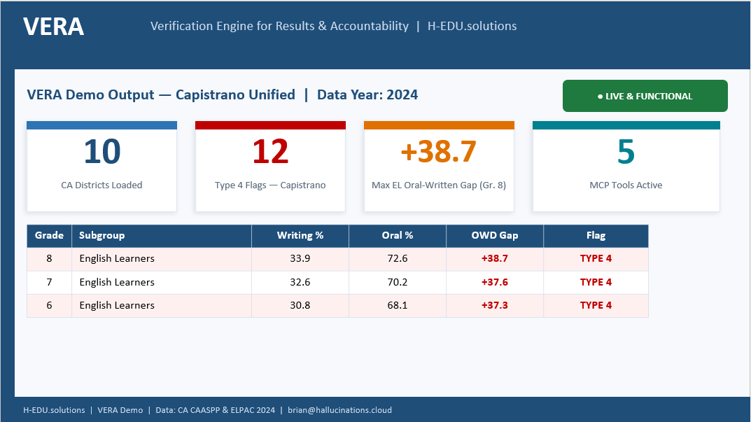
VERA — The Engine That Sees What the State Cannot
Plain-English queries against California assessment data — no data literacy required.
Core Purpose
Five Tools
Enables plain-English queries against CAASPP, ELPAC, and LCAP data
Identifies achievement gaps without requiring data literacy from users
COE reviewers can ask questions and receive formatted reports automatically
list_districts()
List all districts in the database
fetch_caaspp_results()
Retrieve CAASPP data for any district by grade and subgroup
compute_oral_written_delta()
Core Type 4 gap analysis: speaking vs. writing by grade
flag_type4_candidates()
Statewide scan identifying every Type 4 mismatch across all districts
get_lcap_match_summary()
LCAP verification report formatted for COE submission
H-EDU.solutions | VERA | Presented to CSBA | March 2026

Slide 9
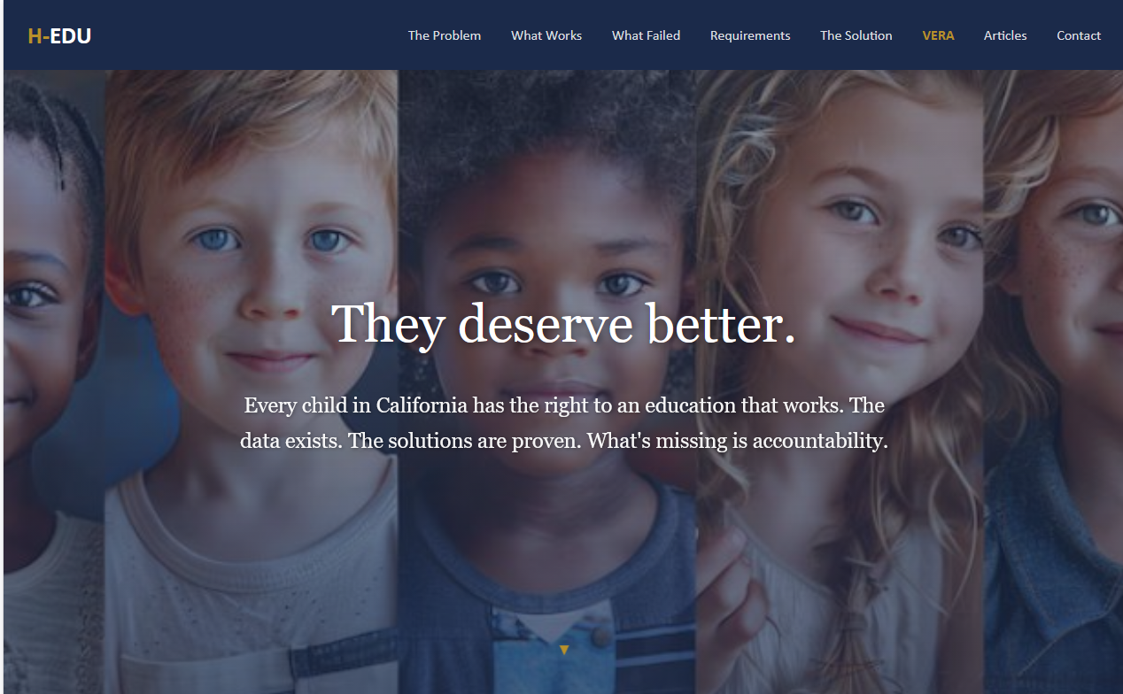
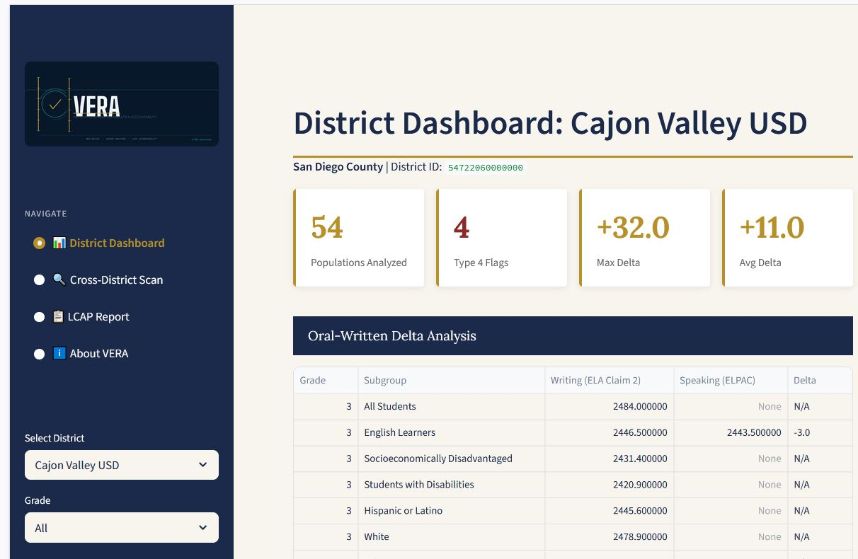
VERA in Action
THE HOME WEB PAGE
THE APPLICATION WEB PAGE
H-EDU.solutions | VERA | Presented to CSBA | March 2026

Slide 10
We Are Building for Where Education Is Going,
Not Where It Has Been
The conversation about AI in education is moving fast — faster than most policy frameworks, and faster than most vendors are prepared to acknowledge. At H-EDU, we have been watching that curve carefully, and we have made a deliberate choice to build ahead of it rather than react to it.
VERA is not a reporting tool dressed up with an AI label. It is a verification engine designed around how AI systems will increasingly be used in public sector accountability — with structured data inputs, closed-loop outputs, and audit trails that districts and their boards can actually stand behind.
The inference revolution — the shift from AI as a one-time query to AI as a continuous, embedded reasoning layer — is already reshaping what enterprise software looks like. VERA is positioned squarely in that architecture. It does not wait to be asked. It monitors, flags, and surfaces the interventions that matter most, in the districts that need them most.
The CSBA community have spent decades working at the intersection of governance and student outcomes. We believe that work deserves tools that are as forward-looking as the mission itself. VERA is our contribution to that alignment.
H-EDU.solutions | VERA | Presented to CSBA | March 2026

Slide 11
HERE'S HOW YOU'LL RATE H-EDU AND VERA, ITS FLAGSHIP APP
Milestone
Time to know
Type 4 students flagged by district
Days
Oral fluency exceeds written performance — students identified by school and classroom
LCAP match rate confirmed
2 weeks
Funded actions verified against flagged students — trustees can see the gap between spend and reach
Cross-district pattern visible
1 month
What one district learns, every district can act on — statewide intelligence in motion
External data integrated into decisions
1 quarter
Attendance, behavior, and MTSS feeds added — VERA tells you what the combined data means
Teacher acts on a student's warning signs
1 semester
Early warning surfaces before the gap becomes a grade retention or a referral
CAASPP ELA scores shift in pilot districts
1 year
The Dashboard confirms what VERA predicted — outcomes move, not just indicators
CDE AI in Education deadline: July 2026 — Before July: founder. After July: vendor.

Slide 12
Thank You
H-EDU and VERA exist because the problem is real, the data is available, and the window to act is closing. We look forward to building this with you.
brian@hallucinations.cloud | H-EDU.solutions

