Slide 1
PHYSICAL MODELS IN REMOTE SENSING Final Report
Deadline for Emailing Your PDF Report: Monday May-04-2026 @ 9 AM
How to Prepare Your Report
STEP 01
Download the code
Download the accompanying DOCUMENT from class website (April-02-2026)
Run the code (input “0” for no interpolation)
The code outputs an Energy Balance Table (See Slide 2 here)
The “Reflectance” in the Table is DHR (fdir=1) or BHR (fdir NE 1)
The code does calculations at RED and NIR wavelengths at two LAI values (1.5 & 4.0)
STEP 02
Run the code (input “1” for no interpolation)
The code additionally outputs BRF (fdir = 1) or HDRF (fdir NE 1) in 45x90 directions
STEP 03
The 11 figures of your report are in the following Slides
Each figure should be on a new page in your report. Each figure should contain an explanation of what information is being conveyed through this figure
The first 5 are easy to do.
Figs. 6 and 7 can be drawn using the results from the interpolated directions
Figs. 8 to 11 require modifications to code

Slide 2
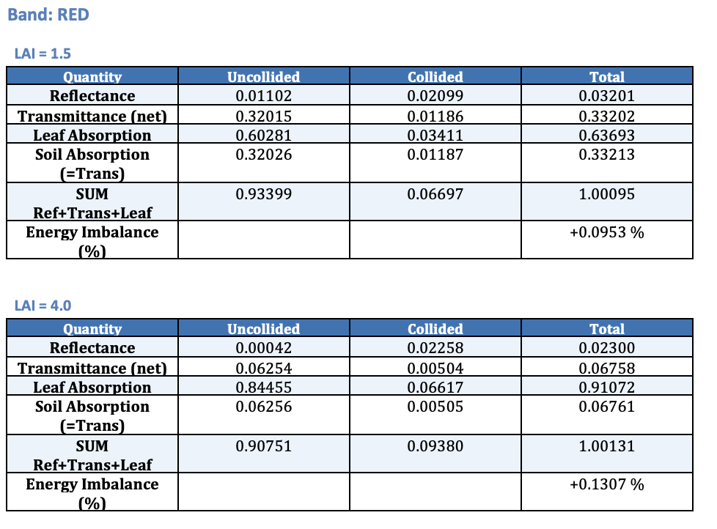
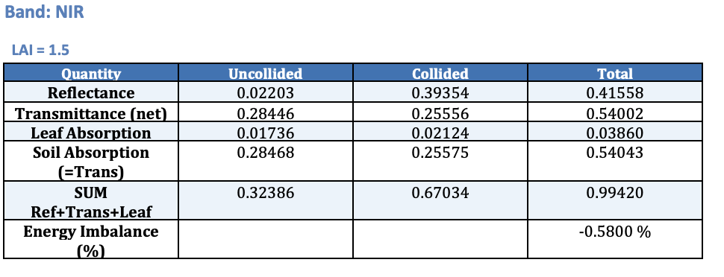
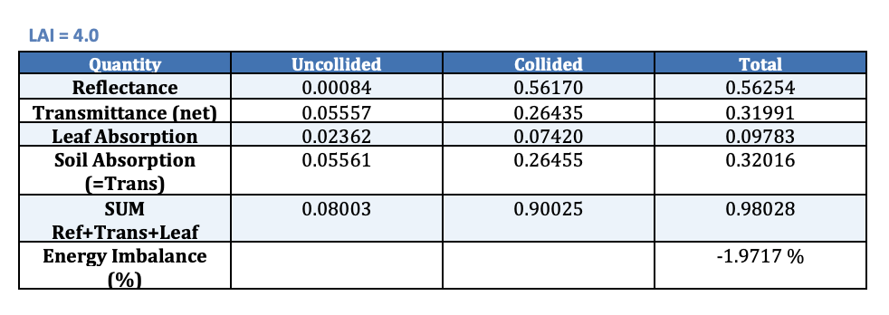
PHYSICAL MODELS IN REMOTE SENSING Final Report
Energy Balance

Slide 3
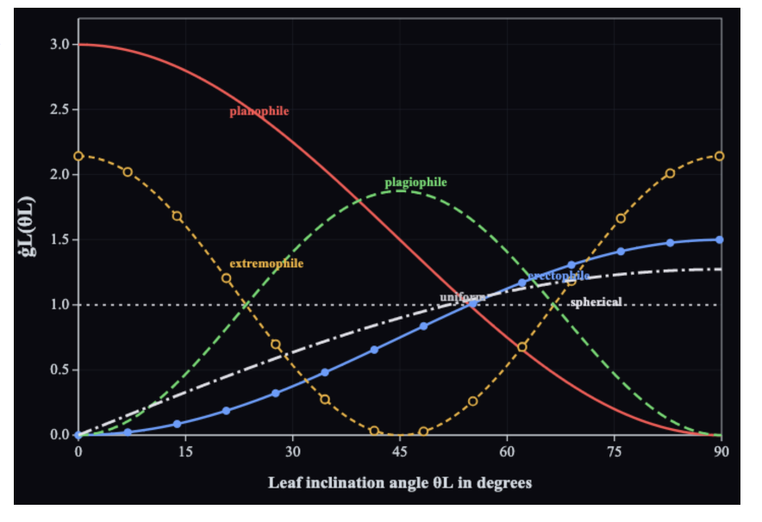
PHYSICAL MODELS IN REMOTE SENSING Final Report
Fig. 01
Leaf Angle Distributions

Slide 4
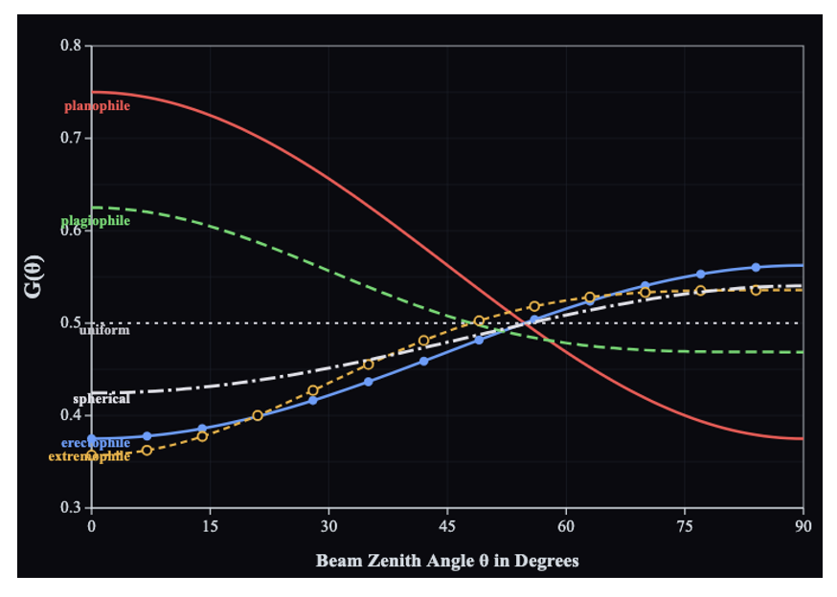
PHYSICAL MODELS IN REMOTE SENSING Final Report
Fig. 02
G-Function for Various Leaf Angle Distributions

Slide 5
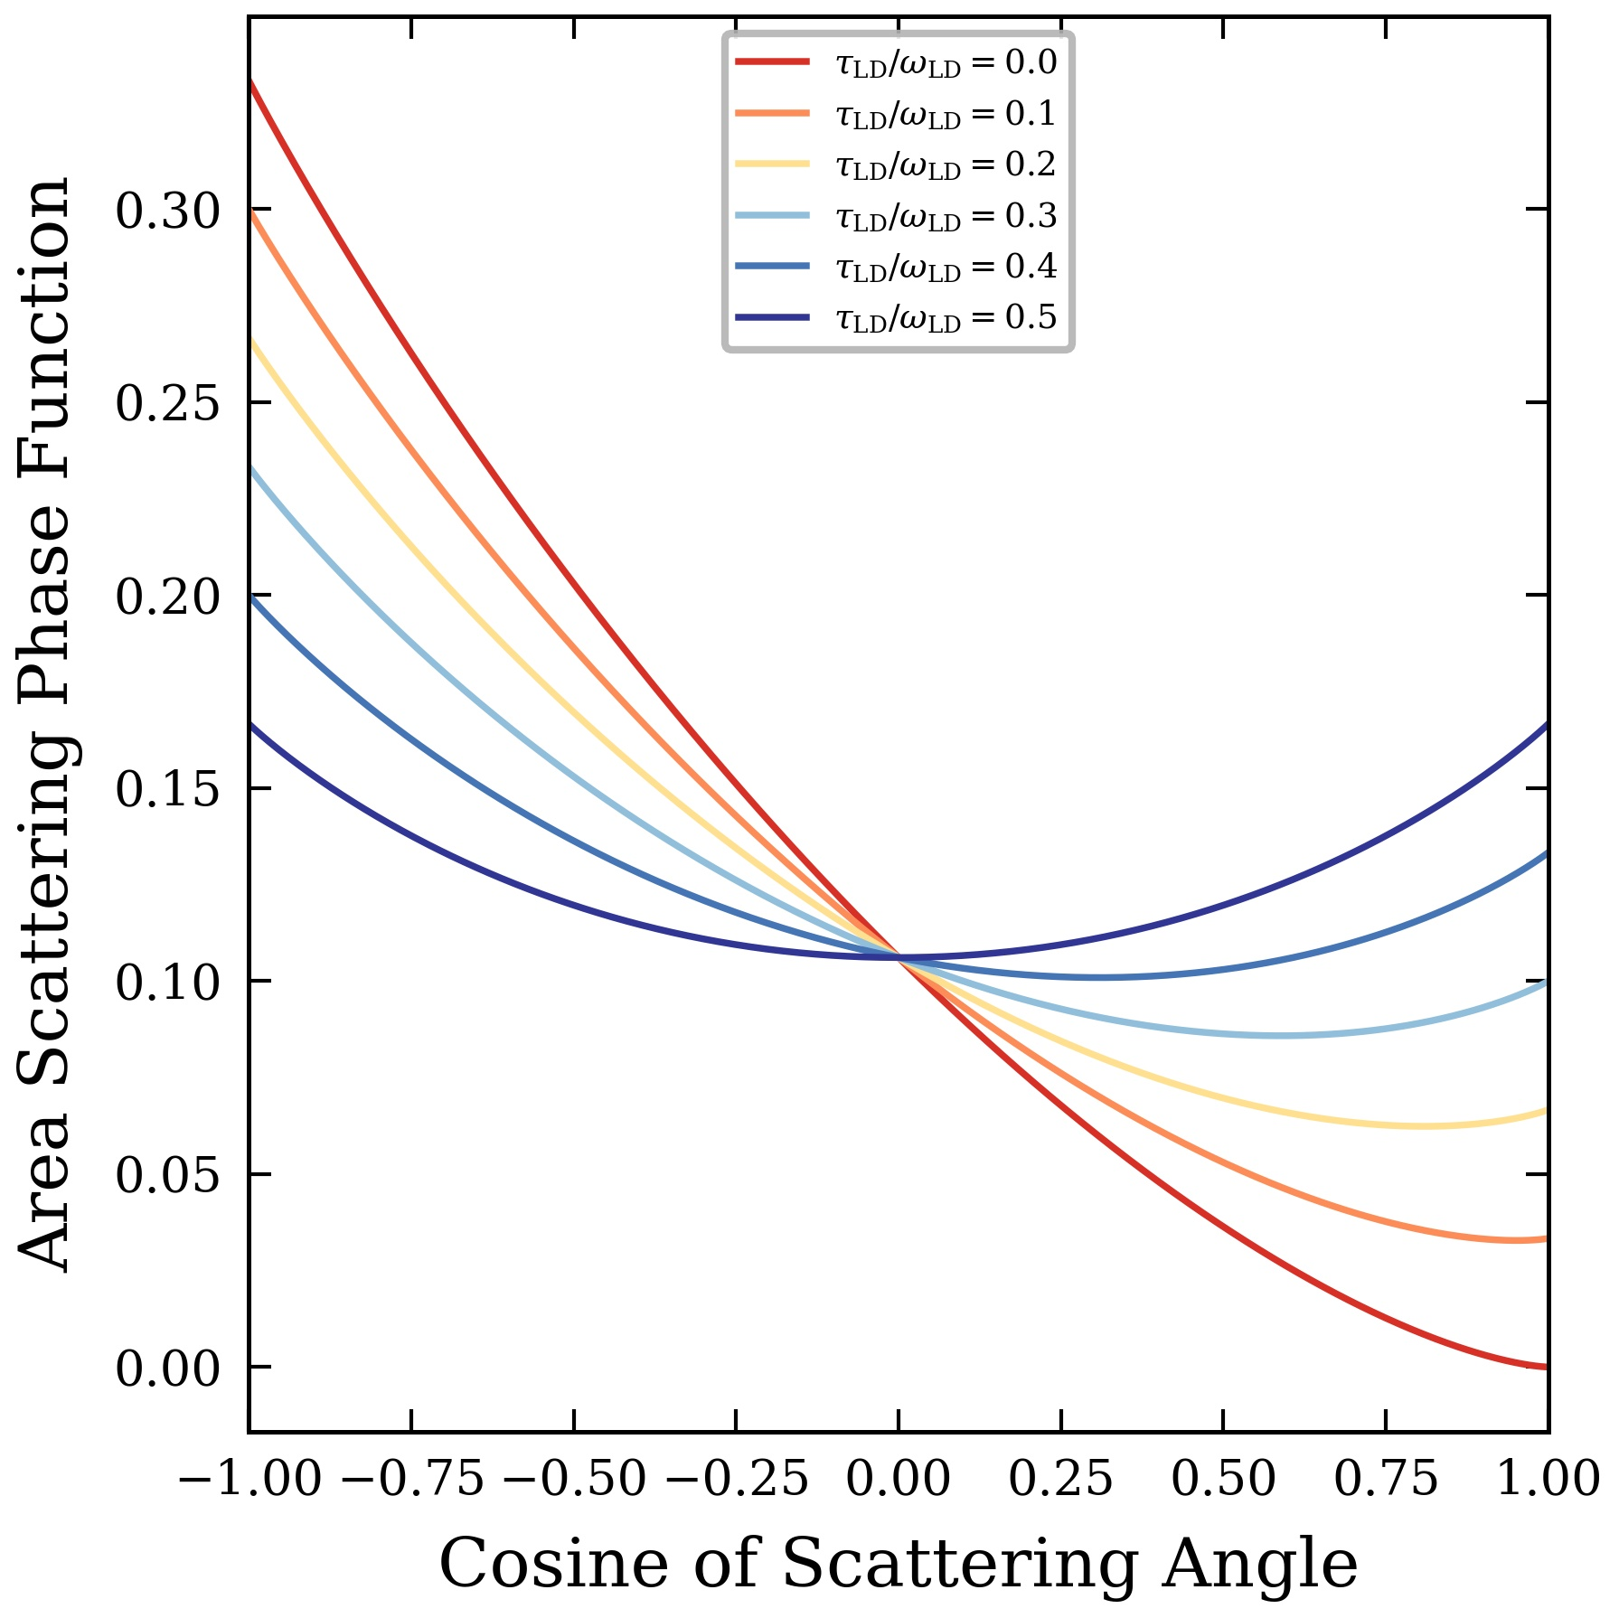
PHYSICAL MODELS IN REMOTE SENSING Final Report
Fig. 03
Scattering Phase Function for Uniform Leaf Angle Distribution

Slide 6
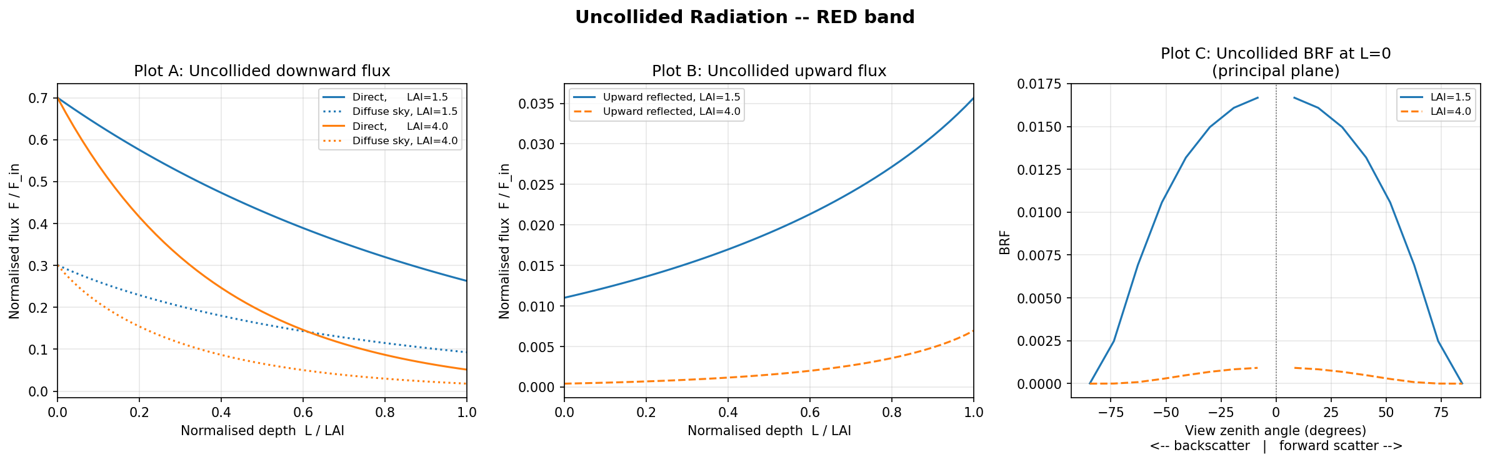
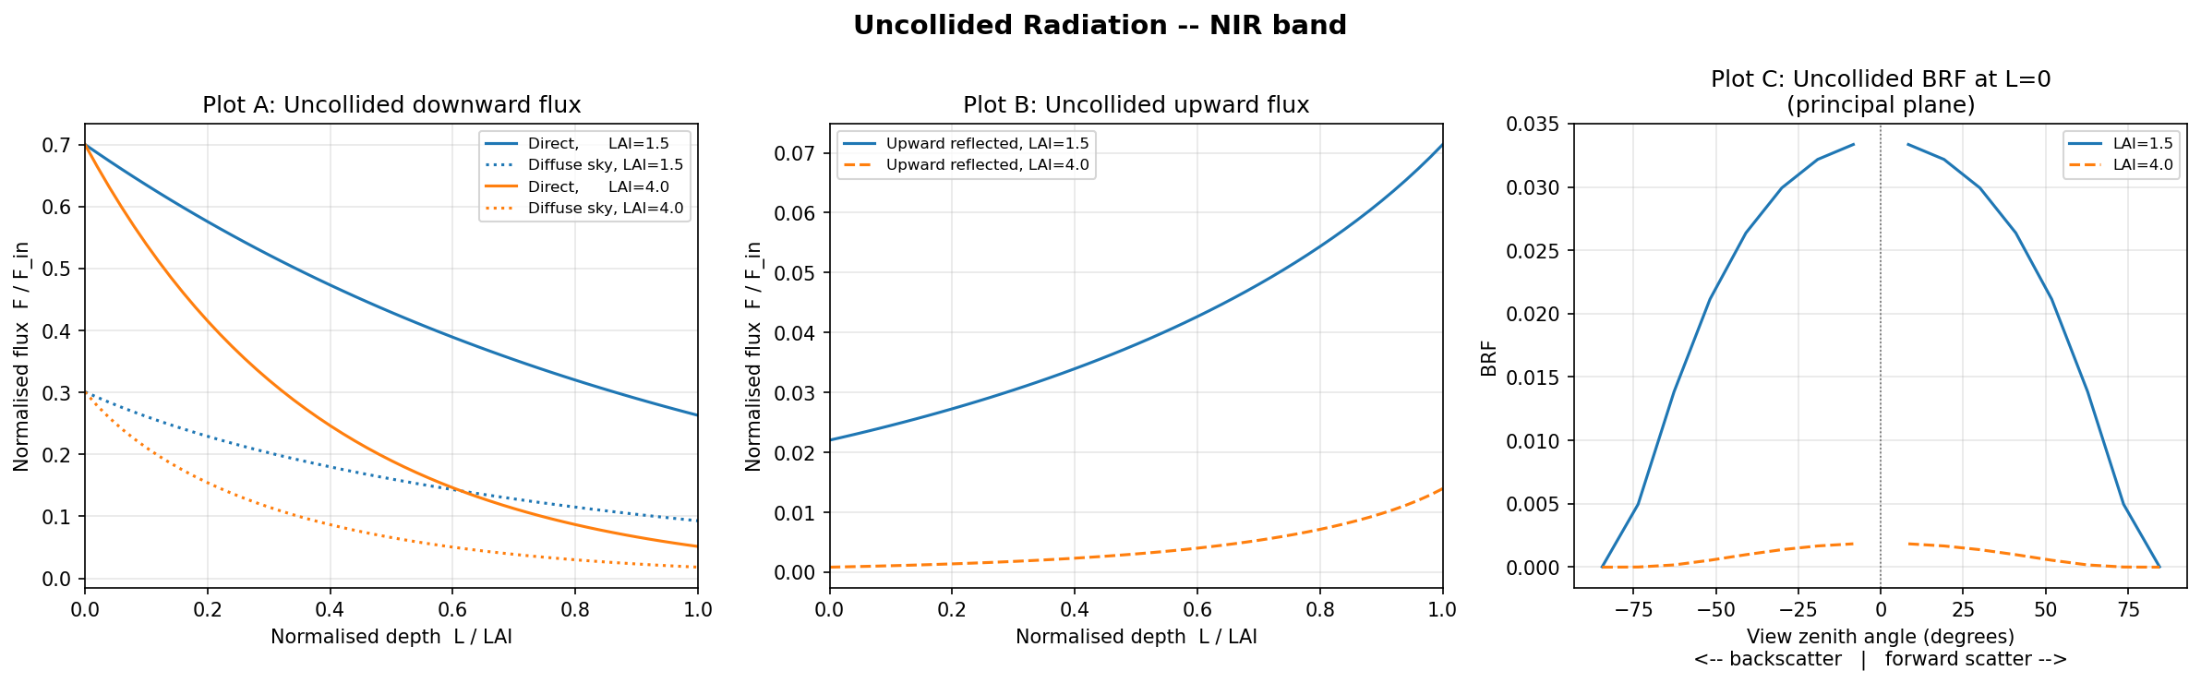
PHYSICAL MODELS IN REMOTE SENSING Final Report
Figs. 04 & 05
These Figures are produced by the uncollided DOM code: Download

Slide 7
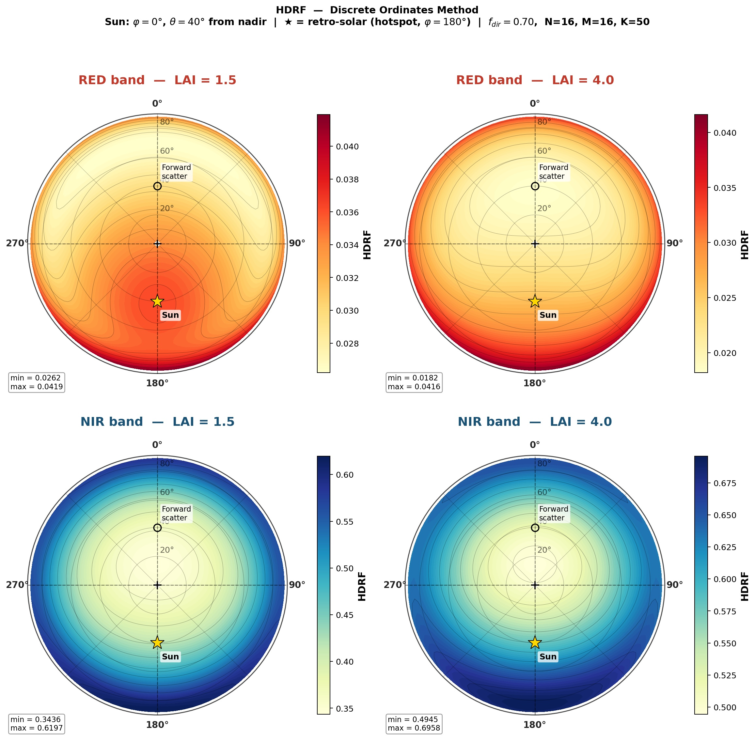
PHYSICAL MODELS IN REMOTE SENSING Final Report
Fig. 06
HDRF Angular Shape

Slide 8
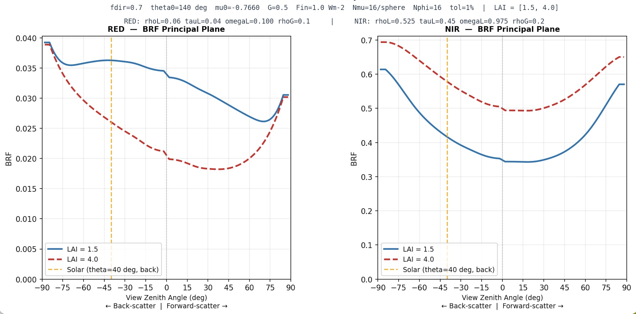
PHYSICAL MODELS IN REMOTE SENSING Final Report
Fig. 07
HDRF Angular Shape
Although the Y axis says BRF, it is really HDRF because fdir = 0.7. There is no error in calculation.

Slide 9
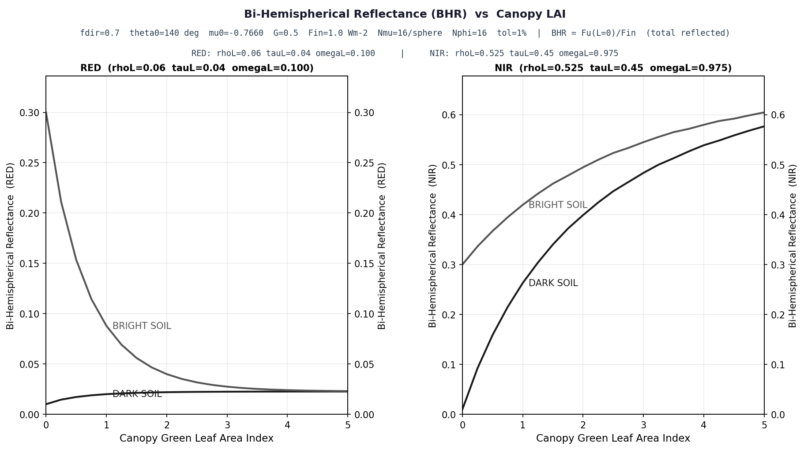
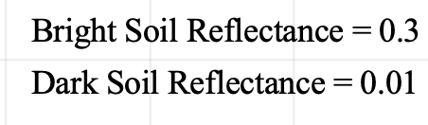
PHYSICAL MODELS IN REMOTE SENSING Final Report
Fig. 08
BHR as a function of LAI and Soil brightness
Bright Soil Reflectance = 0.3
Dark Soil Reflectance = 0.01

Slide 10
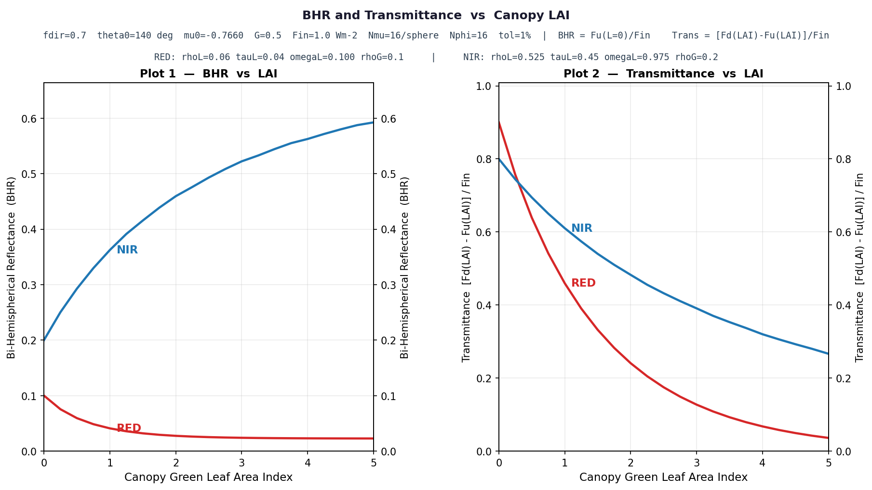
PHYSICAL MODELS IN REMOTE SENSING Final Report
Fig. 09
LAI Effect on BHR and Transmittance

Slide 11
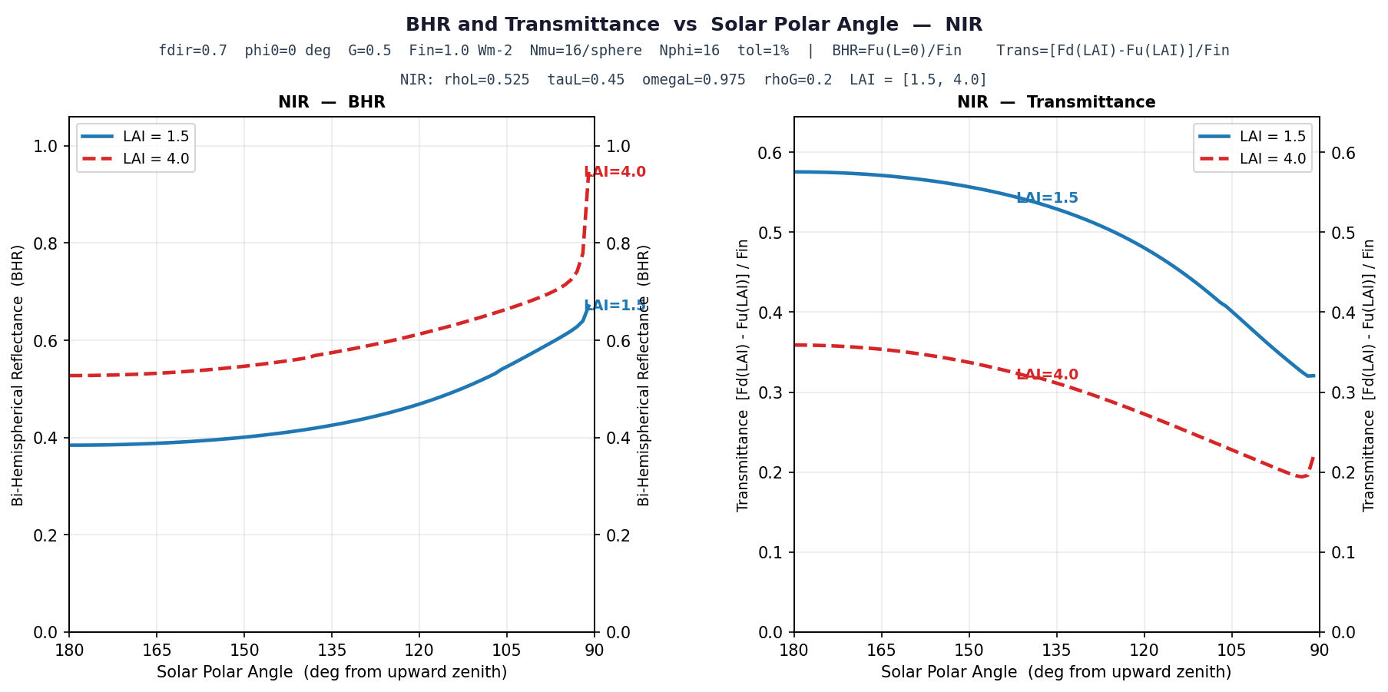
PHYSICAL MODELS IN REMOTE SENSING Final Report
Fig. 10
Solar Polar Angle Effect on BHR and Transmittance

Slide 12
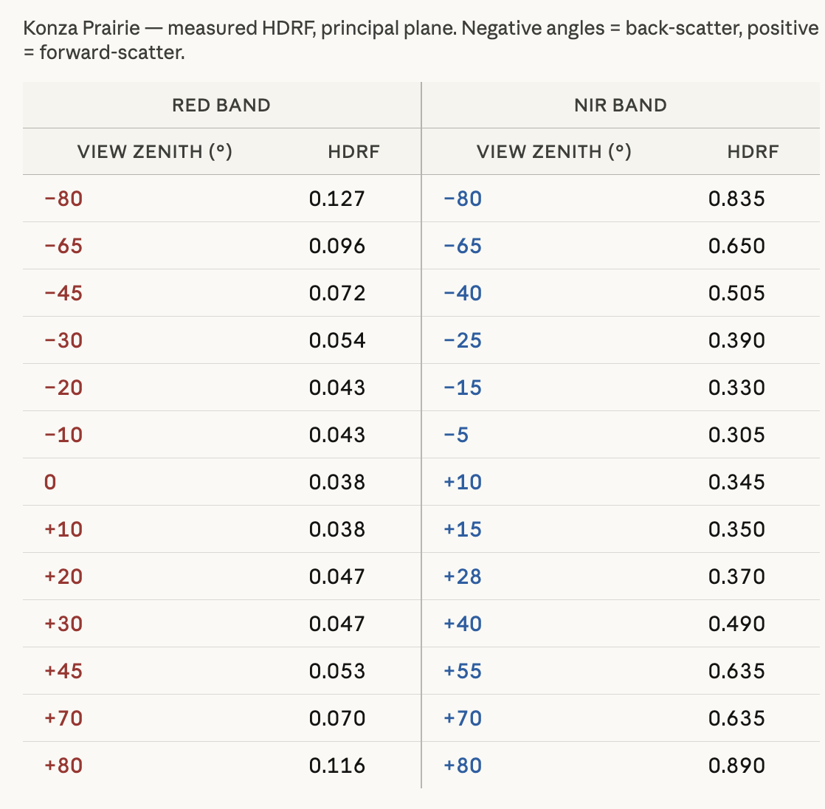
PHYSICAL MODELS IN REMOTE SENSING Final Report
Fig. 11
Use these data to make Fig. 11 on next Slide

Slide 13
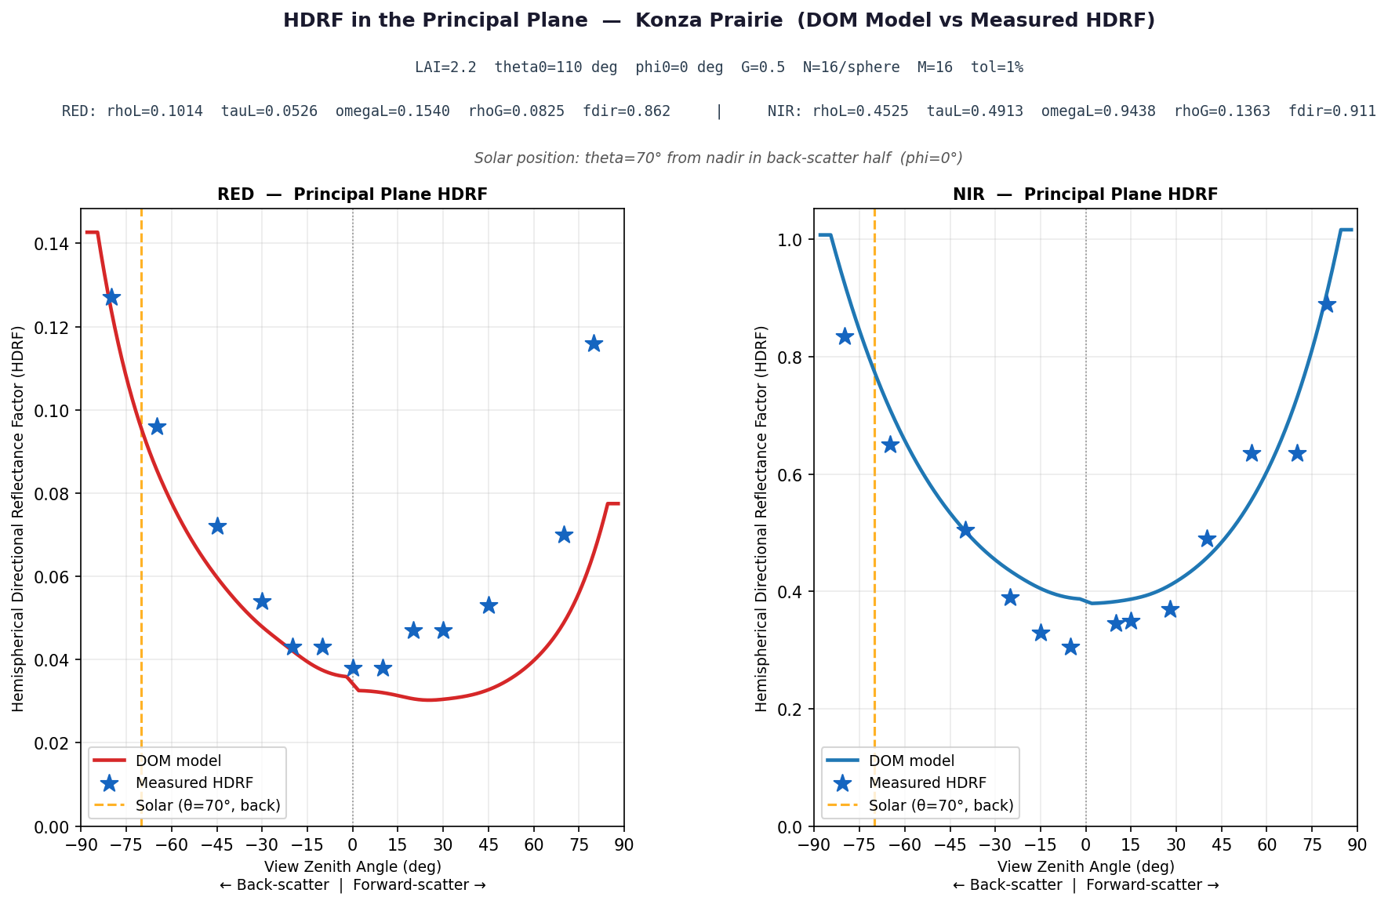
PHYSICAL MODELS IN REMOTE SENSING Final Report
Fig. 11
Comparison with Field Data

