Slide 1
PHYSICAL MODELS IN REMOTE SENSING Chapter 01 – Part 01: Basic Definitions
Electromagnetic Radiation
Boltzmann’s Law
Wien’s Law
Planck’s Law
Photons
Geometry
Mukkulo7558Pokkulu
Mukkulo7558Pokkulu

Slide 2
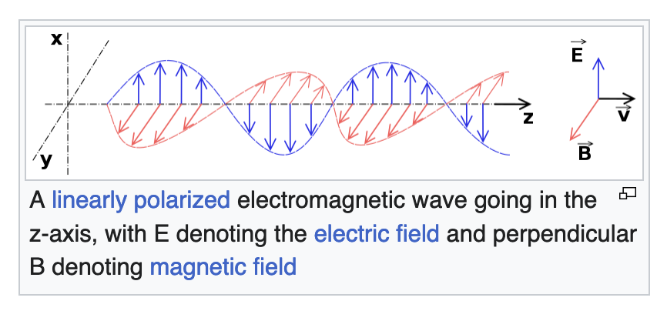
PHYSICAL MODELS IN REMOTE SENSING Chapter 01 – Part 01: Basic Definitions
Electro-Magnetic Radiation (Wave)
In physics, electromagnetic radiation (EMR) consists of waves of the electromagnetic (EM)
field, which propagate through space and carry momentum and electromagnetic radiant energy.
Types of EMR include radio waves, microwaves, infrared, (visible) light, ultraviolet, X-rays,
and gamma rays, all of which are part of the electromagnetic spectrum.
Mukkulo7558Pokkulu
Mukkulo7558Pokkulu
Ref: Wikipedia

Slide 3
PHYSICAL MODELS IN REMOTE SENSING Chapter 01 – Part 01: Basic Definitions
Electro-Magnetic Radiation (Particle)
In 1900, Max Planck developed a new theory of black-body radiation that explained the
observed spectrum. Planck's theory was based on the idea that black bodies emit light
(and other electromagnetic radiation) only as discrete bundles or packets of energy.
These packets were called quanta.
In 1905, Albert Einstein proposed that light quanta be regarded as real particles. Later the
particle of light was given the name photon, to correspond with other particles being described
around this time, such as the electron and proton.
Mukkulo7558Pokkulu
Mukkulo7558Pokkulu
Ref: Wikipedia

Slide 4
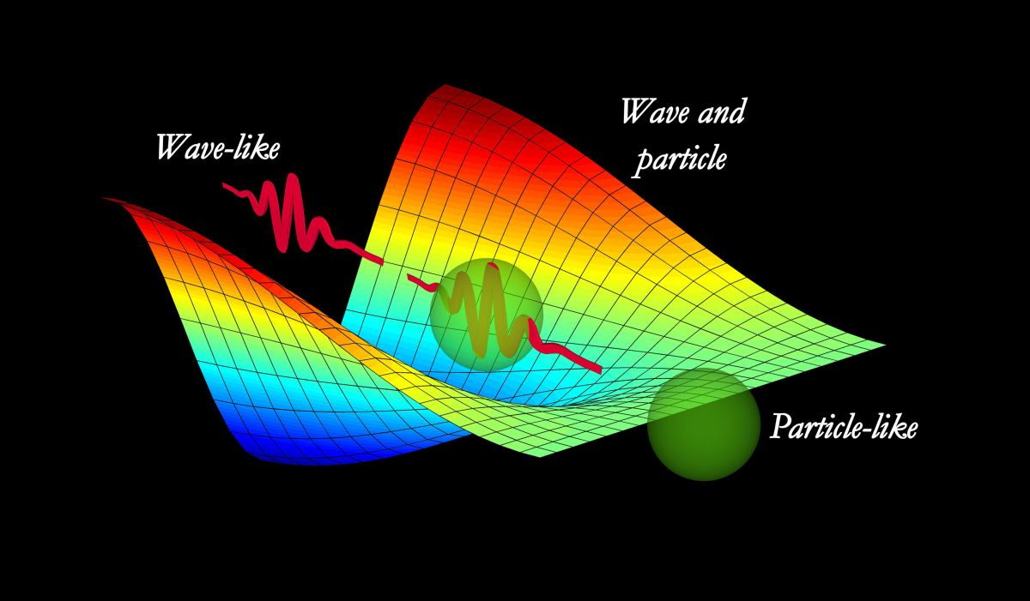
PHYSICAL MODELS IN REMOTE SENSING Chapter 01 – Part 01: Basic Definitions
Wave-Particle Duality
Wave–particle duality is the concept in quantum mechanics that quantum entities exhibit
particle or wave properties according to the experimental circumstances. It expresses the inability
of the classical concepts such as particle or wave to fully describe the behavior of quantum
objects. During the 19th and early 20th centuries, light was found to behave as a wave, and then
later discovered to have a particulate character, whereas electrons were found to act as particles,
and then later discovered to have wavelike aspects. The concept of duality arose to resolve this
confusion.
Mukkulo7558Pokkulu
Mukkulo7558Pokkulu
Ref: Wikipedia

Slide 5
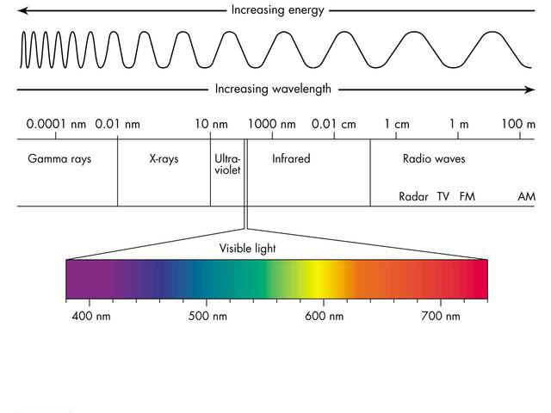
PHYSICAL MODELS IN REMOTE SENSING Chapter 01 – Part 01: Basic Definitions
Electro-Magnetic Spectrum
Mukkulo7558Pokkulu
Mukkulo7558Pokkulu
Ref: Wikipedia

Slide 6
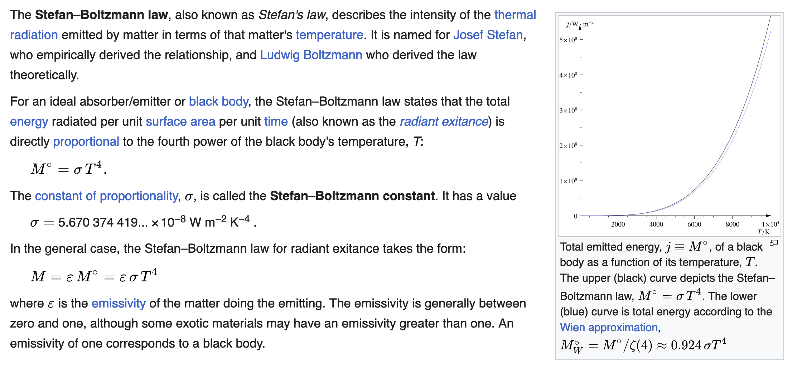
PHYSICAL MODELS IN REMOTE SENSING Chapter 01 – Part 01: Basic Definitions
Boltzmann’s Law
Mukkulo7558Pokkulu
Mukkulo7558Pokkulu
Ref: Wikipedia

Slide 7
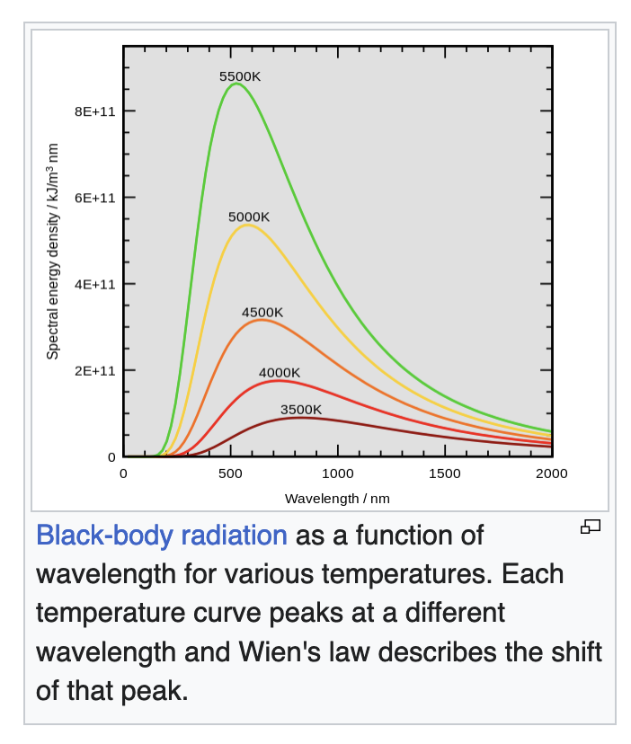
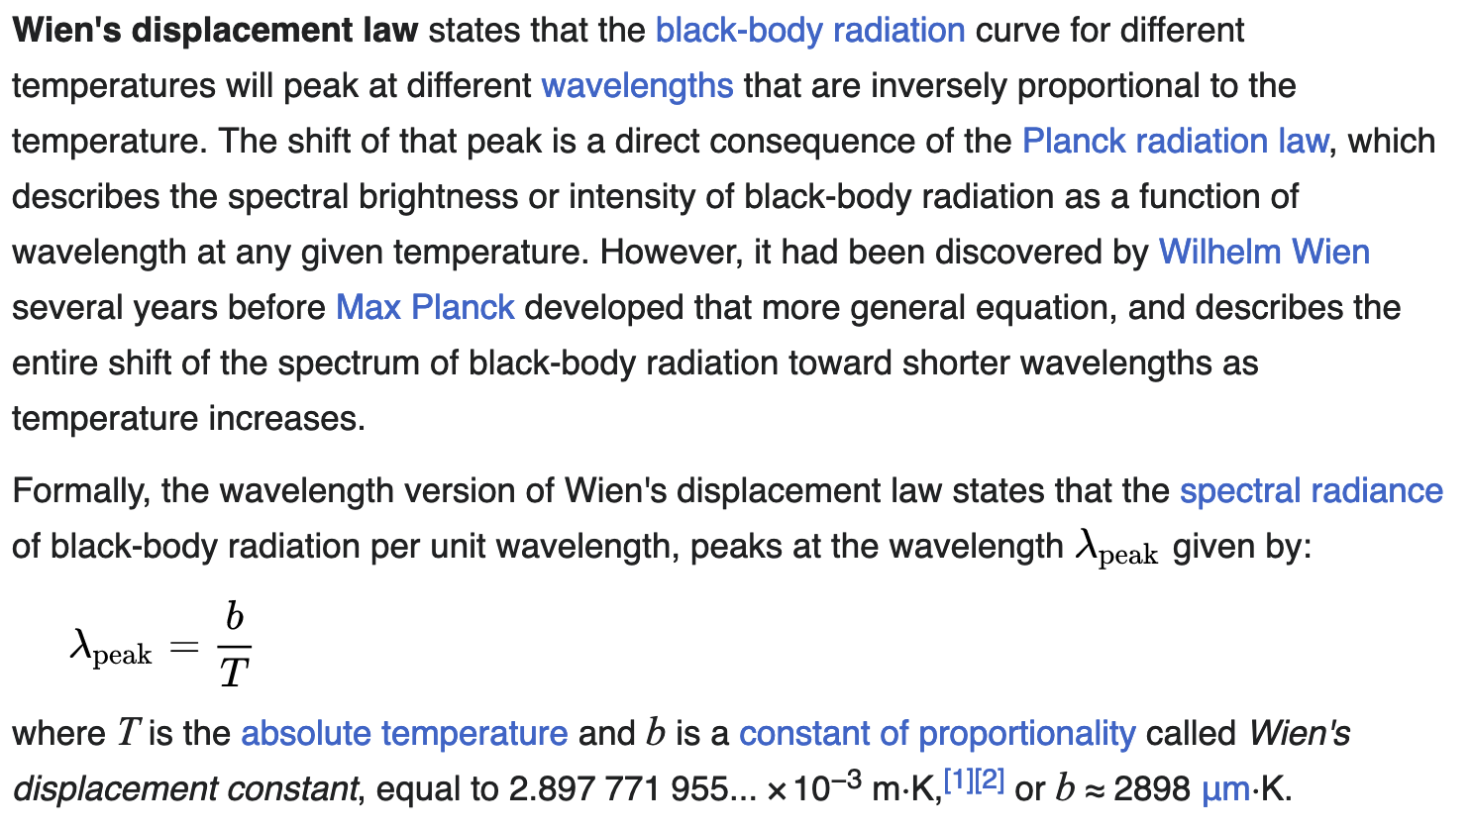
PHYSICAL MODELS IN REMOTE SENSING Chapter 01 – Part 01: Basic Definitions
Wien’s Law
Mukkulo7558Pokkulu
Mukkulo7558Pokkulu
Ref: Wikipedia

Slide 8
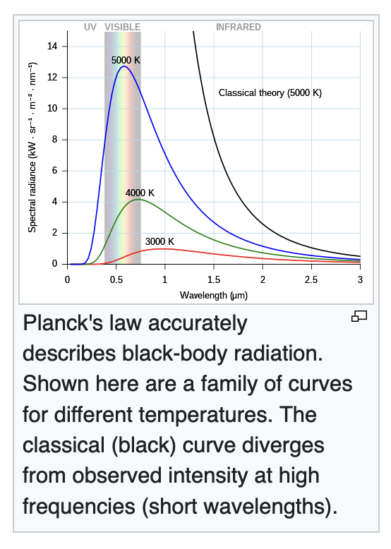
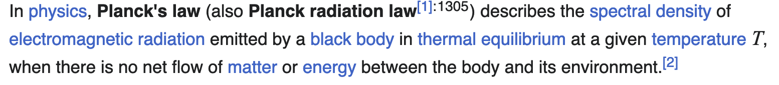
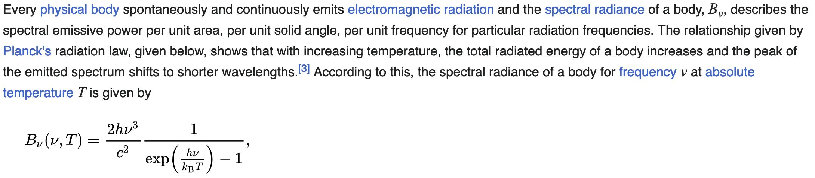
PHYSICAL MODELS IN REMOTE SENSING Chapter 01 – Part 01: Basic Definitions
Planck’s Law
Mukkulo7558Pokkulu
Mukkulo7558Pokkulu
Ref: Wikipedia

Slide 9
PHYSICAL MODELS IN REMOTE SENSING Chapter 01 – Part 01: Basic Definitions
Derivations
Planck’s law is fundamental. Integrating it yields the Boltzmann’s law (see next page)
Can you similarly derive Wein’s law from Planck’s law? Do it in the wavelength and
frequency domains and see something interesting.
Mukkulo7558Pokkulu
Mukkulo7558Pokkulu

Slide 10
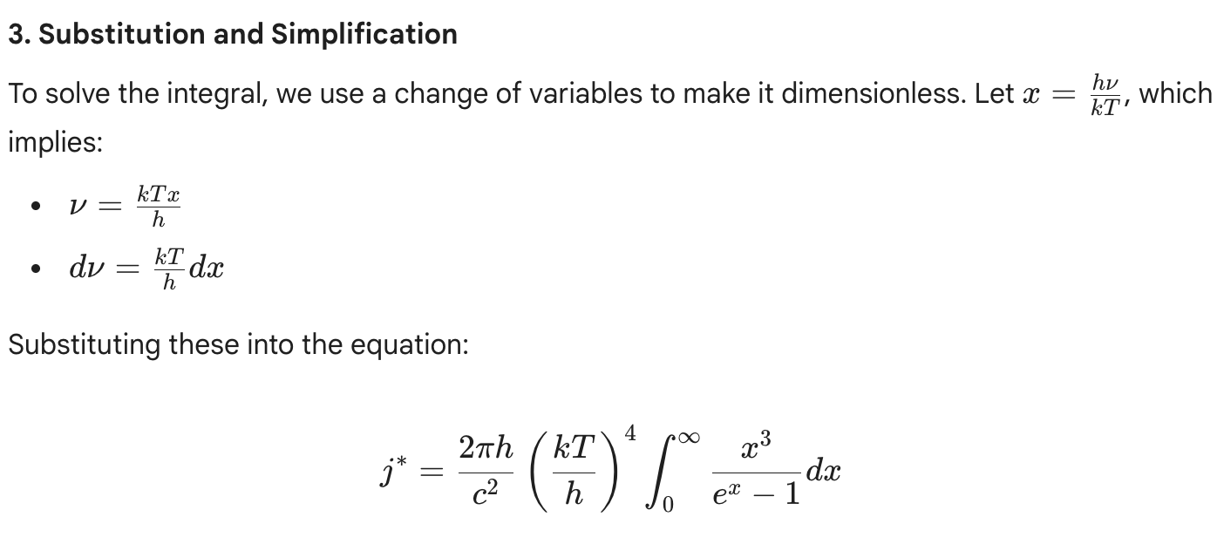
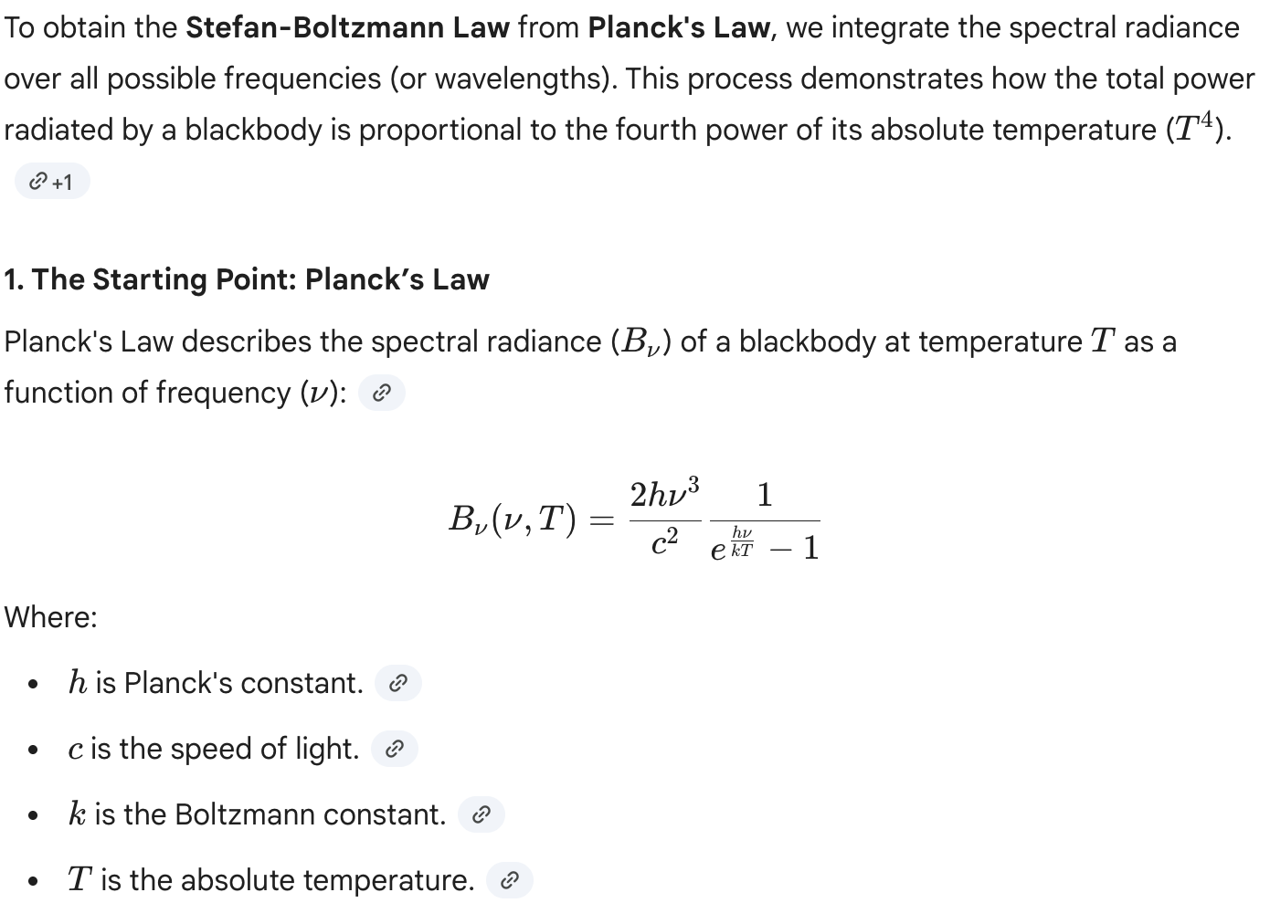
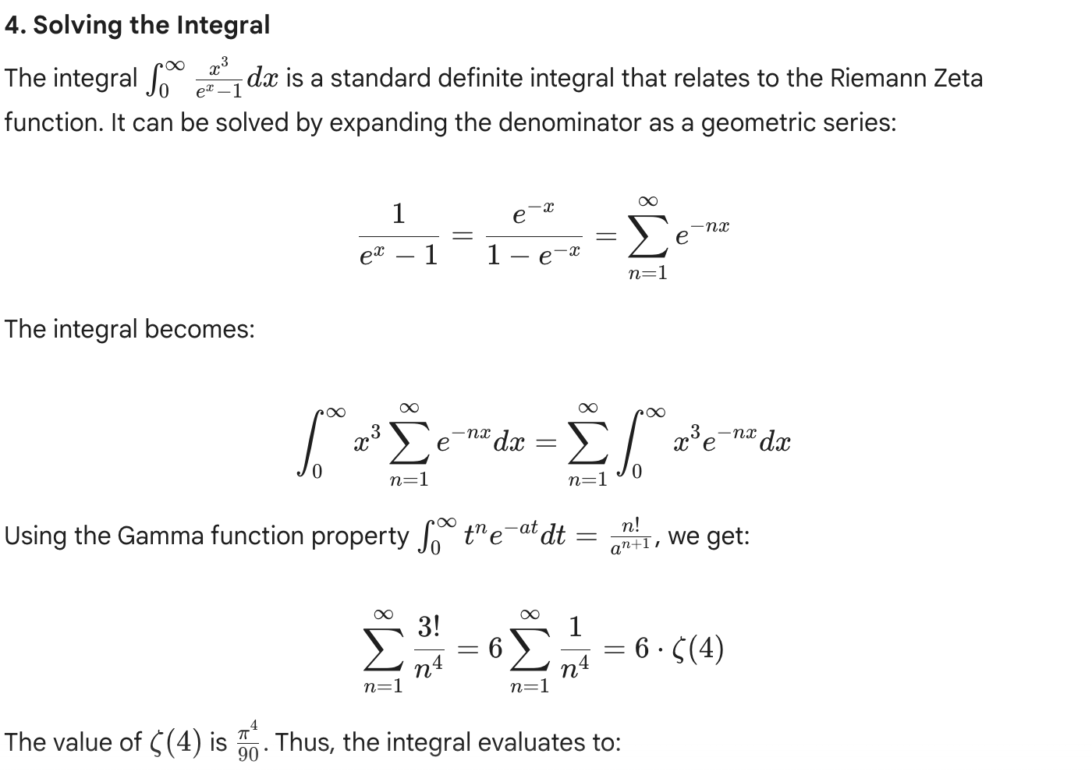
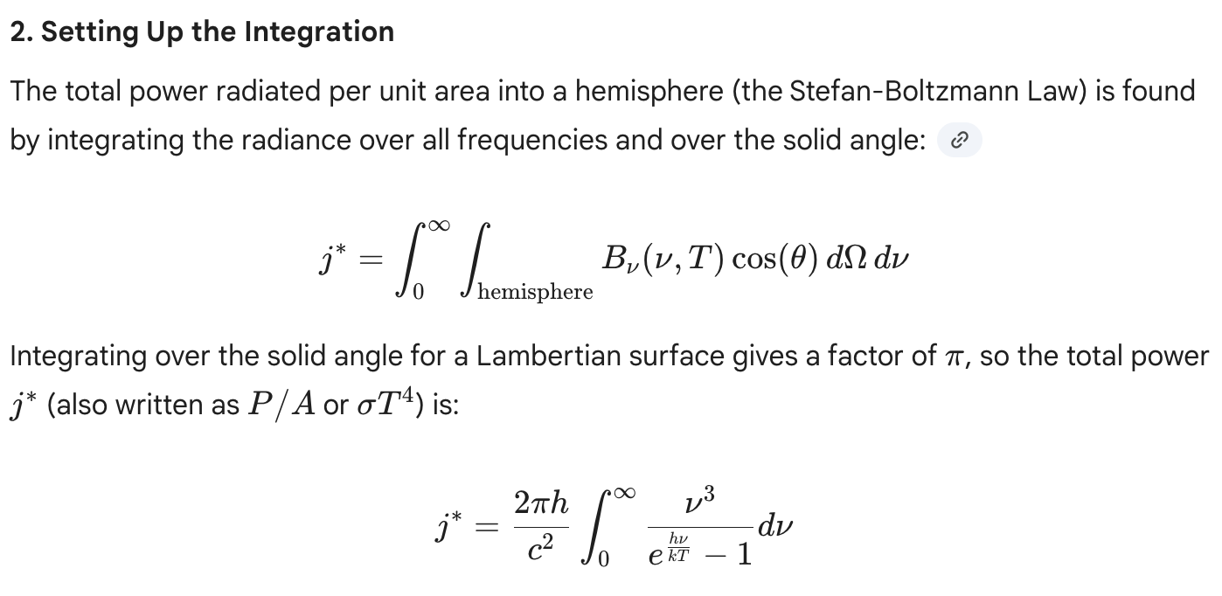
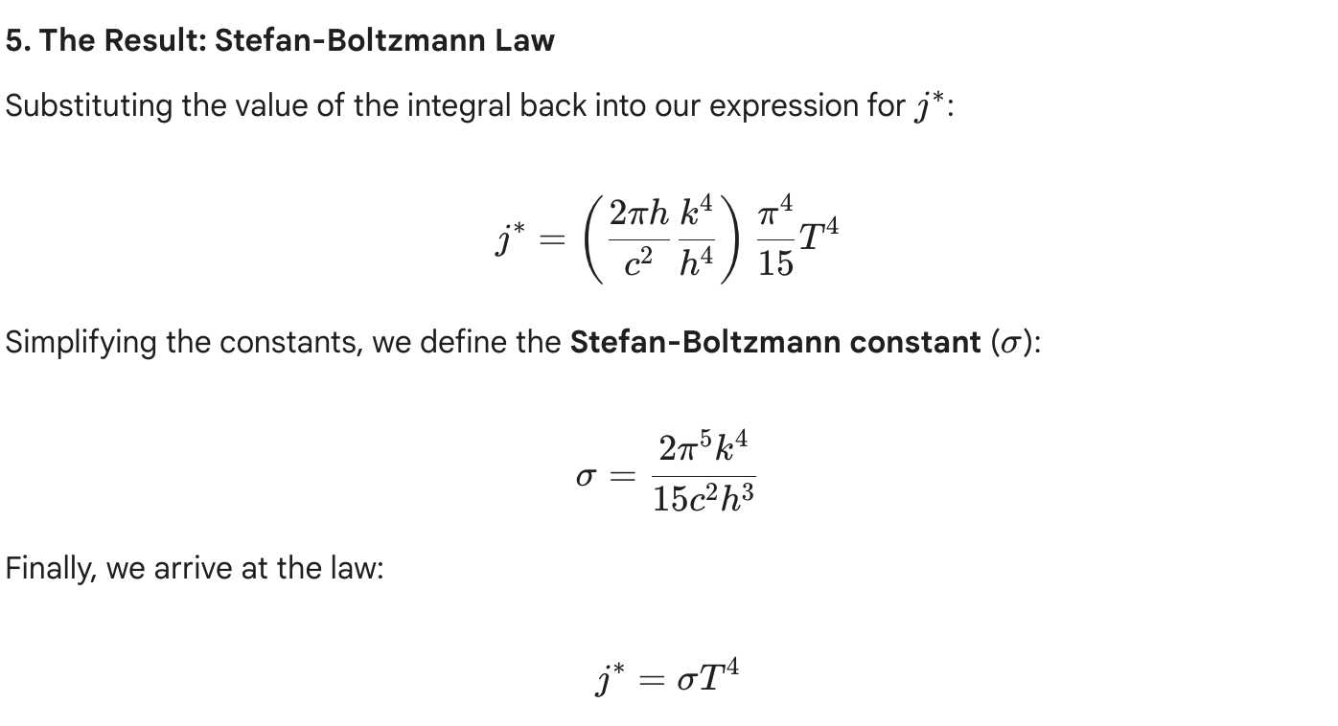
PHYSICAL MODELS IN REMOTE SENSING Chapter 01 – Part 01: Basic Definitions
Derivation
Gemini:
Integrate the Planck’s function to obtain the Boltzmann’s law

Slide 11
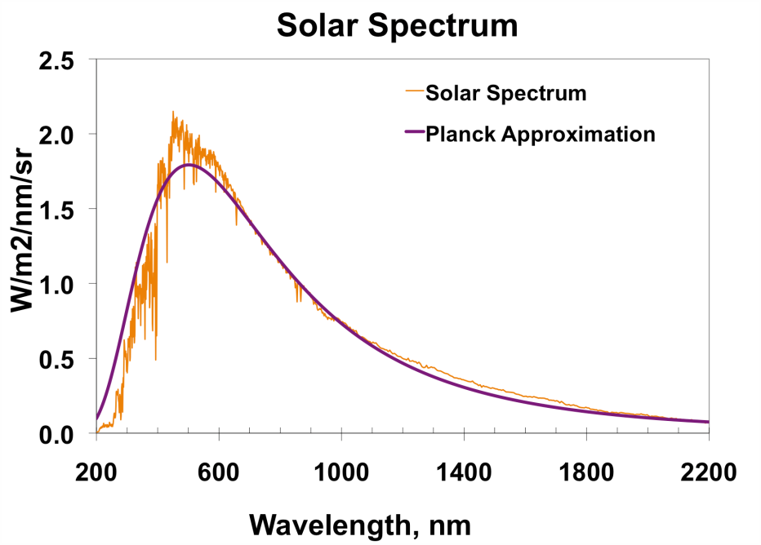
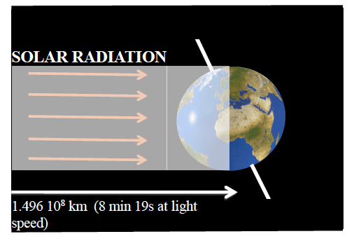
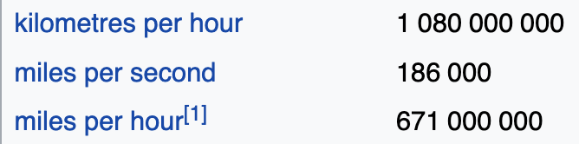
PHYSICAL MODELS IN REMOTE SENSING Chapter 01 – Part 01: Basic Definitions
Mukkulo7558Pokkulu
Mukkulo7558Pokkulu
Assumptions (mathematical idealization)
Sun is a distant point source of EM radiation
Energy from the sun is carried by photons
Photons are treated as point, mass-less (neutral) particles
Photons travel in straight lines between collisions with host material
Their speed is c=299,792,458 m/sec
No photon-photon collisions are allowed
Visual of Photons Streaming in Space

Slide 12
PHYSICAL MODELS IN REMOTE SENSING Chapter 01 – Part 01: Basic Definitions
Mukkulo7558Pokkulu
Mukkulo7558Pokkulu
Radiant energy
Energy is carried by photons
A unit of radiant energy in the SI is Joule (J)
The energy of a photon: E_{ν} = ν
ν is photon frequency (# of oscillations per second). Units: Hertz (Hz). 1 Hz = s⁻¹
Wavelength, λ=c/ν (c is speed of light). Units: m
 is Planck’s constant (Units: Js)

Slide 13
PHYSICAL MODELS IN REMOTE SENSING Chapter 01 – Part 01: Basic Definitions
Mukkulo7558Pokkulu
Mukkulo7558Pokkulu
Photon is characterized
Frequency (s⁻¹) or wavelength (m)
Given ν or λ, E_{ν} = ν or E_{ν} = c/λ. Unit: J
Location: r = (x,y,z)
Direction of photon travel, Ω = (Ω_{x}, Ω_{y}, Ω_{z})
Time t
Seven dimenions (x,y,z,θ,ϕ,ν,t)

Slide 14
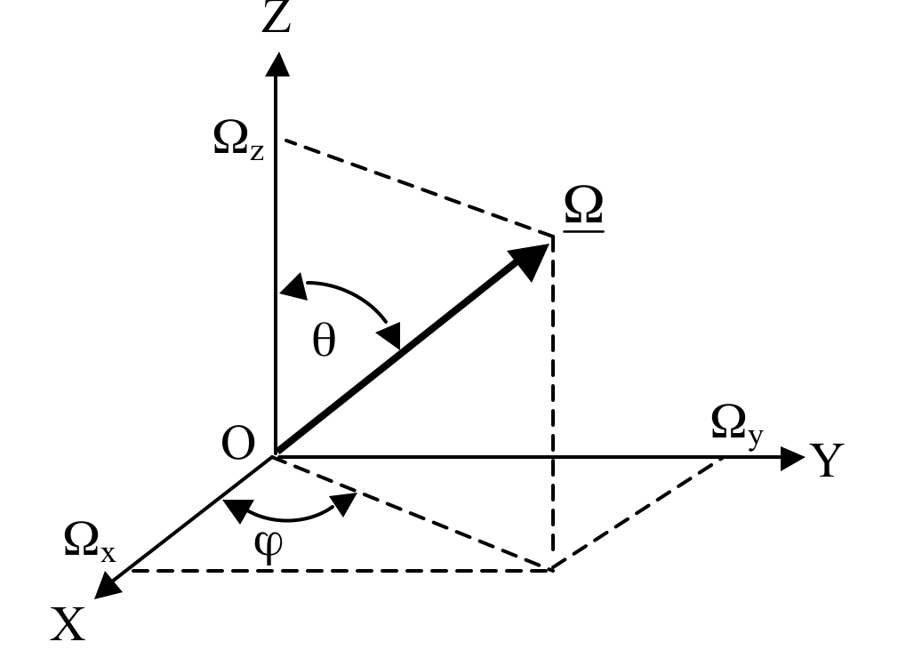
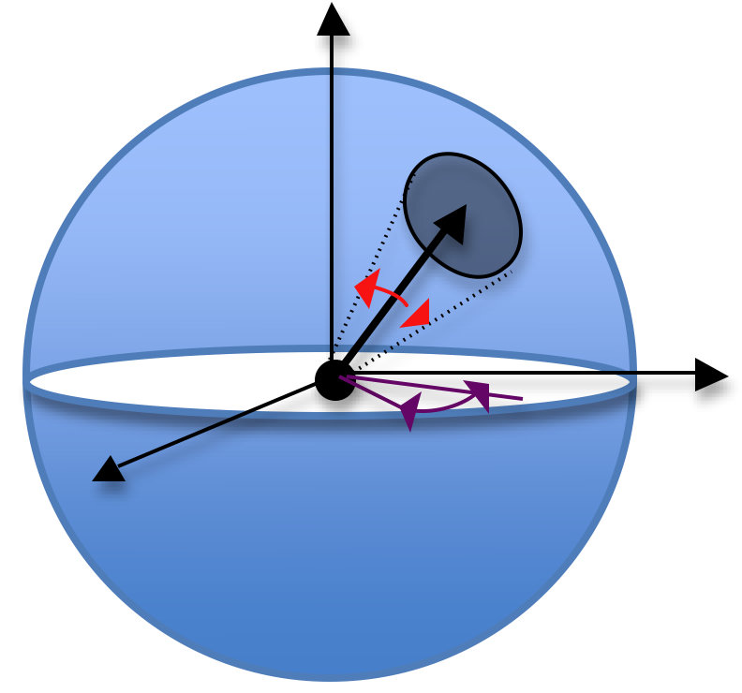
PHYSICAL MODELS IN REMOTE SENSING Chapter 01 – Part 01: Basic Definitions
Direction
Solid angle
UNITS: none
UNITS: steradian (sr)
_
dΩ
_
dθ
_
dϕ
Mukkulo7558Pokkulu
Mukkulo7558Pokkulu
Unit sphere
_
Directional cosines
Location: r = (x,y,z)
Direction of photon travel, Ω
Solid angle dΩ is used to quantify variation in Ω
14

Slide 15
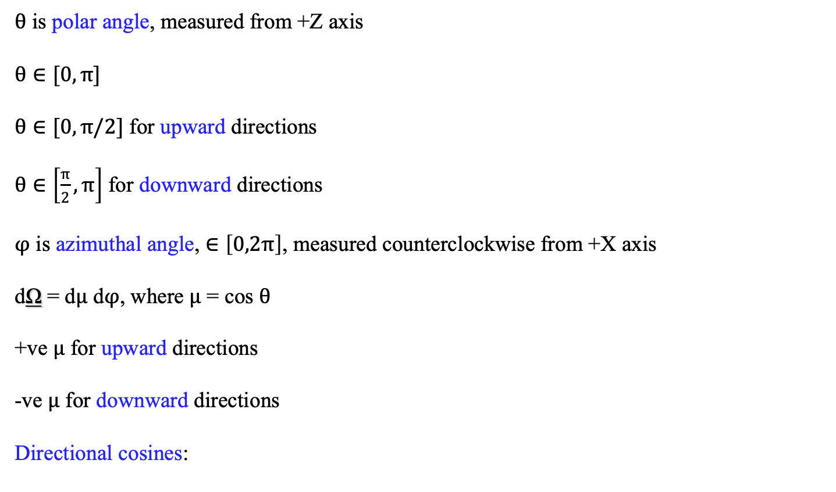


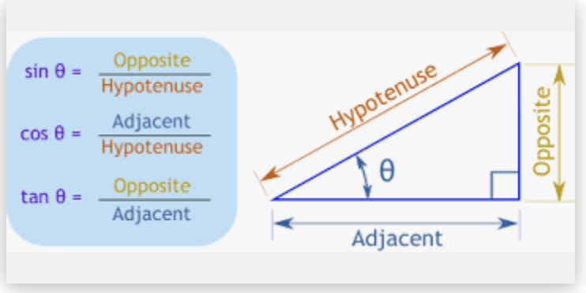
PHYSICAL MODELS IN REMOTE SENSING Chapter 01 – Part 01: Basic Definitions
Polar Coordinates
Mukkulo7558Pokkulu
Mukkulo7558Pokkulu
15

Slide 16
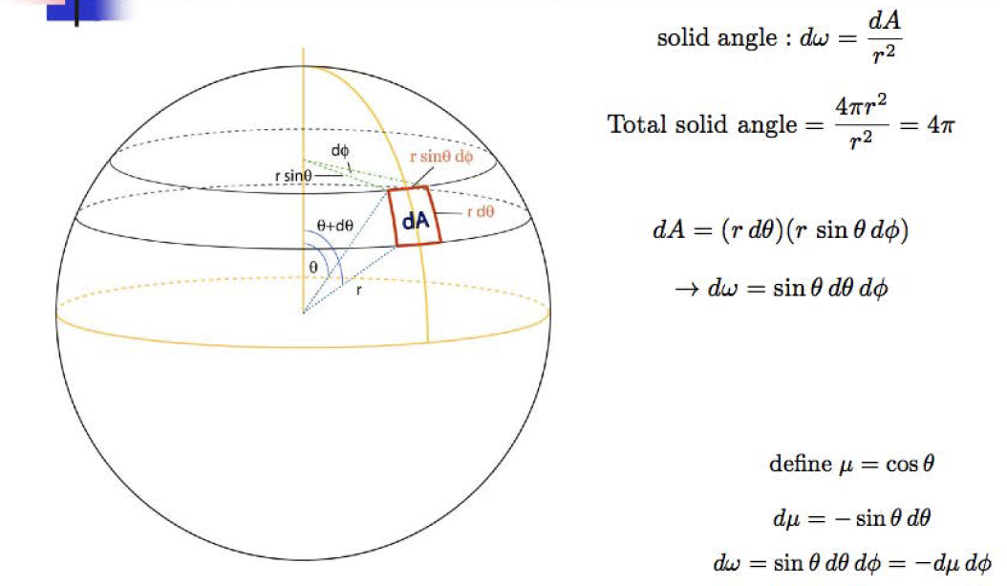
PHYSICAL MODELS IN REMOTE SENSING Chapter 01 – Part 01: Basic Definitions
Solid Angle
Mukkulo7558Pokkulu
Mukkulo7558Pokkulu
16

Slide 17
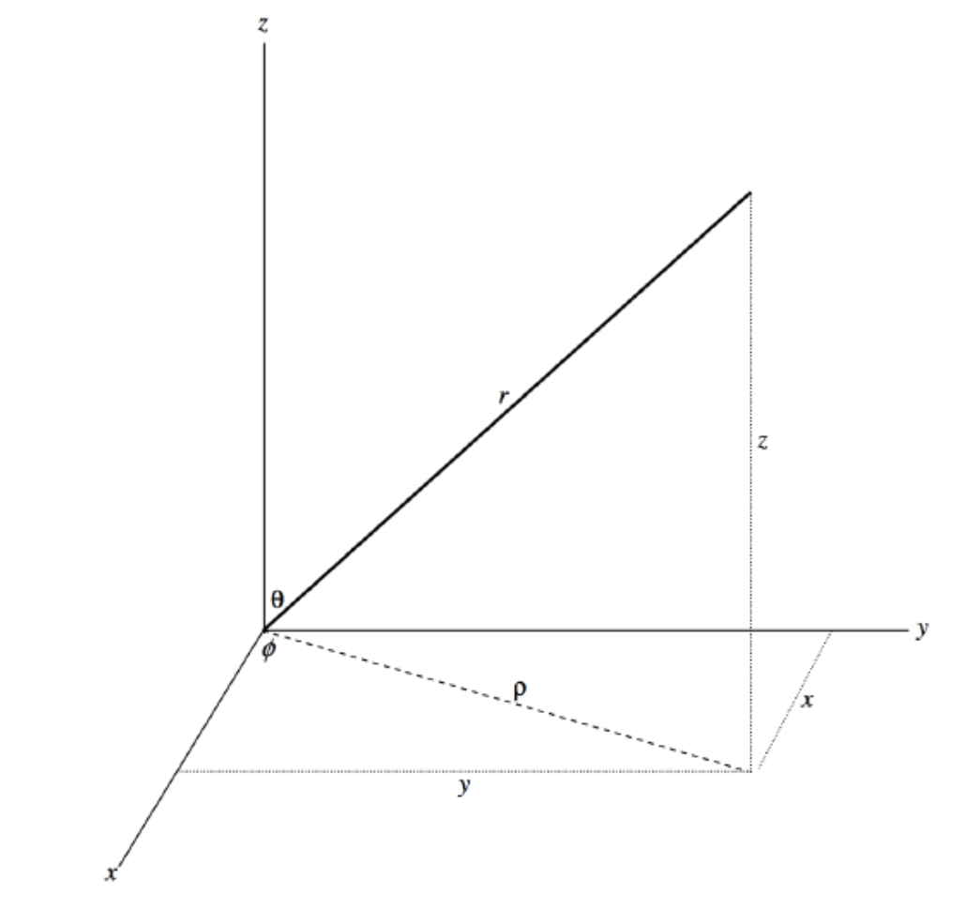
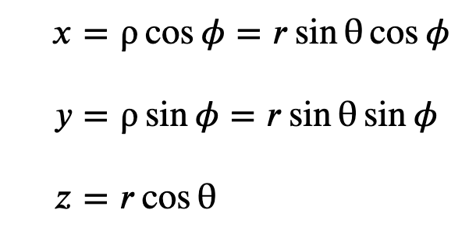
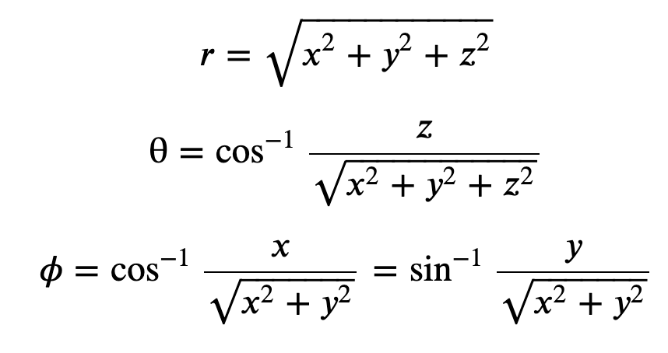
PHYSICAL MODELS IN REMOTE SENSING Chapter 01 – Part 01: Basic Definitions
Directional Cosines
https://phys.libretexts.org/
Mukkulo7558Pokkulu
Mukkulo7558Pokkulu
17

Slide 18
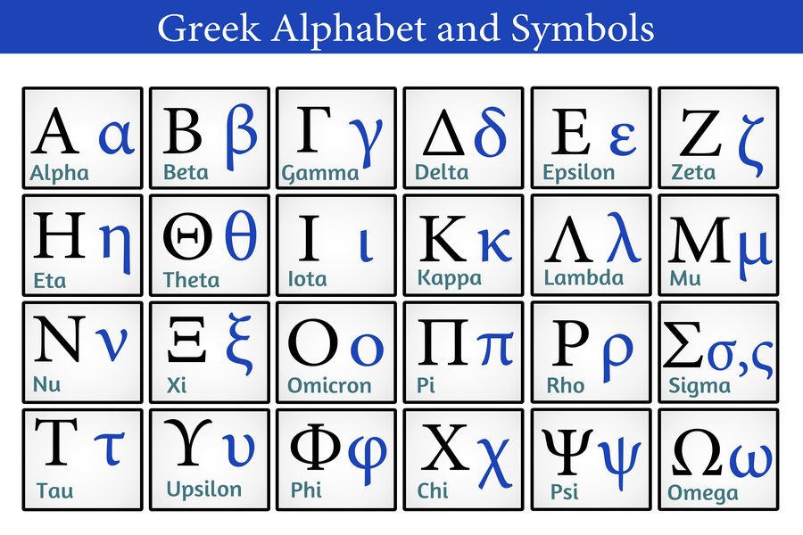
PHYSICAL MODELS IN REMOTE SENSING Chapter 01 – Part 01: Basic Definitions
Greek Symbols
18

Slide 19
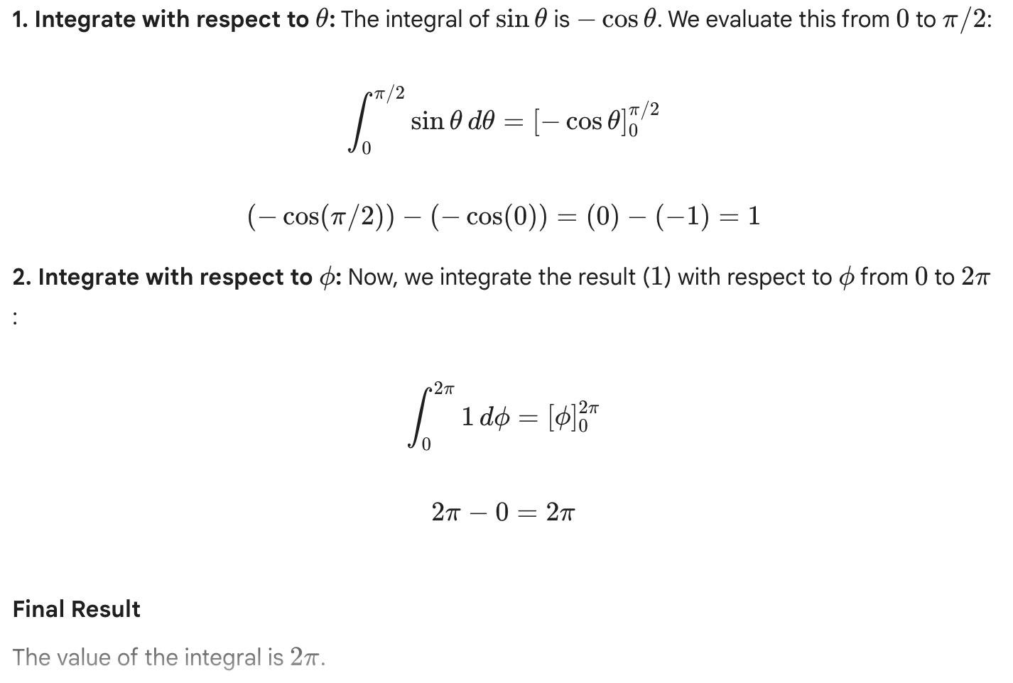
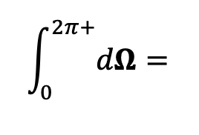
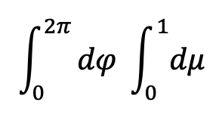
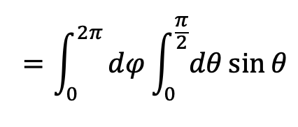
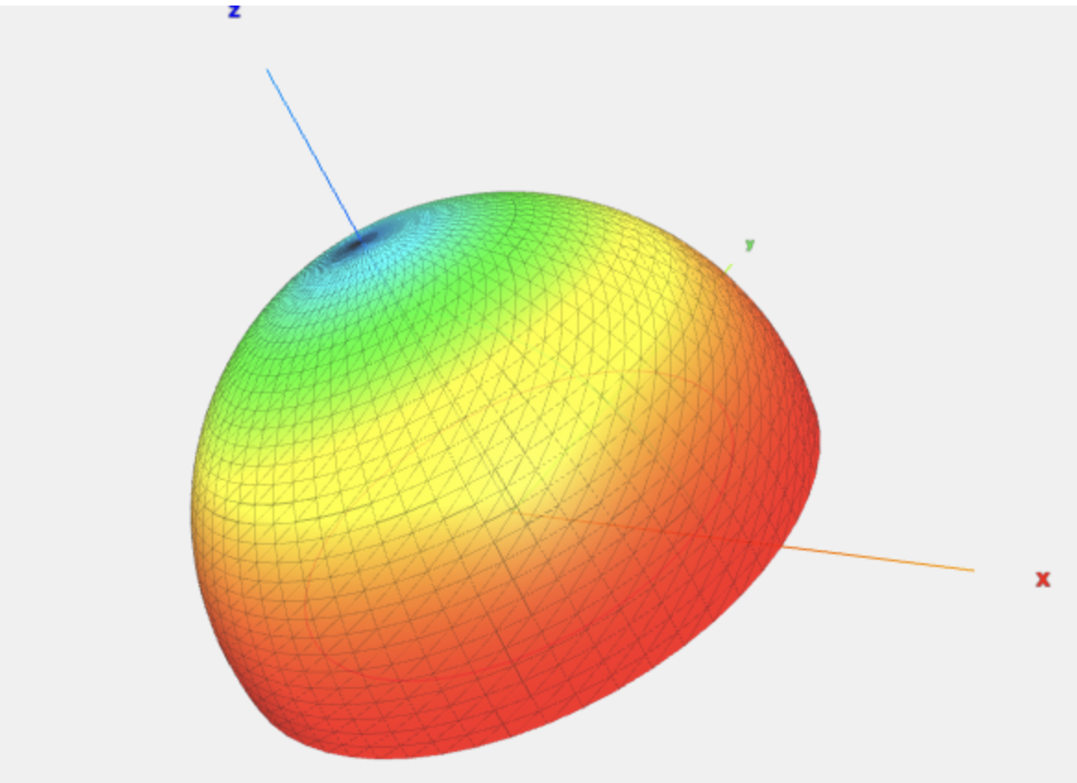
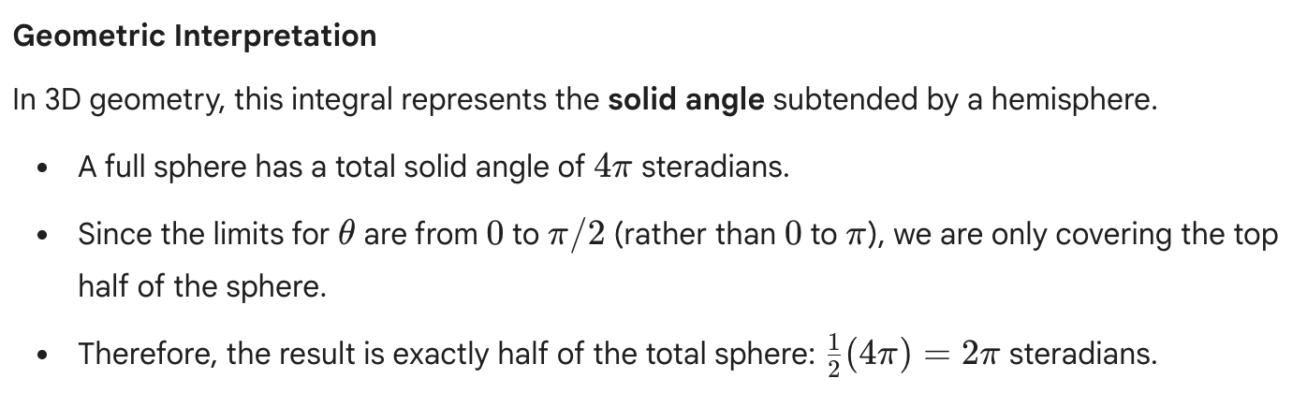
PHYSICAL MODELS IN REMOTE SENSING Chapter 01 – Part 01: Basic Definitions
Simple Angluar Integrals
Evaluate:
Claude Graphic
19

Slide 20
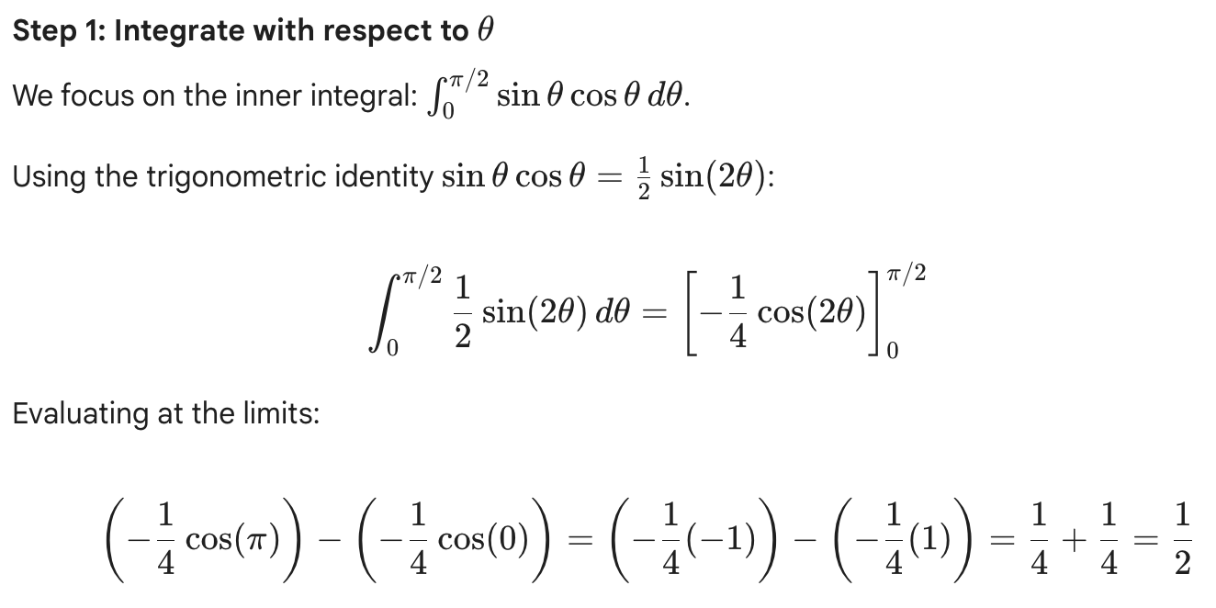
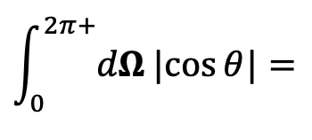
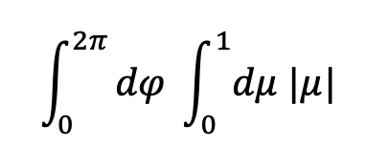
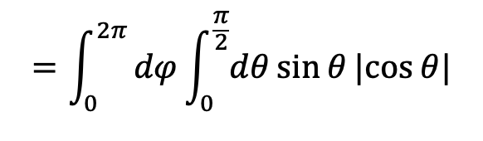
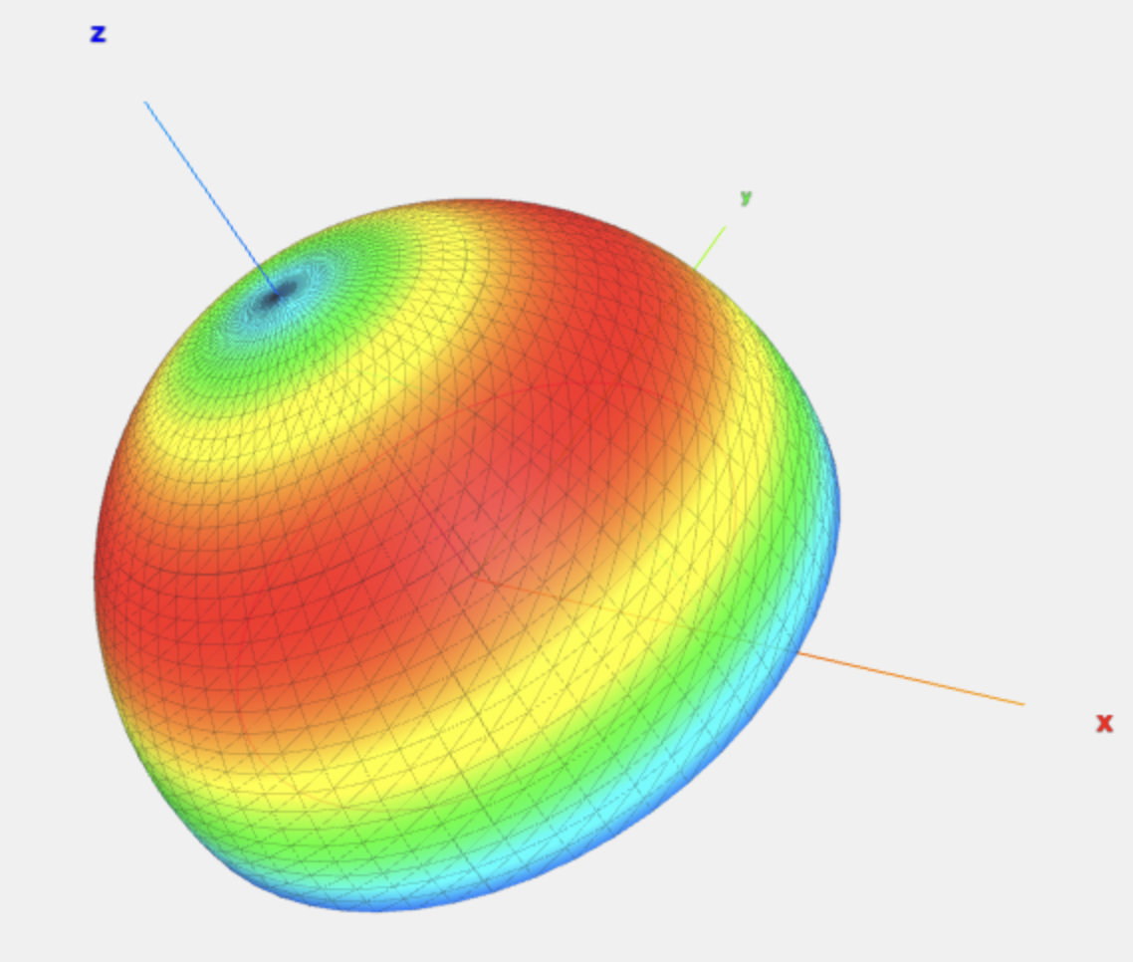
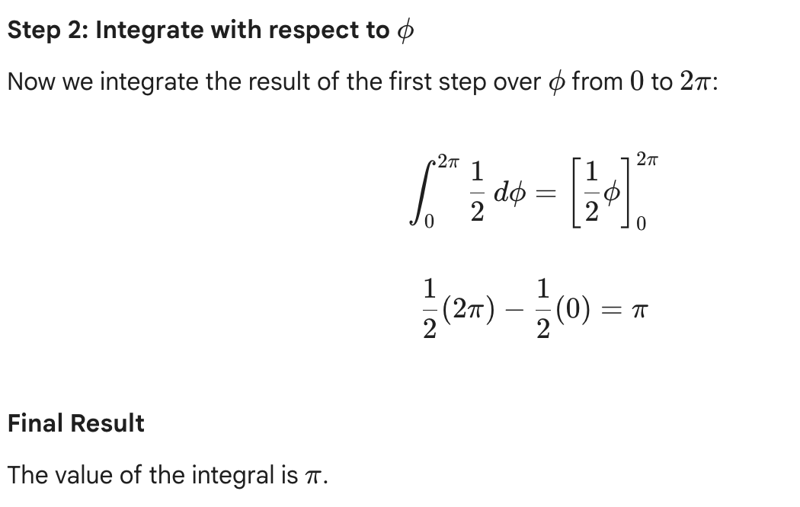
PHYSICAL MODELS IN REMOTE SENSING Chapter 01 – Part 01: Basic Definitions
Simple Angluar Integrals
Evaluate:
Claude Graphic
20

