Slide 1
PHYSICAL MODELS IN REMOTE SENSING Chapter 01 – Part 02: Radiative Quantities
Photon Cloud
Photon Distribution Function
Energy Transport by Photons
Radiation Intensity
Flux Density
Fluxes across a Horizontal Surface
Irradiance
Radiant Power

Slide 2
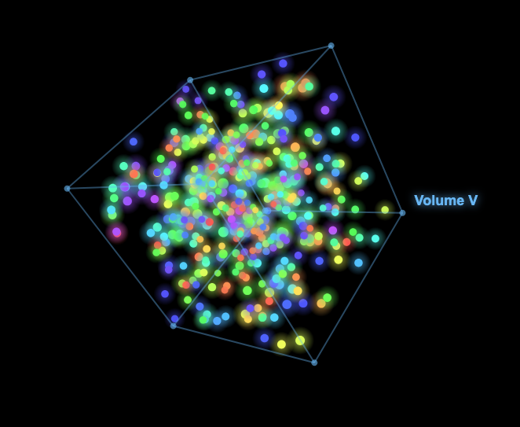
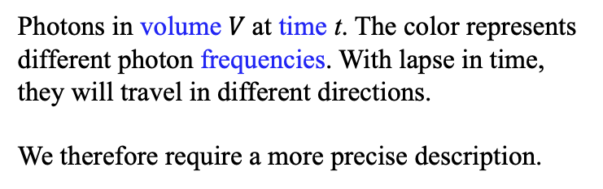
PHYSICAL MODELS IN REMOTE SENSING Chapter 01 – Part 02: Radiative Quantities
Photon Cloud
Photons in volume $V$at time t. The color represents different photon frequencies. With lapse in time, they will travel in different directions.
We therefore require a more precise description.
01-Photon-Cloud.html

Slide 3
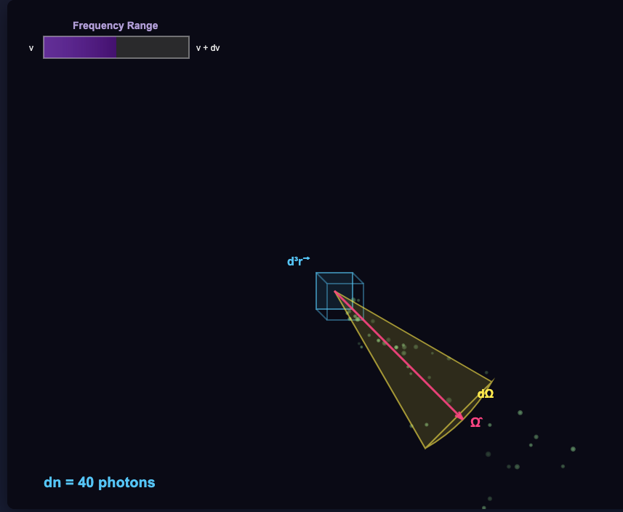
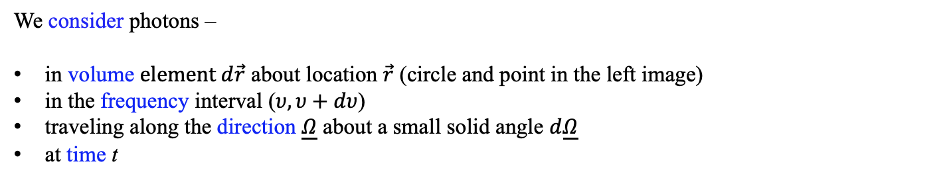
PHYSICAL MODELS IN REMOTE SENSING Chapter 01 – Part 02: Radiative Quantities
Counting Photons Precisely
We consider photons –
in volume $element d\vec{r}$ about location $\vec{r}$ (circle and point in the left image)
in the frequency interval ($υ,υ+dυ$)
traveling along the direction $\underline{Ω}$ about a small solid angle $d\underline{Ω}$
at time t

Slide 4
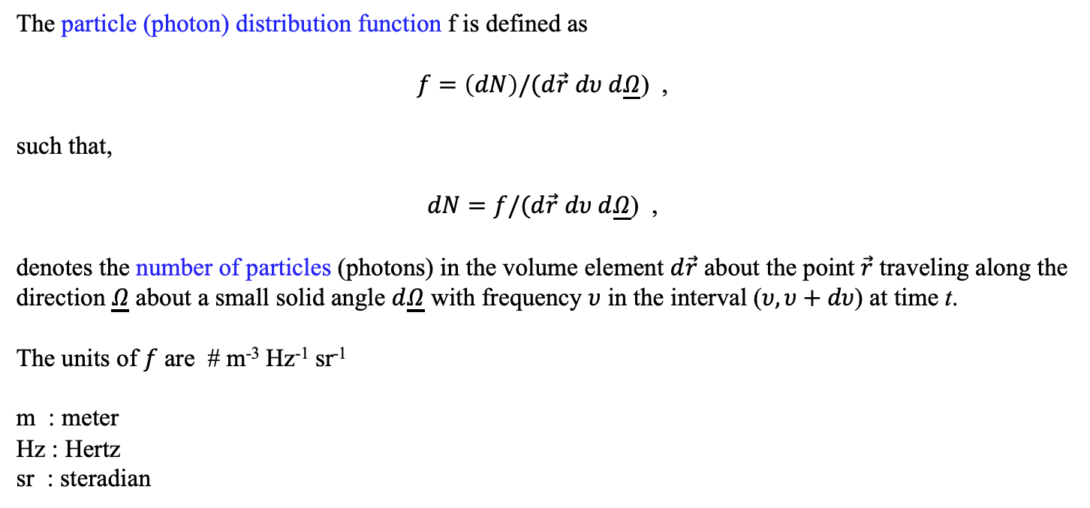
PHYSICAL MODELS IN REMOTE SENSING Chapter 01 – Part 02: Radiative Quantities
Particle distribution function, “f”
The particle (photon) distribution function f is defined as
$f=\left(dN\right)/(d\vec{r}$ $dυ d\underline{Ω}$) ,
such that,
$dN=f/(d\vec{r}$ $dυ d\underline{Ω}$) ,
denotes the number of particles (photons) in the volume element $d\vec{r}$ about the point $\vec{r}$ traveling along the direction $\underline{Ω}$ about a small solid angle $d\underline{Ω}$ with frequency $υ$ in the interval ($υ,υ+dυ$) at time t.
The units of $f$ are # m⁻³ Hz⁻¹ sr⁻¹
m : meter
Hz : Hertz
sr : steradian
02-Photon-Number.html

Slide 5
PHYSICAL MODELS IN REMOTE SENSING Chapter 01 – Part 02: Radiative Quantities
Particles Transporting Energy
It is convenient to express the particle distribution in terms of energy that photons transport because many radiometric devices used in remote sensing and plant ecology measure radiant energy, and not photon counts (lidars measure photon counts).
Remember that the particle distribution function f tells us something about the number of particle at a time instant t. Each particle carries energy (E in Joules) according to its frequency ν,
E_{ν} = ν ,
where  is a constant.
To realize energy transport by particles, we need to let time elapse! Therefore, we consider a time interval (t + dt) during which particles travel and transport energy across a surface of area ds.
This raises some questions: What is time? What is space?

Slide 6
PHYSICAL MODELS IN REMOTE SENSING Chapter 01 – Part 02: Radiative Quantities
Time and Space
The speed of electromagnetic radiation (EMR) c in vacuum is an absolute constant,
c = d/t = 299,792,458 m/sec .
This defines time and space –
Time: a second, unit of time, is the time EMR takes to travel distance of 299,792,458 meters
Space: a meter, unit of lineal space, is the distance EMR travels in (1/299,792,458)^{th} of a second
The space in our universe is 3 dimensional (how do we know this? Ask AI). EMR traveling in 3D space and imparting energy to objects it encounters requires geometrical concepts.

Slide 7
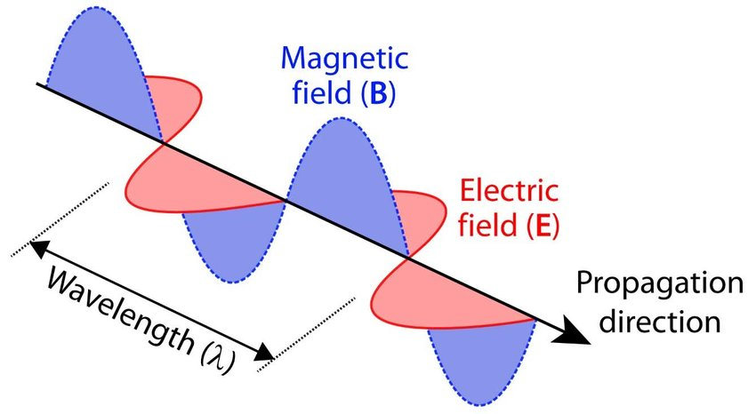
PHYSICAL MODELS IN REMOTE SENSING Chapter 01 – Part 02: Radiative Quantities
But, Why Does EMR Travel in the First Place?
Electromagnetic radiation (EMR) travels because of a unique "leapfrog" effect between electric and magnetic fields. Unlike sound waves, which need air or water to move, EMR is self-propagating — it creates its own "track" as it moves through space.
A changing Magnetic Field creates an Electric Field: If you have a magnetic field that is fluctuating (getting stronger or weaker), it naturally pushes on the space around it to generate an electric field.
A changing Electric Field creates a Magnetic Field: That newly created electric field is also changing, and a changing electric field naturally generates a magnetic field.
Because each field creates the other, they "feed" off one another. The electric field creates a magnetic field slightly ahead of it, which then creates an electric field even further ahead, and so on. This allows the wave to move forward indefinitely, even through the empty vacuum of space.
Most waves we encounter are mechanical waves. A wave in the ocean moves because water molecules bump into each other; sound moves because air molecules vibrate.
EMR is different because it is a field wave. Fields (like gravity or electricity) exist everywhere in the universe, even in a vacuum. EMR isn't "stuff" moving through space; it is a vibration of space itself (specifically the electromagnetic field that permeates space).

Slide 8
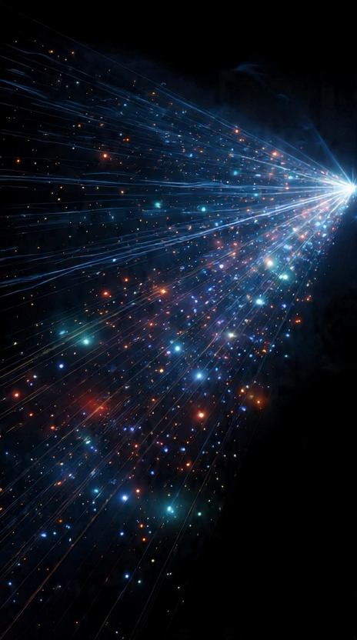
PHYSICAL MODELS IN REMOTE SENSING Chapter 01 – Part 02: Radiative Quantities
Illustration of Photons Streaming in 3D Space & Energy Transport
Anim

Slide 9
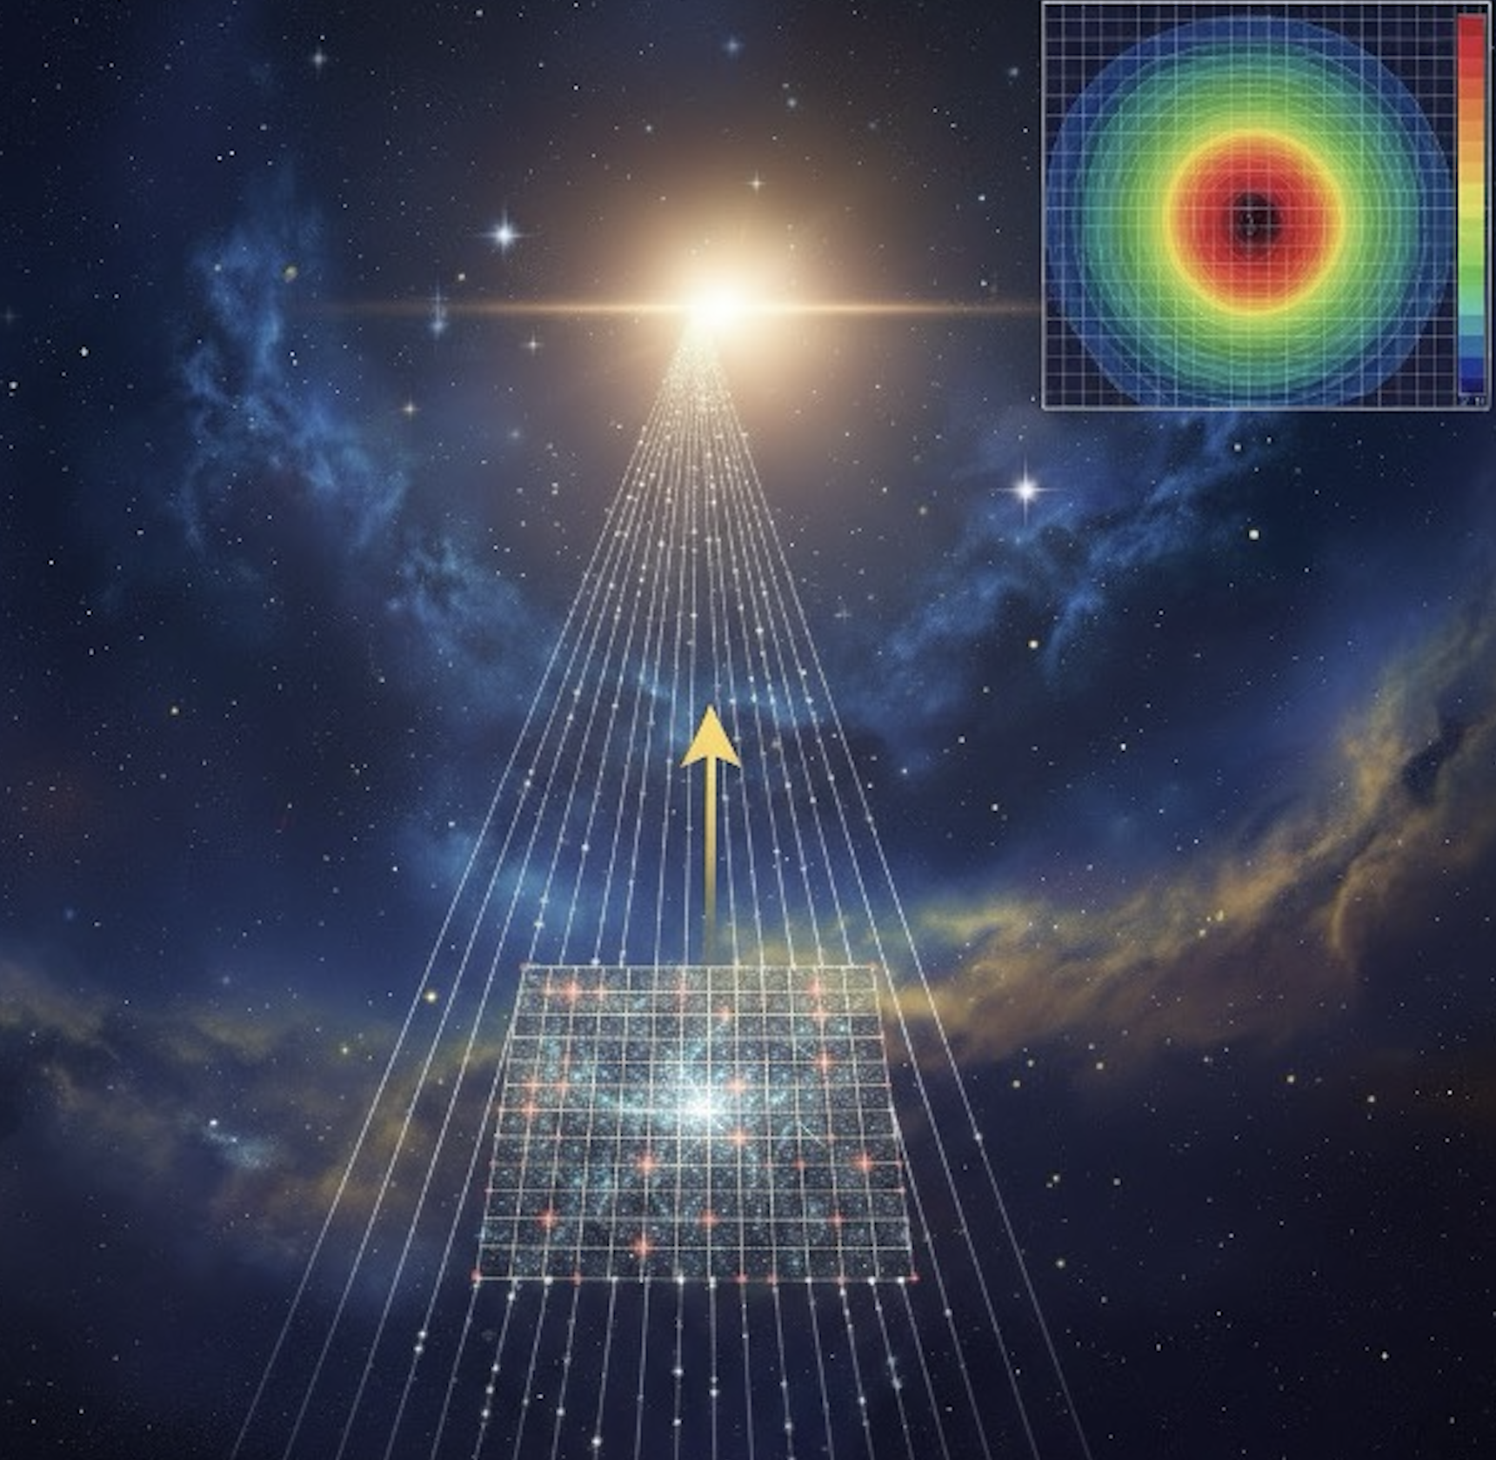
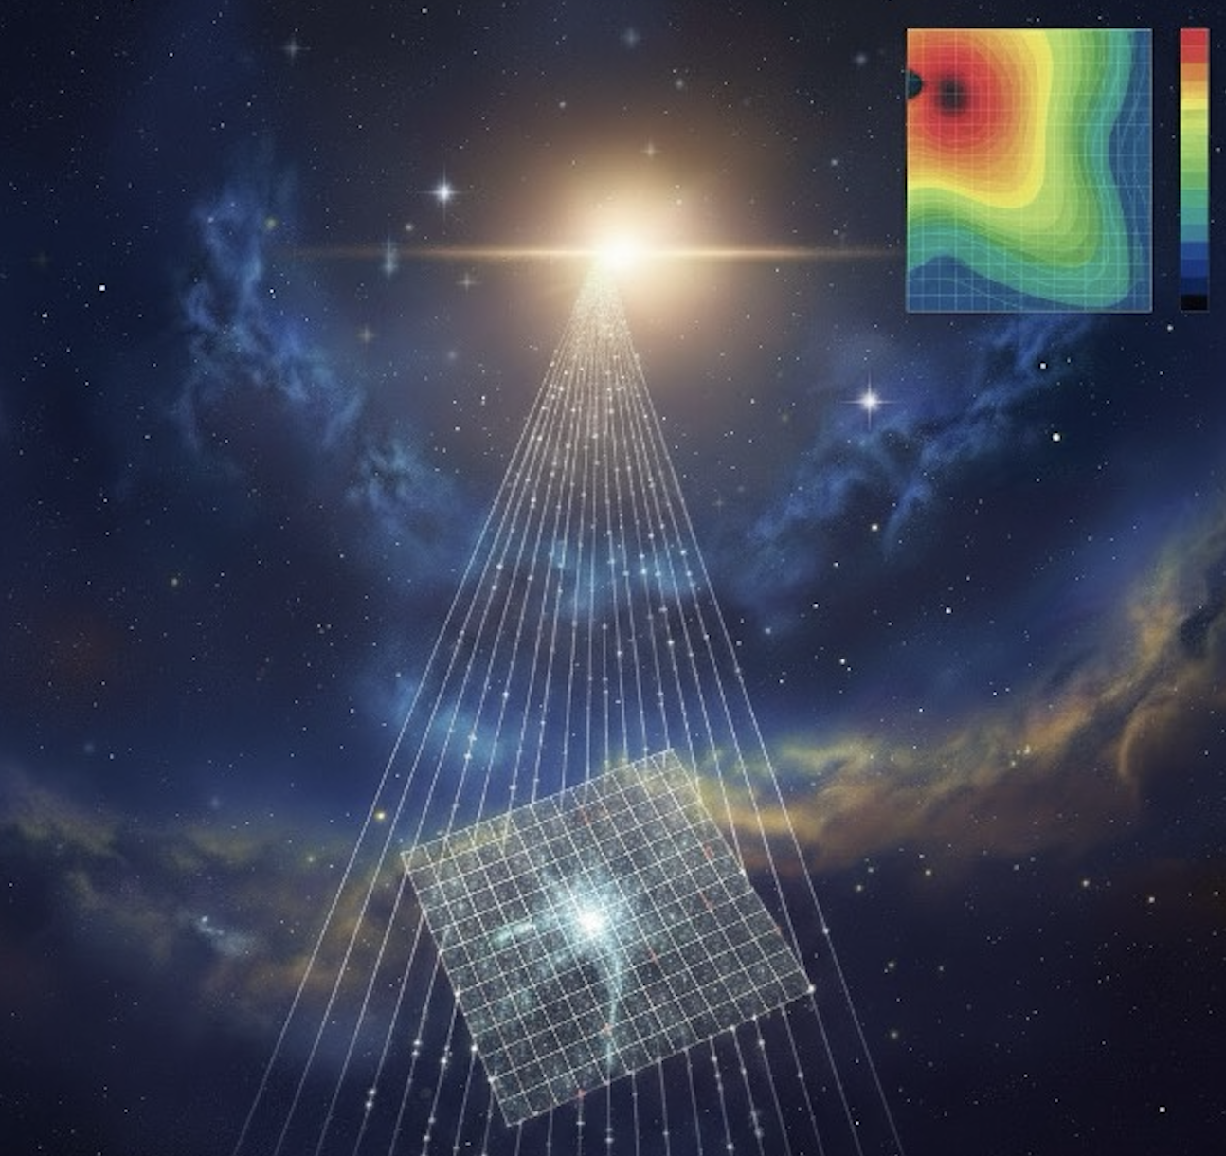


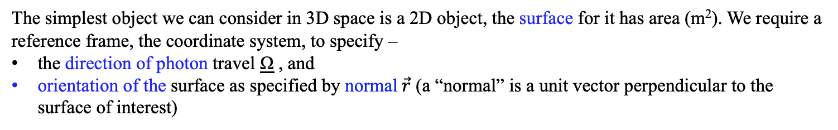
PHYSICAL MODELS IN REMOTE SENSING Chapter 01 – Part 02: Radiative Quantities
Particle Flow & Energy Transport Across a Surface
Ω
Ω
$\vec{r}$
$\vec{r}$
The simplest object we can consider in 3D space is a 2D object, the surface for it has area (m²). We require a reference frame, the coordinate system, to specify –
the direction of photon travel Ω , and
orientation of the surface as specified by normal$\vec{r}$ (a “normal” is a unit vector perpendicular to the surface of interest)

Slide 10
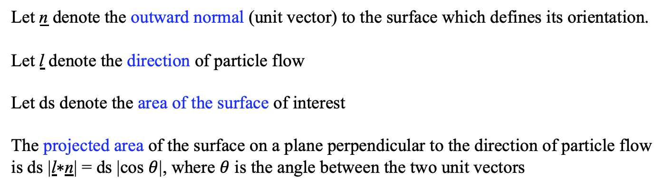
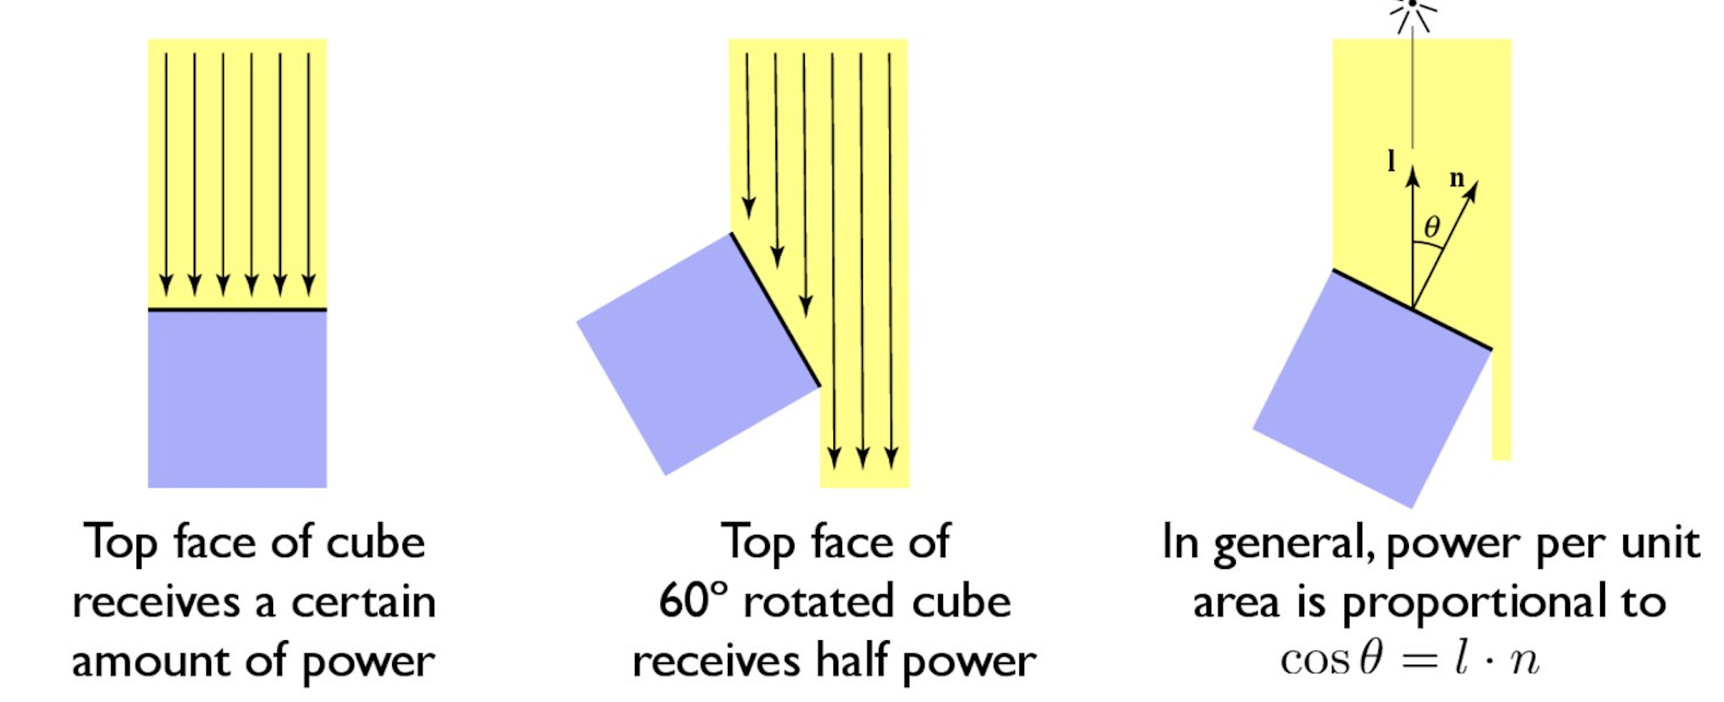

PHYSICAL MODELS IN REMOTE SENSING Chapter 01 – Part 02: Radiative Quantities
Surface Projection to Particle Flow Direction
ds
ds

Slide 11
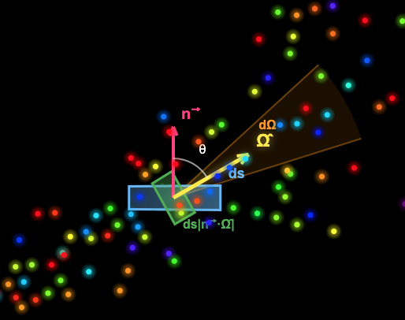
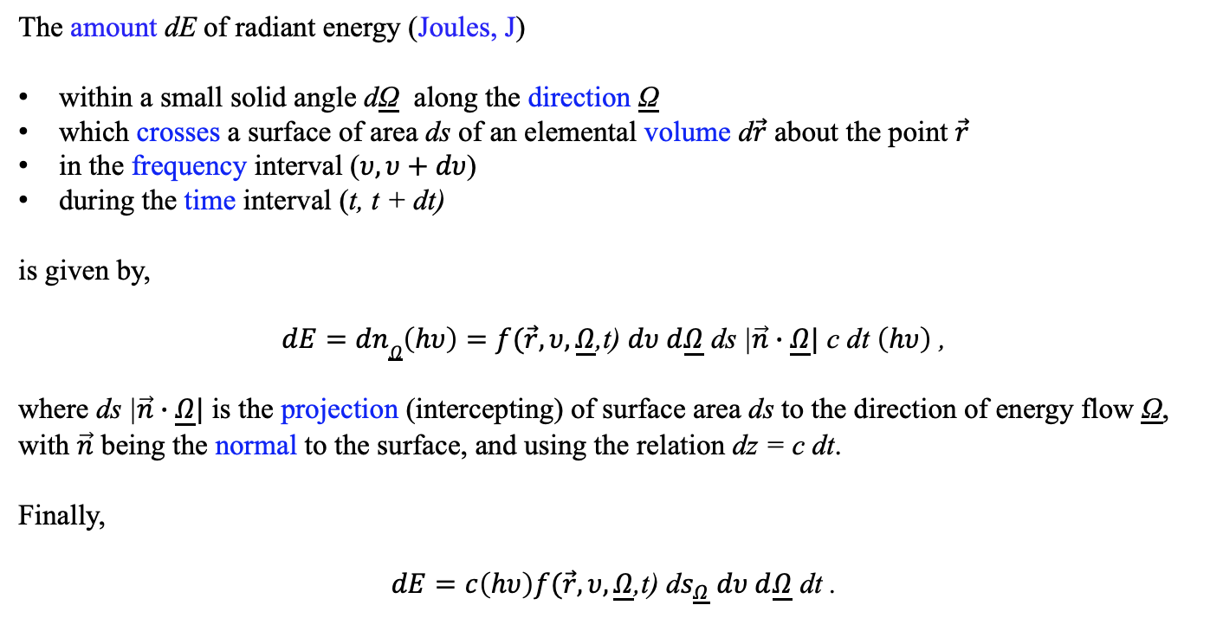
PHYSICAL MODELS IN REMOTE SENSING Chapter 01 – Part 02: Radiative Quantities
=
Energy Flow Across a Surface
The amount dE of radiant energy (Joules, J)
within a small solid angle dΩ along the direction Ω
which crosses a surface of area ds of an elemental volume d$\vec{r}$ about the point $\vec{r}$
in the frequency interval ($υ,υ+dυ$)
during the time interval (t, t + dt)
is given by,
$dE=dn\underline{Ω}\left(hυ\right)=f(\vec{r},υ,\underline{Ω}$,t) $dυ d\underline{Ω}$ ds |$\vec{n}∙\underline{Ω}|$ c dt $\left(hυ\right)$ ,
where ds |$\vec{n}∙\underline{Ω}|$ is the projection (intercepting) of surface area ds to the direction of energy flow Ω, with $\vec{n}$ being the normal to the surface, and using the relation dz = c dt.
Finally,
$dE=c\left(hυ\right)f(\vec{r},υ,\underline{Ω}$,t) d$s_{\underline{Ω}}$ $dυ d\underline{Ω}$ dt .
03-Energy-Flow.html

Slide 12
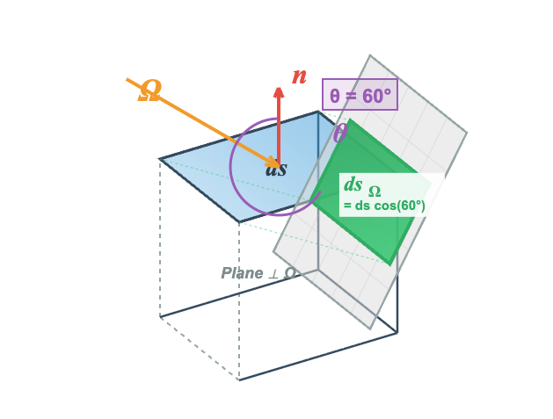
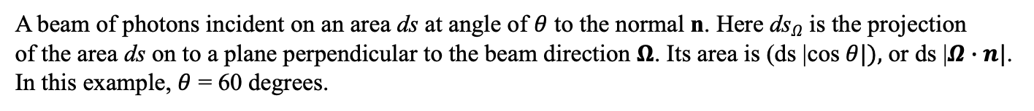
PHYSICAL MODELS IN REMOTE SENSING Chapter 01 – Part 02: Radiative Quantities
Illustration of Energy Flow Across a Surface
04-Projection.html
A beam of photons incident on an area ds at angle of $θ$ to the normal n. Here ds$Ω$ is the projection
of the area ds on to a plane perpendicular to the beam direction $Ω$. Its area is (ds |cos$θ|),$ or ds |$Ω∙n|$.
In this example, $θ$ = 60 degrees.

Slide 13
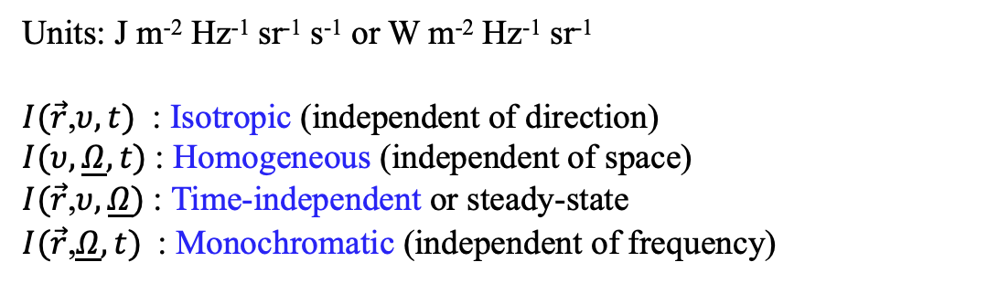
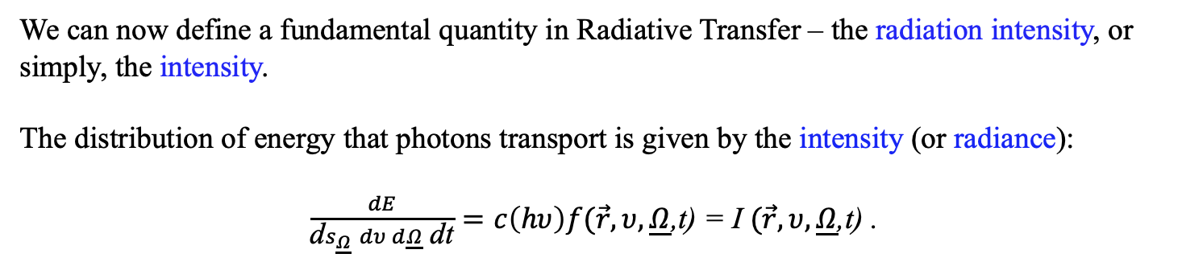
PHYSICAL MODELS IN REMOTE SENSING Chapter 01 – Part 02: Radiative Quantities
Specific Intensity, “I”
We can now define a fundamental quantity in Radiative Transfer – the radiation intensity, or simply, the intensity.
The distribution of energy that photons transport is given by the intensity (or radiance):
$\frac{dE}{\text{d}s_{\underline{Ω}} dυ d\underline{Ω} \text{dt}}=c\left(hυ\right)f(\vec{r},υ,\underline{Ω}$,t) = I $(\vec{r},υ,\underline{Ω}$,t) .
Units: J m⁻² Hz⁻¹ sr⁻¹ s⁻¹ or W m⁻² Hz⁻¹ sr⁻¹
$I(\vec{r}$,$υ, t)$ : Isotropic (independent of direction)
$I(υ,\underline{Ω},t)$: Homogeneous (independent of space)
$I(\vec{r}$,$υ,\underline{Ω})$: Time-independent or steady-state
$I(\vec{r}$,$\underline{Ω},t)$: Monochromatic (independent of frequency)

Slide 14
PHYSICAL MODELS IN REMOTE SENSING Chapter 01 – Part 02: Radiative Quantities
Radiation Intensity on a Tilting Surface

Slide 15
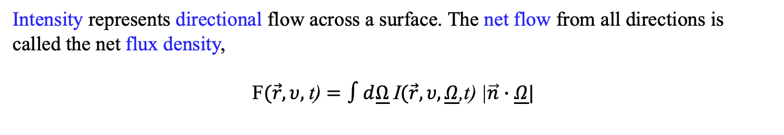

PHYSICAL MODELS IN REMOTE SENSING Chapter 01 – Part 02: Radiative Quantities
Net Flux Density, “F”
Intensity represents directional flow across a surface. The net flow from all directions is called the net flux density,
F$(\vec{r},υ,$t) $=∫d\underline{Ω}$I$(\vec{r},υ,\underline{Ω}$,t) |$\vec{n}∙\underline{Ω}|$
$$4π$$
It defines the rate of flow of radiant energy across a unit area and per unit frequency interval. It is also monochromatic irradiance.
Units: W m⁻² Hz⁻¹

Slide 16
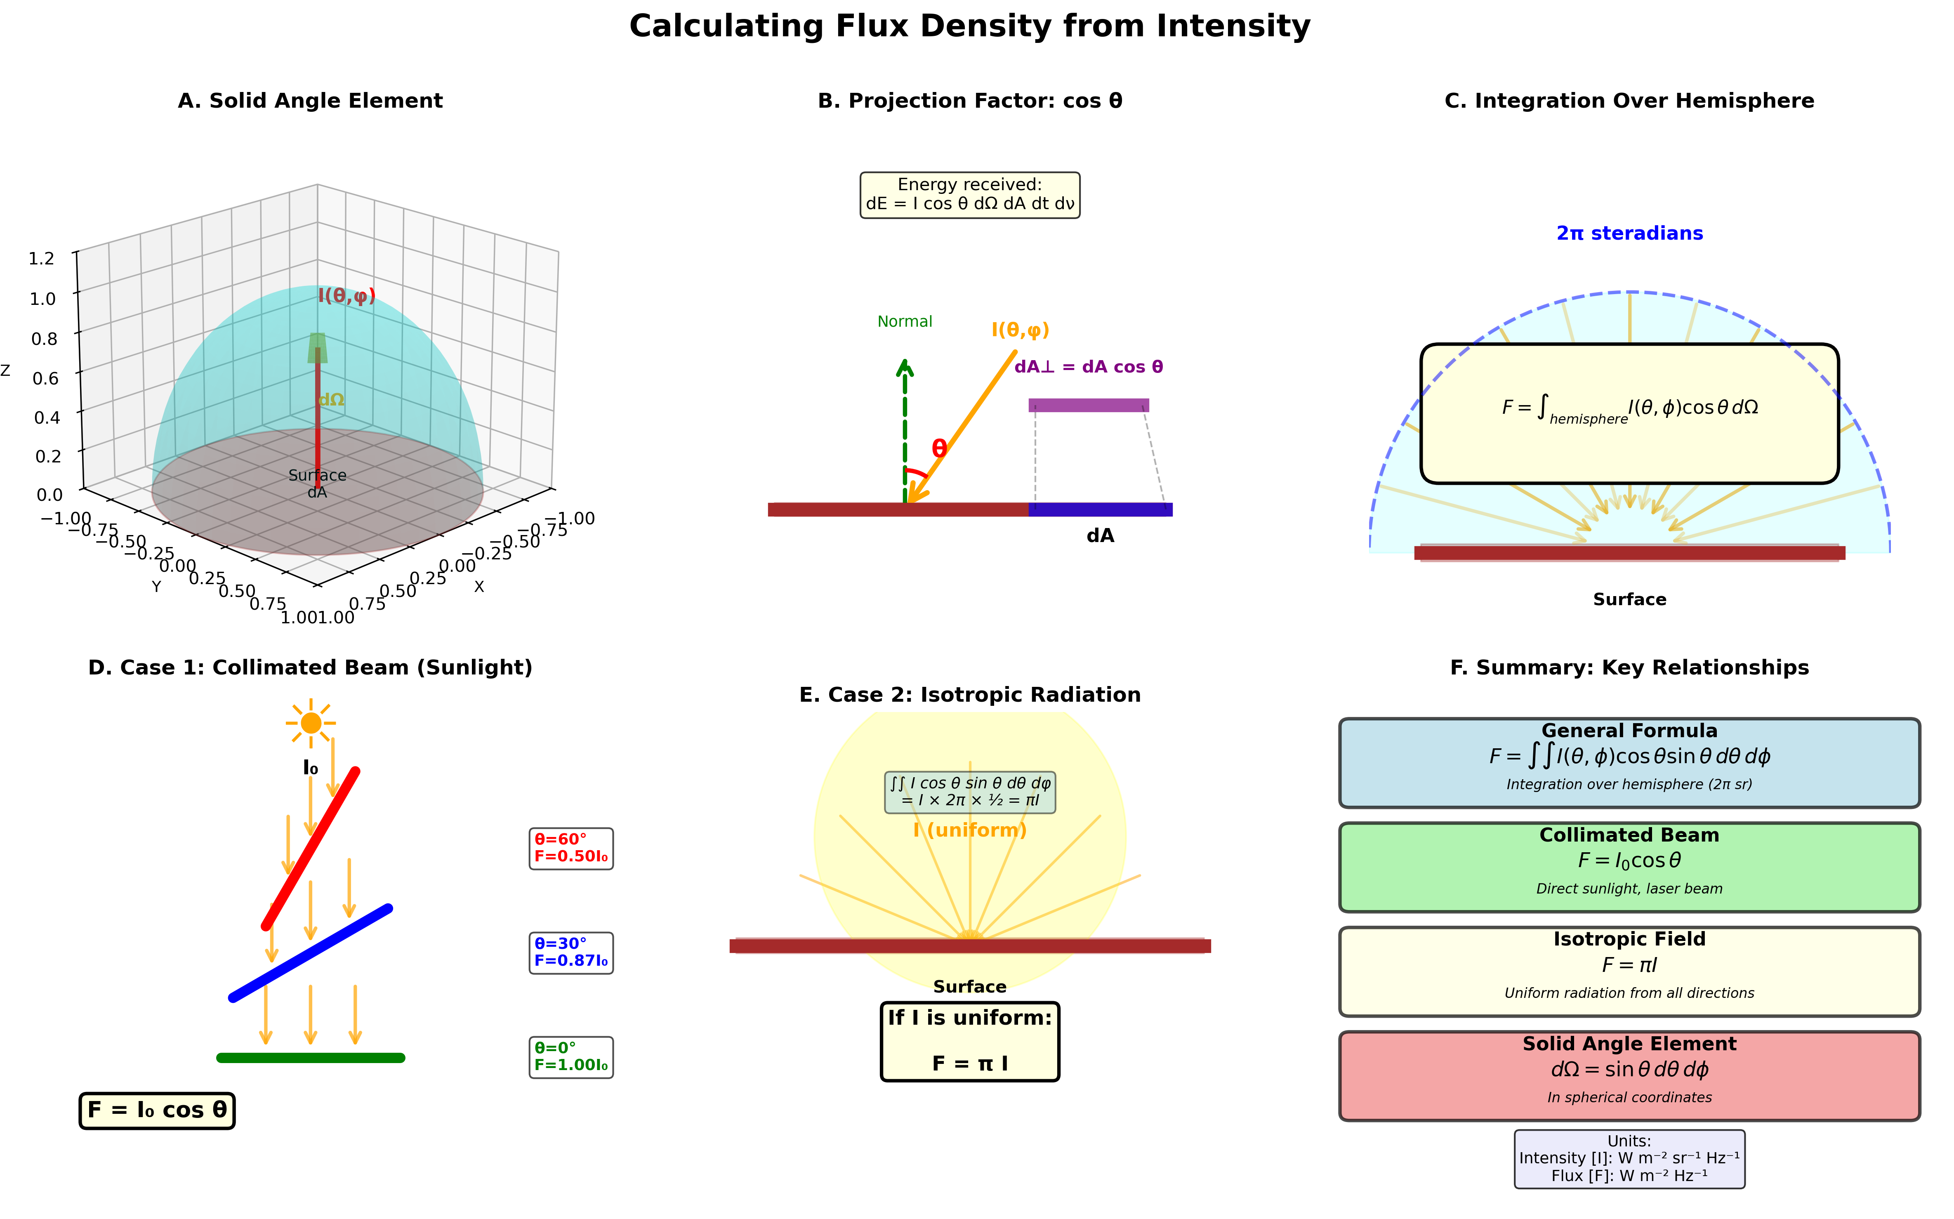
PHYSICAL MODELS IN REMOTE SENSING Chapter 01 – Part 02: Radiative Quantities
Summary: Flux Density

Slide 17
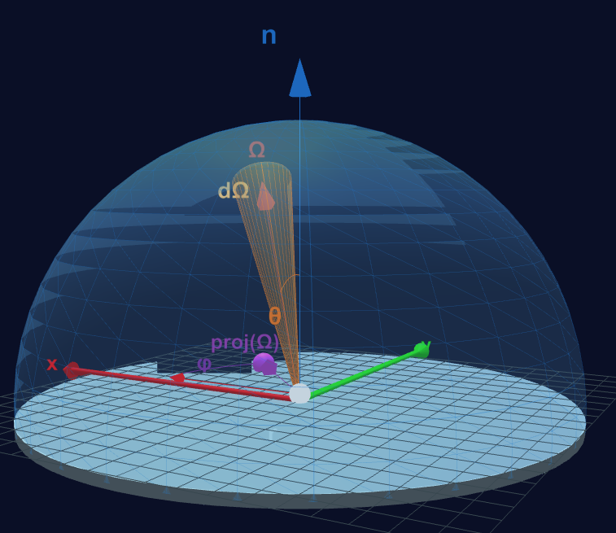
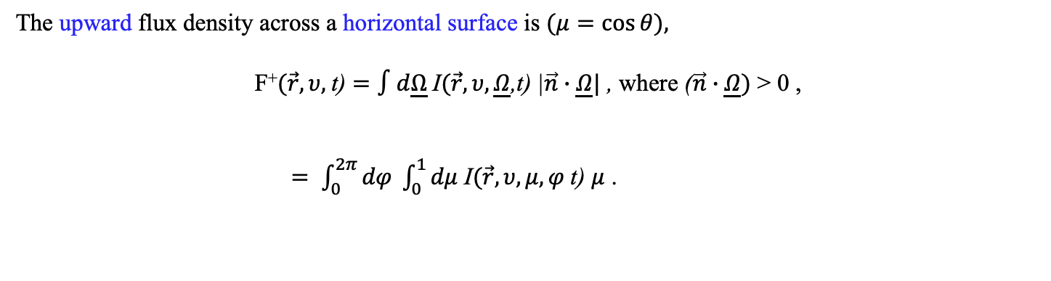

PHYSICAL MODELS IN REMOTE SENSING Chapter 01 – Part 02: Radiative Quantities
Upward Flux Density
05-Upward-Flux-Density.html
The upward flux density across a horizontal surface is $(μ=\cos{θ),}$
F⁺$(\vec{r},υ,$t) $=∫d\underline{Ω}$I$(\vec{r},υ,\underline{Ω}$,t) |$\vec{n}∙\underline{Ω}|$ , where ($\vec{n}∙\underline{Ω})$ > 0 ,
$= \int_{0}^{2π}{dφ \int_{0}^{1}{dμ}}$ I$(\vec{r},υ,μ,φ$t) $μ$ .
$2π$⁺

Slide 18
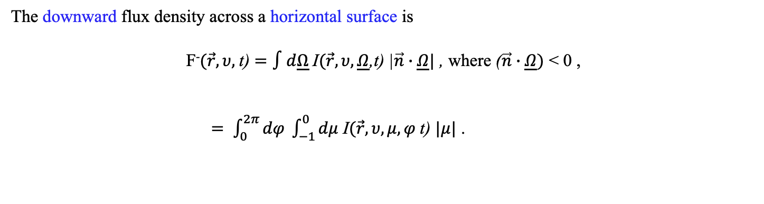

PHYSICAL MODELS IN REMOTE SENSING Chapter 01 – Part 02: Radiative Quantities
Downward Flux Density
The downward flux density across a horizontal surface is
F⁻$(\vec{r},υ,$t) $=∫d\underline{Ω}$I$(\vec{r},υ,\underline{Ω}$,t) |$\vec{n}∙\underline{Ω}|$ , where ($\vec{n}∙\underline{Ω})$ < 0 ,
$= \int_{0}^{2π}{dφ \int_{−1}^{0}{dμ}}$ I$(\vec{r},υ,μ,φ$t) $|μ|$ .
$$2π−$$

Slide 19
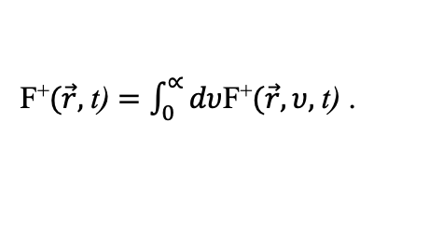
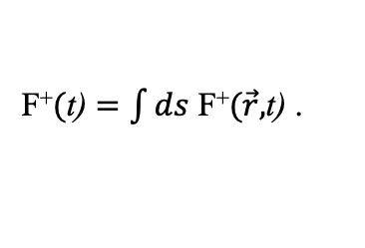
PHYSICAL MODELS IN REMOTE SENSING Chapter 01 – Part 02: Radiative Quantities
Irradiance
The total hemispherical flux density, in Wm⁻², or irradiance, is obtained by integrating the monochromatic irradiance over the entire electromagnetic spectrum,
F⁺$(\vec{r},$t) $=\int_{0}^{∝}{dυ}$F⁺$(\vec{r},υ,$t) .
Radiant Power
The integral of the irradiance over an area A is the total flux, in W, or radiant power,
F⁺$($t) $=\int{ds}$ F⁺$(\vec{r},$t) .
A

