Slide 1
PHYSICAL MODELS IN REMOTE SENSING Chapter 01 – Part 03: Radiative Interactions
Radiative Interactions
Absorption Coefficient
Scattering Coefficient
Differential Scattering Coefficient
Scattering Phase Functions
Extinction Coefficient
Single Scattering Albedo
Emission Sources

Slide 2
PHYSICAL MODELS IN REMOTE SENSING Chapter 01 – Part 03: Radiative Interactions
Radiative Interactions
When photons travel through a medium, they interact with the atoms and electrons of the host material in distinct ways. These interactions can be broadly categorized into scattering (where the photon changes direction and possibly its frequency) and absorption (where the photon disappears and transfers its energy).
Absorption: A photon is completely absorbed by an atom. All its energy is transferred to an inner-shell electron, which is then ejected from the atom. This is the dominant interaction for low-energy photons like visible light.
Coherent or Elastic Scattering: The photon interacts with the atom as a whole or with its entire electron cloud. The photon is deflected into a new path, but it loses no energy. This occurs with low-energy photons, as with gases in the atmosphere (Rayleigh scattering).
Inelastic Scattering: The photon interacts with an outer-shell electron. It transfers part of its energy to the electron (ejecting it) and then continues on in a new direction with lower energy (longer wavelength). This kind interaction is typical for mid-energy photons (e.g., diagnostic X-rays) and is called Compton scattering.

Slide 3
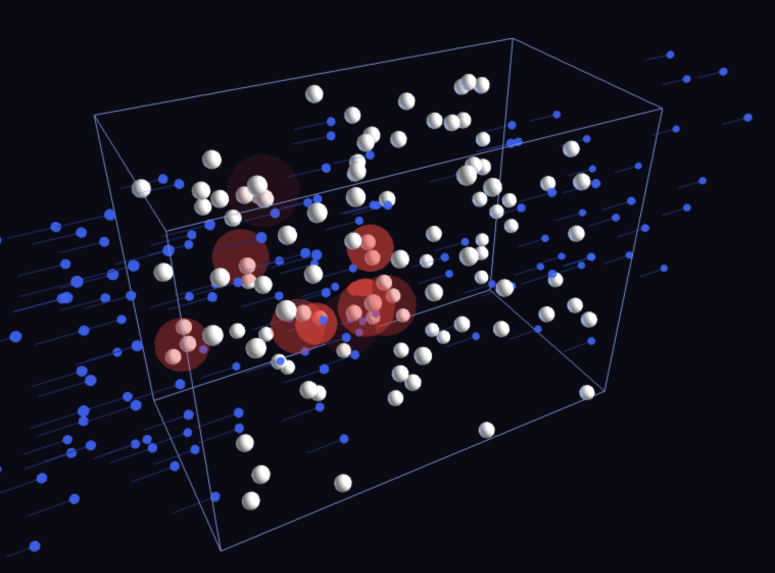
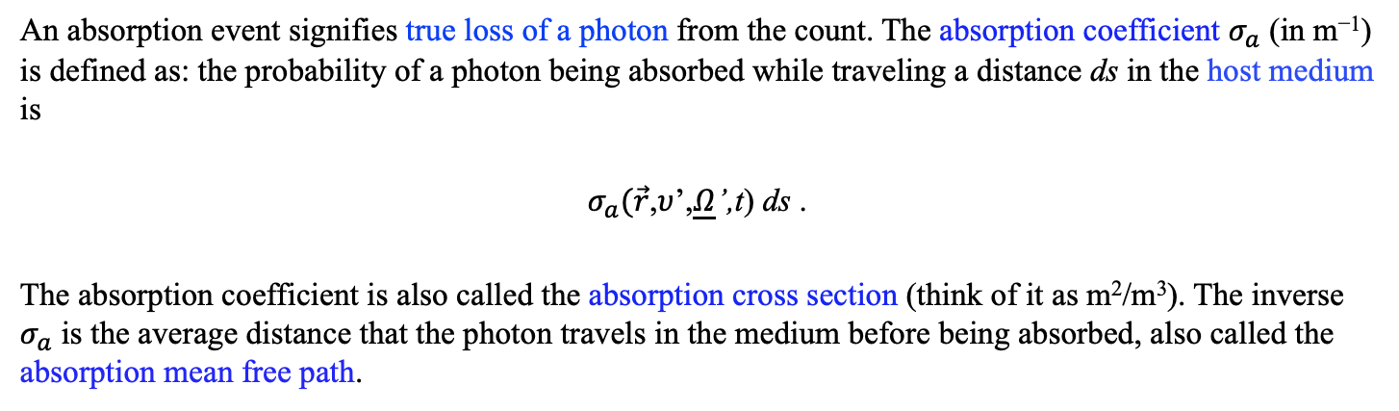
PHYSICAL MODELS IN REMOTE SENSING Chapter 01 – Part 03: Radiative Interactions
Absorption
01-Photon-Absorption.html
An absorption event signifies true loss of a photon from the count. The absorption coefficient $σ_{a}$ (in m⁻¹) is defined as: the probability of a photon being absorbed while traveling a distance ds in the host medium is
$σ_{a}(\vec{r}$,$υ$’,$\underline{Ω}$’,t) ds .
The absorption coefficient is also called the absorption cross section (think of it as m²/m³). The inverse $σ_{a}$ is the average distance that the photon travels in the medium before being absorbed, also called the absorption mean free path.

Slide 4
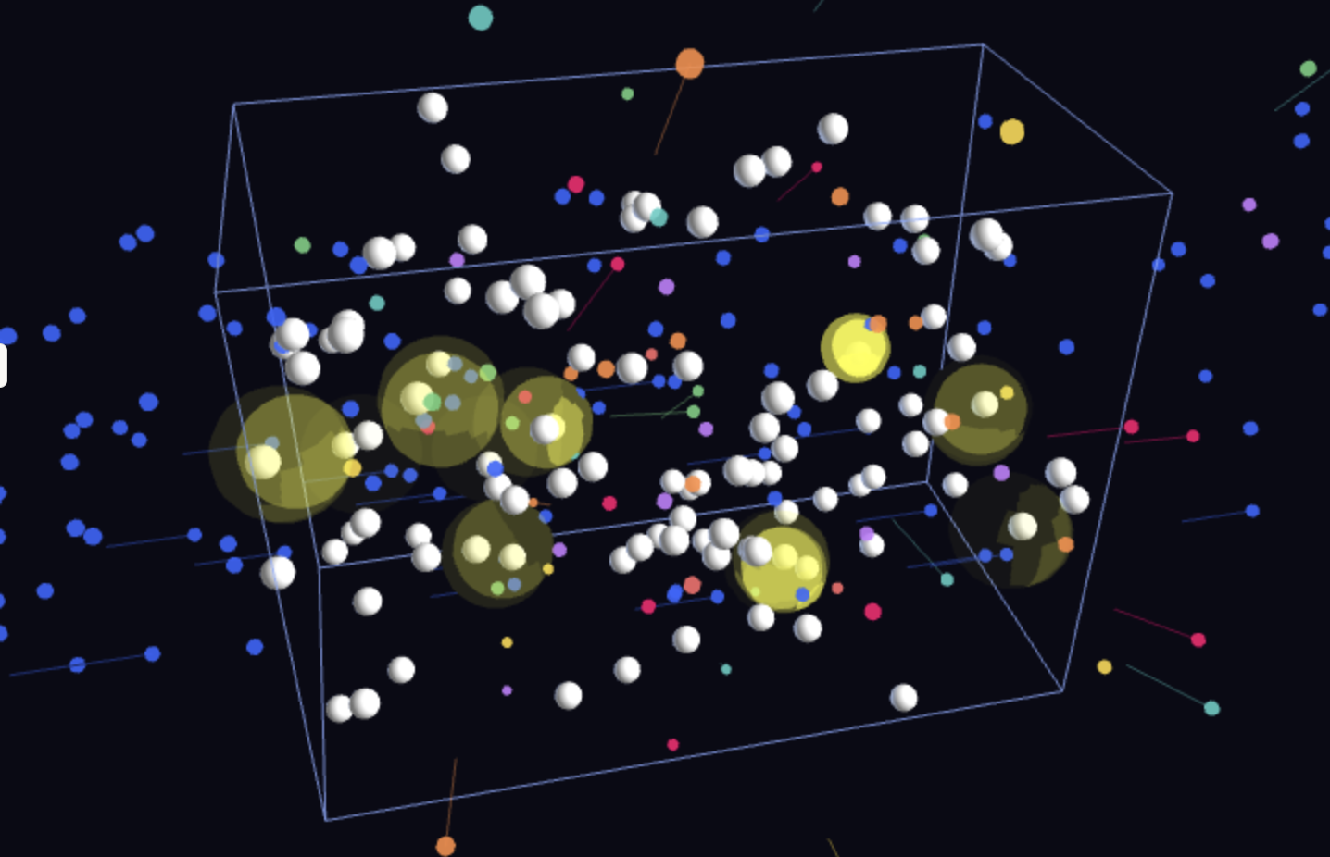
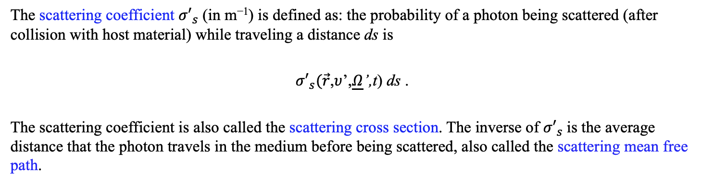
PHYSICAL MODELS IN REMOTE SENSING Chapter 01 – Part 03: Radiative Interactions
Scattering
02-Photon-Scattering.html
The scattering coefficient ${σ′}_{s}$ (in m⁻¹) is defined as: the probability of a photon being scattered (after collision with host material) while traveling a distance ds is
${σ′}_{s}(\vec{r}$,$υ$’,$\underline{Ω}$’,t) ds .
The scattering coefficient is also called the scattering cross section. The inverse of ${σ′}_{s}$is the average distance that the photon travels in the medium before being scattered, also called the scattering mean free path.

Slide 5
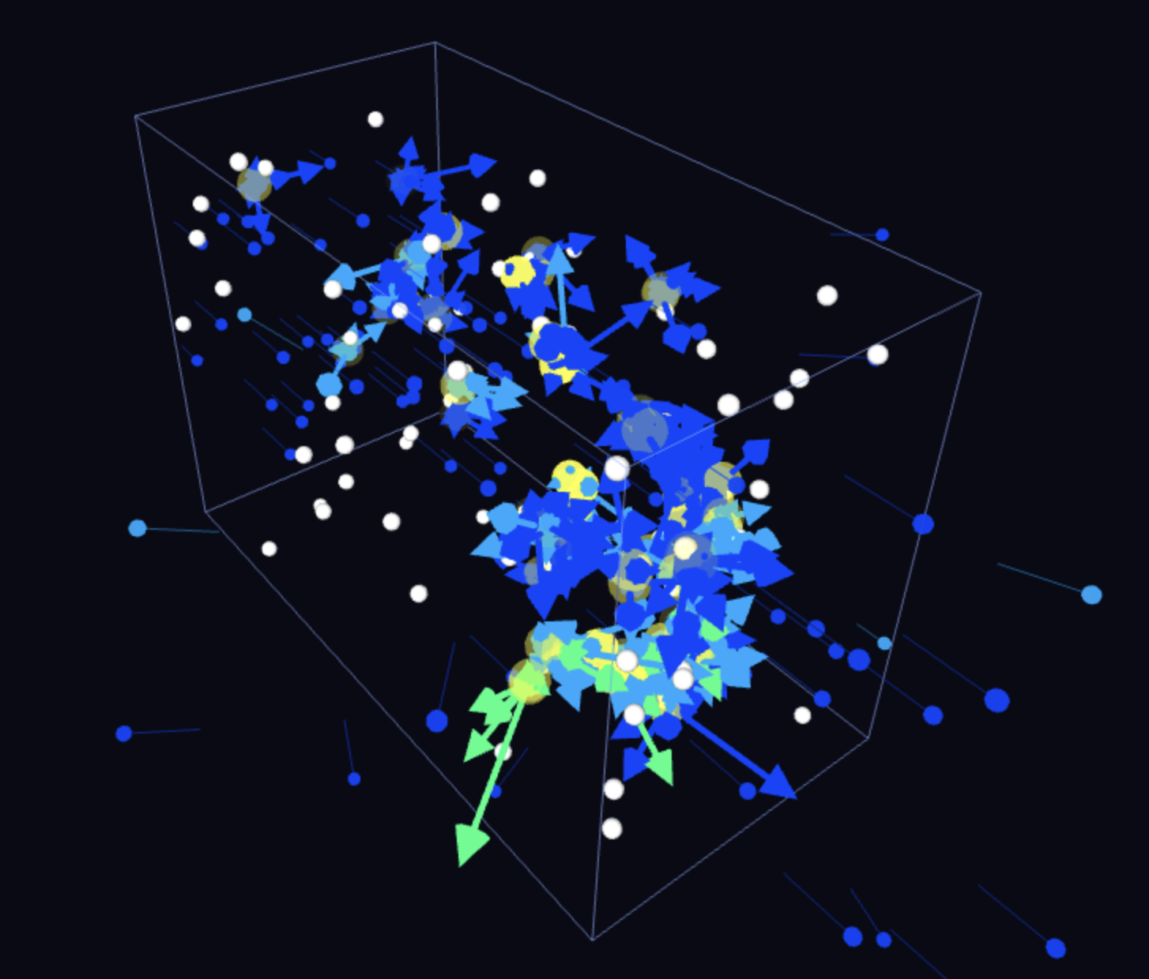
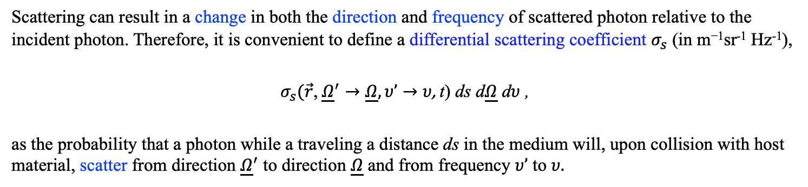
PHYSICAL MODELS IN REMOTE SENSING Chapter 01 – Part 03: Radiative Interactions
Differential Scattering Coefficient
03-Differential-Scattering-Coefficient.html
Scattering can result in a change in both the direction and frequency of scattered photon relative to the incident photon. Therefore, it is convenient to define a differential scattering coefficient $σ_{s}$ (in m⁻¹sr⁻¹ Hz⁻¹),
$σ_{s}(\vec{r}\text{,} {\underline{Ω}}^{′}→\underline{Ω}, υ’→υ\text{, }\text{t}\text{) }\text{ds}$ d$\underline{Ω}$ d$υ$ ,
as the probability that a photon while a traveling a distance ds in the medium will, upon collision with host material, scatter from direction ${\underline{Ω}}^{′}$ to direction $\underline{Ω}$ and from frequency $υ’$ to $υ.$

Slide 6
PHYSICAL MODELS IN REMOTE SENSING Chapter 01 – Part 03: Radiative Interactions
Downscattering and Upscattering
Downscattering: Scattered photon has lower energy than incident photon (e.g., Compton scattering).
High-energy photon scatters off a free or loosely-bound electron
Photon transfers energy to the electron, emerging with lower frequency
Example: Fluorescence (indicator of photosynthetic activity)
Photon gives energy to matter (driving processes within the matter)
Upscattering: Scattered photon has higher energy than incident photon (inverse Compton scattering)
Low-energy photon scatters off a high-energy electron
Photon gains energy from the electron's kinetic energy
Critical in astrophysics (e.g., cosmic microwave background photons upscattered by hot electrons)
Matter gives energy to photon (heating the radiation field)

Slide 7
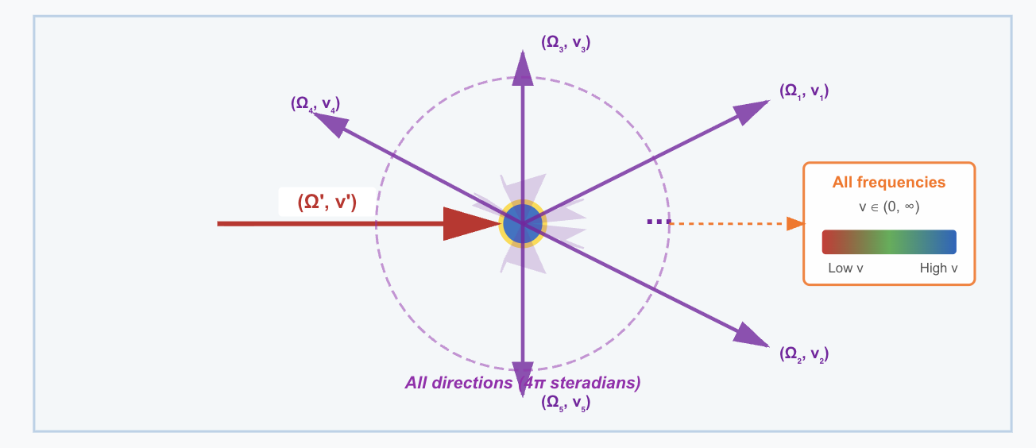
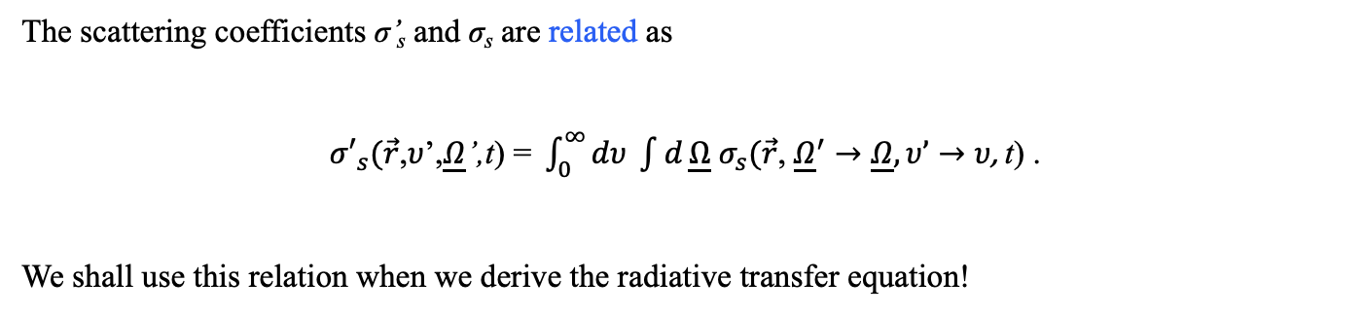

PHYSICAL MODELS IN REMOTE SENSING Chapter 01 – Part 03: Radiative Interactions
Relationship between Scattering & Differential Scattering Coefficients
The scattering coefficients σ’_{s} and σ_{s} are related as
${σ′}_{s}(\vec{r}\text{,}υ\text{’,}\underline{Ω}\text{’,}\text{t}\text{)}\text{ = }\int_{0}^{∞}{dυ \int{d}}\underline{Ω}$ $σ_{s}(\vec{r}\text{,} {\underline{Ω}}^{′}→\underline{Ω}, υ’→υ\text{, }\text{t}\text{)}$ .
We shall use this relation when we derive the radiative transfer equation!
$$4π$$

Slide 8
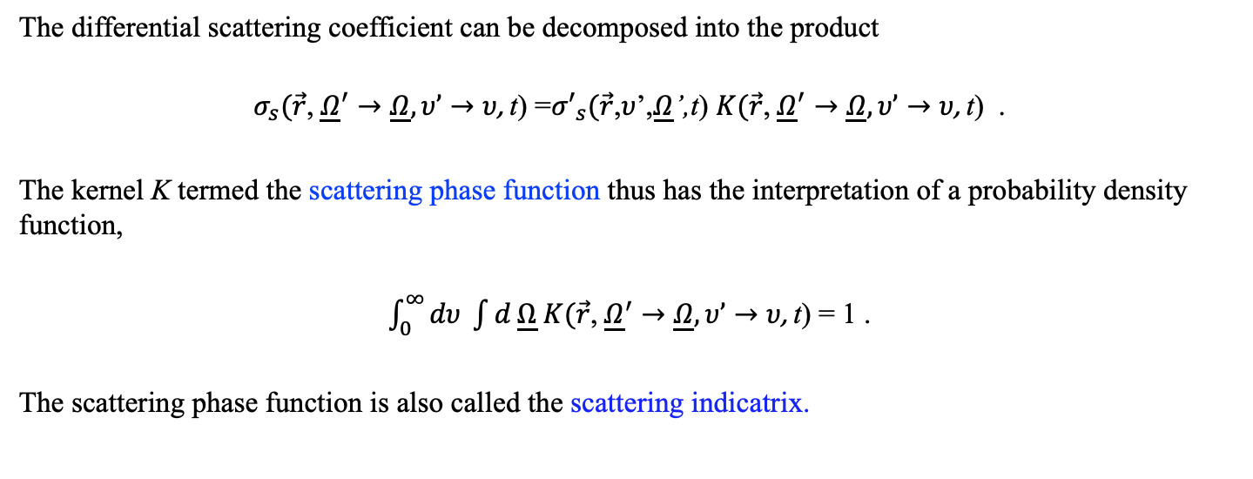

PHYSICAL MODELS IN REMOTE SENSING Chapter 01 – Part 03: Radiative Interactions
Scattering Phase Function
The differential scattering coefficient can be decomposed into the product
$$σ_{s}(\vec{r}\text{,} {\underline{Ω}}^{′}→\underline{Ω}, υ’→υ\text{, }\text{t}\text{)}\text{ =}{σ′}_{s}(\vec{r}\text{,}υ\text{’,}\underline{Ω}\text{’,}\text{t}\text{)} K(\vec{r}\text{,} {\underline{Ω}}^{′}→\underline{Ω}, υ’→υ\text{, }\text{t}\text{)}\text{ .}$$
The kernel K termed the scattering phase function thus has the interpretation of a probability density function,
$\int_{0}^{∞}{dυ \int{d}}\underline{Ω} K(\vec{r}\text{,} {\underline{Ω}}^{′}→\underline{Ω}, υ’→υ\text{, }\text{t}\text{)}$ = 1 .
The scattering phase function is also called the scattering indicatrix.
$$4π$$

Slide 9
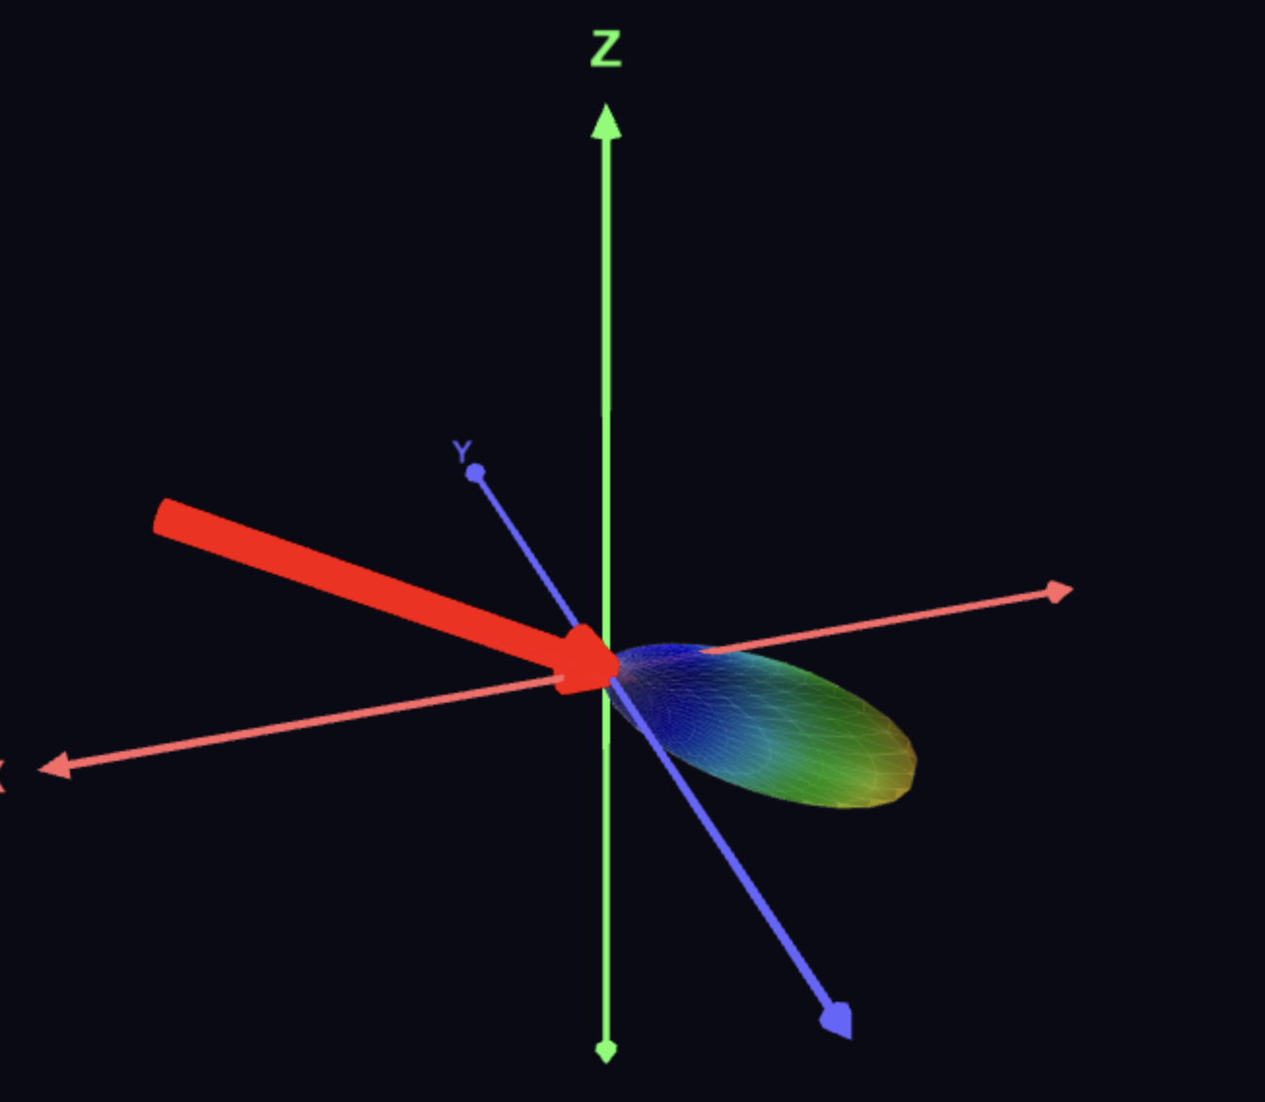
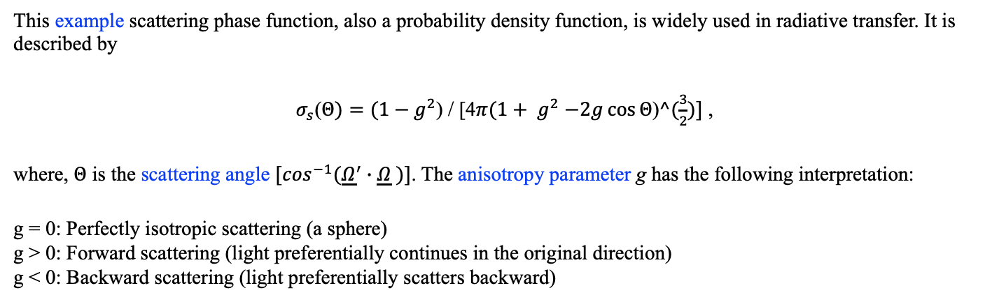
PHYSICAL MODELS IN REMOTE SENSING Chapter 01 – Part 03: Radiative Interactions
Henyey-Greenstein phase function
04-Henyey-Greenstein-PF.html
This example scattering phase function, also a probability density function, is widely used in radiative transfer. It is described by
$σ_{s}$($Θ)=(1−g^{2}$) / [4$π(1+ g^{2}$ $−2g\cos{Θ}$)$^(\frac{3}{2})]$ ,
where, $Θ$ is the scattering angle ${[cos}^{−1}({\underline{Ω}}^{′}∙\underline{Ω} )]$. The anisotropy parameter g has the following interpretation:
g = 0: Perfectly isotropic scattering (a sphere)
g > 0: Forward scattering (light preferentially continues in the original direction)
g < 0: Backward scattering (light preferentially scatters backward)

Slide 10
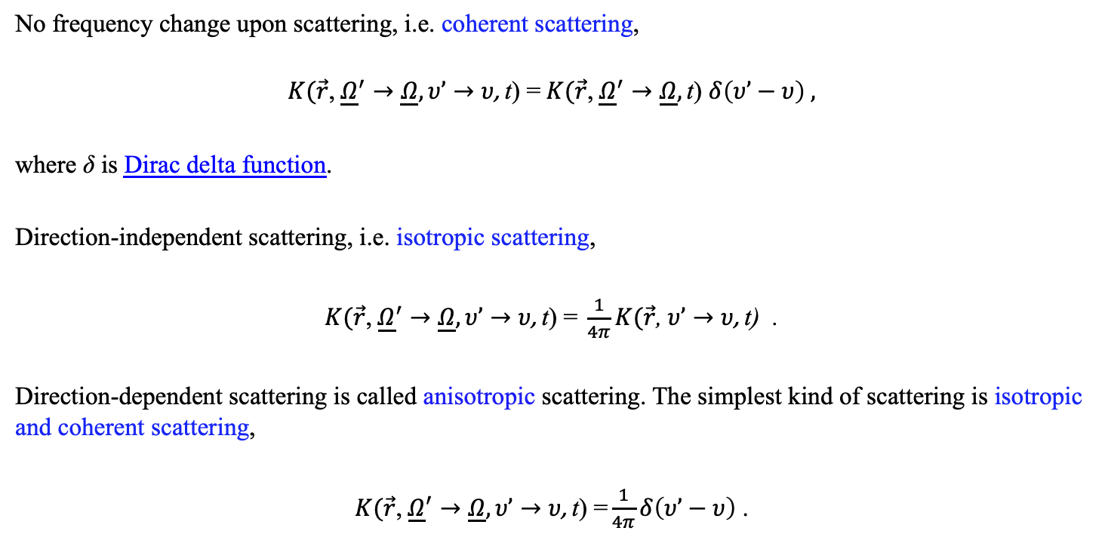
PHYSICAL MODELS IN REMOTE SENSING Chapter 01 – Part 03: Radiative Interactions
Example Scattering Phase Functions
No frequency change upon scattering, i.e. coherent scattering,
$$K(\vec{r}\text{,} {\underline{Ω}}^{′}→\underline{Ω}, υ’→υ\text{, }\text{t}\text{)}\text{ =} K(\vec{r}\text{,} {\underline{Ω}}^{′}→\underline{Ω}, \text{t}\text{)} δ\left(υ’−υ\right) ,$$
where δ is Dirac delta function.
Direction-independent scattering, i.e. isotropic scattering,
$K(\vec{r}\text{,} {\underline{Ω}}^{′}→\underline{Ω}, υ’→υ\text{, }\text{t}\text{) =} \frac{1}{4π}K(\vec{r}\text{,} υ’→υ\text{, }\text{t}\text{)}$ .
Direction-dependent scattering is called anisotropic scattering. The simplest kind of scattering is isotropic and coherent scattering,
$K(\vec{r}\text{,} {\underline{Ω}}^{′}→\underline{Ω}, υ’→υ\text{, }\text{t}\text{) =}\frac{1}{4π}δ\left(υ’−υ\right)$ .

Slide 11
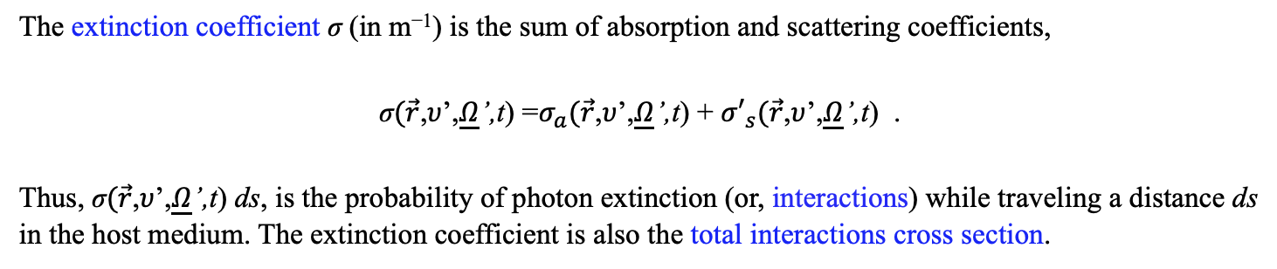
PHYSICAL MODELS IN REMOTE SENSING Chapter 01 – Part 03: Radiative Interactions
Extinction
The extinction coefficient σ (in m⁻¹) is the sum of absorption and scattering coefficients,
$\text{σ}(\vec{r}\text{,}υ\text{’,}\underline{Ω}\text{’,}\text{t}\text{)}\text{ =}σ_{a}(\vec{r}\text{,}υ\text{’,}\underline{Ω}\text{’,}\text{t}\text{)}\text{ + }{σ′}_{s}(\vec{r}$,$υ$’,$\underline{Ω}$’,t) .
Thus, $\text{σ}(\vec{r}\text{,}υ\text{’,}\underline{Ω}\text{’,}\text{t}\text{) }\text{ds}\text{, }$is the probability of photon extinction (or, interactions) while traveling a distance ds in the host medium. The extinction coefficient is also the total interactions cross section.
The quantity 1/σ denotes photon mean free path, that is, the average distance a photon will travel in the medium before suffering a collision.
The dependence on the direction of photon travel is noteworthy and is especially important in the case of vegetation media.

Slide 12
PHYSICAL MODELS IN REMOTE SENSING Chapter 01 – Part 03: Radiative Interactions
Single Scattering Albedo
The probability of scattering given that a collision has occurred is given by the single scattering albedo,
ω = σʹ_{s} / σ (dimensionless).
In the case of conservative scattering, ω = 1, i.e., white medium.
The case ω = 0 corresponds to pure absorption, i.e. black medium.
Question: what if scattering results in production of more scattered particles than the incident particles?

Slide 13
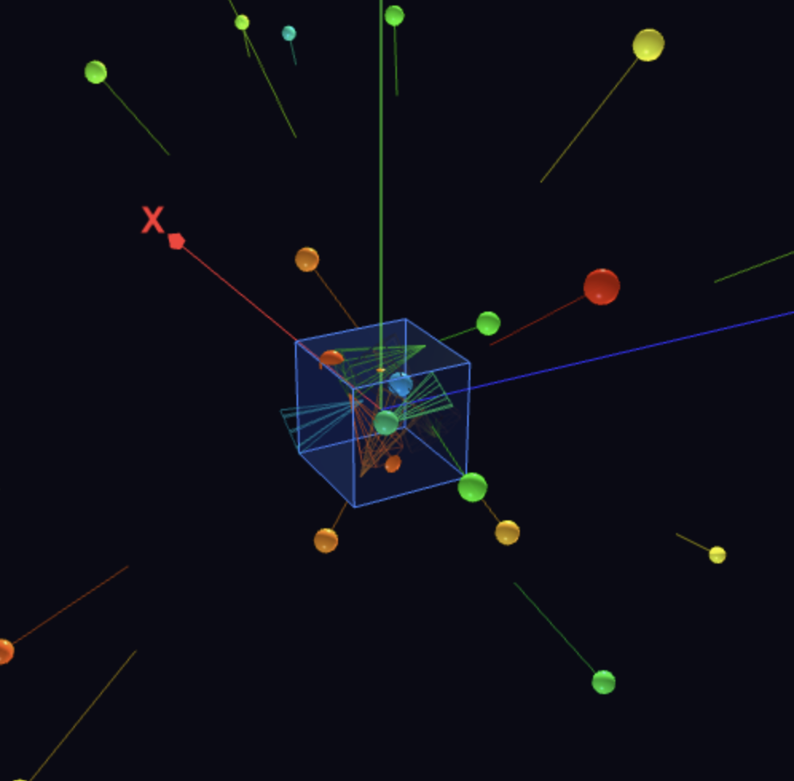
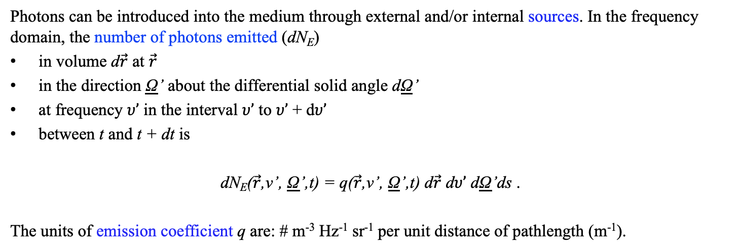
PHYSICAL MODELS IN REMOTE SENSING Chapter 01 – Part 03: Radiative Interactions
Emission
05-Photon-Emission.html
Photons can be introduced into the medium through external and/or internal sources. In the frequency domain, the number of photons emitted (dN_{E})
in volume d$\vec{r}$ at $\vec{r}$
in the direction Ω’ about the differential solid angle dΩ’
at frequency $υ’$ in the interval $υ’$ to $υ’$ + d$υ’$
between t and t + dt is
dN_{E}($\vec{r}$,ν’, Ω’,t) = q($\vec{r}$,ν’, Ω’,t) d$\vec{r}$ d$υ’$ dΩ’ds .
The units of emission coefficient q are: # m⁻³ Hz⁻¹ sr⁻¹ per unit distance of pathlength (m⁻¹).

