Slide 1
PHYSICAL MODELS IN REMOTE SENSING Chapter 01 – Part 04: The Radiative Transfer Equation
The Domain
Transport Equation / Equation of Radiative Transfer
Change in Particle Number
Losses due to Absorption
Losses due to Outscattering
Gains due to Inscattering
Gains due to Emission
The Final Equation
Initial and Boundary Conditions
Active and Passive Remote Sensing
Lidar Sensing of Vegetation Leaf Area Profiles
Passive Sensing of Vegetation Leaf Area
Emissive Remote Sensing

Slide 2
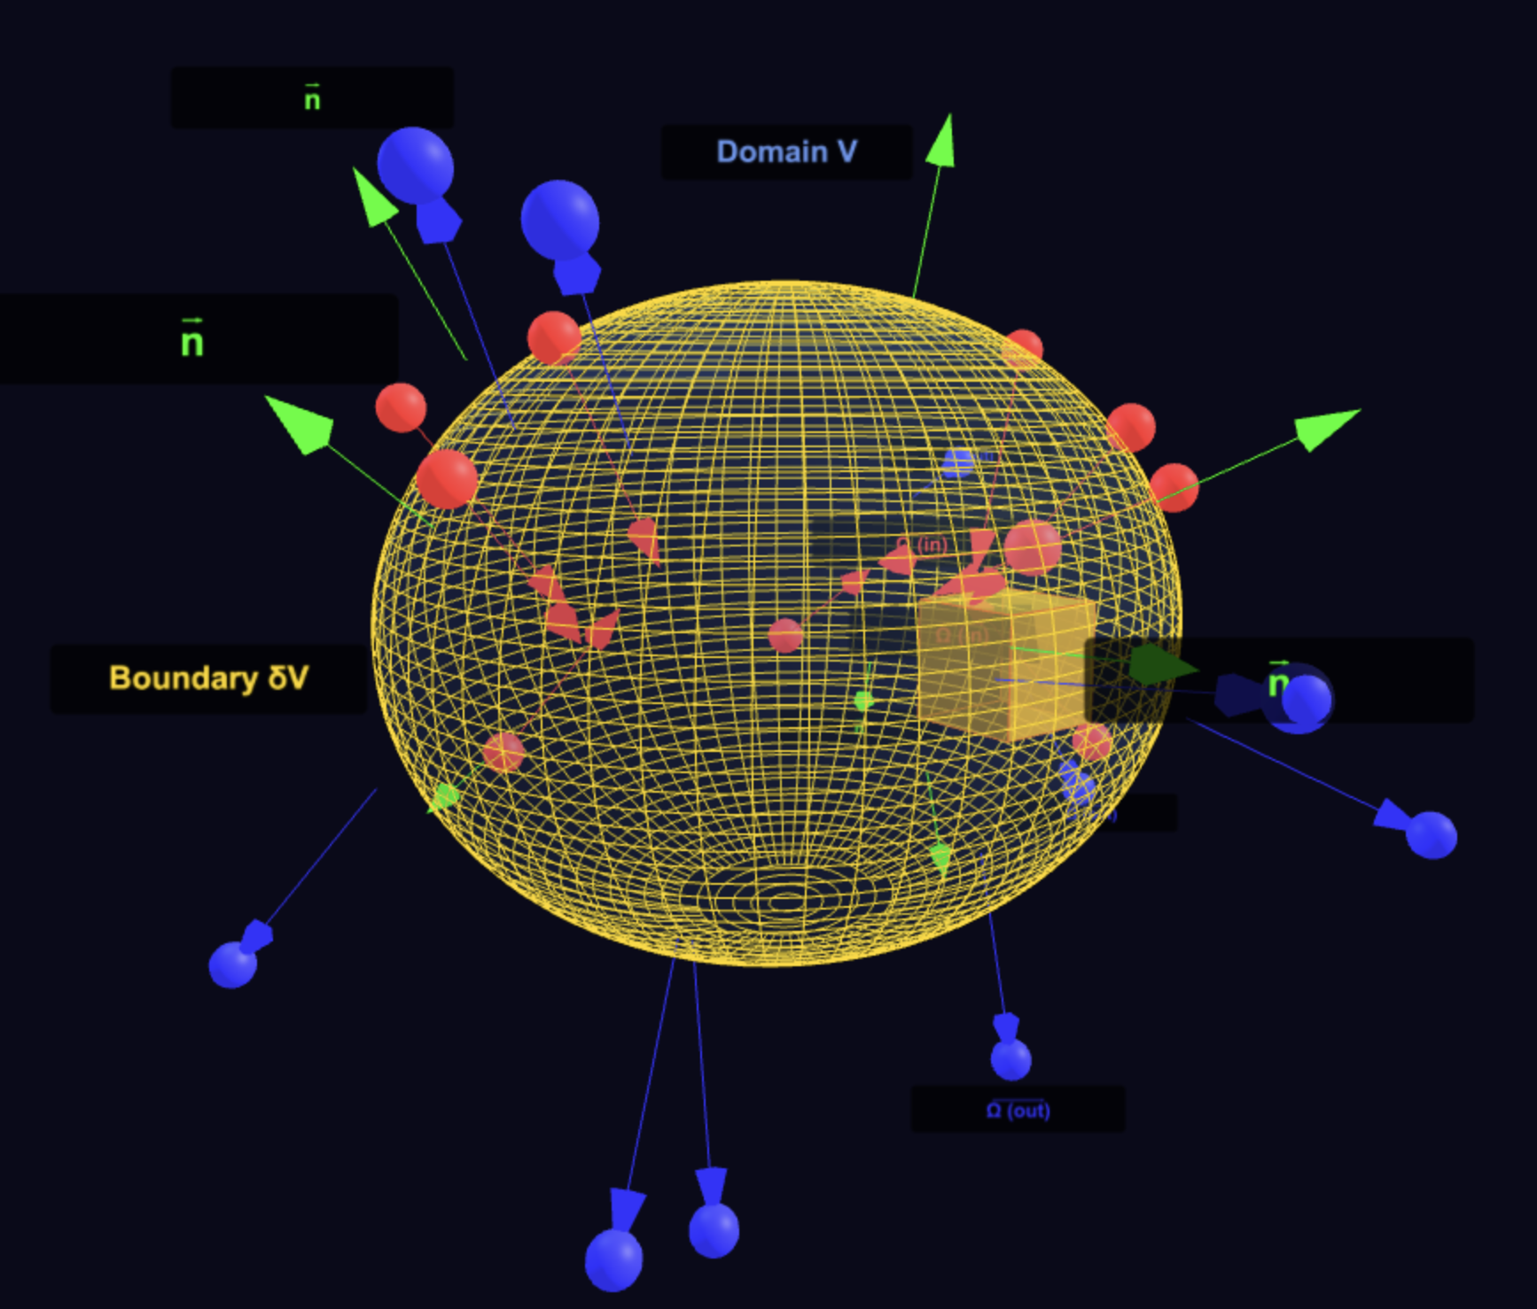
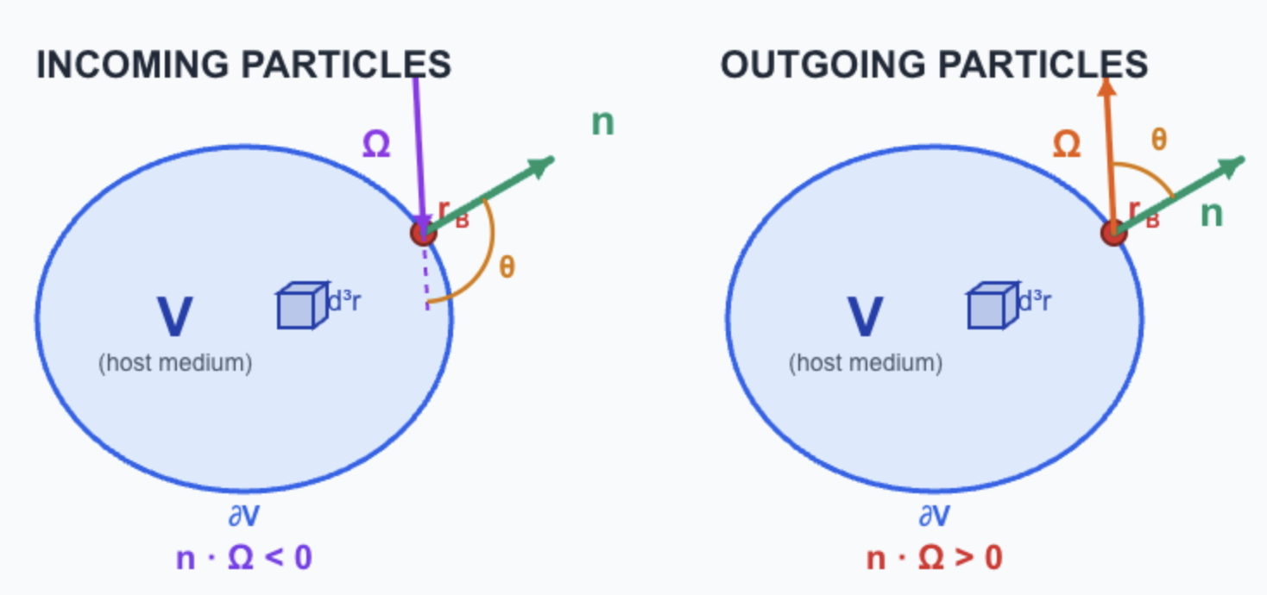
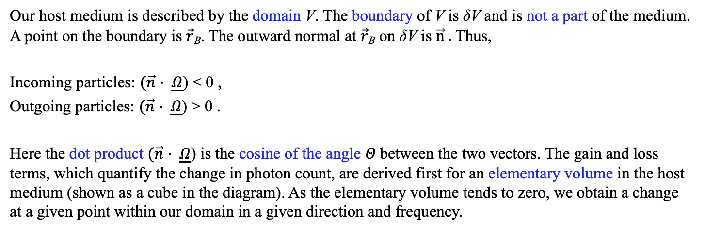
PHYSICAL MODELS IN REMOTE SENSING Chapter 01 – Part 04: The Radiative Transfer Equation
The Domain
Our host medium is described by the domain V. The boundary of V is δV and is not a part of the medium. A point on the boundary is $\vec{r}$_{B}. The outward normal at $\vec{r}$_{B} on δV is $\vec{n} .$ Thus,
Incoming particles: $(\vec{n}$ $∙ \underline{Ω}$) < 0 ,
Outgoing particles: $(\vec{n}$ $∙ \underline{Ω}$) > 0 .
Here the dot product $(\vec{n}$ $∙ \underline{Ω}$) is the cosine of the angle $Θ$between the two vectors. The gain and loss terms, which quantify the change in photon count, are derived first for an elementary volume in the host medium (shown as a cube in the diagram). As the elementary volume tends to zero, we obtain a change at a given point within our domain in a given direction and frequency.
01-Domain-etc.html

Slide 3
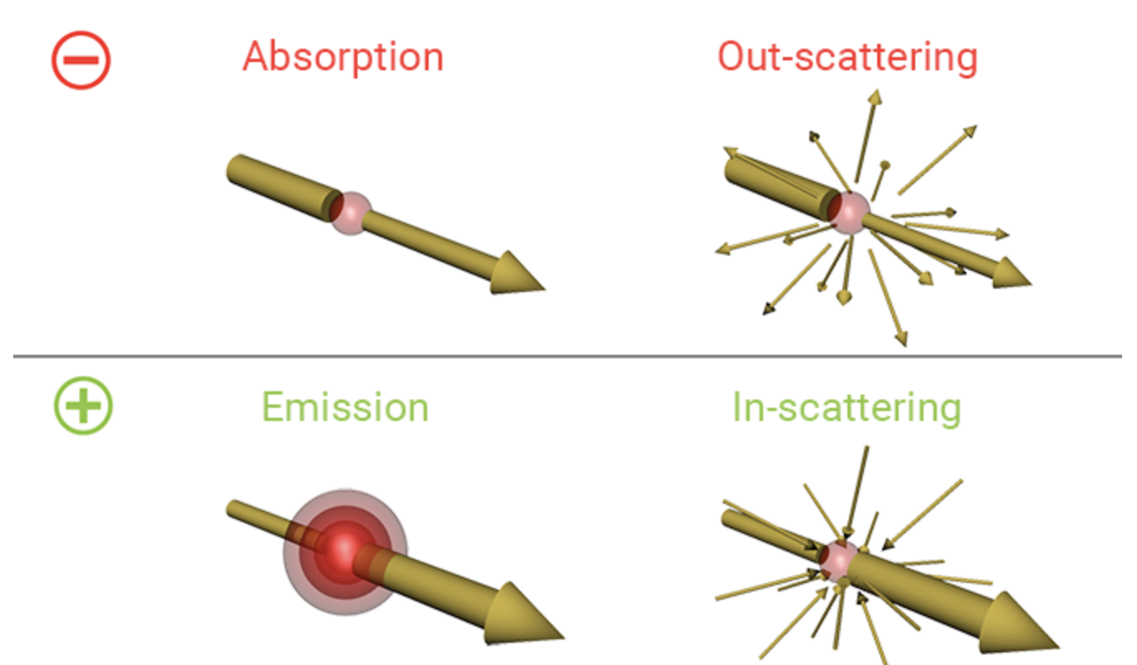
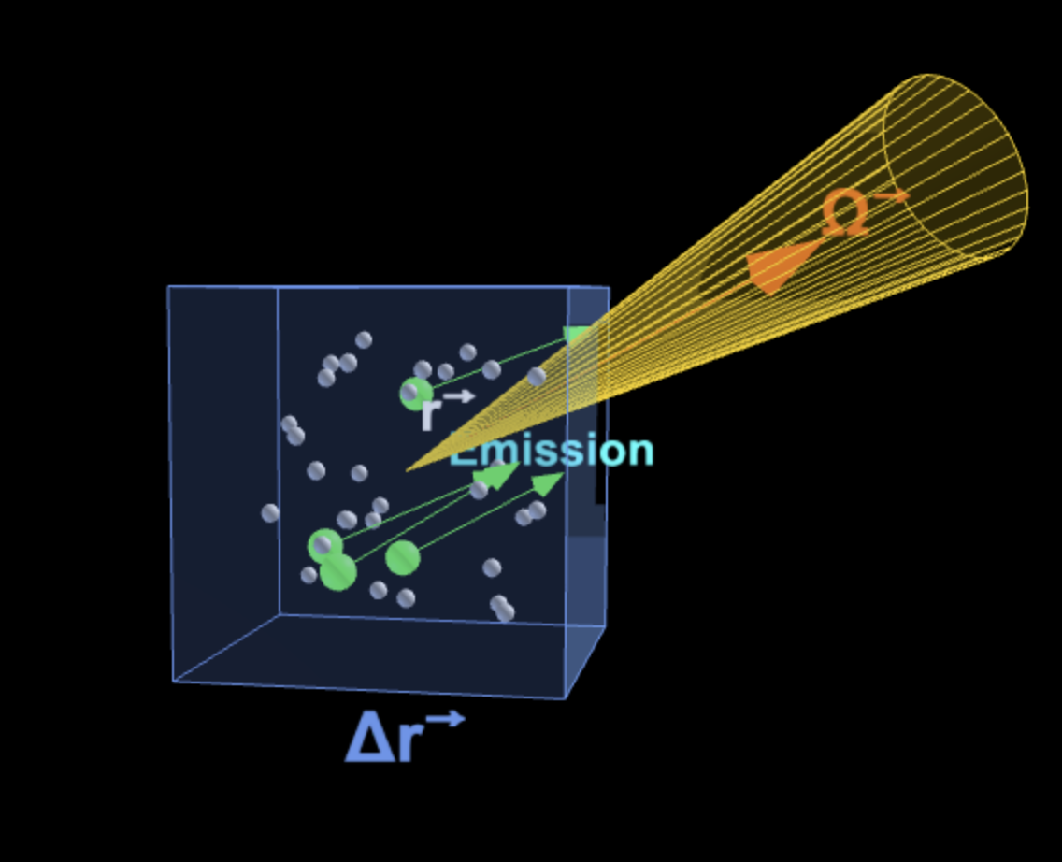
PHYSICAL MODELS IN REMOTE SENSING Chapter 01 – Part 04: The Radiative Transfer Equation
Particle Transport Equation & Radiative Transfer Equation
The particle (photon) transport equation is a statement of particle balance at a given spatial point, frequency and direction. The analogous equation in the energy domain is the radiative transfer equation, which is a statement of energy balance (obeys the law of energy conservation).
The transport equation in words is:
Change in Photon number = Gains (Inscattering + Emission) – Losses (Absorption + Outscattering)
02-RTE-Simple.html

Slide 4
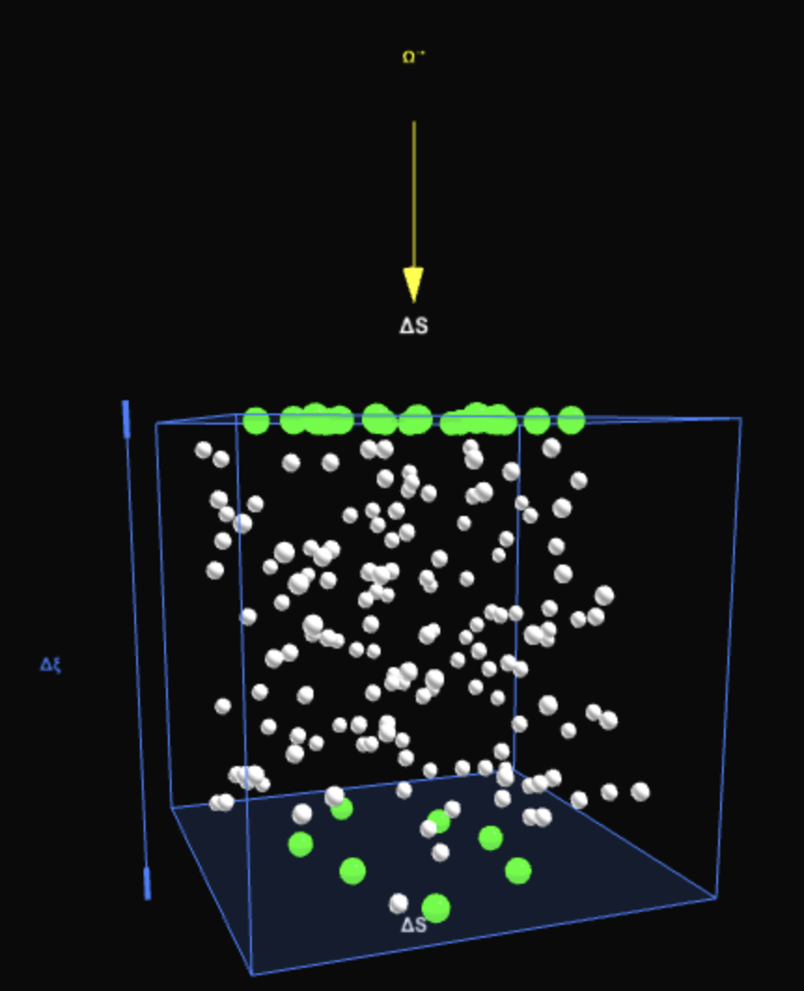
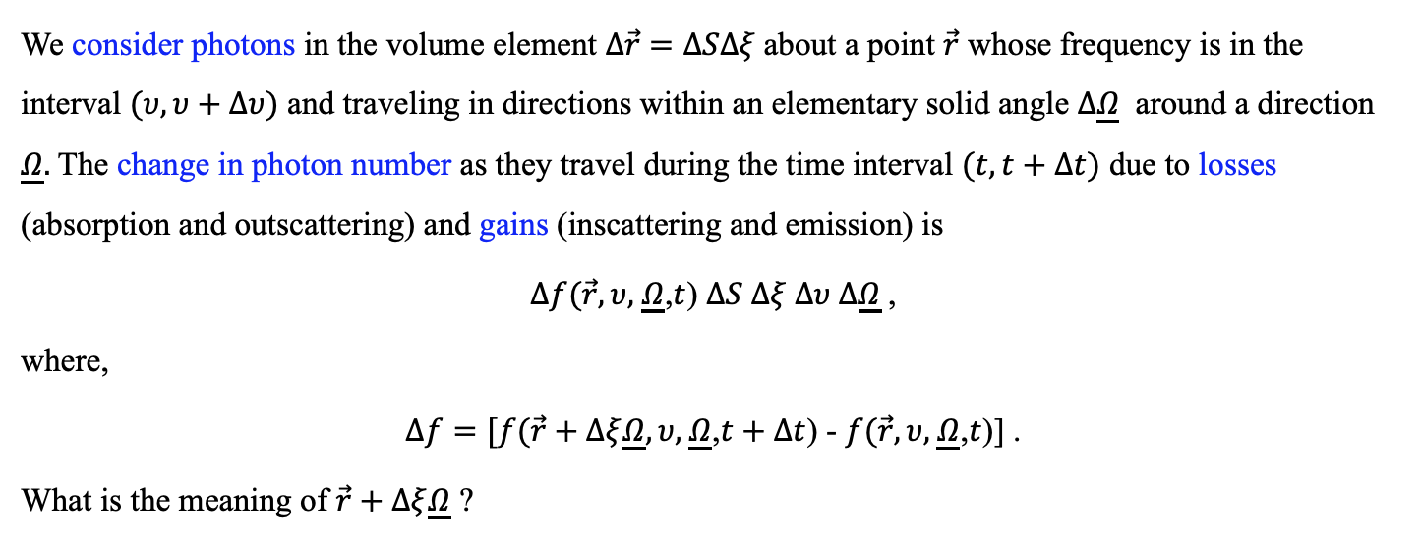
PHYSICAL MODELS IN REMOTE SENSING Chapter 01 – Part 04: The Radiative Transfer Equation
Change in Photon Number
03-Change-Photon-Number.html
We consider photons in the volume element $Δ\vec{r}$ $=ΔSΔξ$about a point $\vec{r}$ whose frequency is in the interval $(υ, υ+Δυ)$ and traveling in directions within an elementary solid angle $Δ\underline{Ω}$ around a direction $\underline{Ω}.$The change in photon number as they travel during the time interval $(t, t+Δt)$ due to losses (absorption and outscattering) and gains (inscattering and emission) is
$Δf(\vec{r},υ,$ $\underline{Ω}$,$t$) $ΔS Δξ Δυ Δ\underline{Ω}$,
where,
$Δf=[f(\vec{r}+Δξ\underline{Ω},υ,$ $\underline{Ω}$,$t+Δt$) - $f(\vec{r},υ,$ $\underline{Ω}$,$t$)] .
What is the meaning of $\vec{r}+Δξ\underline{Ω}$ ?

Slide 5
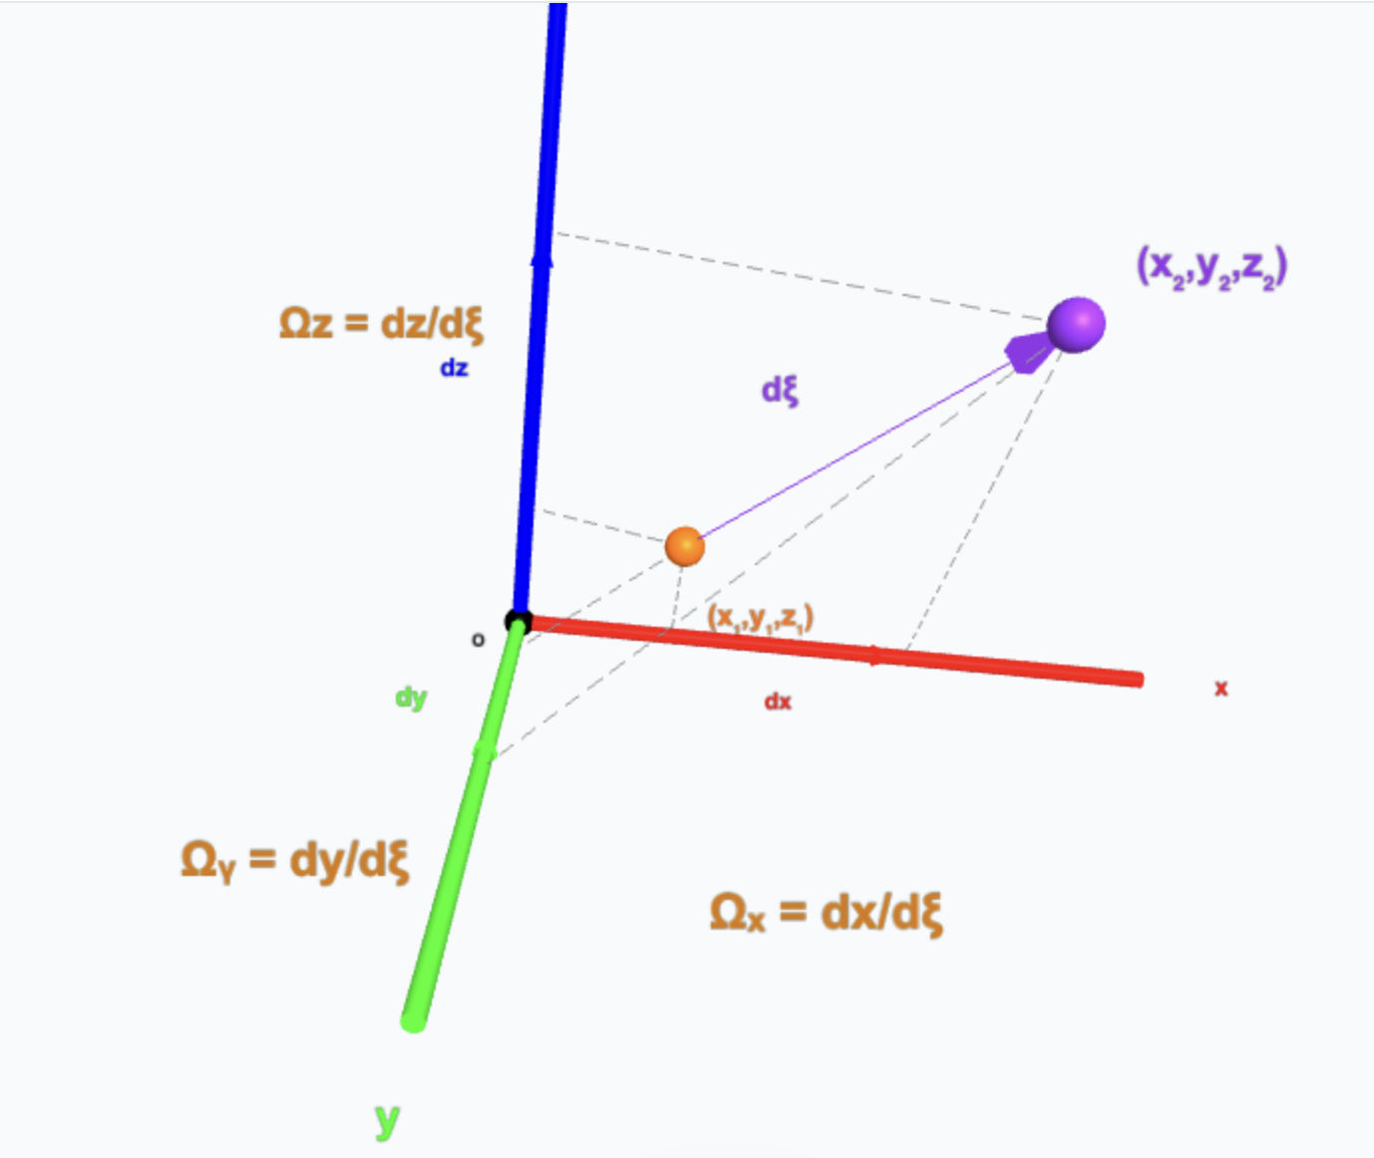
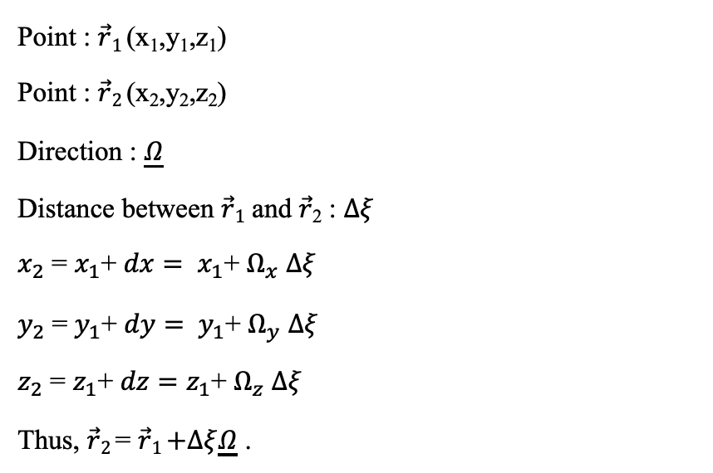
PHYSICAL MODELS IN REMOTE SENSING Chapter 01 – Part 04: The Radiative Transfer Equation
Equation of a Line: $\vec{r}+Δξ\underline{Ω}$
Point : $\vec{r}1$ (x₁,y₁,z₁)
Point : $\vec{r}2$ (x₂,y₂,z₂)
Direction : $\underline{Ω}$
Distance between $\vec{r}1$ and $\vec{r}$₂ : $Δξ$
$x_{2}$ = $x_{1}$+ $dx= {x_{1}\text{+} Ω}_{x}$ $Δξ$
$y_{2}$ = $y_{1}$+ $dy= {y_{1}\text{+} Ω}_{y}$ $Δξ$
$z_{2}$ = $z_{1}$+ $dz=z_{1}\text{+} Ω_{z}$ $Δξ$
Thus, $\vec{r}2$ = $\vec{r}1$ $+Δξ\underline{Ω}$ .
z
04-Line-Equation.html

Slide 6
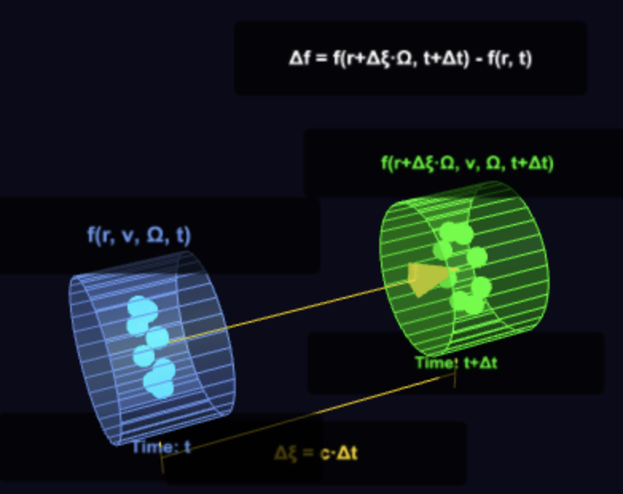
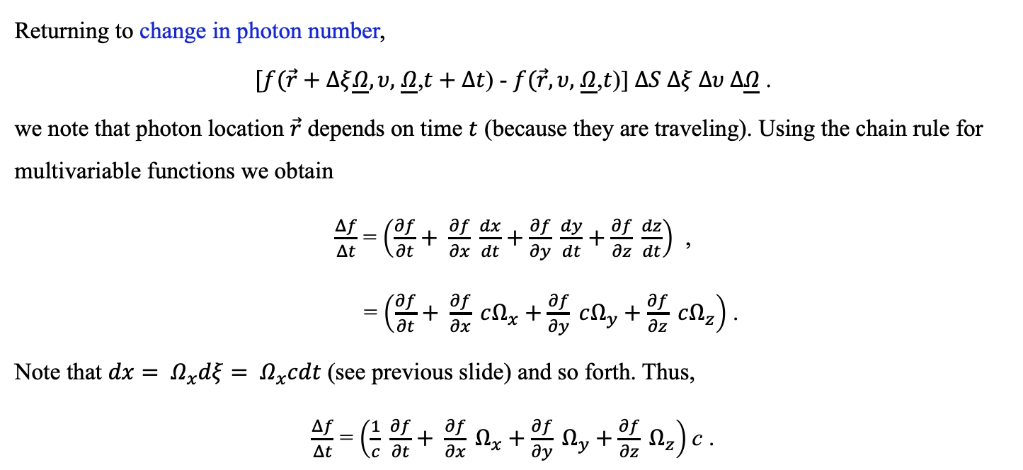
PHYSICAL MODELS IN REMOTE SENSING Chapter 01 – Part 04: The Radiative Transfer Equation
Change in Photon Number
05-Photon-Number-Change.html
Returning to change in photon number,
$[f(\vec{r}+Δξ\underline{Ω},υ,$ $\underline{Ω}$,$t+Δt$) - $f(\vec{r},υ,$ $\underline{Ω}$,$t$)] $ΔS Δξ Δυ Δ\underline{Ω}$.
we note that photon location $\vec{r}$ depends on time $t$ (because they are traveling). Using the chain rule for multivariable functions we obtain
$\frac{Δf}{Δt}$ = $\left(\frac{∂f}{∂t}+ \frac{∂f}{∂x} \frac{dx}{dt}+\frac{∂f}{∂y} \frac{dy}{dt}+\frac{∂f}{∂z} \frac{dz}{dt}\right)$ ,
= $\left(\frac{∂f}{∂t}+ \frac{∂f}{∂x} cΩ_{x}+\frac{∂f}{∂y} cΩ_{y}+\frac{∂f}{∂z} cΩ_{z}\right)$ .
Note that $dx= Ω_{x}dξ= Ω_{x}cdt$ (see previous slide) and so forth. Thus,
$\frac{Δf}{Δt}$ = $\left(\frac{1}{c} \frac{∂f}{∂t}+ \frac{∂f}{∂x} Ω_{x}+\frac{∂f}{∂y} Ω_{y}+\frac{∂f}{∂z} Ω_{z}\right)$c .

Slide 7
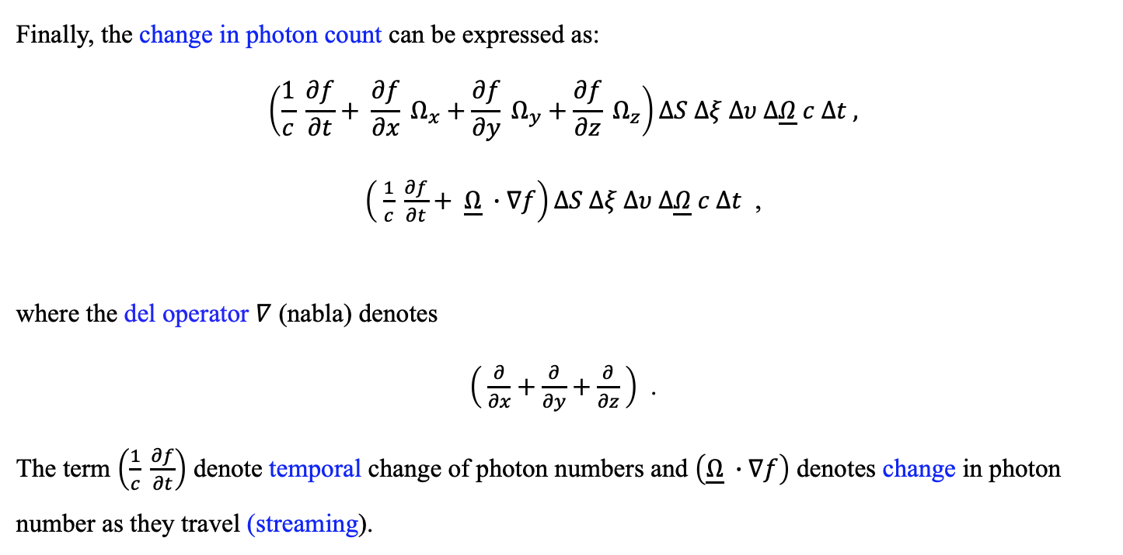
PHYSICAL MODELS IN REMOTE SENSING Chapter 01 – Part 04: The Radiative Transfer Equation
Change in Photon Number
Finally, the change in photon count can be expressed as:
$$\left(\frac{1}{c} \frac{∂f}{∂t}+ \frac{∂f}{∂x} Ω_{x}+\frac{∂f}{∂y} Ω_{y}+\frac{∂f}{∂z} Ω_{z}\right)ΔS Δξ Δυ Δ\underline{Ω} c Δt ,$$
$\left( \frac{1}{c} \frac{∂f}{∂t}+ \underline{Ω} ∙∇f\right)ΔS Δξ Δυ Δ\underline{Ω} c Δt$ ,
where the del operator $∇$ (nabla) denotes
$\left( \frac{∂}{∂x}+\frac{∂}{∂y}+\frac{∂}{∂z} \right)$ .
The term $\left(\frac{1}{c} \frac{∂f}{∂t}\right)$ denote temporal change of photon numbers and $\left(\underline{Ω} ∙∇f\right)$ denotes change in photon number as they travel (streaming).

Slide 8
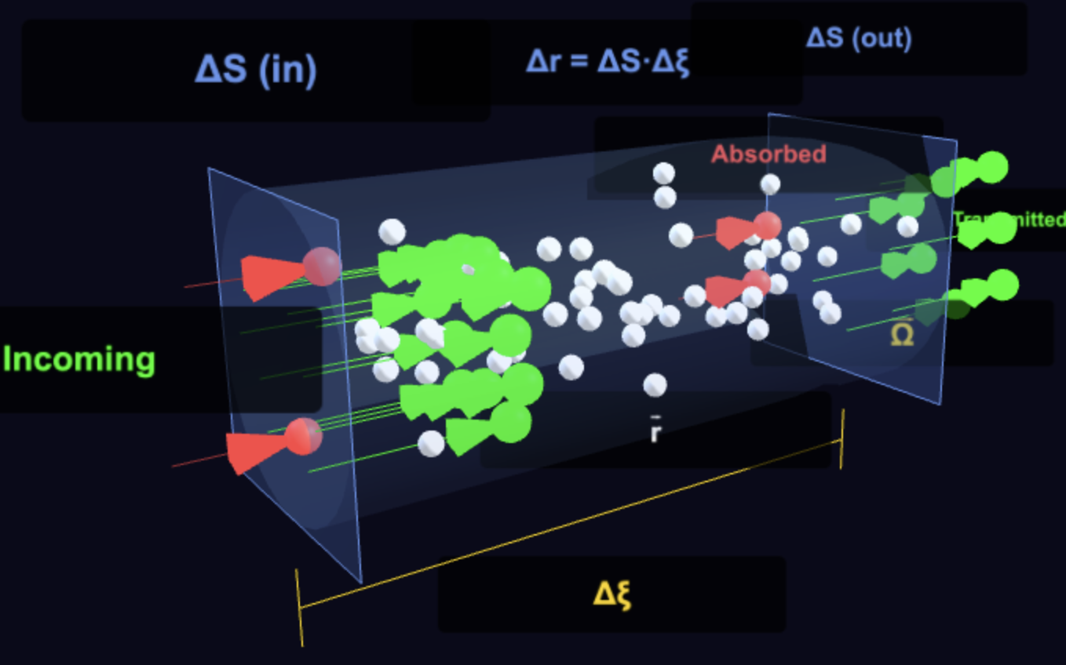
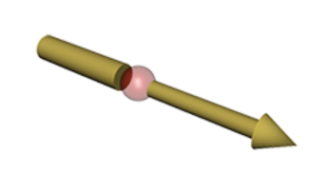
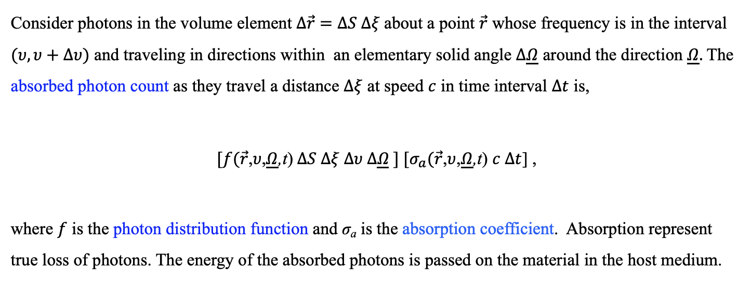

PHYSICAL MODELS IN REMOTE SENSING Chapter 01 – Part 04: The Radiative Transfer Equation
Absorption (Loss)
$(υ$,$\underline{Ω})$
06-Absorption.html
Consider photons in the volume element $Δ\vec{r}$ $=ΔS Δξ$about a point $\vec{r}$ whose frequency is in the interval $(υ, υ+Δυ)$ and traveling in directions within an elementary solid angle $Δ\underline{Ω}$ around the direction $\underline{Ω}.$The absorbed photon count as they travel a distance $Δξ$ at speed $c$ in time interval $Δt$ is,
${[f(\vec{r}\text{,}υ\text{,}\underline{Ω}\text{,}\text{t}\text{)} ΔS Δξ Δυ Δ\underline{Ω} ] [σ}_{a}(\vec{r}$,$υ$,$\underline{Ω}$,t) $c Δt$] ,
where $f$ is the photon distribution function and σ_{a} is the absorption coefficient. Absorption represent true loss of photons. The energy of the absorbed photons is passed on the material in the host medium.

Slide 9
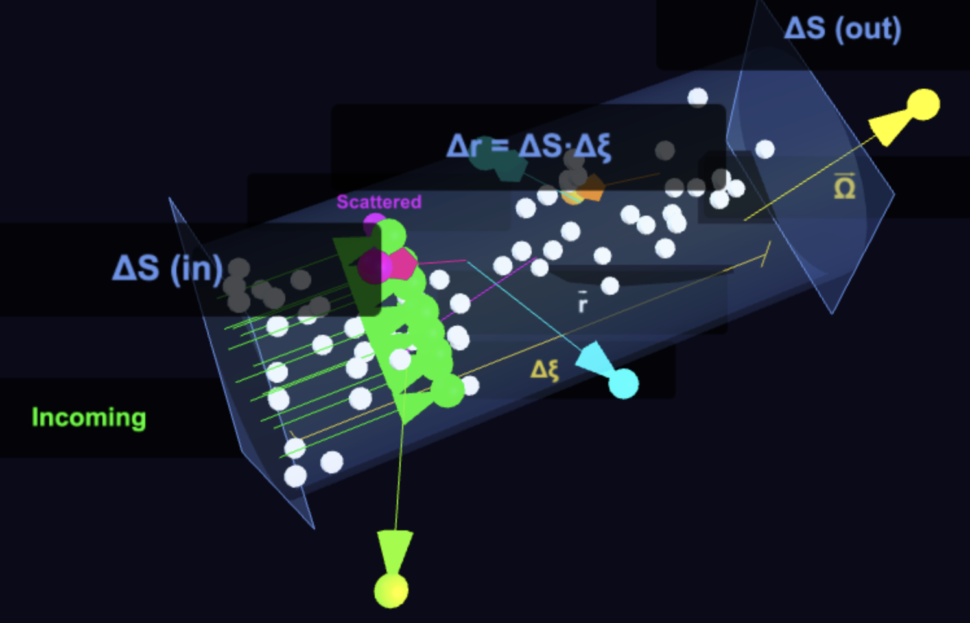
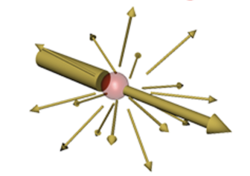
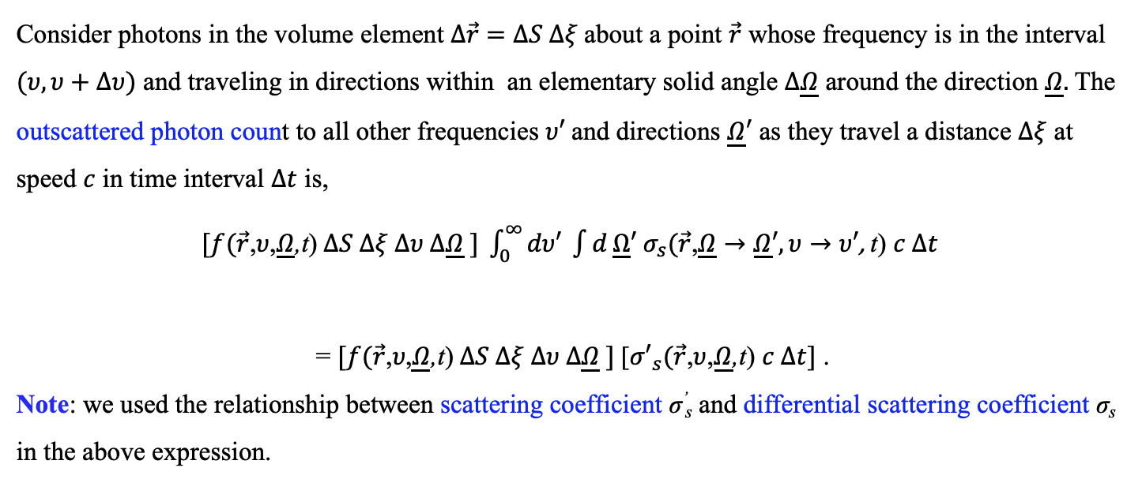



PHYSICAL MODELS IN REMOTE SENSING Chapter 01 – Part 04: The Radiative Transfer Equation
Outscattering (Loss)
$(υ$,$\underline{Ω})$
$(υ′$,$\underline{Ω}′)$
07-Outscattering.html
Consider photons in the volume element $Δ\vec{r}$ $=ΔS Δξ$about a point $\vec{r}$ whose frequency is in the interval $(υ, υ+Δυ)$ and traveling in directions within an elementary solid angle $Δ\underline{Ω}$ around the direction $\underline{Ω}.$The outscattered photon count to all other frequencies $υ′$and directions $\underline{Ω}′$ as they travel a distance $Δξ$ at speed $c$ in time interval $Δt$ is,
$[f(\vec{r}\text{,}υ\text{,}\underline{Ω}\text{,}\text{t}\text{)} ΔS Δξ Δυ Δ\underline{Ω} ] {\int_{0}^{∞}{dυ′ \int{d}}\underline{Ω}′ σ}_{s}(\vec{r}\text{,}\underline{Ω}→\underline{Ω}′, υ→υ′\text{, }\text{t}\text{)}$ $c Δt$
= $[f(\vec{r}\text{,}υ\text{,}\underline{Ω}\text{,}\text{t}\text{)} ΔS Δξ Δυ Δ\underline{Ω} ]$[${σ′}_{s}(\vec{r}$,$υ$,$\underline{Ω}$,t) $c Δt]$ .
Note: we used the relationship between scattering coefficient σ’_{s} and differential scattering coefficient σ_{s} in the above expression.
$$4π$$

Slide 10
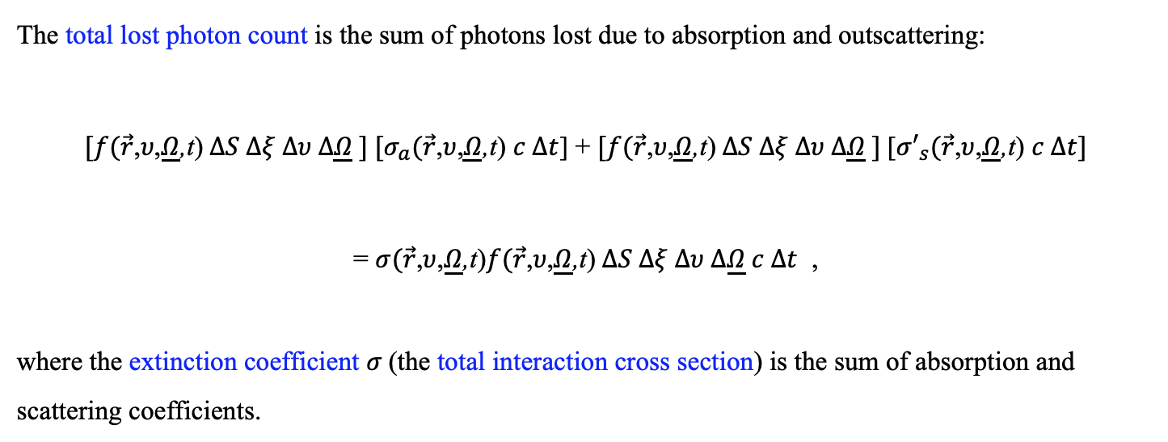
PHYSICAL MODELS IN REMOTE SENSING Chapter 01 – Part 04: The Radiative Transfer Equation
Total Loss From Absorption and Outscattering
The total lost photon count is the sum of photons lost due to absorption and outscattering:
${[f(\vec{r}\text{,}υ\text{,}\underline{Ω}\text{,}\text{t}\text{)} ΔS Δξ Δυ Δ\underline{Ω} ] [σ}_{a}(\vec{r}$,$υ$,$\underline{Ω}$,t) $c Δt$] + $[f(\vec{r}\text{,}υ\text{,}\underline{Ω}\text{,}\text{t}\text{)} ΔS Δξ Δυ Δ\underline{Ω} ]$[${σ′}_{s}(\vec{r}$,$υ$,$\underline{Ω}$,t) $c Δt]$
= $σ(\vec{r}$,$υ$,$\underline{Ω}$,t)$f(\vec{r}\text{,}υ\text{,}\underline{Ω}\text{,}\text{t}\text{)} ΔS Δξ Δυ Δ\underline{Ω} c Δt$ ,
where the extinction coefficient $σ$(the total interaction cross section) is the sum of absorption and scattering coefficients.

Slide 11
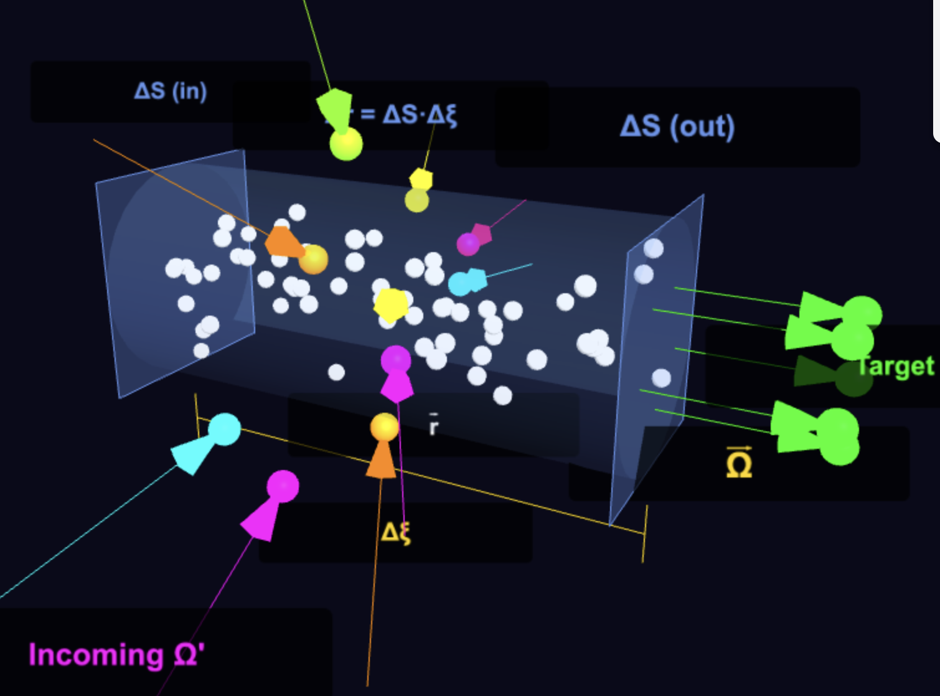
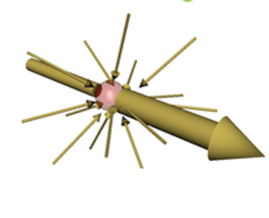

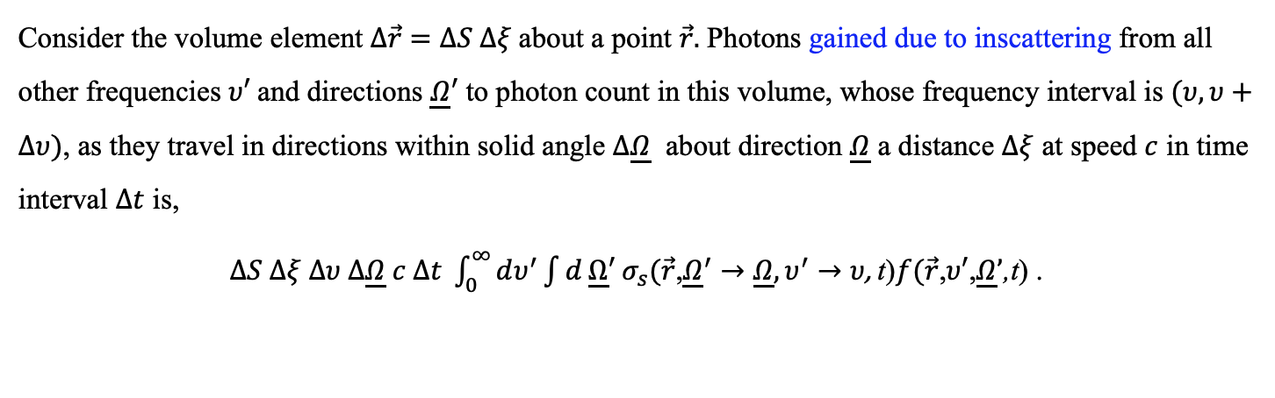


PHYSICAL MODELS IN REMOTE SENSING Chapter 01 – Part 04: The Radiative Transfer Equation
Inscattering (Gain)
$(υ′$,$\underline{Ω}′)$
$(υ$,$\underline{Ω})$
08-Inscattering.html
Consider the volume element $Δ\vec{r}$ $=ΔS Δξ$about a point $\vec{r}.$ Photons gained due to inscattering from all other frequencies $υ′$and directions $\underline{Ω}′$ to photon count in this volume, whose frequency interval is $(υ, υ+Δυ)$, as they travel in directions within solid angle $Δ\underline{Ω}$ about direction $\underline{Ω}$ a distance $Δξ$ at speed $c$ in time interval $Δt$ is,
$ΔS Δξ Δυ Δ\underline{Ω} c Δt {\int_{0}^{∞}{dυ^{′}\int{d}}\underline{Ω}′ σ}_{s}(\vec{r}\text{,}{\underline{Ω}}^{′}→\underline{Ω}, υ^{′}→υ\text{, }\text{t}\text{)}f(\vec{r}\text{,}υ′\text{,}\underline{Ω}’\text{,}\text{t}\text{)}$ .
$$4π$$

Slide 12
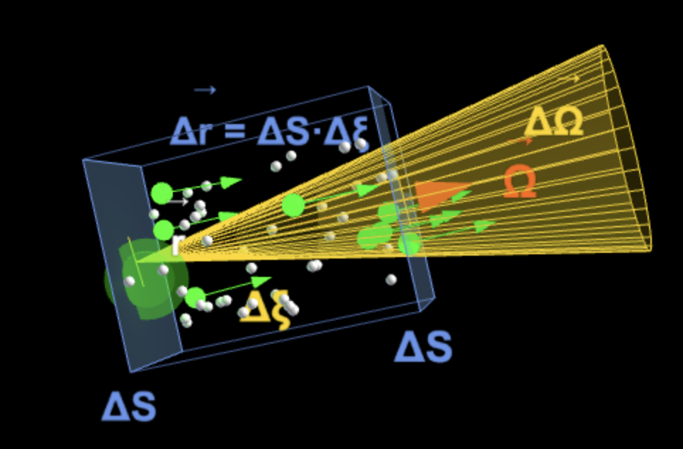
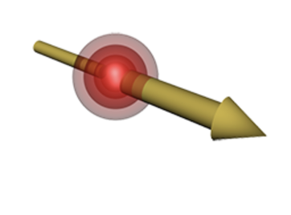
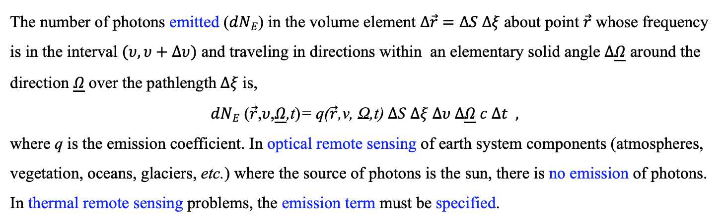

PHYSICAL MODELS IN REMOTE SENSING Chapter 01 – Part 04: The Radiative Transfer Equation
Emission of Photons (Gains)
$(υ$,$\underline{Ω})$
09-Emission.html
The number of photons emitted ($dNE$) in the volume element $Δ\vec{r}$ $=ΔS Δξ$about point $\vec{r}$ whose frequency is in the interval $(υ, υ+Δυ)$ and traveling in directions within an elementary solid angle $Δ\underline{Ω}$ around the direction $\underline{Ω}$over the pathlength$Δξ$is,
$dNE$ ($\vec{r}\text{,}υ\text{,}\underline{Ω}\text{,}\text{t}\text{)}\text{= }\text{q}\text{(}\vec{r}\text{,}\text{ν}\text{,} \text{Ω}\text{,}\text{t}\text{)} ΔS Δξ Δυ Δ\underline{Ω} c Δt ,$
where q is the emission coefficient. In optical remote sensing of earth system components (atmospheres, vegetation, oceans, glaciers, etc.) where the source of photons is the sun, there is no emission of photons. In thermal remote sensing problems, the emission term must be specified.

Slide 13
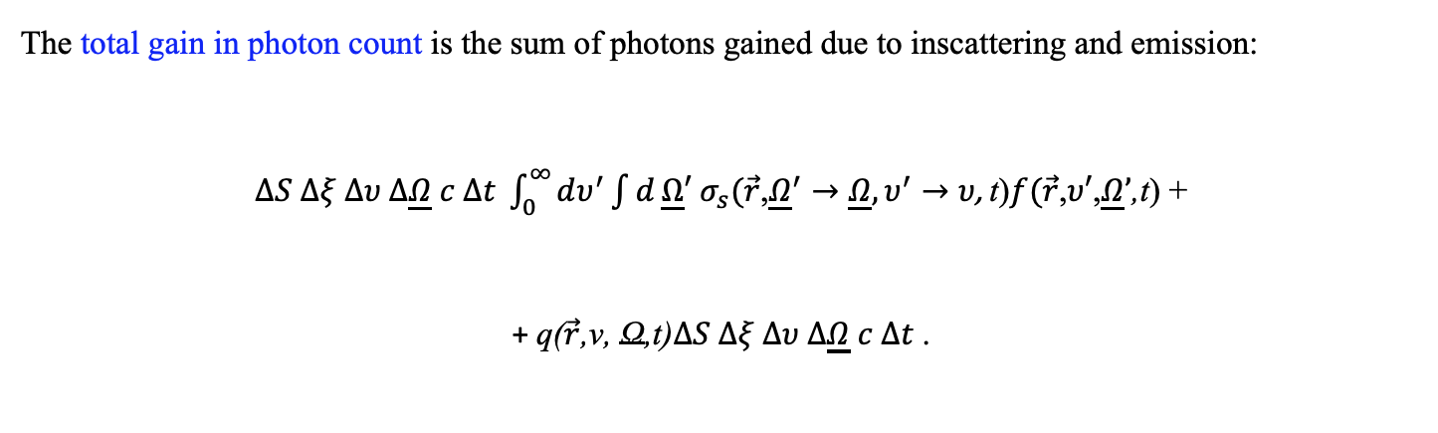

PHYSICAL MODELS IN REMOTE SENSING Chapter 01 – Part 04: The Radiative Transfer Equation
Total Gain From Inscattering and Emission
The total gain in photon count is the sum of photons gained due to inscattering and emission:
$ΔS Δξ Δυ Δ\underline{Ω} c Δt {\int_{0}^{∞}{dυ^{′}\int{d}}\underline{Ω}′ σ}_{s}(\vec{r}\text{,}{\underline{Ω}}^{′}→\underline{Ω}, υ^{′}→υ\text{, }\text{t}\text{)}f(\vec{r}\text{,}υ′\text{,}\underline{Ω}’\text{,}\text{t}\text{)}$ +
+ $\text{q}\text{(}\vec{r}\text{,}\text{ν}\text{,} \text{Ω}\text{,}\text{t}\text{)}ΔS Δξ Δυ Δ\underline{Ω} c Δt$.
$$4π$$

Slide 14
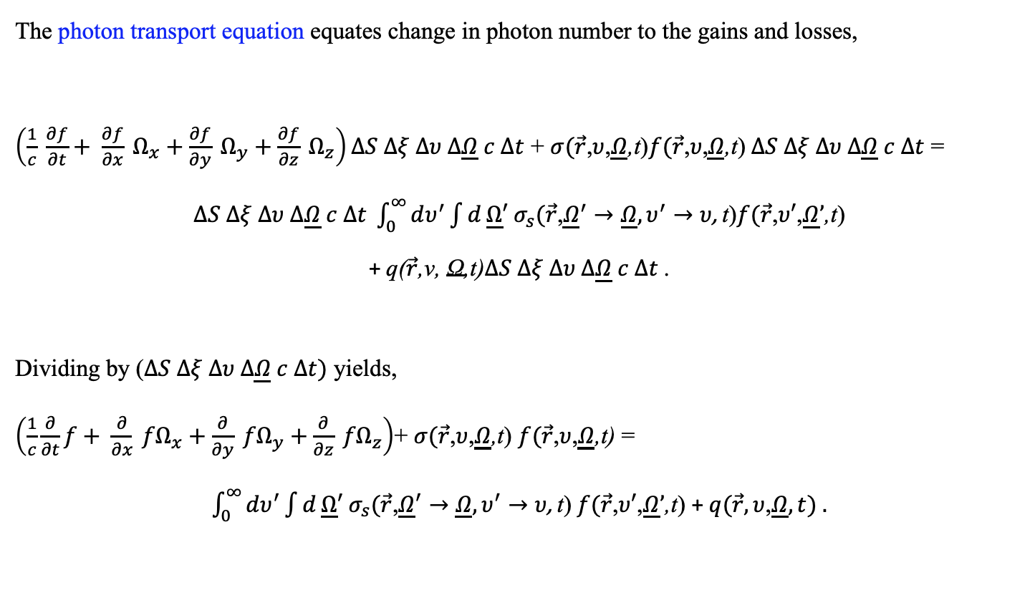

PHYSICAL MODELS IN REMOTE SENSING Chapter 01 – Part 04: The Radiative Transfer Equation
Photon Transport Equation
The photon transport equation equates change in photon number to the gains and losses,
$\left(\frac{1}{c} \frac{∂f}{∂t}+ \frac{∂f}{∂x} Ω_{x}+\frac{∂f}{∂y} Ω_{y}+\frac{∂f}{∂z} Ω_{z}\right)ΔS Δξ Δυ Δ\underline{Ω} c Δt$ + $σ(\vec{r}$,$υ$,$\underline{Ω}$,t)$f(\vec{r}\text{,}υ\text{,}\underline{Ω}\text{,}\text{t}\text{)} ΔS Δξ Δυ Δ\underline{Ω} c Δt$ =
$ΔS Δξ Δυ Δ\underline{Ω} c Δt {\int_{0}^{∞}{dυ^{′}\int{d}}\underline{Ω}′ σ}_{s}(\vec{r}\text{,}{\underline{Ω}}^{′}→\underline{Ω}, υ^{′}→υ\text{, }\text{t}\text{)}f(\vec{r}\text{,}υ′\text{,}\underline{Ω}’\text{,}\text{t}\text{)}$
+ $\text{q}\text{(}\vec{r}\text{,}\text{ν}\text{,} \text{Ω}\text{,}\text{t}\text{)}ΔS Δξ Δυ Δ\underline{Ω} c Δt$.
Dividing by ($ΔS Δξ Δυ Δ\underline{Ω} c Δt)$ yields,
$\left(\frac{1}{c}\frac{∂}{∂t}f+ \frac{∂}{∂x} {fΩ}_{x}+\frac{∂}{∂y} {fΩ}_{y}+\frac{∂}{∂z} {fΩ}_{z}\right)$+ $σ(\vec{r}$,$υ$,$\underline{Ω}$,t) $f(\vec{r}$,$υ$,$\underline{Ω}$,t) =
${\int_{0}^{∞}{dυ^{′}\int{d}}\underline{Ω}′ σ}_{s}(\vec{r}\text{,}{\underline{Ω}}^{′}→\underline{Ω}, υ^{′}→υ\text{, }\text{t}\text{)} f(\vec{r}\text{,}υ′\text{,}\underline{Ω}’\text{,}\text{t}\text{)}$ +$q(\vec{r},υ$,$\underline{Ω},t) .$
$$4π$$
$$4π$$

Slide 15



PHYSICAL MODELS IN REMOTE SENSING Chapter 01 – Part 04: The Radiative Transfer Equation
Radiative Transfer Equation
The Radiative Transfer Equation (RTE) uses radiation intensity instead of photon counts. Recall that the two are related as,
I $(\vec{r},υ,\underline{Ω}$,t) = $c\left(hυ\right)f(\vec{r},υ,\underline{Ω}$,t) .
Thus, multiplying the terms in the photon transport equation by the energy of photons [c $\left(hυ\right)]$, we obtain the radiative transfer equation:
$\left(\frac{1}{c}\frac{∂}{∂t}I+ \frac{∂}{∂x} {I Ω}_{x}+\frac{∂}{∂y} {I Ω}_{y}+\frac{∂}{∂z} {I Ω}_{z}\right)$ + $σ(\vec{r}$,$υ$,$\underline{Ω}$,t) I$(\vec{r}$,$υ$,$\underline{Ω}$,t) =
${\int_{0}^{∞}{dυ^{′}\int{d}}\underline{Ω}′ σ}_{s}(\vec{r}\text{,}{\underline{Ω}}^{′}→\underline{Ω}, υ^{′}→υ\text{, }\text{t}\text{)} I(\vec{r}\text{,}υ′\text{,}\underline{Ω}’\text{,}\text{t}\text{)}$ + Q$(\vec{r},υ$,$\underline{Ω},t)$ ,
where the source $\text{Q}(\vec{r},υ\text{,}\underline{Ω},t=c\left(hυ\right) q(\vec{r},υ$,$\underline{Ω},t).$The final form is,
$\left( \frac{1}{c} \frac{∂I}{∂t}\right)$ $+ \underline{Ω} ∙∇ I$+ $σ(\vec{r}$,$υ$,$\underline{Ω}$,t) I$(\vec{r}$,$υ$,$\underline{Ω}$,t) =
${\int_{0}^{∞}{dυ^{′}\int{d}}\underline{Ω}′ σ}_{s}(\vec{r}\text{,}{\underline{Ω}}^{′}→\underline{Ω}, υ^{′}→υ\text{, }\text{t}\text{)} I(\vec{r}\text{,}υ′\text{,}\underline{Ω}’\text{,}\text{t}\text{)}$ + $Q(\vec{r},υ$,$\underline{Ω},t)$ .
$$4π$$
$$4π$$

Slide 16

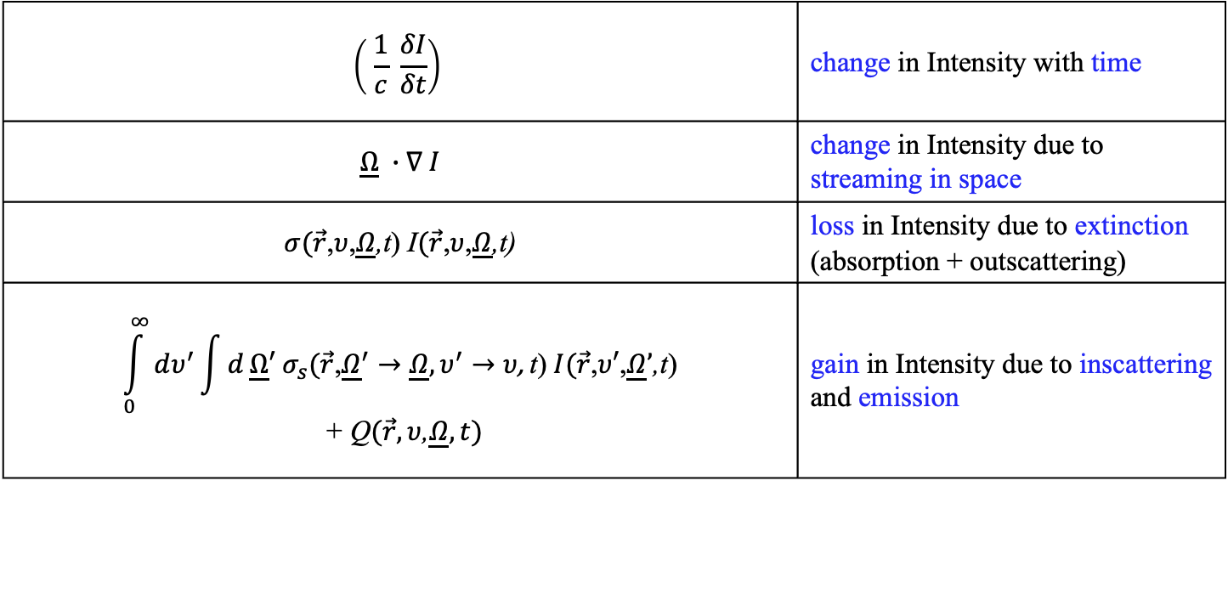
PHYSICAL MODELS IN REMOTE SENSING Chapter 01 – Part 04: The Radiative Transfer Equation
Meaning of RTE Terms
The terms in RTE have the following meaning:
$$\left( \frac{1}{c} \frac{δI}{δt}\right)$$ | change in Intensity with time
$\underline{Ω} ∙∇ I$ | change in Intensity due to streaming in space
$σ(\vec{r}$,$υ$,$\underline{Ω}$,t) I$(\vec{r}$,$υ$,$\underline{Ω}$,t) | loss in Intensity due to extinction (absorption + outscattering)
$${\int_{0}^{∞}{dυ^{′}\int{d}}\underline{Ω}′ σ}_{s}(\vec{r}\text{,}{\underline{Ω}}^{′}→\underline{Ω}, υ^{′}→υ\text{, }\text{t}\text{)} I(\vec{r}\text{,}υ′\text{,}\underline{Ω}’\text{,}\text{t}\text{)}$$ + Q$(\vec{r},υ$,$\underline{Ω},t)$ | gain in Intensity due to inscattering and emission
$$4π$$

Slide 17
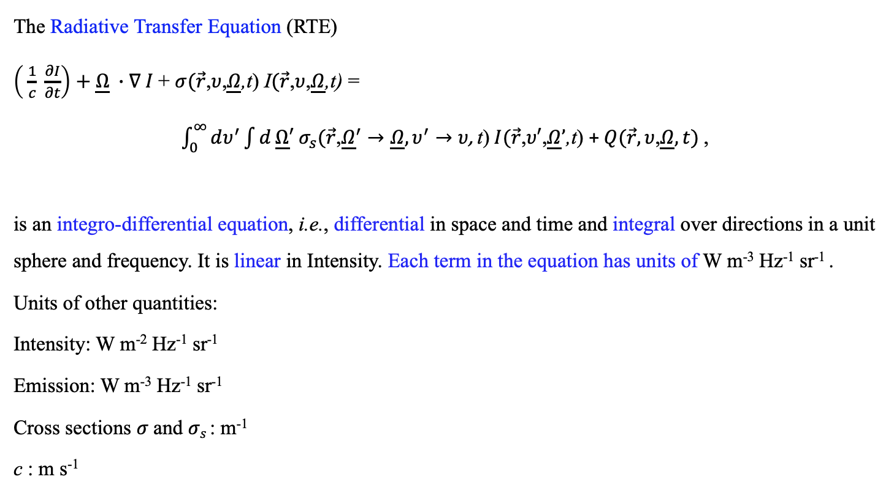

PHYSICAL MODELS IN REMOTE SENSING Chapter 01 – Part 04: The Radiative Transfer Equation
Units of RTE
The Radiative Transfer Equation (RTE)
$\left( \frac{1}{c} \frac{∂I}{∂t}\right)$ $+ \underline{Ω} ∙∇ I$+ $σ(\vec{r}$,$υ$,$\underline{Ω}$,t) I$(\vec{r}$,$υ$,$\underline{Ω}$,t) =
${\int_{0}^{∞}{dυ^{′}\int{d}}\underline{Ω}′ σ}_{s}(\vec{r}\text{,}{\underline{Ω}}^{′}→\underline{Ω}, υ^{′}→υ\text{, }\text{t}\text{)} I(\vec{r}\text{,}υ′\text{,}\underline{Ω}’\text{,}\text{t}\text{)}$ + $Q(\vec{r},υ$,$\underline{Ω},t)$,
is an integro-differential equation, i.e., differential in space and time and integral over directions in a unit sphere and frequency. It is linear in Intensity. Each term in the equation has units of W m⁻³ Hz⁻¹ sr⁻¹ .
Units of other quantities:
Intensity: W m⁻² Hz⁻¹ sr⁻¹
Emission: W m⁻³ Hz⁻¹ sr⁻¹
Cross sections $σ$and $σs$: m⁻¹
c : m s⁻¹
$$4π$$

Slide 18
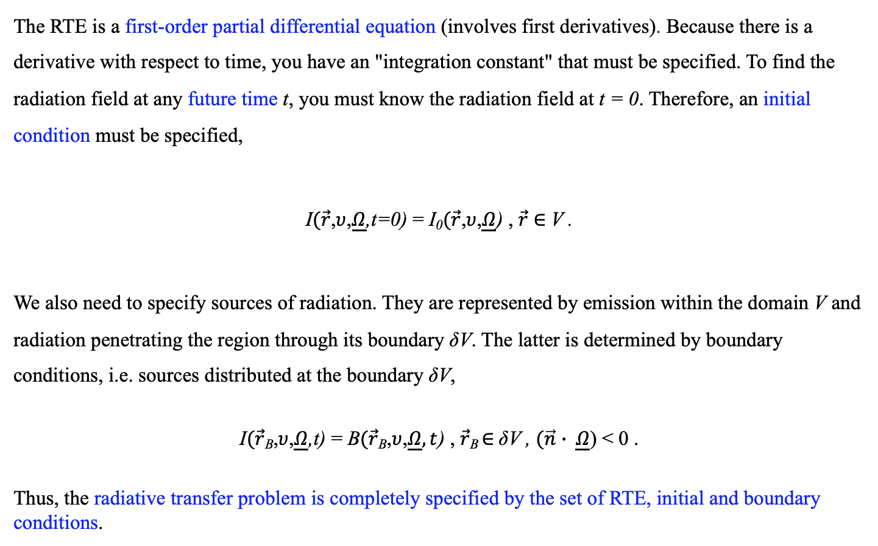
PHYSICAL MODELS IN REMOTE SENSING Chapter 01 – Part 04: The Radiative Transfer Equation
Initial & Boundary Conditions
The RTE is a first-order partial differential equation (involves first derivatives). Because there is a derivative with respect to time, you have an "integration constant" that must be specified. To find the radiation field at any future time t, you must know the radiation field at t = 0. Therefore, an initial condition must be specified,
I$(\vec{r}$,$υ$,$\underline{Ω}$,t=0) = I₀$(\vec{r}$,$υ$,$\underline{Ω}$) , $\vec{r}$ $∈$V .
We also need to specify sources of radiation. They are represented by emission within the domain V and radiation penetrating the region through its boundary δV. The latter is determined by boundary conditions, i.e. sources distributed at the boundary δV,
I$(\vec{r}\text{B}$,$υ$,$\underline{Ω}$,t) = B$(\vec{r}\text{B}$,$υ$,$\underline{Ω},t$) , $\vec{r}$_{B} $∈$δV , $(\vec{n}$ $∙ \underline{Ω}$) < 0 .
Thus, the radiative transfer problem is completely specified by the set of RTE, initial and boundary conditions.

Slide 19
PHYSICAL MODELS IN REMOTE SENSING Chapter 01 – Part 04: The Radiative Transfer Equation
Active and Passive Remote Sensing
Active Remote Sensing: In this mode, the system provides its own energy source.
The Process: The sensor emits a pulse of Electromagnetic Radiation (EMR) toward a target and measures the time it takes for the signal to bounce back (the "backscatter").
Key Advantage: It can operate day or night and, depending on the wavelength, can often "see" through clouds or smoke.
Examples: Lidars (Light Detection and Ranging) and Radars (Radio Detection and Ranging). Check out the Lidar hanging on the space station GEDI
Passive Remote Sensing: This mode relies on naturally occurring radiation.
The Process: The sensor measures energy that is already there. This is typically reflected sunlight (visible/near-infrared) during the day or thermal infrared (longwave radiation) emitted by the Earth or objects themselves.
Key Limitation: If it relies on solar reflection, it is not useful under cloudy conditions.
Examples: Standard satellite photography, thermal cameras, and radiometers. Check out NASA’s MODIS sensor

Slide 20
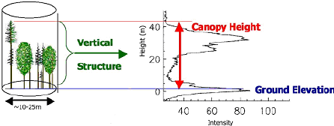
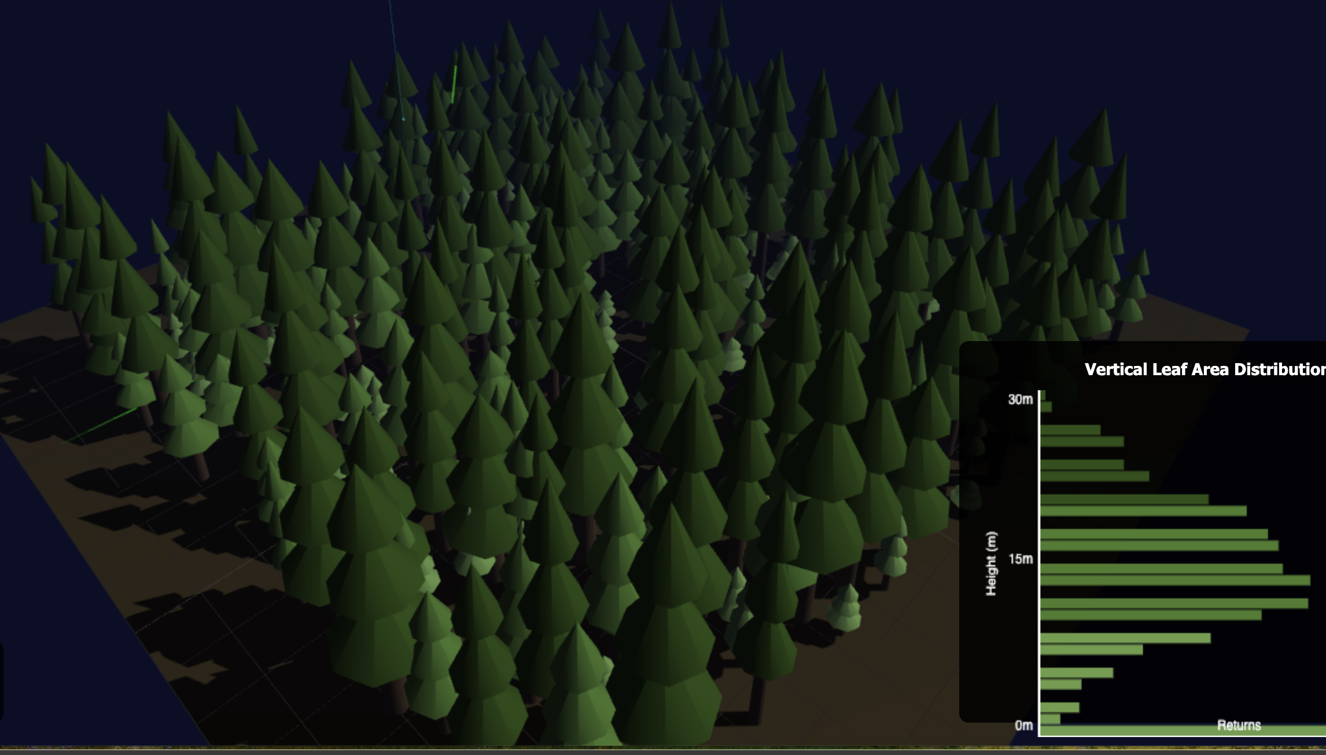
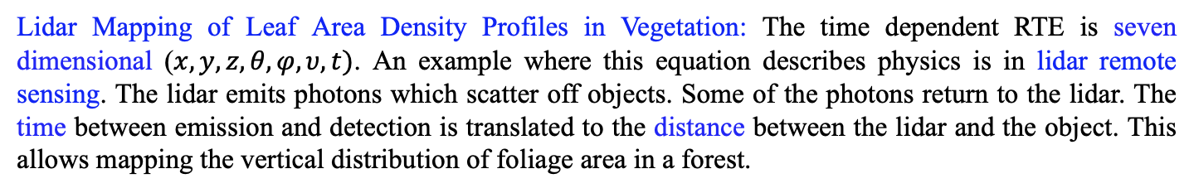
PHYSICAL MODELS IN REMOTE SENSING Chapter 01 – Part 04: The Radiative Transfer Equation
Time Dependent Problems in Remote Sensing
Lidar Mapping of Leaf Area Density Profiles in Vegetation: The time dependent RTE is seven dimensional ($x,y,z,θ,φ,υ,t)$. An example where this equation describes physics is in lidar remote sensing. The lidar emits photons which scatter off objects. Some of the photons return to the lidar. The time between emission and detection is translated to the distance between the lidar and the object. This allows mapping the vertical distribution of foliage area in a forest.
Dubayah, R. and Drake, J.B. 2000. Lidar remote sensing for forestry applications.
In: Journal of Forestry, vol. 98: 44-46.
10-Lidar-Veg-LAD.html
The scientific article describing this problem is: Kotchenova et al., 2013. Modeling lidar waveforms with time-dependent stochastic radiative transfer theory for remote estimations of forest biomass. J. Geophys. Res., Vol. 108, No. D15, 4484, 10.1029/2002JD003288.

Slide 21

PHYSICAL MODELS IN REMOTE SENSING Chapter 01 – Part 04: The Radiative Transfer Equation
Time Independent Problems in Remote Sensing
Measuring Leaf Area of Vegetation: Solar radiation reflected by objects at different frequencies (wavelengths, multi-spectral) and directions (multi-angle) is used to estimate geophysical variables of interest. An example is using red and near-infrared reflectances to estimate leaf area of vegetation. Red radiation is strongly absorbed and near-infrared radiation is strong reflected by leaves, thus creating a strong contrast in reflectance signatures that is indicative of leaf area. Such measurements span a range of spatial resolutions, from tens of meters (Landsat) to hundreds of meters (MODIS, MISR, VIIRS, 500 m).
11-SR-Reflection.html
The scientific articles describing this problem is:
Myneni, R.B. et al., 1990. Radiative transfer in three-dimensional leaf canopies. Transport Theory and Statistical Physics, 19:205-250.
Shultis, J.K. and Myneni, R.B., 1988. Radiative transfer in vegetation canopies with anisotropic scattering. J. Quant. Spectroscp. Radiat. Transfer, 39:115-129.

Slide 22
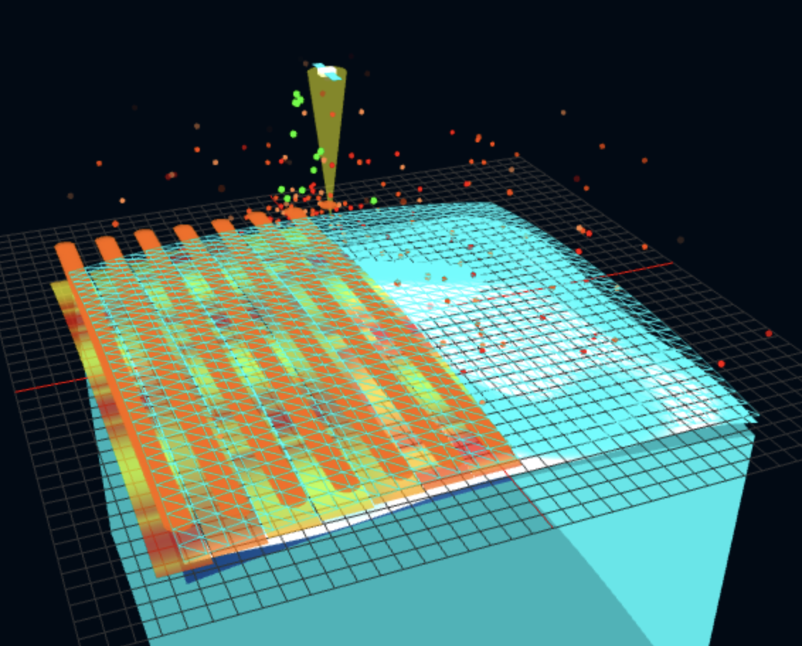
PHYSICAL MODELS IN REMOTE SENSING Chapter 01 – Part 04: The Radiative Transfer Equation
Emmisive Problems in Remote Sensing
Measuring Sea Surface Temperature: In some cases, there is no external source of radiation. Instead, the EMR emitted by the target is measured to infer, for example, its temperature. A good example of remote sensing products of sea surface temperature inferred from thermal EMR emitted by the surface waters of the ocean. The source term in the RTE is based on Planck’s law. The solution of RTE then provides an estimate of the emitted EMR received by the remote sensor. More information here.
12-SST-Sensing.html

