Slide 1
PHYSICAL MODELS IN REMOTE SENSING Chapter 01 – Part 05: Integral RTE
Time-Independent Radiative Transfer
Radiative Transfer in Vacuum
Atmospheric Refraction and Stellar Twinkling
Absorbing and Non-Scattering Media
The Gap Fraction and Applications
Weakly Scattering Media: Single Scattering
Multiple Scattering and Successive Orders
The Integral Equation of Transfer
Historical Perspective: S. Chandrasekhar

Slide 2

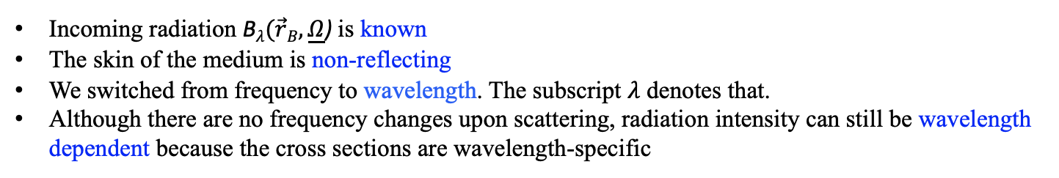

PHYSICAL MODELS IN REMOTE SENSING Chapter 01 – Part 05: Integral RTE
Time-independent (Stationary) RTE
Assume:
No emitting sources within the host medium
Cross sections and boundary conditions are stationary
No frequency shifting scattering interactions in the medium
The medium is non-re-entrant (photons leaving the medium cannot come back)
The corresponding stationary RT problem is specified by:
$\underline{Ω} ∙∇ Iλ$+ $σλ(\vec{r}\text{,}\underline{Ω}$) I$λ(\vec{r}$,$\underline{Ω}$) = ${\int{d\underline{Ω}′}σ}_{sλ}(\vec{r}\text{,}{\underline{Ω}}^{′}→\underline{Ω}\text{)} Iλ(\vec{r}\text{,}\underline{Ω}’\text{)}$ ,
$$4π$$
$\text{I}λ(\vec{r}\text{,}\underline{Ω}\text{)}\text{ = }\text{B}λ(\vec{r}B,\underline{Ω}\text{)}\text{ , }\vec{r}B$ $∈$ $δ$V , [$\vec{n}B\left(\vec{r}B\right)∙\underline{Ω}]<0 .$
Incoming radiation $\text{B}λ(\vec{r}B,\underline{Ω}\text{) }$is known
The skin of the medium is non-reflecting
We switched from frequency to wavelength. The subscript $λ$ denotes that.
Although there are no frequency changes upon scattering, radiation intensity can still be wavelength dependent because the cross sections are wavelength-specific

Slide 3
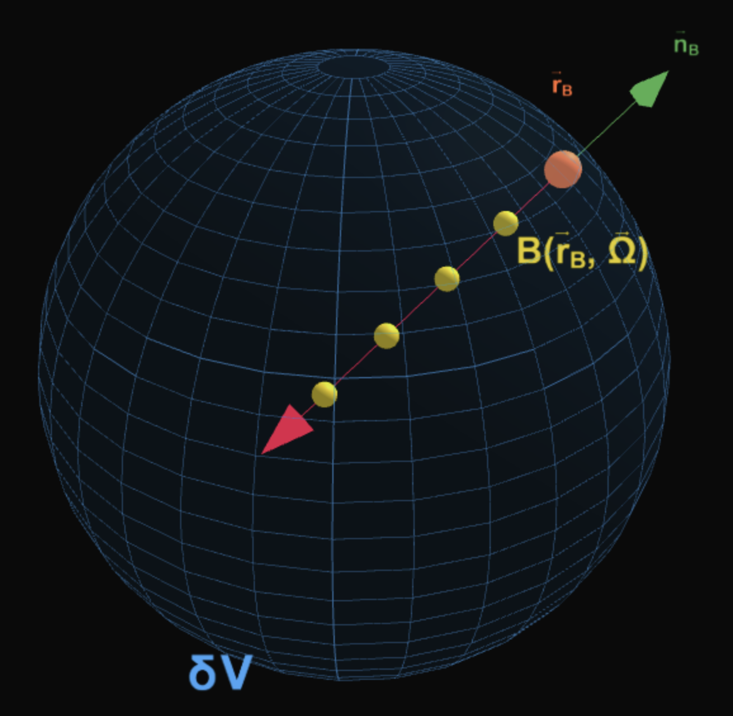
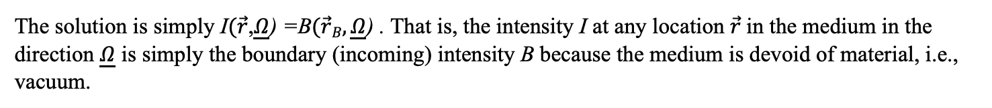
PHYSICAL MODELS IN REMOTE SENSING Chapter 01 – Part 05: Integral RTE
RT in Vacuum
01-Vacuum RT
The simplest RT problem is one where the medium is devoid of any material. This is described by (where
we drop wavelength notation for simplicity) :
$\underline{Ω} ∙∇ I$= $\frac{dI(\vec{r}+s\underline{Ω},\underline{Ω})}{ds}$= $0$,
$\text{I}(\vec{r}\text{,}\underline{Ω}\text{)}\text{ = }\text{B}(\vec{r}B,\underline{Ω}\text{)}\text{ , }\vec{r}B$ $∈$ $δ$V , [$\vec{n}B\left(\vec{r}B\right)∙\underline{Ω}]<0 .$
The solution is simply $\text{I}(\vec{r}\text{,}\underline{Ω}\text{) =}\text{B}(\vec{r}B,\underline{Ω}\text{) }\text{.}$ That is, the intensity I at any location $\vec{r}$in the medium in the
direction $\underline{Ω}$ is simply the boundary (incoming) intensity B because the medium is devoid of material, i.e.,
vacuum.

Slide 4





PHYSICAL MODELS IN REMOTE SENSING Chapter 01 – Part 05: Integral RTE
Solution to the Vacuum RT Problem
$$\text{B}(\vec{r}B,\underline{Ω}\text{)}$$
$$\vec{r}B$$
$$\vec{r}$$
$$\text{I}(\vec{r}\text{,}\underline{Ω}\text{)}$$
$$\underline{Ω}$$
Radiation intensity I at location $\vec{r}$in the medium in the direction $\underline{Ω}$ is simply the boundary intensity B as
photons suffer no interactions while traveling from $\vec{r}B$ to $\vec{r}$along $\underline{Ω}$.

Slide 5
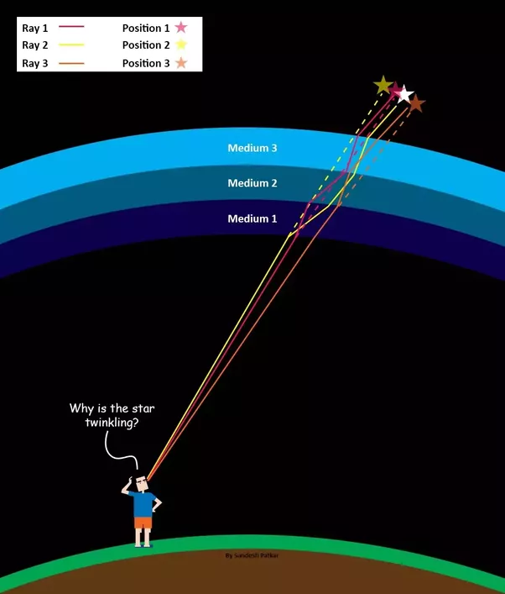
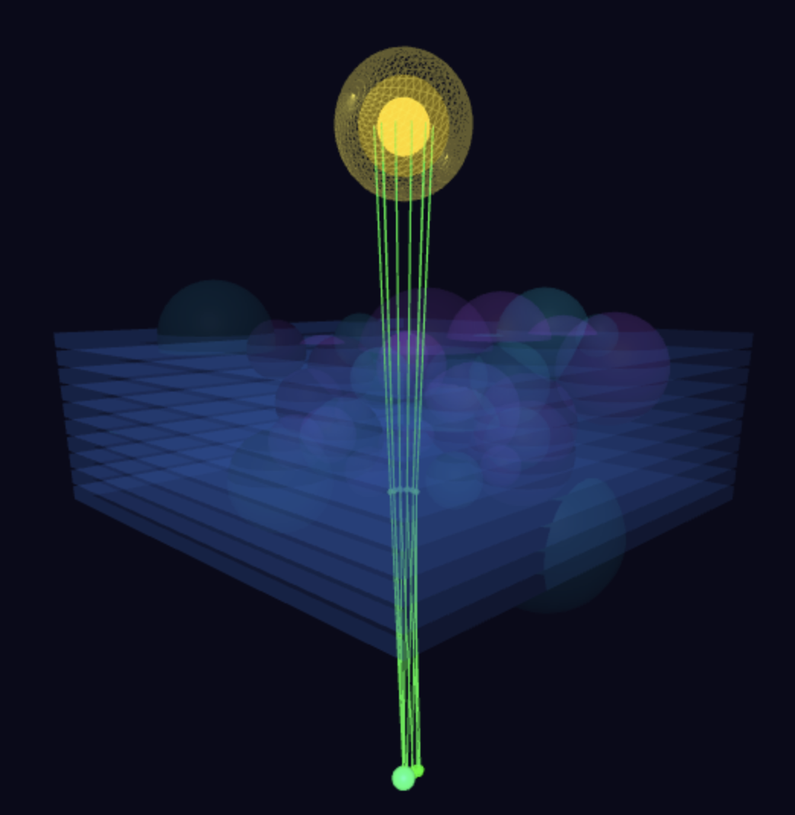
PHYSICAL MODELS IN REMOTE SENSING Chapter 01 – Part 05: Integral RTE
Why do Stars Twinkle?
The refractive index of a material describes how fast light travels through the material. It is defined as
n = c/v, where c is the speed of light in vacuum and v is the speed of light in the medium.
For example, the refractive index of water is 1.333, meaning that light travels 1.333 times slower in water than in a vacuum. Increasing the refractive index corresponds to decreasing the speed of light in the material.
The refractive index determines how much the path of light is bent or refracted when entering a material.
02-Twinkling-Stars

Slide 6
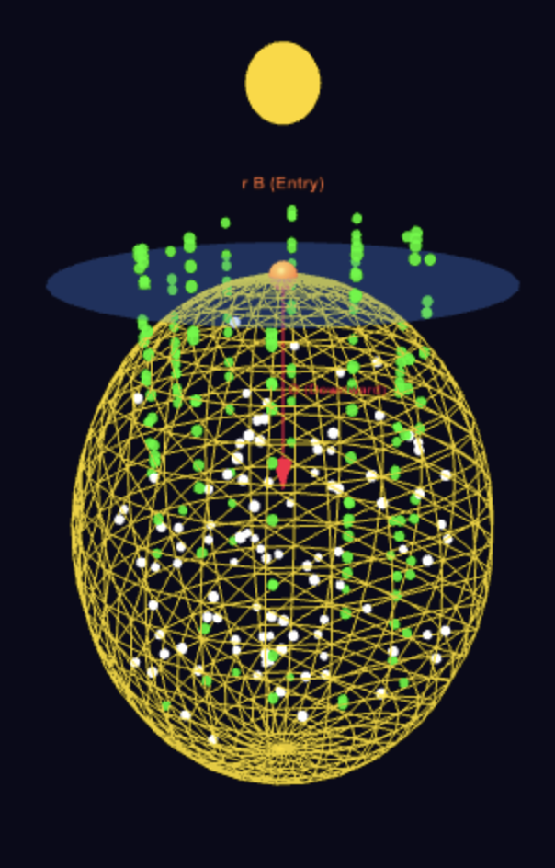
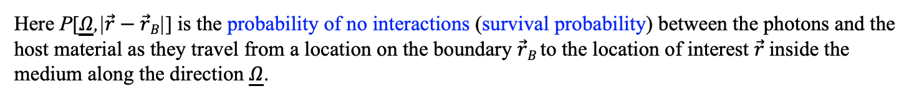

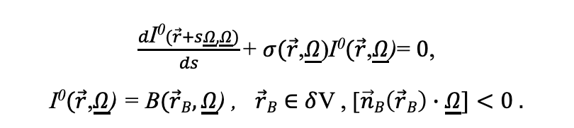
PHYSICAL MODELS IN REMOTE SENSING Chapter 01 – Part 05: Integral RTE
RT in Absorbing and Non-Scattering Medium
The medium consists of host material which absorbs but does not scatter radiation. When photons encounter
host material they are absorbed. If they do not, they get transmitted through the medium. The radiation field
I can also be called the uncollided radiation field as it is comprised of photons that have not interacted with
the host material. This uncollided intensity will be denoted as I⁰ .The corresponding RT problem is,
$\frac{d\text{I}\text{0}(\vec{r}+s\underline{Ω},\underline{Ω})}{ds}\text{+ }σ(\vec{r}\text{,}\underline{Ω}\text{)}\text{I}\text{0}(\vec{r}\text{,}\underline{Ω}\text{)}$= $0$,
I⁰$(\vec{r}\text{,}\underline{Ω}\text{) = }\text{B}(\vec{r}B,\underline{Ω}\text{) , }\vec{r}B$ $∈$ $δ$V , [$\vec{n}B\left(\vec{r}B\right)∙\underline{Ω}]<0 .$
Note that in this case the extinction coefficient $σ is equal to the absorption$
coefficient $σa.$ The solution is (see Appendix A in Lecture Notes),
I⁰$(\vec{r}\text{,}\underline{Ω}\text{) = }\text{B}(\vec{r}B,\underline{Ω}\text{)} \text{P}\text{[}\underline{Ω}\text{,|}\vec{r}−\vec{r}B\text{|}\text{]}\text{ .}$
03-Uncollided-Problem
Here $\text{P}\text{[}\underline{Ω}\text{,|}\vec{r}−\vec{r}B\text{|}\text{]}$is the probability of no interactions (survival probability) between the photons and the host material as they travel from a location on the boundary $\vec{r}B$to the location of interest $\vec{r}$inside the medium along the direction $\underline{Ω}$.

Slide 7
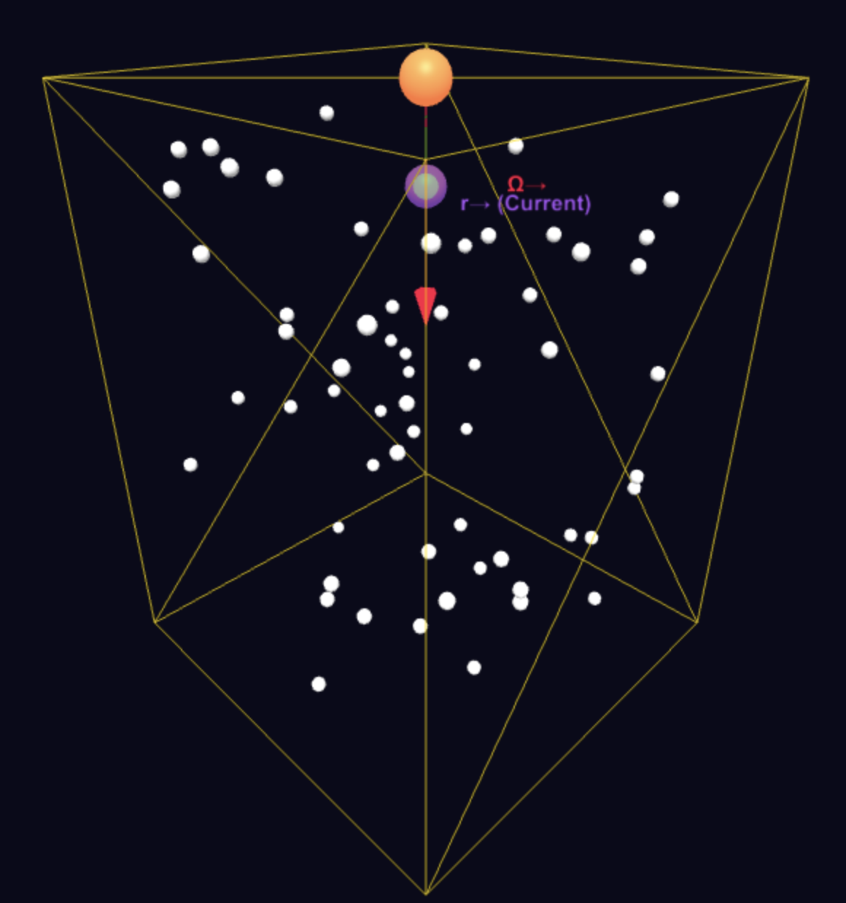






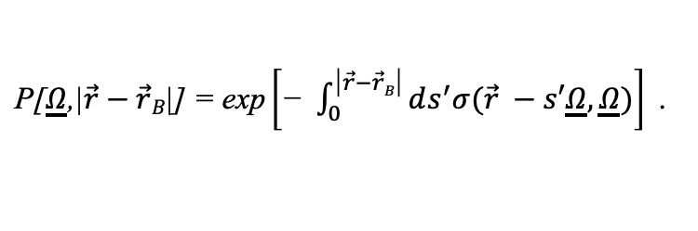
PHYSICAL MODELS IN REMOTE SENSING Chapter 01 – Part 05: Integral RTE
Solution to RT in Absorbing and Non-Scattering Medium
$$\text{B}(\vec{r}B,\underline{Ω}\text{)}$$
$$\vec{r}B$$
$$s^{′}$$
$$\vec{r}$$
$$\text{I}(\vec{r}\text{,}\underline{Ω}\text{)}$$
$$\underline{Ω}$$
04-Photon-Survival-Prob
Radiation intensity I at location $\vec{r}$in the medium in the direction $\underline{Ω}$ is simply the boundary intensity B as
photons suffer no interactions while traveling from $\vec{r}B$ to $\vec{r}$along $\underline{Ω}$.
$\text{P}\text{[}\underline{Ω}\text{,|}\vec{r}−\vec{r}B\text{|]}\text{ = }\text{exp}\left[\text{− }\int_{0}^{\text{|}\vec{r}−\vec{r}B\text{|}}{ds^{′}σ(\vec{r} −s′\underline{Ω},\underline{Ω}})\right]$.

Slide 8

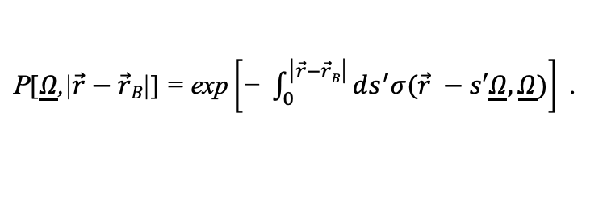
PHYSICAL MODELS IN REMOTE SENSING Chapter 01 – Part 05: Integral RTE
Gap Fraction or Probability
$\text{P}\text{[}\underline{Ω}\text{,|}\vec{r}−\vec{r}B\text{|}\text{]}\text{ = }\text{exp}\left[\text{− }\int_{0}^{\text{|}\vec{r}−\vec{r}B\text{|}}{ds^{′}σ(\vec{r} −s′\underline{Ω},\underline{Ω}})\right]$.

Slide 9

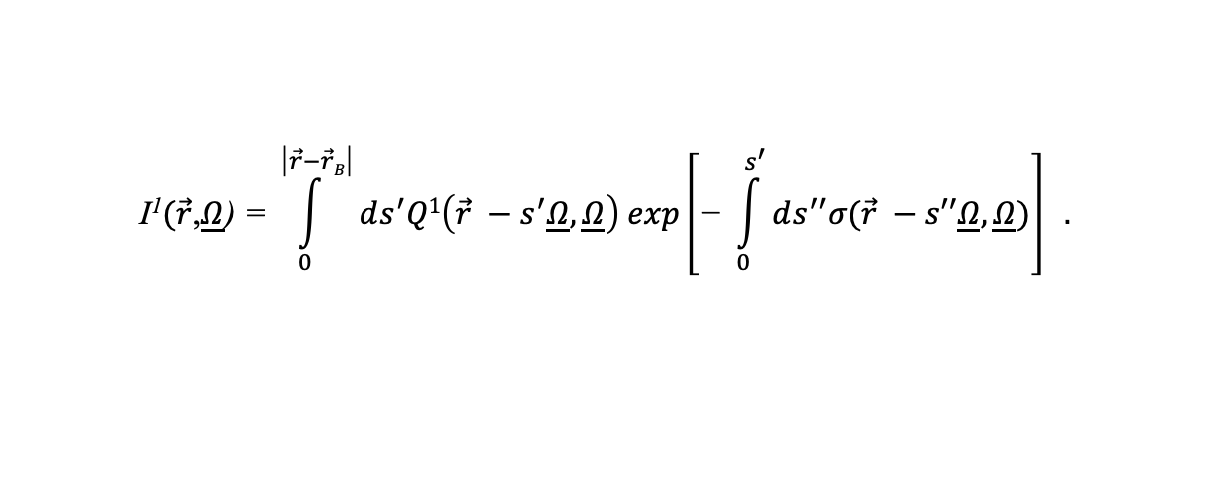
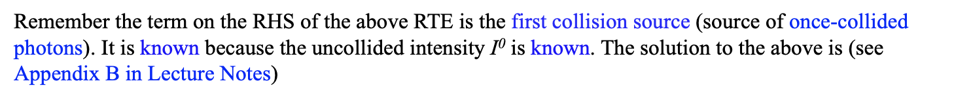

PHYSICAL MODELS IN REMOTE SENSING Chapter 01 – Part 05: Integral RTE
RT in Absorbing and Weakly Scattering Medium
The medium consists of host material which absorbs and scatters radiation. Assume that scattering is weak.
So, calculating one order of scattering suffices, i.e., the scattered radiation field consists of photons that
suffered one collision with the host material. The energy of these photons is once-collided intensity I¹.
The corresponding RT problem is,
$\underline{Ω} ∙∇\text{I}\text{1}$+ $σ(\vec{r}\text{,}\underline{Ω}$) I¹$(\vec{r}$,$\underline{Ω}$) = ${\int{d\underline{Ω}′}σ}_{s}(\vec{r}\text{,}{\underline{Ω}}^{′}→\underline{Ω}\text{)}\text{I}\text{0}(\vec{r}\text{,}\underline{Ω}’\text{)}$ ,
$$4π$$
$\text{I}\text{1}(\vec{r}\text{,}\underline{Ω}\text{)}\text{ = 0, }\vec{r}B$ $∈$ $δ$V , [$\vec{n}B\left(\vec{r}B\right)∙\underline{Ω}]<0 .$
Remember the term on the RHS of the above RTE is the first collision source (source of once-collided photons). It is known because the uncollided intensity $\text{I}\text{0}$ is known. The solution to the above is (see Appendix B in Lecture Notes)
$$\text{I}\text{1}(\vec{r}\text{,}\underline{Ω}\text{)}\text{ = }\int_{0}^{\text{|}\vec{r}−\vec{r}B\text{|}}{ds^{′}Q1\left(\vec{r} −s^{′}\underline{Ω},\underline{Ω}\right) exp\left[\text{− }\int_{0}^{s^{′}}{ds^{′′}σ(\vec{r} −s′′\underline{Ω},\underline{Ω}})\right]} .$$

Slide 10
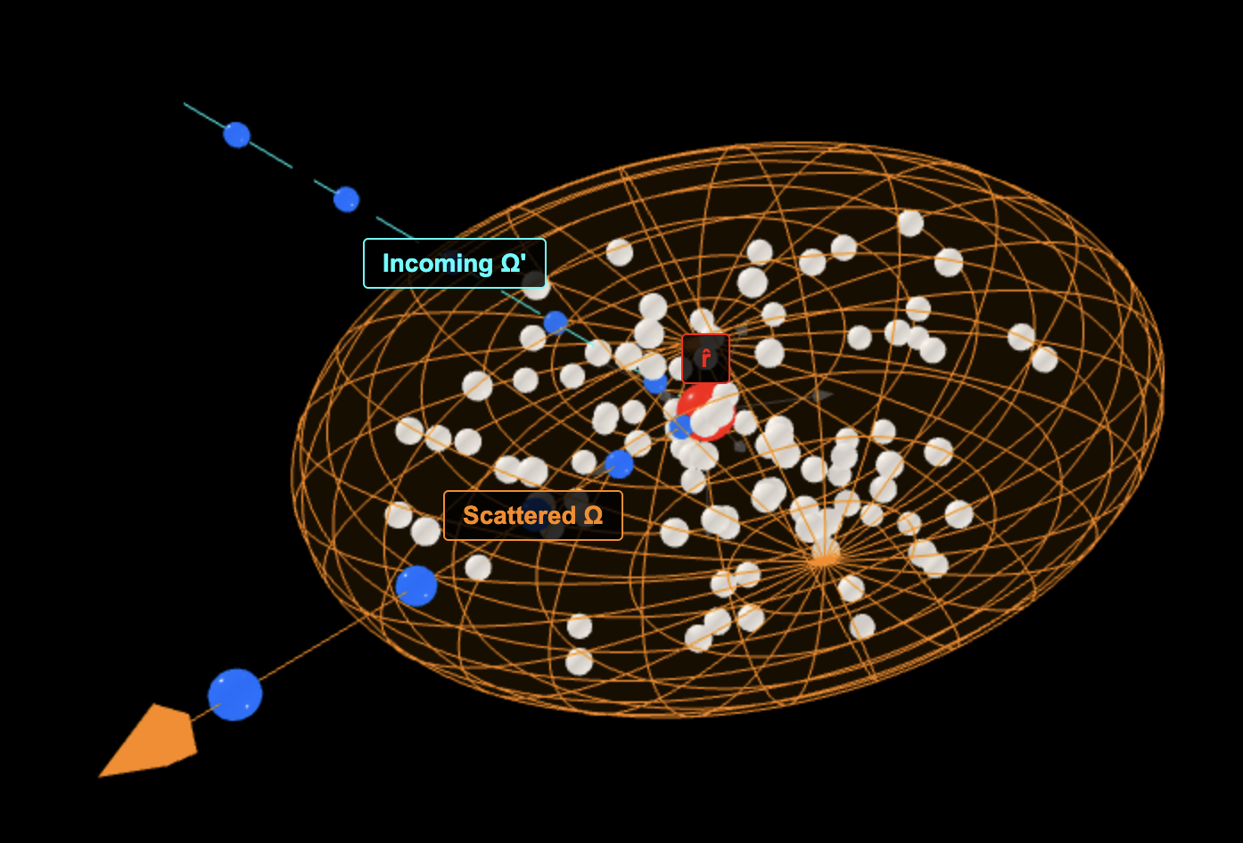

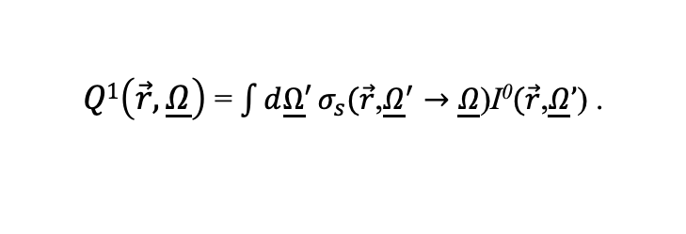






PHYSICAL MODELS IN REMOTE SENSING Chapter 01 – Part 05: Integral RTE
First Collision Source
The first-collision source $Q1$is the source of photons that collided once with the host material. The input
to this source are photons comprising the uncollided radiation intensity $\text{I}\text{0}$ . This source is evaluated as,
$Q1\left(\vec{r},\underline{Ω}\right)$= ${\int{d\underline{Ω}′}σ}_{s}(\vec{r}\text{,}{\underline{Ω}}^{′}→\underline{Ω}\text{)}\text{I}\text{0}(\vec{r}\text{,}\underline{Ω}’\text{)}$ .
$$4π$$
Remember that the uncollided intensity $\text{I}\text{0}$ is known.
$$\text{B}(\vec{r}B,\underline{Ω}′\text{)}$$
$$\underline{Ω}’$$
$$\vec{r}B$$
$$\vec{r}$$
$Q1\left(\vec{r},\underline{Ω}\right)$ = $σ_{s}(\vec{r}\text{,}{\underline{Ω}}^{′}→\underline{Ω}\text{)}\text{I}\text{0}(\vec{r}\text{,}\underline{Ω}’\text{)}$
$$\underline{Ω}$$
05-First-Collision-Source

Slide 11


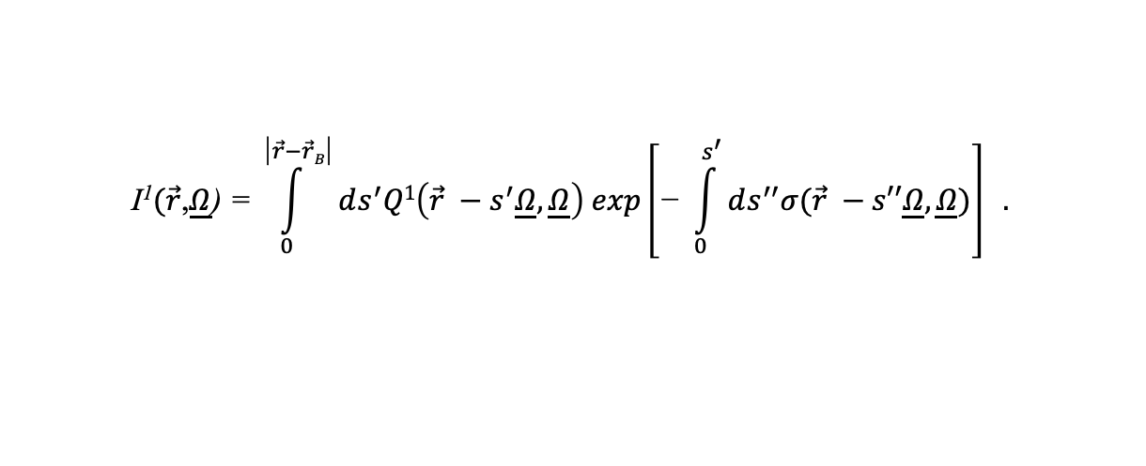






PHYSICAL MODELS IN REMOTE SENSING Chapter 01 – Part 05: Integral RTE
Once-Scattered Intensity
The once-scattered intensity $\text{I}\text{1}$ at a location $\vec{r}$in direction $\underline{Ω}$is evaluated as,
$$\text{I}\text{1}(\vec{r}\text{,}\underline{Ω}\text{)}\text{ = }\int_{0}^{\text{|}\vec{r}−\vec{r}B\text{|}}{ds^{′}Q1\left(\vec{r} −s^{′}\underline{Ω},\underline{Ω}\right) exp\left[\text{− }\int_{0}^{s^{′}}{ds^{′′}σ(\vec{r} −s′′\underline{Ω},\underline{Ω}})\right]} .$$
The exponential term indicates the probability that the first-collision source photons will not further
interact in the medium as they travel in the direction $\underline{Ω}$along the pathlength s’.
$$\vec{r}B$$
$$\vec{r}B$$
$$Q1\left(\vec{r} −s^{′}\underline{Ω},\underline{Ω}\right)$$
$$Q1\left(\vec{r} −s^{′}\underline{Ω},\underline{Ω}\right)$$
s’
$$Q1\left(\vec{r} −s^{′}\underline{Ω},\underline{Ω}\right)$$
s’
s’
$$\text{I}\text{1}(\vec{r}\text{,}\underline{Ω}\text{)}$$
$$\text{I}\text{1}(\vec{r}\text{,}\underline{Ω}\text{)}$$
$$\text{I}\text{1}(\vec{r}\text{,}\underline{Ω}\text{)}$$

Slide 12
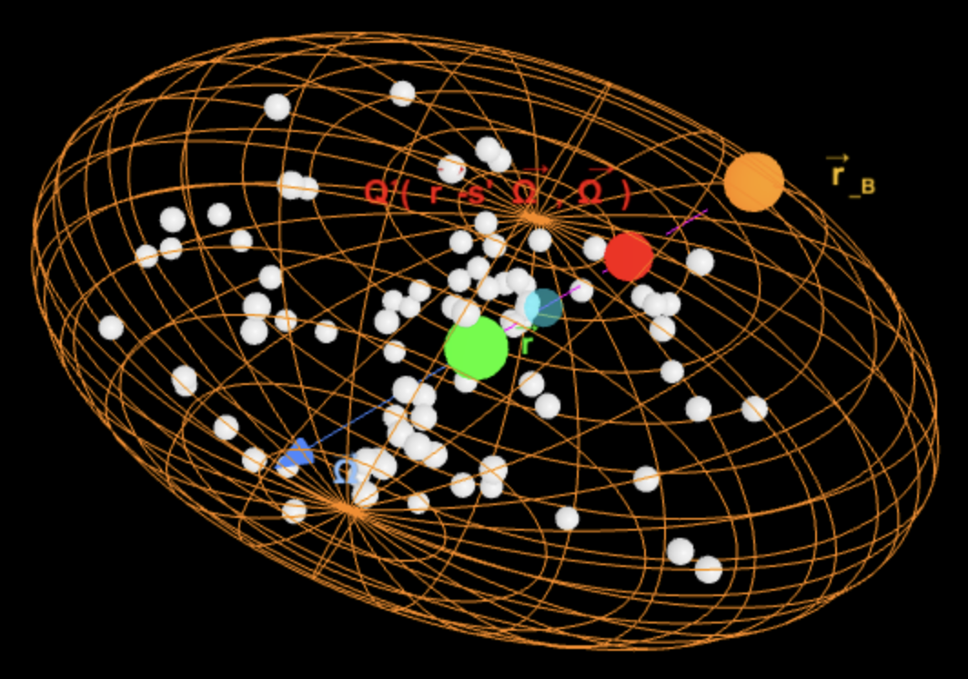
PHYSICAL MODELS IN REMOTE SENSING Chapter 01 – Part 05: Integral RTE
Once-Scattered Intensity
The once-scattered intensity $\text{I}\text{1}$ at a location $\vec{r}$in direction $\underline{Ω}$is evaluated as,
$$\text{I}\text{1}(\vec{r}\text{,}\underline{Ω}\text{)}\text{ = }\int_{0}^{\text{|}\vec{r}−\vec{r}B\text{|}}{ds^{′}Q1\left(\vec{r} −s^{′}\underline{Ω},\underline{Ω}\right) exp\left[\text{− }\int_{0}^{s^{′}}{ds^{′′}σ(\vec{r} −s′′\underline{Ω},\underline{Ω}})\right]} .$$
The exponential term indicates the probability that the first-collision source photons will not further
interact in the medium as they travel in the direction $\underline{Ω}$along the pathlength s’.
06-Once-Collided-Intensity

Slide 13
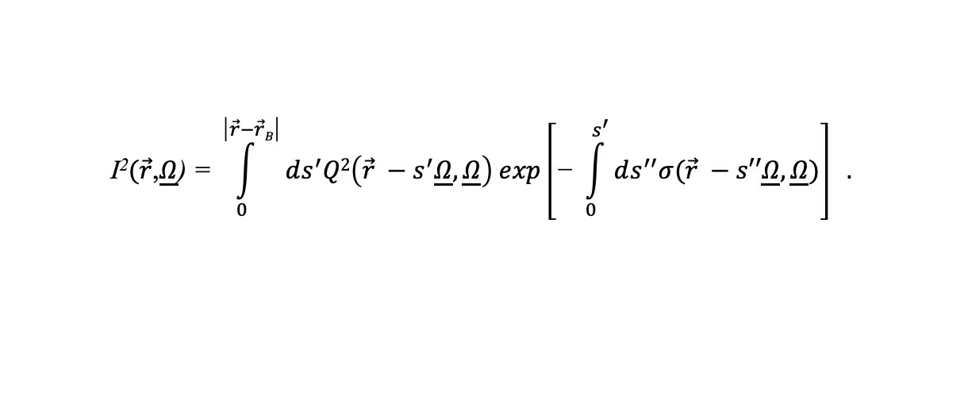


PHYSICAL MODELS IN REMOTE SENSING Chapter 01 – Part 05: Integral RTE
RT in Absorbing and Scattering Medium
The medium consists of host material which absorbs and scatters radiation. We can evaluate the radiation
intensity of photons that scattered twice $\text{I}\text{2}$ in the medium as,
$\underline{Ω} ∙∇\text{I}\text{2}$+ $σ(\vec{r}\text{,}\underline{Ω}$) I²$(\vec{r}$,$\underline{Ω}$) = ${\int{d\underline{Ω}′}σ}_{s}(\vec{r}\text{,}{\underline{Ω}}^{′}→\underline{Ω}\text{)}\text{I}\text{1}(\vec{r}\text{,}\underline{Ω}’\text{)}$ ,
$$4π$$
$\text{I}\text{2}(\vec{r}\text{,}\underline{Ω}\text{)}\text{ = 0, }\vec{r}B$ $∈$ $δ$V , [$\vec{n}B\left(\vec{r}B\right)∙\underline{Ω}]<0 .$
Remember the term on the RHS of the above RTE is the second collision source (source of twice-collided photons). It is known because the once-collided intensity $\text{I}\text{1}$ is known. The solution to the above is
$$\text{I}\text{2}(\vec{r}\text{,}\underline{Ω}\text{)}\text{ = }\int_{0}^{\text{|}\vec{r}−\vec{r}B\text{|}}{ds^{′}Q2\left(\vec{r} −s^{′}\underline{Ω},\underline{Ω}\right) exp\left[\text{− }\int_{0}^{s^{′}}{ds^{′′}σ(\vec{r} −s′′\underline{Ω},\underline{Ω}})\right]} .$$
This order-by-order of scattered radiation intensity can be continued indefinitely.

Slide 14


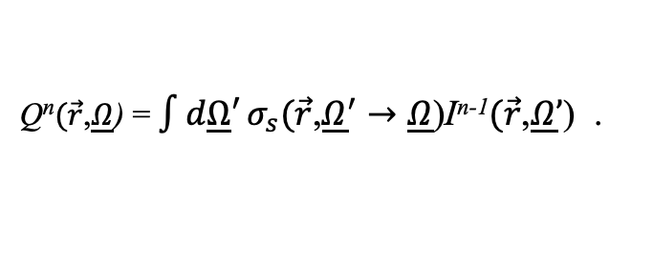
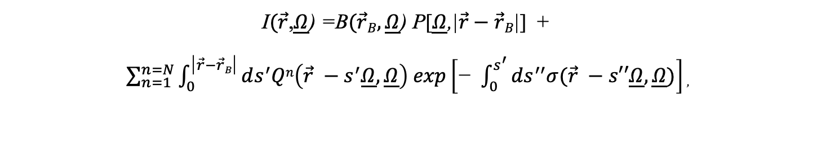

PHYSICAL MODELS IN REMOTE SENSING Chapter 01 – Part 05: Integral RTE
Solution to the RT Problem in Absorbing and Scattering Medium
The solution to the RT problem in the case of a medium which absorbs, and scatters radiation can be
written as,
$$\text{I}(\vec{r}\text{,}\underline{Ω}\text{)}\text{ =}\text{I}\text{0}(\vec{r}\text{,}\underline{Ω}\text{)}\text{ +}\text{I}\text{1}(\vec{r}\text{,}\underline{Ω}\text{)}\text{ +}\text{I}\text{2}(\vec{r}\text{,}\underline{Ω}\text{)}\text{ +}\text{I}3(\vec{r}\text{,}\underline{Ω}\text{)}\text{ + }…+\text{I}n(\vec{r}\text{,}\underline{Ω}\text{)}\text{ ,}$$
$\text{I}(\vec{r}\text{,}\underline{Ω}\text{) =}\text{I}\text{0}(\vec{r}\text{,}\underline{Ω}\text{) +}I^{C}(\vec{r}\text{,}\underline{Ω}\text{)}$ ,
where $\text{I}\text{0}$ is uncollided radiation intensity and $\text{I}\text{C}$ is collided radiation intensity. Formally,
$$\text{I}(\vec{r}\text{,}\underline{Ω}\text{)}\text{ =}\text{B}(\vec{r}B,\underline{Ω}\text{) }\text{P}\text{[}\underline{Ω}\text{,|}\vec{r}−\vec{r}B\text{|}\text{]}\text{ + }$$
$\sum_{n=1}^{n=N}{\int_{0}^{\text{|}\vec{r}−\vec{r}B\text{|}}{ds^{′}Qn\left(\vec{r} −s^{′}\underline{Ω},\underline{Ω}\right) exp\left[\text{− }\int_{0}^{s^{′}}{ds^{′′}σ(\vec{r} −s′′\underline{Ω},\underline{Ω}})\right]}}$ ,
where the source term $Qn$ is,
Q^{n}$(\vec{r}$,$\underline{Ω}$) = ${\int{d\underline{Ω}′}σ}_{s}(\vec{r}\text{,}{\underline{Ω}}^{′}→\underline{Ω}\text{)}\text{I}\text{n}\text{−1}(\vec{r}\text{,}\underline{Ω}’\text{)}\text{ .}$
$$4π$$
In the above “N” is the total order of scattering. This approximate numerical solution method is called
the method of Successive Orders of Scattering.

Slide 15


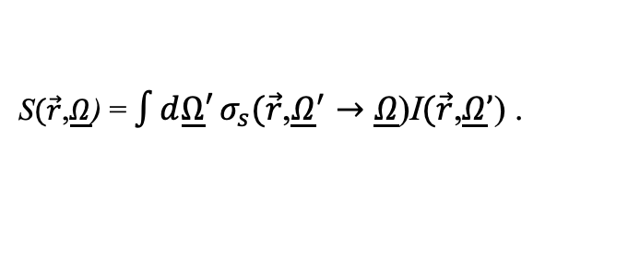
PHYSICAL MODELS IN REMOTE SENSING Chapter 01 – Part 05: Integral RTE
The Integral Equation of Transfer
The previous discussion can be generalized into a formal solution of the RTE in absorbing and scattering
media as (see Appendix C in Lecture Notes),
$$\text{I}(\vec{r}\text{,}\underline{Ω}\text{)}\text{ =}\text{B}(\vec{r}B,\underline{Ω}\text{) }\text{P}\text{[}\underline{Ω}\text{,|}\vec{r}−\vec{r}B\text{|}\text{]}\text{ + }$$
$\int_{0}^{\text{|}\vec{r}−\vec{r}B\text{|}}{ds^{′}S\left(\vec{r} −s^{′}\underline{Ω},\underline{Ω}\right) exp\left[\text{− }\int_{0}^{s^{′}}{ds^{′′}σ(\vec{r} −s′′\underline{Ω},\underline{Ω}})\right]}$ .
where S is the total source,
S$(\vec{r}$,$\underline{Ω}$) = ${\int{d\underline{Ω}′}σ}_{s}(\vec{r}\text{,}{\underline{Ω}}^{′}→\underline{Ω}\text{)}\text{I}(\vec{r}\text{,}\underline{Ω}’\text{)}\text{ .}$
$$4π$$
The formal solution is thus the integral equation of transfer. It is not an actual solution because radiation intensity appears on both sides of the equation. The next two slides present a more formal derivation of the integral equation of transfer. Also see Appendix C in Lecture Notes.

Slide 16
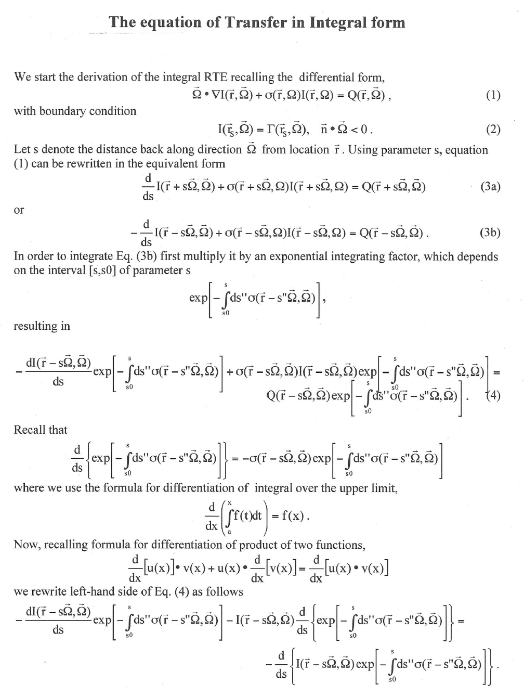
PHYSICAL MODELS IN REMOTE SENSING Chapter 01 – Part 05: Integral RTE

Slide 17
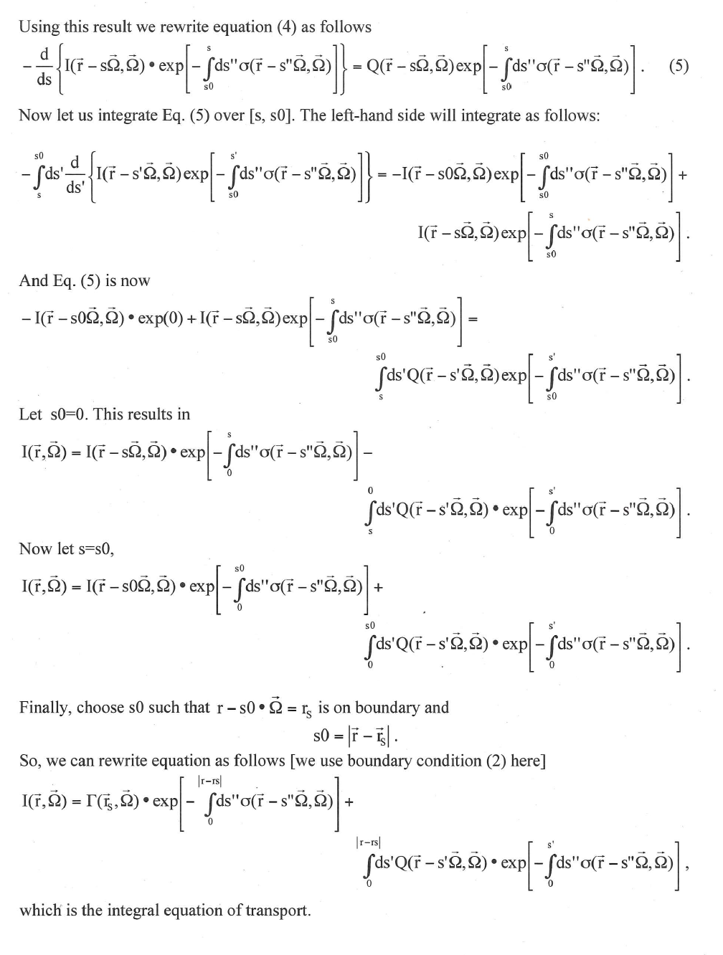
PHYSICAL MODELS IN REMOTE SENSING Chapter 01 – Part 05: Integral RTE

Slide 18
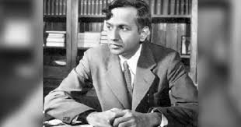
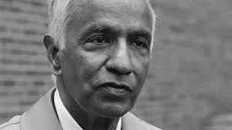
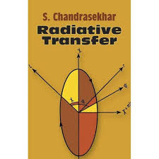
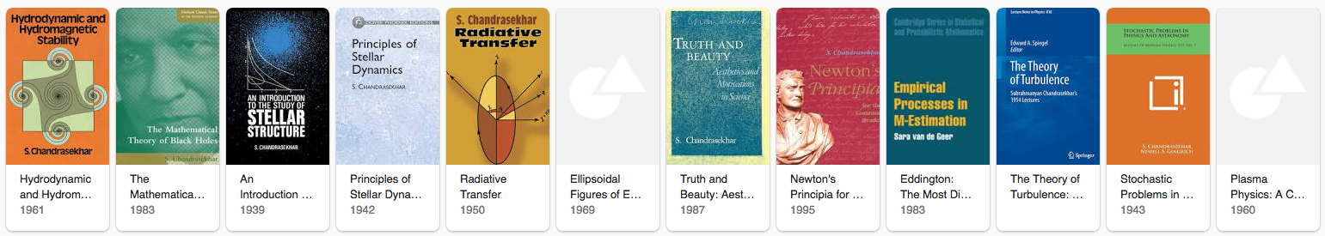
PHYSICAL MODELS IN REMOTE SENSING Chapter 01 – Part 05: Integral RTE
S. Chandrasekhar
19 October 1910 – 21 August 1995
Nobel Prize in Physics, 1983
https://en.wikipedia.org/wiki/Subrahmanyan_Chandrasekhar
< $20 paperback edition

