Slide 1
PHYSICAL MODELS IN REMOTE SENSING Chapter 01 – Part 06: Energy Balance
Problem Specification
Integration over the Domain and Solid Angles
Integration over Solid Angles: RHS Terms
Integration over Solid Angles: LHS Terms
Integration over Spatial Domain V
Divergence Theorem (Gauss’ Theorem)
Integration over Spatial Domain V: RHS and LHS Terms
The Doubly Integrated Result
Final Energy Balance Statement

Slide 2
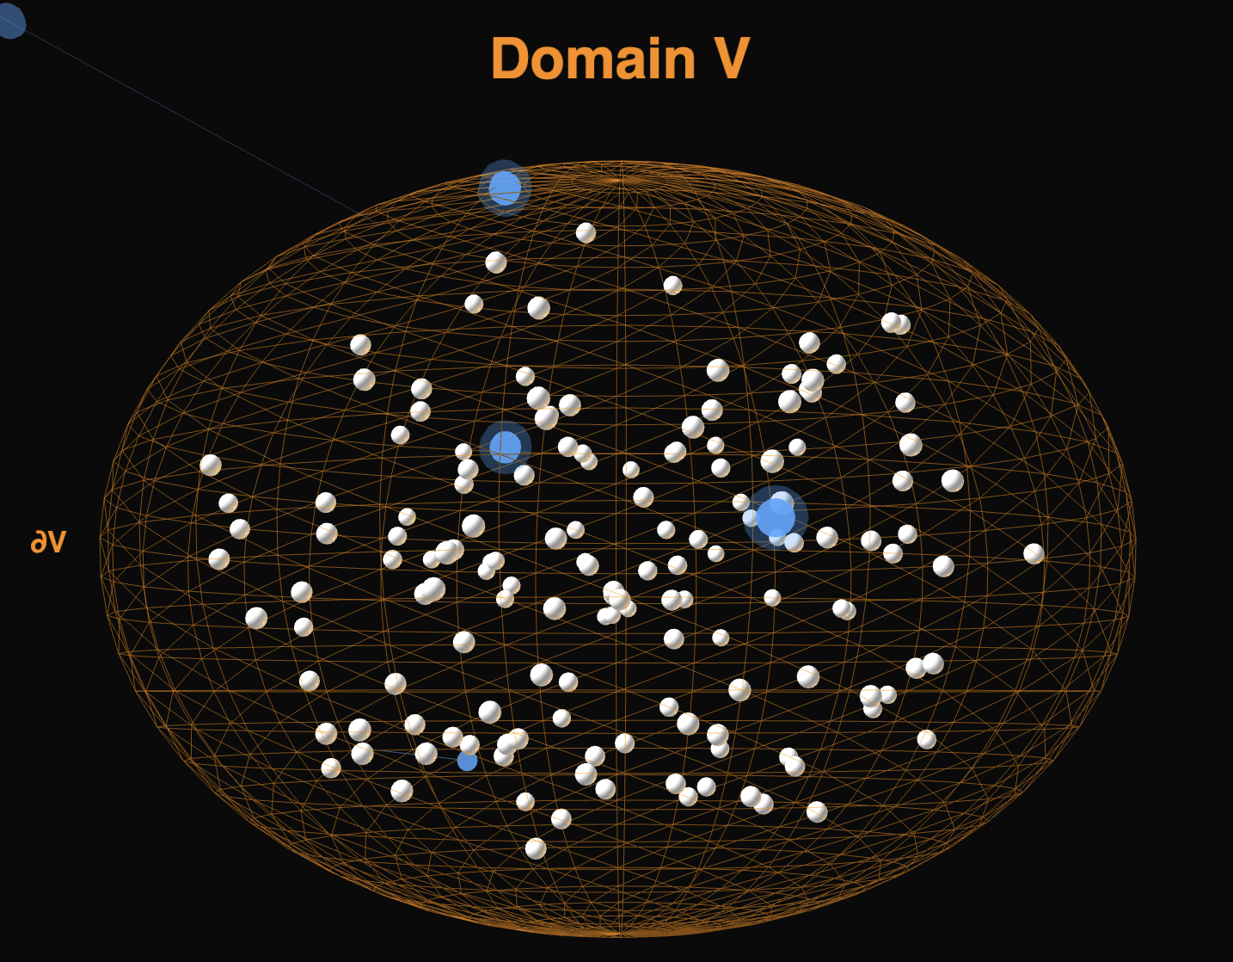
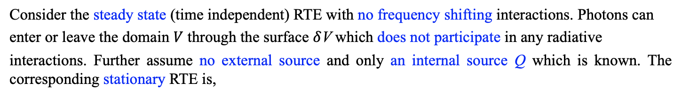
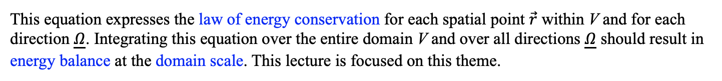


PHYSICAL MODELS IN REMOTE SENSING Chapter 01 – Part 06: Energy Balance
Problem Specification
01-Energy-Balance
Consider the steady state (time independent) RTE with no frequency shifting interactions. Photons can
enter or leave the domain $V$ through the surface $δ$V which does not participate in any radiative
interactions. Further assume no external source and only an internal source Q which is known. The corresponding stationary RTE is,
$\underline{Ω} ∙∇ I$+ $σ(\vec{r}\text{,}\underline{Ω}$) I$(\vec{r}$,$\underline{Ω}$) = ${\int{d\underline{Ω}′}σ}_{s}(\vec{r}\text{,}{\underline{Ω}}^{′}→\underline{Ω}\text{)} I(\vec{r}\text{,}\underline{Ω}’\text{)}$ + Q($\vec{r}$,$\underline{Ω}$) .
$$4π$$
This equation expresses the law of energy conservation for each spatial point $\vec{r}$ within V and for each
direction $\underline{Ω}$. Integrating this equation over the entire domain V and over all directions $\underline{Ω}$ should result in
energy balance at the domain scale. This lecture is focused on this theme.

Slide 3
PHYSICAL MODELS IN REMOTE SENSING Chapter 01 – Part 06: Energy Balance
Integration over the Domain and Solid Angles
We integrate the radiative transfer equation (RTE) over a three-dimensional spatial domain V and over all solid angles on a sphere (4π steradians). The starting equation is:
Ω · ∇I + σ(r,Ω) I(r,Ω) = ∫₄π dΩ′ σₛ(r,Ω′ → Ω) I(r,Ω′) + Q(r,Ω) ,
where (note: vectors are denoted in boldface):
I(r,Ω) is the radiation intensity at position r propagating in direction Ω
Ω is the unit direction vector (points in the direction of photon travel)
∇ is the gradient operator with respect to position r (spatial derivative)
σ(r,Ω) is the total extinction coefficient (units: m⁻¹)
σₛ(r,Ω′ → Ω) is the differential scattering coefficient (units: m⁻¹ sr⁻¹) describing scattering from direction Ω′ into direction Ω
σ′ₛ(r) is the total scattering coefficient (units: m⁻¹) — note that σ′ₛ = ∫₄π dΩ σₛ(Ω′ → Ω)
Q(r,Ω) is the volumetric source term (emission)
The notation ∫₄π means integration over the full sphere (4π steradians).

Slide 4
PHYSICAL MODELS IN REMOTE SENSING Chapter 01 – Part 06: Energy Balance
Integration over Solid Angles: RHS
We integrate both sides over all solid angles ∫₄π dΩ:
∫₄π dΩ [Ω · ∇I + σ(r,Ω) I(r,Ω)] = ∫₄π dΩ [∫₄π dΩ′ σₛ(r,Ω′ → Ω) I(r,Ω′) + Q(r,Ω) .
Right-Hand Side: Scattering Integral
For the scattering term:
∫₄π dΩ [∫₄π dΩ′ σₛ(r,Ω′ → Ω) I(r,Ω′)] .
By conservation of scattering, the total scattering out of direction Ω′ into all directions equals the total
scattering coefficient σ′ₛ(r):
∫₄π dΩ σₛ(r,Ω′ → Ω) = σ′ₛ(r,Ω′) .
This is the definition of the total scattering coefficient (with prime) as distinct from the differential
scattering coefficient (without prime). Applying this:
∫₄π dΩ′ σ′ₛ(r ,Ω′) I(r,Ω′) = Inscattered Flux
Right-Hand Side: Source Term
∫₄π dΩ Q(r,Ω) = Emitted Flux

Slide 5
PHYSICAL MODELS IN REMOTE SENSING Chapter 01 – Part 06: Energy Balance
Integration over Solid Angles: LHS
Left-Hand Side: First Term (Streaming Term)
Consider:
∫₄π dΩ (Ω · ∇I) .
The gradient ∇ acts on spatial coordinates r, while ∫₄π dΩ integrates over the angular variable Ω. Since they
operate on different independent variables, they commute:
∫₄π dΩ (Ω · ∇I) = ∇ · ∫₄π dΩ (Ω I) .
We define the radiation flux vector:
F(r) = ∫₄π dΩ Ω I(r,Ω) .
Thus:
∫₄π dΩ (Ω · ∇I) = ∇ · F(r) = Flux Net Outflow
Left-Hand Side: Second Term (Extinction)
The extinction term integrates as:
∫₄π dΩ σ(r,Ω) I(r,Ω) = Extinction Flux

Slide 6
PHYSICAL MODELS IN REMOTE SENSING Chapter 01 – Part 06: Energy Balance
Integration over Spatial Domain V
After Angular Integration
Combining all terms:
∇ · F(r) + ∫₄π dΩ σ(r,Ω) I(r,Ω) = ∫₄π dΩ′ σ′ₛ(r ,Ω′) I(r,Ω′) + ∫₄π dΩ Q(r,Ω) .
Integrate Over the Spatial Domain V
Now integrate over volume V. The volume element is d³r and the integral is ∫_{V} d³r (where V appears as a
subscript of equal size to ∫):
∫_{V} d³r [∇ · F(r) + ∫₄π dΩ σ(r,Ω) I(r,Ω)] = ∫_{V} d³r ∫₄π dΩ′ σ′ₛ(r ,Ω′) I(r,Ω′) + ∫₄π dΩ Q(r,Ω)] .

Slide 7
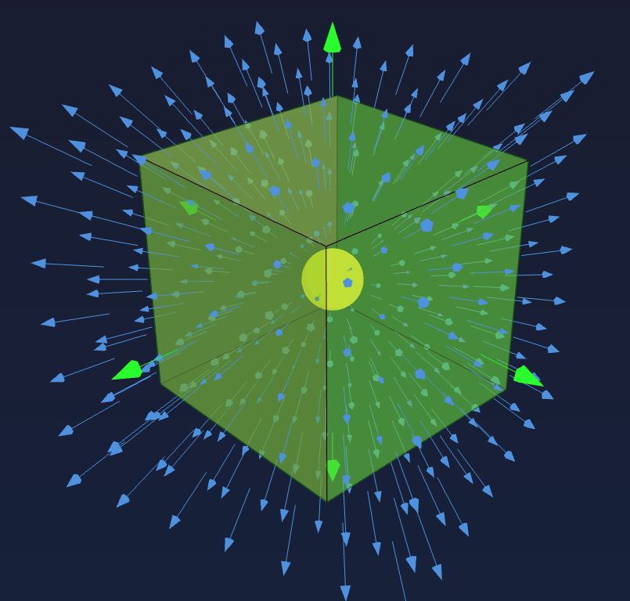
PHYSICAL MODELS IN REMOTE SENSING Chapter 01 – Part 06: Energy Balance
Divergence Theorem (Gauss’ Theorem)
The divergence theorem (Gauss's theorem) relates a volume integral of a divergence to a surface integral
over the boundary:
∫_{V} d³r (∇ · F) = ∫_{∂V} dA (n · F) ,
where:
∇ · F = ∂Fₓ/∂x + ∂Fᵧ/∂y + ∂Fᵤ/∂z is the divergence in Cartesian coordinates
V is the three-dimensional volume region
∂V is the closed surface boundary of V
dA is a surface area element on ∂V
n is the outward-pointing unit normal vector perpendicular to the surface
n · F is the component of F perpendicular to the surface (flux through surface)
Physical meaning: The divergence ∇ · F measures net outward flow per unit volume. If ∇ · F > 0, there is
a net source (flow emanating outward); if ∇ · F < 0, there is a net sink (flow converging inward).
The surface integral ∫_{∂V} dA (n · F) computes the total flux of F passing through the boundary surface ∂V
in the outward direction. The dot product n · F picks out only the component of F that is perpendicular to
(normal to) the surface.
The divergence theorem states that the total divergence (source/sink strength) within a volume equals the
net flux leaving through its boundary.
02-Divergence-Theorem

Slide 8
PHYSICAL MODELS IN REMOTE SENSING Chapter 01 – Part 06: Energy Balance
Integration over Spatial Domain V: RHS and LSH Terms
LHS Term 1: In our radiative transfer equation, the vector field is the radiation flux F(r). The quantity n · F
represents the radiation flux component leaving the volume V through the surface element dA. Integrating
over the entire boundary surface ∂V gives the total net radiation flux escaping the volume.
Therefore:
∫_{V} d³r (∇ · F) = ∫_{∂V} dA (n · F) = Net radiation flux leaving V
LHS Term 2: Total extinction
∫_{V} d³r ∫₄π dΩ σ(r,Ω) I(r,Ω) = Total Extinction Flux .
RHS Term 2: Total in-scattering
∫_{V} d³r ∫₄π dΩ′ σ′ₛ(r,Ω′) I(r,Ω′) = Total Inscattered Flux .
RHS Term 2: Total source
∫_{V} d³r ∫₄π dΩ Q(r,Ω) = Total Source Flux .

Slide 9
PHYSICAL MODELS IN REMOTE SENSING Chapter 01 – Part 06: Energy Balance
The Doubly-Integrated Result
The double integration,
∫_{∂V} dA (n · F) + ∫_{V} d³r ∫₄π dΩ σ(r,Ω) I(r,Ω) =
∫_{V} d³r ∫₄π dΩ′ σ′ₛ(r,Ω′) I(r,Ω′) + ∫_{V} d³r ∫₄π dΩ Q(r,Ω) ,
results in
Net Flux Leaving V + Total Extinction Flux = Total Inscattered Flux + Total Source Flux .
Remember that,
Total Extinction Flux = Total Absorption Flux + Total Outscattered Flux .
The Total Outscattered Flux is equal to the Total Inscattered Flux at the domain scale because scattering
results in neither gain nor loss of energy (it simply changes the direction of photon travel). Thus,
Total Outscattered Flux = Total Inscattered Flux .
Therefore,
Total Source Flux = Net Flux Leaving V + Total Absorbed .

Slide 10
PHYSICAL MODELS IN REMOTE SENSING Chapter 01 – Part 06: Energy Balance
Final Energy Balance Statement
The double integration,
∫_{∂V} dA (n · F) + ∫_{V} d³r ∫₄π dΩ σ(r,Ω) I(r,Ω) =
∫_{V} d³r ∫₄π dΩ′ σ′ₛ(r,Ω′) I(r,Ω′) + ∫_{V} d³r ∫₄π dΩ Q(r,Ω) ,
results in
∫_{V} d³r ∫₄π dΩ Q(r,Ω) = ∫∂_{V} dA (n · F) + ∫_{V} d³r ∫₄π dΩ σₐ(r,Ω) I(r,Ω) ,
i.e.,
Total Source = Net Outflow + Total Absorption .
This is the fundamental conservation law: All radiation energy generated within volume V (sources) must either escape through the boundary (net outflow) or be absorbed within the volume. Energy is conserved.

Slide 11
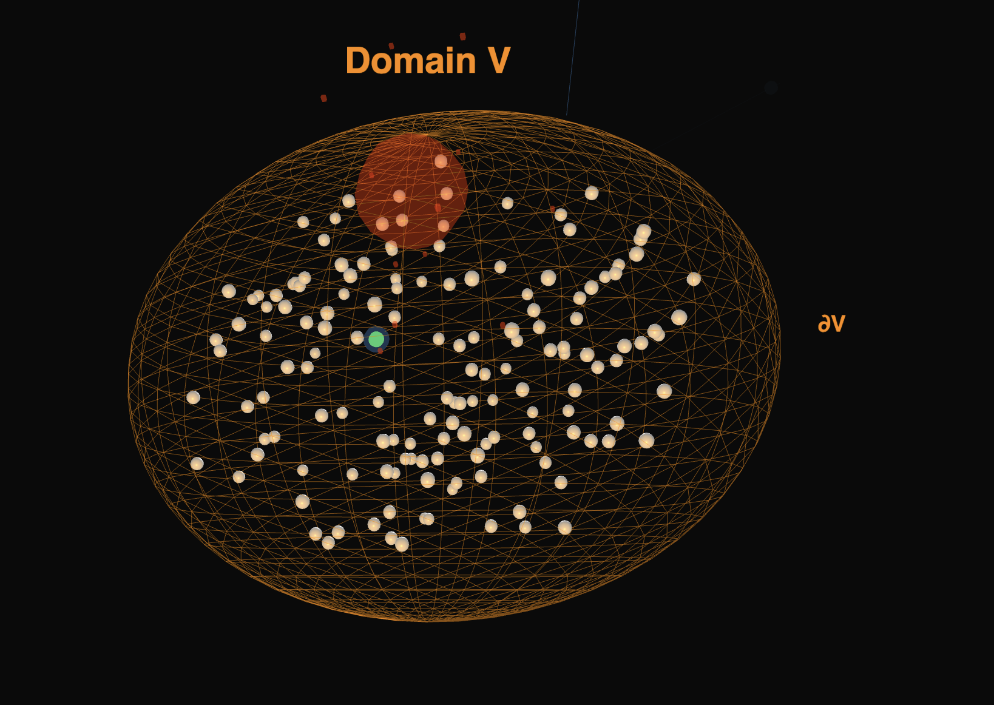
PHYSICAL MODELS IN REMOTE SENSING Chapter 01 – Part 06: Energy Balance
Final Energy Balance Statement
Let us look at the animation again …
01-Energy-Balance

