Slide 1
PHYSICAL MODELS IN REMOTE SENSING Chapter 01 – Part 07: The Principle of Reciprocity
Reciprocity
Formal Statement
Model BRFs at Two SZA
Configuration A
Configuration B

Slide 2
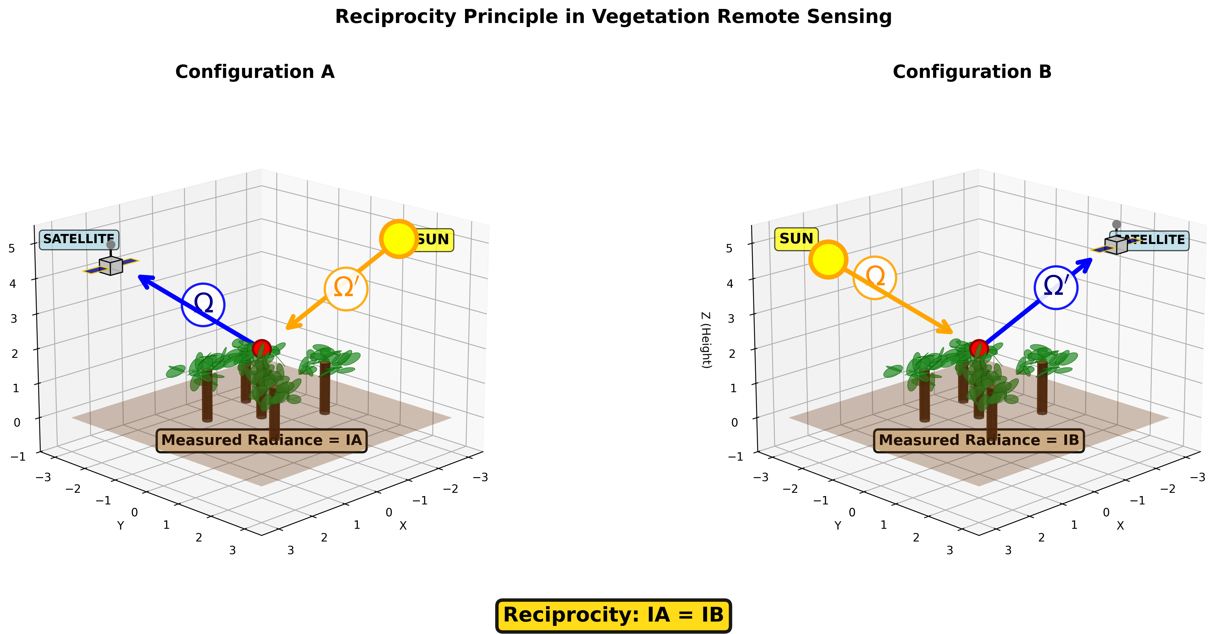
PHYSICAL MODELS IN REMOTE SENSING Chapter 01 – Part 07: The Principle of Reciprocity
Reciprocity
The principle of reciprocity in an absorbing and scattering media states that exchanging the source and detector positions and directions yields the same detected radiance.
This fundamental result stems from the symmetry of the scattering phase function and the linearity of the radiative transfer equation.
In vegetation remote sensing, this principle simplifies BRDF modeling, enables efficient multi-angle observations, and provides a consistency check for radiative transfer models.

Slide 3
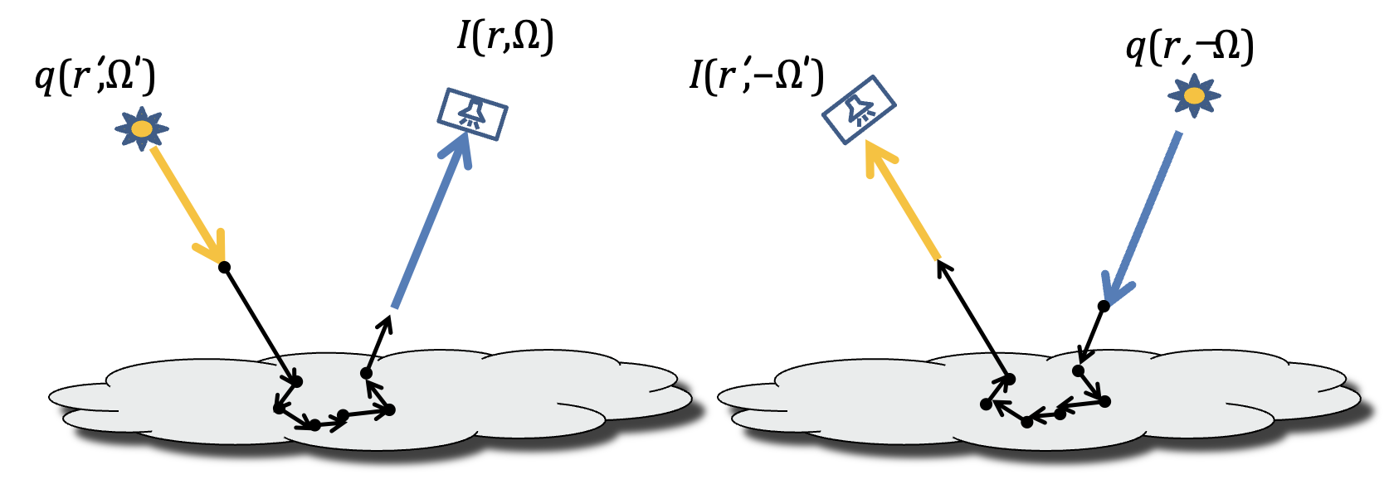
PHYSICAL MODELS IN REMOTE SENSING Chapter 01 – Part 07: The Principle of Reciprocity
Formal Statement
The intensity (radiance), I(r,Ω), at r in the direction Ω due to a point source at r’ emitting in direction Ω’ is the same as the intensity I(r’,−Ω’) at r’ in the direction −Ω’ due to a point source at r emitting in direction −Ω .
Switching detector and source and inverting the directions of propagation yield the same result

Slide 4

PHYSICAL MODELS IN REMOTE SENSING Chapter 01 – Part 07: The Principle of Reciprocity
Model BRFs at Two SZA
Simulation: RTE model
SZA=45
SZA=60
SZA=60
SZA=45
Forward Scattering
Backscattering
Principal plane
BRFs as a function of SZA and VZA in the principal plane

Slide 5
PHYSICAL MODELS IN REMOTE SENSING Chapter 01 – Part 07: The Principle of Reciprocity
Configuration A
Simulation: RTE model
SZA=60
SZA=45
SZA=60
SZA=45
Forward Scattering
Backscattering
Principal plane
Source: (120º,0º), Sensor: (45º, 180º)

Slide 6
PHYSICAL MODELS IN REMOTE SENSING Chapter 01 – Part 07: The Principle of Reciprocity
Configuration B
Simulation: RTE model
SZA=60
SZA=45
SZA=60
SZA=45
Forward Scattering
Backscattering
Principal plane
Source: (120º,0º), Sensor: (45º, 180º)
Source: (135º,180º), Sensor: (60º,0º)

