Slide 1
PHYSICAL MODELS IN REMOTE SENSING Chapter 02– Part 01: Vegetation Canopy Structure
Turbid Medium
Lidar Scanning of Vegetation Canopies
Simulated Lidar Cloud of Foliage: Temperature Forest
Leaf Area Density
Vertical Profile of LAD
Leaf Area Index
Leaf Normal Distribution Function
Leaf Normal Inclination and Azimuthal Distribution Functions
Models for Leaf Normal Inclination Distribution Function
Models for Leaf Normal Azimuthal Distribution Function
Case of Needle Canopies

Slide 2
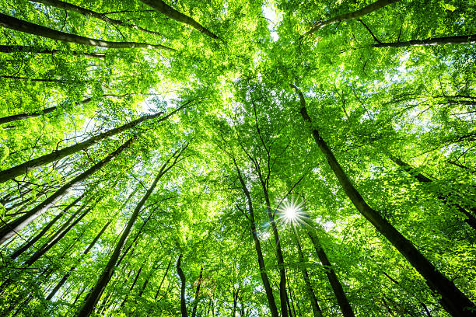
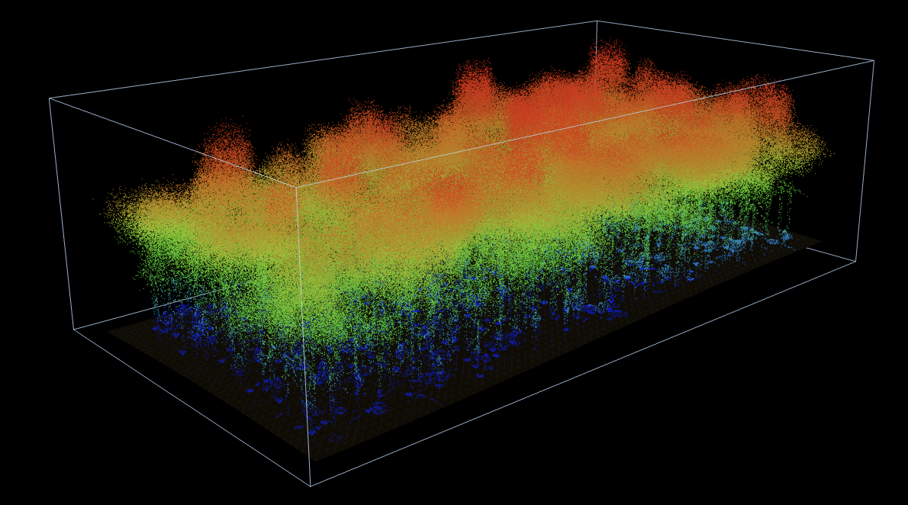
PHYSICAL MODELS IN REMOTE SENSING Chapter 02– Part 01: Vegetation Canopy Structure
Turbid medium
Canopies of natural vegetation exhibit significant complexity and dynamics in structure
Trying to capture this complexity and dynamic is a difficult, if not impossible, task
Therefore, the vegetation canopy is idealized as a medium filled densely with small planar elements of negligible thickness and area, i.e., a turbid medium or a green gas.
This abstraction ignores all organs other than green leaves. It captures the most significant aspect of the canopy that plays a central role in exchanges of energy, mass and momentum with the overlying boundary layer.
Two key variables, leaf area density and leaf normal orientation distribution, capture characteristics of the vegetation canopy in this context.

Slide 3
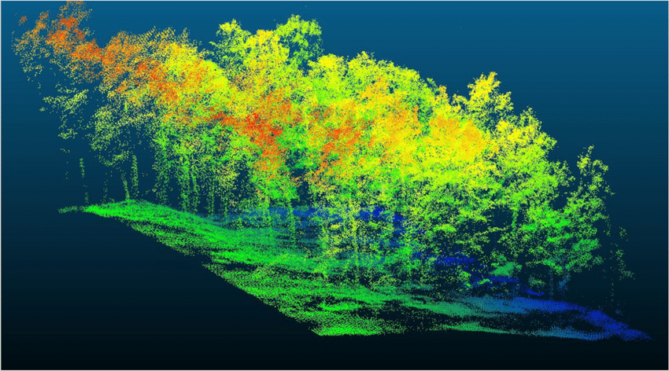
PHYSICAL MODELS IN REMOTE SENSING Chapter 02– Part 01: Vegetation Canopy Structure
Lidar Scanning of Vegetation Canopies
Santopuoli, G. et al., (2020). Remote Sensing. 12. 1-19. 10.3390/rs12132142.
Airborne or ground based Lidar scanning can be used to recreate vegetation canopies.
The scans can be converted into precise locations of foliage elements in the canopy
The reconstructed canopies not only look realistic but accurately represent the spatial distribution of foliage in the canopy space
They are extremely useful in studies of vegetation structure, biomass, carbon, hydrology etc.

Slide 4
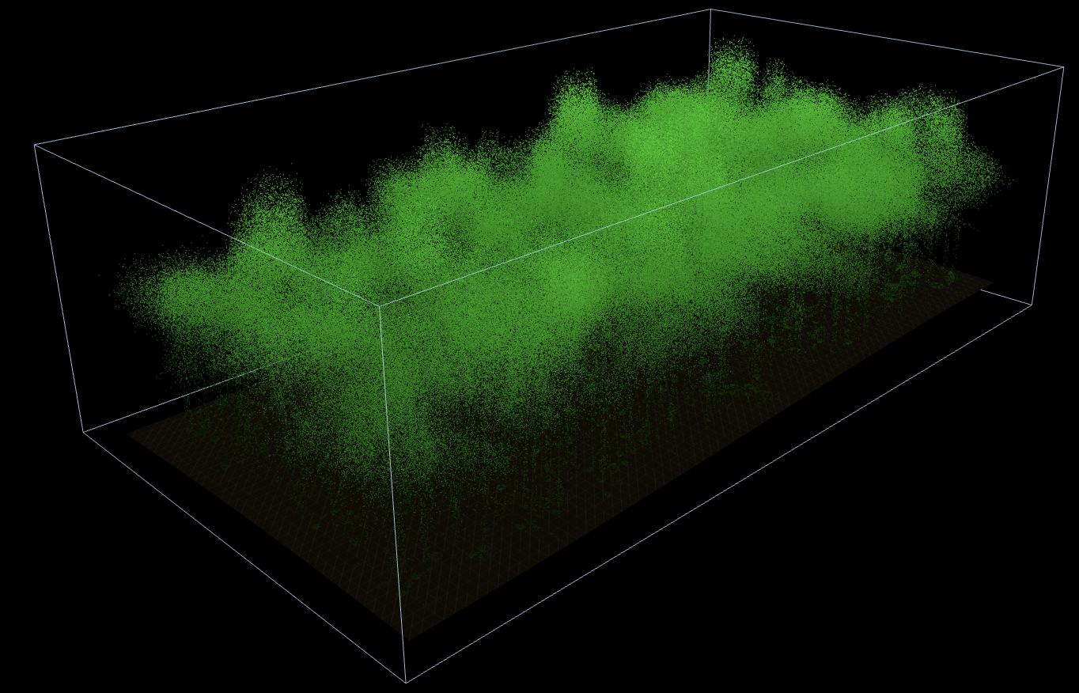
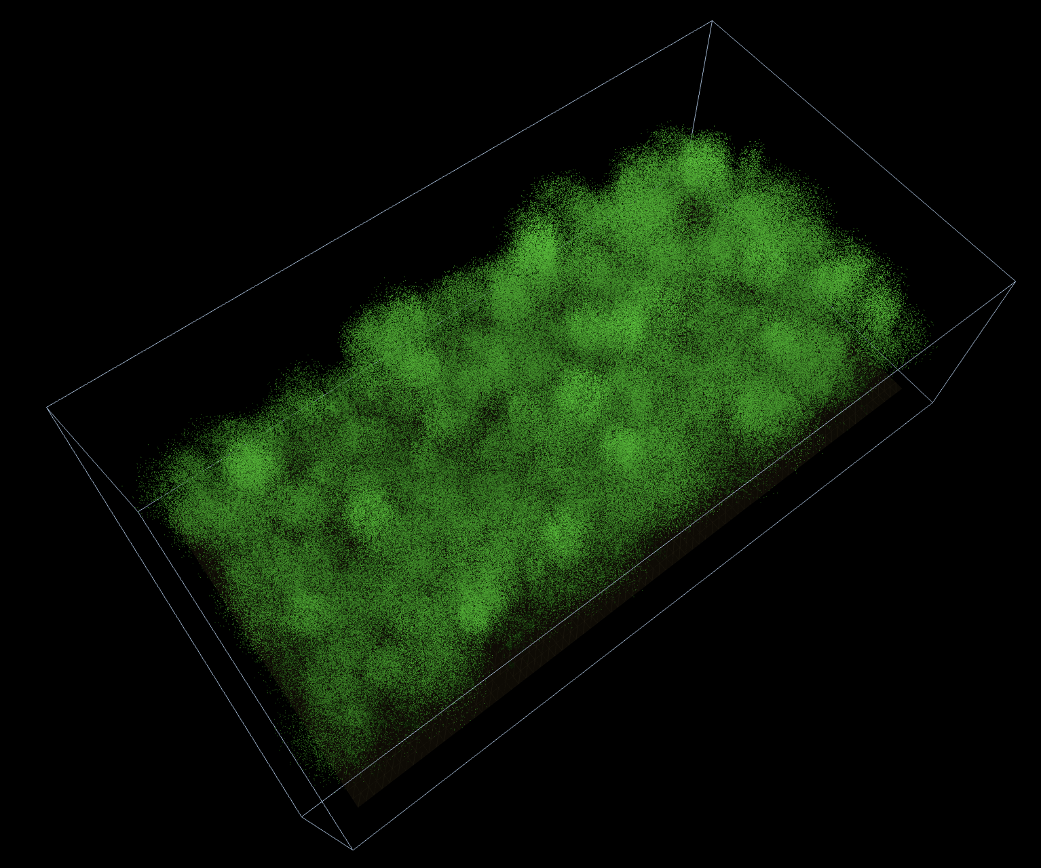
PHYSICAL MODELS IN REMOTE SENSING Chapter 02– Part 01: Vegetation Canopy Structure
Simulated Lidar Cloud of Foliage: Temperature Forest
Simulated Temperate Forest Lidar Scans
Plot dimensions: 120 x 60 m
Tree density: 500 Individual trees, ~700 trees/ha, random tree location, 10 broadleaf deciduous species
Leaf area index: 3.84 (each leaf of about 0.0411 m²)
Points: 750,000 to 850,000 points (700,000 leaf points, rest for other foliage elements)

Slide 5
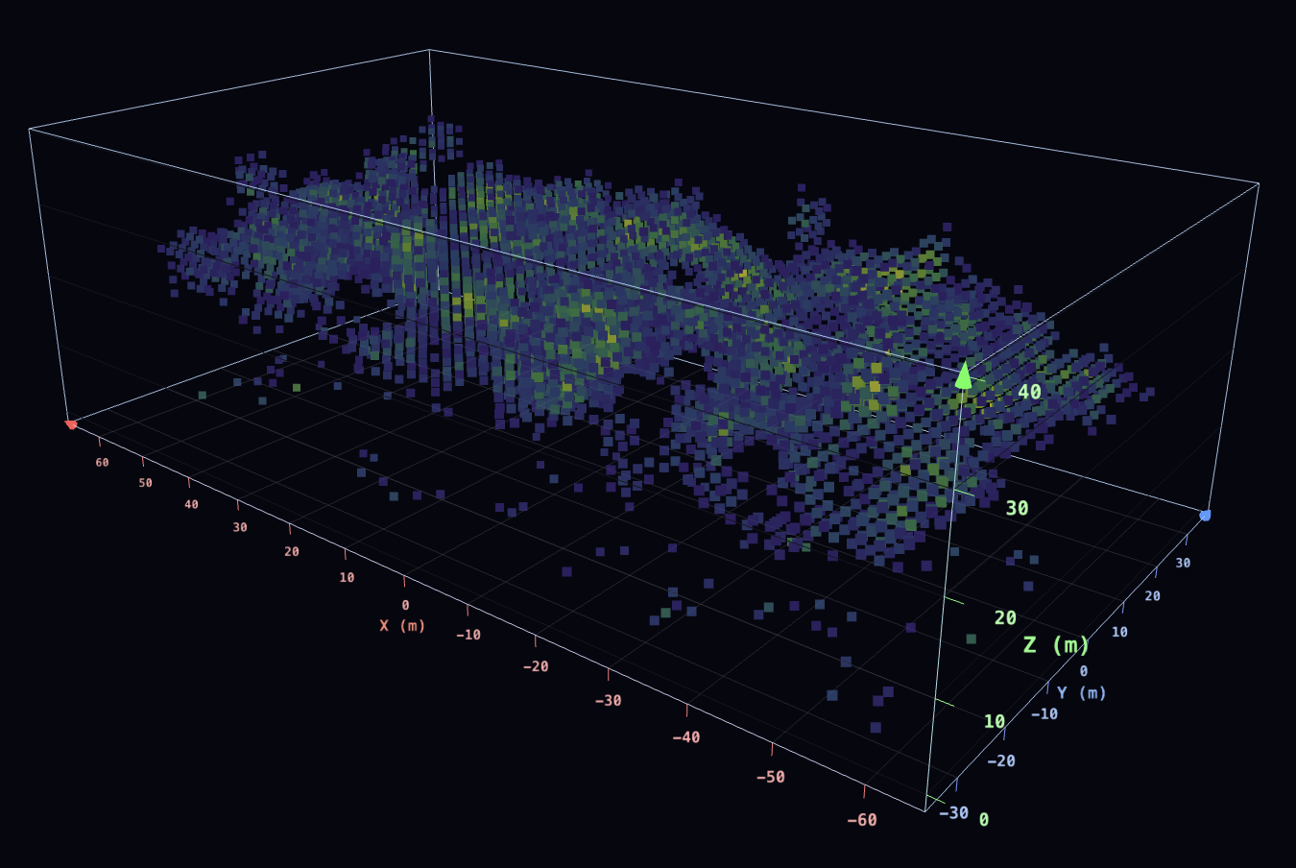
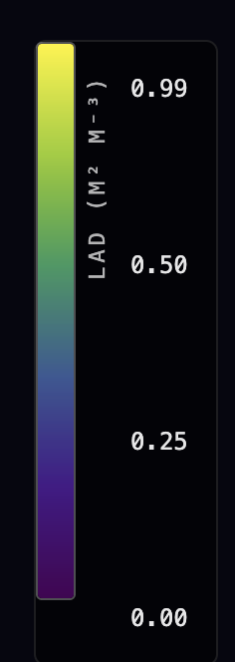
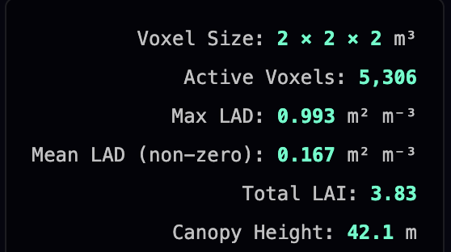
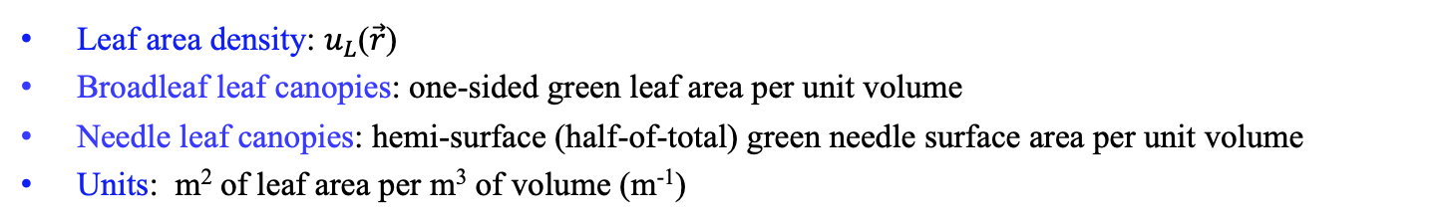
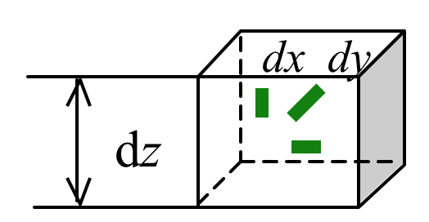
PHYSICAL MODELS IN REMOTE SENSING Chapter 02– Part 01: Vegetation Canopy Structure
Leaf Area Density
LAD-3D
Leaf area density: $u_{L}$($\vec{r}$)
Broadleaf leaf canopies: one-sided green leaf area per unit volume
Needle leaf canopies: hemi-surface (half-of-total) green needle surface area per unit volume
Units: m² of leaf area per m³ of volume (m⁻¹)

Slide 6
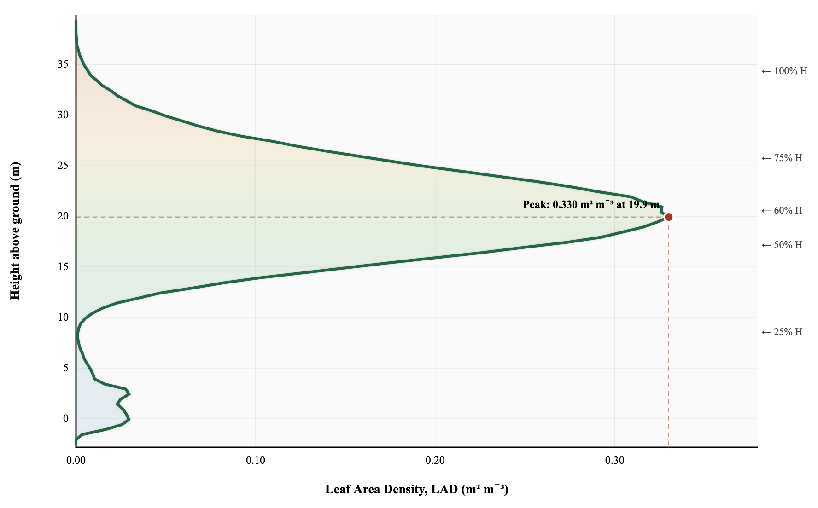
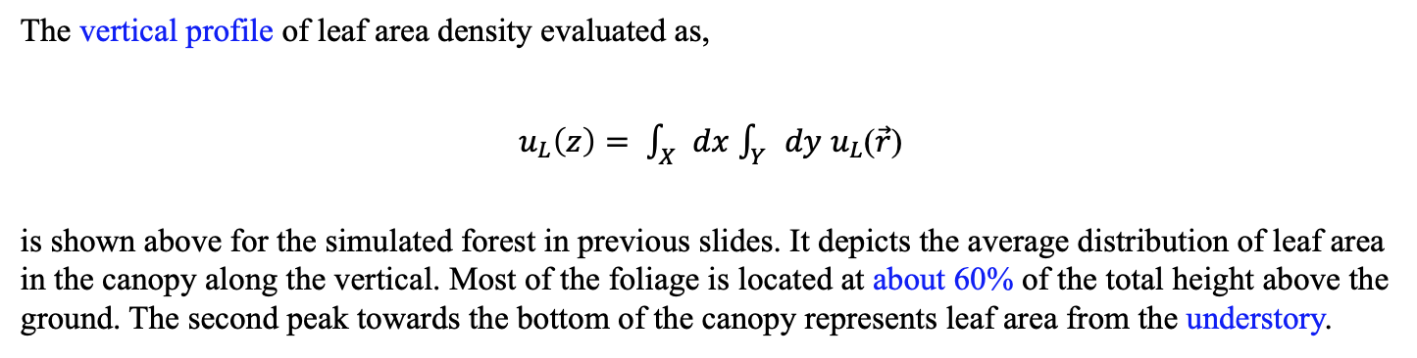
PHYSICAL MODELS IN REMOTE SENSING Chapter 02– Part 01: Vegetation Canopy Structure
Vertical Profile of LAD
LAD-Profile
The vertical profile of leaf area density evaluated as,
$u_{L}\left(z\right)= \int_{X}{dx}$ $\int_{Y}{dy}$ $u_{L}$($\vec{r}$)
is shown above for the simulated forest in previous slides. It depicts the average distribution of leaf area in the canopy along the vertical. Most of the foliage is located at about 60% of the total height above the ground. The second peak towards the bottom of the canopy represents leaf area from the understory.

Slide 7
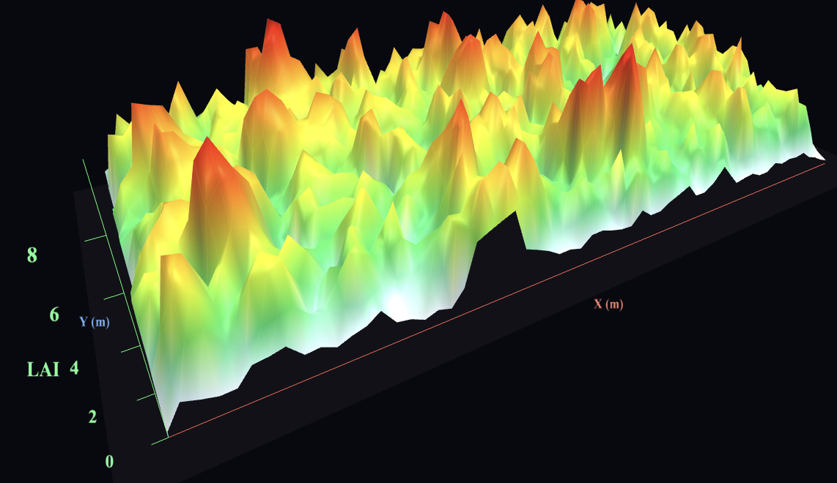
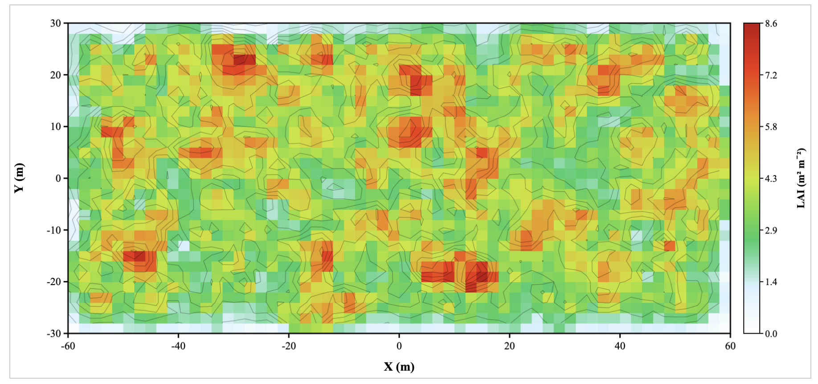
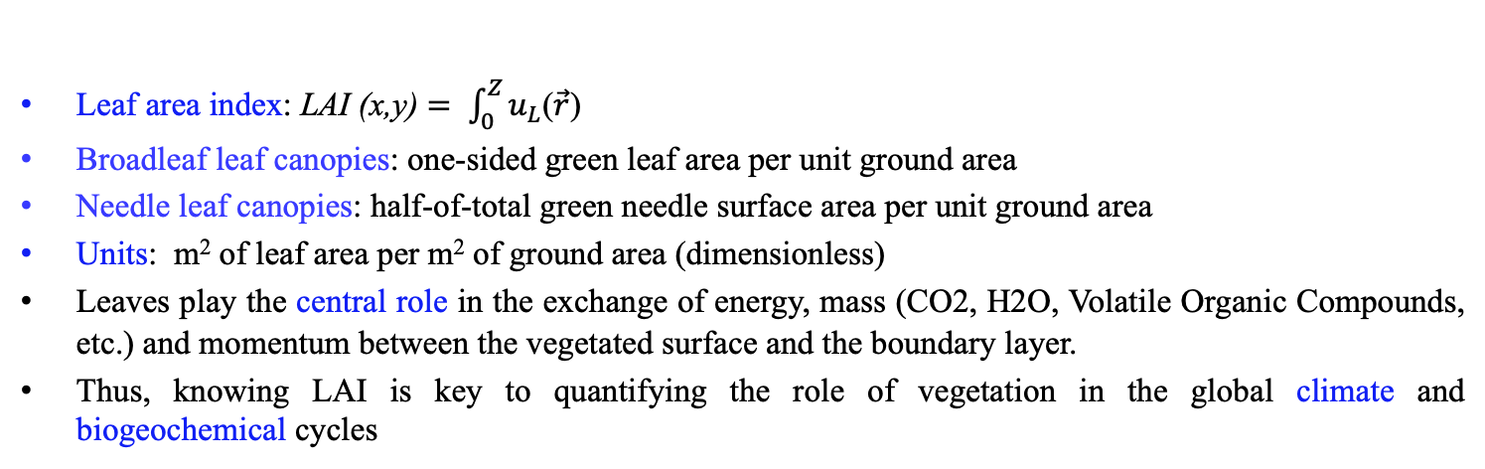
PHYSICAL MODELS IN REMOTE SENSING Chapter 02– Part 01: Vegetation Canopy Structure
Leaf Area Index
LAI
Leaf area index: LAI (x,y) $= \int_{0}^{Z}{u_{L}\text{(}\vec{r}\text{)}}$
Broadleaf leaf canopies: one-sided green leaf area per unit ground area
Needle leaf canopies: half-of-total green needle surface area per unit ground area
Units: m² of leaf area per m² of ground area (dimensionless)
Leaves play the central role in the exchange of energy, mass (CO2, H2O, Volatile Organic Compounds, etc.) and momentum between the vegetated surface and the boundary layer.
Thus, knowing LAI is key to quantifying the role of vegetation in the global climate and biogeochemical cycles

Slide 8
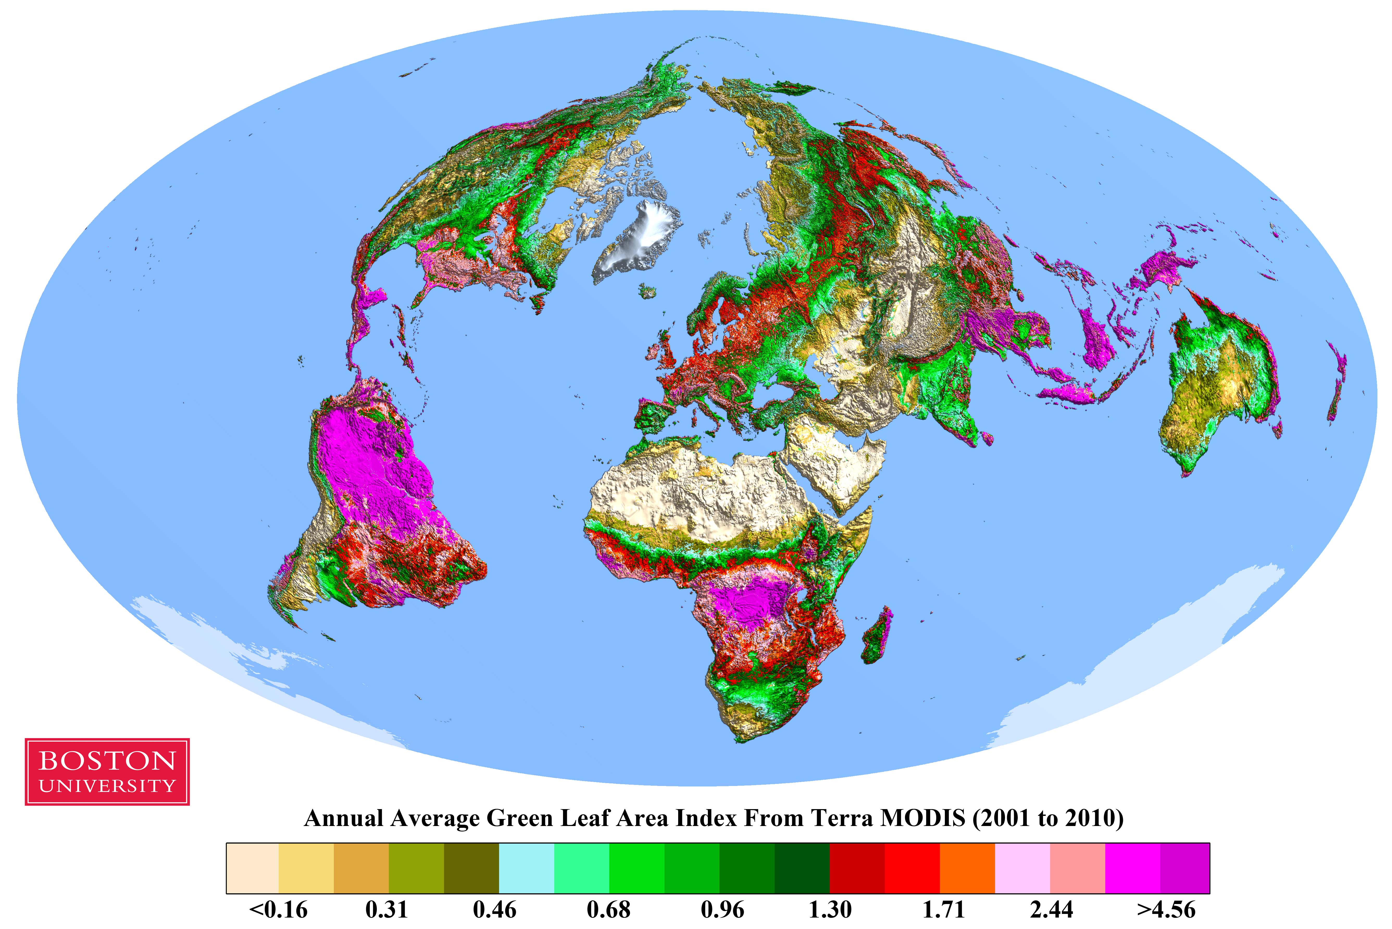
PHYSICAL MODELS IN REMOTE SENSING Chapter 02– Part 01: Vegetation CanopyStructure
Global Leaf Area Index:
Global distribution of annual average vegetation green leaf area index L(x,y) at 1 km resolution derived from MODIS measurements of surface reflectances using the Knyazikhin algorithm.

Slide 9
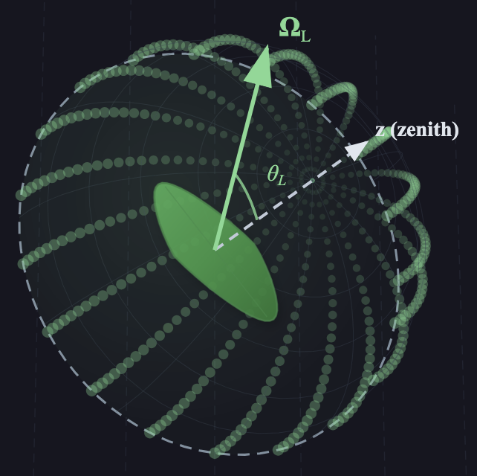
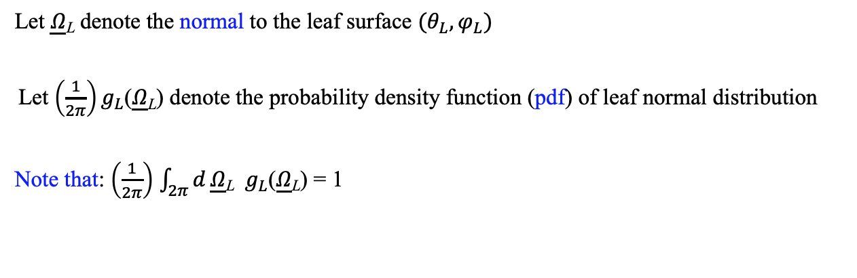
PHYSICAL MODELS IN REMOTE SENSING Chapter 02– Part 01: Vegetation Canopy Structure
Leaf Normal Distribution Function
Geometry of Leaf Normals
Let $\underline{Ω}$_{L} denote the normal to the leaf surface $(θ_{L},φ_{L})$
Let $\left(\frac{1}{2π}\right)g_{L}$($\underline{Ω}$_{L}) denote the probability density function (pdf) of leaf normal distribution
Note that: $\left(\frac{1}{2π}\right)$ $\int_{2π}{d}\underline{Ω}$_{L} $g_{L}$($\underline{Ω}$_{L}) = 1

Slide 10
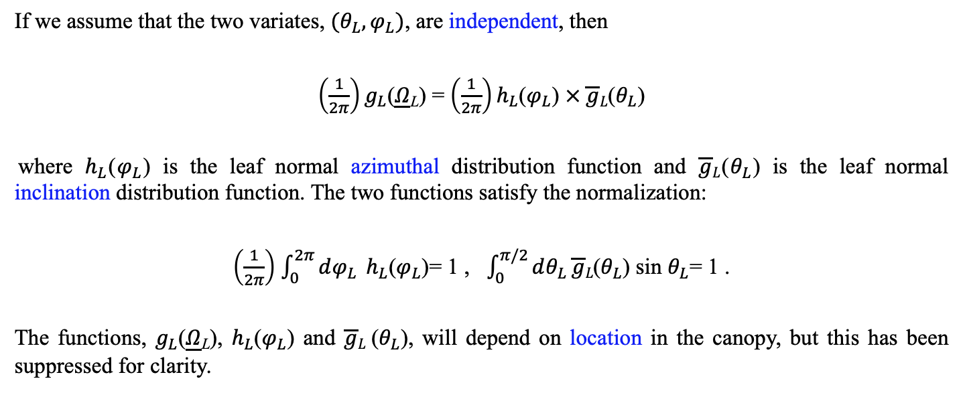
PHYSICAL MODELS IN REMOTE SENSING Chapter 02– Part 01: Vegetation Canopy Structure
Leaf Normal Inclination and Azimuthal Distribution Functions
If we assume that the two variates, $(θ_{L},φ_{L})$, are independent, then
$\left(\frac{1}{2π}\right)g_{L}$($\underline{Ω}$_{L}) = $\left(\frac{1}{2π}\right)h_{L}$($φ_{L}$) $× \overline{g}L$($θ_{L}$)
where $h_{L}$($φ_{L}$) is the leaf normal azimuthal distribution function and $\overline{g}L$($θ_{L}$) is the leaf normal inclination distribution function. The two functions satisfy the normalization:
$\left(\frac{1}{2π}\right)$ $\int_{0}^{2π}{dφ_{L}} h_{L}$($φ_{L}$)= 1 , $\int_{0}^{π/2}{dθ_{L}}\overline{g}L\text{(}θ_{L}\text{)} \text{sin} θ_{L}\text{= }$1 .
The functions, $g_{L}$($\underline{Ω}$_{L}), $h_{L}$($φ_{L}$) and $\overline{g}L$($θ_{L}$), will depend on location in the canopy, but this has been suppressed for clarity.

Slide 11
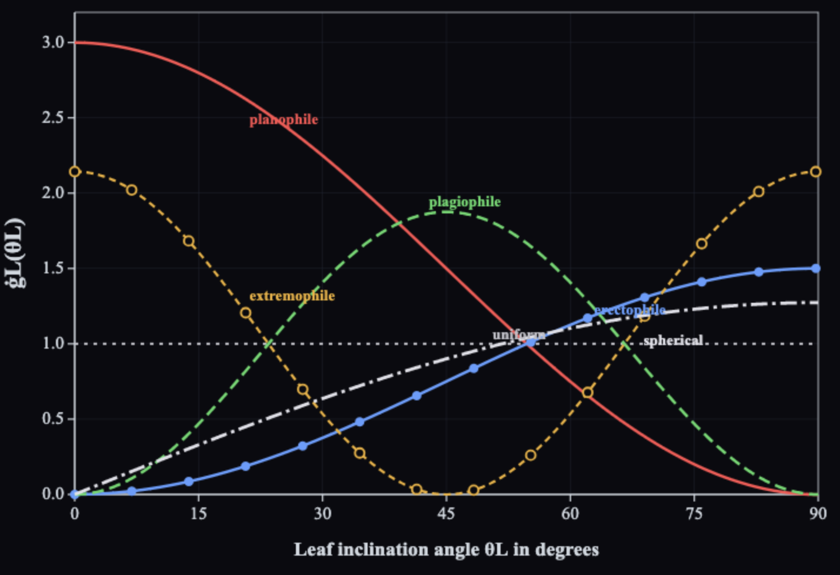
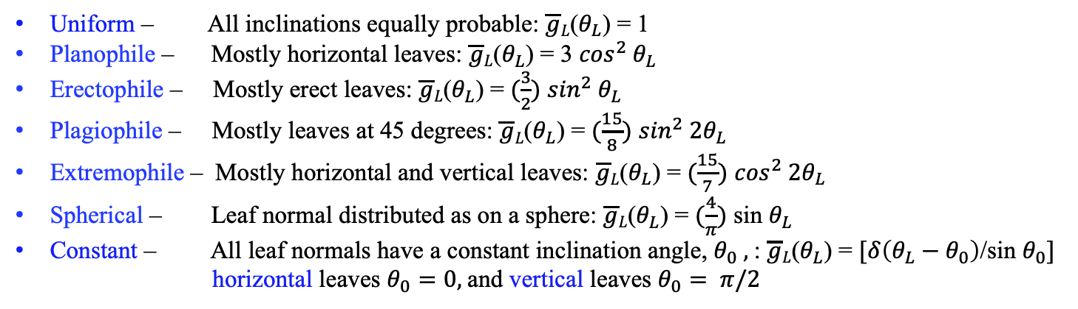
PHYSICAL MODELS IN REMOTE SENSING Chapter 02– Part 01: Vegetation Canopy Structure
Models for Leaf Normal Inclination Distribution Function
Leaf Normal Inclination Distribution
The models below differ from those conventionally used as these pdfs satisfy the normalization given in the previous slide.
Uniform – All inclinations equally probable: $\overline{g}L$($θ_{L}$) = 1
Planophile – Mostly horizontal leaves: $\overline{g}L$($θ_{L}$) = 3 $\cos^{2}{ θ}_{L}$
Erectophile – Mostly erect leaves: $\overline{g}L$($θ_{L}$) = $(\frac{3}{2})$ $\sin^{2}{ θ}_{L}$
Plagiophile – Mostly leaves at 45 degrees: $\overline{g}L$($θ_{L}$) = $(\frac{15}{8})$ $\sin^{2}{ 2θ}_{L}$
Extremophile – Mostly horizontal and vertical leaves: $\overline{g}L$($θ_{L}$) = $(\frac{15}{7})$ $\cos^{2}{ 2θ}_{L}$
Spherical – Leaf normal distributed as on a sphere: $\overline{g}L$($θ_{L}$) = $(\frac{4}{π})$sin $θ_{L}$
Constant – All leaf normals have a constant inclination angle, $θ_{0} ,$: $\overline{g}L$($θ_{L}$) = $[δ\left(θ_{L}−θ_{0}\right)$/sin $θ_{0}]$
horizontal leaves $θ_{0}=0,$and vertical leaves $θ_{0}= π/2$

Slide 12
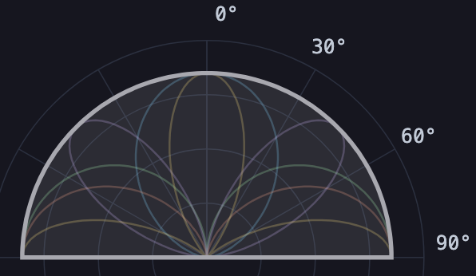
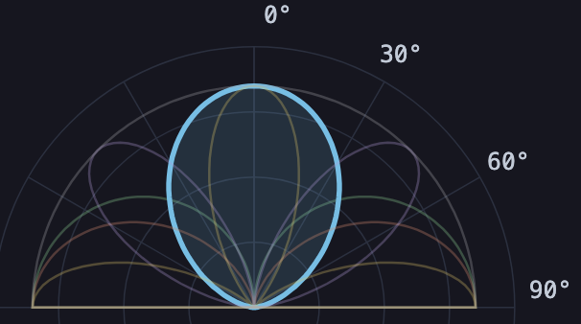
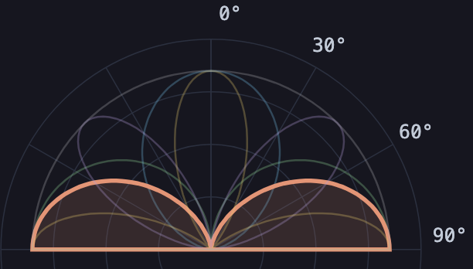
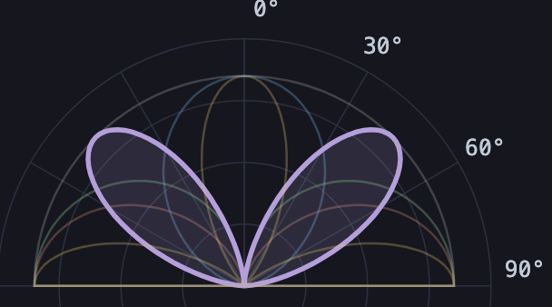
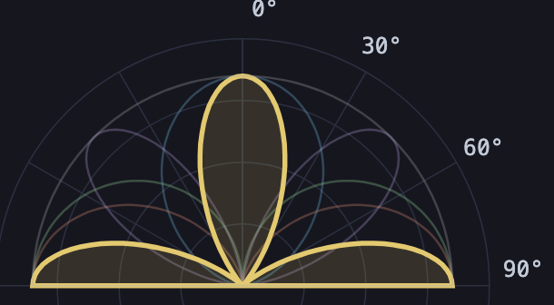
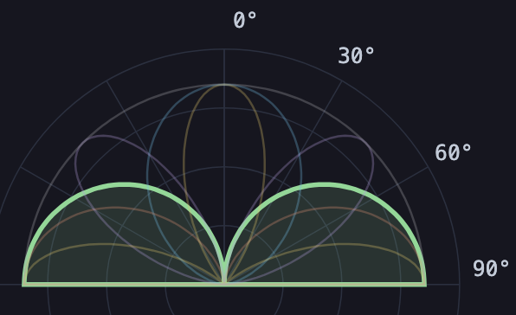
PHYSICAL MODELS IN REMOTE SENSING Chapter 02– Part 01: Vegetation Canopy Structure
Models for Leaf Normal Inclination Distribution Function
Models for Leaf Normal Inclination PDFs
(1) Uniform – all inclinations equally probable
(2) Planophile – mostly horizontal leaves
(3) Erectophile – mostly erect leaves
(4) Plagiophile – mostly leaves at 45 degrees
(5) Extremophile – mostly horizontal and vertical leaves
(6) Spherical – leaf normal distributed as on a sphere

Slide 13
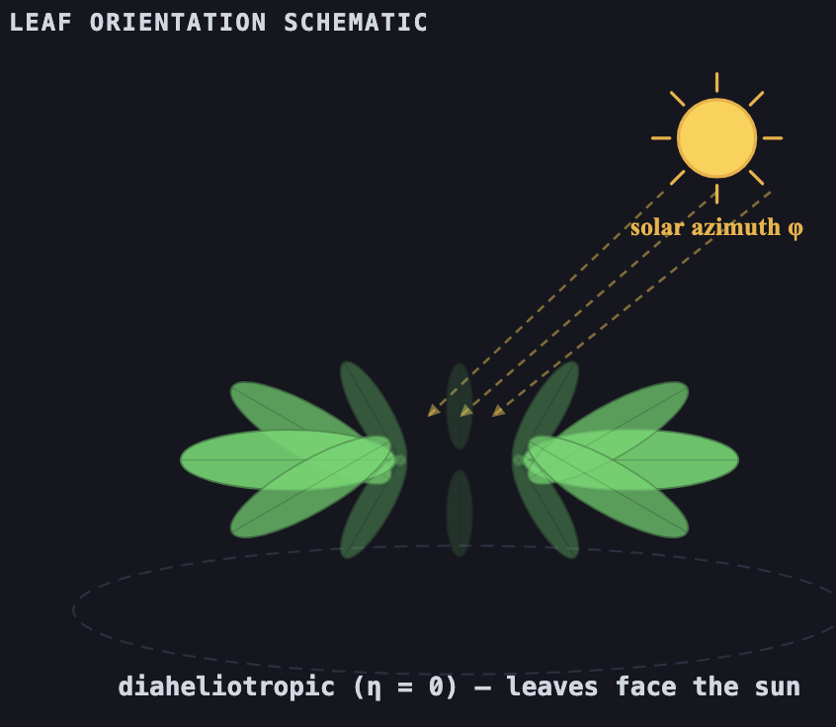
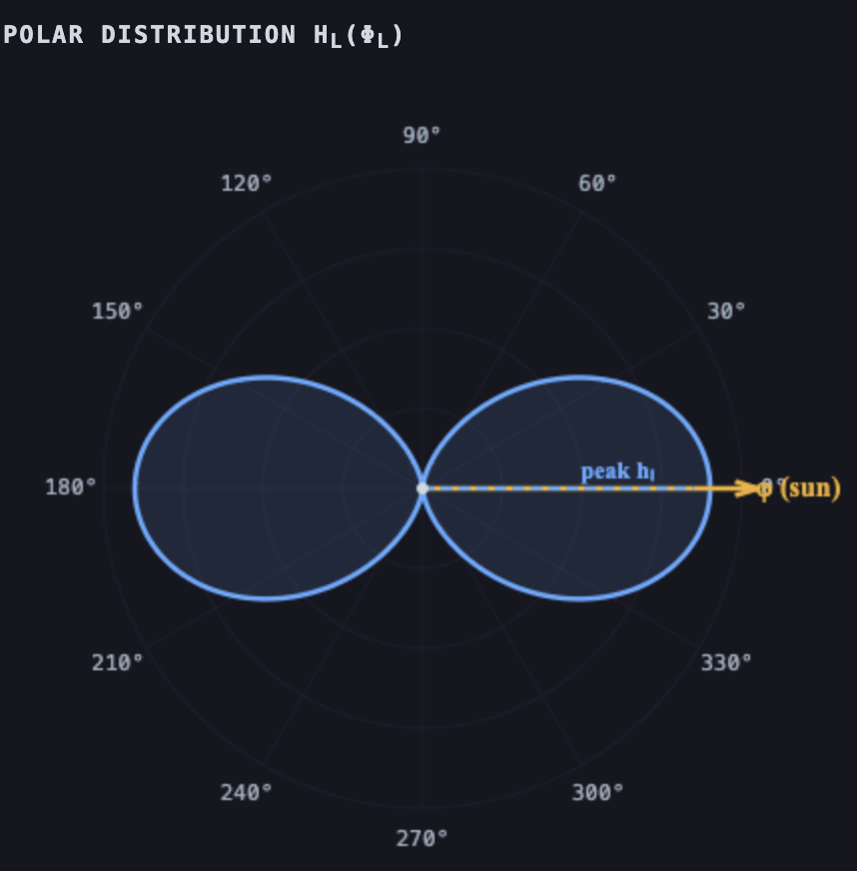
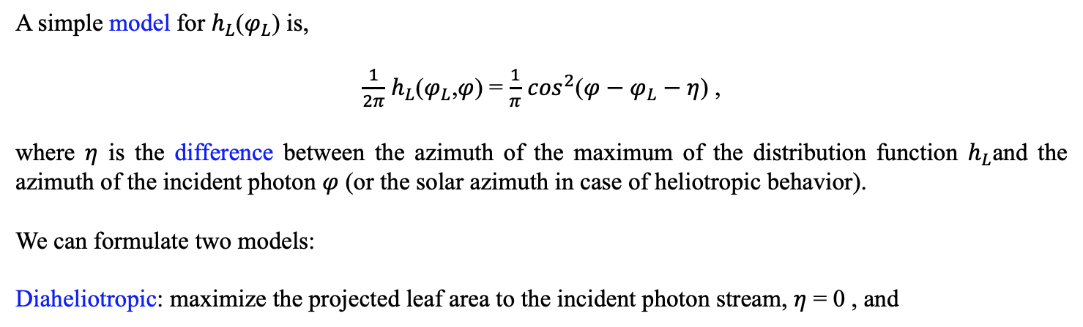
PHYSICAL MODELS IN REMOTE SENSING Chapter 02– Part 01: Vegetation Canopy Structure
Models for Leaf Normal Azimuthal Distribution Function
Leaf Normal Azimuthal Distribution
A simple model for $h_{L}$($φ_{L}$) is,
$\frac{1}{2π}$ $h_{L}$($φ_{L}$,$φ$) = $\frac{1}{π}$ $\cos^{2}$($φ−$ $φ_{L}−η$) ,
where $η$ is the difference between the azimuth of the maximum of the distribution function $h_{L}$and the azimuth of the incident photon $φ$ (or the solar azimuth in case of heliotropic behavior).
We can formulate two models:
Diaheliotropic: maximize the projected leaf area to the incident photon stream, $η$ = 0 , and

Slide 14
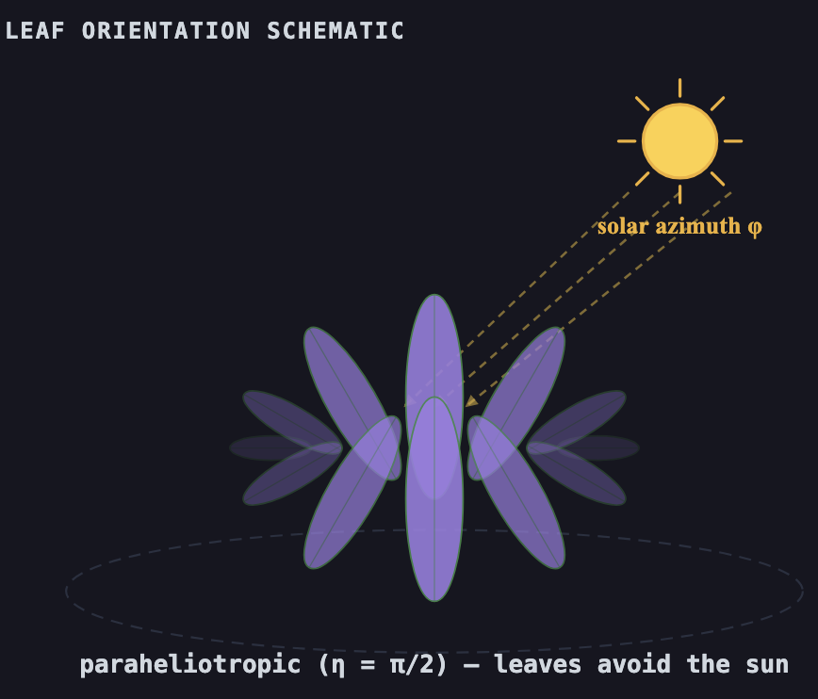
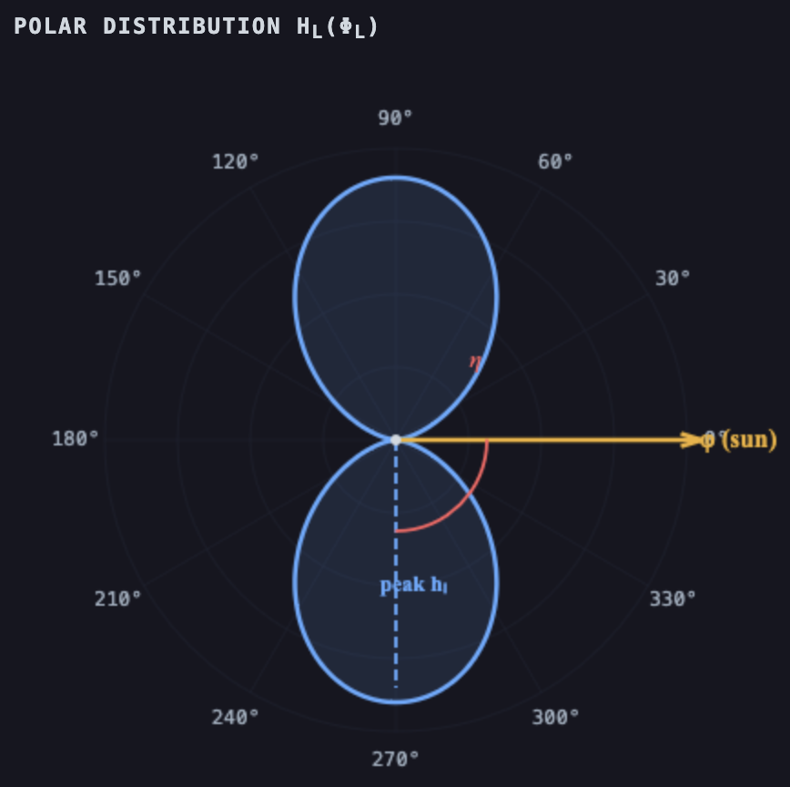
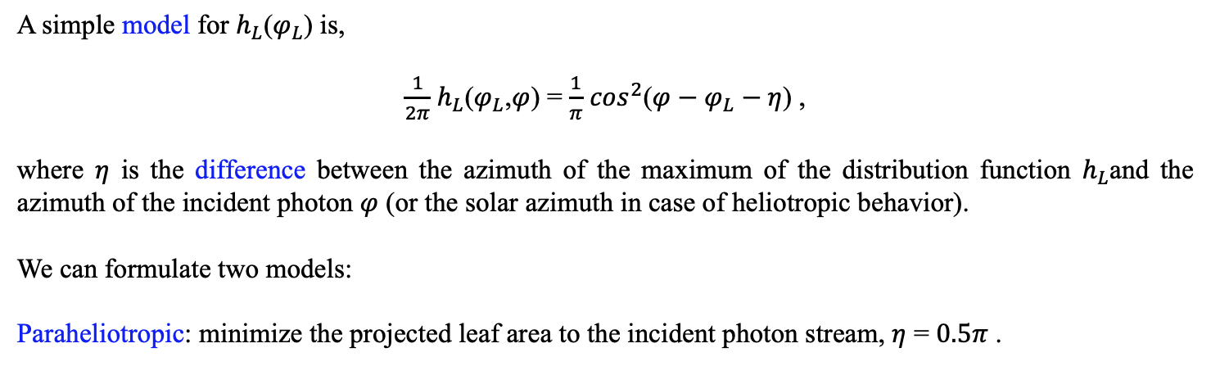
PHYSICAL MODELS IN REMOTE SENSING Chapter 02– Part 01: Vegetation Canopy Structure
Models for Leaf Normal Azimuthal Distribution Function
A simple model for $h_{L}$($φ_{L}$) is,
$\frac{1}{2π}$ $h_{L}$($φ_{L}$,$φ$) = $\frac{1}{π}$ $\cos^{2}$($φ−$ $φ_{L}−η$) ,
where $η$ is the difference between the azimuth of the maximum of the distribution function $h_{L}$and the azimuth of the incident photon $φ$ (or the solar azimuth in case of heliotropic behavior).
We can formulate two models:
Paraheliotropic: minimize the projected leaf area to the incident photon stream, $η$ = $0.5π$ .
Leaf Normal Azimuthal Distribution

Slide 15
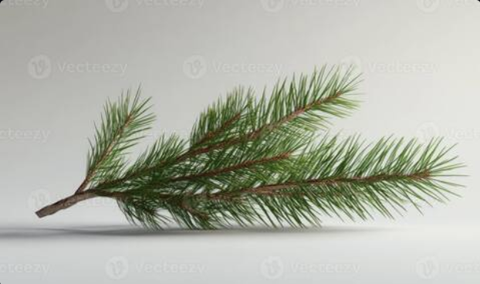
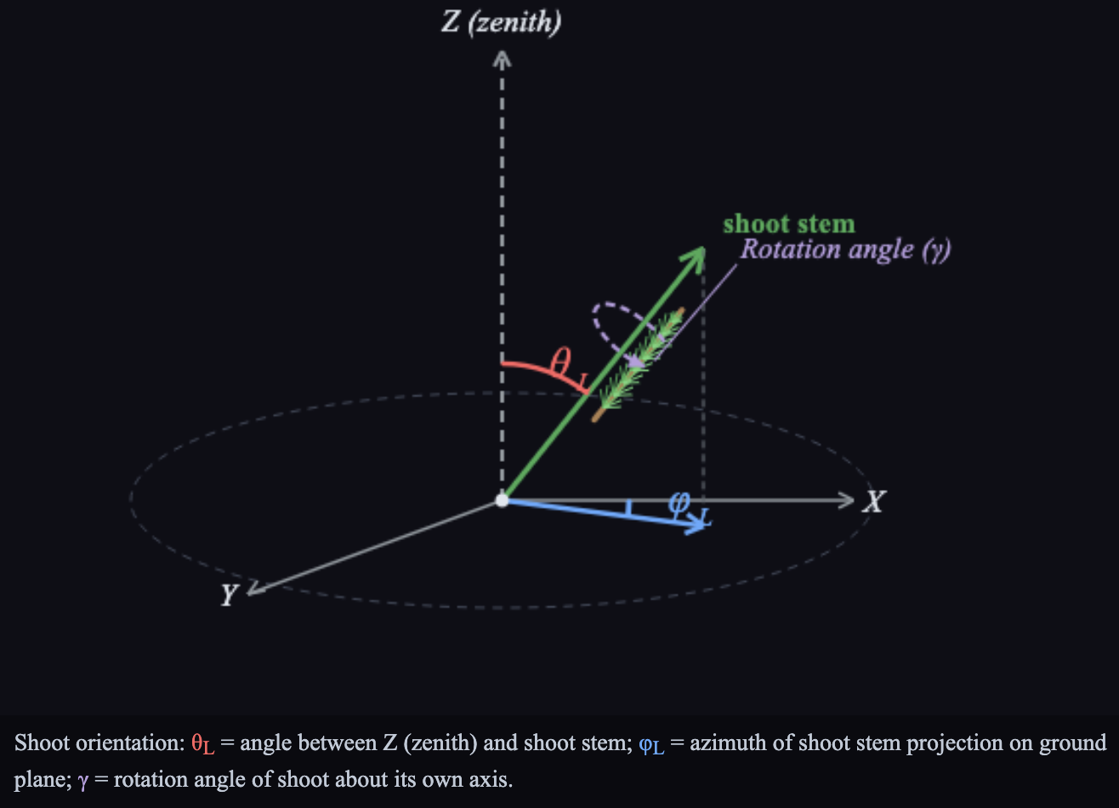
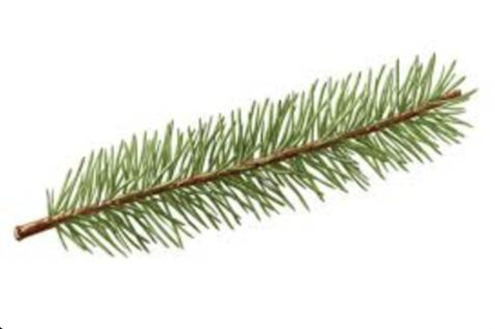
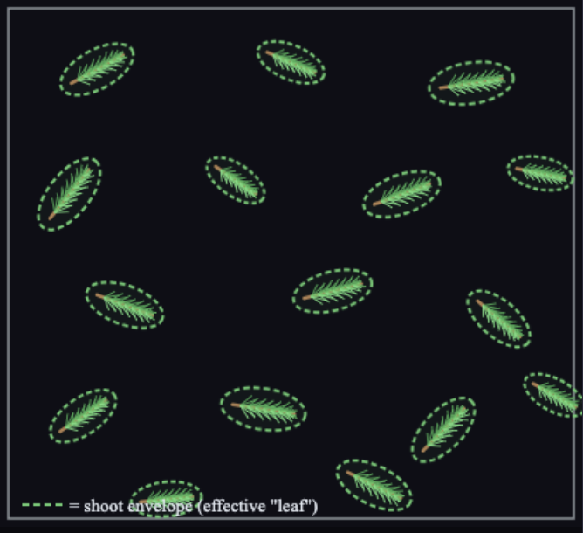
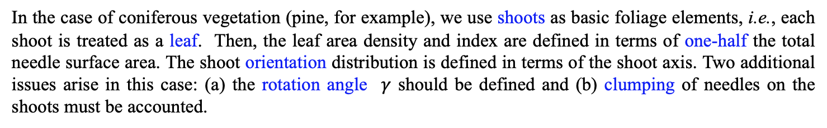
PHYSICAL MODELS IN REMOTE SENSING Chapter 02– Part 01: Vegetation Canopy Structure
Case of Needle Canopies
Shoot Idealization and Geometry
C2-P1-07-hsubL
In the case of coniferous vegetation (pine, for example), we use shoots as basic foliage elements, i.e., each shoot is treated as a leaf. Then, the leaf area density and index are defined in terms of one-half the total needle surface area. The shoot orientation distribution is defined in terms of the shoot axis. Two additional issues arise in this case: (a) the rotation angle $γ$ should be defined and (b) clumping of needles on the shoots must be accounted.

Slide 16
PHYSICAL MODELS IN REMOTE SENSING Chapter 02– Part 01: Vegetation CanopyStructure
Gauss (double) Quadrature:
N : Order of Gauss quadrature
w_{i} : Quadrature weights (w₁, w₂, …, w_{N})
x_{i} : Quadrature ordinates (x₁, x₂, …, x_{N})
Example: Say N = 12, it means -
w₁
w₂
w₃
w₄
w₅
w₆
w₇
w₈
w₉
w₁₀
w₁₁
w₁₂
-1
+1
x₁
x₂
x₃
x₄
x₅
x₆
x₇
x₈
x₉
x₁₀
x₁₁
x₁₂
0
You have N/2 weights and ordinates between the interval (-1,0) and the same between (0,1)

Slide 17
PHYSICAL MODELS IN REMOTE SENSING Chapter 02– Part 01: Vegetation CanopyStructure
Check Weights:
+1
N
∫
dx =
∑
w_{i} = 2
-1
i=1
+1
N
∫
dx x =
∑
x_{i} w_{i} = 0.5
0
i=(N/2)+1
General Case:
B
N
∫
dx x = C₁
x’_{i} w_{i}
∑
A
i=1
x’_{i} = C₁ x_{i} + C₂
C₁ = (B-A)/2 and C₂ = (B+A)/2
In the above, x’_{i} are the modified ordinates that run between A and B.

Slide 18
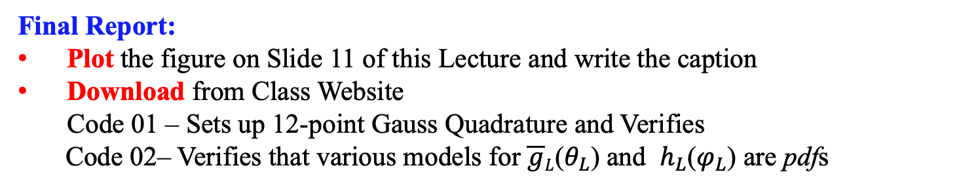
PHYSICAL MODELS IN REMOTE SENSING Chapter 02– Part 01: Vegetation CanopyStructure
General Case:
B
N
∫
dx x = C₁
x’_{i} w_{i}
∑
A
i=1
x’_{i} = C₁ x_{i} + C₂
C₁ = (B-A)/2 and C₂ = (B+A)/2
Test Case:
π/2
_
_
∫
dθ_{L} g_{L}(θ_{L}) sin θ_{L} = 1, where g_{L}(θ_{L}) = (2/π (1 + cos 2θ_{L})
0
Final Report:
Plot the figure on Slide 11 of this Lecture and write the caption
Download from Class Website Code 01 – Sets up 12-point Gauss Quadrature and Verifies
Code 02– Verifies that various models for $\overline{g}L$($θ_{L}$) and $h_{L}$($φ_{L}$) are pdfs

