Slide 1
PHYSICAL MODELS IN REMOTE SENSING Chapter 02 – Part 02: Extinction Coefficient
Assumptions
Definition of Extinction Coefficient
Conceptualization
Derivation
The Switch
G-Function Normalization
G-Function and Extinction Coefficient Properties
Limitations
Analytical Forms of the G-Functions
G-Function in Coniferous Canopies

Slide 2
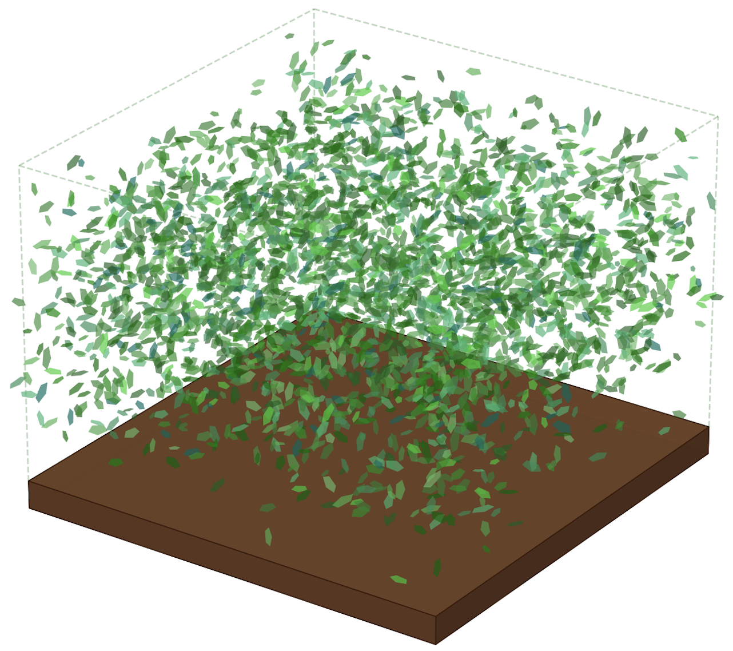
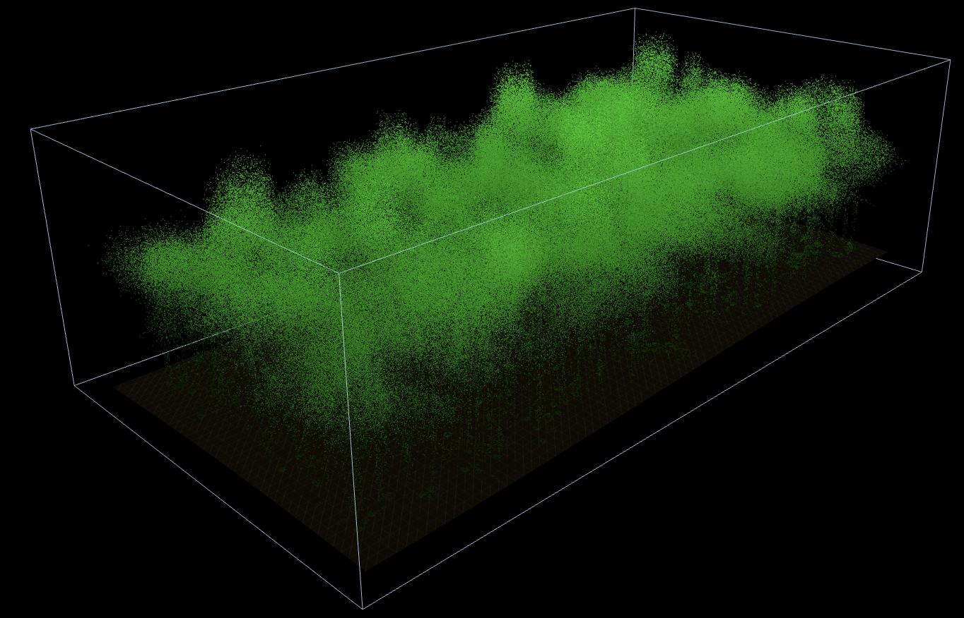
PHYSICAL MODELS IN REMOTE SENSING Chapter 02 – Part 02: Extinction Coefficient
Assumptions
Simulated Temperate Forest Lidar Scans
We discussed the complexity and dynamics of vegetation canopy structure previously.
Therefore, we resort to a simple abstraction of canopy structure as a turbid medium or a green gas.
The medium is assumed to be densely filled with small planar elements of negligible thickness.
These elements are oriented in space as specified by a distribution function of their normals.
A critical assumption is that the shadows of these small elements, that is, their projections on a plane perpendicular to any direction in the sphere, do not overlap.

Slide 3
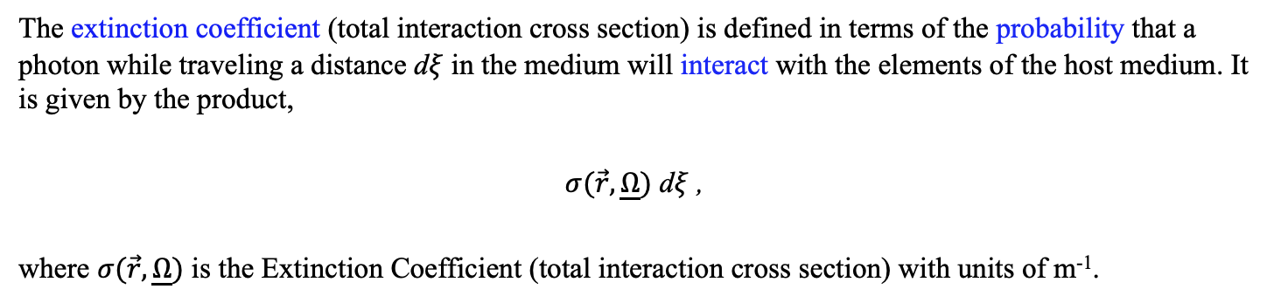
PHYSICAL MODELS IN REMOTE SENSING Chapter 02 – Part 02: Extinction Coefficient
Definition of Extinction Coefficient
The extinction coefficient (total interaction cross section) is defined in terms of the probability that a photon while traveling a distance d$ξ$ in the medium will interact with the elements of the host medium. It is given by the product,
$σ(\vec{r},\underline{Ω})$ d$ξ$ ,
where $σ(\vec{r},\underline{Ω})$ is the Extinction Coefficient (total interaction cross section) with units of m⁻¹.

Slide 4
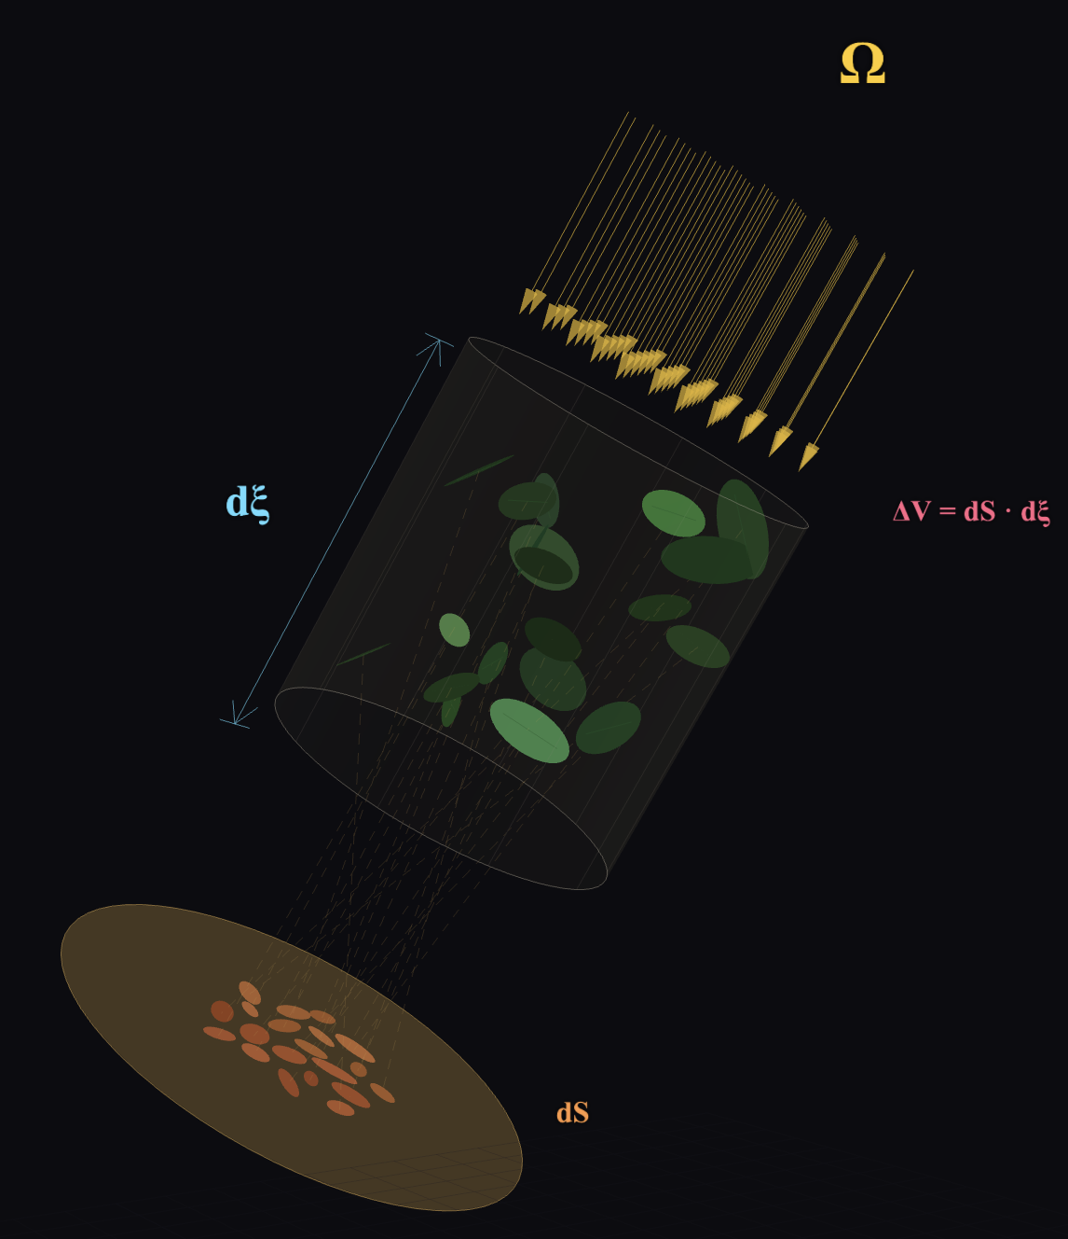
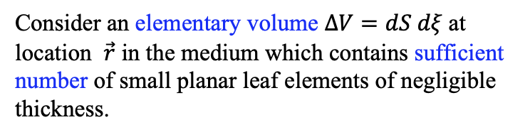
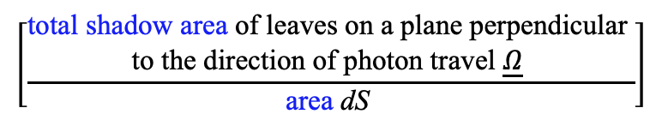
PHYSICAL MODELS IN REMOTE SENSING Chapter 02 – Part 02: Extinction Coefficient
Conceptualization
Consider an elementary volume $ΔV=dS dξ$at location $\vec{r}$ in the medium which contains sufficient number of small planar leaf elements of negligible thickness.
The probability that photons comprising the incident beam will collide with leaf elements in this volume is equal to the ratio:
$$\left[\frac{\begin{aligned}\text{total} \text{shadow} \text{area} \text{of} \text{leaves} \text{on} \text{a} \text{plane} \text{perpendicular} \\ \text{to} \text{the} \text{direction} \text{of} \text{photon} \text{travel} \underline{Ω} \end{aligned}}{\text{area} \text{dS} }\right]$$
Projection of leaf elements on to a plane perpendicular to $\underline{Ω}$

Slide 5
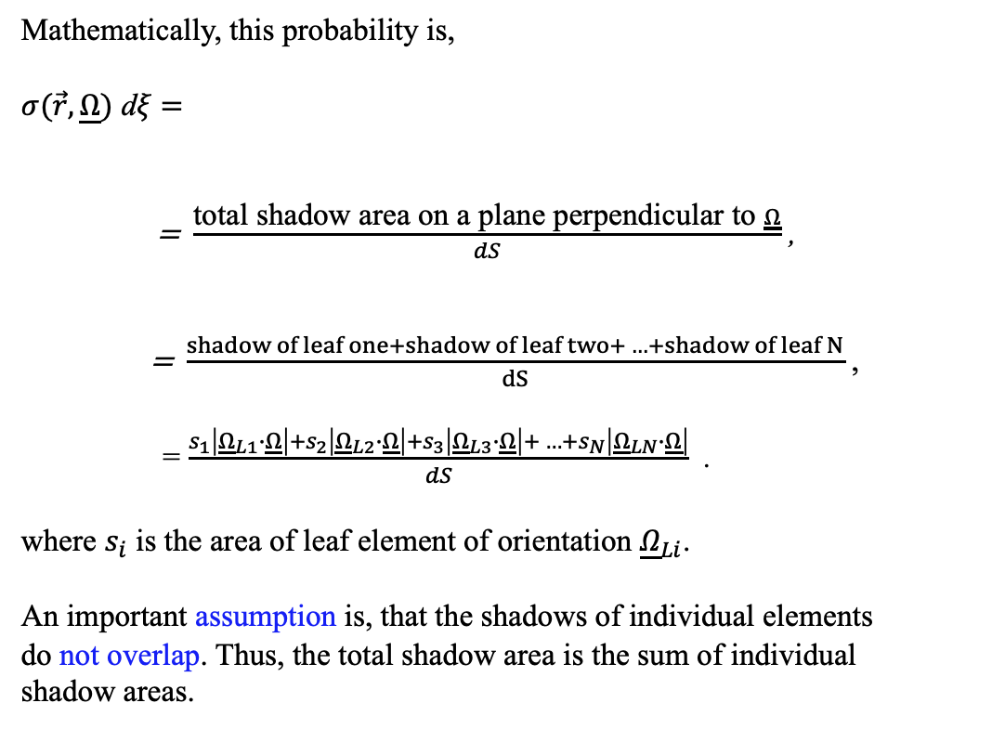
PHYSICAL MODELS IN REMOTE SENSING Chapter 02 – Part 02: Extinction Coefficient
Derivation
Mathematically, this probability is,
$σ(\vec{r},\underline{Ω})$ d$ξ$ $=$
= $\frac{\text{total} \text{shadow} \text{area} \text{on} \text{a} \text{plane} \text{perpendicular} \text{to} \underline{Ω}}{dS}$ ,
= $\frac{shadow of leaf one+shadow of leaf two+ …+shadow of leaf N}{dS}$ ,
= $\frac{s_{1}\left|{\underline{Ω}}_{L1}∙\underline{Ω}\right|+s_{2}\left|{\underline{Ω}}_{L2}∙\underline{Ω}\right|+s_{3}\left|{\underline{Ω}}_{L3}∙\underline{Ω}\right|+ …+s_{N}\left|{\underline{Ω}}_{LN}∙\underline{Ω}\right|}{dS}$ .
where $s_{i}$ is the area of leaf element of orientation ${\underline{Ω}}_{Li}$.
An important assumption is, that the shadows of individual elements
do not overlap. Thus, the total shadow area is the sum of individual
shadow areas.

Slide 6
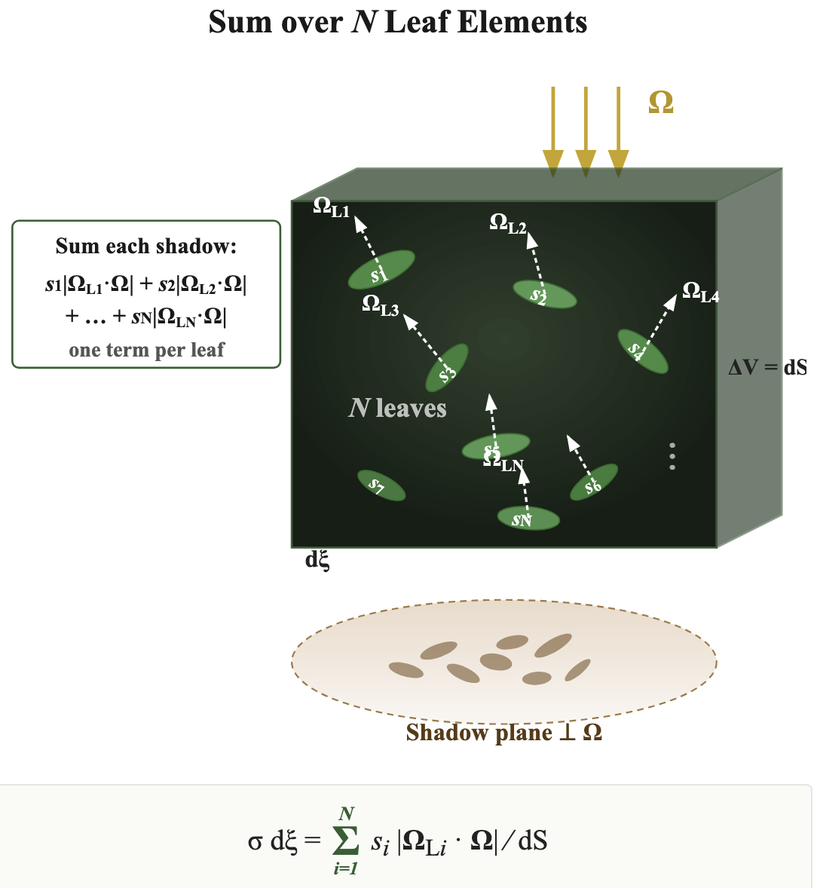
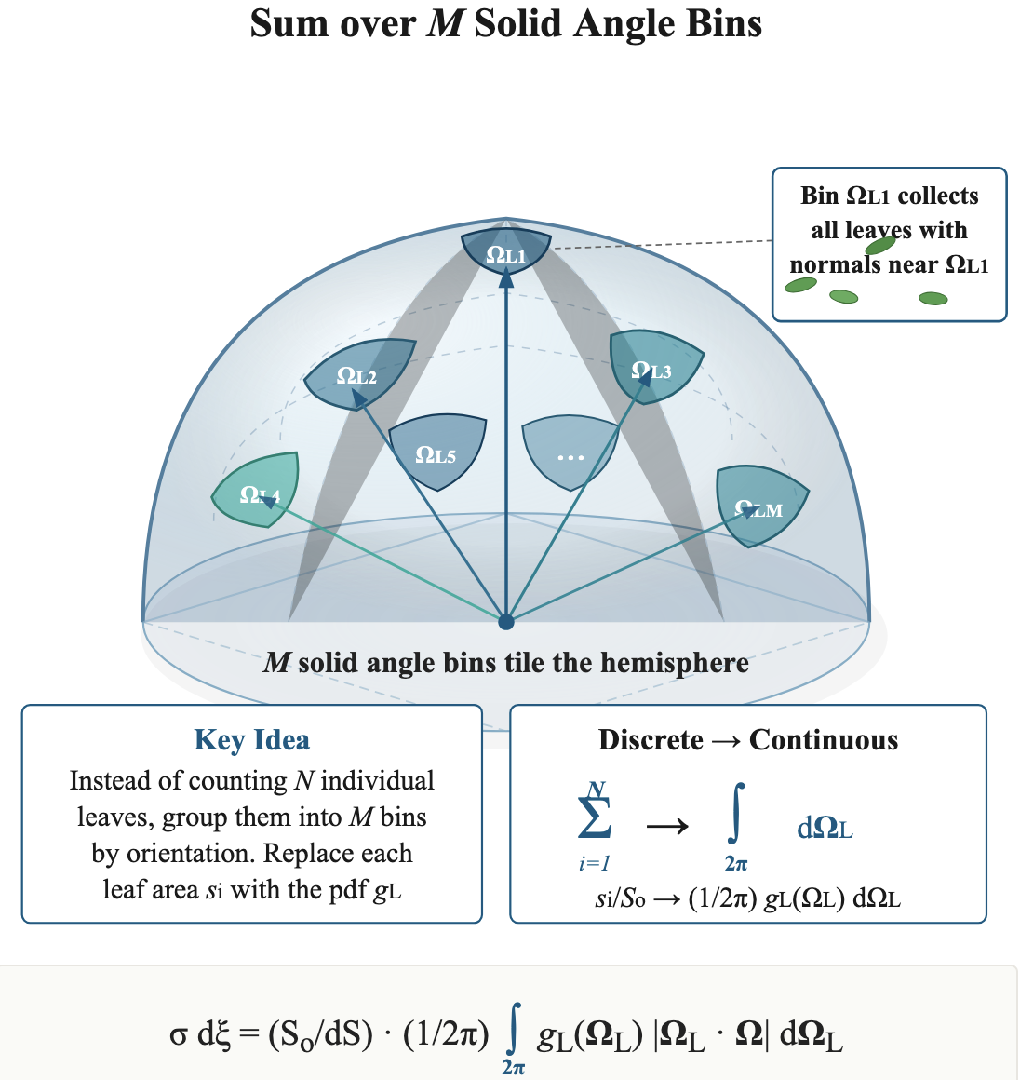
PHYSICAL MODELS IN REMOTE SENSING Chapter 02 – Part 02: Extinction Coefficient
The Switch
Two equivalent ways to compute the extinction cross-section σ of a vegetation canopy modeled as a turbid medium. Left panel shows the direct approach: each of the N leaf elements (areas s₁, s₂, …, s_{N}) in the elementary volume is individually projected onto a plane perpendicular to the photon travel direction Ω, and their shadow areas are summed term by term. The projection of leaf i with normal Ω_{Li} contributes s_{i} |Ω_{Li} · Ω| to the total shadow. This is exact but impractical when N is large. Right panel shows the efficient alternative: instead of enumerating leaves one by one, the upper hemisphere of leaf normal directions is partitioned into M solid angle bins, each collecting all leaves whose normals fall within that bin. The fractional area of leaves in bin Ω_{Li} is expressed through the leaf angle probability density g_{L}(Ω_{L}), so the discrete sum over N leaves becomes a continuous integral over the hemisphere.

Slide 7
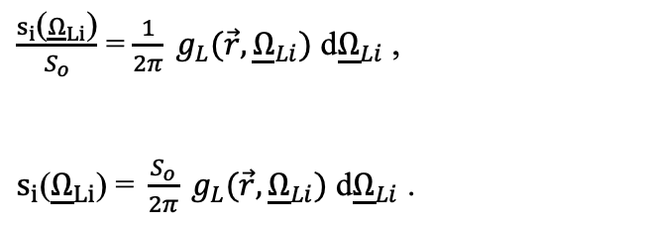
PHYSICAL MODELS IN REMOTE SENSING Chapter 02 – Part 02: Extinction Coefficient
Derivation
Counting over number of planar elements is tedious and inefficient as N can be a large. It is convenient to count over a certain number of fixed solid angles in a hemisphere, M, which contain all the normals of these N elements.
By definition, the ratio of the area of all leaf elements s_{i} of orientation Ω_{Li} to the total leaf area S_{o} in the elementary volume is equivalent to the probability of leaf elements of orientation Ω_{Li} ,
$\frac{s_{i}\text{(}{\underline{Ω}}_{Li}\text{)}}{S_{o}}$ = $\frac{1}{2π} g_{L}(\vec{r},{\underline{Ω}}_{Li})$ d${\underline{Ω}}_{Li}$ ,
$s_{i}\text{(}{\underline{Ω}}_{Li}\text{)}\text{ = }\frac{S_{o}}{2π} g_{L}(\vec{r},{\underline{Ω}}_{Li})$ d${\underline{Ω}}_{Li}$ .
In the above, $g_{L}$ is the probability density function (pdf) of leaf normal orientation.

Slide 8
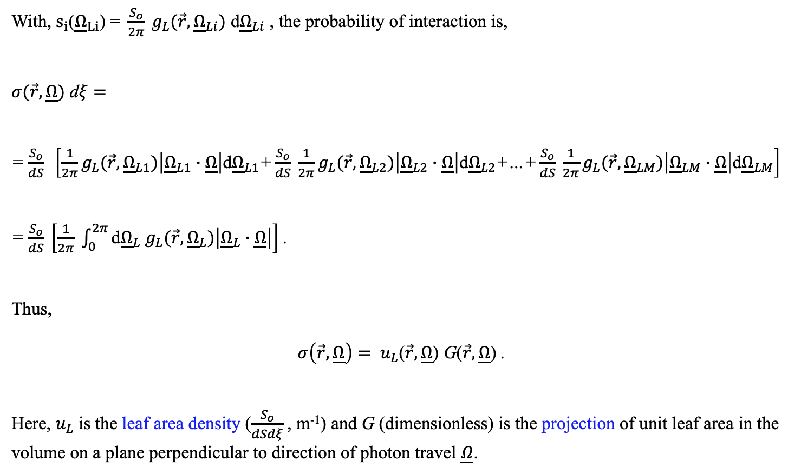
PHYSICAL MODELS IN REMOTE SENSING Chapter 02 – Part 02: Extinction Coefficient
Derivation
With, $s_{i}\text{(}{\underline{Ω}}_{Li}\text{) = }\frac{S_{o}}{2π} g_{L}(\vec{r},{\underline{Ω}}_{Li})$ d${\underline{Ω}}_{Li}$ , the probability of interaction is,
$σ(\vec{r},\underline{Ω})$ d$ξ=$
= $\frac{S_{o}}{dS} \left[{\frac{1}{2π}g}_{L}(\vec{r},{\underline{Ω}}_{L1})\left|{\underline{Ω}}_{L1}∙\underline{Ω}\right|\text{d}{\underline{Ω}}_{L1}\text{+}\frac{S_{o}}{dS} {\frac{1}{2π}g}_{L}(\vec{r},{\underline{Ω}}_{L2})\left|{\underline{Ω}}_{L2}∙\underline{Ω}\right|\text{d}{\underline{Ω}}_{L2}\text{+…+}\frac{S_{o}}{dS} {\frac{1}{2π}g}_{L}(\vec{r},{\underline{Ω}}_{LM})\left|{\underline{Ω}}_{LM}∙\underline{Ω}\right|\text{d}{\underline{Ω}}_{LM}\right]$
= $\frac{S_{o}}{dS} \left[\frac{1}{2π} \int_{0}^{2π}{{\text{d}{\underline{Ω}}_{L} g}_{L}(\vec{r},{\underline{Ω}}_{L})\left|{\underline{Ω}}_{L}∙\underline{Ω}\right|}\right]$ .
Thus,
$σ\left(\vec{r},\underline{Ω}\right)= u_{L}$($\vec{r},\underline{Ω}$) G($\vec{r},\underline{Ω}$) .
Here, $u_{L}$ is the leaf area density ($\frac{S_{o}}{dSdξ}$, m⁻¹) and G (dimensionless) is the projection of unit leaf area in the volume on a plane perpendicular to direction of photon travel $\underline{Ω}$.

Slide 9
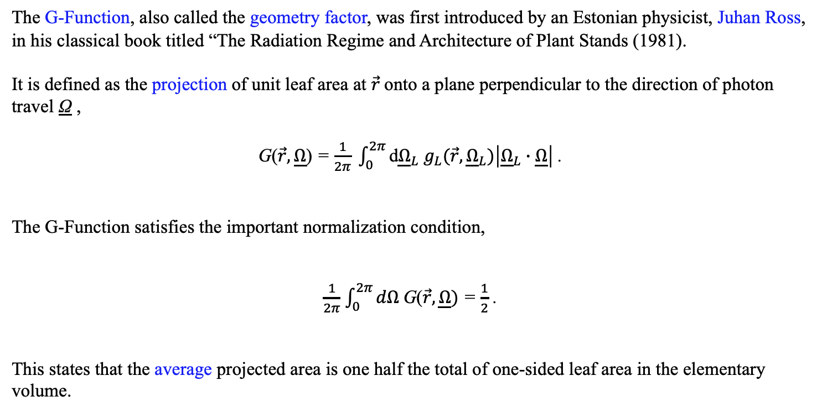
PHYSICAL MODELS IN REMOTE SENSING Chapter 02 – Part 02: Extinction Coefficient
G-Function Normalization
The G-Function, also called the geometry factor, was first introduced by an Estonian physicist, Juhan Ross, in his classical book titled “The Radiation Regime and Architecture of Plant Stands (1981).
It is defined as the projection of unit leaf area at $\vec{r}$onto a plane perpendicular to the direction of photon travel Ω ,
G($\vec{r},\underline{Ω}$) = $\frac{1}{2π} \int_{0}^{2π}{{\text{d}{\underline{Ω}}_{L} g}_{L}(\vec{r},{\underline{Ω}}_{L})\left|{\underline{Ω}}_{L}∙\underline{Ω}\right|}$ .
The G-Function satisfies the important normalization condition,
$\frac{1}{2π}$ $\int_{0}^{2π}{dΩ }$G($\vec{r},\underline{Ω})$ = $\frac{1}{2}$ .
This states that the average projected area is one half the total of one-sided leaf area in the elementary volume.

Slide 10
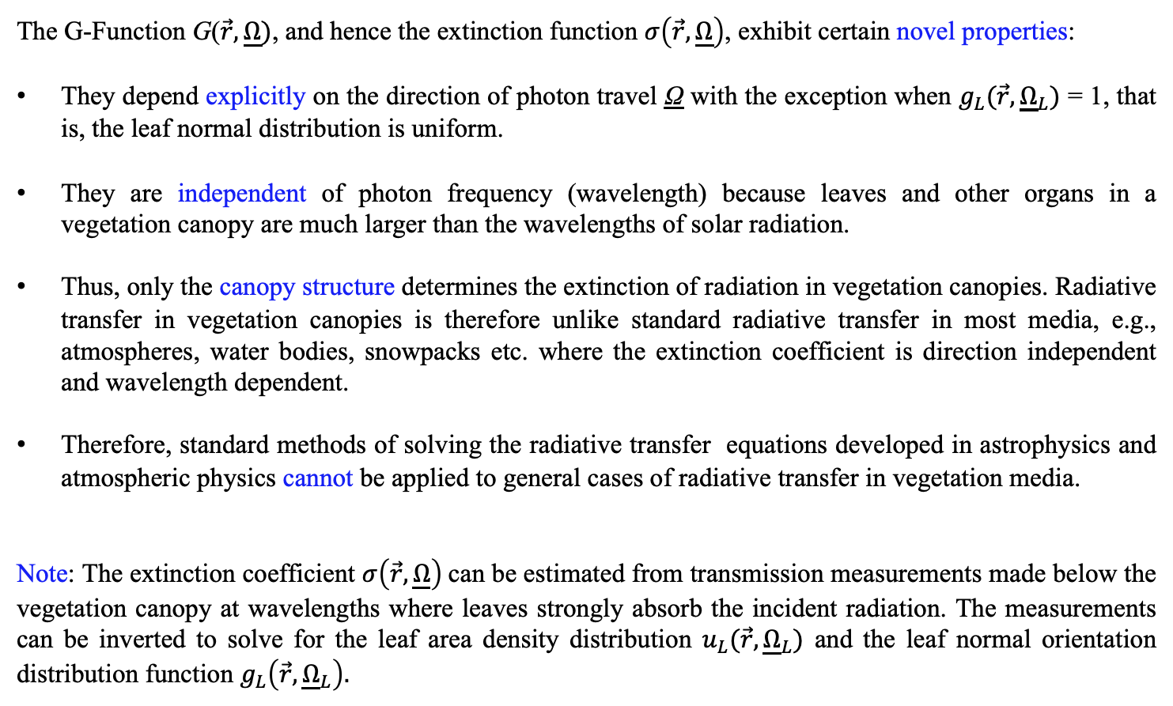
PHYSICAL MODELS IN REMOTE SENSING Chapter 02 – Part 02: Extinction Coefficient
G-Function and Extinction Coefficient Properties
The G-Function G($\vec{r},\underline{Ω})$, and hence the extinction function $σ\left(\vec{r},\underline{Ω}\right)$, exhibit certain novel properties:
They depend explicitly on the direction of photon travel Ω with the exception when $g_{L}(\vec{r},{\underline{Ω}}_{L})$ = 1, that is, the leaf normal distribution is uniform.
They are independent of photon frequency (wavelength) because leaves and other organs in a vegetation canopy are much larger than the wavelengths of solar radiation.
Thus, only the canopy structure determines the extinction of radiation in vegetation canopies. Radiative transfer in vegetation canopies is therefore unlike standard radiative transfer in most media, e.g., atmospheres, water bodies, snowpacks etc. where the extinction coefficient is direction independent and wavelength dependent.
Therefore, standard methods of solving the radiative transfer equations developed in astrophysics and atmospheric physics cannot be applied to general cases of radiative transfer in vegetation media.
Note: The extinction coefficient $σ\left(\vec{r},\underline{Ω}\right)$can be estimated from transmission measurements made below the vegetation canopy at wavelengths where leaves strongly absorb the incident radiation. The measurements can be inverted to solve for the leaf area density distribution $u_{L}(\vec{r},{\underline{Ω}}_{L})$ and the leaf normal orientation distribution function $g_{L}\left(\vec{r},{\underline{Ω}}_{L}\right).$

Slide 11
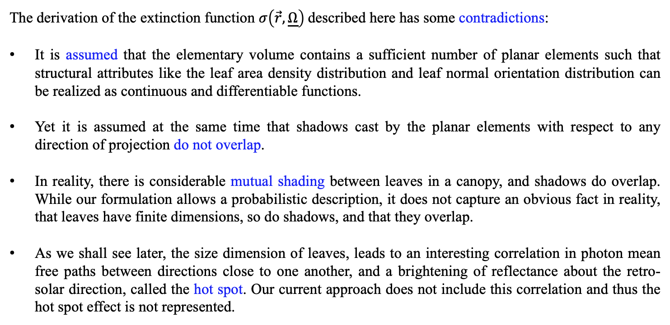
PHYSICAL MODELS IN REMOTE SENSING Chapter 02 – Part 02: Extinction Coefficient
Limitations
The derivation of the extinction function $σ\left(\vec{r},\underline{Ω}\right)$described here has some contradictions:
It is assumed that the elementary volume contains a sufficient number of planar elements such that structural attributes like the leaf area density distribution and leaf normal orientation distribution can be realized as continuous and differentiable functions.
Yet it is assumed at the same time that shadows cast by the planar elements with respect to any direction of projection do not overlap.
In reality, there is considerable mutual shading between leaves in a canopy, and shadows do overlap. While our formulation allows a probabilistic description, it does not capture an obvious fact in reality, that leaves have finite dimensions, so do shadows, and that they overlap.
As we shall see later, the size dimension of leaves, leads to an interesting correlation in photon mean free paths between directions close to one another, and a brightening of reflectance about the retro-solar direction, called the hot spot. Our current approach does not include this correlation and thus the hot spot effect is not represented.

Slide 12
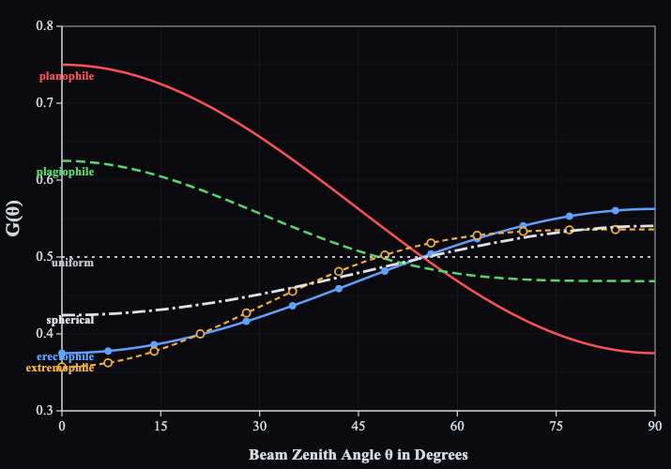
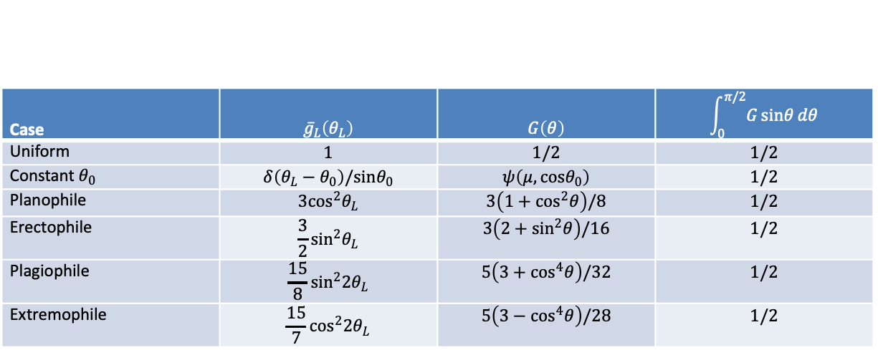
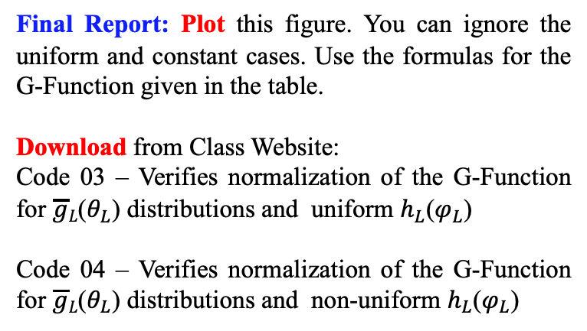
PHYSICAL MODELS IN REMOTE SENSING Chapter 02 – Part 02: Extinction Coefficient
Analytical Forms of the G-Function
Explicit analytical forms can be found for the various leaf normal orientation distribution function. These are given in the table below.
Case | $${\overset{‾}{g}}_{L}\left(θ_{L}\right)$$ | $$G\left(θ\right)$$ | $$\int_{0}^{π/2}{G}sinθ dθ$$
Uniform | $$1$$ | $$1/2$$ | $$1/2$$
Constant $θ_{0}$ | $$δ\left(θ_{L}−θ_{0}\right)/sinθ_{0}$$ | $$ψ\left(μ,cosθ_{0}\right)$$ | $$1/2$$
Planophile | $$3\cos^{2}θ_{L}$$ | $$3\left(1+\cos^{2}θ\right)/8$$ | $$1/2$$
Erectophile | $$\frac{3}{2}\sin^{2}θ_{L}$$ | $$3\left(2+\sin^{2}θ\right)/16$$ | $$1/2$$
Plagiophile | $$\frac{15}{8}\sin^{2}2θ_{L}$$ | $$5\left(3+\cos^{4}θ\right)/32$$ | $$1/2$$
Extremophile | $$\frac{15}{7}\cos^{2}2θ_{L}$$ | $$5\left(3−\cos^{4}θ\right)/28$$ | $$1/2$$
Final Report: Plot this figure. You can ignore the uniform and constant cases. Use the formulas for the G-Function given in the table.
Download from Class Website:
Code 03 – Verifies normalization of the G-Function for $\overline{g}L$($θ_{L}$) distributions and uniform $h_{L}$($φ_{L}$)
Code 04 – Verifies normalization of the G-Function for $\overline{g}L$($θ_{L}$) distributions and non-uniform $h_{L}$($φ_{L}$)

Slide 13
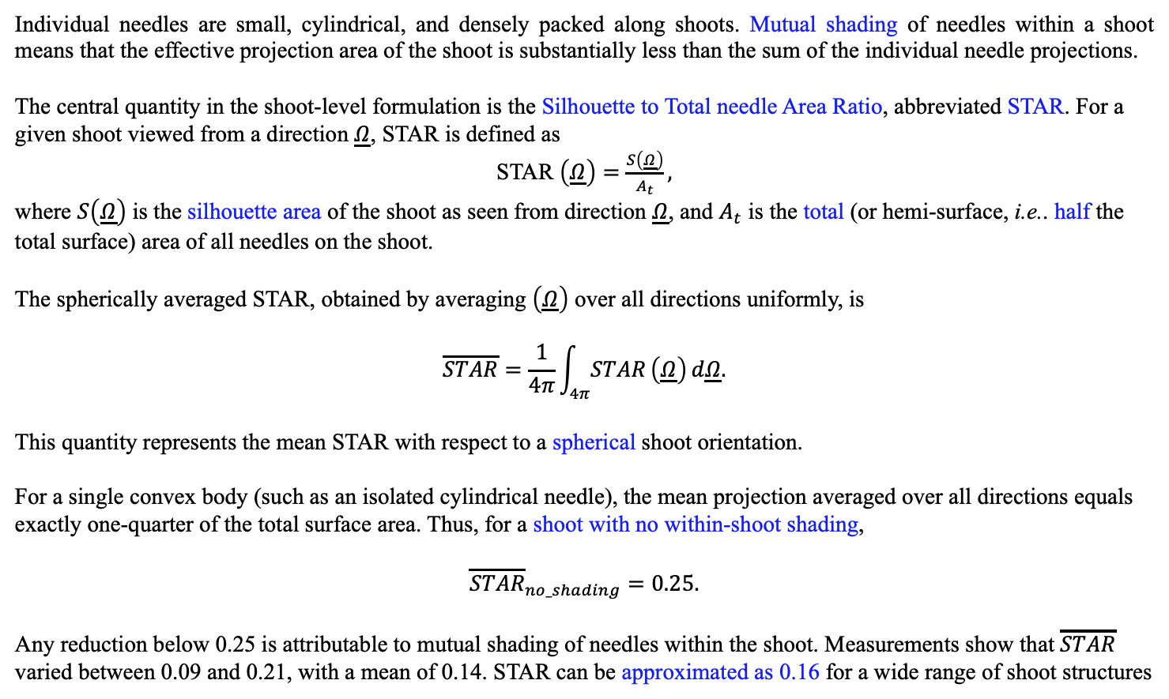
PHYSICAL MODELS IN REMOTE SENSING Chapter 02 – Part 02: Extinction Coefficient
G-Function in Coniferous Canopies
Individual needles are small, cylindrical, and densely packed along shoots. Mutual shading of needles within a shoot means that the effective projection area of the shoot is substantially less than the sum of the individual needle projections.
The central quantity in the shoot-level formulation is the Silhouette to Total needle Area Ratio, abbreviated STAR. For a given shoot viewed from a direction $\underline{Ω}$, STAR is defined as
STAR $\left(\underline{Ω}\right)=\frac{S\left(\underline{Ω}\right)}{A_{t}},$
where $S\left(\underline{Ω}\right)$ is the silhouette area of the shoot as seen from direction $\underline{Ω}$, and $A_{t}$ is the total (or hemi-surface, i.e.. half the total surface) area of all needles on the shoot.
The spherically averaged STAR, obtained by averaging $\left(\underline{Ω}\right)$ over all directions uniformly, is
$$\overline{STAR}=\frac{1}{4π}\int_{4π}^{​}{STAR}\left(\underline{Ω}\right) d\underline{Ω}.$$
This quantity represents the mean STAR with respect to a spherical shoot orientation.
For a single convex body (such as an isolated cylindrical needle), the mean projection averaged over all directions equals exactly one-quarter of the total surface area. Thus, for a shoot with no within-shoot shading,
$${\overline{STAR}}_{no_shading}=0.25.$$
Any reduction below 0.25 is attributable to mutual shading of needles within the shoot. Measurements show that $\overline{STAR}$ varied between 0.09 and 0.21, with a mean of 0.14. STAR can be approximated as 0.16 for a wide range of shoot structures

