Slide 1
PHYSICAL MODELS IN REMOTE SENSING Chapter 02 – Part 03: Leaf Optics
Leaf Forms
Structure
Biochemical Content
Chloroplasts
Photosynthesis
Absorption Spectra
Interactions at Leaf Surface and Interior
Leaf Scattering Phase Function
Leaf Albedo
Leaf Hemispherical Reflectance and Transmittance
Diffuse and Specular Leaf Scattering Phase Functions
Diffuse Interactions: Prospect Leaf Model
Diffuse Interactions: Prospect Sensitivity Analysis
Diffuse Interactions: The Bi-Lambertian Model
Surface Interactions: Specular Reflection Model

Slide 2
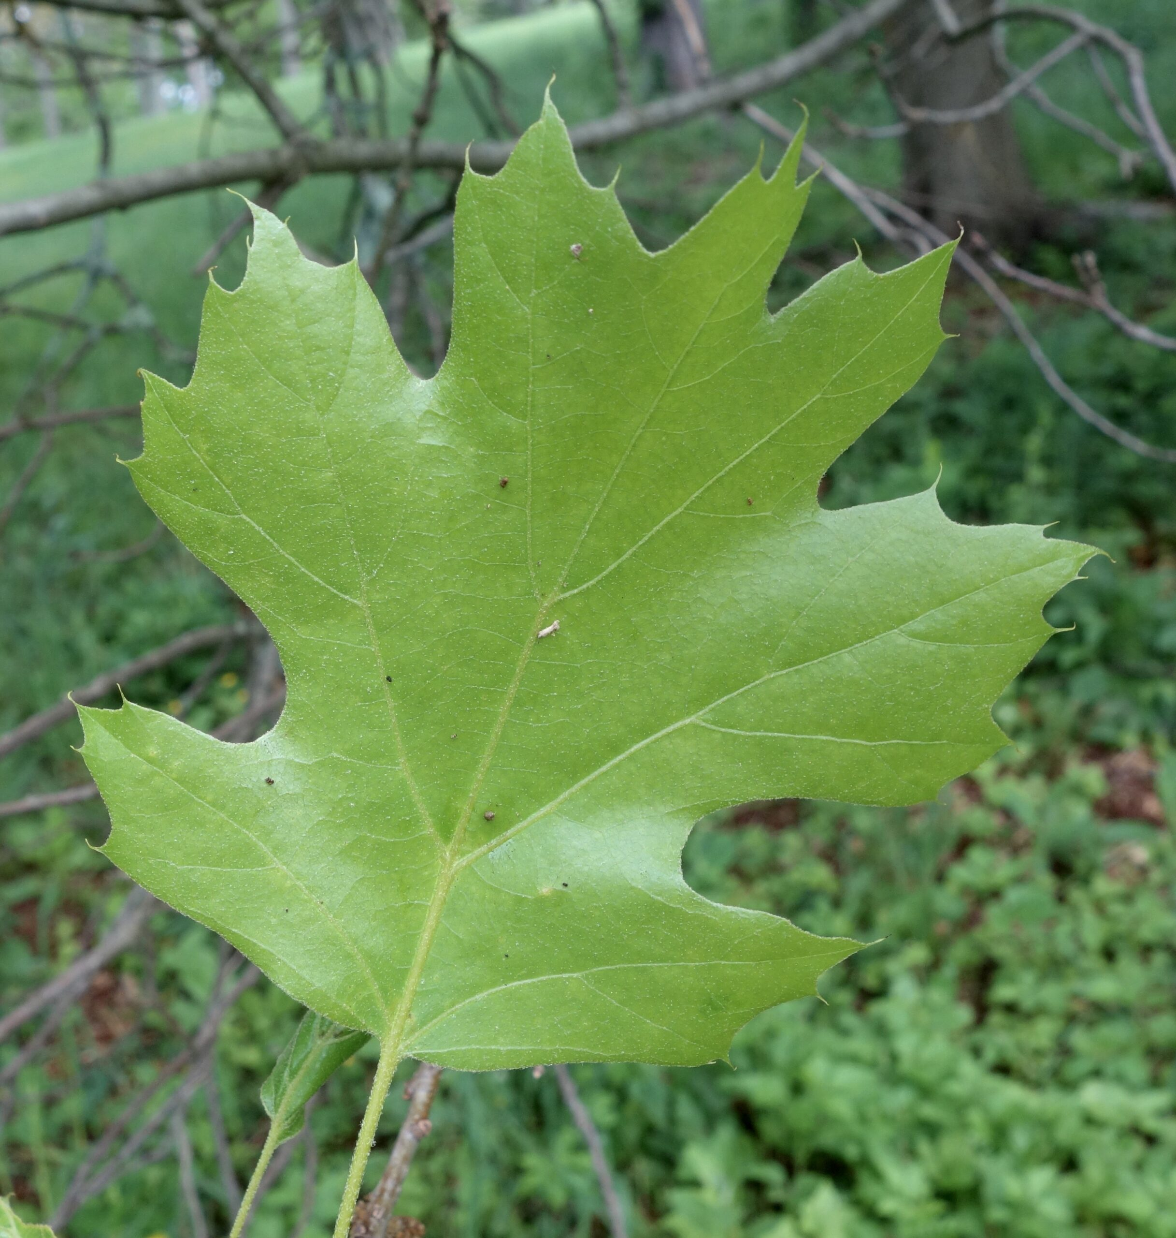
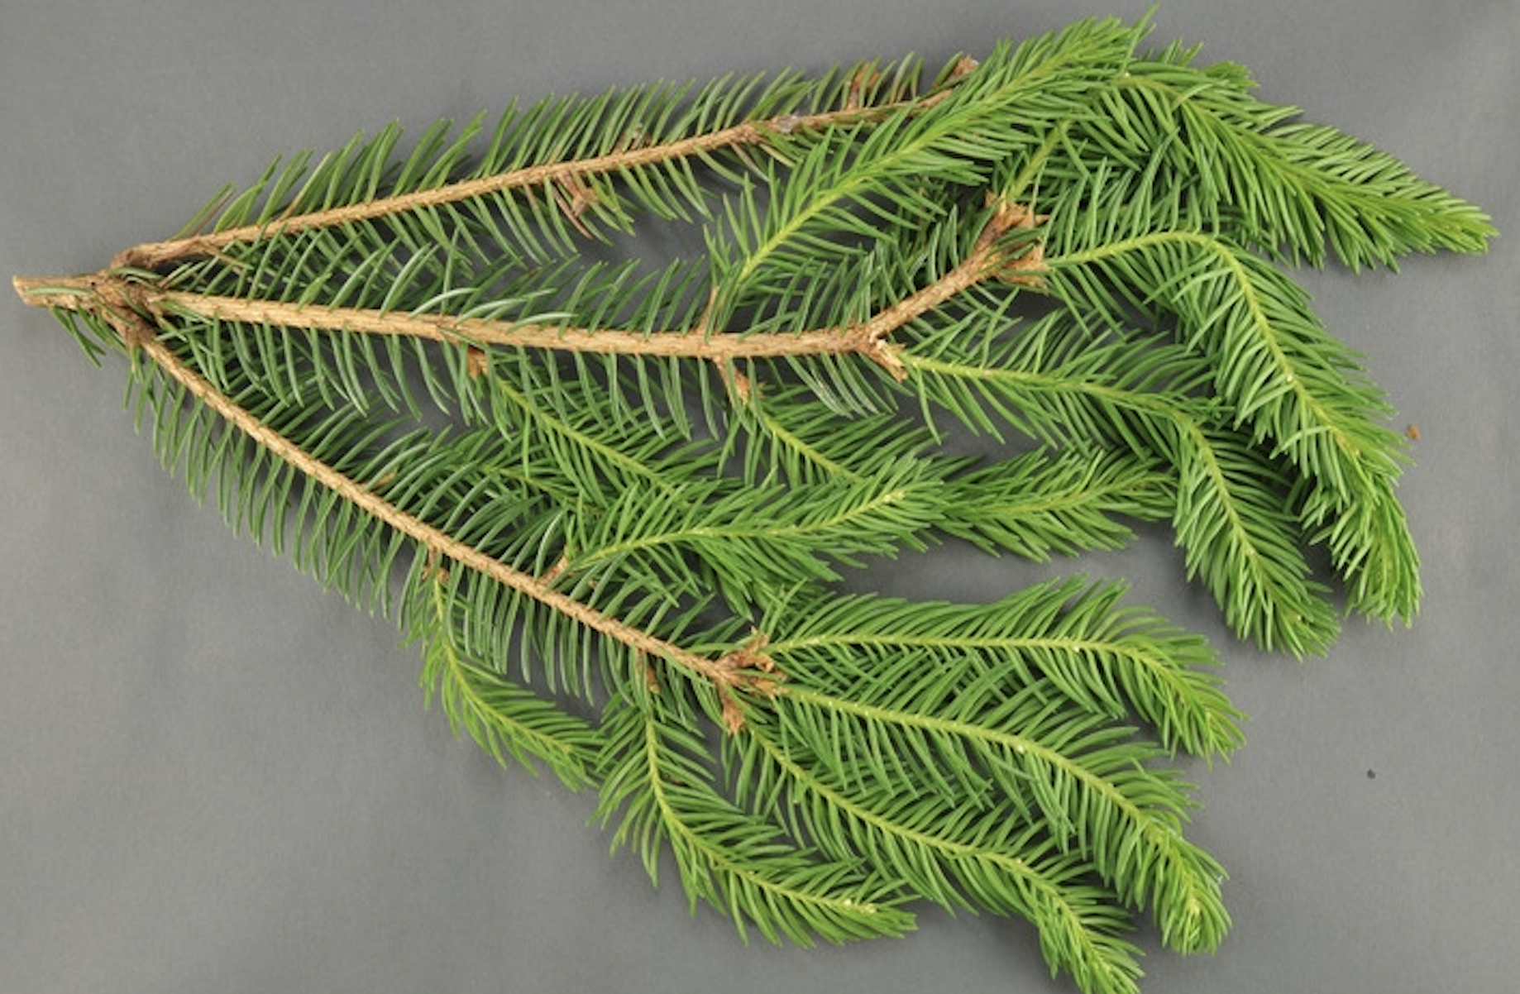
PHYSICAL MODELS IN REMOTE SENSING Chapter 02 – Part 03: Leaf Optics
Leaf Forms
Maple-leaf Oak - Arnold Arboretum
Lorraine Graney, Bartlett Tree Experts, Bugwood.org
There are two leaf forms we are concerned with - the flat broadleaf and a conifer shoot. These generally cover the herbaceous (grasses, shrubs and crops) and woody vegetation life forms (forests and woodlands) and their mixture (savannas). The forests can be purely broadleaf or needleleaf, or their combination, as in a mixed forest. The interaction of electromagnetic radiation with plant leaves depends on the bio-chemical constitution of the leaves and their internal structures

Slide 3
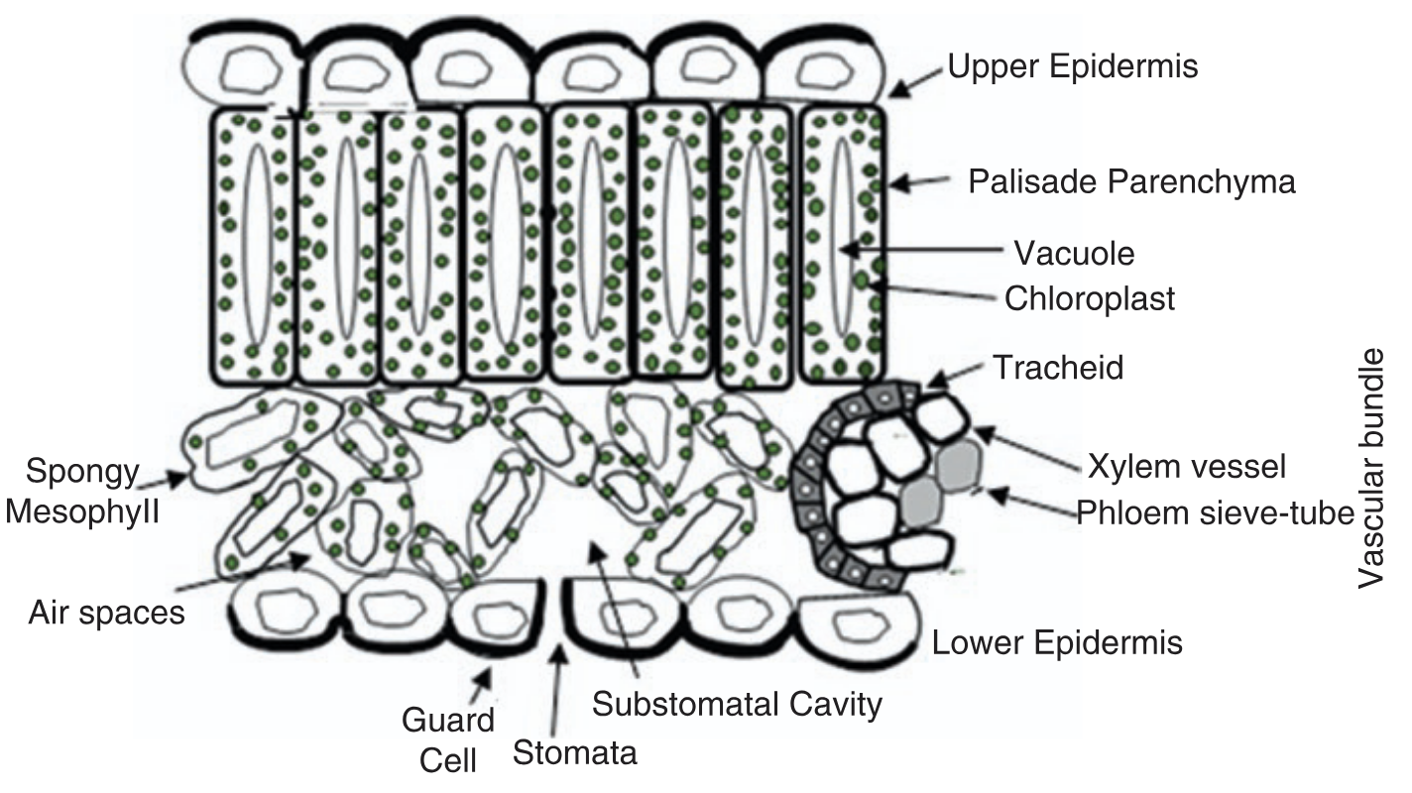
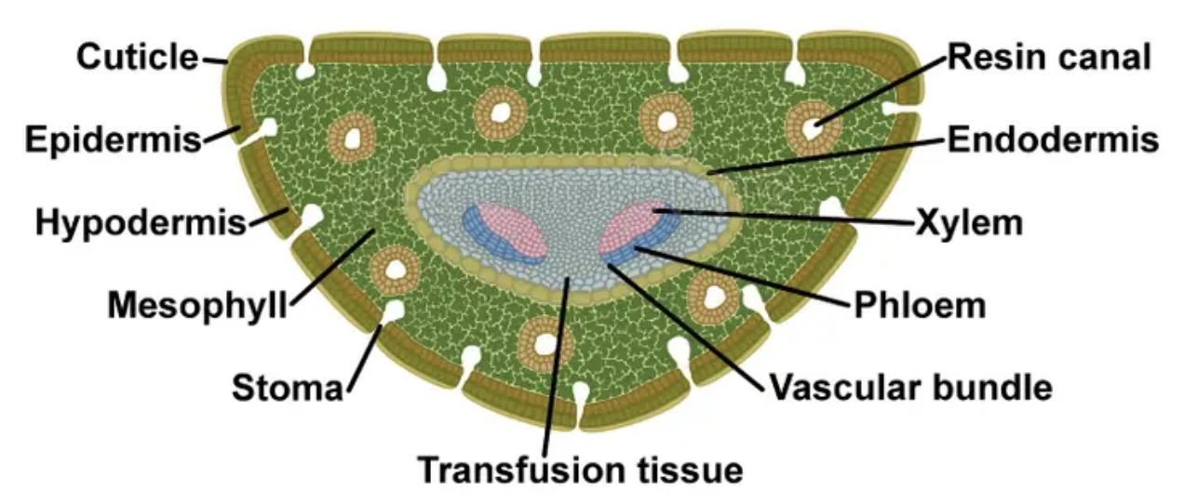
PHYSICAL MODELS IN REMOTE SENSING Chapter 02 – Part 03: Leaf Optics
Structure
Pine Needle
Ustin, S.L., Jacquemoud, S. (2020). Doi: 10.1007/978-3-030-33157-3_14
Illustration by Jamilia Marini
The cross section of a broadleaf shows stomatal openings at the surfaces that are generally covered by a waxy cuticle. Below the upper epidermal layer is the palisade mesophyll that is densely packed with vertical cylindrical cells containing chloroplasts. The spongy mesophyll contains many pockets of air spaces among which cells containing chlorophyll are situated. The cross section of conifer needle has similar layering of tissues with the transfusion tissue in the middle.

Slide 4
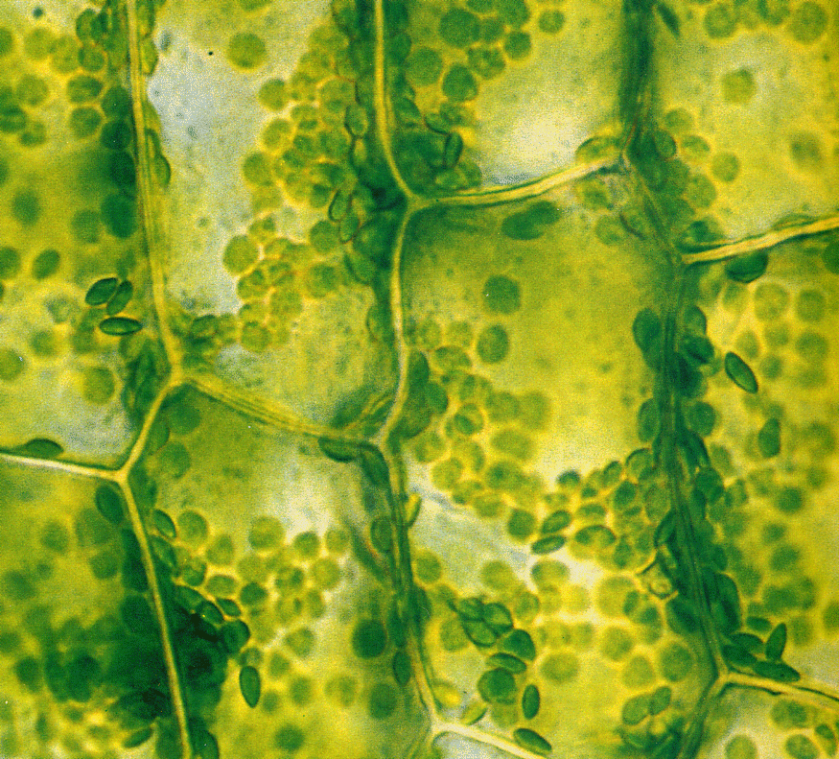
PHYSICAL MODELS IN REMOTE SENSING Chapter 02 – Part 03: Leaf Optics
Biochemical Content
A typical cell of a green-fresh leaf contains:
water (vacuole): 90-95%
dry matter (cell walls): 5-10%
- cellulose: 15-30%
- hemicellulose: 10-30%
- proteins: 10-20%
- lignin: 5-15%
- starch: 0.2-2.7%
- sugar
- etc.
chlorophyll a and b (chloroplasts)
- (about 10 to 100 μg.cm⁻²)
- (about 0.1 to 1.5%)
accessory pigments
- carotenoids
- anthocyanins, flavons
- brown pigments
- etc.

Slide 5
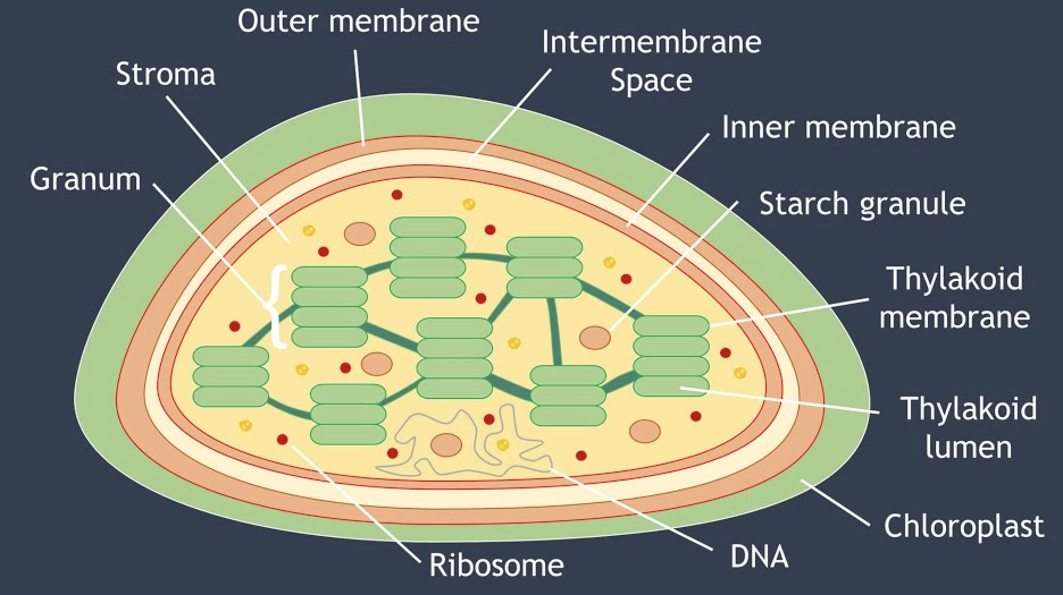
PHYSICAL MODELS IN REMOTE SENSING Chapter 02 – Part 03: Leaf Optics
Chloroplasts
Biology Goal
Chloroplasts are roughly 1–2 μm (1 μm = 0.001 mm) thick and 5–7 μm in diameter.
They are enclosed in a chloroplast envelope, which consists of a double membrane with outer and inner layers, between which is a gap called the intermembrane space. A third, internal membrane, extensively folded and characterized by the presence of closed disks (or thylakoids), is known as the thylakoid membrane.
The thylakoids are arranged in tight stacks called grana. Grana are connected by stromal lamellae, extensions that run from one granum, through the stroma, into a neighboring granum. The thylakoid membrane envelops a central aqueous region known as the thylakoid lumen.
The space between the inner membrane and the thylakoid membrane is filled with stroma, a matrix containing dissolved enzymes, starch granules and copies of the chloroplast genome.

Slide 6
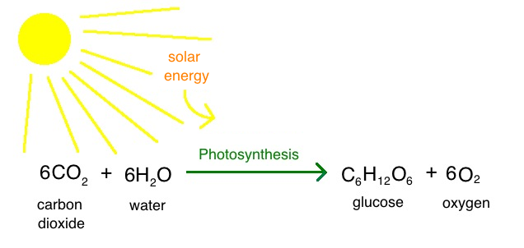
PHYSICAL MODELS IN REMOTE SENSING Chapter 02 – Part 03: Leaf Optics
Photosynthesis
Chemistrytalk.org
The thylakoid membrane houses chlorophylls and different protein complexes, including photosystem I, photosystem II, and ATP (adenosine triphosphate) synthase, which are specialized for light-dependent photosynthesis.
Light Reaction: When EMR of 400 to 700 nm strikes the thylakoids, the light energy excites chlorophyll pigments, causing them to give up electrons. The electrons then enter the electron transport chain that ultimately drives the phosphorylation of adenosine diphosphate (ADP) to the energy-rich storage compound ATP. Electron transport also results in the production of the reducing agent nicotinamide adenine dinucleotide phosphate (NADPH).
Dark Reaction: ATP and NADPH are used in the dark reactions of photosynthesis, in which carbon dioxide and water are assimilated into organics compounds (sugars). These reactions are carried out in the chloroplast stroma, which contains the required enzyme ribulose-1,5-bisphosphate carboxylase/oxygenase (rubisco).

Slide 7
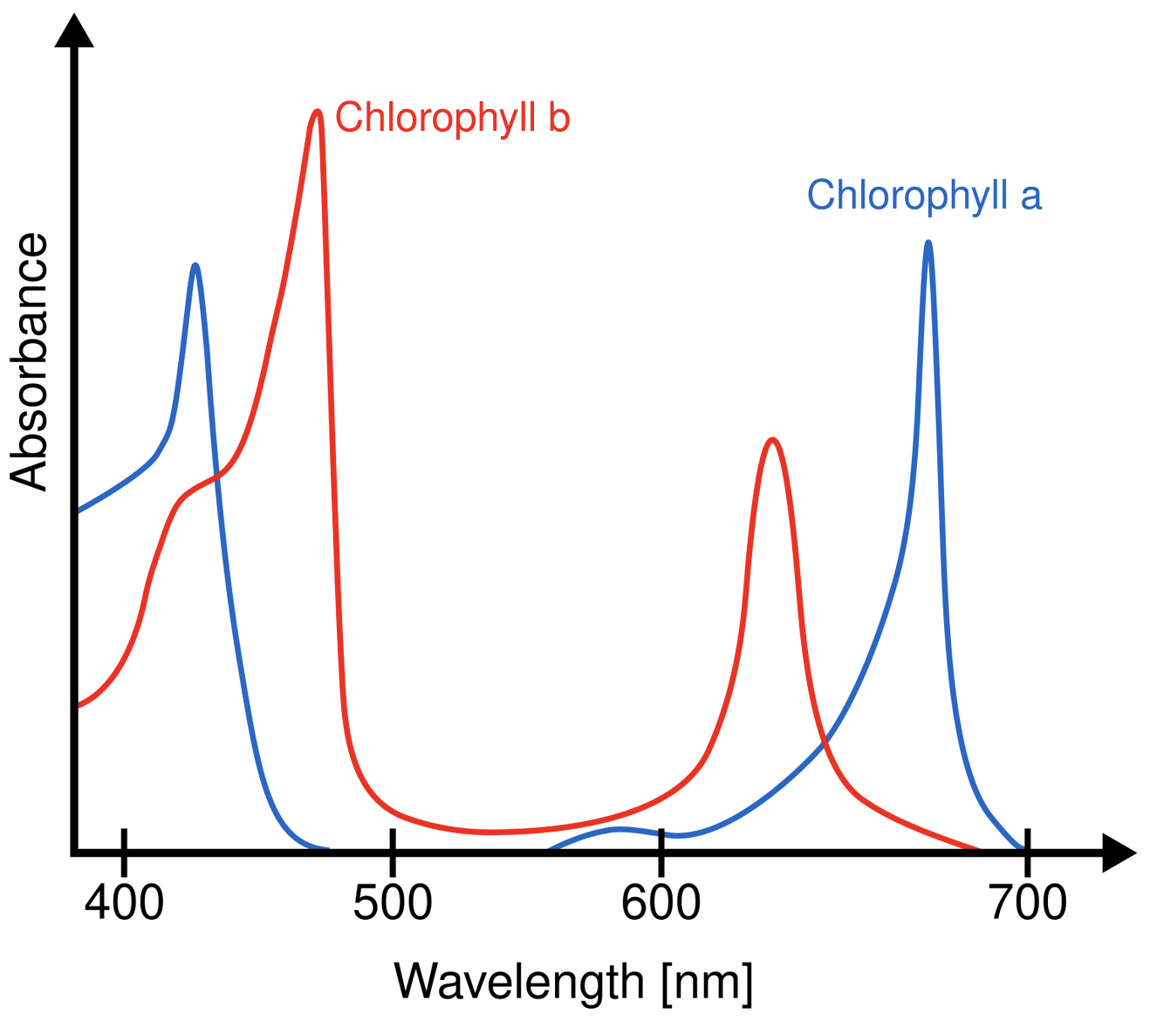
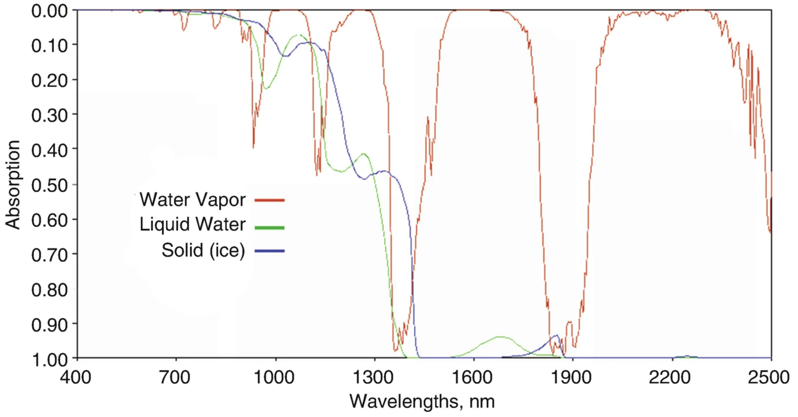
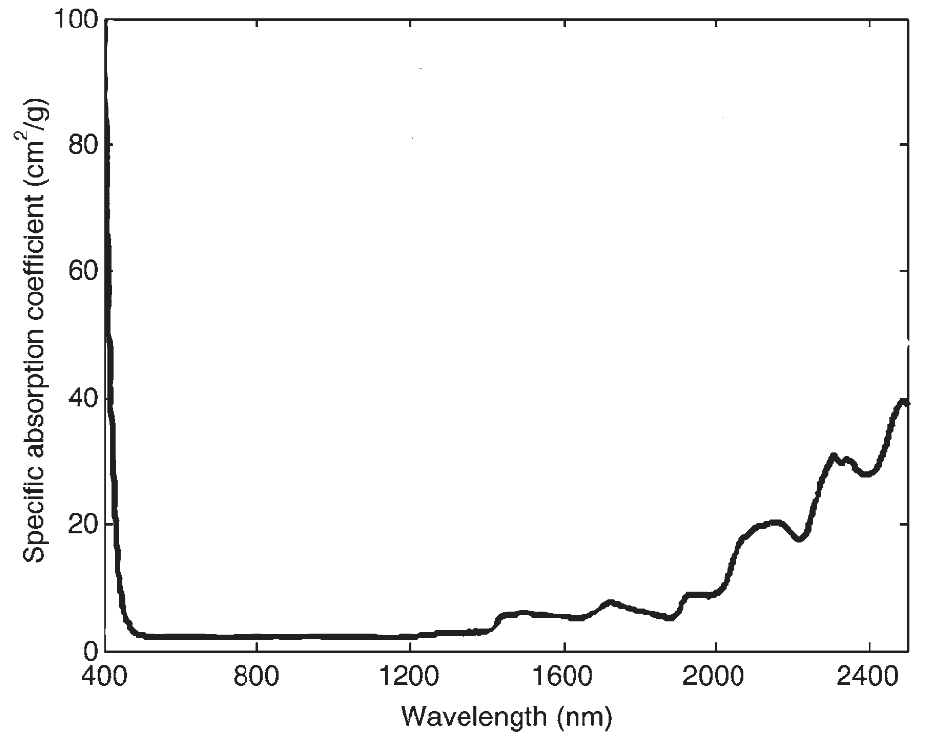
PHYSICAL MODELS IN REMOTE SENSING Chapter 02 – Part 03: Leaf Optics
Absorption Spectra
Leaf dry matter
Wikipedia
Ustin, S.L., Jacquemoud, S. (2020). Doi: 10.1007/978-3-030-33157-3_14
The absorption maxima of chlorophyll a are 430 & 662 nm, and of chlorophyll b are at 453 & 642 nm.
Water absorption features in leaves are found around 980 nm and 1240 nm.
The Shortwave Infrared (SWIR) part of the leaf spectrum (ca. > 1000 nm) is dominated by water absorption when the leaves are living and by leaf chemical constituents when dry.
Many plant compounds have absorptions in the SWIR, including cellulose, lignin, nitrogen (N), sugars, starch, and waxes. The cell wall C compounds comprise the largest fraction of the dry biomass of a leaf.

Slide 8
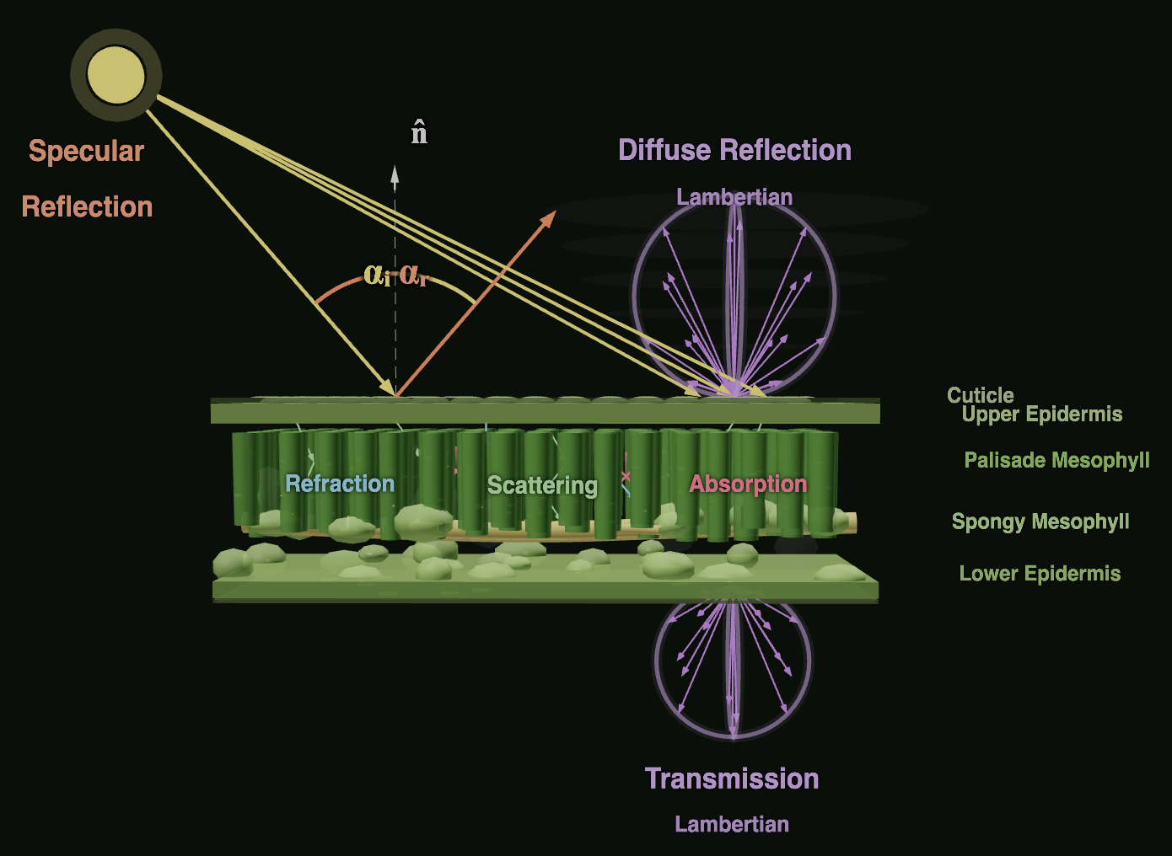
PHYSICAL MODELS IN REMOTE SENSING Chapter 02 – Part 03: Leaf Optics
Interactions at Leaf Surface and Interior
Interactions
Photons can be specularly reflected from the surface of the leaf. These contain no information about leaf biochemical constituents
Photons that enter the interior of the leaf can be either absorbed or refracted and scattered
Absorption depends on wavelength
Photons that are not absorbed in the interior of the leaf emerge through the epidermal cells as diffuse radiation (reflection/transmission)

Slide 9
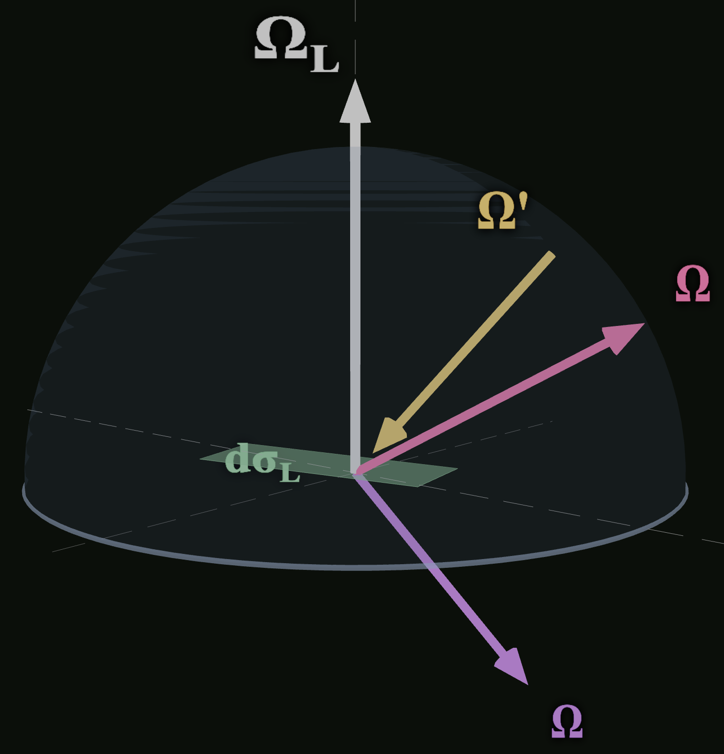
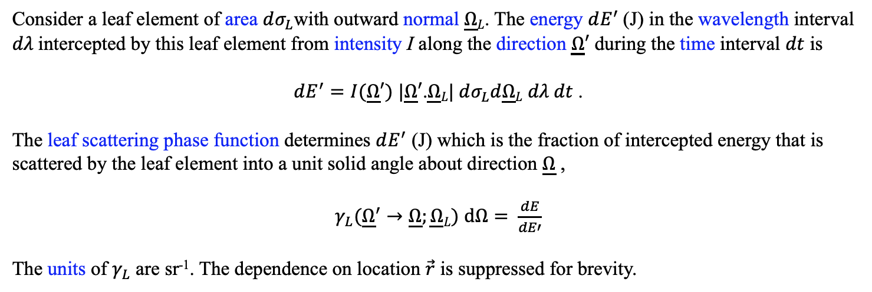
PHYSICAL MODELS IN REMOTE SENSING Chapter 02 – Part 03: Leaf Optics
Leaf Scattering Phase Function: γ_{L}(Ω’−>Ω, Ω_{L})
Consider a leaf element of area $dσ_{L}$with outward normal $\underline{Ω}L$. The energy $dE^{′}$(J) in the wavelength interval $dλ$intercepted by this leaf element from intensity I along the direction $\underline{Ω}′$ during the time interval $dt$ is
$dE^{′}=I(\underline{Ω}′)$ $|\underline{Ω}′$.$\underline{Ω}L| dσ_{L}d\underline{Ω}L$ $dλ dt$ .
The leaf scattering phase function determines $dE^{′}$ (J) which is the fraction of intercepted energy that is scattered by the leaf element into a unit solid angle about direction $\underline{Ω}$ ,
$γ_{L}({\underline{Ω}}^{′}→\underline{Ω};\underline{Ω}L)$ $dΩ= \frac{dE}{dE′}$
The units of $γ_{L}$ are sr⁻¹. The dependence on location $\vec{r}$ is suppressed for brevity.

Slide 10
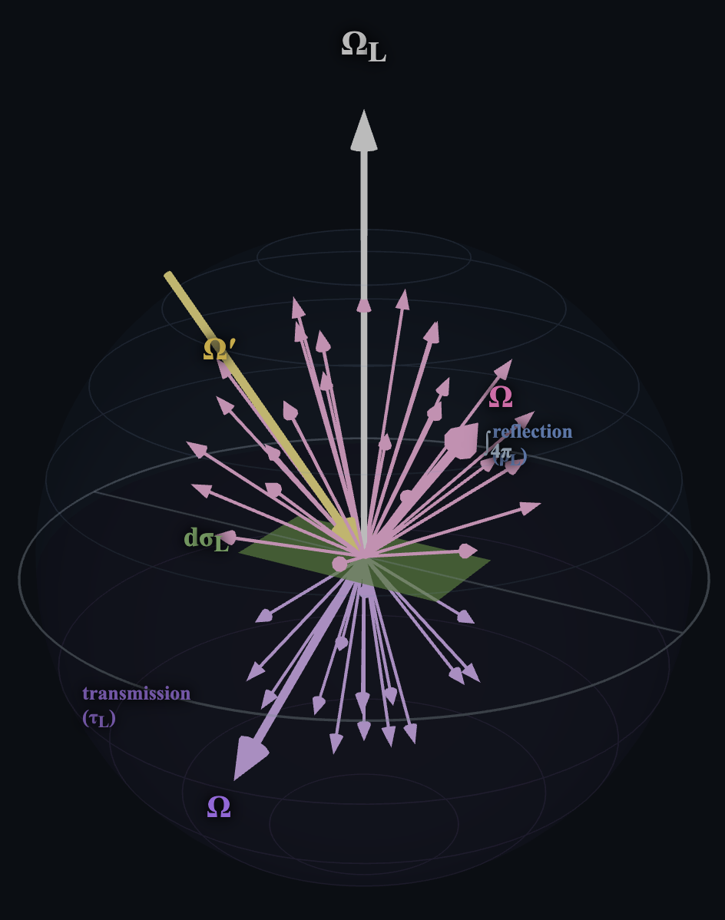
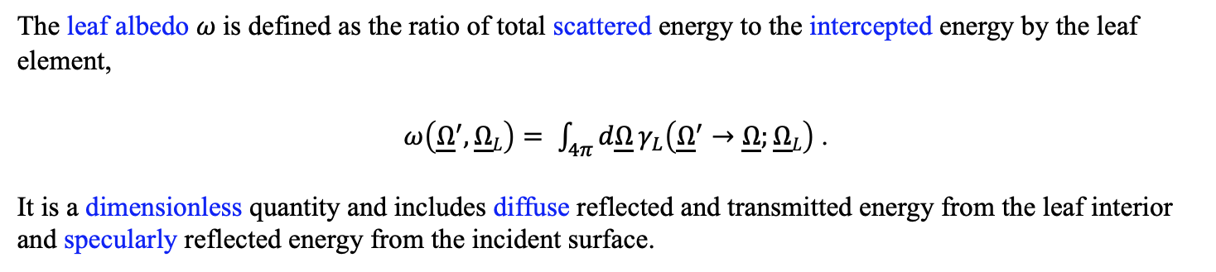
PHYSICAL MODELS IN REMOTE SENSING Chapter 02 – Part 03: Leaf Optics
Leaf Albedo
The leaf albedo $ω$is defined as the ratio of total scattered energy to the intercepted energy by the leaf element,
$ω\left({\underline{Ω}}^{′},\underline{Ω}L\right)= \int_{4π}{d\underline{Ω}}γ_{L}\left({\underline{Ω}}^{′}→\underline{Ω};\underline{Ω}L\right)$ .
It is a dimensionless quantity and includes diffuse reflected and transmitted energy from the leaf interior and specularly reflected energy from the incident surface.

Slide 11
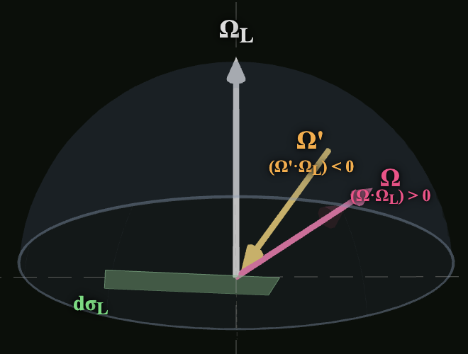
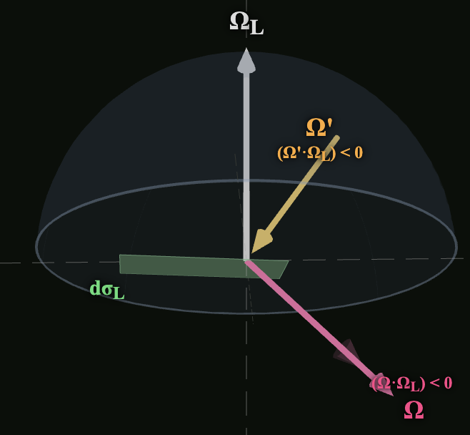
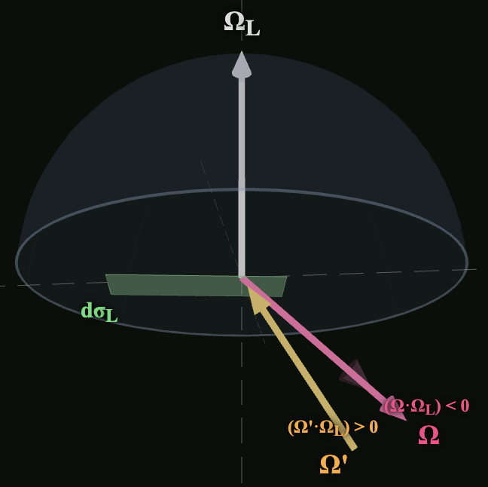
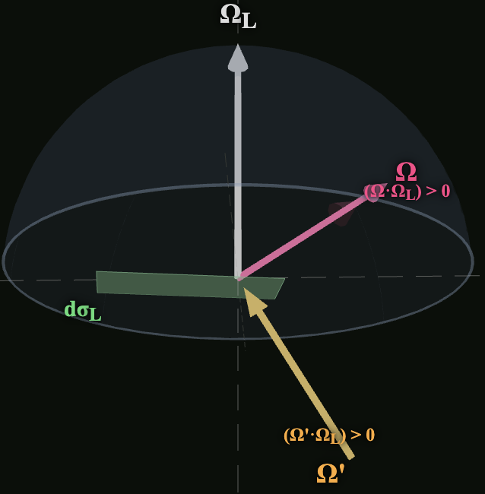
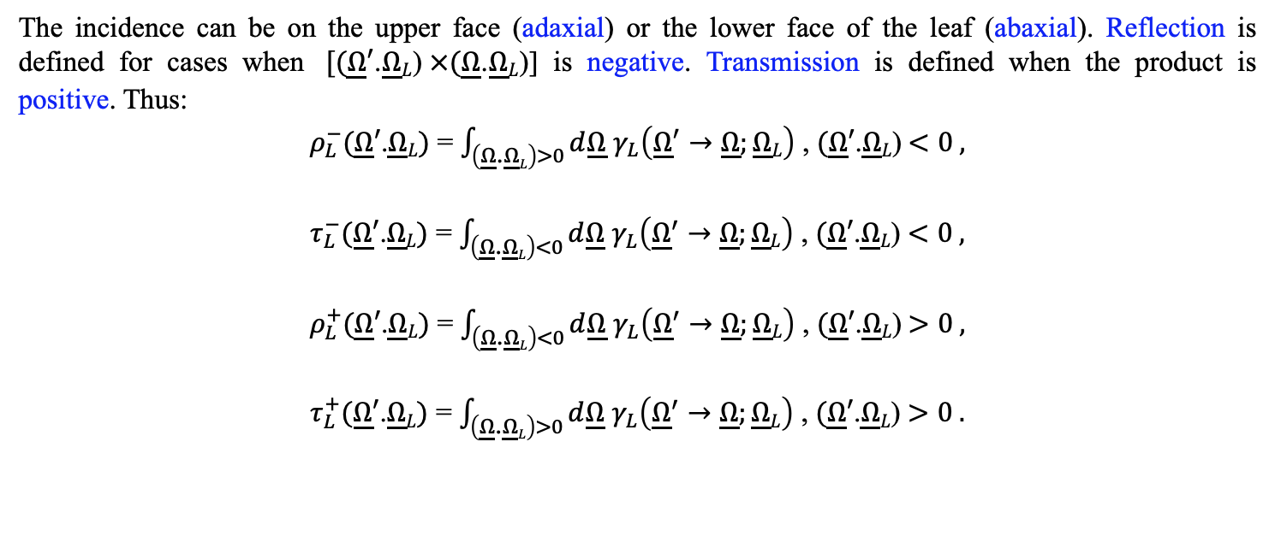
PHYSICAL MODELS IN REMOTE SENSING Chapter 02 – Part 03: Leaf Optics
Leaf Hemispherical Reflectance and Transmittance
Adaxial and Abaxial Interactions
The incidence can be on the upper face (adaxial) or the lower face of the leaf (abaxial). Reflection is defined for cases when $[(\underline{Ω}′$.$\underline{Ω}L$)$×(\underline{Ω}$.$\underline{Ω}L$)] is negative. Transmission is defined when the product is positive. Thus:
$ρ_{L}^{−}(\underline{Ω}′\text{.}\underline{Ω}L)$ = $\int_{\left(\underline{Ω}\text{.}\underline{Ω}L\right)>0}{d\underline{Ω}}$ $γ_{L}\left({\underline{Ω}}^{′}→\underline{Ω};\underline{Ω}L\right)$ , $(\underline{Ω}′$.$\underline{Ω}L$)$<0 ,$
$τ_{L}^{−}(\underline{Ω}′\text{.}\underline{Ω}L)$ = $\int_{\left(\underline{Ω}\text{.}\underline{Ω}L\right)<0}{d\underline{Ω}}$ $γ_{L}\left({\underline{Ω}}^{′}→\underline{Ω};\underline{Ω}L\right)$ , $(\underline{Ω}′$.$\underline{Ω}L$) $<0 ,$
$ρ_{L}^{+}(\underline{Ω}′\text{.}\underline{Ω}L)$ = $\int_{\left(\underline{Ω}\text{.}\underline{Ω}L\right)<0}{d\underline{Ω}}$ $γ_{L}\left({\underline{Ω}}^{′}→\underline{Ω};\underline{Ω}L\right)$ , $(\underline{Ω}′$.$\underline{Ω}L$)$>0 ,$
$τ_{L}^{+}(\underline{Ω}′\text{.}\underline{Ω}L)$ = $\int_{\left(\underline{Ω}\text{.}\underline{Ω}L\right)>0}{d\underline{Ω}}$ $γ_{L}\left({\underline{Ω}}^{′}→\underline{Ω};\underline{Ω}L\right)$ , $(\underline{Ω}′$.$\underline{Ω}L$) $>0 .$

Slide 12
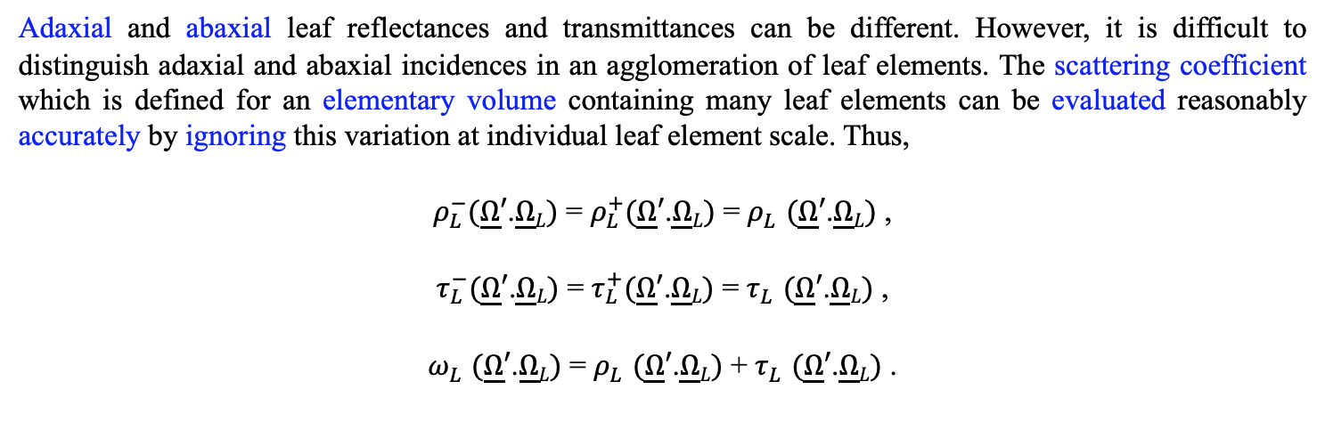
PHYSICAL MODELS IN REMOTE SENSING Chapter 02 – Part 03: Leaf Optics
Leaf Hemispherical Reflectance and Transmittance
Adaxial and abaxial leaf reflectances and transmittances can be different. However, it is difficult to distinguish adaxial and abaxial incidences in an agglomeration of leaf elements. The scattering coefficient which is defined for an elementary volume containing many leaf elements can be evaluated reasonably accurately by ignoring this variation at individual leaf element scale. Thus,
$ρ_{L}^{−}(\underline{Ω}′\text{.}\underline{Ω}L)$ = $ρ_{L}^{+}(\underline{Ω}′\text{.}\underline{Ω}L)$ = $ρ_{L}^{}(\underline{Ω}′\text{.}\underline{Ω}L)$ ,
$τ_{L}^{−}(\underline{Ω}′\text{.}\underline{Ω}L)$ = $τ_{L}^{+}(\underline{Ω}′\text{.}\underline{Ω}L)$ = $τ_{L}^{}(\underline{Ω}′\text{.}\underline{Ω}L)$ ,
$ω_{L}^{}(\underline{Ω}′\text{.}\underline{Ω}L)$ = $ρ_{L}^{}(\underline{Ω}′\text{.}\underline{Ω}L)$ + $τ_{L}^{}(\underline{Ω}′\text{.}\underline{Ω}L)$ .

Slide 13
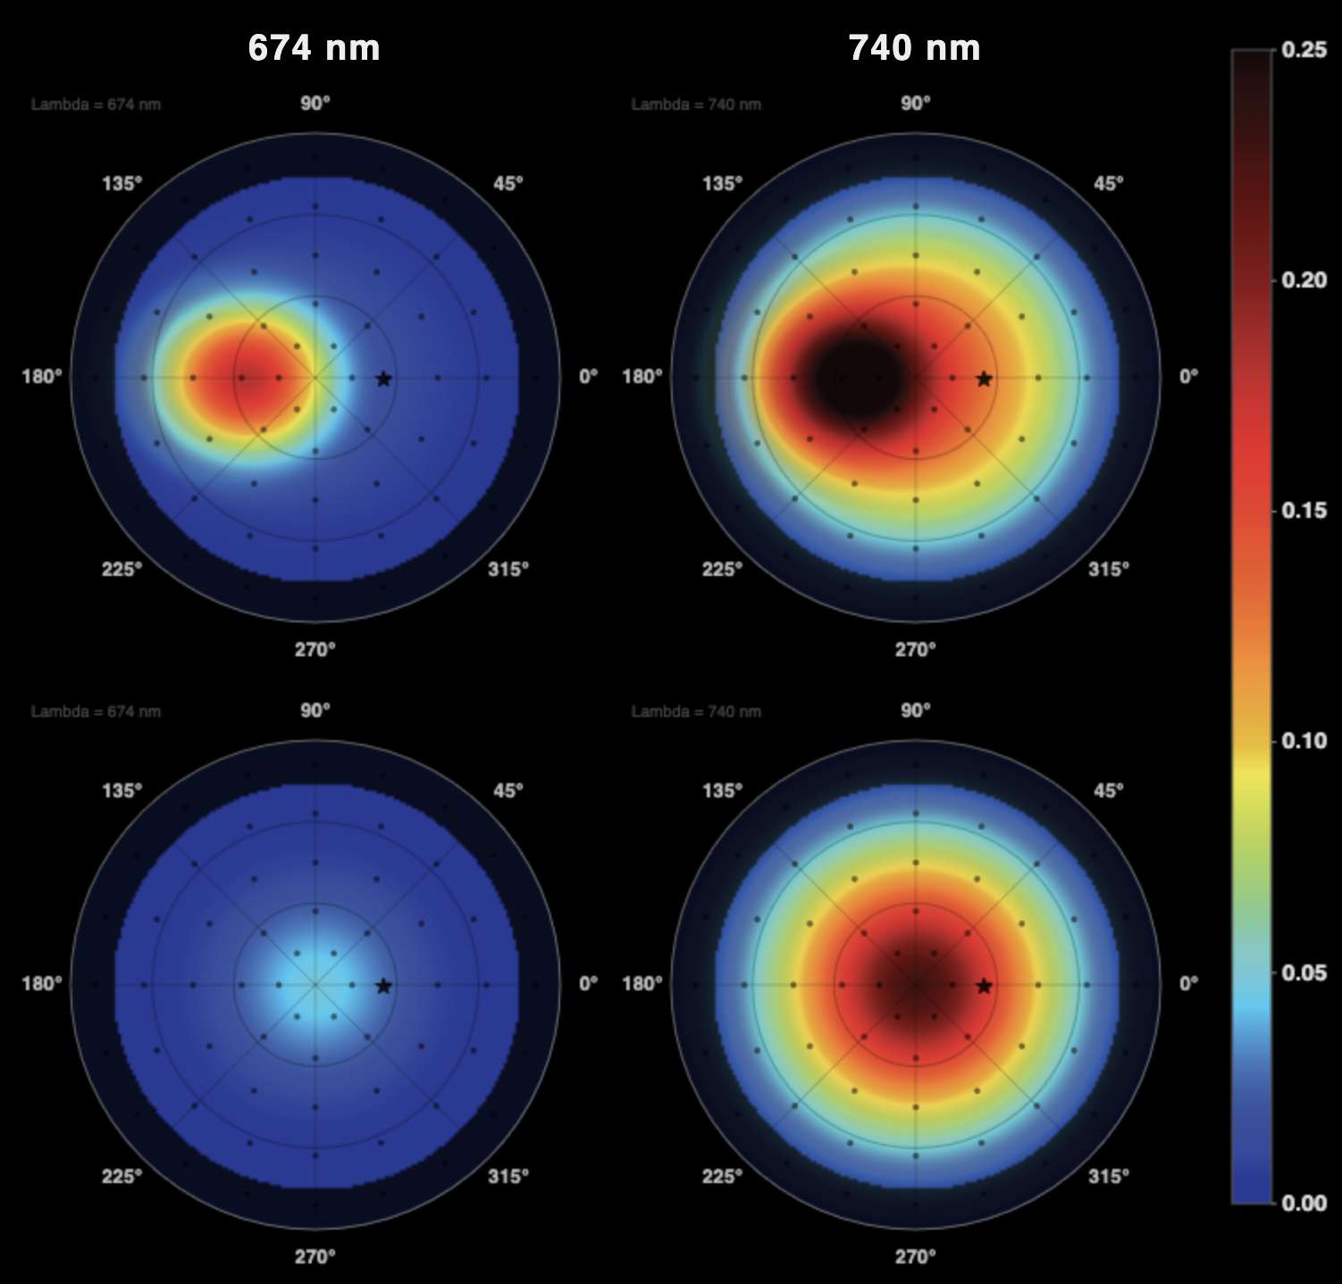
PHYSICAL MODELS IN REMOTE SENSING Chapter 02 – Part 03: Leaf Optics
Diffuse and Specular Leaf Scattering Phase Functions
Absorption and scattering of radiation by a leaf depends on the wavelength. Leaves have a unique signature comprising of strong absorption at the red waveband (~680 nm) and strong scattering at the near-infrared waveband (700 to 1100 nm). This signature is used in remote sensing of vegetation type and properties such as leaf area index.
The angular distribution of radiation reflected by a green leaf shows strong anisotropy with a characteristic peak about the specular direction. The transmitted radiation on the other hand is more Lambertian. These angular distributions vary with wavelength, especially in their magnitude.

Slide 14
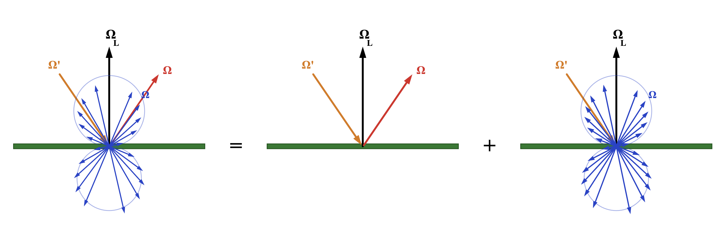
PHYSICAL MODELS IN REMOTE SENSING Chapter 02 – Part 03: Leaf Optics
Diffuse and Specular Leaf Scattering Phase Functions
$γ_{L}\left({\underline{Ω}}^{′}→\underline{Ω};\underline{Ω}L\right)$ = $γ_{LD}\left({\underline{Ω}}^{′}→\underline{Ω};\underline{Ω}L\right)$ + $γ_{LS}\left({\underline{Ω}}^{′}→\underline{Ω};\underline{Ω}L\right)$
It is convenient to express the leaf scattering phase function as the sum of its diffuse and specular components for the purpose of formulating simple models to capture diffuse scattering from the leaf interior and specular reflection from the leaf surface.

Slide 15
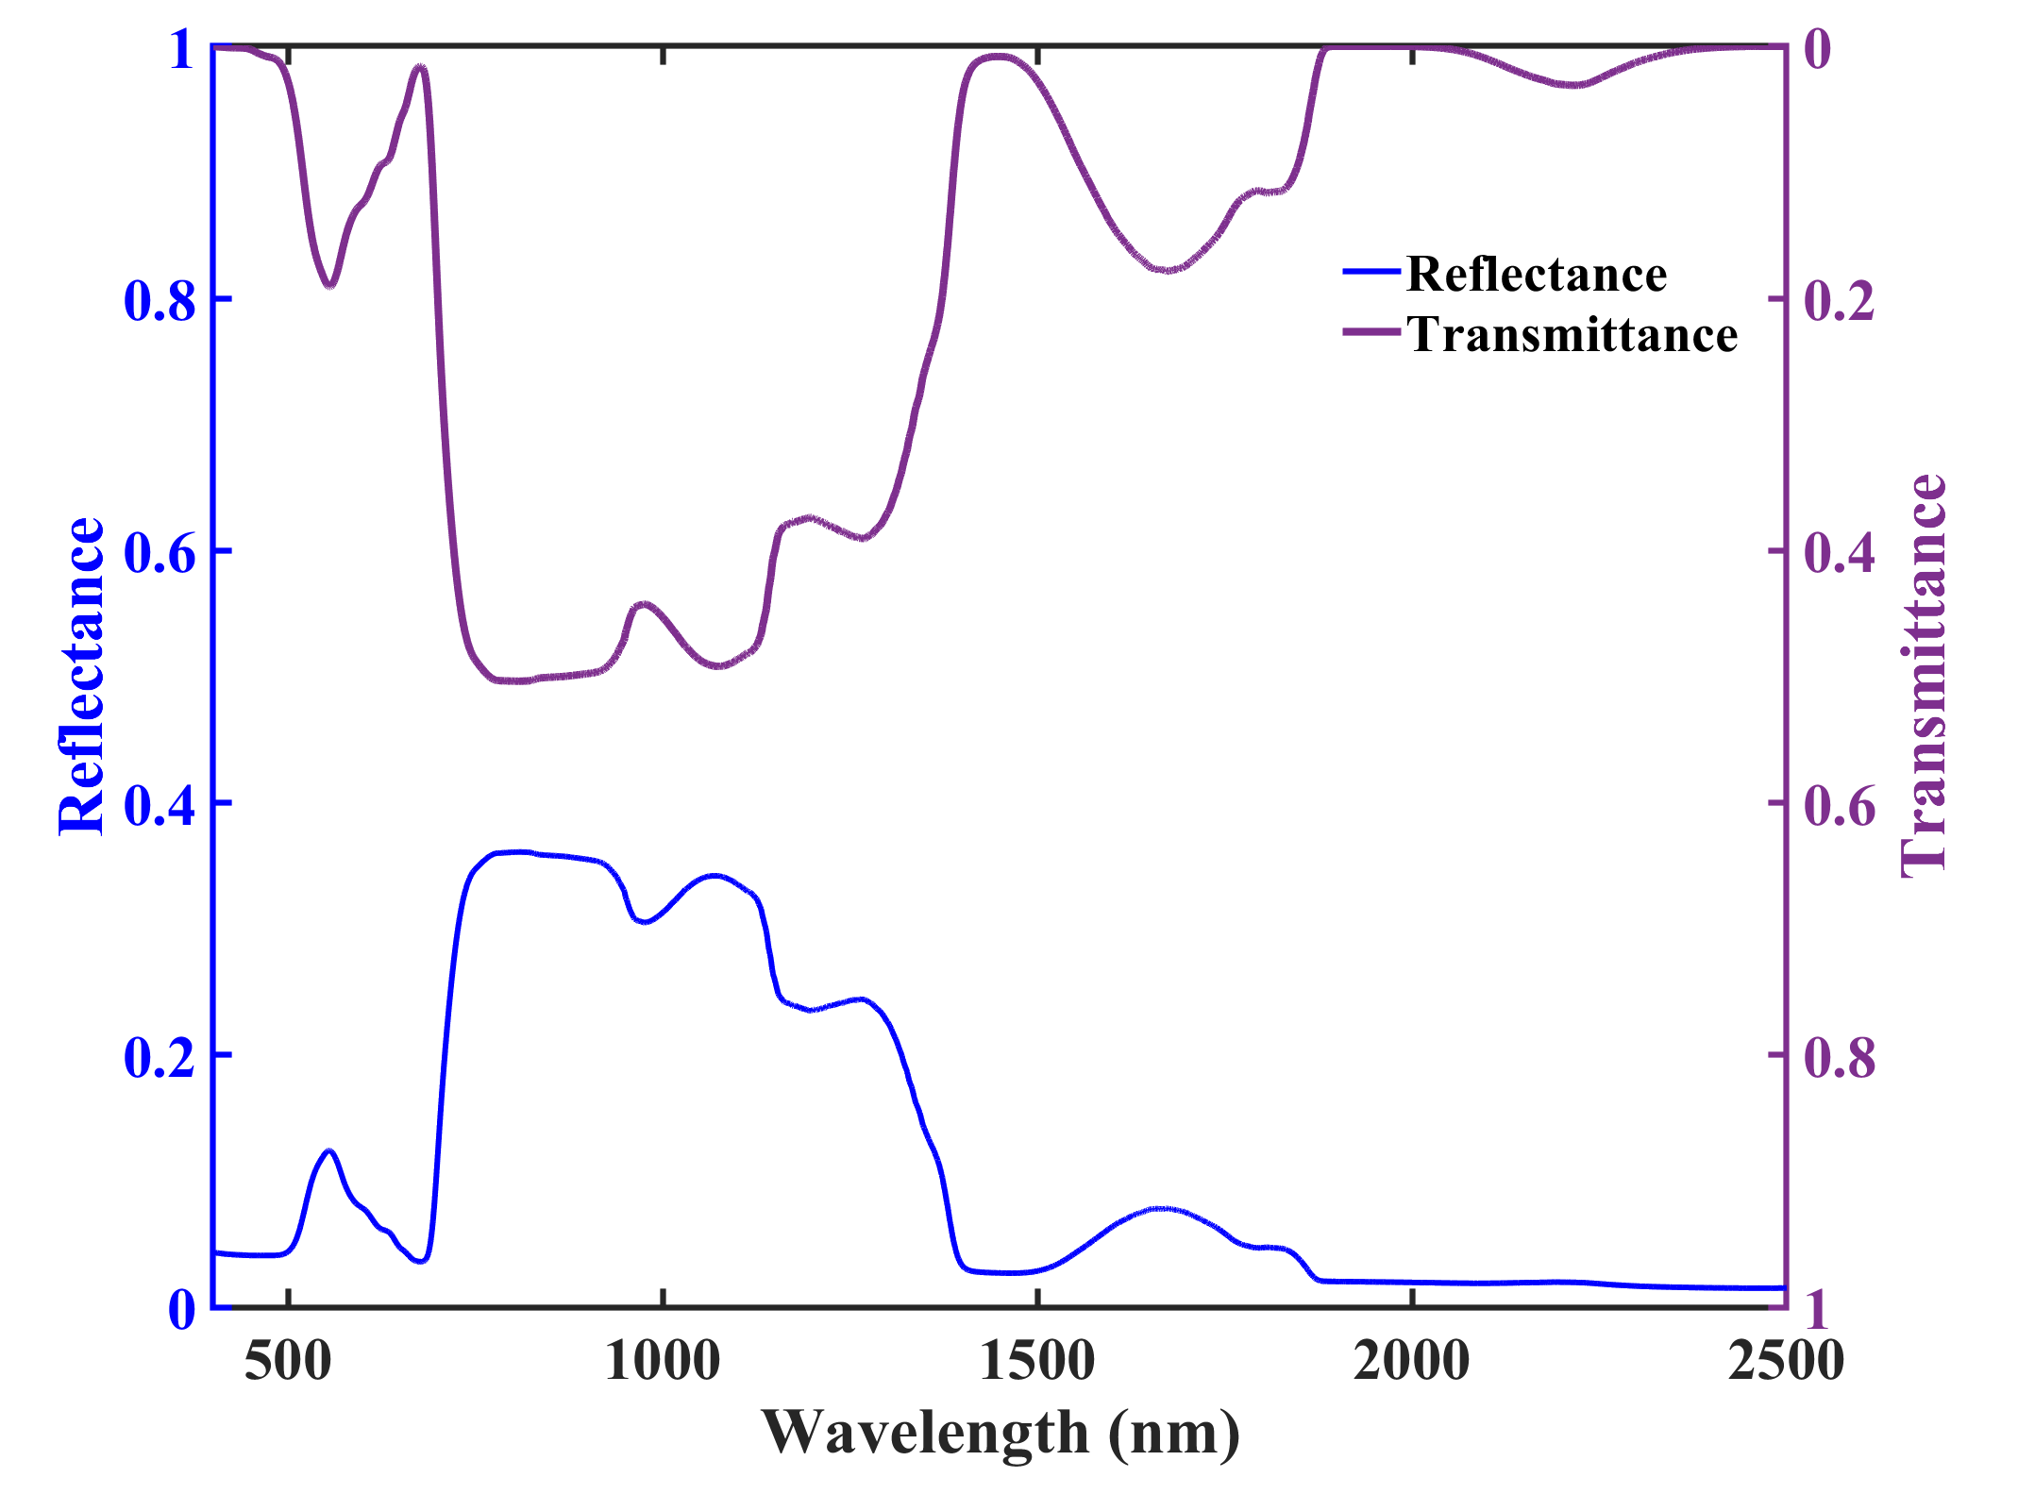
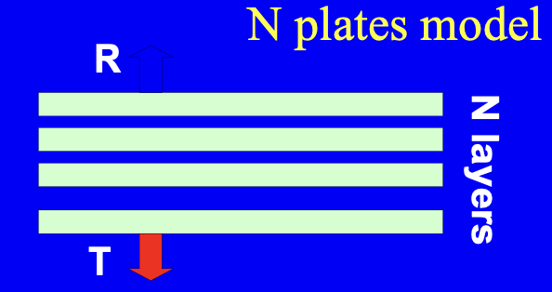
PHYSICAL MODELS IN REMOTE SENSING Chapter 02 – Part 03: Leaf Optics
Diffuse Interactions: Prospect Leaf Model
“Prospect” models a single leaf diffuse reflectance and transmittance as a function of leaf biochemical content and anatomical structure. The model combines transmission through an elementary layer using Beer-Lambert law and multiple reflection between N layers (Stokes system).
Inputs to the Prospect leaf model include a structure parameter N the number of layers (1.2) and its biochemical constituents (chlorophyll a+b concentration (30 μg.cm⁻²), carotenoids (10 μg.cm⁻²), anthocyanins (1 μg.cm⁻²), dry matter content (0.0015 g.cm⁻²) and equivalent water thickness (0.09 g. cm⁻²). The model outputs leaf reflectance and transmittance spectra in the wavelength range 400 to 2500 nm. The outputs are directional-hemispherical quantities, and they represent the result of photon transport and interactions in the interior of the leaf.

Slide 16
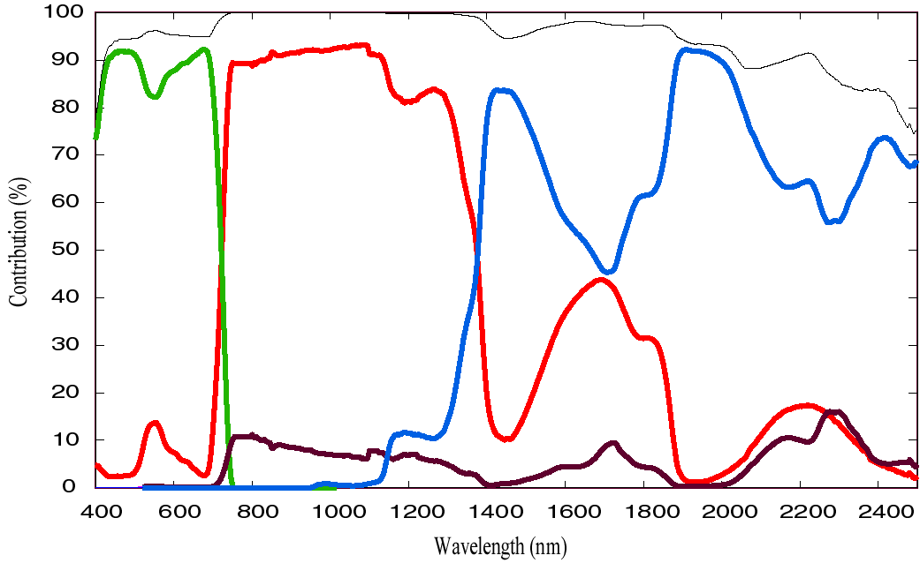
PHYSICAL MODELS IN REMOTE SENSING Chapter 02 – Part 03: Leaf Optics
Diffuse Interactions: Prospect Sensitivity Analysis
Leaf structure parameter, N
Chlorophyll content, C_{ab}
Equivalent water thickness, C_{w}
Dry matter content, C_{m}
Sum of the contributions to reflectance
Jacquemoud S, Ustin S., 2019.
doi: 10.1017/9781108686457
The sensitivity analysis shows the contribution of leaf internal structure and biochemical content to its diffuse reflectance. Chlorophyll dominates the signature in the visible region (400-700 nm), the structure contributes the most in the near-infrared region (700-1100 nm). Absorption features of water in the shortwave infrared region (> 1400 nm) imbue a characteristic signature to the leaf reflectance. The contribution of dry matter is generally less that 15% and is important only at wavelengths greater than 1500 nm.

Slide 17
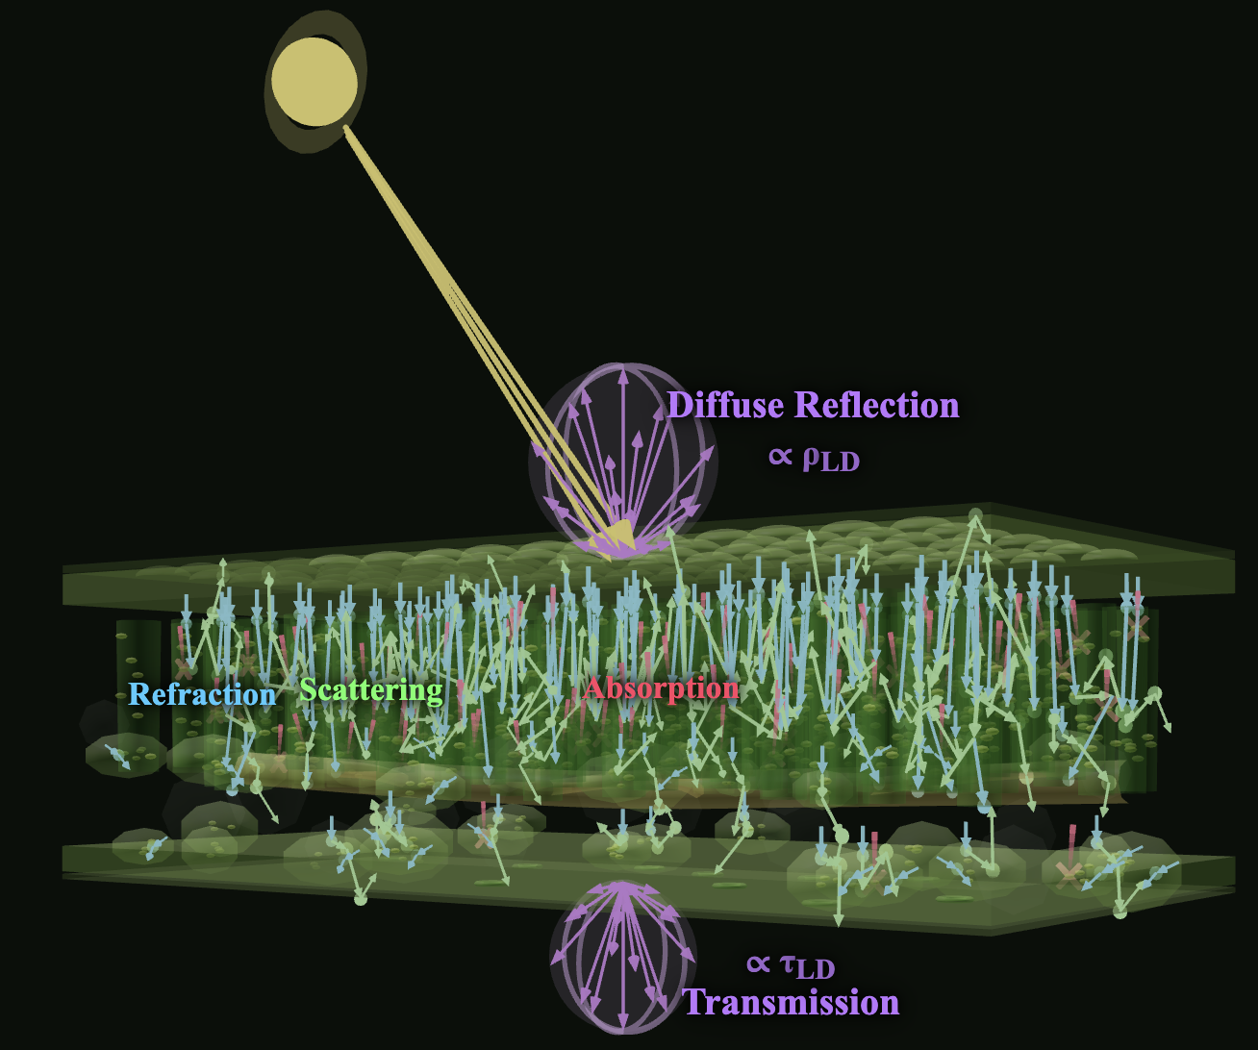
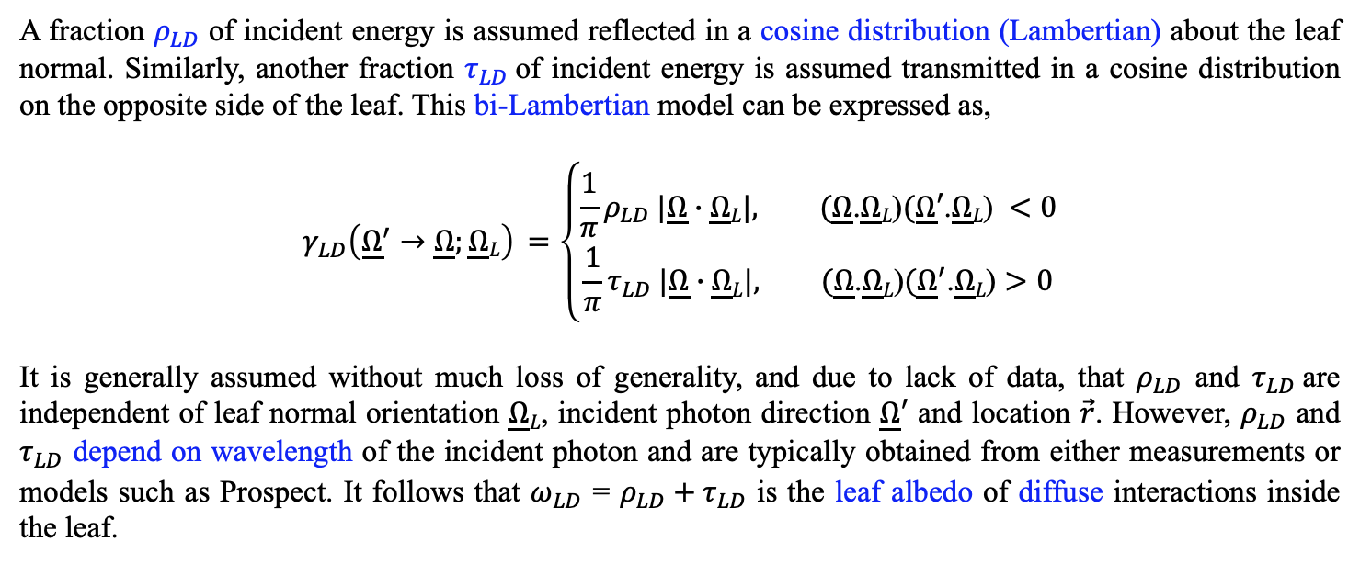
PHYSICAL MODELS IN REMOTE SENSING Chapter 02 – Part 03: Leaf Optics
Diffuse Interactions: The Bi-Lambertian Model
Diffuse Interactions
A fraction $ρ_{LD}$ of incident energy is assumed reflected in a cosine distribution (Lambertian) about the leaf normal. Similarly, another fraction $τ_{LD}$of incident energy is assumed transmitted in a cosine distribution on the opposite side of the leaf. This bi-Lambertian model can be expressed as,
$$γ_{LD}\left({\underline{Ω}}^{′}→\underline{Ω};\underline{Ω}L\right) =\left\{\begin{aligned}\frac{1}{π}ρ_{LD} |\underline{Ω}∙\underline{Ω}L|, (\underline{Ω}\text{.}\underline{Ω}L\text{)}(\underline{Ω}′\text{.}\underline{Ω}L\text{)} <0 \\ &\frac{1}{π}τ_{LD} |\underline{Ω}∙\underline{Ω}L|, (\underline{Ω}\text{.}\underline{Ω}L\text{)}({\underline{Ω}}^{′}\text{.}\underline{Ω}L\text{)}>0\end{aligned}\right.$$
It is generally assumed without much loss of generality, and due to lack of data, that $ρ_{LD}$ and $τ_{LD}$are independent of leaf normal orientation $\underline{Ω}L$, incident photon direction $\underline{Ω}′$ and location $\vec{r}$. However, $ρ_{LD}$ and $τ_{LD}$ depend on wavelength of the incident photon and are typically obtained from either measurements or models such as Prospect. It follows that $ω_{LD}^{}$ = $ρ_{LD}+τ_{LD}$ is the leaf albedo of diffuse interactions inside the leaf.

Slide 18
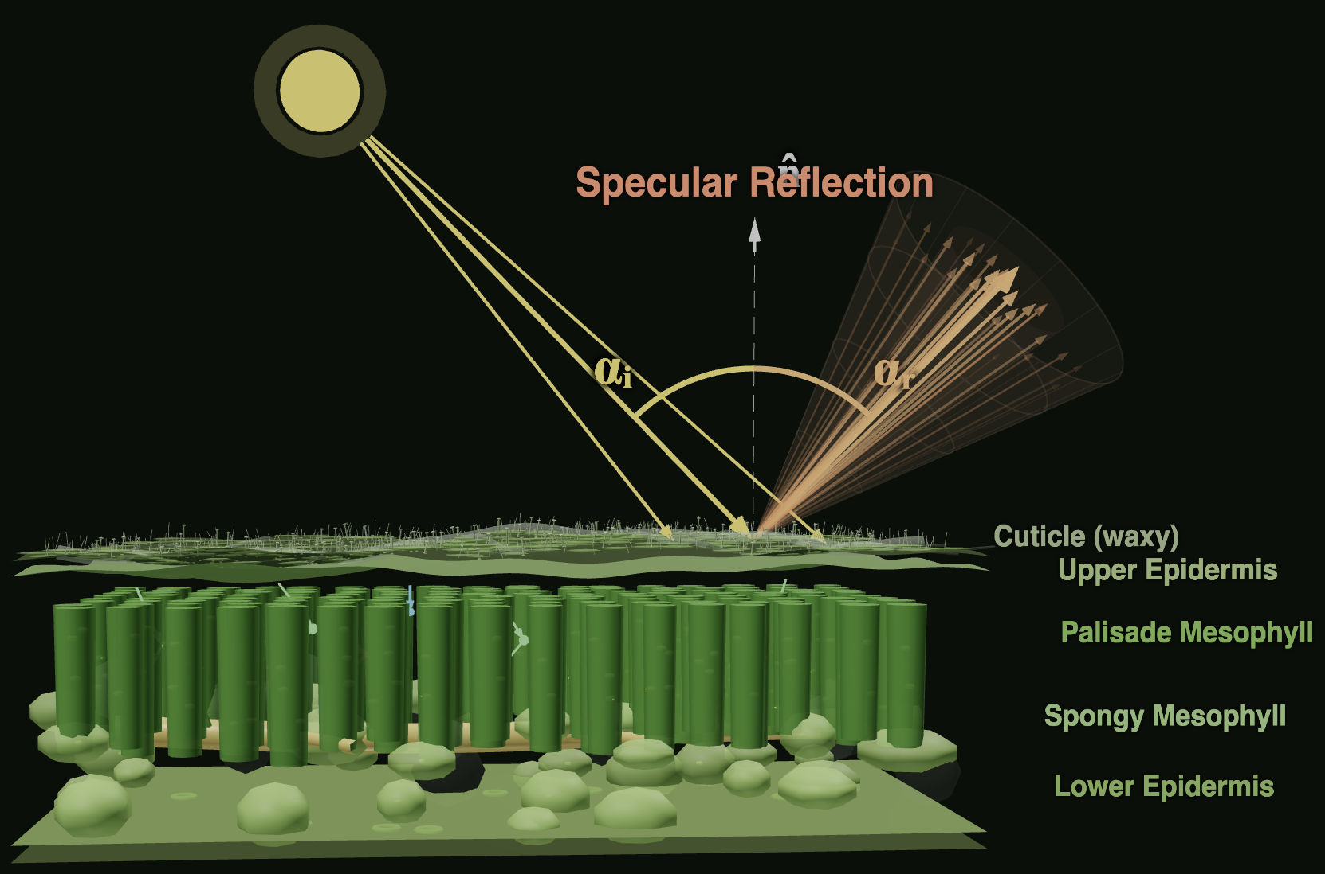
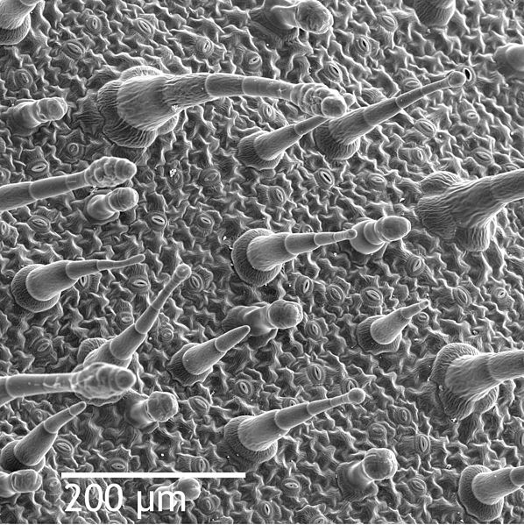
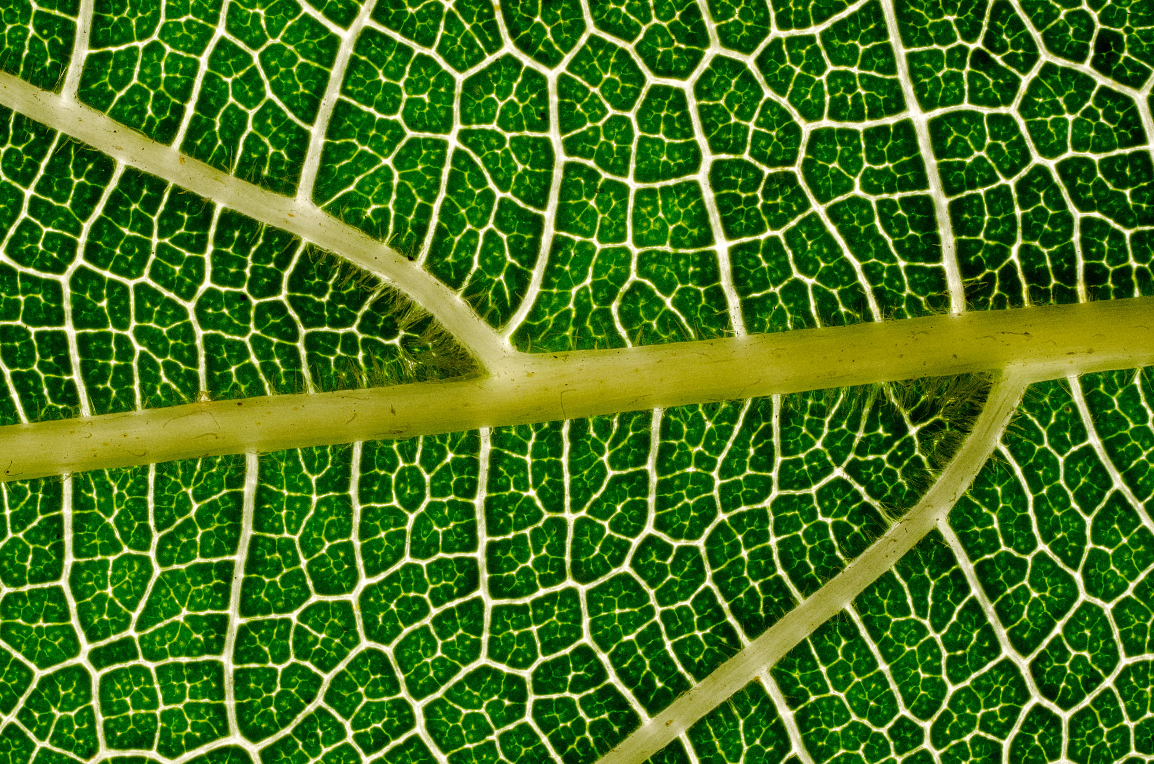
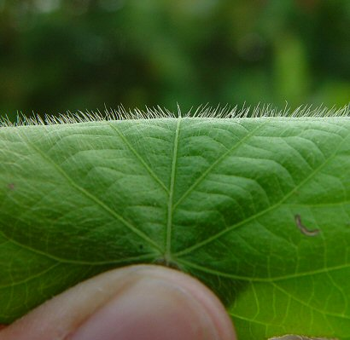
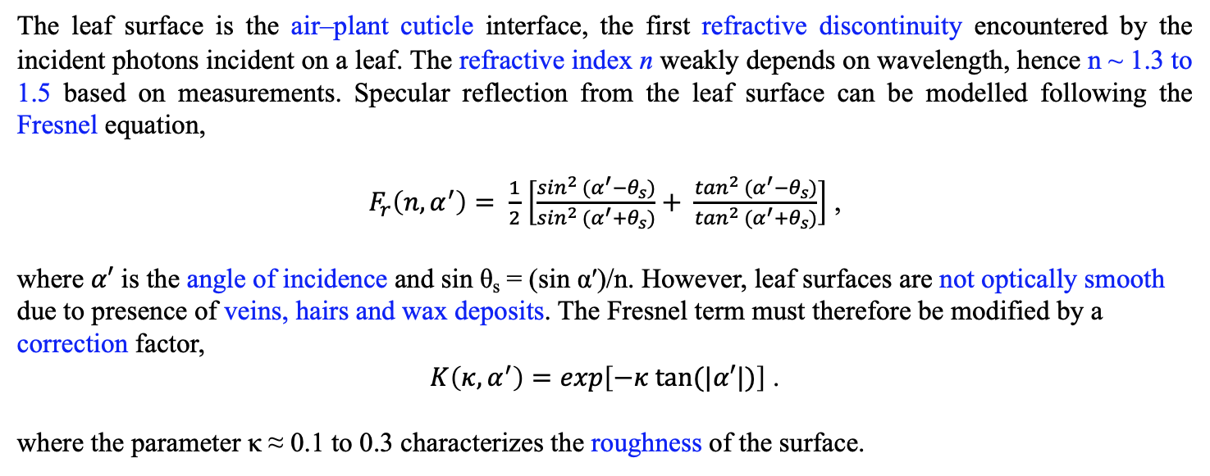
PHYSICAL MODELS IN REMOTE SENSING Chapter 02 – Part 03: Leaf Optics
Surface Interactions: Specular Reflection Model
Leaf epidermis
Wikipedia Commons
Specular Reflection from Leaf Surface
The leaf surface is the air–plant cuticle interface, the first refractive discontinuity encountered by the incident photons incident on a leaf. The refractive index n weakly depends on wavelength, hence n ~ 1.3 to 1.5 based on measurements. Specular reflection from the leaf surface can be modelled following the Fresnel equation,
$F_{r}\left(n,α^{′}\right)= \frac{1}{2}$ $\left[\frac{\sin^{2} (α^{′}−θ_{s})}{\sin^{2} (α^{′}+θ_{s})}+ \frac{\tan^{2} (α^{′}−θ_{s})}{\tan^{2} (α^{′}+θ_{s})}\right]$ ,
where $α′$ is the angle of incidence and sin θ_{s} = (sin α′)/n. However, leaf surfaces are not optically smooth due to presence of veins, hairs and wax deposits. The Fresnel term must therefore be modified by a correction factor,
$K\left(κ,α^{′}\right)=exp\left[−κ tan⁡(|α′|)\right]$ .
where the parameter κ ≈ 0.1 to 0.3 characterizes the roughness of the surface.

Slide 19
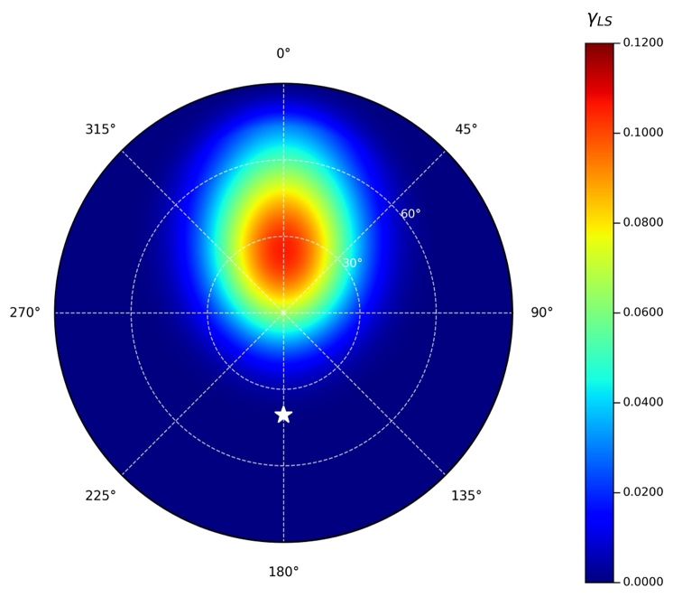
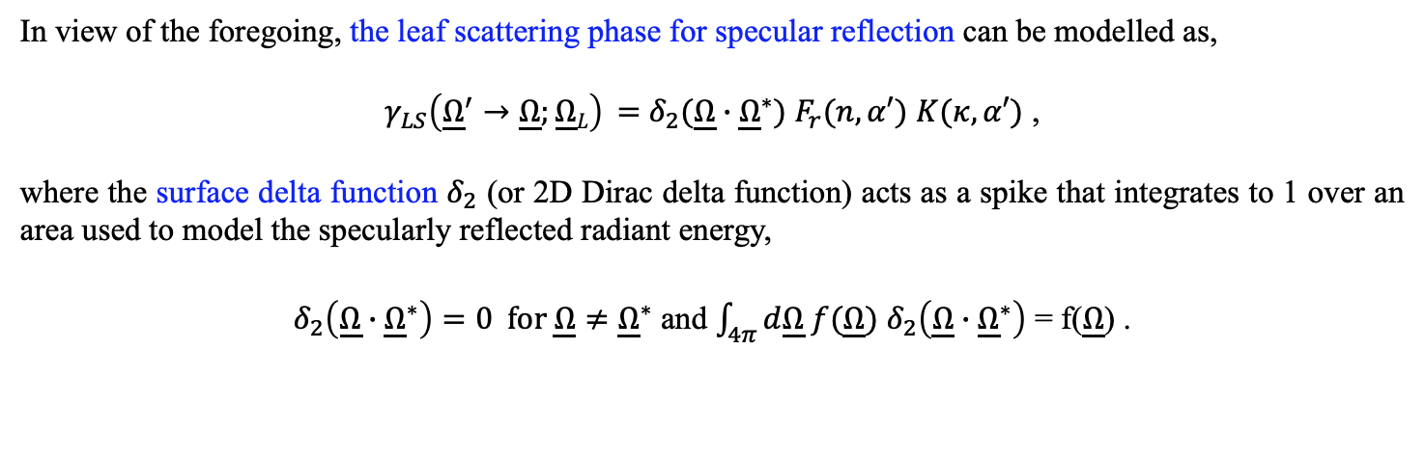
PHYSICAL MODELS IN REMOTE SENSING Chapter 02 – Part 03: Leaf Optics
Surface Interactions: Specular Reflection Model
In view of the foregoing, the leaf scattering phase for specular reflection can be modelled as,
$γ_{LS}\left({\underline{Ω}}^{′}→\underline{Ω};\underline{Ω}L\right) =$ $δ_{2}(\underline{Ω}∙{\underline{Ω}}^{∗})$ $F_{r}(n,α′)$ $K(κ,α′)$ ,
where the surface delta function $δ_{2}$ (or 2D Dirac delta function) acts as a spike that integrates to 1 over an area used to model the specularly reflected radiant energy,
$δ_{2}\left(\underline{Ω}∙{\underline{Ω}}^{∗}\right)=0 for \underline{Ω}≠{\underline{Ω}}^{∗}$ and $\int_{4π}{d\underline{Ω} f(\underline{Ω})}$ $δ_{2}\left(\underline{Ω}∙{\underline{Ω}}^{∗}\right)$ = f($\underline{Ω}$) .

Slide 20
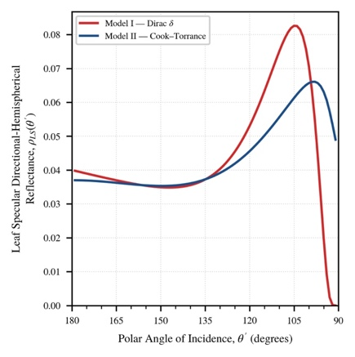

PHYSICAL MODELS IN REMOTE SENSING Chapter 02 – Part 03: Leaf Optics
Surface Interactions: Specular Reflection Model
The leaf albedo for specular reflection $ω_{LS}^{}$is thus,
$ω_{LS}^{}(α^{′},n,κ)$ = $\int_{4π}{d\underline{Ω}}$ + $γ_{LS}\left({\underline{Ω}}^{′}→\underline{Ω};\underline{Ω}L\right)$ = $F_{r}(n,α′)$ $K(κ,α′)$ .

