Slide 1
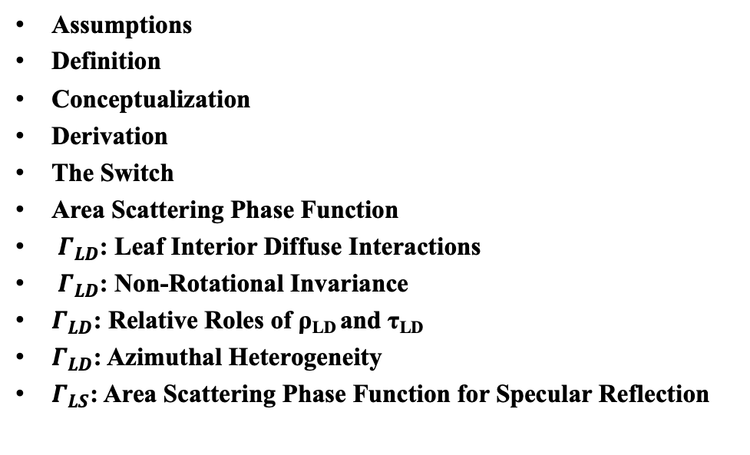
PHYSICAL MODELS IN REMOTE SENSING Chapter 02 – Part 04: Differential Scattering Coefficient
Assumptions
Definition
Conceptualization
Derivation
The Switch
Area Scattering Phase Function
$Γ_{LD}$: Leaf Interior Diffuse Interactions
$Γ_{LD}$: Non-Rotational Invariance
$Γ_{LD}$: Relative Roles of ρ_{LD} and τ_{LD}
$Γ_{LD}$: Azimuthal Heterogeneity
$Γ_{LS}$: Area Scattering Phase Function for Specular Reflection

Slide 2
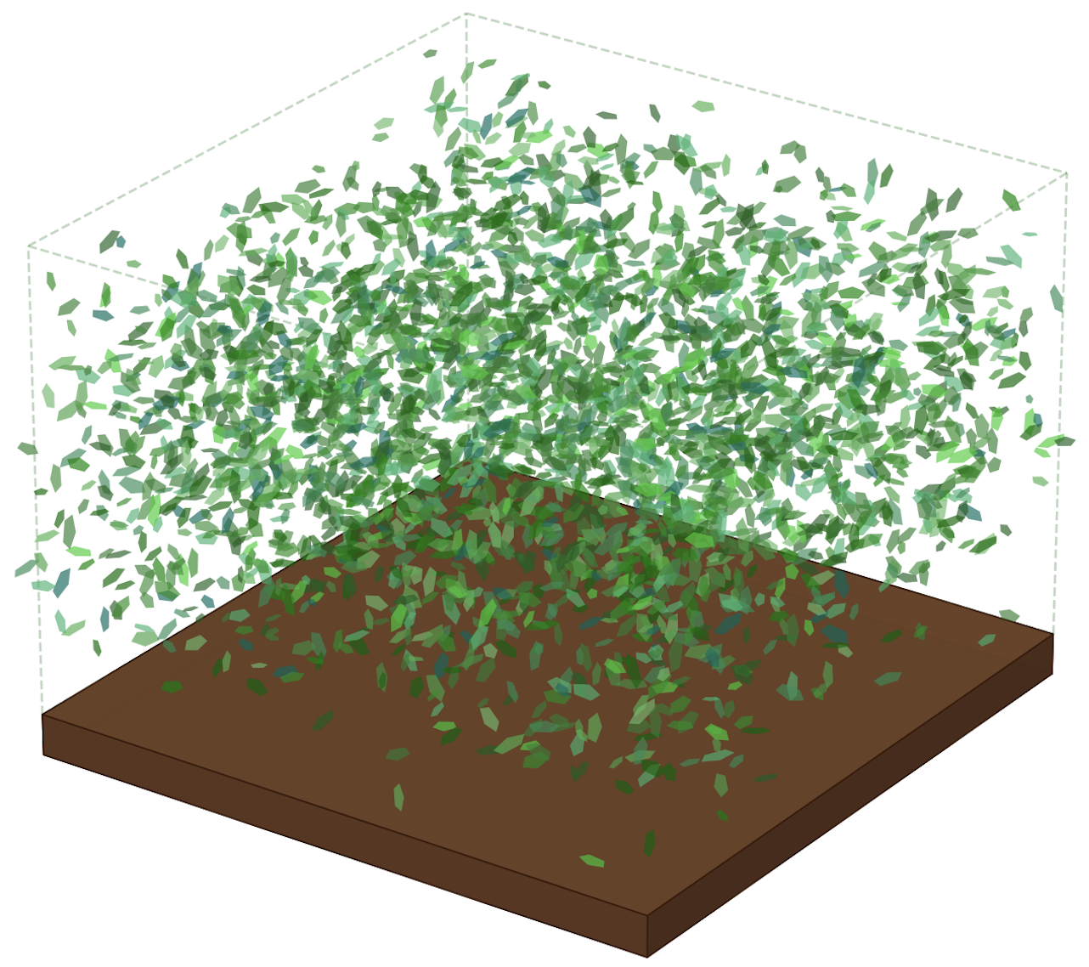
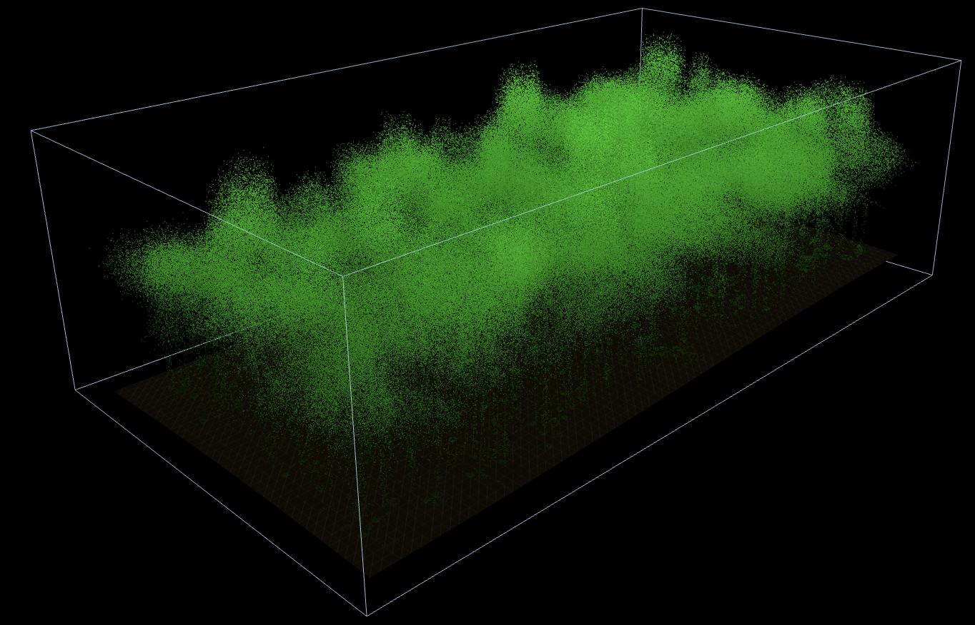
PHYSICAL MODELS IN REMOTE SENSING Chapter 02 – Part 02: Extinction Coefficient
Assumptions
Simulated Temperate Forest Lidar Scans
We discussed the complexity and dynamics of vegetation canopy structure previously.
Therefore, we resort to a simple abstraction of canopy structure as a turbid medium or a green gas.
The medium is assumed to be densely filled with small planar elements of negligible thickness.
These elements are oriented in space as specified by a distribution function of their normals.
A critical assumption is that the shadows of these small elements, that is, their projections on a plane perpendicular to any direction in the sphere, do not overlap.

Slide 3
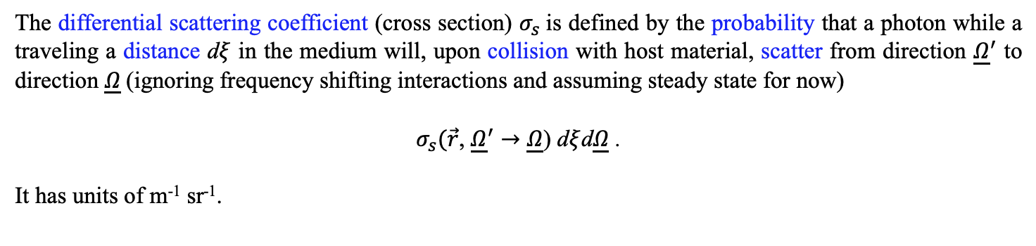
PHYSICAL MODELS IN REMOTE SENSING Chapter 02 – Part 04: Differential Scattering Coefficient
Definition
The differential scattering coefficient (cross section) $σ_{s}$is defined by the probability that a photon while a traveling a distance d$ξ$ in the medium will, upon collision with host material, scatter from direction ${\underline{Ω}}^{′}$ to direction $\underline{Ω}$(ignoring frequency shifting interactions and assuming steady state for now)
$σ_{s}(\vec{r}\text{,} {\underline{Ω}}^{′}→\underline{Ω}\text{)} \text{d}ξ$d$\underline{Ω}$ .
It has units of m⁻¹ sr⁻¹.

Slide 4
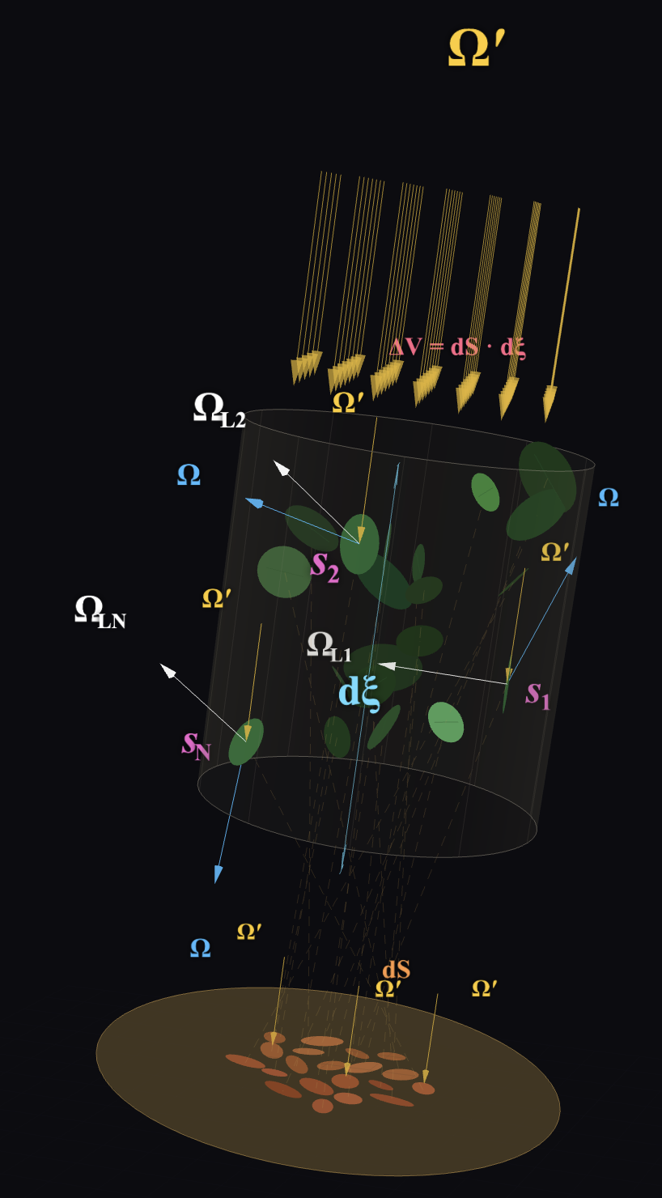
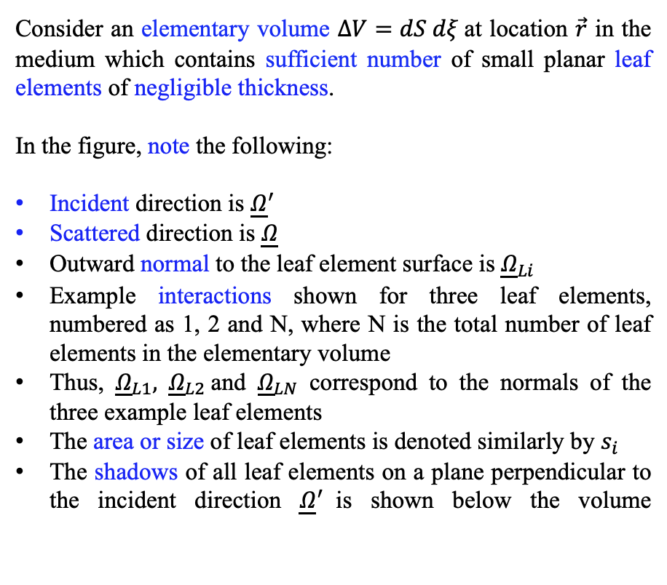
PHYSICAL MODELS IN REMOTE SENSING Chapter 02 – Part 04: Differential Scattering Coefficient
Conceptualization
Consider an elementary volume $ΔV=dS dξ$at location $\vec{r}$ in the medium which contains sufficient number of small planar leaf elements of negligible thickness.
In the figure, note the following:
Incident direction is ${\underline{Ω}}^{′}$
Scattered direction is $\underline{Ω}$
Outward normal to the leaf element surface is ${\underline{Ω}}_{Li}$
Example interactions shown for three leaf elements, numbered as 1, 2 and N, where N is the total number of leaf elements in the elementary volume
Thus, ${\underline{Ω}}_{L1},$ ${\underline{Ω}}_{L2}$and ${\underline{Ω}}_{LN}$ correspond to the normals of the three example leaf elements
The area or size of leaf elements is denoted similarly by $s_{i}$
The shadows of all leaf elements on a plane perpendicular to the incident direction ${\underline{Ω}}^{′}$is shown below the volume
Derivation

Slide 5
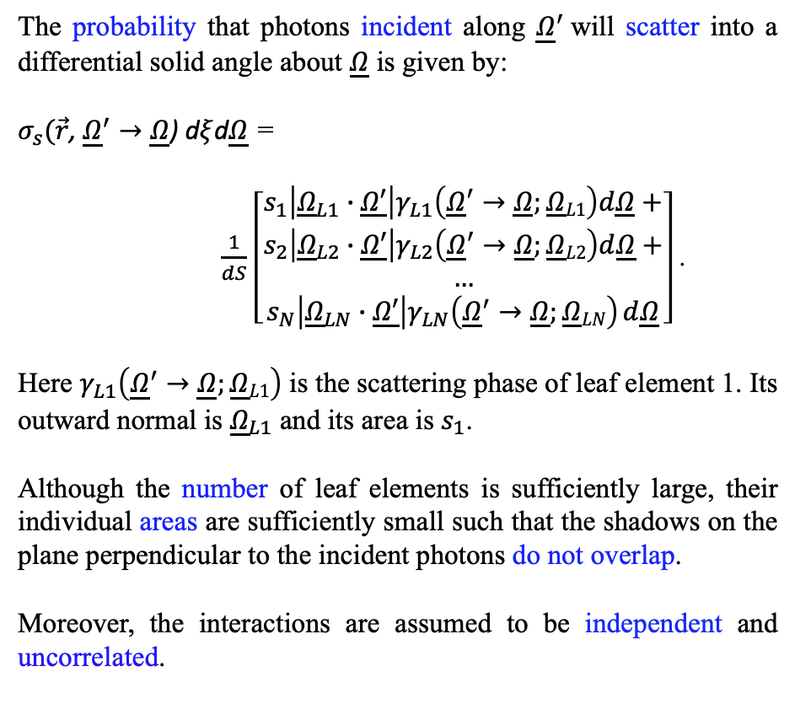
PHYSICAL MODELS IN REMOTE SENSING Chapter 02 – Part 04: Differential Scattering Coefficient
Derivation
The probability that photons incident along ${\underline{Ω}}^{′}$will scatter into a differential solid angle about $\underline{Ω}$ is given by:
$σ_{s}(\vec{r}\text{,} {\underline{Ω}}^{′}→\underline{Ω}\text{) }\text{d}ξ$d$\underline{Ω}$ =
$\frac{1}{dS}$ $\left[\begin{aligned}s_{1}\left|{\underline{Ω}}_{L1}∙\underline{Ω′}\right|γ_{L1}\left({\underline{Ω}}^{′}→\underline{Ω};\underline{Ω}L1\right)d\underline{Ω}+ \\ s_{2}\left|{\underline{Ω}}_{L2}∙\underline{Ω′}\right|γ_{L2}\left({\underline{Ω}}^{′}→\underline{Ω};\underline{Ω}L2\right)d\underline{Ω}+ \\ … \\ s_{N}\left|{\underline{Ω}}_{LN}∙\underline{Ω′}\right|γ_{LN}\left({\underline{Ω}}^{′}→\underline{Ω};\underline{Ω}LN\right) d\underline{Ω}\end{aligned}\right]$ .
Here $γ_{L1}\left({\underline{Ω}}^{′}→\underline{Ω};\underline{Ω}L1\right)$ is the scattering phase of leaf element 1. Its outward normal is ${\underline{Ω}}_{L1}$ and its area is $s_{1}$.
Although the number of leaf elements is sufficiently large, their individual areas are sufficiently small such that the shadows on the plane perpendicular to the incident photons do not overlap.
Moreover, the interactions are assumed to be independent and uncorrelated.

Slide 6
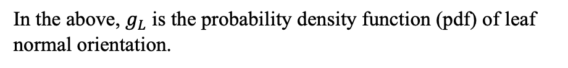
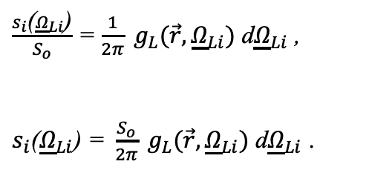
PHYSICAL MODELS IN REMOTE SENSING Chapter 02 – Part 04: Differential Scattering Coefficient
Derivation
Counting over number of planar elements is tedious and inefficient as N can be a large. It is convenient to count over a certain number of fixed solid angles in a hemisphere, M, which contain all the normals of these N elements.
By definition, the ratio of the area of all leaf elements s_{i} of orientation Ω_{Li} to the total leaf area S_{o} in the elementary volume is equivalent to the probability of leaf elements of orientation Ω_{Li} ,
$\frac{s_{i}\text{(}{\underline{Ω}}_{Li}\text{)}}{S_{o}}$ = $\frac{1}{2π} g_{L}(\vec{r},{\underline{Ω}}_{Li})$ d${\underline{Ω}}_{Li}$ ,
$s_{i}\text{(}{\underline{Ω}}_{Li}\text{)}\text{ = }\frac{S_{o}}{2π} g_{L}(\vec{r},{\underline{Ω}}_{Li})$ d${\underline{Ω}}_{Li}$ .
In the above, $g_{L}$ is the probability density function (pdf) of leaf normal orientation.

Slide 7
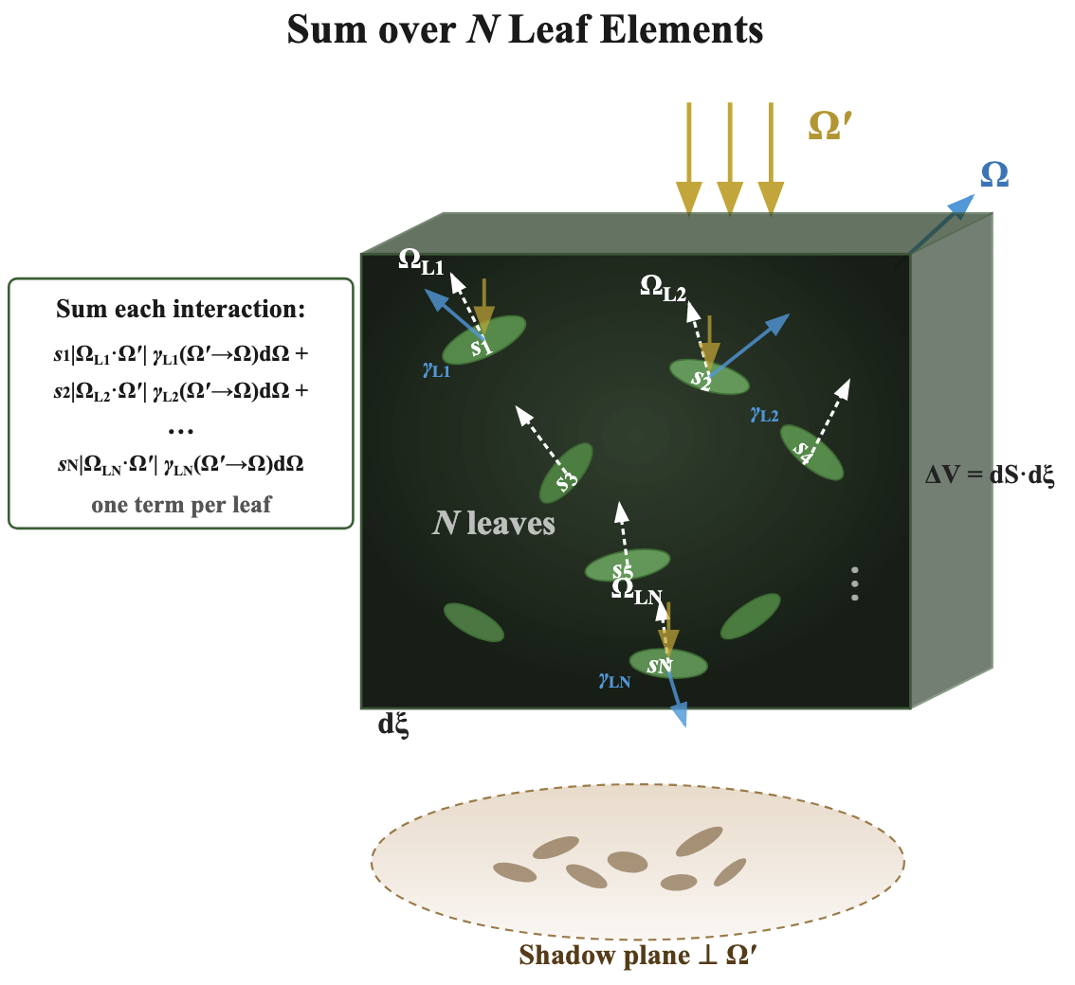
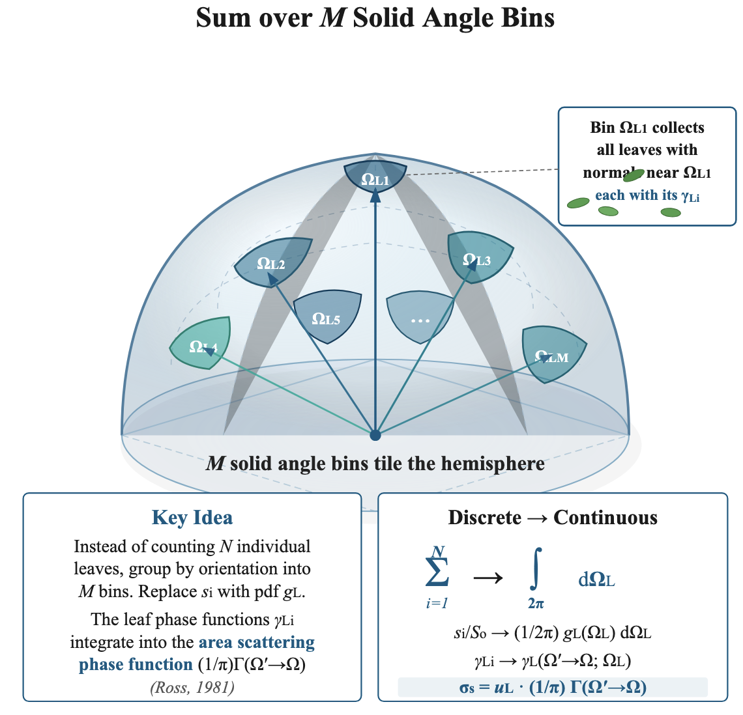
PHYSICAL MODELS IN REMOTE SENSING Chapter 02 – Part 04: Differential Scattering Coefficient
The Switch
Two equivalent ways to compute the differential scattering coefficient σ_{s} of a vegetation canopy modeled as a turbid medium. Left panel shows the direct approach: each of the N leaf elements (areas s₁, s₂, …, s_{N}) in the elementary volume is individually illuminated along the incident direction Ω′. Each leaf i with normal Ω_{Li} contributes a projected area s_{i} |Ω_{Li} · Ω′| weighted by its individual scattering phase function γ_{Li}(Ω′ → Ω; Ω_{Li}) dΩ, which describes the angular redistribution into a differential solid angle about the scattered direction Ω. This is exact but impractical when N is large. Right panel shows the efficient alternative: the upper hemisphere of leaf normal directions is partitioned into M solid angle bins. Replacing the individual leaf areas with the leaf angle pdf g_{L}(Ω_{L}) converts the discrete sum into a continuous integral over the hemisphere, absorbing the individual phase functions γ_{Li} into the area scattering phase function (1/π) Γ(Ω′ → Ω). This yields the differential scattering coefficient σ_{s} = u_{L} · (1/π) Γ, where u_{L} is the leaf area density.

Slide 8
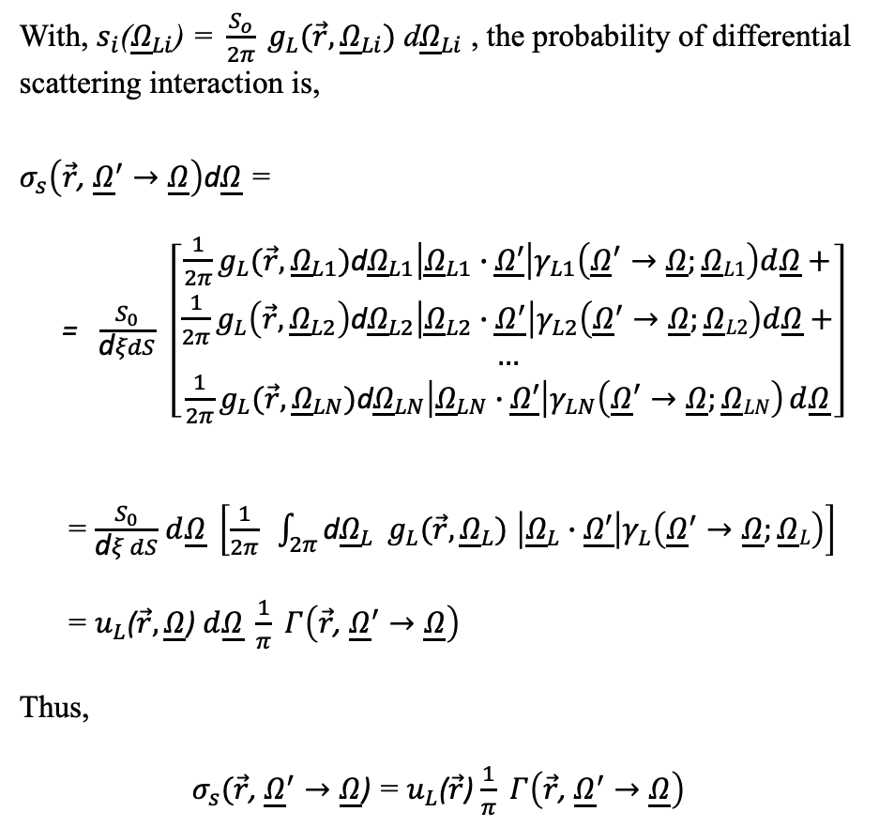
PHYSICAL MODELS IN REMOTE SENSING Chapter 02 – Part 04: Differential Scattering Coefficient
Derivation
With, $s_{i}\text{(}{\underline{Ω}}_{Li}\text{) = }\frac{S_{o}}{2π} g_{L}(\vec{r},{\underline{Ω}}_{Li})$ d${\underline{Ω}}_{Li}$ , the probability of differential scattering interaction is,
$σ_{s}\left(\vec{r}\text{,} {\underline{Ω}}^{′}→\underline{Ω}\right)$d$\underline{Ω}$ =
= $\frac{S_{0}}{\text{d}ξdS}$ $\left[\begin{aligned}{\frac{1}{2π}g}_{L}(\vec{r},{\underline{Ω}}_{L1})\text{d}{\underline{Ω}}_{L1}\left|{\underline{Ω}}_{L1}∙\underline{Ω′}\right|γ_{L1}\left({\underline{Ω}}^{′}→\underline{Ω};\underline{Ω}L1\right)d\underline{Ω}+ \\ {\frac{1}{2π}g}_{L}\left(\vec{r},{\underline{Ω}}_{L2}\right)\text{d}{\underline{Ω}}_{L2}\left|{\underline{Ω}}_{L2}∙\underline{Ω^{′}}\right|γ_{L2}\left({\underline{Ω}}^{′}→\underline{Ω};\underline{Ω}L2\right)d\underline{Ω}+ \\ … \\ {\frac{1}{2π}g}_{L}(\vec{r},{\underline{Ω}}_{LN})\text{d}{\underline{Ω}}_{LN}\left|{\underline{Ω}}_{LN}∙\underline{Ω′}\right|γ_{LN}\left({\underline{Ω}}^{′}→\underline{Ω};\underline{Ω}LN\right) d\underline{Ω}\end{aligned}\right]$
= $\frac{S_{0}}{\text{d}ξ dS}$ $d\underline{Ω} \left[\frac{1}{2π} \int_{2π}{\text{d}{\underline{Ω}}_{L}} g_{L}(\vec{r},{\underline{Ω}}_{L}) \left|{\underline{Ω}}_{L}∙\underline{Ω′}\right|γ_{L}\left({\underline{Ω}}^{′}→\underline{Ω};\underline{Ω}L\right)\right]$
= $u_{L}$($\vec{r},\underline{Ω}$) $d\underline{Ω} \frac{1}{π} Γ\left(\vec{r}\text{,} {\underline{Ω}}^{′}→\underline{Ω}\right)$
Thus,
$σ_{s}(\vec{r}\text{,} {\underline{Ω}}^{′}→\underline{Ω}\text{) }$= $u_{L}$($\vec{r}$) $\frac{1}{π} Γ\left(\vec{r}\text{,} {\underline{Ω}}^{′}→\underline{Ω}\right)$

Slide 9
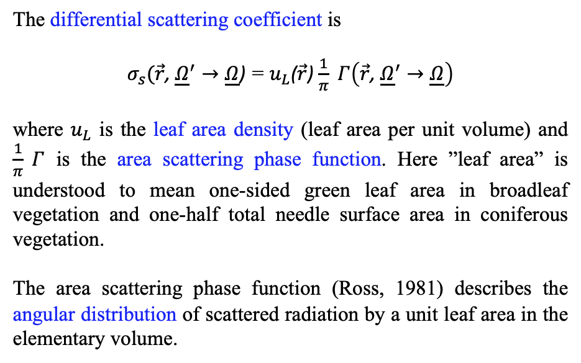
PHYSICAL MODELS IN REMOTE SENSING Chapter 02 – Part 04: Differential Scattering Coefficient
The Area Scattering Phase Function
The differential scattering coefficient is
$σ_{s}(\vec{r}\text{,} {\underline{Ω}}^{′}→\underline{Ω}\text{) }$= $u_{L}$($\vec{r}$) $\frac{1}{π} Γ\left(\vec{r}\text{,} {\underline{Ω}}^{′}→\underline{Ω}\right)$
where $u_{L}$ is the leaf area density (leaf area per unit volume) and $\frac{1}{π} Γ$ is the area scattering phase function. Here ”leaf area” is understood to mean one-sided green leaf area in broadleaf vegetation and one-half total needle surface area in coniferous vegetation.
The area scattering phase function (Ross, 1981) describes the angular distribution of scattered radiation by a unit leaf area in the elementary volume.

Slide 10
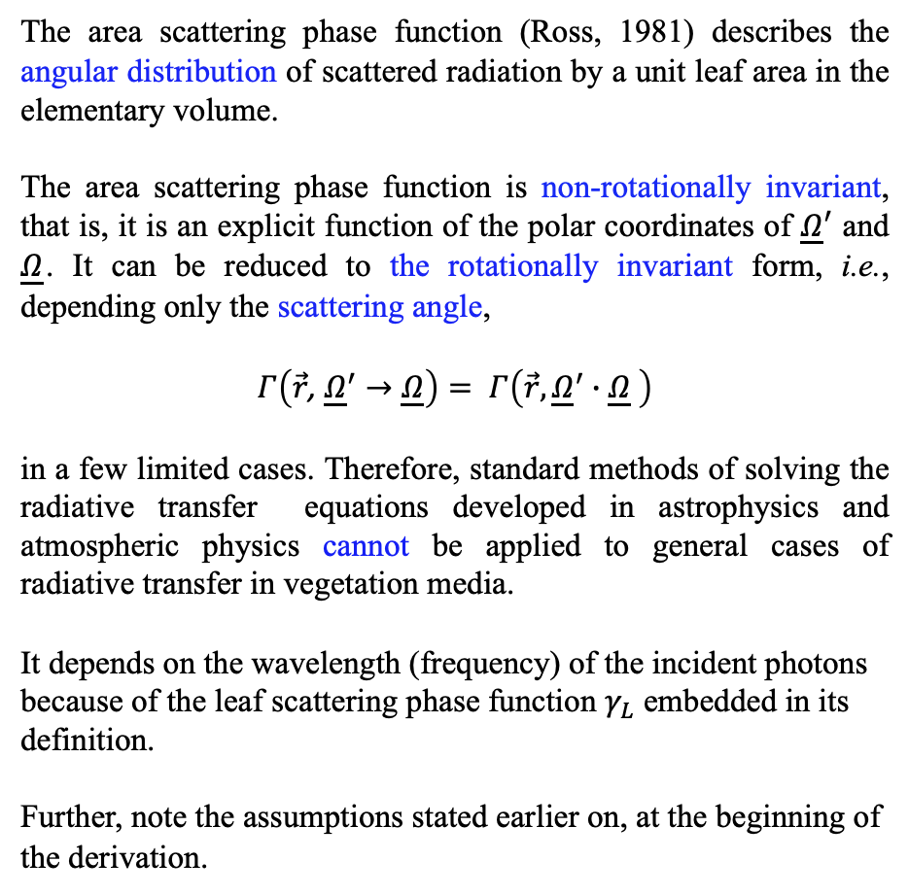
PHYSICAL MODELS IN REMOTE SENSING Chapter 02 – Part 04: Differential Scattering Coefficient
The Area Scattering Phase Function
The area scattering phase function (Ross, 1981) describes the angular distribution of scattered radiation by a unit leaf area in the elementary volume.
The area scattering phase function is non-rotationally invariant, that is, it is an explicit function of the polar coordinates of ${\underline{Ω}}^{′}$ and $\underline{Ω}$. It can be reduced to the rotationally invariant form, i.e., depending only the scattering angle,
$$Γ\left(\vec{r}\text{,} {\underline{Ω}}^{′}→\underline{Ω}\right)= Γ\left({\vec{r}, \underline{Ω}}^{′}∙\underline{Ω} \right)$$
in a few limited cases. Therefore, standard methods of solving the radiative transfer equations developed in astrophysics and atmospheric physics cannot be applied to general cases of radiative transfer in vegetation media.
It depends on the wavelength (frequency) of the incident photons because of the leaf scattering phase function $γ_{L}$ embedded in its definition.
Further, note the assumptions stated earlier on, at the beginning of the derivation.

Slide 11

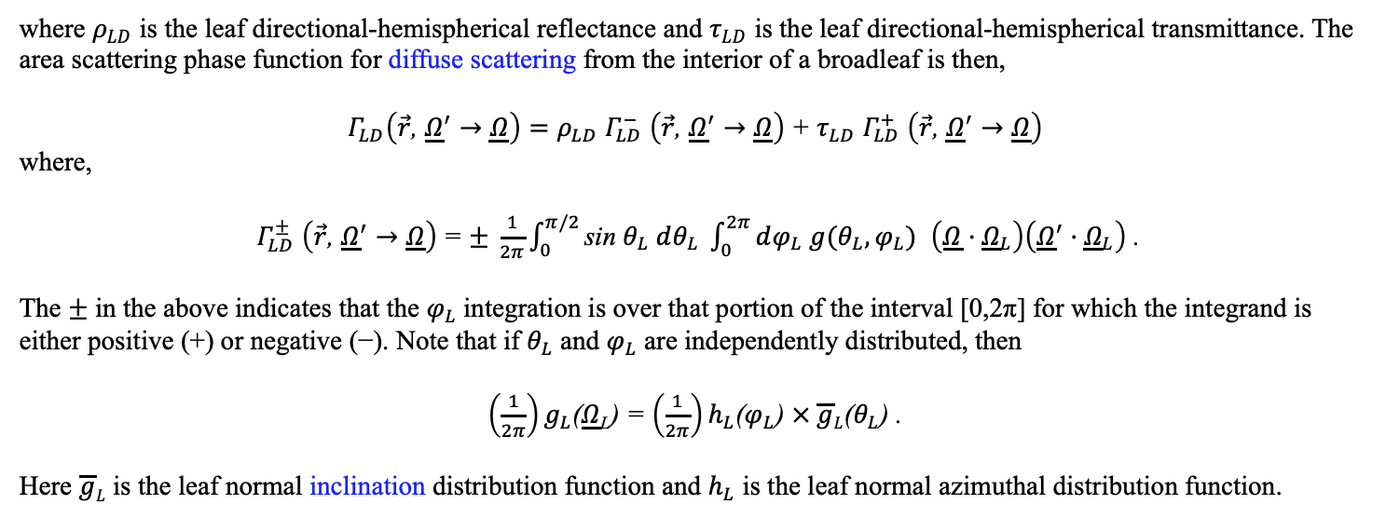

PHYSICAL MODELS IN REMOTE SENSING Chapter 02 – Part 04: Differential Scattering Coefficient
$Γ_{LD}$: Leaf Interior Diffuse Interactions
We use the bi-Lambertian model for diffuse scattering interactions in the interior of a broadleaf,
$$γ_{LD}\left({\underline{Ω}}^{′}→\underline{Ω};{\underline{Ω}}_{L}\right) = \left\{\begin{aligned}\frac{1}{π} ρ_{LD} \left|\underline{Ω}·{\underline{Ω}}_{L}\right|, \left(\underline{Ω}·{\underline{Ω}}_{L}\right)\left({\underline{Ω}}^{′}·{\underline{Ω}}_{L}\right) < 0 , \\ \frac{1}{π} τ_{LD} \left|\underline{Ω}·{\underline{Ω}}_{L}\right|, \left(\underline{Ω}·{\underline{Ω}}_{L}\right)\left({\underline{Ω}}^{′}·{\underline{Ω}}_{L}\right) > 0 .\end{aligned}\right.$$
where $ρ_{LD}$ is the leaf directional-hemispherical reflectance and $τ_{LD}$ is the leaf directional-hemispherical transmittance. The area scattering phase function for diffuse scattering from the interior of a broadleaf is then,
$Γ_{LD}\left(\vec{r}\text{,} {\underline{Ω}}^{′}→\underline{Ω}\right)=ρ_{LD}$ $Γ_{LD}^{−}$ $\left(\vec{r}\text{,} {\underline{Ω}}^{′}→\underline{Ω}\right)$+ $τ_{LD}$ $Γ_{LD}^{+}$ $\left(\vec{r}\text{,} {\underline{Ω}}^{′}→\underline{Ω}\right)$
where,
$Γ_{LD}^{±}$ $\left(\vec{r}\text{,} {\underline{Ω}}^{′}→\underline{Ω}\right)$= $± \frac{1}{2π}\int_{0}^{π/2}{\text{sin} θ_{L} dθ_{L}} \int_{0}^{2π}{dφ_{L} g(θ_{L},φ_{L}) }$ $\left(\underline{Ω}·{\underline{Ω}}_{L}\right)\left({\underline{Ω}}^{′}·{\underline{Ω}}_{L}\right)$ .
The $±$ in the above indicates that the $φ_{L}$integration is over that portion of the interval [0,2π] for which the integrand is either positive (+) or negative (−). Note that if $θ_{L}$ and $φ_{L}$ are independently distributed, then
$\left(\frac{1}{2π}\right)g_{L}$($\underline{Ω}$_{L}) = $\left(\frac{1}{2π}\right)h_{L}$($φ_{L}$) $× \overline{g}L$($θ_{L}$) .
Here $\overline{g}L$ is the leaf normal inclination distribution function and $h_{L}$ is the leaf normal azimuthal distribution function.

Slide 12

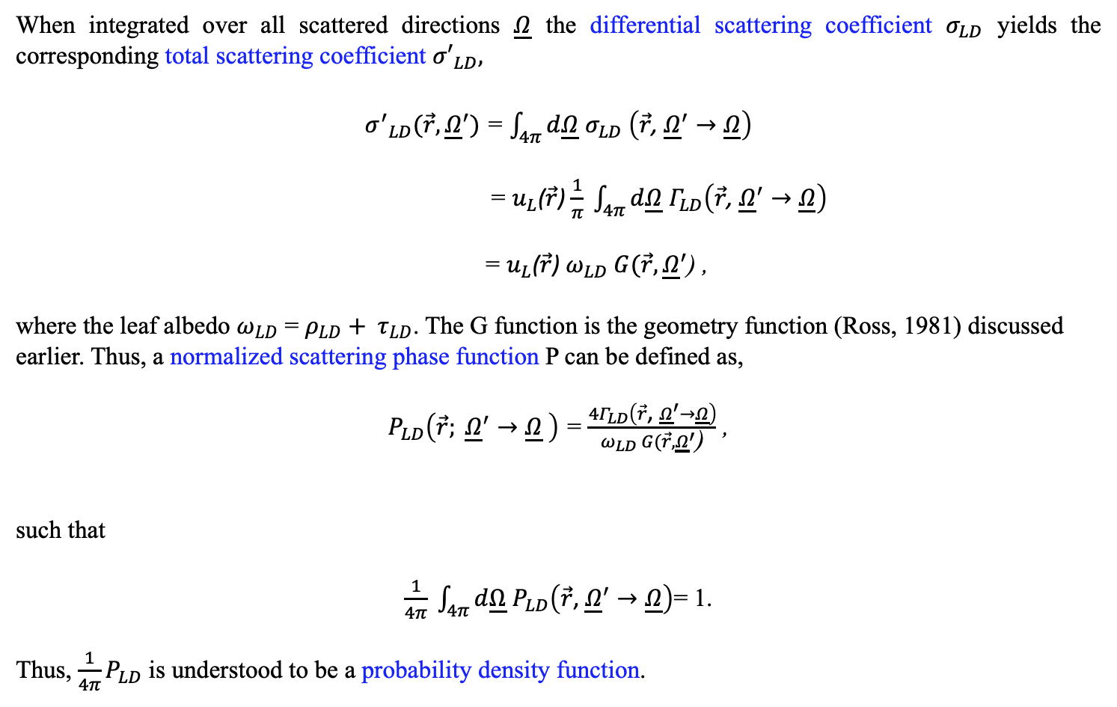
PHYSICAL MODELS IN REMOTE SENSING Chapter 02 – Part 04: Differential Scattering Coefficient
$Γ_{LD}$: Normalization
When integrated over all scattered directions $\underline{Ω}$ the differential scattering coefficient $σ_{LD}$ yields the corresponding total scattering coefficient ${σ′}_{LD},$
${σ^{′}}_{LD}(\vec{r},{\underline{Ω}}^{′})$ = $\int_{4π}{d\underline{Ω}}$ $σ_{LD}$ $\left(\vec{r}\text{,} {\underline{Ω}}^{′}→\underline{Ω}\right)$
= $u_{L}$($\vec{r}$) $\frac{1}{π} \int_{4π}{d\underline{Ω}}$ $Γ_{LD}\left(\vec{r}\text{,} {\underline{Ω}}^{′}→\underline{Ω}\right)$
= $u_{L}$($\vec{r}$) $ω_{LD} G(\vec{r},{\underline{Ω}}^{′}$) ,
where the leaf albedo $ω_{LD}$ = $ρ_{LD}+ τ_{LD}$. The G function is the geometry function (Ross, 1981) discussed earlier. Thus, a normalized scattering phase function P can be defined as,
$P_{LD}\left({\vec{r}; \underline{Ω}}^{′}→\underline{Ω} \right)$ = $\frac{4Γ_{LD}\left(\vec{r}\text{,} {\underline{Ω}}^{′}→\underline{Ω}\right)}{ω_{LD} G(\vec{r},{\underline{Ω}}^{′}\text{)}}$ ,
such that
$\frac{1}{4π} \int_{4π}{d\underline{Ω}}$ $P_{LD}\left(\vec{r}\text{,} {\underline{Ω}}^{′}→\underline{Ω}\right)$= 1.
Thus, ${\frac{1}{4π}P}_{LD}$ is understood to be a probability density function.

Slide 13
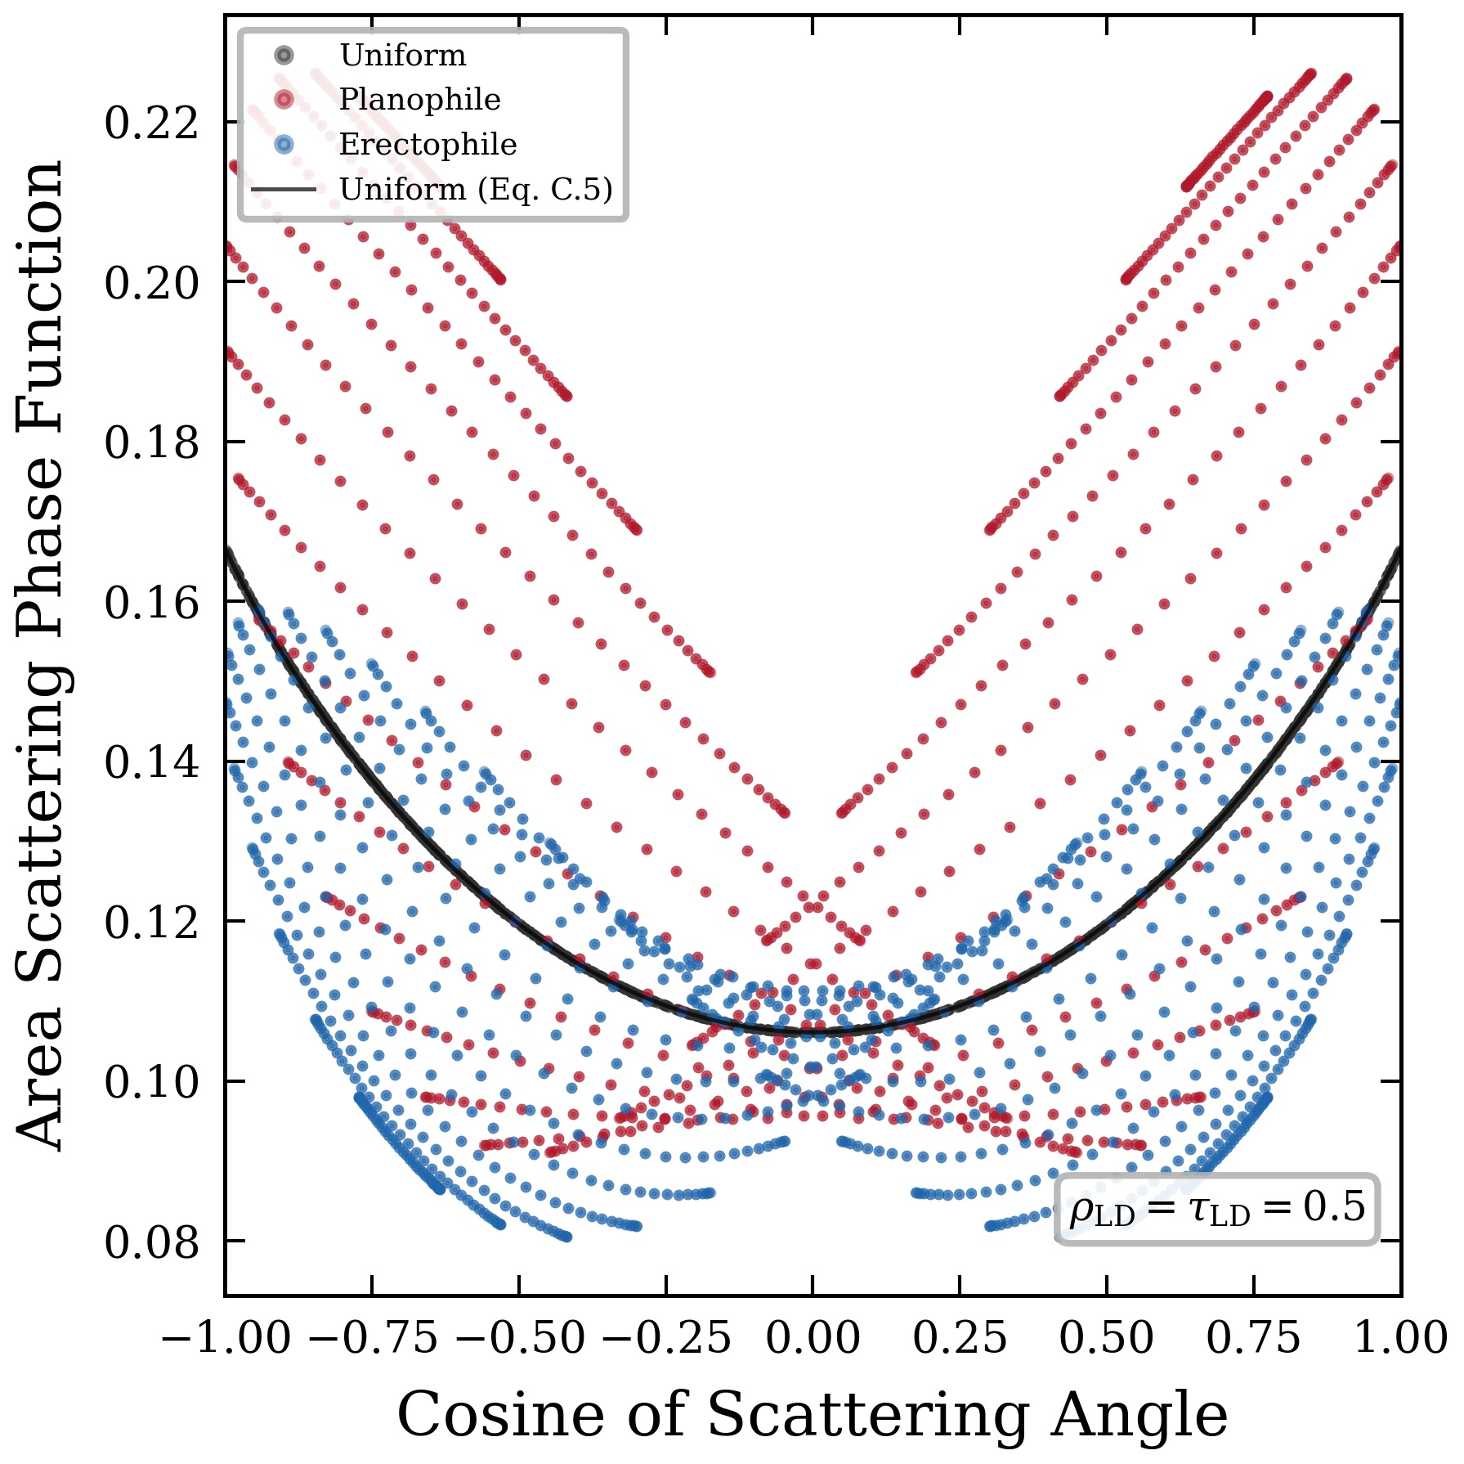

PHYSICAL MODELS IN REMOTE SENSING Chapter 02 – Part 04: Differential Scattering Coefficient
$Γ_{LD}$: Non-Rotational Invariance
Area scattering phase function Γ_{LD} for the special case ρ_{LD}=τ_{LD}=0.5 (ω_{LD}= 1), comparing three leaf inclination distributions: uniform (black dots), planophile (red), and erectophile (blue), all with uniform leaf azimuthal distribution h_{L}=1. The incident direction is θ′=135º, φ′=0º. The solid black curve is the uniform closed form. Each dot represents Γ_{LD} evaluated at a Gauss-quadrature node (θ_{s}, φ_{s}) in the scattered direction, plotted against the corresponding cosine of the scattering angle cos β. Unlike the uniform case, the points do not collapse to a single curve in the planophile and erectophile cases: at each value of cos β, Γ_{LD} fans into distinct strands, each corresponding to a fixed θ_{s} with varying φ_{s}. This demonstrates that for non-uniform leaf inclination distributions, Γ_{LD} is not rotationally invariant—it depends on the full four-angle geometry (θ′, φ′, θ_{s}, φ_{s}), not merely on the scattering angle β.

Slide 14
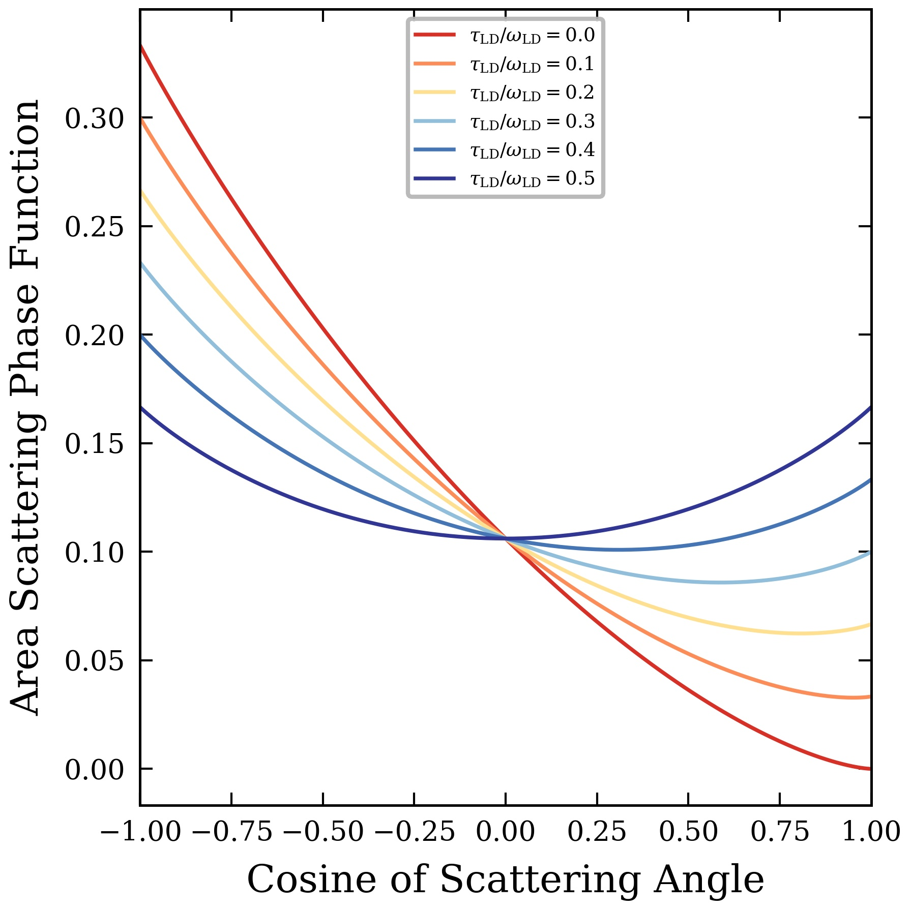

PHYSICAL MODELS IN REMOTE SENSING Chapter 02 – Part 04: Differential Scattering Coefficient
$Γ_{LD}$: Relative Roles of ρ_{LD} and τ_{LD}
Area scattering phase function Γ_{LD} for uniform leaf inclination (ġ_{L}=1) and uniform leaf azimuthal distribution (h_{L}=1), plotted against the cosine of the scattering angle cos β. The single-scattering albedo is ω_{LD}=1, with the leaf transmittance-to-albedo ratio τ_{L}/ω_{L} varying from 0 (pure reflection) to 0.5 (equal reflection and transmission). Computed from the analytical closed form. For this combination of uniform ġ_{L} and uniform h_{L}, Γ_{LD} depends only on the scattering angle and is therefore rotationally invariant.

Slide 15
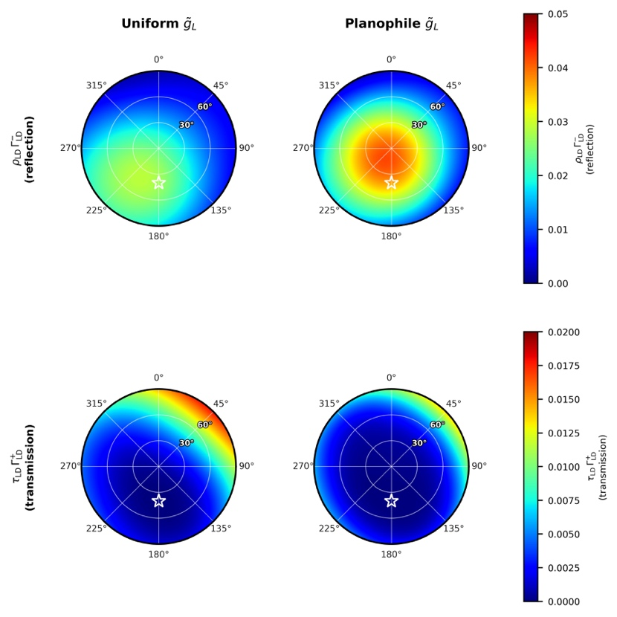

PHYSICAL MODELS IN REMOTE SENSING Chapter 02 – Part 04: Differential Scattering Coefficient
$Γ_{LD}$: Azimuthal Heterogeneity
Polar plots of the weighted diffuse area scattering phase function Γ​_{LD}. Columns: uniform ḡ_{L} (left) and planophile ḡ_{L} (right), both with non-uniform h_{L} (η = 55°). Rows: weighted reflection component ρ_{LD} Γ​⁻_{LD} (top); weighted transmission component τ_{LD} Γ​⁺_{LD} (bottom). Leaf optical properties: ρ_{LD} = 0.55, τ_{LD} = 0.45 (ω_{LD} = 1.00). The polar coordinate is the scattered zenith angle θ_{s}; the azimuthal coordinate is the scattered azimuth φ_{s}, increasing clockwise from north (0°). Incident direction: θ′ = 140°, φ′ = 0°. The white star marks retro-incident direction (θ_{s} = 40°, φ_{s} = 180°).

Slide 16
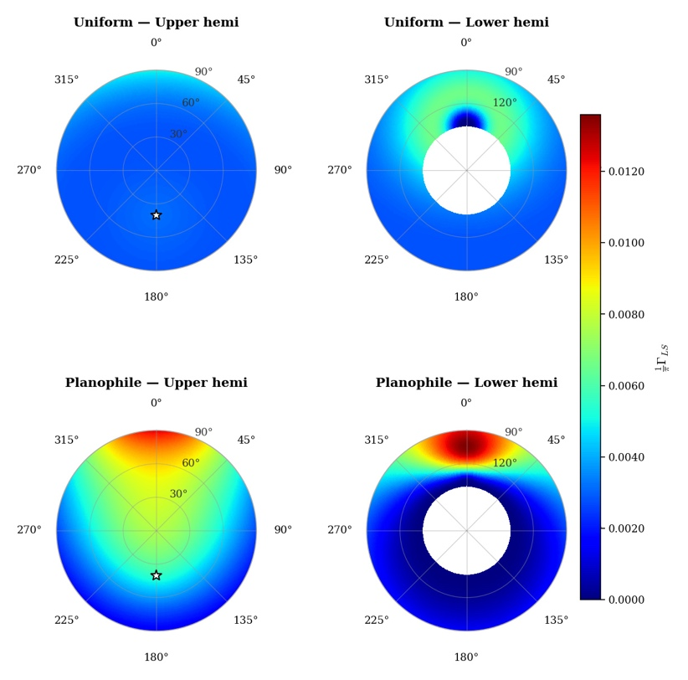
PHYSICAL MODELS IN REMOTE SENSING Chapter 02 – Part 04: Differential Scattering Coefficient
$Γ_{LS}$: Area Scattering Phase Function for Specular Reflection
Area specular phase function (1/π) Γ_{LS}(Ω′ → Ω) [sr⁻¹] for the Dirac delta leaf model, plotted as a function of scattered direction Ω for a fixed incident direction Ω′ at zenith angle θ′ = 40°, azimuth φ′ = 0° (i.e. the source travels in the direction θ = 140°, φ = 0°). Two leaf normal inclination distributions are shown: uniform (top row) and planophile (bottom row). The leaf normal azimuthal distribution in both cases is uniform. Parameters: refractive index n = 1.5, roughness extinction coefficient κ = 0.3.

Slide 17
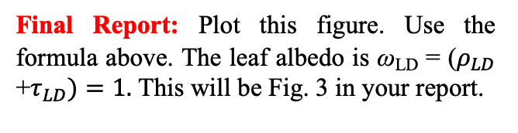
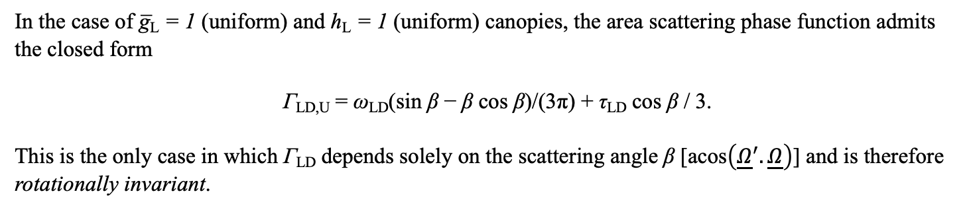
PHYSICAL MODELS IN REMOTE SENSING Chapter 02 – Part 04: Differential Scattering Coefficient
$Γ_{LD}$: Area Scattering Phase Function for Uniform LNOD
In the case of g̅_{L} = 1 (uniform) and h_{L} = 1 (uniform) canopies, the area scattering phase function admits the closed form
Γ_{LD,U} = ω_{LD}(sin β − β cos β)/(3π) + τ_{LD} cos β / 3.
This is the only case in which Γ_{LD} depends solely on the scattering angle β [acos$\left({\underline{Ω}}^{′}.\underline{Ω}\right)$] and is therefore rotationally invariant.
Final Report: Plot this figure. Use the formula above. The leaf albedo is ω_{LD} = ($ρ_{LD}$ +$τ_{LD})=1.$ This will be Fig. 3 in your report.

