Slide 1
PHYSICAL MODELS IN REMOTE SENSING Chapter 03 – Part 01: Radiative Quantities of Interest
Turbid Medium Approximation
Simulated Temperate Forest
Assumptions
The Horizontally Homogeneous Medium
Solar and Sky Illumination
The Incident Radiation Field
1D RT Problem
Solution
Radiative Quantities of Interest
G-Function in Coniferous Canopies

Slide 2

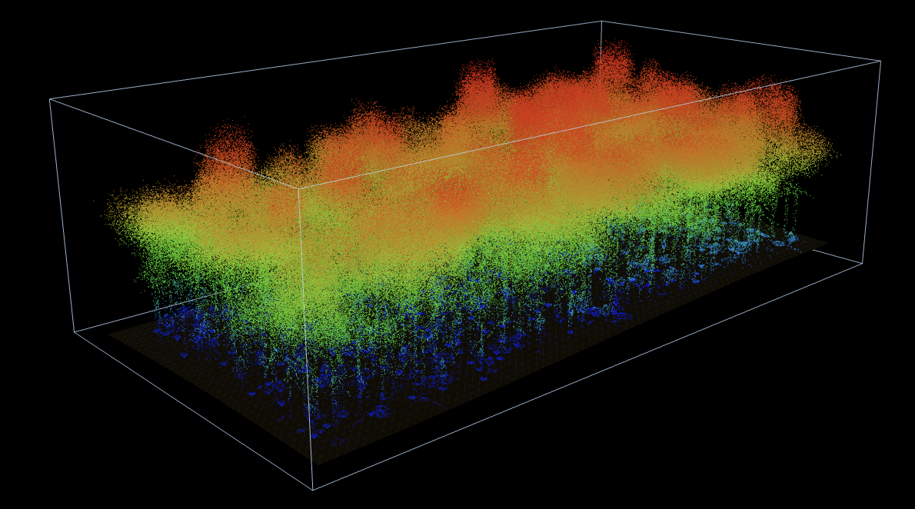
PHYSICAL MODELS IN REMOTE SENSING Chapter 03– Part 01: Radiative Quantities of Interest
Turbid medium
Canopies of natural vegetation exhibit significant complexity and dynamics in structure
Trying to capture this complexity and dynamic is a difficult, if not impossible, task
Therefore, the vegetation canopy is idealized as a medium filled densely with small planar elements of negligible thickness and area, i.e., a turbid medium or a green gas.
This abstraction ignores all organs other than green leaves. It captures the most significant aspect of the canopy that plays a central role in exchanges of energy, mass and momentum with the overlying boundary layer.
Two key variables, leaf area density and leaf normal orientation distribution, capture characteristics of the vegetation canopy in this context.

Slide 3
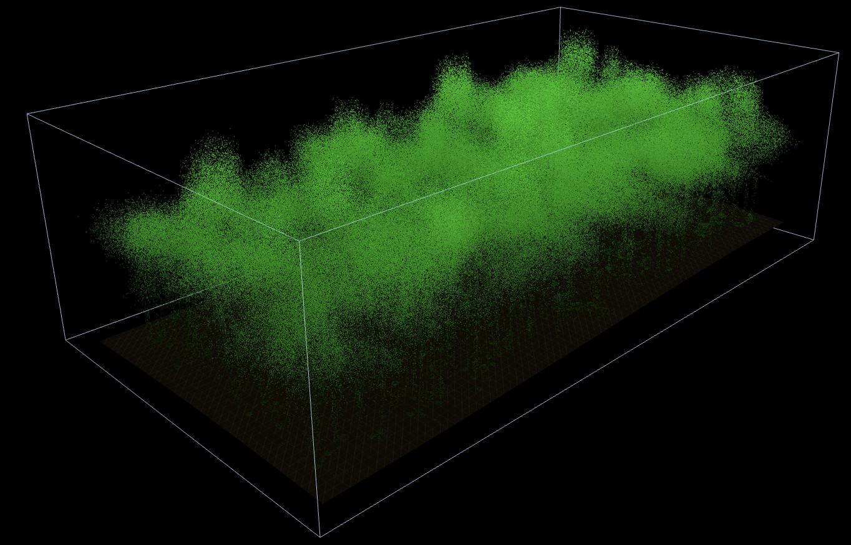
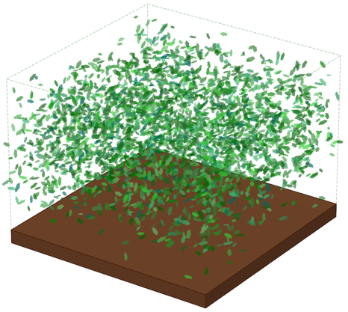
PHYSICAL MODELS IN REMOTE SENSING Chapter 03– Part 01: Radiative Quantities of Interest
Simulated Lidar Cloud of Foliage: Temperature Forest
Simulated Temperate Forest Lidar Scans
Plot dimensions: 120 x 60 m
Tree density: 500 Individual trees, ~700 trees/ha, random tree location, 10 broadleaf deciduous species
Leaf area index: 3.84 (each leaf of about 0.0411 m²)
Points: 750,000 to 850,000 points (700,000 leaf points, rest for other foliage elements)

Slide 4
PHYSICAL MODELS IN REMOTE SENSING Chapter 03 – Part 01: Radiative Quantities of Interest
Assumptions
Horizontally homogeneous vegetation canopy
Medium consist of planar leaves only
Medium illuminated from above by
direct solar radiation
isotropic diffuse sky radiation
Stationary (time-independent) problem
No frequency shifting interactions
Scattering depends on wavelength
No emission of radiation within the medium
Top and bottom boundaries of the medium are non-reflecting
Medium is non-re-entrant
Standard Problem in Optical Remote Sensing of Vegetation

Slide 5

PHYSICAL MODELS IN REMOTE SENSING Chapter 03 – Part 01: Radiative Quantities of Interest
Schematic: Horizontally Homogeneous Medium
z=0
top
z-axis
leaf canopy
z=z_{H}
bottom

Slide 6
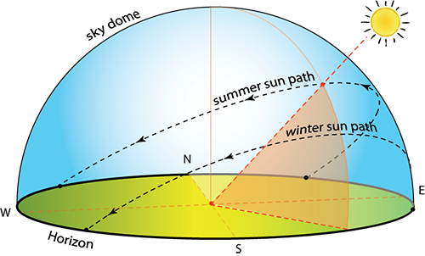
PHYSICAL MODELS IN REMOTE SENSING Chapter 03 – Part 01: Radiative Quantities of Interest
Schematic: Solar and Sky Illumination
Direct sunlight
Diffuse sky illumination
I_{0λ}
δ(Ω−Ω₀)
Ω₀
I_{dλ}
Ω_{d}
z=0
top
z-axis
leaf canopy
z=z_{H}
bottom

Slide 7
PHYSICAL MODELS IN REMOTE SENSING Chapter 03 – Part 01: Radiative Quantities of Interest
The Incident Radiant Field
Direct Solar Radiation
Intensity: I_{0λ}
δ(Ω−Ω₀)
Flux Density: F_{0λ} = |μ₀| I_{0λ}
Cosine of solar polar angle: |μ₀|
Diffuse Sky Radiation
Intensity: I_{dλ}
π
Flux Density: F_{dλ} = I_{dλ}

Slide 8
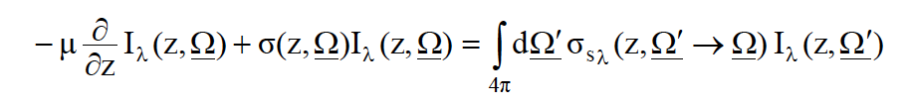



PHYSICAL MODELS IN REMOTE SENSING Chapter 03 – Part 01: Radiative Quantities of Interest
The RT Problem (1D monochromatic RT)
0,
Diffuse sky illumination
Ω₀
Direct sunlight
I_{dλ}
I_{0λ}
δ(Ω−Ω₀)
Ω_{d}
z=0
top
z-axis
leaf canopy
z=z_{H}
bottom

Slide 9

PHYSICAL MODELS IN REMOTE SENSING Chapter 03 – Part 01: Radiative Quantities of Interest
Solution
Assume that the RT problem is solved. It means we know the following:
λ
λ
λ
λ
4) Collided Intensity in the medium in all directions: I^{s}(z,Ω) for all Ω
λ

Slide 10
PHYSICAL MODELS IN REMOTE SENSING Chapter 03 – Part 01: Radiative Quantities of Interest
Radiative Quantities of Interest
(A) Radiative Fluxes of Interest:
Reflectivity
Transmissivity
Absorptivity
(B) Radiative Fluxes of Interest in Remote Sensing:
Bi-Hemispherical Reflectance (BHR)
Directional-Hemispherical Reflectance (DHR)
Albedo
Fraction of Vegetation Absorbed Photosynthetically Active Radiation (FPAR)
(C) Directional Radiative Quantities of Interest in Remote Sensing:
Hemispherical-Directional Reflectance Factor (HDRF)
Bi-Directional Reflectance Factor (BRF)
Bi-Directional Reflectance Distribution Funtion (BRDF)

Slide 11
PHYSICAL MODELS IN REMOTE SENSING Chapter 03 – Part 01: Radiative Quantities of Interest
A: Radiative Fluxes of Interest:
Reflectivity
Transmissivity
Absorptivity
From energy conservation: These should sum to unity.
Note: All these quantities implicitly depend on solar direction, Ω₀

Slide 12
PHYSICAL MODELS IN REMOTE SENSING Chapter 03 – Part 01: Radiative Quantities of Interest
Canopy Reflectivity
F_{R} (z=0) = Reflected Flux / Incident Flux
λ
∫
dΩ |μ| I^{s}(z=0,Ω)
2π⁺
λ
=
F_{0λ} + F_{dλ}
Units: Dimensionless

Slide 13
PHYSICAL MODELS IN REMOTE SENSING Chapter 03 – Part 01: Radiative Quantities of Interest
Canopy Transmissivity
F_{T} (z=z_{H}) = Transmitted Flux / Incident Flux
λ
A + B + C
=
F_{0λ} + F_{dλ}
A = uncollided direct solar radiation exiting at the bottom = |μ₀| I_{0λ}(z=z_{H})
∫
dΩ_{d} |μ_{d}| I_{dλ}(z=z_{H},Ω_{d})
B = uncollided diffuse sky radiation exiting at the bottom =
2π⁻
∫
C = collided radiation exiting at the bottom =
dΩ |μ| I^{s}_{λ}(z=z_{H},Ω)
2π⁻
Units: Dimensionless

Slide 14
PHYSICAL MODELS IN REMOTE SENSING Chapter 03 – Part 01: Radiative Quantities of Interest
Canopy Absoptivity
F_{A} = Absorbed Flux / Incident Flux
λ
z_{H}
∫
dz F_{0Aλ}(z) + F_{dAλ}(z) + F^{s}_{Aλ}(z)
=
0
F_{0λ} + F_{dλ}
F_{0Aλ}(z) = absorbed uncollided direct solar radiation at z = |μ₀| I_{0λ}(z) σ_{aλ}(z,Ω₀)
∫
F_{dAλ}(z) = absorbed uncollided diffuse sky radiation at z =
dΩ_{d} |μ_{d}| I_{dλ}(z,Ω_{d}) σ_{aλ}(z,Ω_{d})
2π⁻
F^{s}_{Aλ}(z) = absorbed collided radiation at z =
∫
dΩ |μ| I^{s}_{λ}(z,Ω) σ_{aλ}(z,Ω)
4π
Units: Dimensionless

Slide 15
PHYSICAL MODELS IN REMOTE SENSING Chapter 03 – Part 01: Radiative Quantities of Interest
Radiative Fluxes of Interest in Remote Sensing
Bi-Hemispherical Reflectance (BHR)
Directional-Hemispherical Reflectance (DHR)
Albedo
Fraction of Vegetation Absorbed Photosynthetically Active Radiation (FPAR)

Slide 16
PHYSICAL MODELS IN REMOTE SENSING Chapter 03 – Part 01: Radiative Quantities of Interest
Bi-Hemispherical Reflectance (BHR)
BHR = F_{Rλ}
∫
dΩ |μ| I^{s}(z=0,Ω)
2π⁺
λ
=
F_{0λ} + F_{dλ}
i.e. canopy reflectivity under solar and sky illumination
Also called white sky albedo
This is a standard product from MODIS
Units: Dimensionless

Slide 17
PHYSICAL MODELS IN REMOTE SENSING Chapter 03 – Part 01: Radiative Quantities of Interest
Directional-Hemispherical Reflectance (DHR)
DHR = F_{Rλ}
∫
dΩ |μ| I^{s}(z=0,Ω)
2π⁺
λ
=
F_{0λ}
i.e. canopy reflectivity under solar illumination only
Also called black sky albedo
This is a standard product from MODIS
Units: Dimensionless

Slide 18
PHYSICAL MODELS IN REMOTE SENSING Chapter 03 – Part 01: Radiative Quantities of Interest
Canopy Albedo
Albedo = total reflected flux / total incident flux
λ2
∫
dλ
F_{Rλ}(z=0)
=
λ1
λ2
∫
dλ
(F_{0λ} + F_{dλ})
λ1
where, λ1 and λ2 are wavelength limits of solar radiation.
This is a standard product from MODIS
Because (1-Albedo) is canopy absorbed radiant flux, it is important in energy
balance studies.
Units: Dimensionless

Slide 19
PHYSICAL MODELS IN REMOTE SENSING Chapter 03 – Part 01: Radiative Quantities of Interest
Fraction of Vegetation Absorbed Photosynthetically Active Radiation (FPAR)
FPAR = absorbed PAR flux / incident PAR flux
λ2
∫
dλ
F_{Aλ}
=
λ1
λ2
∫
dλ
(F_{0λ} + F_{dλ})
λ1
where, λ1 (400 nm) and λ2 (700 nm) are wavelength limits of PAR.
This is a standard product from MODIS
This is important quantity in most carbon studies because this is the energy that
drives photosynthesis.
Units: Dimensionless

Slide 20
PHYSICAL MODELS IN REMOTE SENSING Chapter 03 – Part 01: Radiative Quantities of Interest
Directional Radiative Quantities of Interest in Remote Sensing
Hemispherical-Directional Reflectance Factor (HDRF)
Bi-Directional Reflectance Factor (BRF)
Bi-Directional Reflectance Distribution Funtion (BRDF)

Slide 21
PHYSICAL MODELS IN REMOTE SENSING Chapter 03 – Part 01: Radiative Quantities of Interest
Hemispherical-Directional Reflectance Factor (HDRF)
HDRF_{λ}(Ω,Ω₀) =
Intensity exiting the canopy at the top
Intensity from an isotropically-reflecting conservative white panel (100% reflecting)
I^{s}_{λ}(z=0,Ω,Ω₀)
=
I^{R}_{λ}(z=0,Ω,Ω₀)
Note:
Both quantities are measured under identical illumination conditions
Illumination conditions include both solar and sky illumination
Units: Dimensionless

Slide 22
PHYSICAL MODELS IN REMOTE SENSING Chapter 03 – Part 01: Radiative Quantities of Interest
Bi-Directional Reflectance Factor (BRF)
BRF_{λ}(Ω,Ω₀) = HDRF_{λ}(Ω,Ω₀) under solar illumination only =
Intensity exiting the canopy at the top
Intensity from an isotropically-reflecting conservative white panel (100% reflecting)
I^{s}_{λ}(z=0,Ω,Ω₀)
I^{s}_{λ}(z=0,Ω,Ω₀)
=
=
I^{R}_{λ}(z=0,Ω,Ω₀)
F_{0λ} (1/π)
Note:
Both quantities are measured under identical illumination conditions
Illumination conditions include both solar illumination only
Units: Dimensionless

Slide 23
PHYSICAL MODELS IN REMOTE SENSING Chapter 03 – Part 01: Radiative Quantities of Interest
Bi-Directional Reflectance Distribution Function (BRDF)
Intensity exiting the canopy at the top
BRDF_{λ}(Ω,Ω₀) =
Incident flux density along Ω₀
I^{s}_{λ}(z=0,Ω,Ω₀)
=
F_{0λ}(z=0,Ω₀)
Note:
Mono-directional (e.g. solar) illumination only
BRDF_{λ}(Ω, Ω₀) = BRF_{λ}(Ω, Ω₀) x π
Units: sr⁻¹

