Slide 1
PHYSICAL MODELS IN REMOTE SENSING Chapter 04 – Part - 01: 1D RT Problem Setup
Assumptions
Schematic of the 1D Problem
Incident Radiation Field
1D RT Problem
Summary of Input Variables
Separation of Collided and Uncollided Fields
Solution of the Uncollided Field
Example Results

Slide 2
PHYSICAL MODELS IN REMOTE SENSING Chapter 04 – Part - 01: 1D RT Problem Setup
Problem Statement:
RTE
Boundary (& initial) conditions
Solution
Forward Solution (Model building & evaluation)
Known
Canopy Structure
Canopy Optics
Unknown
Radiation field in the medium and emerging from the medium
(b) Inverse Solution (Model parameter estimation)
Known
Radiation field in the medium and/or emerging from the medium
Unknown
Canopy structure
Canopy optics

Slide 3
PHYSICAL MODELS IN REMOTE SENSING Chapter 04 – Part - 01: 1D RT Problem Setup
Assumptions:
Horizontally homogeneous vegetation canopy
Medium consist of planar leaves only
Medium illuminated from above by
direct solar radiation (photons did not experience interactions in the atmosphere above)
isotropic diffuse sky radiation (photons did experience interactions in the atmosphere above)
Stationary (time-independent) problem
No frequency shifting interactions
Scattering cross section depends on wavelength
No emission of radiation within the medium
Top boundary of the medium is non-reflecting (medium non-re-entrant at the top)
Bottom boundary can be reflecting (medium is re-entrant at the bottom)
Collided photons: photons that collided with leaf elements in the vegetation medium
Uncollided photons: photons that did not interact with leaf elements in the vegetation medium

Slide 4

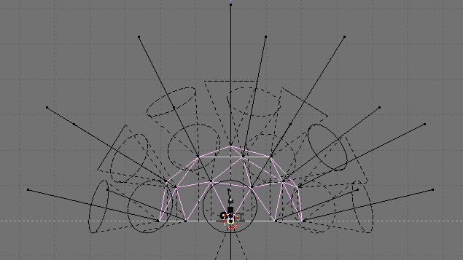

PHYSICAL MODELS IN REMOTE SENSING Chapter 04 – Part - 01: 1D RT Problem Setup
Schematic of 1D Problem
I_{oλ}
δ(Ω−Ω_{o})
Ω_{d}
Direct sunlight
Ω_{o}
Diffuse sky illumination
I_{dλ}
z=0 or L = 0
top
z axis
L = cumulated LAI
leaf canopy
z=z_{H} or L = LAI
Bottom (e.g. ground)
Notation:
LAI: leaf area index of the canopy
-z axis pointed upwards towards the zenith
Directions measured with respect to –z axis
μ > 0 for upward directions
μ < 0 for downward directions

Slide 5
PHYSICAL MODELS IN REMOTE SENSING Chapter 04 – Part - 01: 1D RT Problem Setup
Incident Radiation Field
At the top of the canopy:
Direct solar radiation flux: F_{o}
Diffuse sky radiation flux: F_{d}
The RTE is linear with respect to incident radiation field. Therefore,
F_{o} = f_{dir} x F_{incident} ,
F_{d} = (1-f_{dir}) x F_{incident} ,
and let F_{incident} = 1 Watt/m²
Where f_{dir} is the fraction of direct solar flux in the incident field (input). Therefore,
f_{dir} = 0 (completely overcast sky)
f_{dir} = 1 (completely clear sunny sky)
Note: In general, f_{dir} can be wavelength dependent

Slide 6
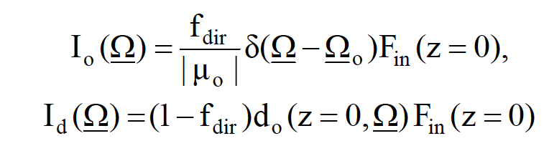

PHYSICAL MODELS IN REMOTE SENSING Chapter 04 – Part - 01: 1D RT Problem Setup
Upper Boundary Condition
In terms of incident intensities,
where d_{o} is the anisotropy of the incident sky diffuse radiation field.
Assume isotropic, then d_{o} = (1/π).
Note that the direction of incident direct solar radiation, Ω₀, requires (θ_{o},ϕ_{o}).
(θ_{o},ϕ_{o}) are inputs
Thus, the boundary condition at the top (upper boundary) of the vegetation canopy is,

Slide 7
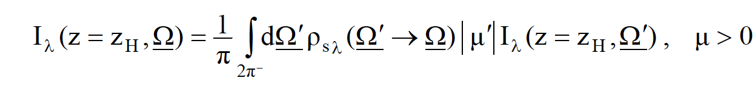
PHYSICAL MODELS IN REMOTE SENSING Chapter 04 – Part - 01: 1D RT Problem Setup
Lower Boundary Condition
At the bottom of the vegetation canopy, we have a reflecting boundary (usually soil or
understory vegetation, and maybe even snow ….,
The corresponding boundary condition is,
Here, ρ_{sλ} is the wavelength-dependent bi-directional reflectance function of the lower surface
If this lower surface is assumed to be an isotropic reflector, then ρ_{sλ} = ρ_{gλ}
Here, ρ_{gλ} is the wavelength dependent reflection coefficient of the lower surface (input) which does not depend on directions. Thus,
I _{λ}(z = z_{H}, Ω) = F^{d}(z = z_{H}) (ρ_{gλ}/π), μ > 0,
where F^{d} is downward flux at z= z_{H}.
_

Slide 8
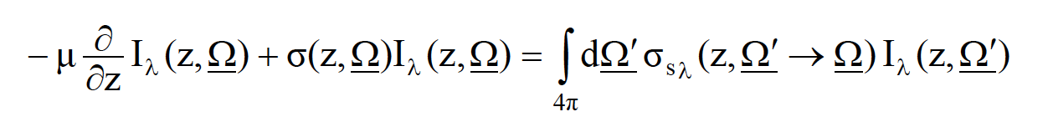
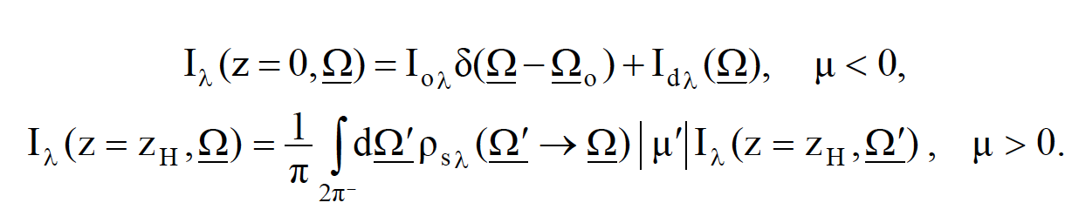
PHYSICAL MODELS IN REMOTE SENSING Chapter 04 – Part - 01: 1D RT Problem Setup
The 1D RTE
The 1D RTE is,
with the following boundary conditions,
The specific intensity I is thus wavelength dependent. However, for ease of expression, this dependence will be not explicitly shown from now on.

Slide 9
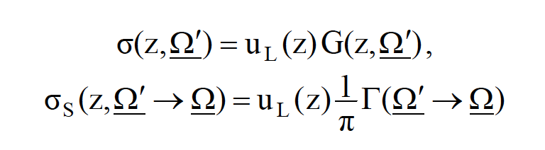
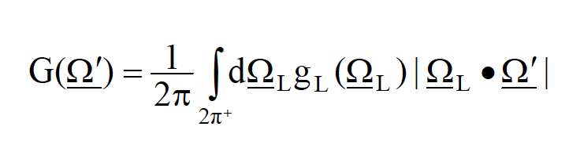
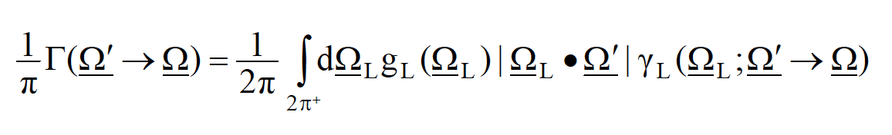
PHYSICAL MODELS IN REMOTE SENSING Chapter 04 – Part - 01: 1D RT Problem Setup
The Cross Sections
If the leaf normal orientation distribution function g_{L} is assumed independent of depth z in the
canopy, the two cross sections are,
where u_{L} is the leaf area density distribution function and G is the geometry factor,
and, Γ is the area scattering phase function
with γ_{L} being the leaf scattering phase function.

Slide 10
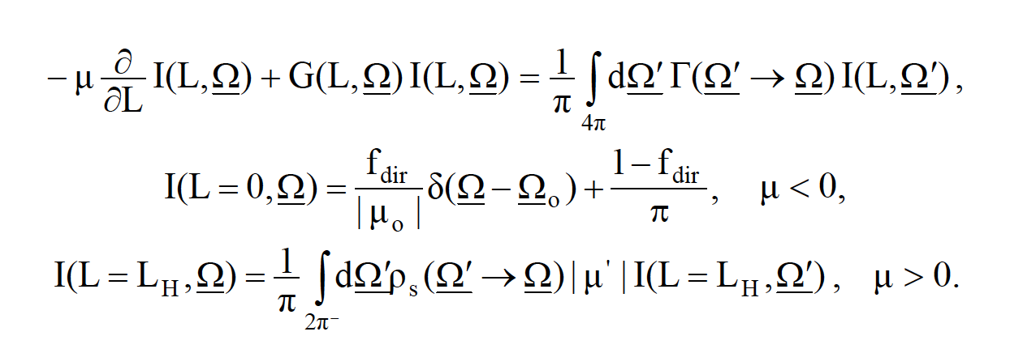
PHYSICAL MODELS IN REMOTE SENSING Chapter 04 – Part - 01: 1D RT Problem Setup
Switch from z to L
The vertical coordinate z can be changed to cumulative leaf area index L by dividing the RTE with u_{L}.
The vegetation canopy is now contained between L = 0 at the top and L = L_{H} at the bottom, where L_{H} is the leaf area index (input) of the canopy.
The 1D RT problem is thus:

Slide 11
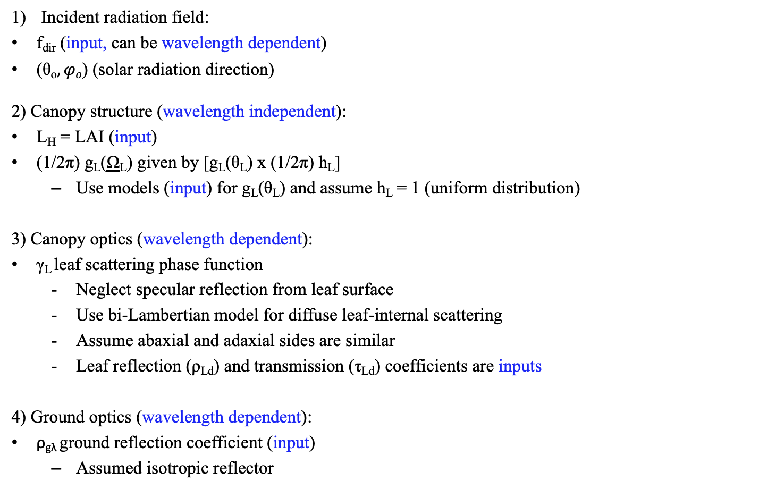
PHYSICAL MODELS IN REMOTE SENSING Chapter 04 – Part - 01: 1D RT Problem Setup
Summary
Incident radiation field:
f_{dir} (input, can be wavelength dependent)
(θ_{o}$,φo$) (solar radiation direction)
2) Canopy structure (wavelength independent):
L_{H} = LAI (input)
(1/2π) g_{L}(Ω_{L}) given by [g_{L}(θ_{L}) x (1/2π) h_{L}]
Use models (input) for g_{L}(θ_{L}) and assume h_{L} = 1 (uniform distribution)
3) Canopy optics (wavelength dependent):
γ_{L} leaf scattering phase function
Neglect specular reflection from leaf surface
Use bi-Lambertian model for diffuse leaf-internal scattering
Assume abaxial and adaxial sides are similar
Leaf reflection (ρ_{Ld}) and transmission (τ_{Ld}) coefficients are inputs
4) Ground optics (wavelength dependent):
ρ_{gλ} ground reflection coefficient (input)
Assumed isotropic reflector
_

Slide 12

PHYSICAL MODELS IN REMOTE SENSING Chapter 04 – Part - 01: 1D RT Problem Setup
Separation into Collided and Uncollided Problems
Separate the uncollided radiation field from the collided field
where I⁰ is the specific intensity of uncollided photons and I^{C} is the specific intensity of photons which experienced collisions with elements of the host medium.
Thus, 1D boundary value problem can be split in to an
Uncollided problem
Collided problem

Slide 13
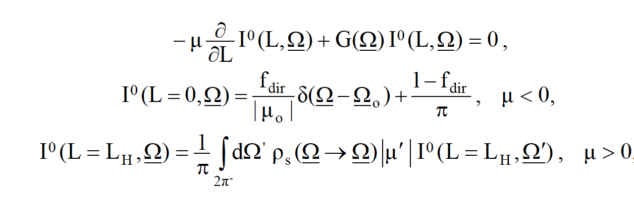
PHYSICAL MODELS IN REMOTE SENSING Chapter 04 – Part - 01: 1D RT Problem Setup
The Uncollided Problem

Slide 14
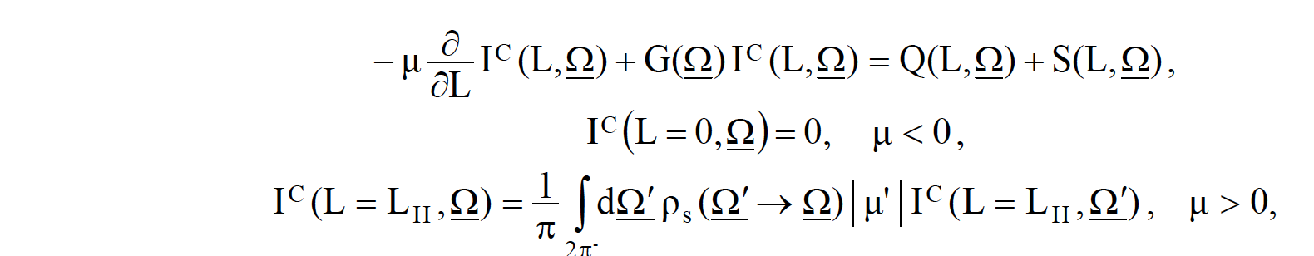
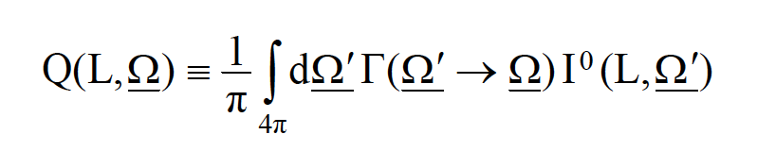
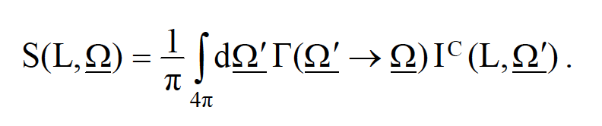
PHYSICAL MODELS IN REMOTE SENSING Chapter 04 – Part - 01: 1D RT Problem Setup
The Collided Problem
where Q is the first collision source,
and S is the distributed (multiple-collision) source,

Slide 15
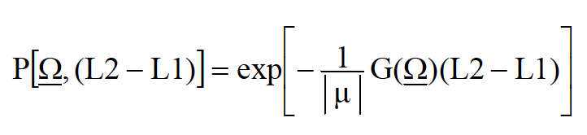
PHYSICAL MODELS IN REMOTE SENSING Chapter 04 – Part - 01: 1D RT Problem Setup
Solution of the Uncollided Problem
The uncollided problem has an analytical solution.
For downward directions:
For upward directions:
where
denotes the probability of photons not experiencing collisions while traveling along Ω between depth L1 and L2 (L2>L1).

Slide 16


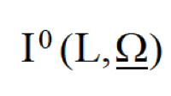
PHYSICAL MODELS IN REMOTE SENSING Chapter 04 – Part - 01: 1D RT Problem Setup
Pictorial Illustration of the Solution to the Uncollided Problem
For downward directions:
: probability of photons not experiencing collisions while traveling along Ω
between depths L and 0
: incident (uncollided!) intensity (known from upper boundary condition)
L
Ω
L_{H}

Slide 17


PHYSICAL MODELS IN REMOTE SENSING Chapter 04 – Part - 01: 1D RT Problem Setup
Pictorial Illustration of the Solution to the Uncollided Problem
For upward directions:
: probability of photons not experiencing collisions while traveling along Ω
between depths L_{H} and L
: incident intensity (known from lower boundary condition)
Ω
L
L_{H}

Slide 18
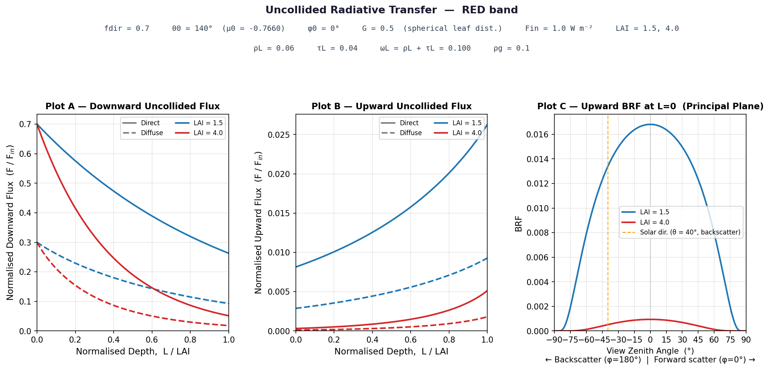
PHYSICAL MODELS IN REMOTE SENSING Chapter 04 – Part - 01: 1D RT Problem Setup
Example Results

Slide 19

PHYSICAL MODELS IN REMOTE SENSING Chapter 04 – Part - 01: 1D RT Problem Setup
Example Results

