Slide 1
PHYSICAL MODELS IN REMOTE SENSING Chapter 04 – Part 02: Successive Orders of Scattering Approximation
Separation into Uncollided and Collided Problems
Solution of Uncollided Problem
The Collided Problem
Method of Successive Orders of Scattering
First-Collision Problem
Solution of the First-Collision Problem
Graphical Description of the Solution
Example Results
Higher Order Collision Problems
Example Results
Concluding Remarks

Slide 2

PHYSICAL MODELS IN REMOTE SENSING Chapter 04 – Part 02: Successive Orders of Scattering Approximation
Separation into Collided and Uncollided Problems
Separate the uncollided radiation field from the collided field
where I⁰ is the specific intensity of uncollided photons and I^{C} is the specific intensity of photons which experienced collisions with elements of the host medium.
Thus, 1D boundary value problem can be split in to an (see Part 01)
Uncollided problem
Collided problem
The uncollided problem can be solved analytically. That means we know I⁰ at any depth L (between 0 and L_{H}) and for all directions Ω (see previous lecture C4-P1).

Slide 3
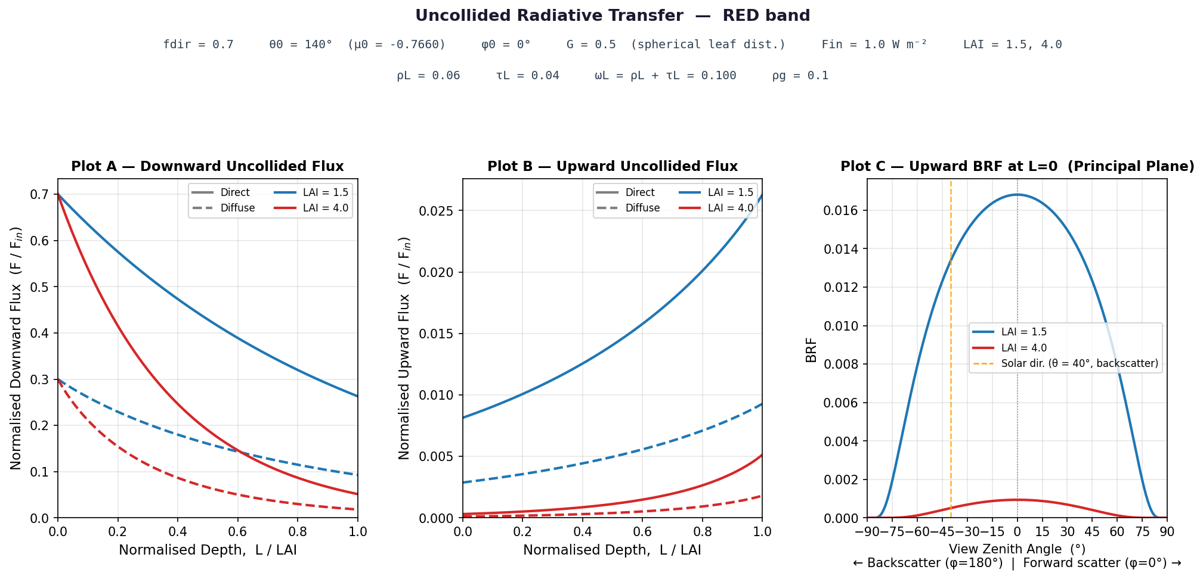
PHYSICAL MODELS IN REMOTE SENSING Chapter 04 – Part - 01: 1D RT Problem Setup
Example Results
This will be the Fig. 04 in your report. Download the code C4-P1-Uncollided-RT.py to help you with this figure and the next.

Slide 4

PHYSICAL MODELS IN REMOTE SENSING Chapter 04 – Part - 01: 1D RT Problem Setup
Example Results
This will be the Fig. 05 in your report.

Slide 5
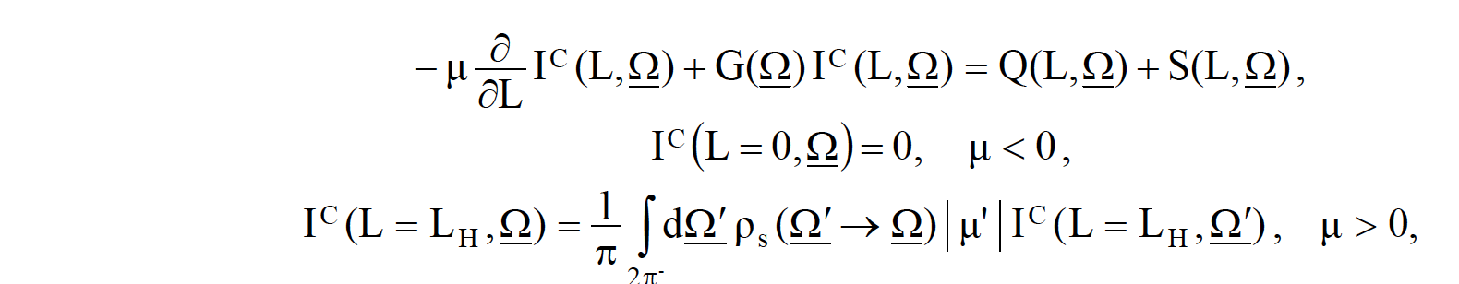
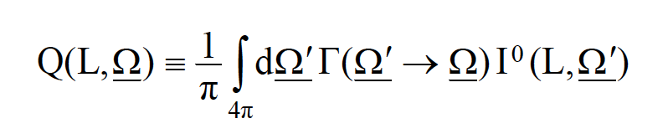
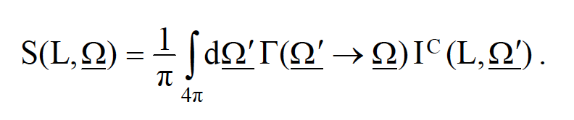
PHYSICAL MODELS IN REMOTE SENSING Chapter 04 – Part 02: Successive Orders of Scattering Approximation
The Collided Problem
where Q is the first collision source (known because I⁰ is known),
and S is the distributed (multiple-collision) source,
The collided problem cannot be solved analytically because the unknown collision intensity is
on both sides of the equation. So, we resort to numerical solutions that involve some sort of approximations.

Slide 6
PHYSICAL MODELS IN REMOTE SENSING Chapter 04 – Part 02: Successive Orders of Scattering Approximation
Successive Orders Approximation
One such approximation involves splitting the collided intensity into successive orders of
scattering intensities, that is,
I^{C}(L,Ω) = I¹(L,Ω) + I²(L,Ω) + I³(L,Ω) + … + I^{n}(L,Ω)
Here I¹(L,Ω) is intensity of once-scattered photons, I²(L,Ω) is intensity of twice-
scattered photons and so on …
Inserting the above into the RTE for collided Intensity (Slide 4), gives ”n” RT problems with appropriate boundary conditions.
We now solve each of them and add the solutions to get the total collided intensity, I^{C}.
Let us start with I¹(L,Ω)

Slide 7
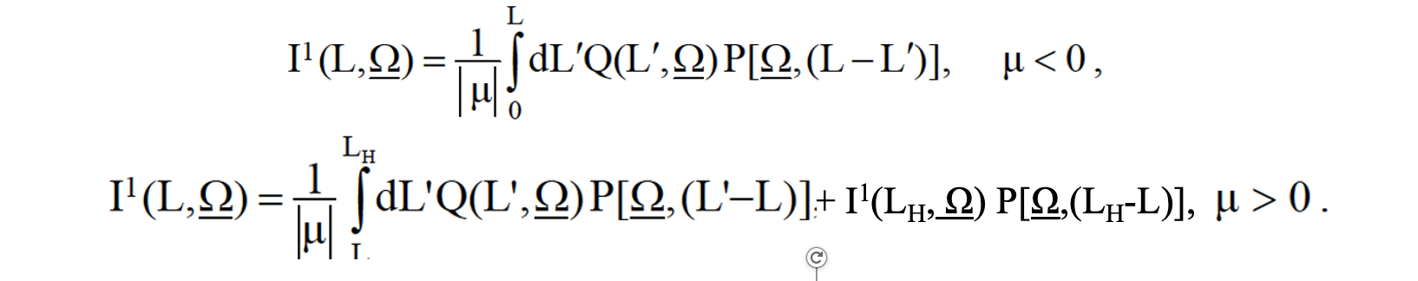
PHYSICAL MODELS IN REMOTE SENSING Chapter 04 – Part 02: Successive Orders of Scattering Approximation
I¹(L,Ω) Problem:
The I¹(L,Ω) problem is,
- μ (∂/ ∂L) I¹(L,Ω) + G(Ω) I¹(L,Ω) = (1/π) ∫ dΩ’ Γ(Ω’→ Ω) I⁰(L,Ω’)
4π
I¹(L=0,Ω) = 0, μ < 0
I¹(L=L_{H},Ω) = (1/π) ∫ dΩ’ ρ_{s}(Ω’→ Ω) |μ’| I¹(L=L_{H},Ω’) , μ > 0
2π⁻
The right-hand side of the RTE is our first collision source term, Q(L,Ω) which can be evaluated because we have already solved for the uncollided intensity I⁰(L,Ω). The pde for I¹(L,Ω) has an analytical solution,

Slide 8
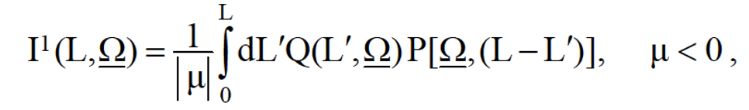
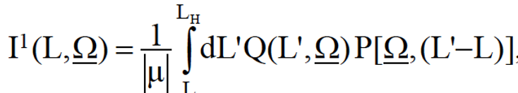

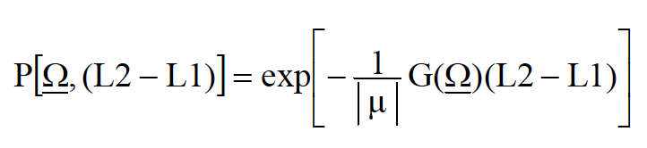
PHYSICAL MODELS IN REMOTE SENSING Chapter 04 – Part 02: Successive Orders of Scattering Approximation
I¹(L,Ω) Problem:
The solution for I¹(L,Ω) is,
+ I¹(L_{H}, Ω) P[Ω,(L_{H}-L)],
where,
denotes the probability of photons not experiencing collisions while traveling along Ω between depth L1 and L2 (L2 > L1).
In weakly scattering media (e.g. single scattering albedo less than 0.1), a single scattering approximation may suffice.

Slide 9
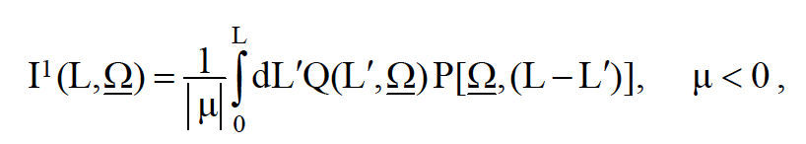

PHYSICAL MODELS IN REMOTE SENSING Chapter 04 – Part 02: Successive Orders of Scattering Approximation
I¹(L,Ω) Problem:
For example, I¹(L,Ω) for downward directions is evaluated as,
L = 0
Q(L’,Ω)
L’
L-L’
L
I¹(L, Ω)
Ω
L = L_{H}
Q(L,Ω) = (1/π) ∫ dΩ’ Γ(Ω’→ Ω) I⁰(L,Ω’)

Slide 10
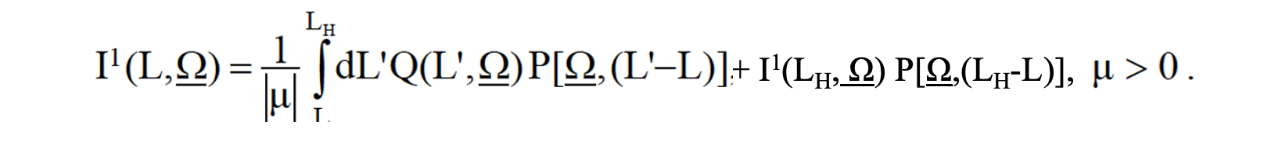
PHYSICAL MODELS IN REMOTE SENSING Chapter 04 – Part 02: Successive Orders of Scattering Approximation
I¹(L,Ω) Problem:
Similarly, I¹(L,Ω) for upward directions is evaluated as,
L = 0
Ω
L’-L
L
I¹(L, Ω)
Q(L’,Ω)
L’
L = L_{H}
Q(L,Ω) = (1/π) ∫ dΩ’ Γ(Ω’→ Ω) I⁰(L,Ω’)

Slide 11
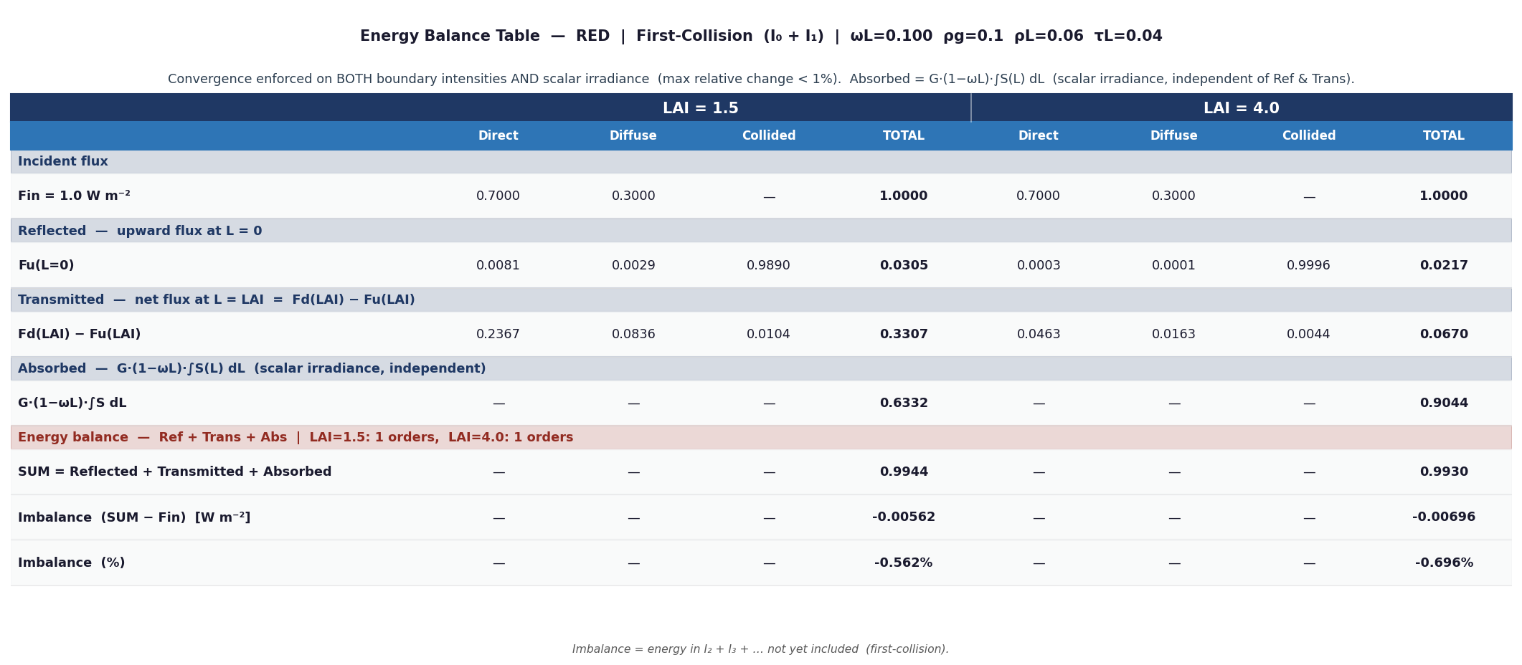
PHYSICAL MODELS IN REMOTE SENSING Chapter 04 – Part - 01: 1D RT Problem Setup
Example Results

Slide 12

PHYSICAL MODELS IN REMOTE SENSING Chapter 04 – Part - 01: 1D RT Problem Setup
Example Results

Slide 13
PHYSICAL MODELS IN REMOTE SENSING Chapter 04 – Part 02: Successive Orders of Scattering Approximation
I²(L,Ω) Problem:
Once the I¹(L,Ω) is solved, we go for I²(L,Ω),
- μ (∂/ ∂L) I²(L,Ω) + G(Ω) I²(L,Ω) = (1/π) ∫ dΩ’ Γ(Ω’→ Ω) I¹(L,Ω’)
4π
I²(L=0,Ω) = 0, μ < 0
I²(L=L_{H},Ω) = (1/π) ∫ dΩ’ ρ_{s}(Ω’→ Ω) |μ’| I²(L=L_{H},Ω’) , μ > 0
2π⁻
The right-hand side of the RTE is now the second collision source term, Q²(L,Ω) which can be evaluated because we have already solved for the first order collided intensity I¹(L,Ω). The pde for I²(L,Ω) has an analytical solution, similar to that for I¹(L,Ω).

Slide 14
PHYSICAL MODELS IN REMOTE SENSING Chapter 04 – Part 02: Successive Orders of Scattering Approximation
I^{n}(L,Ω) Problem:
Once the I^{n-1}(L,Ω) is solved, we go for I^{n}(L,Ω),
- μ (∂/ ∂L) I^{n}(L,Ω) + G(Ω) I^{n}(L,Ω) = (1/π) ∫ dΩ’ Γ(Ω’→ Ω) I^{n-1}(L,Ω’)
4π
I^{n}(L=0,Ω) = 0, μ < 0
I^{n}(L=L_{H},Ω) = (1/π) ∫ dΩ’ ρ_{s}(Ω’→ Ω) |μ’| I^{n}(L=L_{H},Ω’) , μ > 0
2π⁻
The right-hand side of the RTE is now the n^{th} order collision source term, Q^{n}(L,Ω) which can be evaluated because we have already solved for the first order collided intensity I^{n-1}(L,Ω). The pde for I^{n}(L,Ω) has an analytical solution, similar to that for I^{n-1}(L,Ω).
Finally, the total collided intensity is evaluated as
I^{C}(L,Ω) = I¹(L,Ω) + I²(L,Ω) + I³(L,Ω) + … + I^{n}(L,Ω) , and
the total Intensity is:

Slide 15
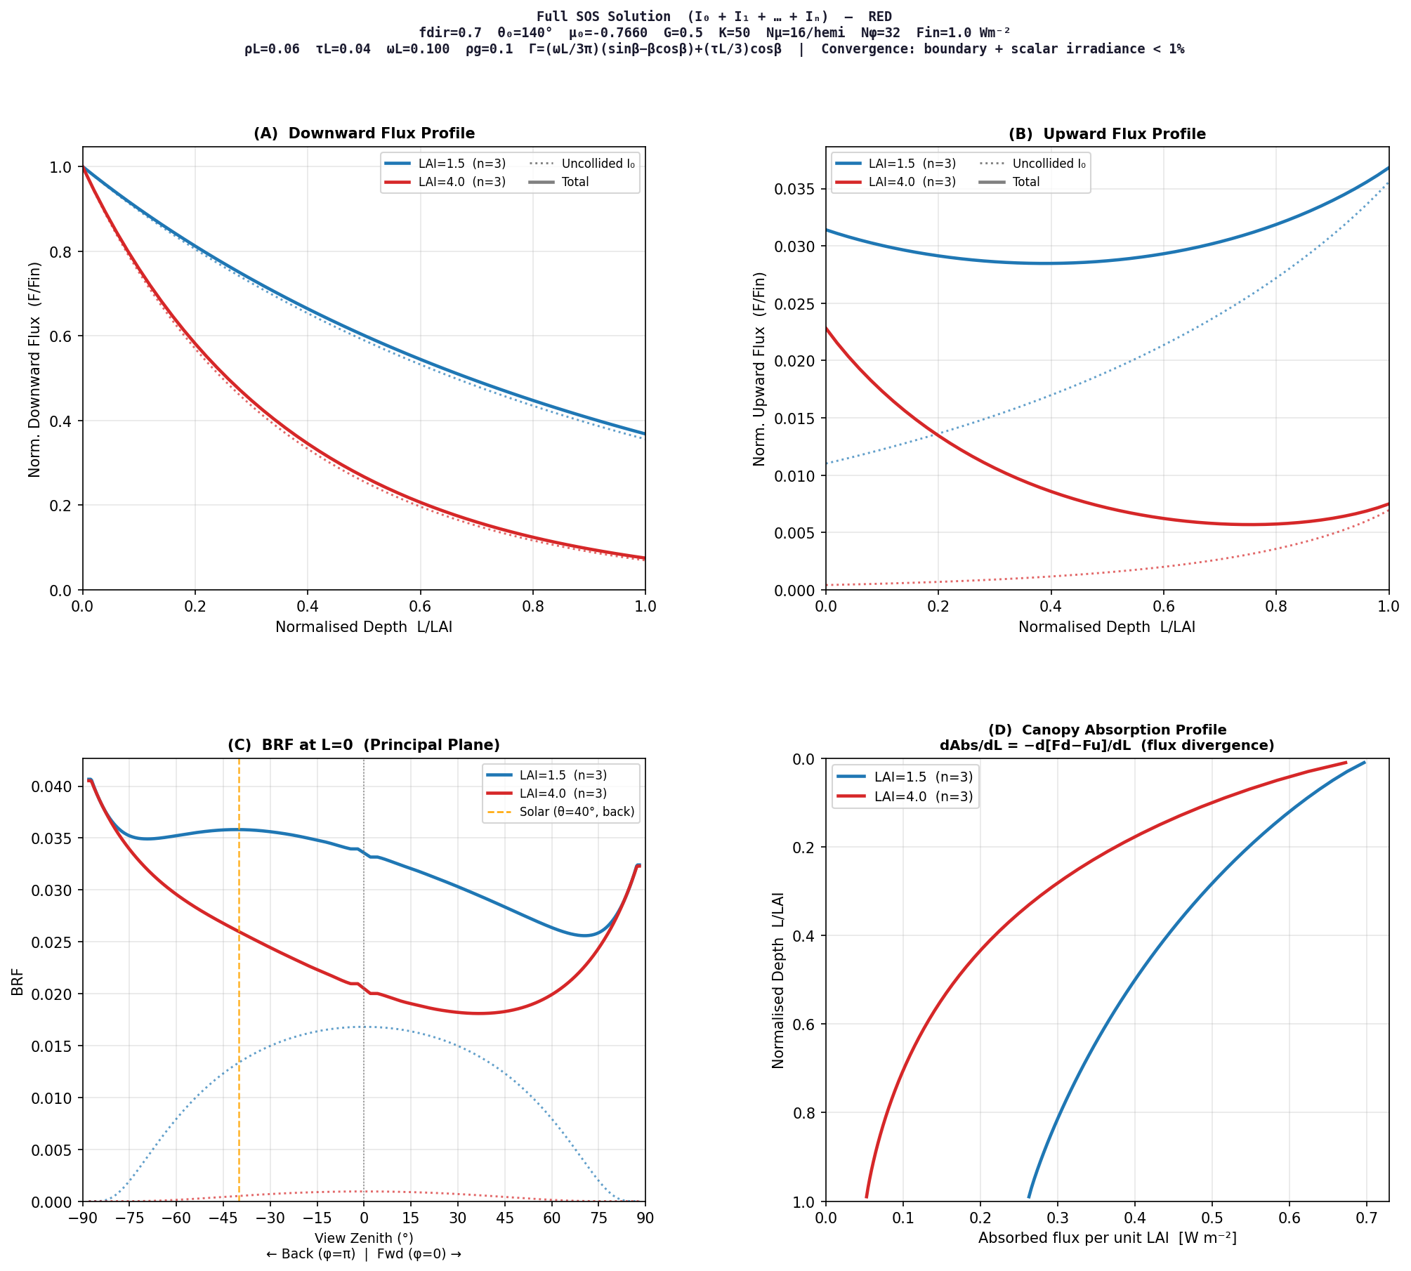
PHYSICAL MODELS IN REMOTE SENSING Chapter 04 – Part - 01: 1D RT Problem Setup
Example Results

Slide 16
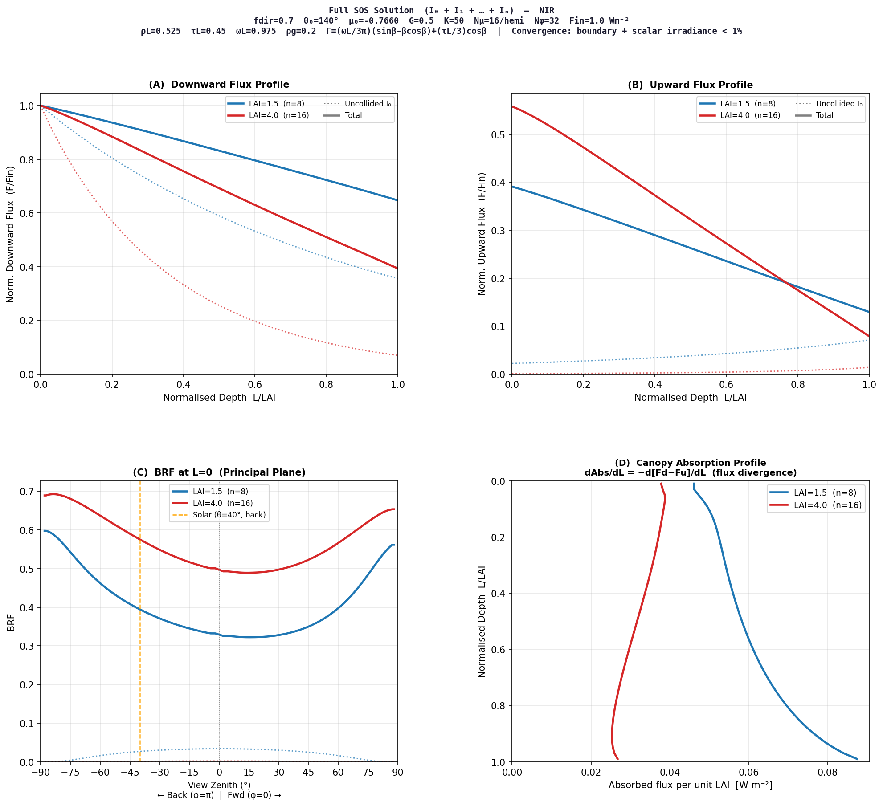
PHYSICAL MODELS IN REMOTE SENSING Chapter 04 – Part - 01: 1D RT Problem Setup
Example Results

Slide 17
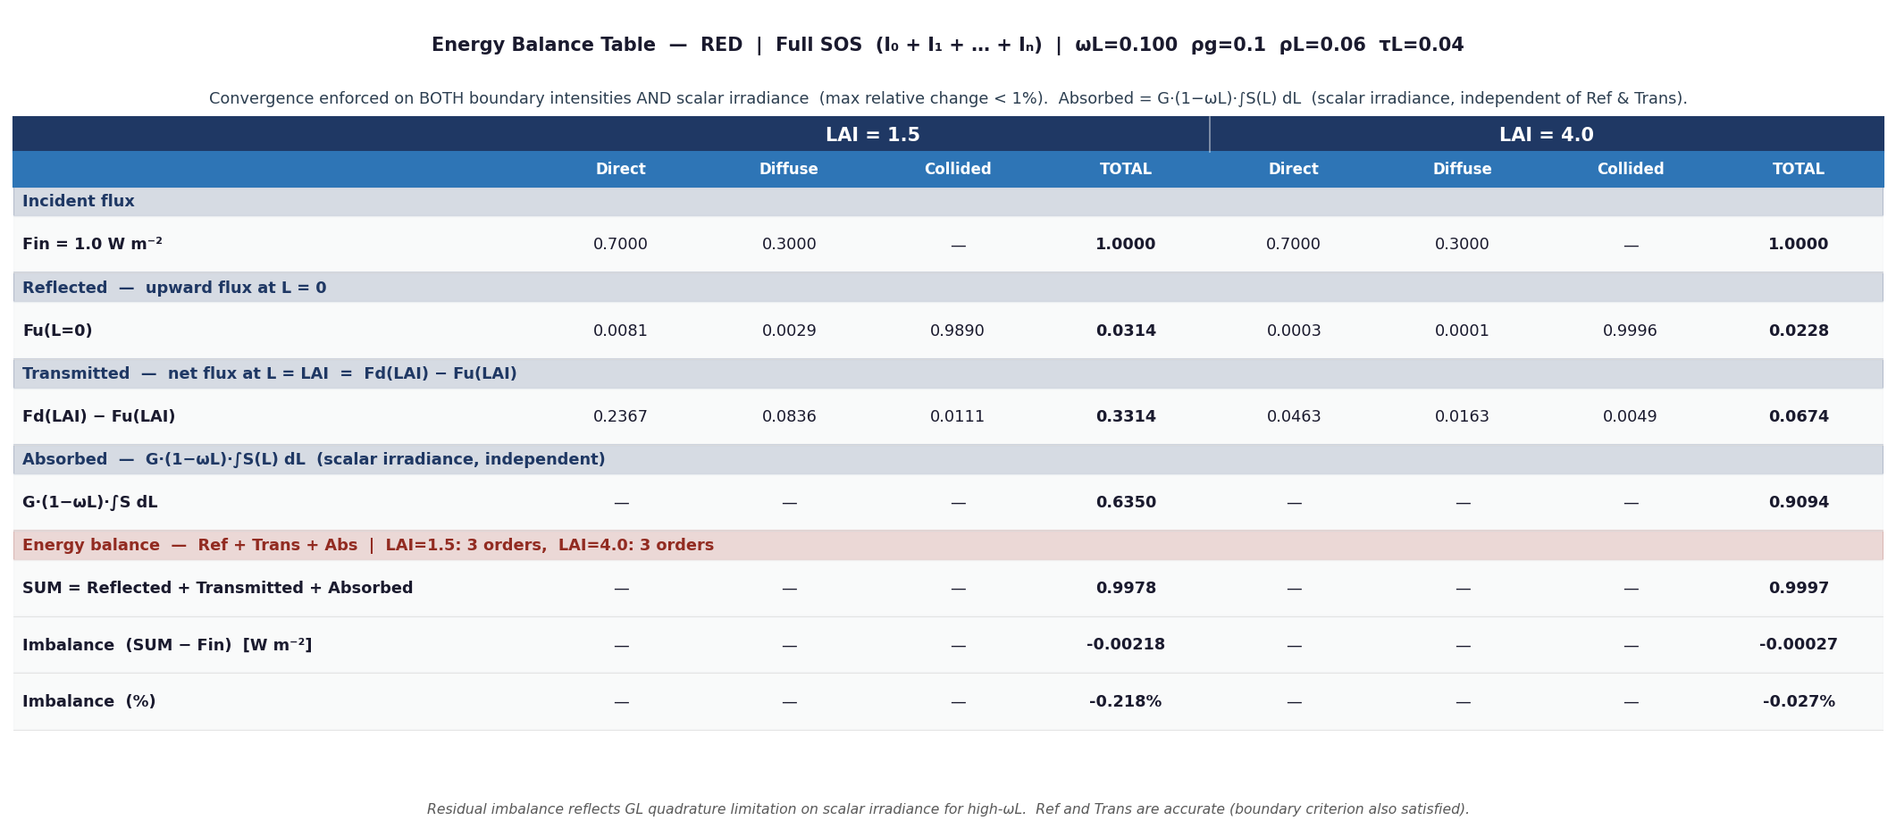
PHYSICAL MODELS IN REMOTE SENSING Chapter 04 – Part - 01: 1D RT Problem Setup
Example Results

Slide 18

PHYSICAL MODELS IN REMOTE SENSING Chapter 04 – Part - 01: 1D RT Problem Setup
Example Results

Slide 19
PHYSICAL MODELS IN REMOTE SENSING Chapter 04 – Part 02: Successive Orders of Scattering Approximation
Positives:
1) Simple
2) Intuitive: best method for understanding the scattering process
Negatives:
1) What should “N” (the number of scattering orders) be?
It depends on canopy depth (LAI) and the single scattering albedo (scattering strength)
Can be as large as 100 in strongly scattering deep media
Stop when further changes in collided intensity are less than some pre-set threshold
2) The depth integrals are difficult to do. We can, and should find, a better way to handle these integrals, as for example, use a spatial grid (more on this later …)
To Do:
Download a detailed description of the SOS algorithm
Download the code

