Slide 1
PHYSICAL MODELS IN REMOTE SENSING Chapter 04 – Part 03: Discrete Ordinates Method (Part One)
Problem Description
Separate the uncollided radiation field from the collided field
Angular Discretization
Gauss Quadrature
Spatial Discretization
Solve for Uncollided Intensity
Solve for Downward Intensity: Direct Solar
Solve for Downward Intensity: Diffuse Sky
Handle the Lower Boundary Condition
Solve for Upward Uncollided Intensity
Evaluate First Collision Source

Slide 2

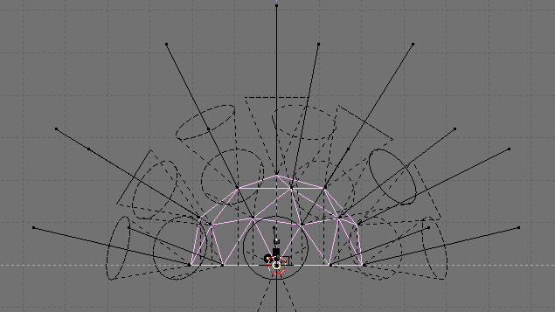

PHYSICAL MODELS IN REMOTE SENSING Chapter 04 – Part - 03: Discrete Ordinates Method (Part One)
Schematic of 1D Problem
I_{oλ}
δ(Ω−Ω_{o})
Ω_{d}
Direct sunlight
Ω_{o}
Diffuse sky illumination
I_{dλ}
z=0 or L = 0
top
z axis
L = cumulated LAI
leaf canopy
z=z_{H} or L = LAI
Bottom (e.g. ground)
Notation:
LAI: leaf area index of the canopy
-z axis pointed upwards towards the zenith
Directions measured with respect to –z axis
μ > 0 for upward directions
μ < 0 for downward directions

Slide 3

PHYSICAL MODELS IN REMOTE SENSING Chapter 04 – Part 03: Discrete Ordinates Method (Part One)
Separation into Collided and Uncollided Problems
Separate the uncollided radiation field from the collided field
where I⁰ is the specific intensity of uncollided photons and I^{C} is the specific intensity of photons which experienced collisions with elements of the host medium.
Thus, 1D boundary value problem can be split in to an (see Part 01)
Uncollided problem
Collided problem
The uncollided problem can be solved analytically. That means we know I⁰ at any depth L
(between 0 and L_{H}) and for all directions Ω (see C4-P1).
However, we will solve both the uncollided and collided problems using the discrete ordinates
Method (Part One) in the following slides.

Slide 4
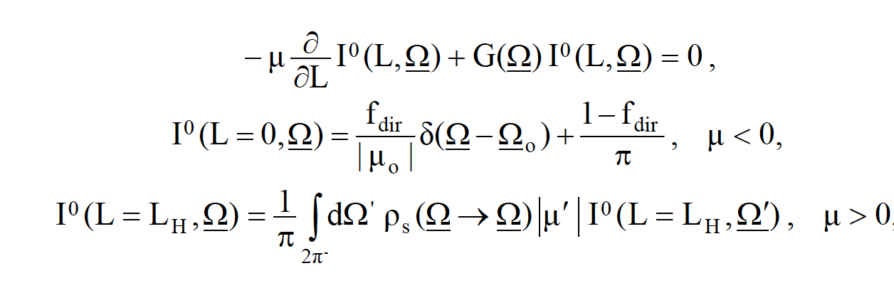
PHYSICAL MODELS IN REMOTE SENSING Chapter 04 – Part - 03: Discrete Ordinates Method (Part One)
The Uncollided Problem

Slide 5
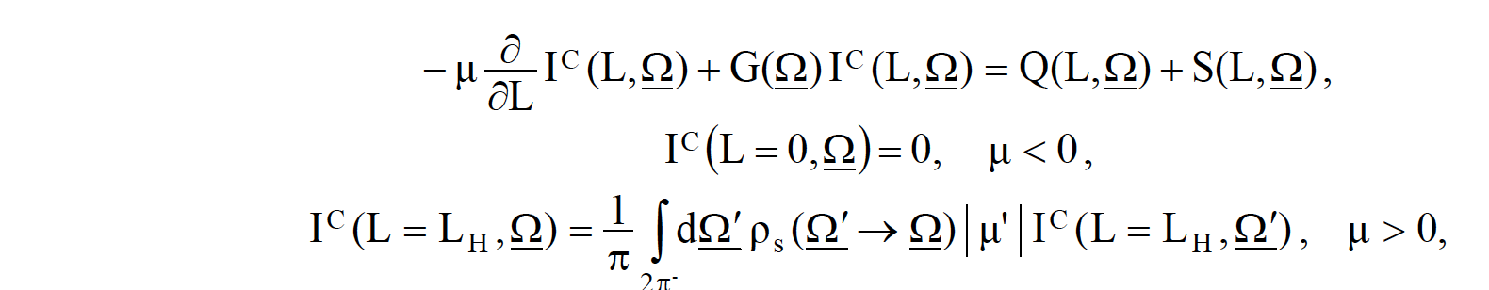
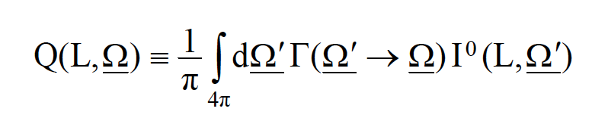
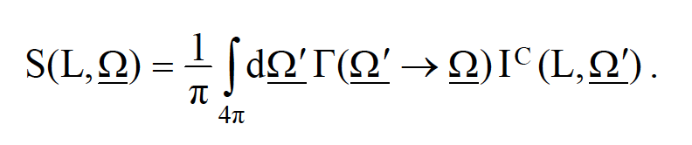
PHYSICAL MODELS IN REMOTE SENSING Chapter 04 – Part - 03: Discrete Ordinates Method (Part One)
The Collided Problem
where Q is the first collision source,
and S is the distributed (multiple-collision) source,

Slide 6
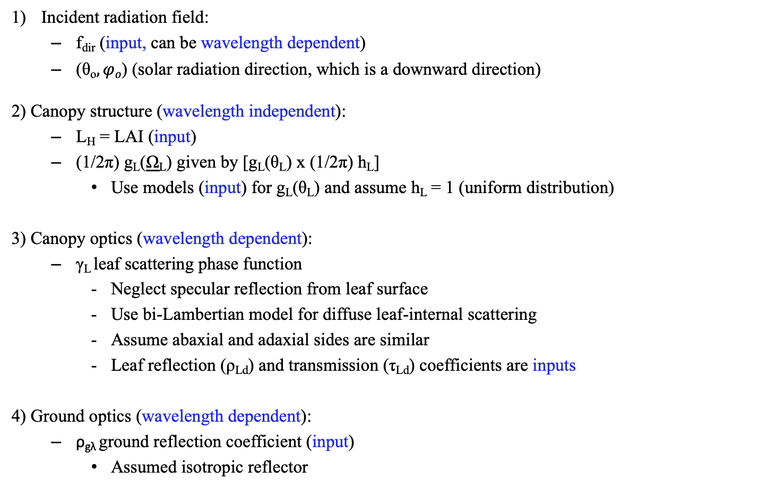
PHYSICAL MODELS IN REMOTE SENSING Chapter 04 – Part - 03: Discrete Ordinates Method (Part One)
Summary
Incident radiation field:
f_{dir} (input, can be wavelength dependent)
(θ_{o}$,φo$) (solar radiation direction, which is a downward direction)
2) Canopy structure (wavelength independent):
L_{H} = LAI (input)
(1/2π) g_{L}(Ω_{L}) given by [g_{L}(θ_{L}) x (1/2π) h_{L}]
Use models (input) for g_{L}(θ_{L}) and assume h_{L} = 1 (uniform distribution)
3) Canopy optics (wavelength dependent):
γ_{L} leaf scattering phase function
Neglect specular reflection from leaf surface
Use bi-Lambertian model for diffuse leaf-internal scattering
Assume abaxial and adaxial sides are similar
Leaf reflection (ρ_{Ld}) and transmission (τ_{Ld}) coefficients are inputs
4) Ground optics (wavelength dependent):
ρ_{gλ} ground reflection coefficient (input)
Assumed isotropic reflector
_

Slide 7
PHYSICAL MODELS IN REMOTE SENSING Chapter 04 – Part 03: Discrete Ordinates Method (Part One)
Step 1: Angular Discretization
Discretize the direction variable Ω using Gauss quadrature in N x M directions
μ -> μ₁, μ₂, …, μ_{N}
ϕ -> ϕ₁, ϕ₂, …, ϕ_{M}
Evaluate the cross sections
G(μ_{o},ϕ_{o}) : where Ω_{o} is the solar direction (μ_{o},ϕ_{o} are inputs)
G(μ_{i},ϕ_{j}) : where Ω_{ij} is the Gauss direction (matrix of size NxM)
Γ(μ_{o},ϕ_{o} -> μ_{i}, ϕ_{j}) : where Ω_{ij} is the Gauss direction (matrix of size NxM)
Γ(μ_{n},ϕ_{m} -> μ_{i}, ϕ_{j}) : where Ω_{nm} and Ω_{ij} are Gauss directions (matrix NxMxNxM)
Assume Uniform leaf normal orientation [g_{L}(θ_{L}) = 1 and (1/2π) h_{L} where h_{L} = 1]
G = 0.5
Γ has an analytical solution

Slide 8
PHYSICAL MODELS IN REMOTE SENSING Chapter 04– Part 03: Discrete Ordinates Method (Part One)
Gauss (double) Quadrature:
N : Order of Gauss quadrature
w_{i} : Quadrature weights (w₁, w₂, …, w_{N})
x_{i} : Quadrature ordinates (x₁, x₂, …, x_{N})
Example: Say N = 12, it means -
w₁
w₂
w₃
w₄
w₅
w₆
w₇
w₈
w₉
w₁₀
w₁₁
w₁₂
-1
+1
x₁
x₂
x₃
x₄
x₅
x₆
x₇
x₈
x₉
x₁₀
x₁₁
x₁₂
0
You have N/2 weights and ordinates between the interval (-1,0) and the same between (0,1)

Slide 9
PHYSICAL MODELS IN REMOTE SENSING Chapter 04– Part 03: Discrete Ordinates Method (Part One)
Check Weights:
+1
N
∫
dx =
∑
w_{i} = 2
-1
i=1
+1
N
∫
dx x =
∑
x_{i} w_{i} = 0.5
0
i=(N/2)+1
General Case:
B
N
∫
dx x = C₁
x’_{i} w_{i}
∑
A
i=1
x’_{i} = C₁ x_{i} + C₂
C₁ = (B-A)/2 and C₂ = (B+A)/2
In the above, x’_{i} are the modified ordinates that run between A and B.

Slide 10
PHYSICAL MODELS IN REMOTE SENSING Chapter 04 – Part 03: Discrete Ordinates Method (Part One)
Step 2: Spatial Discretization
Divide the canopy into K layers
z=0 or L = 0
k=1
(cell edge)
Layer
1
ΔL = LAI/K
k=2
(cell edge)
Layer
2
k=3
(cell edge)
and so on
k=K-1
(cell edge)
Layer
K-1
k=K
(cell edge)
Layer
K
z=z_{H} or L = L_{H} = LAI
k=K+1
(cell edge)
Ground

Slide 11
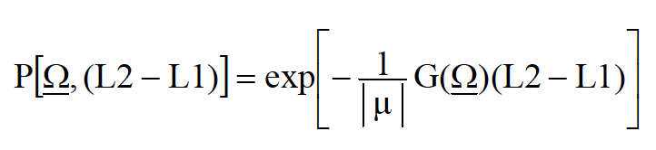
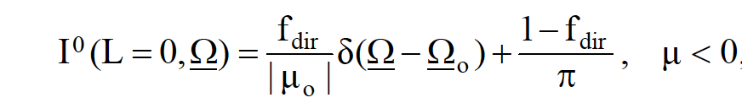
PHYSICAL MODELS IN REMOTE SENSING Chapter 04 – Part 03: Discrete Ordinates Method (Part One)
Step 3: Solve for downward Uncollided Intensity
The solution is:
where
, L2 > L1
and I⁰(L=0,Ω) , the RHS is known from upper boundary condition (Slide 4)

Slide 12
PHYSICAL MODELS IN REMOTE SENSING Chapter 04 – Part 03: Discrete Ordinates Method (Part One)
Step 3a: Solve for downward “direct solar” Uncollided Intensity
I⁰_{dir}(L_{k=1},Ω_{o}) = I⁰_{dir}(L=0,Ω_{o}) , the RHS is known from upper boundary condition (cf. slide 4)
I⁰_{dir}(L_{k=2},Ω_{o}) = I⁰_{dir}(L_{k=1},Ω_{o}) exp[-(1/| μ_{i}|)G(Ω_{o})ΔL]
I⁰_{dir}(L_{k=3},Ω_{o}) = I⁰_{dir}(L_{k=2},Ω_{o}) exp[-(1/| μ_{i}|)G(Ω_{o})ΔL]
and so on till,
I⁰_{dir}(L_{k=K+1},Ω_{o}) = I⁰_{dir}(L_{k=K},Ω_{o}) exp[-(1/| μ_{i}|)G(Ω_{o})ΔL]
This is called sweeping down in the phase-space grid (mesh)
Note that you do this only for the solar direction Ω_{o}

Slide 13
PHYSICAL MODELS IN REMOTE SENSING Chapter 04 – Part 03: Discrete Ordinates Method (Part One)
Step 3b: Solve for downward “diffuse sky” Uncollided Intensity
I⁰_{dif}(L_{k=1},Ω_{ij}) = I⁰_{dif}(L=0,Ω_{ij}) , the RHS is known from upper boundary condition (cf. slide 4)
I⁰_{dif}(L_{k=2},Ω_{ij}) = I⁰_{dif}(L_{k=1},Ω_{ij}) exp[-(1/| μ_{i}|)G(Ω_{ij})ΔL]
I⁰_{dif}(L_{k=3},Ω_{ij}) = I⁰_{dif}(L_{k=2},Ω_{ij}) exp[-(1/| μ_{i}|)G(Ω_{ij})ΔL]
and so on till,
I⁰_{dif}(L_{k=K+1},Ω_{ij}) = I⁰_{dif}(L_{k=K},Ω_{ij}) exp[-(1/| μ_{i}|)G(Ω_{ij})ΔL]
This is called sweeping down in the phase-space grid (mesh)
Do this for all (N/2)xM downward directions

Slide 14
PHYSICAL MODELS IN REMOTE SENSING Chapter 04 – Part 03: Discrete Ordinates Method (Part One)
Step 4: Handle the lower boundary condition
n=N/2
m=M
I⁰(L_{k=K+1},Ω_{ij}) = (ρ_{gλ}/π) ∑ w_{n} ∑ w_{m} |μ_{n}| I⁰_{dif}(L_{k=K+1},Ω_{nm}) + (ρ_{gλ}/π) |μ_{o}| I⁰_{dir}(L_{k=K+1},Ω_{o})
n=1
m=1
Note that direction Ω_{ij} is an upward direction and Ω_{nm} is a downward direction
Ω_{ij}
Ω_{nm}
I⁰(L_{k=K+1},Ω_{ij})
I⁰(L_{k=K+1},Ω_{nm})
z=z_{H} or L = L_{H} = LAI
k=K+1
(cell edge)
Ground

Slide 15
PHYSICAL MODELS IN REMOTE SENSING Chapter 04 – Part 03: Discrete Ordinates Method (Part One)
Step 5: Solve for upward Uncollided Intensity
The solution is:
where
, L2 > L1
and I⁰(L=L_{H},Ω) , the RHS is known from lower boundary condition (see previous slide)

Slide 16
PHYSICAL MODELS IN REMOTE SENSING Chapter 04 – Part 03: Discrete Ordinates Method (Part One)
Step 5: Solve for upward Uncollided Intensity
I0(L_{k=K+1},Ω_{ij}) is known from lower boundary condition (slide 14)
I⁰(L_{k=K},Ω_{ij}) = I⁰(L_{k=K+1},Ω_{ij}) exp[-(1/| μ_{i}|)G(Ω_{ij})ΔL]
I⁰(L_{k=K-1},Ω_{ij}) = I⁰(L_{k=K},Ω_{ij}) exp[-(1/| μ_{i}|)G(Ω_{ij})ΔL]
and so on till,
I⁰(L_{k=1},Ω_{ij}) = I⁰(L_{k=2},Ω_{ij}) exp[-(1/| μ_{i}|)G(Ω_{ij})ΔL]
This is called sweeping up in the phase-space grid (mesh)
Do this for all (N/2)xM upward directions

Slide 17
PHYSICAL MODELS IN REMOTE SENSING Chapter 04 – Part 03: Discrete Ordinates Method (Part One)
What do we have now?
After Step 5, we evaluated at each cell edge
I⁰(L_{k},Ω_{o}) , k = 1, 2, 3 … K+1 for direct solar radiation (downward) direction
I⁰(L_{k},Ω_{ij}), k = 1, 2, 3 … K+1 for all downward directions due to diffuse sky radiation
I⁰(L_{k},Ω_{ij}), k = 1, 2, 3 … K+1 for all upwards directions due to reflection at ground

Slide 18
PHYSICAL MODELS IN REMOTE SENSING Chapter 04 – Part 03: Discrete Ordinates Method (Part One)
Step 6a: Evaluate First Collison Source Q due to Uncollided Downward direct solar
Evaluate FCS for all directions Ω_{ij} as follows
Q¹(L_{k+(1/2)},Ω_{ij}) = (1/π) Γ(μ_{o},ϕ_{o} -> μ_{i}, ϕ_{j}) I⁰_{dir}(L_{k+(1/2)}, Ω_{o})
Note that we are evaluating the source at cell center k+(1/2), where k = 1, 2,…,K
I⁰_{dir}(L_{k+(1/2)}, Ω_{o}) is cell-center intensity and evaluated from cell-edge intensities as:
I⁰_{dir}(L_{k+(1/2)}, Ω_{o}) = (1/2) [I⁰_{dir}(L_{k}, Ω_{o}) + I⁰_{dir}(L_{k+1}, Ω_{o})]
Note that Ω_{ij} represent all directions in a sphere

Slide 19
PHYSICAL MODELS IN REMOTE SENSING Chapter 04 – Part 03: Discrete Ordinates Method (Part One)
Step 6b: Evaluate First Collison Source Q due to Uncollided Downward Diffuse Sky Radiation
n=N/2
m=M
(1/π) ∑ w_{n} ∑ w_{m} Γ(μ_{n},ϕ_{m} -> μ_{i}, ϕ_{j}) I⁰_{dif}(L_{k+(1/2)}, Ω_{nm})
Q²(L_{k+(1/2)},Ω_{ij}) =
n=1
m=1
Note that we are evaluating the source at cell center k+(1/2), where k = 1, 2,…, K
The integration done only for downwards directions
The cell-center intensity and evaluated from cell-edge intensities as the mean of the cell-edge
Intensities, as before (cf. previous slide)
Note that Ω_{ij} represent all directions in a sphere

Slide 20
PHYSICAL MODELS IN REMOTE SENSING Chapter 04 – Part 03: Discrete Ordinates Method (Part One)
Step 6c: Evaluate First Collison Source Q due to Reflection Upwards from Lower Boundary
n = N
m=M
Q³(L_{k+(1/2)},Ω_{ij}) = (1/π) ∑ w_{n} ∑ w_{m} Γ(μ_{n},ϕ_{m} -> μ_{i}, ϕ_{j}) I⁰(L_{k+(1/2)}, Ω_{nm})
n=N/2 + 1
m=1
Note that we are evaluating the source at cell center k+(1/2), where k = 1, 2,…,K
The integration done for upward directions
The cell-center intensity and evaluated from cell-edge intensities as the mean of the cell-edge
Intensities, as before
Note that Ω_{ij} represent all directions in a sphere
Add Q^{1 ,} Q² and Q³ to obtain FCS Q.

Slide 21
PHYSICAL MODELS IN REMOTE SENSING Chapter 04 – Part 03: Discrete Ordinates Method (Part One)
What do we have now?
After Step 6 (Part One, C4-P3), we evaluated and saved the following quantities
I⁰(L_{k},Ω_{o}) , k = 1, 2, 3 … K+1 for direct solar radiation (downward) direction
I⁰(L_{k},Ω_{nm}), k = 1, 2, 3 … K+1 for all downward directions due to diffuse sky radiation
I⁰(L_{k},Ω_{nm}), k = 1, 2, 3 … K+1 for all upwards directions due to reflection at ground
Q¹(L_{k+(1/2)},Ω_{ij}), k = 1, 2, 3 … K for all directions due to direct solar radiation
Q²(L_{k+(1/2)},Ω_{ij}), k = 1, 2, 3 … K for all directions due to diffuse sky radiation
Q³(L_{k+(1/2)},Ω_{ij}), k = 1, 2, 3 … K for all upwards directions due to reflection at ground
Q (L_{k+(1/2)},Ω_{ij}) : the sum Q¹ + Q² + Q³

Slide 22
PHYSICAL MODELS IN REMOTE SENSING Chapter 04 – Part - 03: Discrete Ordinates Method (Part One)
Step 7a: The Collided Problem
where Q is the first collision source,
and S is the distributed (multiple-collision) source,

Slide 23
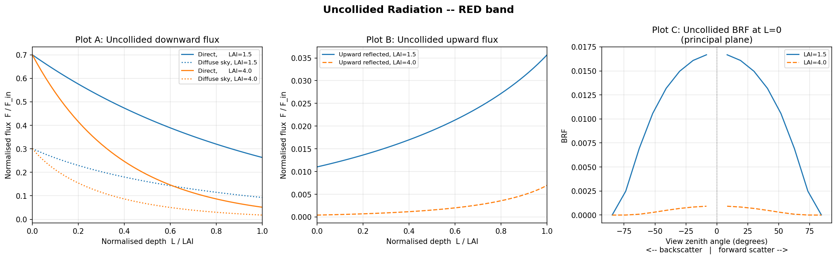
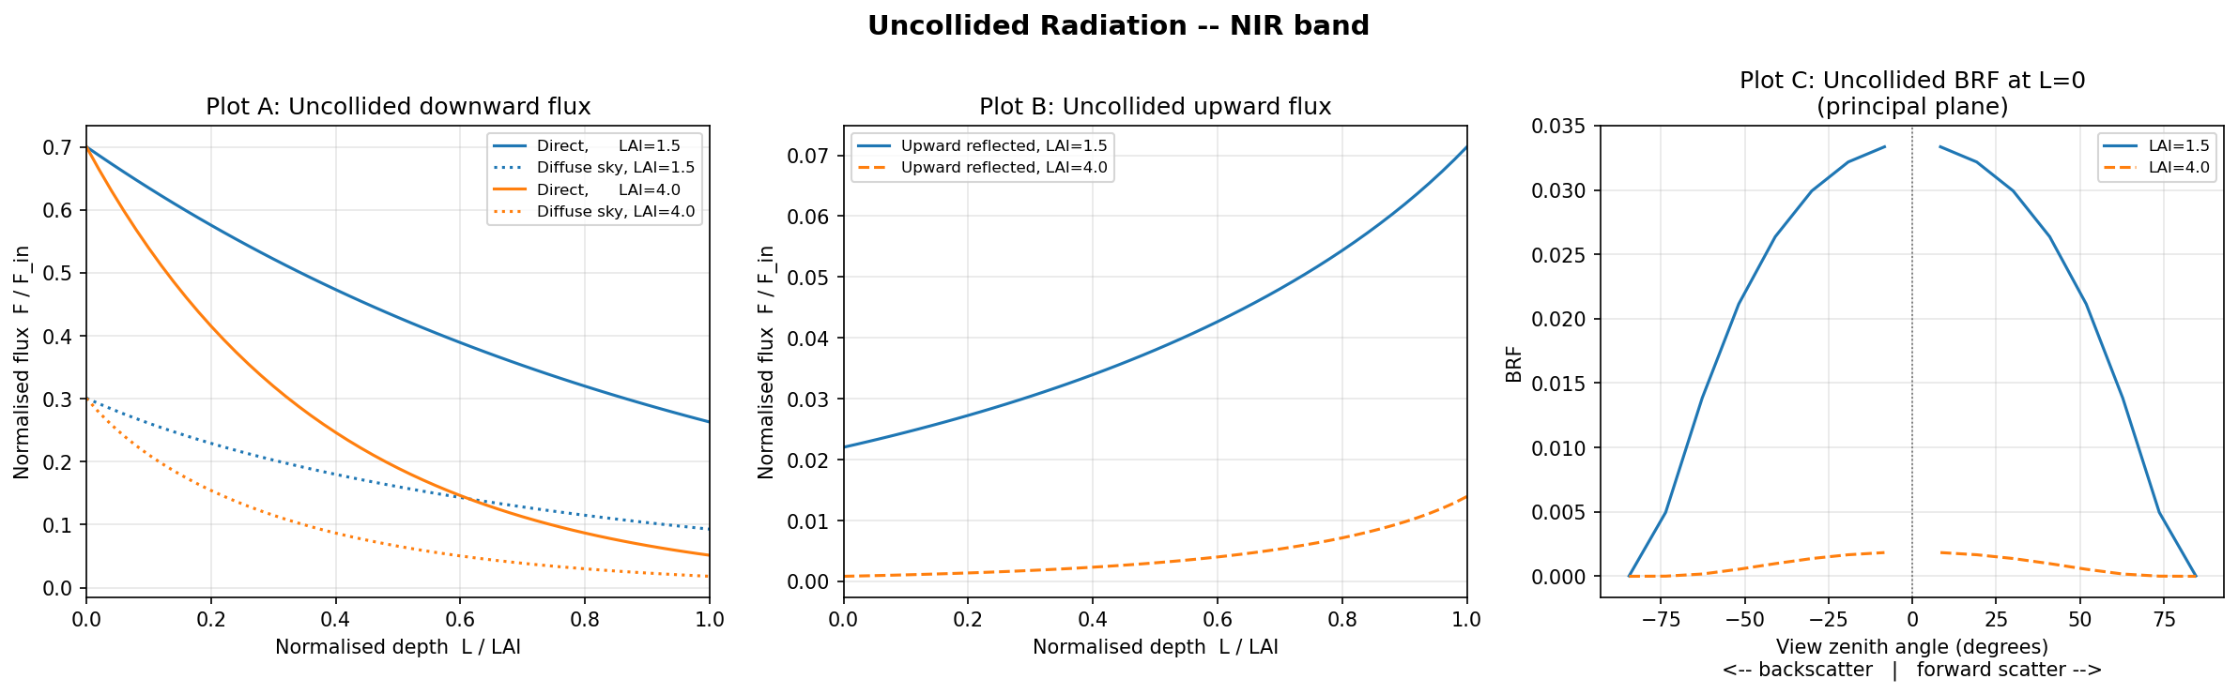
PHYSICAL MODELS IN REMOTE SENSING Chapter 04 – Part - 03: Discrete Ordinates Method (Part One)
Report
Download DOM UNCOLLIDED code
Download Documentation from Class Website
Produce Figs. 04 and 05 for your report (WRITE YOUR OWN CODE)

