Slide 1
PHYSICAL MODELS IN REMOTE SENSING Chapter 04 – Part 04: Discrete Ordinates Method (Part Two)
Quantities Evaluated After 6 Steps
The Collided Problem
Discretize the Collided RTE
Derive the Sweep Equations
Iterate on the Source till Convergence
Do Energy Balance
Example Plots to Show Sensitivity to Inputs
Comparison with Field Data
Interpolation

Slide 2
PHYSICAL MODELS IN REMOTE SENSING Chapter 04 – Part 04: Discrete Ordinates Method (Part Two)
What do we have now?
After Step 6 (Part One, C4-P3), we evaluated and saved the following quantities
I⁰(L_{k},Ω_{o}) , k = 1, 2, 3 … K+1 for direct solar radiation (downward) direction
I⁰(L_{k},Ω_{nm}), k = 1, 2, 3 … K+1 for all downward directions due to diffuse sky radiation
I⁰(L_{k},Ω_{nm}), k = 1, 2, 3 … K+1 for all upwards directions due to reflection at ground
Q¹(L_{k+(1/2)},Ω_{ij}), k = 1, 2, 3 … K for all directions due to direct solar radiation
Q²(L_{k+(1/2)},Ω_{ij}), k = 1, 2, 3 … K for all directions due to diffuse sky radiation
Q³(L_{k+(1/2)},Ω_{ij}), k = 1, 2, 3 … K for all upwards directions due to reflection at ground
Q (L_{k+(1/2)},Ω_{ij}) : the sum Q¹ + Q² + Q³

Slide 3
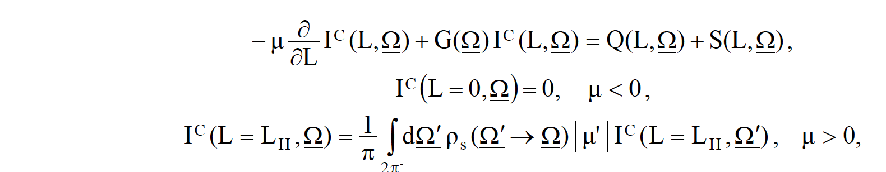
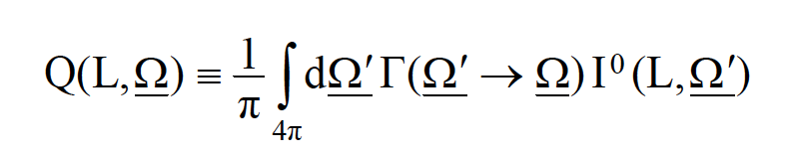
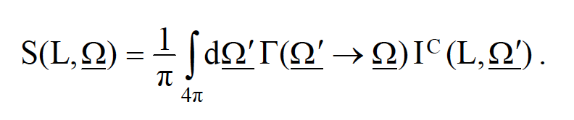
PHYSICAL MODELS IN REMOTE SENSING Chapter 04 – Part 04: Discrete Ordinates Method (Part Two)
Step 7a: The Collided Problem
where Q is the first collision source,
and S is the distributed (multiple-collision) source,

Slide 4
PHYSICAL MODELS IN REMOTE SENSING Chapter 04 – Part 04: Discrete Ordinates Method (Part Two)
Step 7b: Approximate
The spatial derivative δI^{C}/δL as (1/ΔL) [I^{C}(L_{k+1},Ω_{ij}) - I^{C}(L_{k},Ω_{ij})]
Cell-center collided intensity as: I^{C}(L_{k+(1/2)},Ω_{ij}) = (1/2) [I^{C}(L_{k},Ω_{ij}) + I^{C}(L_{k+1},Ω_{ij})]
We know cell-center first collision source Q(L_{k+(1/2)},Ω_{ij}) from previous slide
We evaluate the cell-center multiple scattering source in a similar manner, i.e.
N
m=M
S(L_{k+(1/2)},Ω_{ij}) = (1/π) ∑ w_{n} ∑ w_{m} Γ(μ_{n},ϕ_{m} -> μ_{i}, ϕ_{j}) I^{C}(L_{k+(1/2)},Ω_{nm})
n=1
m=1

Slide 5
PHYSICAL MODELS IN REMOTE SENSING Chapter 04 – Part 04: Discrete Ordinates Method (Part Two)
Step 8: Discretized RTE for Scattered Intensity
- μ_{i} (1/ΔL) [I^{C}(L_{k+1},Ω_{ij}) - I^{C}(L_{k},Ω_{ij})] + G(Ω_{ij}) (1/2) [I^{C}(L_{k},Ω_{ij}) + I^{C}(L_{k+1},Ω_{ij})] =
= Q(L_{k+(1/2)},Ω_{ij}) + S(L_{k+(1/2)},Ω_{ij})
The LHS contains only cell-edge collided intensities
Q is already known
S is unknown but is evaluated from collided cell-center intensity
The cell-center collided intensity itself can be evaluated from cell-edge collided intensities

Slide 6
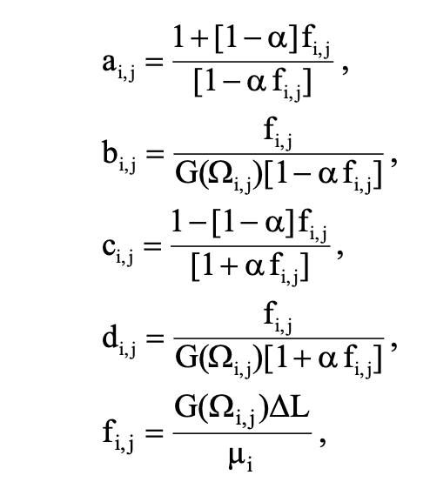
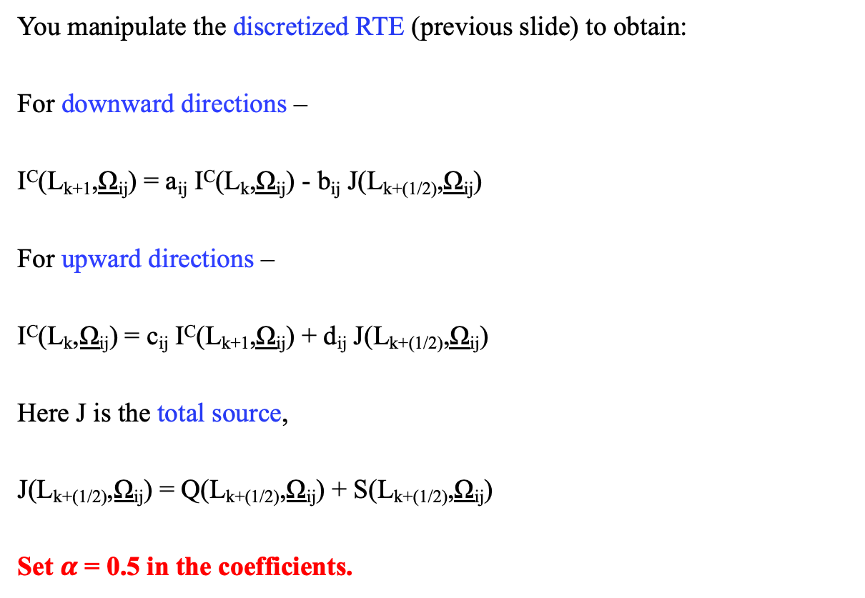
PHYSICAL MODELS IN REMOTE SENSING Chapter 04 – Part 04: Discrete Ordinates Method (Part Two)
Step 9: Derive Equations for Sweeping
You manipulate the discretized RTE (previous slide) to obtain:
For downward directions –
I^{C}(L_{k+1},Ω_{ij}) = a_{ij} I^{C}(L_{k},Ω_{ij}) - b_{ij} J(L_{k+(1/2)},Ω_{ij})
For upward directions –
I^{C}(L_{k},Ω_{ij}) = c_{ij} I^{C}(L_{k+1},Ω_{ij}) + d_{ij} J(L_{k+(1/2)},Ω_{ij})
Here J is the total source,
J(L_{k+(1/2)},Ω_{ij}) = Q(L_{k+(1/2)},Ω_{ij}) + S(L_{k+(1/2)},Ω_{ij})
Set $α$ = 0.5 in the coefficients.

Slide 7
PHYSICAL MODELS IN REMOTE SENSING Chapter 04 – Part 04: Discrete Ordinates Method (Part Two)
Step 10: Iterate Until Convergence on the Multiple Scattering Source
Evaluate S as in one of the previous slides. During the first iteration, S = 0
Evaluate total source J as Q + S
Sweep downwards. For k = 1, I^{C} = 0 (upper boundary condition)
4) Handle lower boundary condition
5) Sweep upwards
6) Now you have an estimate of cell-edge collided intensities
7) Check for convergence
8) If iteration converged stop, else go back to Step (1)
n=N/2
m=M
I^{C}(L_{k=K+1},Ω_{ij}) = (ρ_{gλ}/π) ∑ w_{n} ∑ w_{m} |μ_{n}| I^{C}(L_{k=K+1},Ω_{nm})
n=1
m=1

Slide 8
PHYSICAL MODELS IN REMOTE SENSING Chapter 04 – Part 04: Discrete Ordinates Method (Part Two)
Step 11: Final
Evaluate energy balance
Make Plots

Slide 9
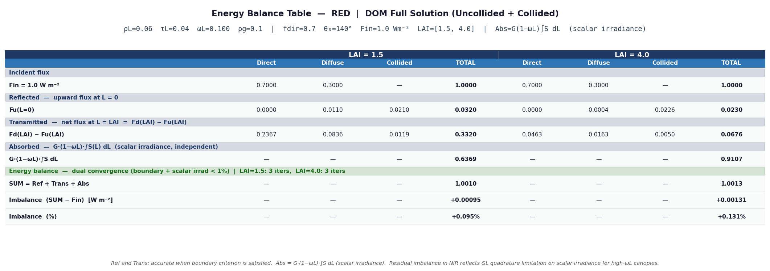
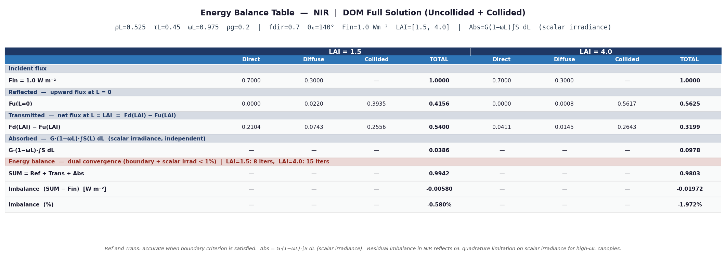
PHYSICAL MODELS IN REMOTE SENSING Chapter 04 – Part 04: Discrete Ordinates Method (Part Two)
Energy Balance

Slide 10
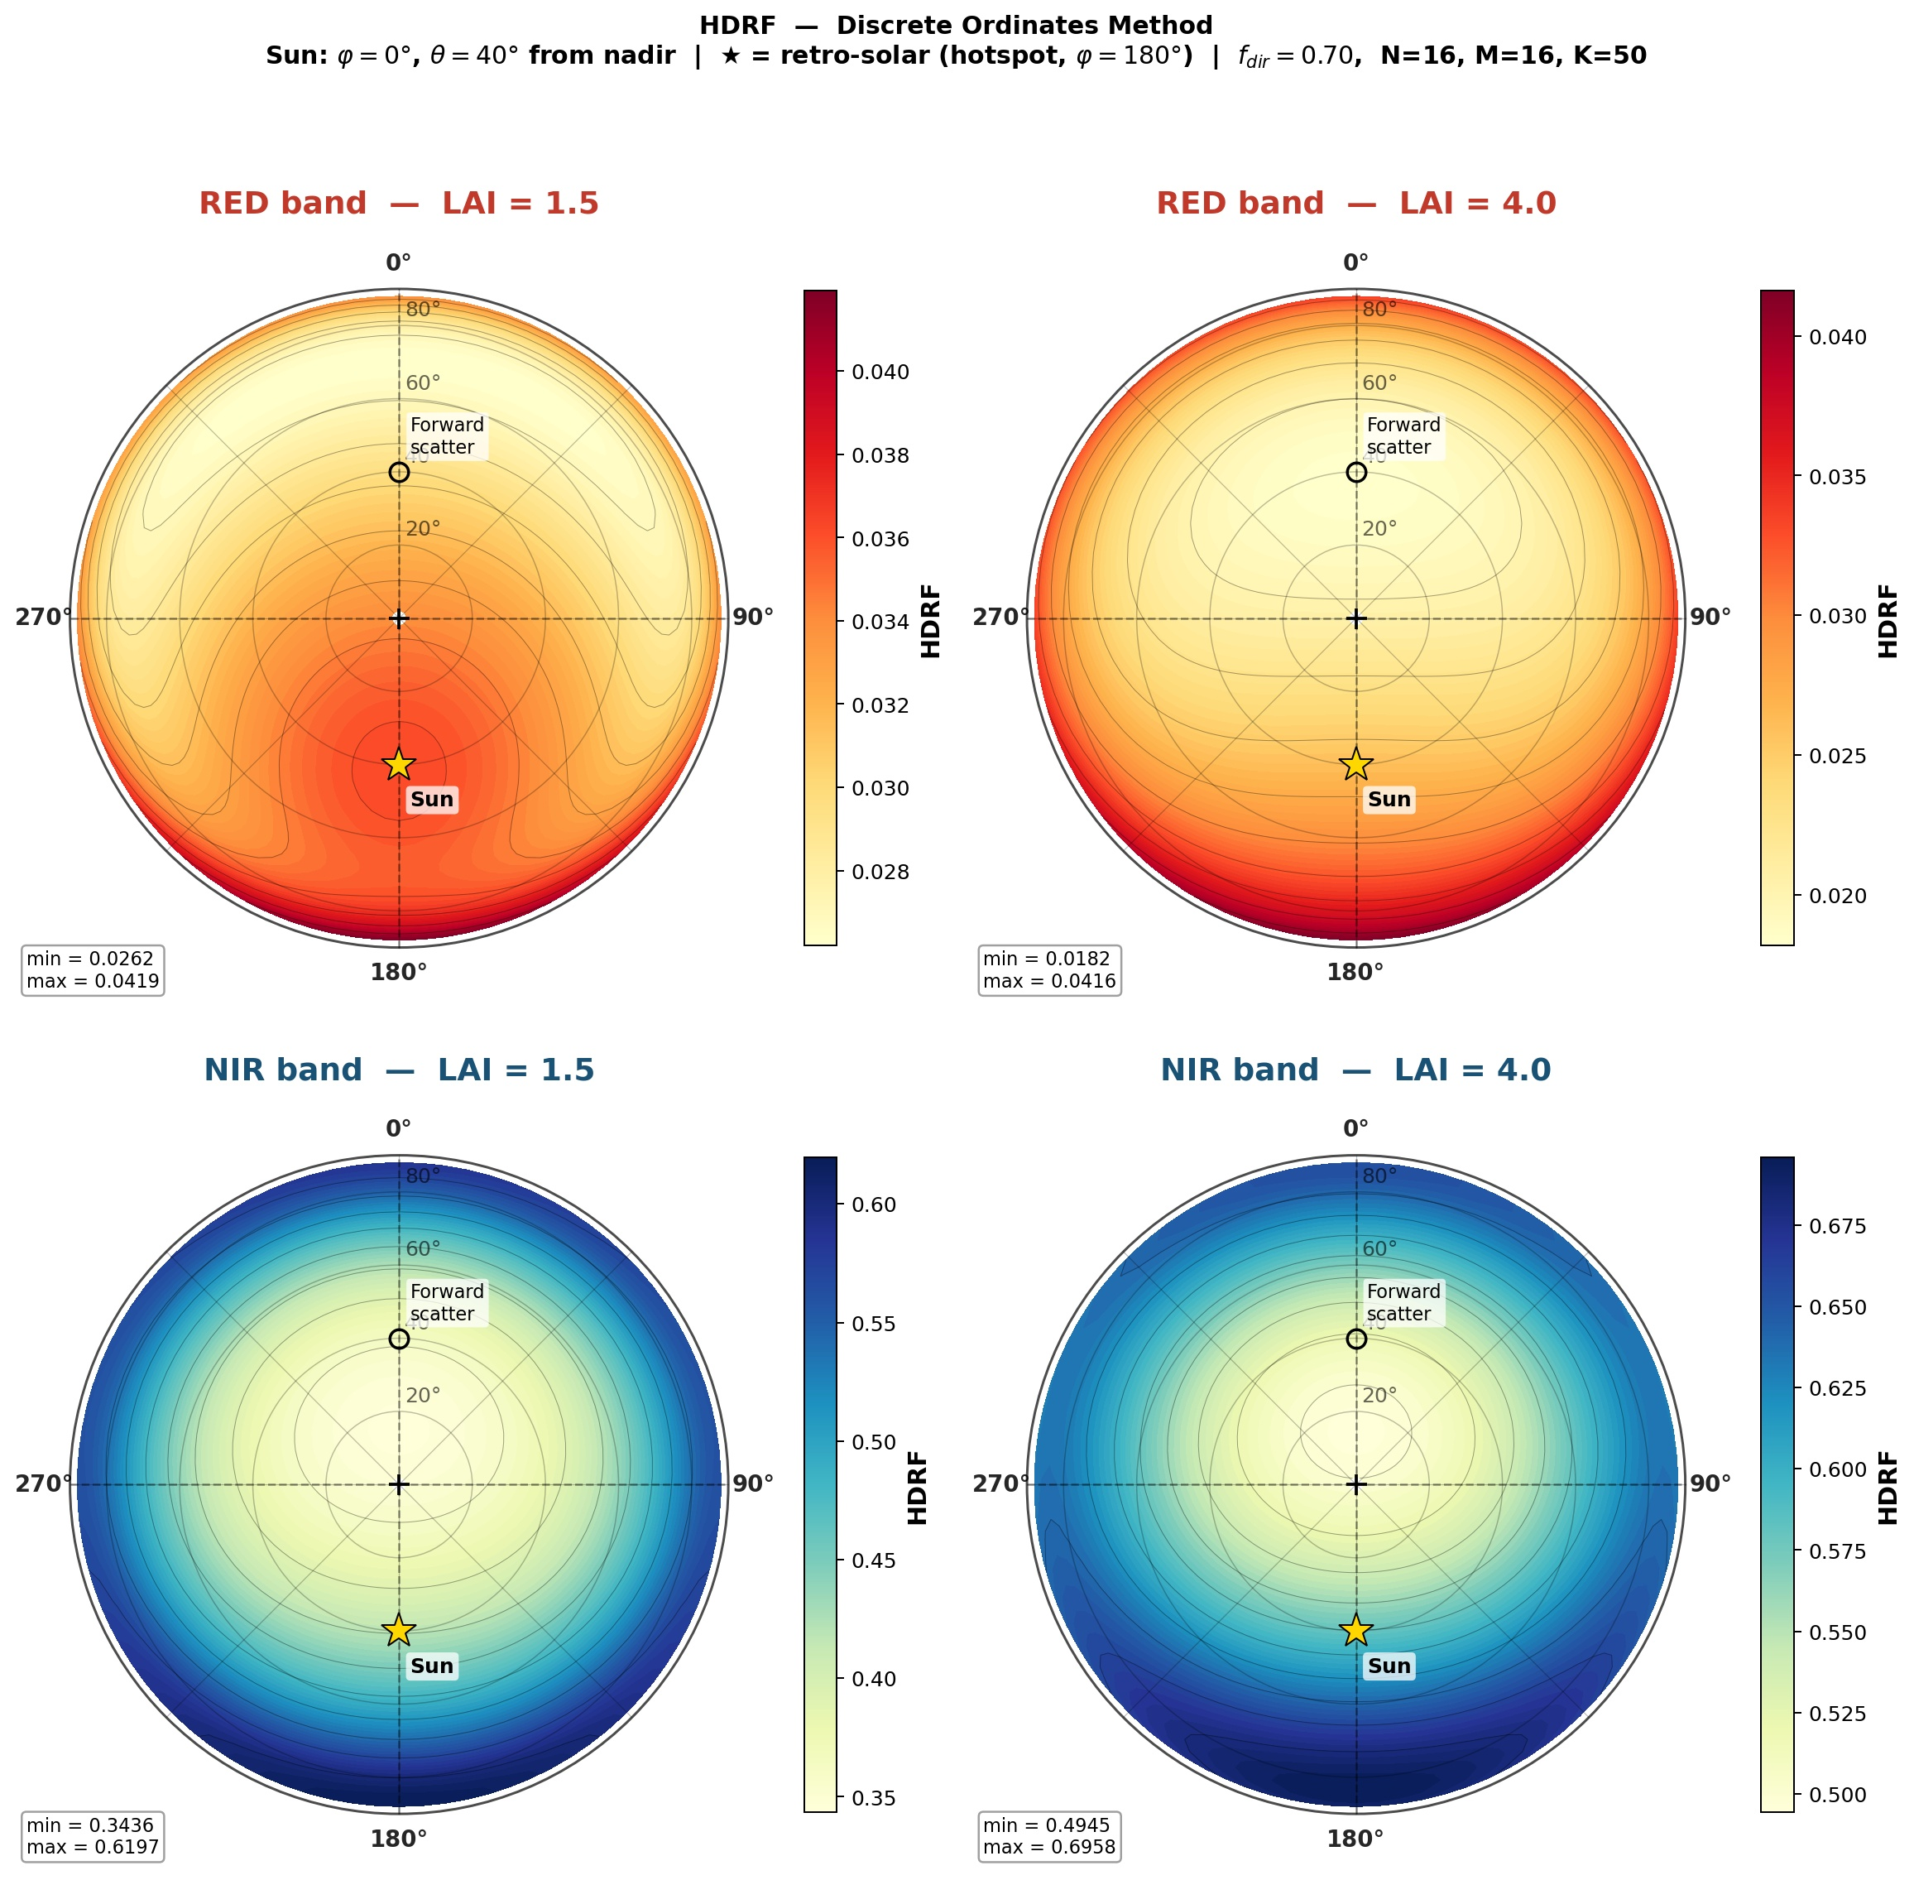
PHYSICAL MODELS IN REMOTE SENSING Chapter 04 – Part 04: Discrete Ordinates Method (Part Two)
BRF Angular Shape

Slide 11
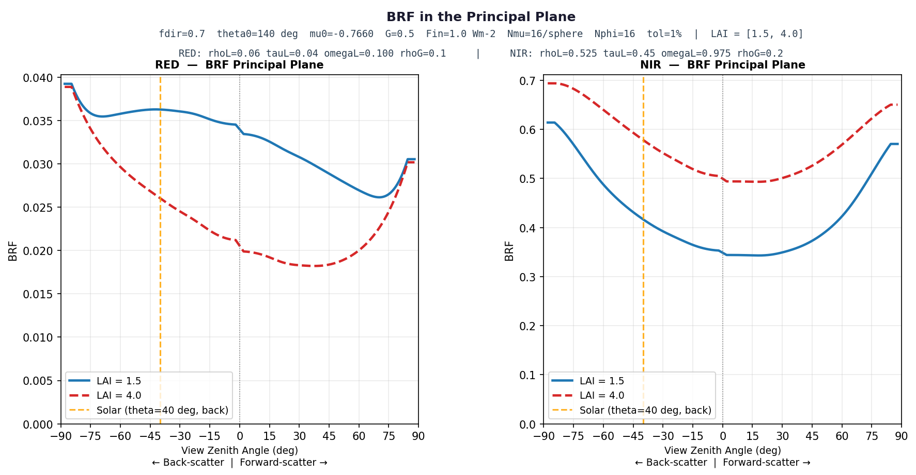
PHYSICAL MODELS IN REMOTE SENSING Chapter 04 – Part 04: Discrete Ordinates Method (Part Two)
BRF Angular Shape

Slide 12
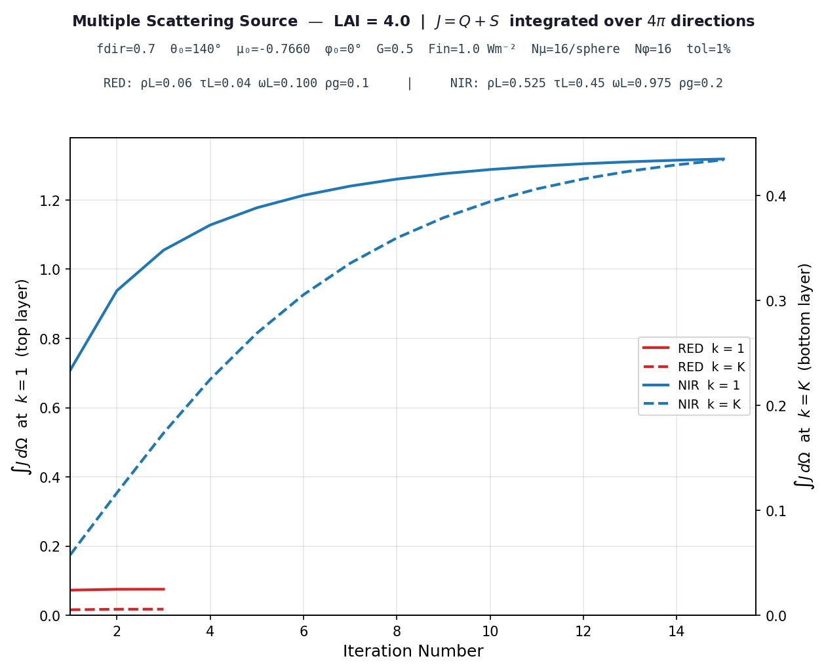
PHYSICAL MODELS IN REMOTE SENSING Chapter 04 – Part 04: Discrete Ordinates Method (Part Two)
Source Convergence

Slide 13
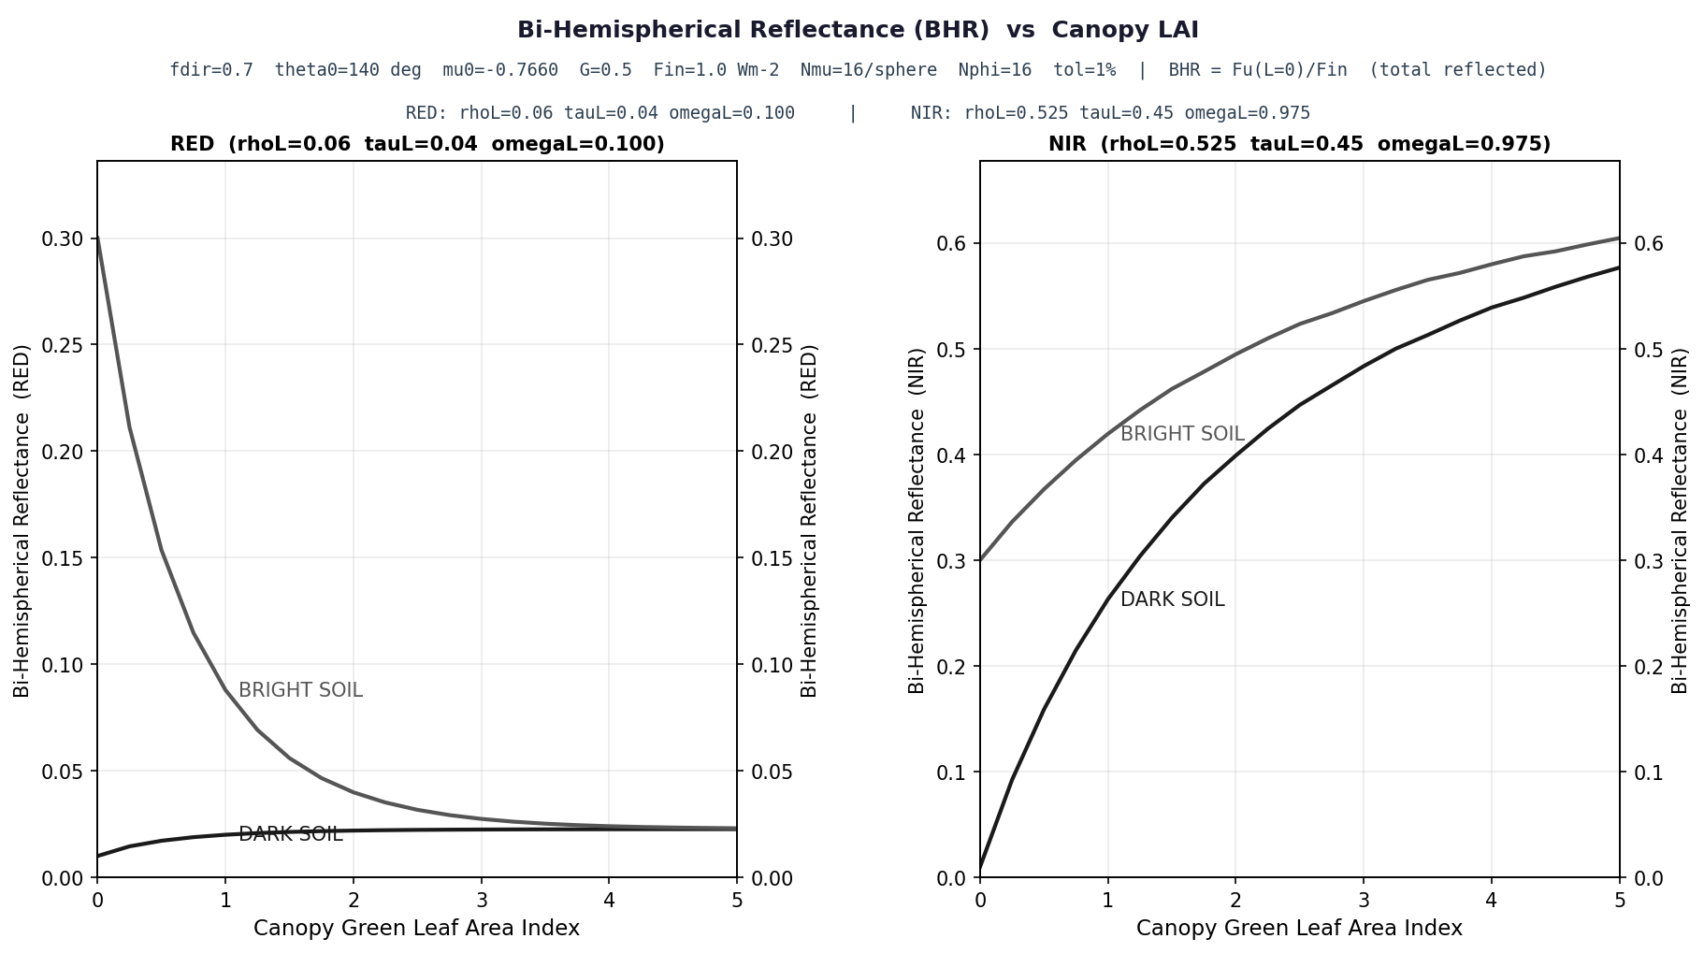
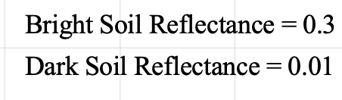
PHYSICAL MODELS IN REMOTE SENSING Chapter 04 – Part 04: Discrete Ordinates Method (Part Two)
Reflectance as a function of LAI and Soil brightness
Bright Soil Reflectance = 0.3
Dark Soil Reflectance = 0.01

Slide 14
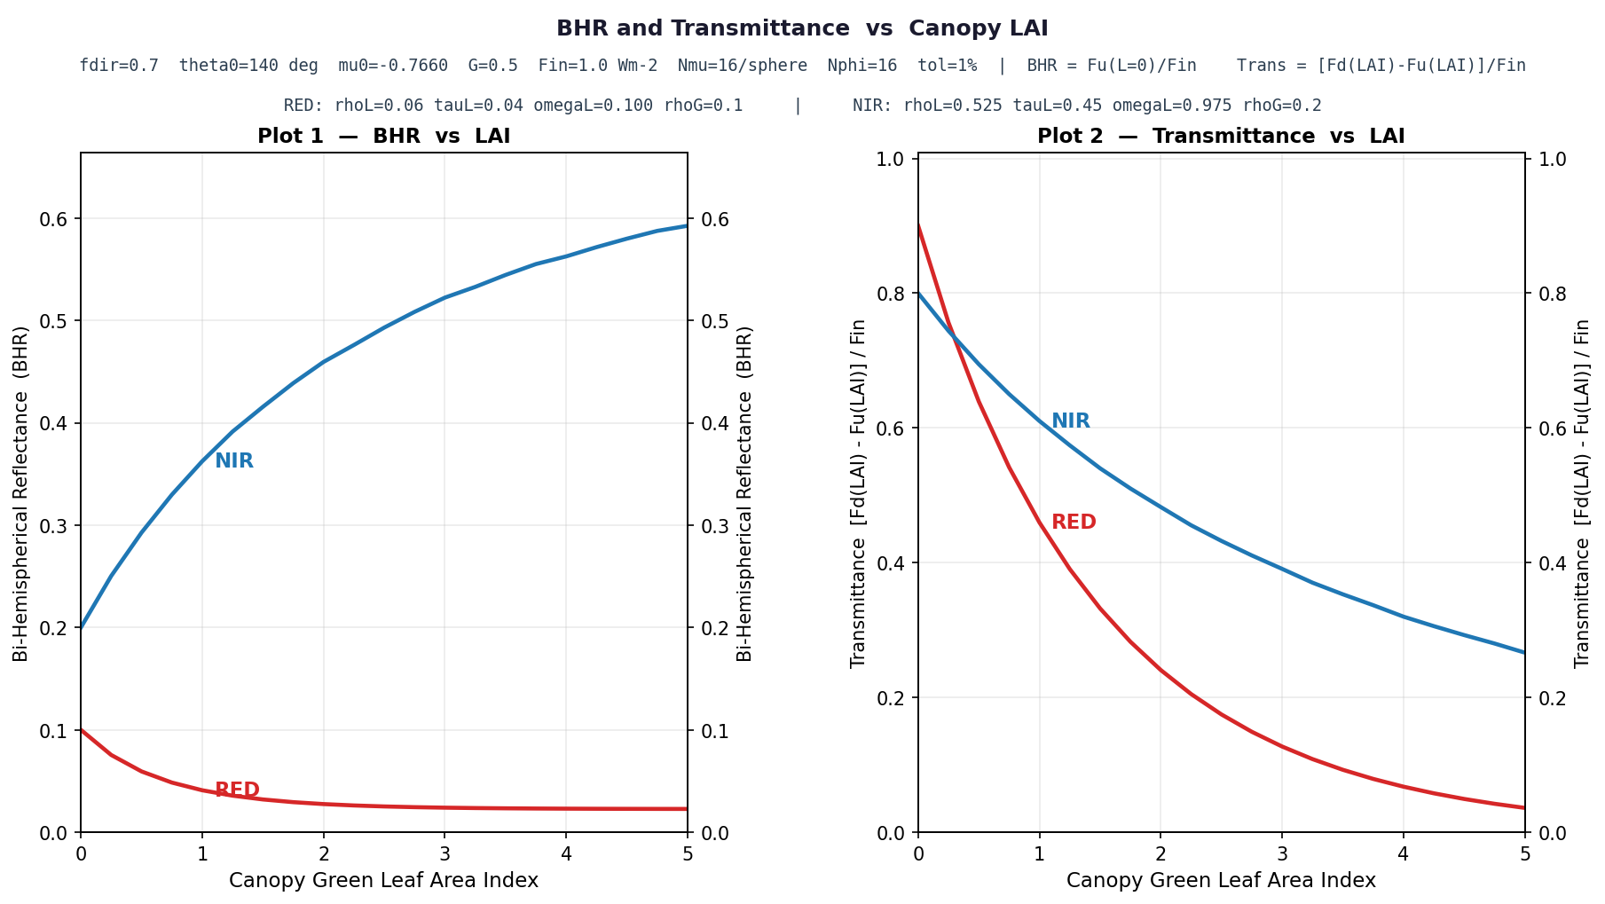
PHYSICAL MODELS IN REMOTE SENSING Chapter 04 – Part 04: Discrete Ordinates Method (Part Two)
LAI Effect on Reflactance and Transmittance

Slide 15
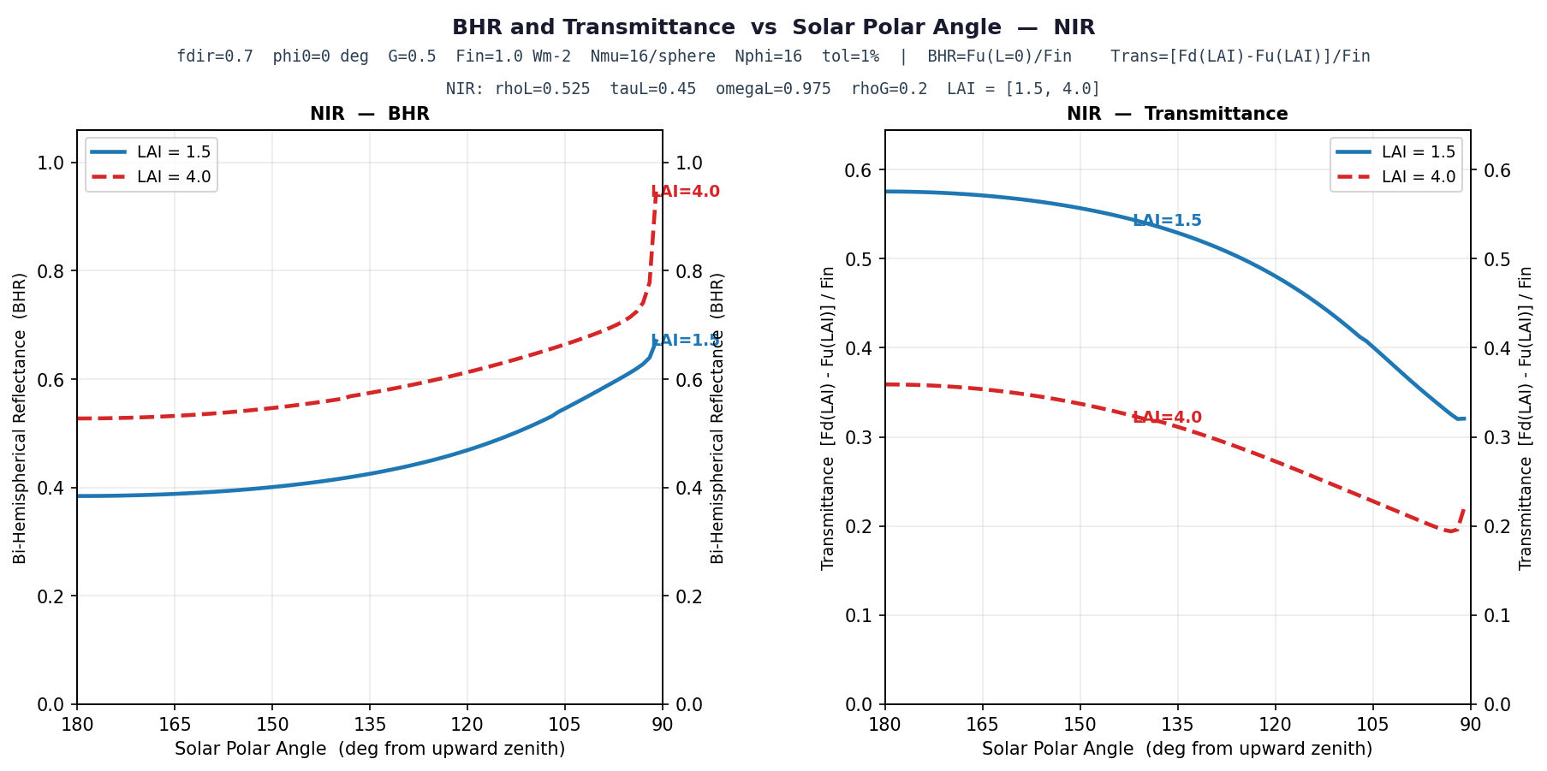
PHYSICAL MODELS IN REMOTE SENSING Chapter 04 – Part 04: Discrete Ordinates Method (Part Two)
Solar Polar Angle Effect on Reflactance and Transmittance

Slide 16
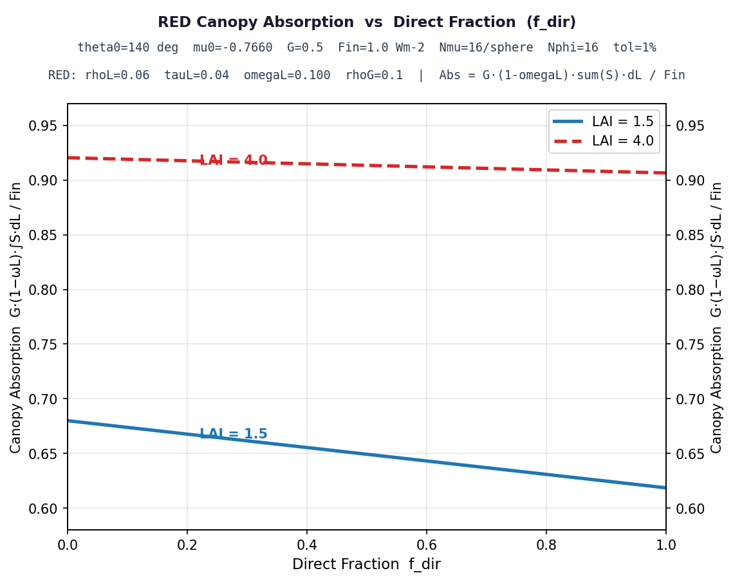
PHYSICAL MODELS IN REMOTE SENSING Chapter 04 – Part 04: Discrete Ordinates Method (Part Two)
fdir Effect on Canopy Absorption
Overcast Sky
Bright Sunny Sky

Slide 17
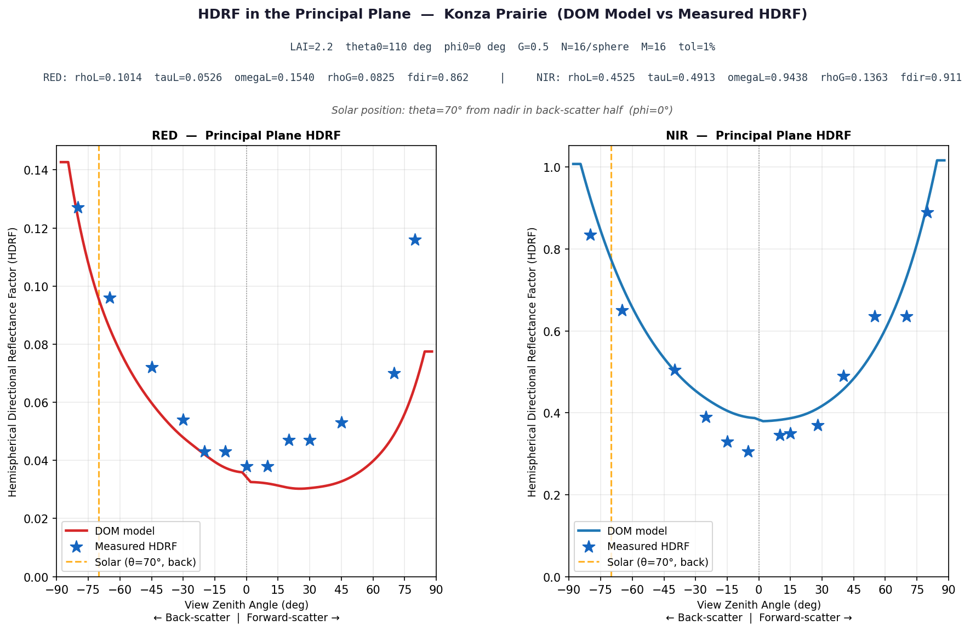
PHYSICAL MODELS IN REMOTE SENSING Chapter 04 – Part 04: Discrete Ordinates Method (Part Two)
Comparison with Field Data

Slide 18
PHYSICAL MODELS IN REMOTE SENSING Chapter 04 – Part 04: Interpolation
Interpolation Problem:
Often you have measured Bidirectional Reflectance Factor (BRF) or HDRF in a direction Ω_{V} that is different than the Gauss directions Ω_{i} , i = 1, 2, …, N
You wish to compare modelled BRF with measured BRF. That means you need to evaluate the total Intensity (uncollided + collided) emerging from the canopy in the direction of measurement, Ω_{V}
Therefore, you need to interpolate total Intensity from Gauss directions to measured direction.
The best way to do that is illustrated here, using the discrete ordinates Method
Assume you are given the measured direction (upward direction) Ω_{V}

Slide 19
PHYSICAL MODELS IN REMOTE SENSING Chapter 04 – Part 04: Discrete Ordinates Method (Part Two)
Step 1: Evaluate Cross Sections
G(Ω_{V})
Γ(μ_{O},ϕ_{O} -> Ω_{V})
Γ(μ_{n},ϕ_{m} -> Ω_{V})
Step 2: Evaluate Uncollided Intensity at the Ground in Ω_{V}
n=N/2
m=M
I⁰(L_{k=K+1},Ω_{V}) = (ρ_{gλ}/π) ∑ w_{n} ∑ w_{m} |μ_{n}| I⁰_{dif}(L_{k=K+1},Ω_{nm}) + (ρ_{gλ}/π) |μ_{o}| I⁰_{dir}(L_{k=K+1},Ω_{o})
n=1
m=1
The uncollided intensity at the ground in all downward Gauss directions I⁰_{dif}(L_{k=K+1},Ω_{nm}) and
I⁰_{dir}(L_{k=K+1},Ω_{o}) in the above is known from the discrete-ordinates Method
Step 3: Evaluate Uncollided Intensity Emerging from the Canopy in Ω_{V}
I⁰(L_{k=1}, Ω_{V}) = I⁰(L_{k=K+1}, Ω_{V}) exp [- (1/|μ_{V}| G(Ω_{V}) LAI]

Slide 20
PHYSICAL MODELS IN REMOTE SENSING Chapter 04 – Part 04: Discrete Ordinates Method (Part Two)
Step 4: Evaluate First Collison Source term for All Layers
Evaluate FCS Q as Q¹ + Q² + Q³
Q¹(L_{k+(1/2)},Ω_{V}) = (1/π) Γ(μ_{o},ϕ_{o} -> μ_{V}, ϕ_{V}) I⁰_{dir}(L_{k+(1/2)}, Ω_{o})
n=N/2
m=M
Q²(L_{k+(1/2)},Ω_{V}) = (1/π) ∑ w_{n} ∑ w_{m} Γ(μ_{n},ϕ_{m} -> μ_{V}, ϕ_{V}) I⁰_{dif}(L_{k+(1/2)}, Ω_{nm})
n=1
m=1
n = N
m=M
Q³(L_{k+(1/2)},Ω_{V}) = (1/π) ∑ w_{n} ∑ w_{m} Γ(μ_{n},ϕ_{m} -> μ_{V}, ϕ_{V}) I⁰(L_{k+(1/2)}, Ω_{nm})
n=N/2+1
m=1

Slide 21
PHYSICAL MODELS IN REMOTE SENSING Chapter 04 – Part 04: Discrete Ordinates Method (Part Two)
Step 5: Evaluate Multiple Scattering Source term for All Layers
N
m=M
S(L_{k+(1/2)},Ω_{V}) = (1/π) ∑ w_{n} ∑ w_{m} Γ(μ_{n},ϕ_{m} -> μ_{V}, ϕ_{V}) I^{C}(L_{k+(1/2)},Ω_{nm})
n=1
m=1
The collided intensity at all cell centers in all Gauss directions I^{C}(L_{k+(1/2)},Ω_{nm}) in the
above is known from the discrete-ordinates Method (Part Two). It is evaluated as the mean of
the cell edge intensities!

Slide 22
PHYSICAL MODELS IN REMOTE SENSING Chapter 04 – Part 04: Discrete Ordinates Method (Part Two)
Step 6: Evaluate Total Source term for All Layers
J(L_{k+(1/2)},Ω_{V}) = Q(L_{k+(1/2)},Ω_{V}) + S(L_{k+(1/2)},Ω_{V})
Step 7: Evaluate Collided Intensity at the Ground in Ω_{V}
n=N/2
m=M
I^{C}(L_{k=K+1}, Ω_{V}) = (ρ_{gλ}/π) ∑ w_{n} ∑ w_{m} |μ_{n}| I^{C}(L_{k=K+1},Ω_{nm})
n=1
m=1
The collided intensity at the ground in all downward Gauss directions I^{C}(L_{k=K+1},Ω_{nm}) in the
above is known from the discrete-ordinates Method
Step 8: Sweep Upwards along Direction Ω_{V}
Sweep upwards once to evaluate collided Intensities I^{C}(L_{k},Ω_{V}), where k = K, K-1, K-2, …, 1
The collided intensity I^{C}(L_{k=1},Ω_{V}) is the emerging intensity you need

Slide 23
PHYSICAL MODELS IN REMOTE SENSING Chapter 04 – Part 04: Discrete Ordinates Method (Part Two)
Step 9: Add uncollided and collided intensities
I(L_{k=1},Ω_{V}) = I⁰(L_{k=1},Ω_{V}) + I^{C}(L_{k=1},Ω_{V})
The total intensity I(L_{k=1},Ω_{V}) is used to evaluate the BRF or HDRF and compared with the
measurement

