Slide 1

PHYSICAL MODELS IN REMOTE SENSING Chapter 04 – Part 05: 3D Discrete Ordinates Method
Why a 3D Problem?
The vegetation canopy is horizontally &
vertically heterogeneous
Cross sections vary in 3 dimensions
2) The incident radiation field varies spatially
3) Radiation reflected by the surface below the canopy varies spatially
Thus, the radiation field (within and exiting the canopy) varies spatially and resolving this requires solution of the 3D RTE

Slide 2
PHYSICAL MODELS IN REMOTE SENSING Chapter 04 – Part 05: 3D Discrete Ordinates Method
3D Canopy
Spatially heterogeneous canopy
0 < z < Z_{s}
0 < x < X_{s}
0 < y < Y_{s}
Bottom: Reflecting + Absorbing
Others: Non-re-entrant
TOP
O
RIGHT
LEFT
Y_{S}
BOTTOM
Z_{S}
X_{S}

Slide 3
PHYSICAL MODELS IN REMOTE SENSING Chapter 04 – Part 05: 3D Discrete Ordinates Method
3D Canopy
FRONT
Spatially heterogeneous canopy
0 < z < Z_{s}
0 < x < X_{s}
0 < y < Y_{s}
O
Y_{S}
BACK
Z_{S}
X_{S}

Slide 4
PHYSICAL MODELS IN REMOTE SENSING Chapter 04 – Part 05: 3D Discrete Ordinates Method
Directional Cosines
Let +ξ, +η and +μ denote directional cosines with respect to +X, +Y and -Z axes
+μ denotes upward directions (“up”)
-μ denotes downward directions (“down”)
+ξ denotes travel from left to right (“right”)
-ξ denotes travel from right to left (“left”)
+η denotes travel from back to front (“front”)
-η denotes travel from front to back (“back”)
Note that: μ = cos θ, ξ = sin θ cos ϕ, η = sin θ sin ϕ
θ is the polar angle measured off the –Z axis
ϕ is the azimuthal angle measured anti-clockwise from the +X axis

Slide 5
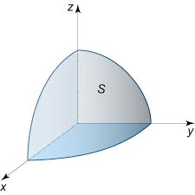
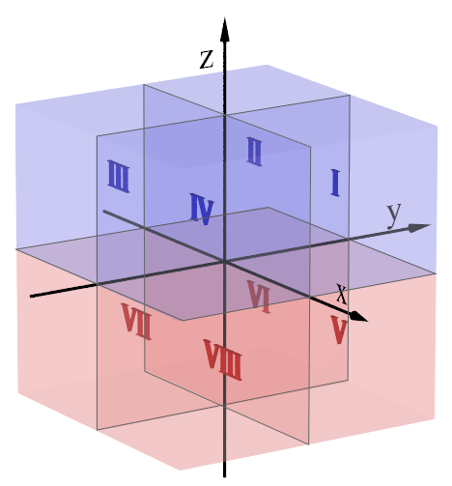
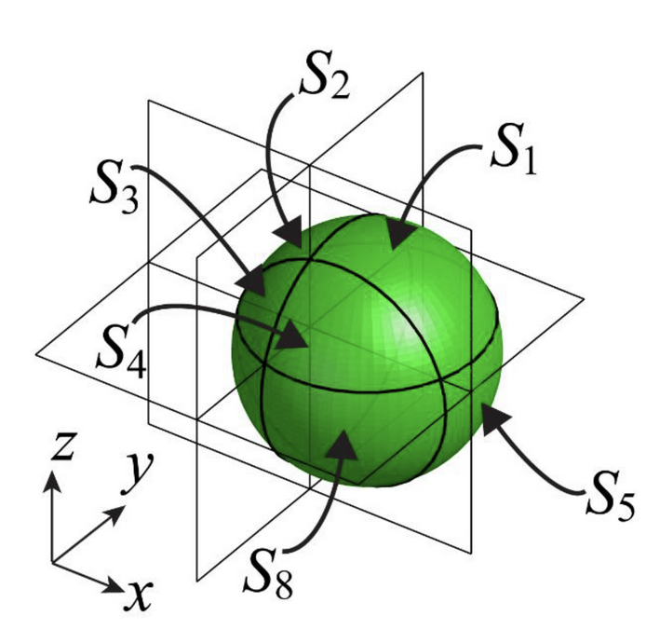
PHYSICAL MODELS IN REMOTE SENSING Chapter 04 – Part 05: 3D Discrete Ordinates Method
Octants
-Z
Divide the sphere in to 8 Octants
Octants 1, 2, 3 and 4 represent the upward facing hemisphere
Octants 5, 6, 7 and 8 represent the downward facing hemisphere
X
-Y
4th Octant
-
-

Slide 6
PHYSICAL MODELS IN REMOTE SENSING Chapter 04 – Part 05: 3D Discrete Ordinates Method
Directional Cosines in Octants
-
Octant 1: +μ, +ξ, +η
Octant 2: +μ, -ξ, +η
Octant 3: +μ, -ξ, -η
Octant 4: +μ, +ξ, -η
Octant 5: -μ, +ξ, +η
Octant 6: -μ, -ξ, +η
Octant 7: -μ, -ξ, -η
Octant 8: -μ, +ξ, -η
Y
+η
O6
O5
X
-ξ
+ξ
O7
-η
O8

Slide 7
PHYSICAL MODELS IN REMOTE SENSING Chapter 04 – Part 05: 3D Discrete Ordinates Method
Directions in Octant 5
In Octant 5,
-μ : photons travel from top to bottom (down)
+ξ : photons travel from left to right
+η : photons travel from back to front
Y
+η
O6
O5
X
-ξ
+ξ
O7
-η
O8

Slide 8
PHYSICAL MODELS IN REMOTE SENSING Chapter 04 – Part 05: 3D Discrete Ordinates Method
Directional Cosines in Octants
-
Octant 1: +μ, +ξ, +η: up, right, front
Octant 2: +μ, -ξ, +η: up, left, front
Octant 3: +μ, -ξ, -η: up, left, back
Octant 4: +μ, +ξ, -η: up, right, back
Octant 5: -μ, +ξ, +η: down, right, front
Octant 6: -μ, -ξ, +η : down, left, front
Octant 7: -μ, -ξ, -η: down, left, back
Octant 8: -μ, +ξ, -η: down, right, back
Y
+η
O2
O1
X
-ξ
+ξ
O3
-η
O4

Slide 9

PHYSICAL MODELS IN REMOTE SENSING Chapter 04 – Part 05: 3D Discrete Ordinates Method
Direct Sunlight
I_{oλ}
δ(Ω−Ω_{o})
FRONT
TOP
In this example:
Ω_{o} in Octant 7
-μ_{o}, -ξ_{o}, -η_{o} : down, left, back
O
RIGHT
Y_{S}
Z_{S}
X_{S}

Slide 10
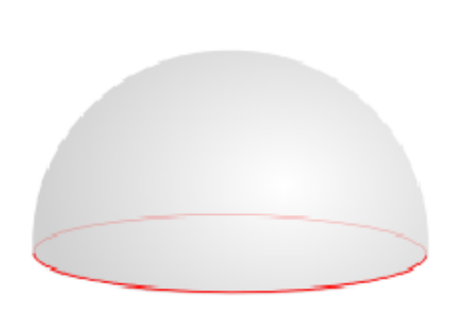
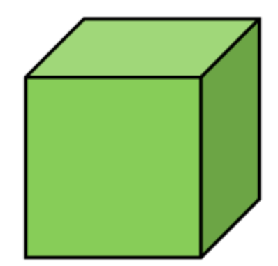
PHYSICAL MODELS IN REMOTE SENSING Chapter 04 – Part 05: 3D Discrete Ordinates Method
Diffuse Skylight
Diffuse sky illumination I_{dλ}
All faces, except the bottom, are illuminated
Enters through directions in Octants 5-8

Slide 11
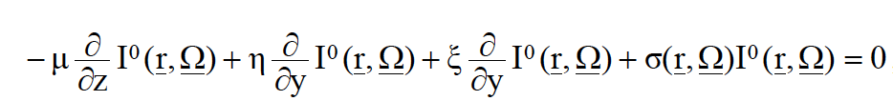
PHYSICAL MODELS IN REMOTE SENSING Chapter 04 – Part 05: 3D Discrete Ordinates Method
The 3D RTE
The governing 3D RTE is:
Separate the total intensity I into uncollided (I⁰) and collided (I^{C}) intensity. The RTE for
uncollided intensity is:
We suppress wavelength dependence through out!

Slide 12
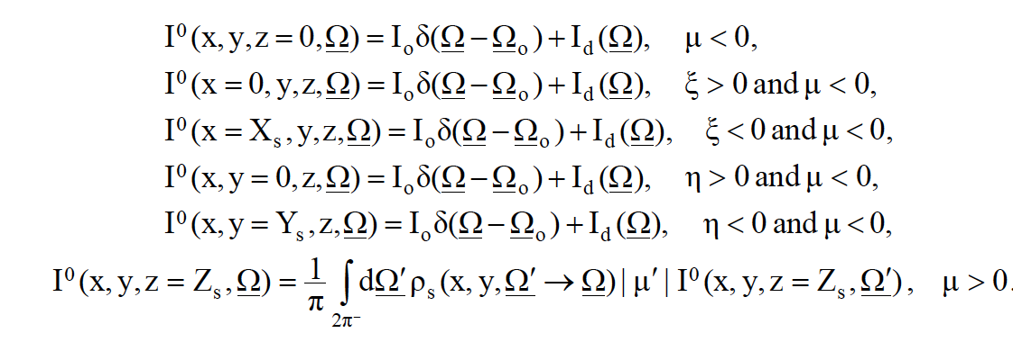
PHYSICAL MODELS IN REMOTE SENSING Chapter 04 – Part 05: 3D Discrete Ordinates Method
Boundary Conditions for Uncollided 3D RTE
Top
Left
Right
Back
Front
Bottom
ρ_{s} is the wavelength-dependent bi-directional reflectance function of the ground below the canopy

Slide 13
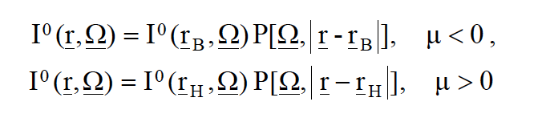
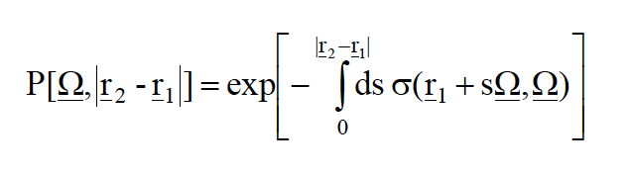
PHYSICAL MODELS IN REMOTE SENSING Chapter 04 – Part 05: 3D Discrete Ordinates Method
Analytical Solution for the Uncollided 3D RTE
The uncollided RTE has an analytical solution:
where r_{B} is a point on the top or the lateral faces of the canopy and r_{H} is a point on the ground below the canopy. The quantity
denotes the probability of photons not experiencing collisions while traveling along Ω between
the points r₁ and r₂.
Thus, I⁰ can be calculated for any location within the canopy and on the boundary faces of the
canopy for any direction Ω in the sphere.

Slide 14



PHYSICAL MODELS IN REMOTE SENSING Chapter 04 – Part 05: 3D Discrete Ordinates Method
Analytical Solution for the Uncollided 3D RTE
The uncollided intensity in a downward direction (octants 5-8) is:
r_{B}
r

Slide 15

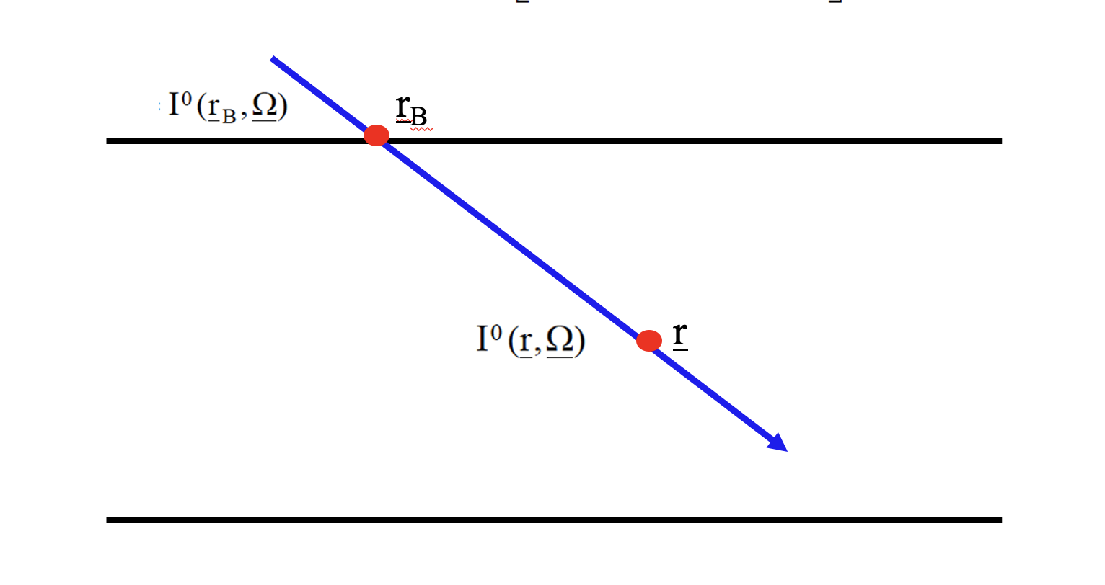


PHYSICAL MODELS IN REMOTE SENSING Chapter 04 – Part 05: 3D Discrete Ordinates Method
Analytical Solution for the Uncollided 3D RTE
The uncollided intensity in a upward direction (octants 1-4) is:
r
r_{H}

