Slide 1
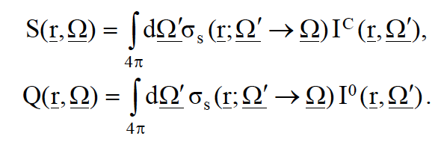
PHYSICAL MODELS IN REMOTE SENSING Chapter 04 – Part 06: 3D Discrete Ordinates Method – (Cont.)
The Collided 3D RTE
The collided RTE is:
where the distributed source S and first collision source Q are
Q is known because I⁰ is known. The distributed source S is unknown. So, we will have to
iterate on it. Which we shall do using the discrete ordinates method.

Slide 2
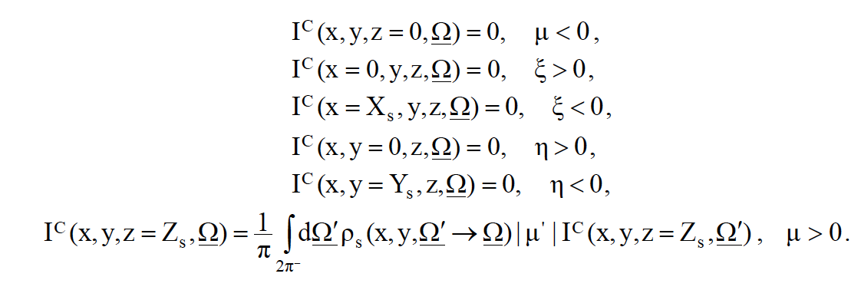
PHYSICAL MODELS IN REMOTE SENSING Chapter 04 – Part 06: 3D Discrete Ordinates Method – (Cont.)
Boundary Conditions for the Collided 3D RTE
The corresponding boundary conditions are:
This obviously follows from the fact that the all sides, except the bottom, are non-re-entrant
surfaces, i.e. collided photons that leave the canopy from the top, left, right, back and front faces do not renter the canopy.

Slide 3
PHYSICAL MODELS IN REMOTE SENSING Chapter 04 – Part 06: 3D Discrete Ordinates Method – (Cont.)
Angular Discretization
Discretize the direction variable Ω using EQ_{N} quadrature (Equal Weight or Carlson’s quadrature) into N directions
Ω -> Ω₁, Ω₂, …, Ω_{N}
Ω₁ -> (μ₁,ϕ₁) for example
Therefore, we have N/8 directions per Octant
An integral is simply evaluated with EQ_{N} quadrature as follows:
p=4
q=N/8
F^{u}(x,y,z=0) = ∫ dΩ |μ| I(r, Ω) = ∑ ∑ w |μ_{pq}| I(x,y,z=0,Ω_{pq})
2π⁺
p=1
q=1
where, p represents Octants, q represents directions in an Octant, N is the number of
directions in the sphere (order of EQ_{N} quadrature), and w is the weight of the quadrature
(does not depend on the direction!).

Slide 4
PHYSICAL MODELS IN REMOTE SENSING Chapter 04 – Part 06: 3D Discrete Ordinates Method – (Cont.)
Spatial Discretization
Discretize the canopy in to I x J x K cells
J
3
Y
2
Δy = Y_{S}/J
1
X
Δz = Z_{S}/I
1
2
3
K
Δx = X_{S}/K
2
Z
3
I

Slide 5
PHYSICAL MODELS IN REMOTE SENSING Chapter 04 – Part 06: 3D Discrete Ordinates Method – (Cont.)
Spatial Discretization
Denote cell edges as shown
J
3
2
1
1
2
3
K
x_{0+1/2}
x_{1+1/2}
x_{2+1/2}
x_{3+1/2}
x_{K+1/2}
2
3
I

Slide 6
PHYSICAL MODELS IN REMOTE SENSING Chapter 04 – Part 06: 3D Discrete Ordinates Method – (Cont.)
Spatial Discretization
y_{J+1/2}
Denote cell edges as shown
J
y_{3+1/2}
3
y_{2+1/2}
2
y_{1+1/2}
1
y_{0+1/2}
1
2
3
K
2
3
I

Slide 7
PHYSICAL MODELS IN REMOTE SENSING Chapter 04 – Part 06: 3D Discrete Ordinates Method – (Cont.)
Spatial Discretization
Denote cell edges as shown
J
3
2
1
z_{0+1/2}
1
2
3
K
z_{1+1/2}
2
z_{2+1/2}
3
z_{3+1/2}
I
z_{I+1/2}

Slide 8
PHYSICAL MODELS IN REMOTE SENSING Chapter 04 – Part 06: 3D Discrete Ordinates Method – (Cont.)
Spatial Discretization
Example cell edge notation
y_{j+1/2}
z_{i-1/2}
y_{j-1/2}
x_{k-1/2}
x_{k+1/2}
z_{i+1/2}

Slide 9
PHYSICAL MODELS IN REMOTE SENSING Chapter 04 – Part 06: 3D Discrete Ordinates Method – (Cont.)
Cross Sections
The cross sections σ and σ_{S} are assumed to be piece-wise constant
That is, they can take new values only at the cell-boundaries
Within the cell volume V_{ijk}, bounded by
(x_{k−1/2} < x < x_{k+1/2} ) ,
(y_{j−1/2} < y < y_{j+1/2} ) ,
(z_{i−1/2} < z < z_{i+1/2} ) ,
the cross sections are denoted as σ_{ijk} and σ_{Sijk}

Slide 10
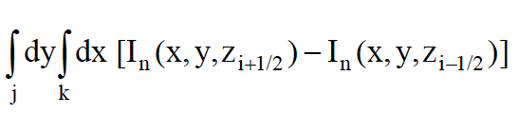
PHYSICAL MODELS IN REMOTE SENSING Chapter 04 – Part 06: 3D Discrete Ordinates Method – (Cont.)
Discrete 3D RTE
Denote the intensity I^{C}(r,Ω) as I_{n}(x,y,z)
Approximate the spatial derivatives with finite difference approximation. For example,
δI/δz as (1/Δz) [I_{n}(x,y,z_{i+1}) - I_{n}(x,y,z_{i+1/2})]
Integrate over the cell volume and divide by the same. For example,
[1/(ΔyΔx)]
{[1/(Δz)] ∫ dz}
i
∫ dx denotes integration from x_{k−1/2} to x_{k+1/2} , and so on
k

Slide 11
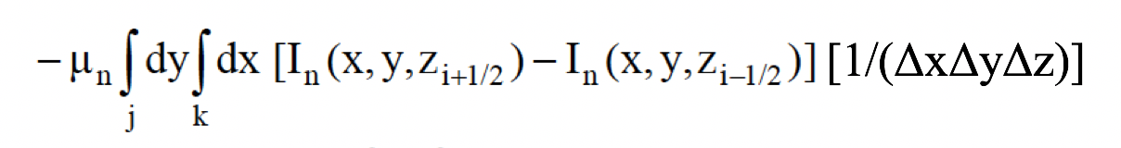
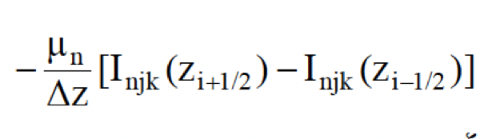
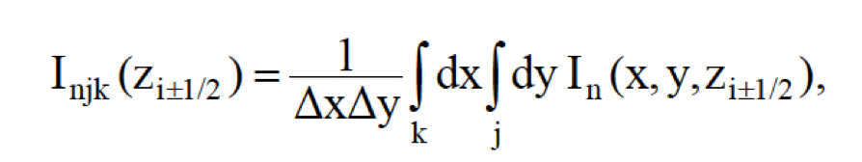
PHYSICAL MODELS IN REMOTE SENSING Chapter 04 – Part 06: 3D Discrete Ordinates Method – (Cont.)
Discrete 3D RTE
The first term in the RTE therefore reads as
This can be re-written as
where the average radiation intensities over the cell surfaces areare:

Slide 12
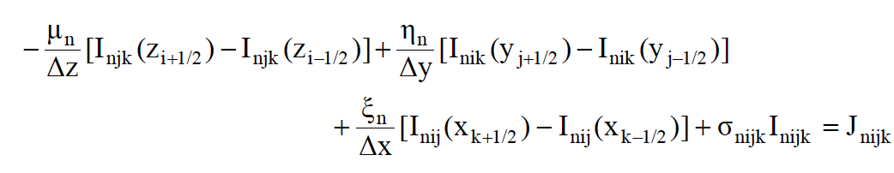
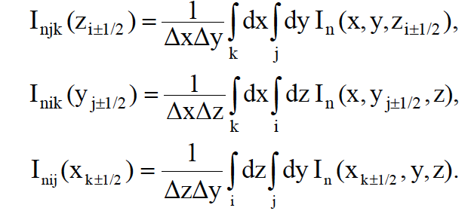
PHYSICAL MODELS IN REMOTE SENSING Chapter 04 – Part 06: 3D Discrete Ordinates Method – (Cont.)
The Discretized 3D RTE
The discretized 3D RTE is:
where the average radiation intensities over the cell surfaces are:

Slide 13
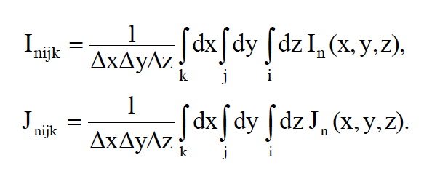
PHYSICAL MODELS IN REMOTE SENSING Chapter 04 – Part 06: 3D Discrete Ordinates Method – (Cont.)
The Discretized 3D RTE
And, the averages over the cell volume of the specific intensity and the total source J = Q + S are:
The discretized RTE (previous slide) is exact but not closed.
Known: Flows across the three surfaces through which photons enter a cell are known either
from the boundary conditions or from previous calculations
Unknown: Cell-center angular intensity I_{nijk} and flows across the three surfaces through which
photons can leave a cell
Need: Three additional relations

Slide 14
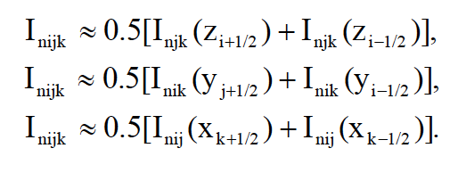
PHYSICAL MODELS IN REMOTE SENSING Chapter 04 – Part 06: 3D Discrete Ordinates Method – (Cont.)
Diamond Difference Relations
For example, we can use the so-called diamond difference relations:
Problem: These relations can lead to negative intensities!
Solution: Set the offending flow to zero and proceed with iteration

Slide 15
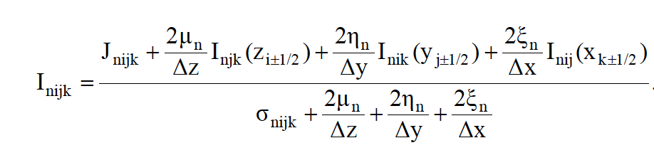
PHYSICAL MODELS IN REMOTE SENSING Chapter 04 – Part 06: 3D Discrete Ordinates Method – (Cont.)
Equation for Sweeping in the Phase-Space Grid
With the difference relations, we can solve the discretized RTE for cell center Intensity by eliminating the unknown flows out of the cell:
The 3 flows in the numerator denote incoming flows. They are specific to an Octant.
The cell center Intensity I_{nijk} is thus evaluated
Then, the unknown flows leaving the cell are evaluated with the diamond difference relations (previous slide)

Slide 16
PHYSICAL MODELS IN REMOTE SENSING Chapter 04 – Part 06: 3D Discrete Ordinates Method – (Cont.)
Sweeping for Directions in Octant 5
In Octant 5,
-μ : photons travel from top to bottom (down)
+ξ : photons travel from left to right
+η : photons travel from back to front
Y
+η
O6
O5
X
-ξ
+ξ
O7
-η
O8

Slide 17
PHYSICAL MODELS IN REMOTE SENSING Chapter 04 – Part 06: 3D Discrete Ordinates Method – (Cont.)
Sweeping for Directions in Octant 5: Identify Incoming Flows
In Octant 5, -μ, +ξ, +η
Therefore, the incoming flows are:
y_{j+1/2}
I_{njk}(z_{i-1/2})
I_{njk}(z_{i-1/2}): on the top face
I_{nij}(x_{k-1/2}): on the left face
TOP
I_{nik}(y_{j-1/2}): on the back face
z_{i-1/2}
y_{j-1/2}
They are known:
From boundary conditions
Or, from previous calculation
I_{nij}(x_{k-1/2})
LEFT
BACK
I_{nik}(y_{j-1/2})
x_{k-1/2}
x_{k+1/2}
z_{i+1/2}

Slide 18
PHYSICAL MODELS IN REMOTE SENSING Chapter 04 – Part 06: 3D Discrete Ordinates Method – (Cont.)
Sweeping for Directions in Octant 5: Evaluate Cell-Center Intensity
Use:
During the first iteration, J = Q, else J = Q + S
All terms are known
Evaluate cell-center Intensity I_{nijk}

Slide 19
PHYSICAL MODELS IN REMOTE SENSING Chapter 04 – Part 06: 3D Discrete Ordinates Method – (Cont.)
Sweeping for Directions in Octant 5: Evaluate Outgoing flows
Evaluate outgoing flows using:
The incoming flow and cell-center Intensity are known.
Set any negative fluxes to zero

Slide 20
PHYSICAL MODELS IN REMOTE SENSING Chapter 04 – Part 06: 3D Discrete Ordinates Method – (Cont.)
Sweeping for Directions in Octant 5: Evaluate Outgoing flows
Use:
I_{njk}(z_{i-1/2})
y_{j+1/2}
I_{nik}(y_{j+1/2})
FRONT
z_{i-1/2}
y_{j-1/2}
RIGHT
I_{nij}(x_{k+1/2})
I_{nij}(x_{k-1/2})
BOTTOM
I_{nik}(y_{j-1/2})
x_{k-1/2}
x_{k+1/2}
z_{i+1/2}
I_{njk}(z_{i+1/2})

Slide 21
PHYSICAL MODELS IN REMOTE SENSING Chapter 04 – Part 06: 3D Discrete Ordinates Method – (Cont.)
Sweeping for Directions in Octant 5: Stepping Through the Grid
In Octant 5, -μ, +ξ, +η
Notation: cell is (k, j, i)
Start with cell (1,1,1)
Move to cell (2, 1, 1)
And so on to cell (K, 1, 1)
Now, move to cell (1, 2, 1)
And so on to cell (K, 2, 1)
And so on to cell (K, J, 1)
Step down to i = 2
Repeat all of the above
Your last cell is (K, J, I)
Same for all directions in O5
J
3
2
1
z_{0+1/2}
1
2
3
K
z_{1+1/2}
2
z_{2+1/2}
3
z_{3+1/2}
I
z_{I+1/2}

Slide 22
PHYSICAL MODELS IN REMOTE SENSING Chapter 04 – Part 06: 3D Discrete Ordinates Method – (Cont.)
Sweeping for Directions in Octants 6 to 8
In Octant 6, -μ, -ξ, +η : Sweep down, right to left, back to front
In Octant 7, -μ, -ξ, -η : Sweep down, right to left, front to back
In Octant 8, -μ, +ξ, -η : Sweep down, left to right, front to back
Y
+η
O6
O5
X
-ξ
+ξ
O7
-η
O8

Slide 23
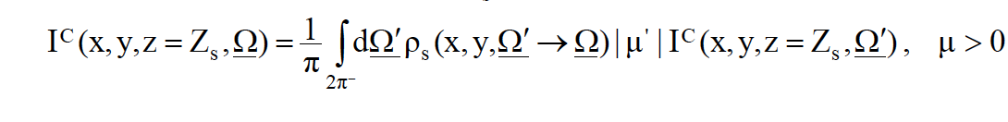
PHYSICAL MODELS IN REMOTE SENSING Chapter 04 – Part 06: 3D Discrete Ordinates Method – (Cont.)
Handle the Lower Boundary Condition
After sweeping through the spatial grid for all directions in Octants 5 to 8 (Lower Hemisphere) –
Handle the lower boundary condition

Slide 24
PHYSICAL MODELS IN REMOTE SENSING Chapter 04 – Part 06: 3D Discrete Ordinates Method – (Cont.)
Sweeping for Directions in Octants 1 to 4
In Octant 1, +μ, +ξ, +η : Sweep up, left to right, back to front
In Octant 2, +μ, -ξ, +η : Sweep up, right to left, back to front
In Octant 3, +μ, -ξ, -η : Sweep up, right to left, front to back
In Octant 4, +μ, +ξ, -η : Sweep up, left to right, front to back
Thus, done with all directions in the sphere!
Y
+η
O2
O1
X
-ξ
+ξ
O3
-η
O4

Slide 25
PHYSICAL MODELS IN REMOTE SENSING Chapter 04 – Part 06: 3D Discrete Ordinates Method – (Cont.)
Iterate Until Convergence on the Multiple Scattering Source
Evaluate S (during the first iteration, S = 0)
Evaluate total source J as Q + S (Q is known as I⁰ is known)
3) Sweep for directions in Octants 5 to 8
4) Handle lower boundary condition
5) Sweep for directions in Octants 1 to 4
6) Now you have an estimate of cell-edge and cell-center collided intensities for all cells
7) Check for convergence
8) If iteration converged stop, else go back to Step (1)

Slide 26
PHYSICAL MODELS IN REMOTE SENSING Chapter 04 – Part 06: 3D Discrete Ordinates Method – (Cont.)
Other Issues
May need to implement methods to accelerate the iteration
Check for energy conservation
3) If cells are large, the method may fail or yield distorted effects
4) If too many cells, calculations take too long
5) Check 3D code first by having it do the 1D problem
6) Implement an interpolation scheme to obtain intensities in non quadrature direction
Myneni, R.B., et al., 1990. Radiative transfer in three dimensional leaf canopies. Transport Theory and Statistical Physics, 19:205-250.
Levashova et al., 2018. Application of a Three-Dimensional Radiative Transfer Model to Retrieve the Species Composition of a Mixed Forest Stand from Canopy Reflected Radiation
Remote Sens. 2018, 10(10), 1661; https://doi.org/10.3390/rs10101661

