Slide 1
PHYSICAL MODELS IN REMOTE SENSING Chapter 04 – Part 07: Two-Stream Approximation
Fluxes vs Intensities
In some cases, fluxes are of interest as opposed to intensities (as in remote sensing).
Examples include: models of land surface energy budget, carbon assimilation, hydrology, etc.
Typically, such models require –
reflected flux (e.g. surface energy budget),
absorbed flux (e.g. GPP calculation)
transmitted flux (e.g. ground heat/temp calculation)
So, there is no need to solve the RTE in terms of intensities. A simplified approach is often
sufficient.

Slide 2
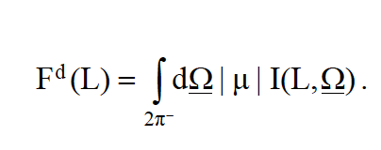
PHYSICAL MODELS IN REMOTE SENSING Chapter 04 – Part 07: Two-Stream Approximation
Fluxes vs Intensities
Remember the relation between the two. For example, the downward flux density crossing
a horizontally surface at depth L is:
Similarly integrating over the upper hemisphere yields the upward flux at L.
F^{u}(L) = ∫ dΩ |μ| I(L, Ω)
2π⁺

Slide 3
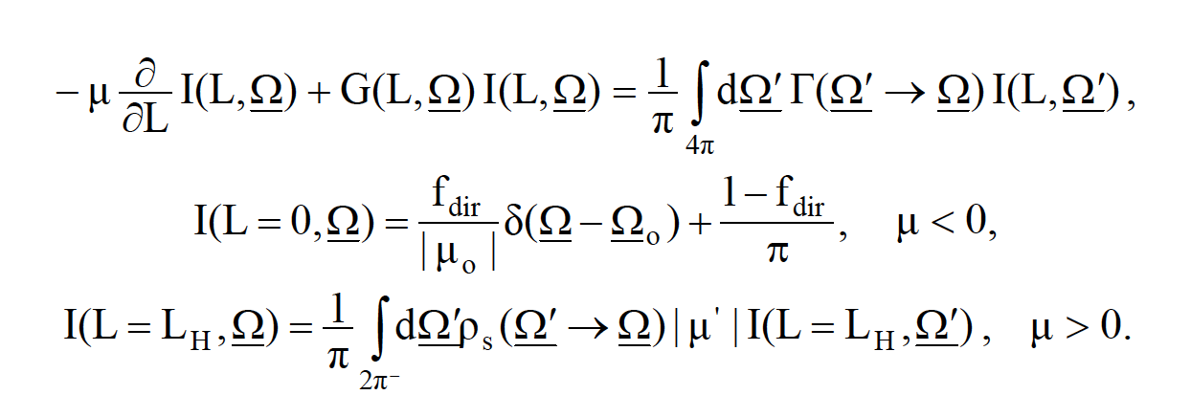
PHYSICAL MODELS IN REMOTE SENSING Chapter 04 – Part 07: Two-Stream Approximation
Step 1:
Start with the RTE:

Slide 4
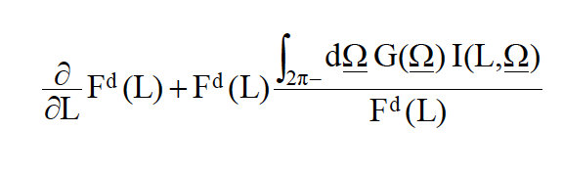
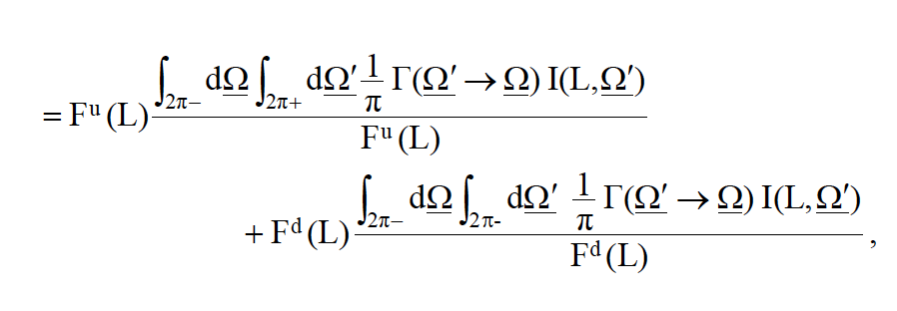
PHYSICAL MODELS IN REMOTE SENSING Chapter 04 – Part 07: Two-Stream Approximation
Step 2:
Integrate the transport equation over all downward directions:

Slide 5
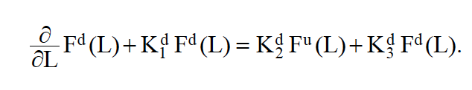
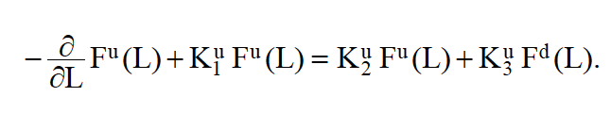
PHYSICAL MODELS IN REMOTE SENSING Chapter 04 – Part 07: Two-Stream Approximation
Step 3:
Simplifying results in a differential equation for downward fluxes:
Step 4:
Similarly, you can derive another equation for upward fluxes:

Slide 6
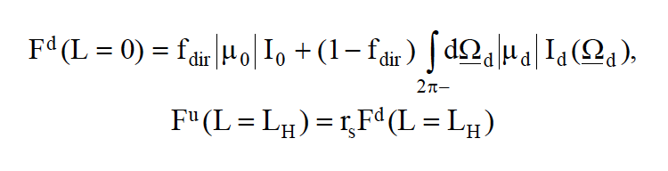
PHYSICAL MODELS IN REMOTE SENSING Chapter 04 – Part 07: Two-Stream Approximation
Step 5:
Specify the boundary conditions:
where r_{s} is the ground reflectance.

Slide 7
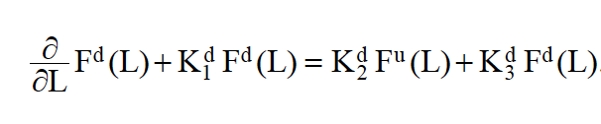

PHYSICAL MODELS IN REMOTE SENSING Chapter 04 – Part 07: Two-Stream Approximation
The Two-Stream Problem:
The general two-stream problem is thus:
with the following boundary conditions:
In the general case, it is not possible to derive analytical expressions for the coefficients. So,
we consider some simple cases.

Slide 8
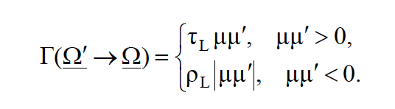
PHYSICAL MODELS IN REMOTE SENSING Chapter 04 – Part 07: Two-Stream Approximation
Horizontal leaves:
The G(Ω) function is equal to |μ| and the area scattering phase function is,
We ignore specular reflection from leaf surfaces. In the above ρ_{L} and τ_{L} are leaf reflectance
and transmittance coefficients. The coefficients in the flux equations are simply:
With the coefficients, the two-stream equations can be analytically solved (see Notes).

Slide 9
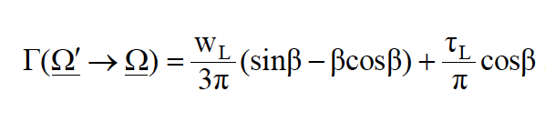
PHYSICAL MODELS IN REMOTE SENSING Chapter 04 – Part 07: Two-Stream Approximation
Spherically-Oriented leaves:
The G(Ω) function is equal to 0.5 and the area scattering phase function is,
We ignore specular reflection from leaf surfaces. In the above ρ_{L} and τ_{L} are leaf reflectance
and transmittance coefficients. The coefficients in the flux equations can be derived and
the corresponding two-stream equations can be analytically solved (see Notes).
This particular case has been widely used in most land surface models.

Slide 10
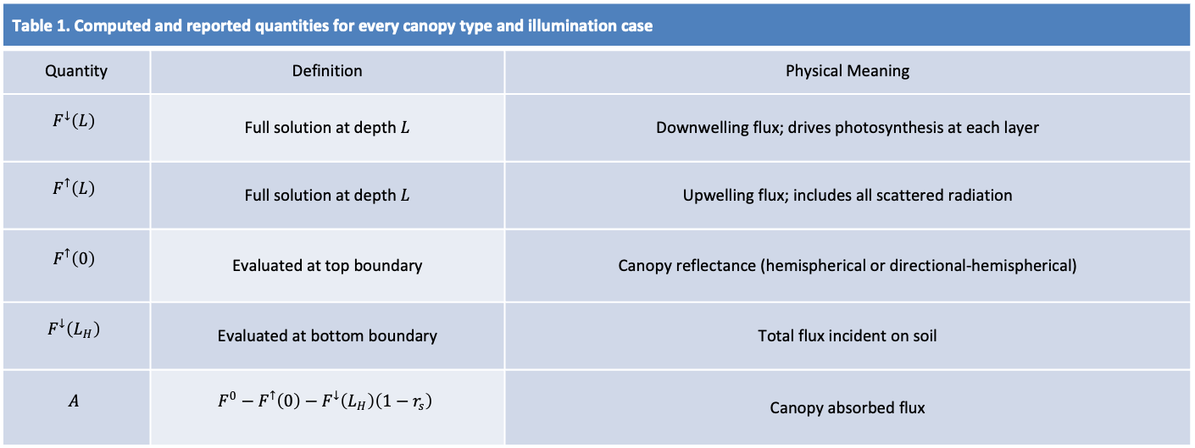
PHYSICAL MODELS IN REMOTE SENSING Chapter 04 – Part 07: Two-Stream Approximation
Example Results
Table 1. Computed and reported quantities for every canopy type and illumination case
Quantity | Definition | Physical Meaning
$$F^{↓}\left(L\right)$$ | Full solution at depth $L$ | Downwelling flux; drives photosynthesis at each layer
$$F^{↑}\left(L\right)$$ | Full solution at depth $L$ | Upwelling flux; includes all scattered radiation
$$F^{↑}\left(0\right)$$ | Evaluated at top boundary | Canopy reflectance (hemispherical or directional-hemispherical)
$$F^{↓}\left(L_{H}\right)$$ | Evaluated at bottom boundary | Total flux incident on soil
$$A$$ | $$F^{0}−F^{↑}\left(0\right)−F^{↓}\left(L_{H}\right)\left(1−r_{s}\right)$$ | Canopy absorbed flux

Slide 11
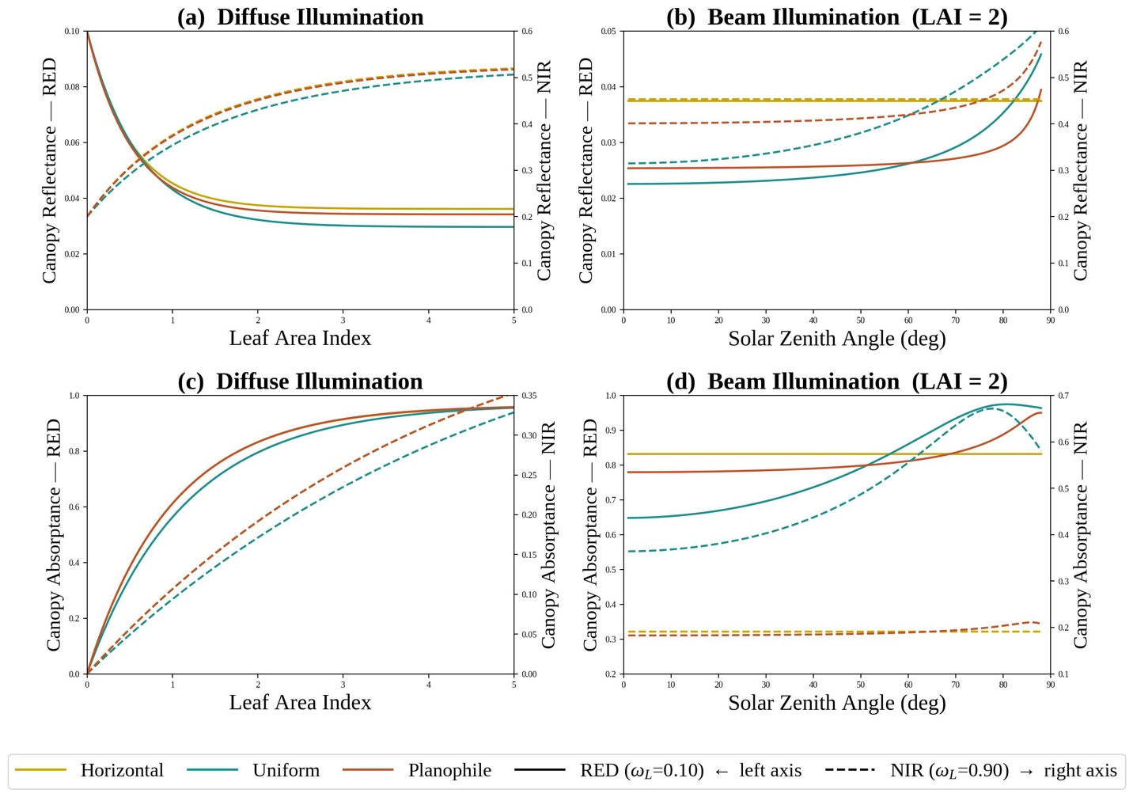
PHYSICAL MODELS IN REMOTE SENSING Chapter 04 – Part 07: Two-Stream Approximation
Example Results
Canopy reflectance $F^{↑}\left(0\right)$ (top row) and canopy absorptance $A_{c}$ (bottom row) computed from the three
two-stream models for an incident flux $F^{0}=1 W m^{−2}$.

Slide 12
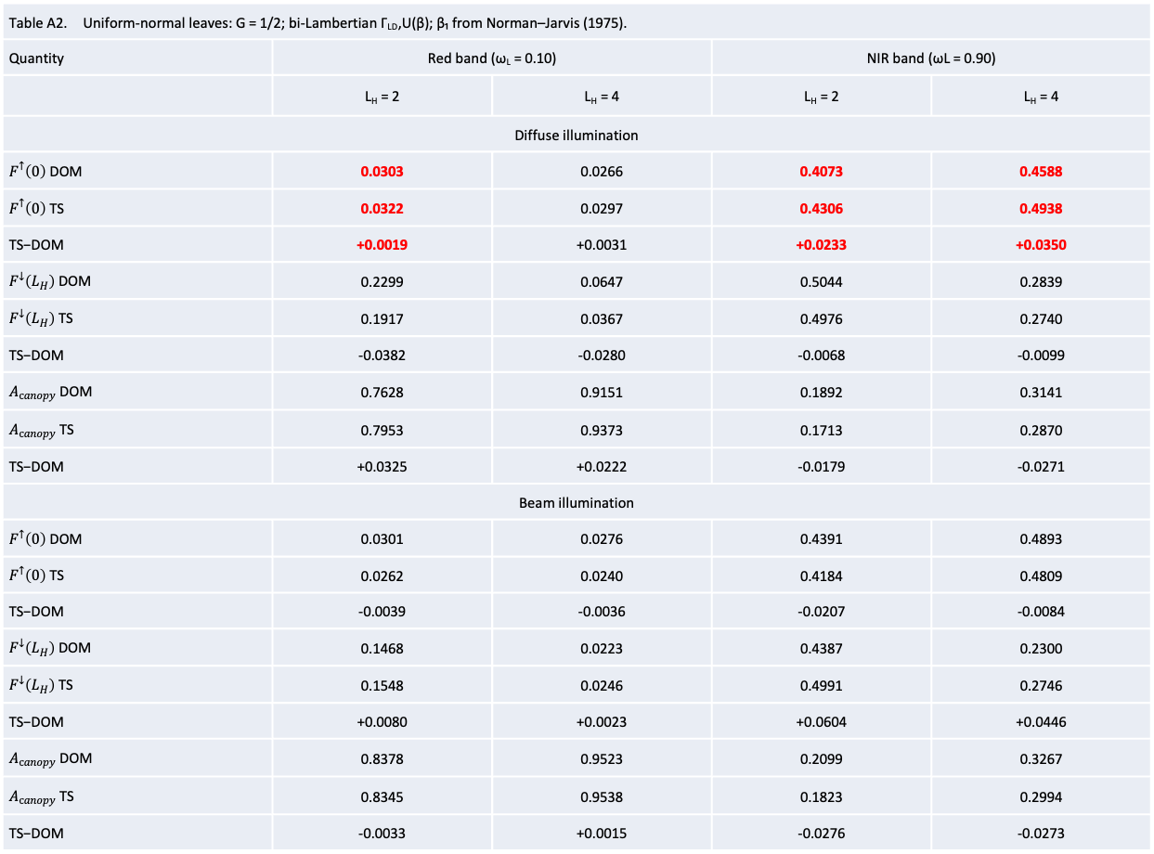
PHYSICAL MODELS IN REMOTE SENSING Chapter 04 – Part 07: Two-Stream Approximation
Example Results
Table A2. Uniform-normal leaves: G = 1/2; bi-Lambertian Γ_{LD},U(β); β₁ from Norman–Jarvis (1975).
Quantity | Red band (ω_{L} = 0.10) |  | NIR band (ωL = 0.90)
 | L_{H} = 2 | L_{H} = 4 | L_{H} = 2 | L_{H} = 4
Diffuse illumination
$F^{↑}\left(0\right)$ DOM | 0.0303 | 0.0266 | 0.4073 | 0.4588
$F^{↑}\left(0\right)$ TS | 0.0322 | 0.0297 | 0.4306 | 0.4938
TS−DOM | +0.0019 | +0.0031 | +0.0233 | +0.0350
$F^{↓}\left(L_{H}\right)$ DOM | 0.2299 | 0.0647 | 0.5044 | 0.2839
$F^{↓}\left(L_{H}\right)$ TS | 0.1917 | 0.0367 | 0.4976 | 0.2740
TS−DOM | -0.0382 | -0.0280 | -0.0068 | -0.0099
$A_{canopy}$ DOM | 0.7628 | 0.9151 | 0.1892 | 0.3141
$A_{canopy}$ TS | 0.7953 | 0.9373 | 0.1713 | 0.2870
TS−DOM | +0.0325 | +0.0222 | -0.0179 | -0.0271
Beam illumination
$F^{↑}\left(0\right)$ DOM | 0.0301 | 0.0276 | 0.4391 | 0.4893
$F^{↑}\left(0\right)$ TS | 0.0262 | 0.0240 | 0.4184 | 0.4809
TS−DOM | -0.0039 | -0.0036 | -0.0207 | -0.0084
$F^{↓}\left(L_{H}\right)$ DOM | 0.1468 | 0.0223 | 0.4387 | 0.2300
$F^{↓}\left(L_{H}\right)$ TS | 0.1548 | 0.0246 | 0.4991 | 0.2746
TS−DOM | +0.0080 | +0.0023 | +0.0604 | +0.0446
$A_{canopy}$ DOM | 0.8378 | 0.9523 | 0.2099 | 0.3267
$A_{canopy}$ TS | 0.8345 | 0.9538 | 0.1823 | 0.2994
TS−DOM | -0.0033 | +0.0015 | -0.0276 | -0.0273

