Slide 1
PHYSICAL MODELS IN REMOTE SENSING Chapter 04 – Part 08: Vegetation Canopy Hot Spot Effect
The Hot Spot Effect
Vegetation canopies consist of flat planar leaves of finite size
We treated such a canopy as a green turbid medium, much like a gas, having very small flat green leaves, so small that their shadows do not overlap when projected on a plane perpendicular to the direction of photon travel, Ω
The fact is, leaves are large enough, and their shadows overlap
The casting of shadows and their overlapment means the vegetation canopy consists of sunlit and shaded leaf elements
The proportion of sunlit and shaded elements visible when viewed along a direction Ω_{V} depends both on the solar direction Ω_{O} and view direction Ω_{V}

Slide 2
PHYSICAL MODELS IN REMOTE SENSING Chapter 04 – Part 08: Vegetation Canopy Hot Spot Effect
Schematic
Ω_{V}
Ω_{O}
Sh
Su
Su
If, Ω_{V} is not equal to -Ω_{O}
then you see both sunlit and shaded elements (not all of them)
If, Ω_{V} is equal to -Ω_{O}
then you see only sunlit elements (all of them)
Therefore, reflectance peaks at Ω_{V} = - Ω_{O} (the Hot Spot Effect)

Slide 3
PHYSICAL MODELS IN REMOTE SENSING Chapter 04 – Part 08: Vegetation Canopy Hot Spot Effect
Photographic Evidence

Slide 4
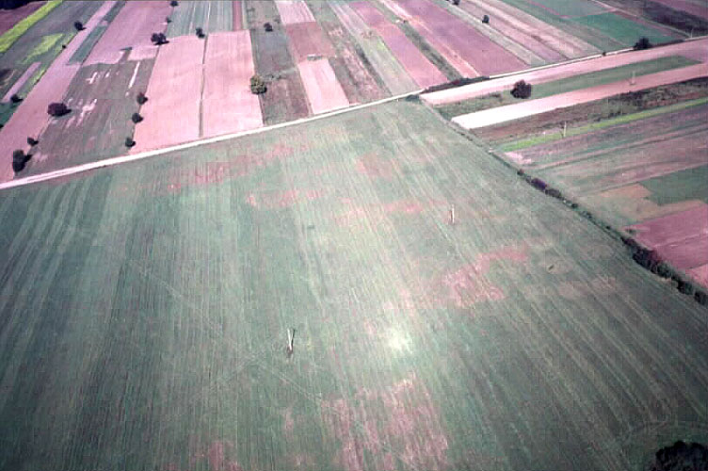
PHYSICAL MODELS IN REMOTE SENSING Chapter 04 – Part 08: Vegetation Canopy Hot Spot Effect
Photographic Evidence

Slide 5
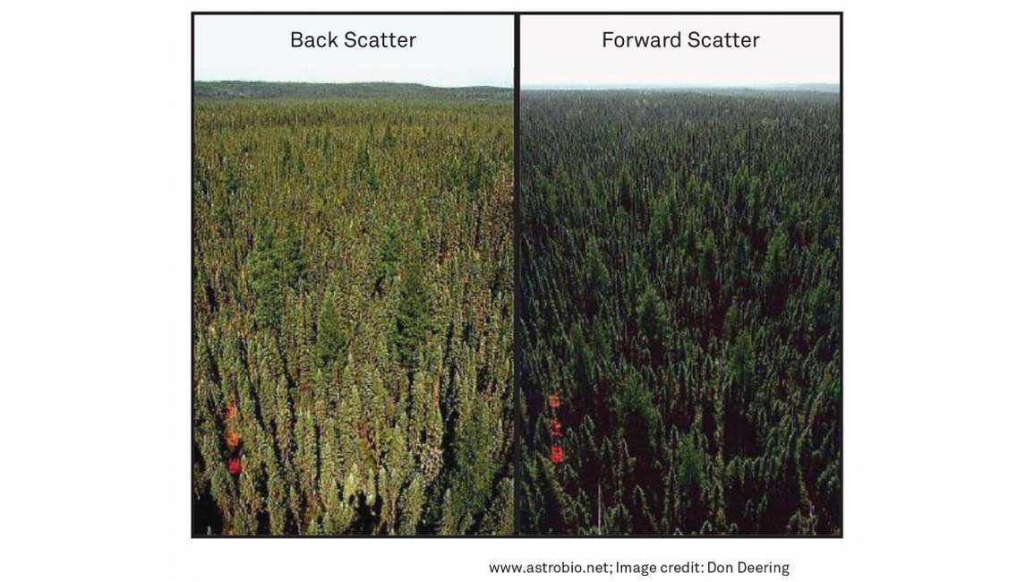
PHYSICAL MODELS IN REMOTE SENSING Chapter 04 – Part 08: Vegetation Canopy Hot Spot Effect
Photographic Evidence

Slide 6
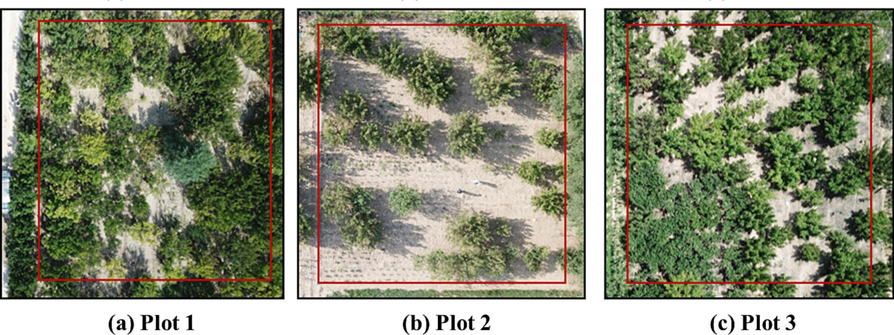
PHYSICAL MODELS IN REMOTE SENSING Chapter 04 – Part 08: Vegetation Canopy Hot Spot Effect
Photographic Evidence

Slide 7
PHYSICAL MODELS IN REMOTE SENSING Chapter 04 – Part 08: Vegetation Canopy Hot Spot Effect
Observing the Hot Spot
You can see the hot spot by following the shadow of an airplane as it takes off. The shadow gets smaller and smaller and at some altitude of the airplane you will no longer see its shadow but a bright spot on the ground (assuming you are flying over vegetated lands) that travels with you.
The key to seeing the hot spot is that there must a strong contract in brightness of sunlit and shaded canopy elements. It is visible at ”visible” wavelengths because leaves are strong absorbed of visible light. At NIR wavelengths, leaves strongly scatter, so the contrast between sunlit and shaded elements is minimal and the hot spot effect diminishes

Slide 8
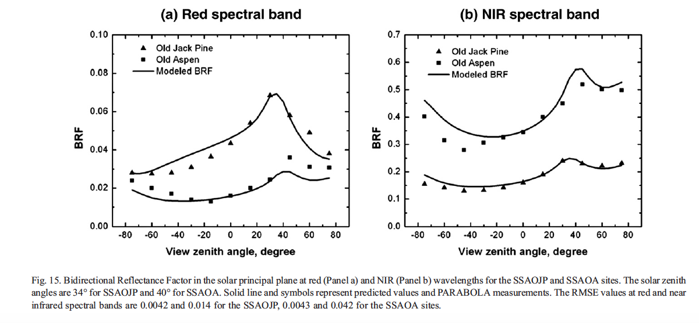
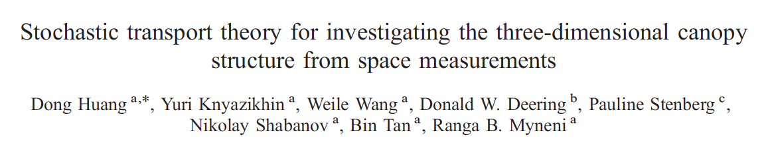
PHYSICAL MODELS IN REMOTE SENSING Chapter 04 – Part 08: Vegetation Canopy Hot Spot Effect
BRF Profiles

Slide 9
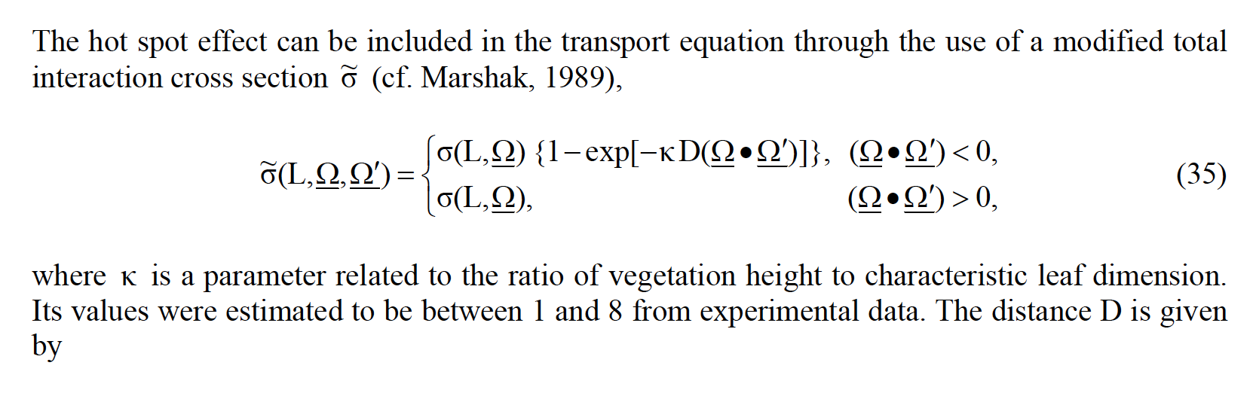
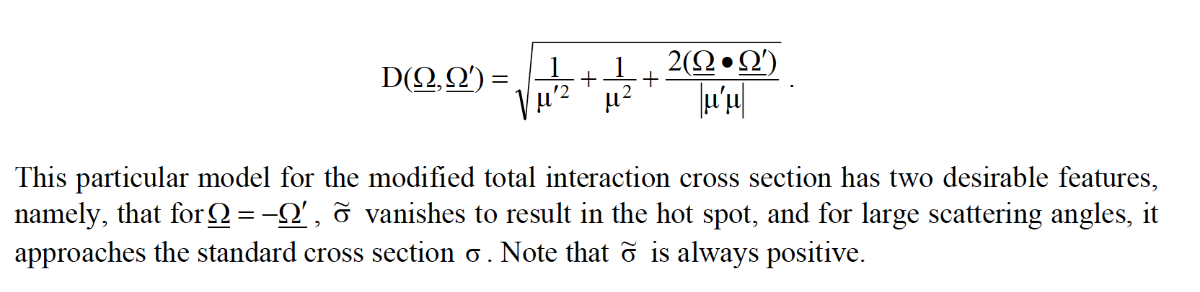
PHYSICAL MODELS IN REMOTE SENSING Chapter 04 – Part 08: Vegetation Canopy Hot Spot Effect
Modeling the Hot Spot Effect

Slide 10
PHYSICAL MODELS IN REMOTE SENSING Chapter 04 – Part 08: Vegetation Canopy Hot Spot Effect
Including the Hot Spot Effect in Numerical Methods
Separate the Intensity field into:
Uncollided I⁰
First-collided I¹,
Second and higher-order collided I^{m}
Use modified extinction coefficient to calculate I⁰ and I¹
Use standard extinction coefficient to calculate I^{m}
This will not conserve energy.
Evaluate the discrepancy by comparison to I^{tot} evaluated with standard extinction coefficient

Slide 11
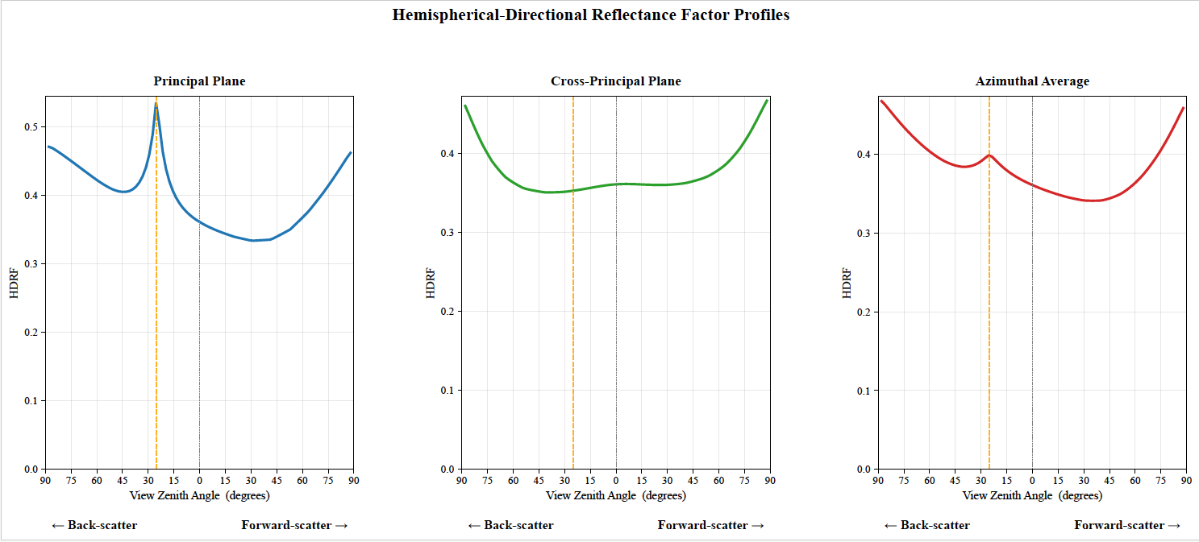
PHYSICAL MODELS IN REMOTE SENSING Chapter 04 – Part 08: Vegetation Canopy Hot Spot Effect
HDRF Profiles

Slide 12
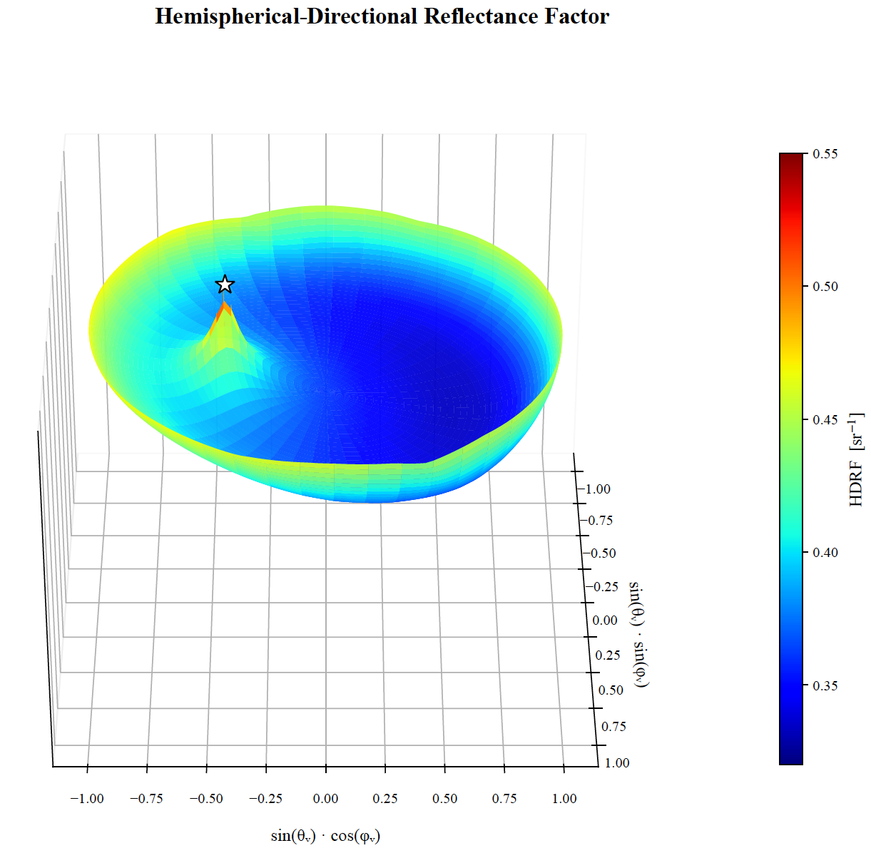
PHYSICAL MODELS IN REMOTE SENSING Chapter 04 – Part 08: Vegetation Canopy Hot Spot Effect
HDRF in 3D

Slide 13
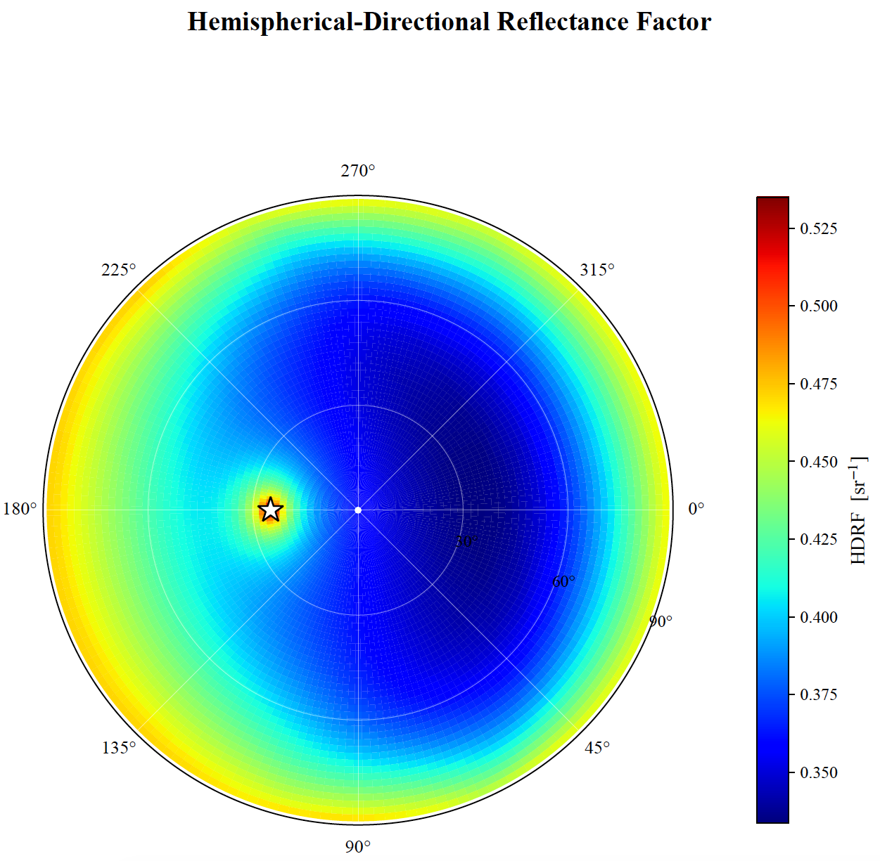
PHYSICAL MODELS IN REMOTE SENSING Chapter 04 – Part 08: Vegetation Canopy Hot Spot Effect
HDRF in Polar View

Slide 14
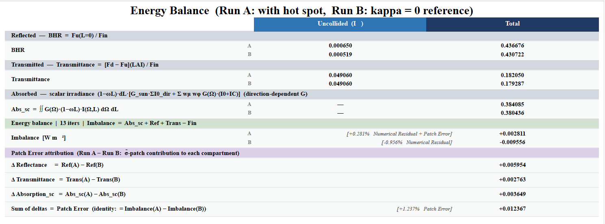
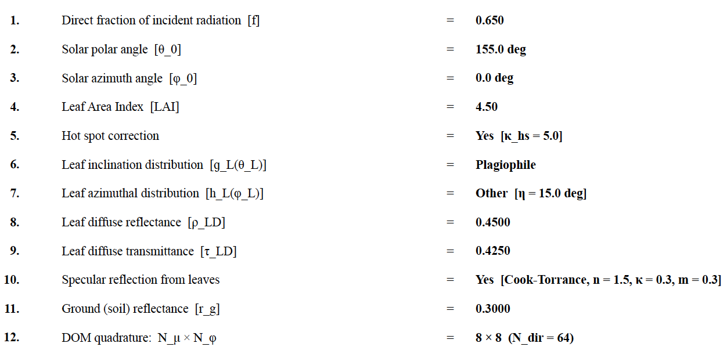
PHYSICAL MODELS IN REMOTE SENSING Chapter 04 – Part 08: Vegetation Canopy Hot Spot Effect
Energy Imbalance

