Slide 1
Introduction Collaboration and Goals

Slide 2
What does it mean to be a Developer?
A software developer is an individual who plans and creates computer programs based on user needs.
Role:
Software developers are not programmers
Software developers are not designers
Software developers are not business analysts
Software developers are not testers
Software developers are a combination of ALL THE ABOVE AND MORE
Software developers will communicate will clients (directly or indirectly) to identify and create solutions.
Software developers use a variety of tools and technologies to modify, write, debug, document and test software applications, which may invariably change over time.

Slide 3
Full Stack Web Development
Full Stack Developers should understand and handle work at a database, server, system, or client level.
Database level – Repositories which contain a bulk of static information for storage and retrieval purposes.
Server level – A computer or system that provides resources, data, services or programs for other computers or systems.
System level – A cohesive group of interrelated and interdependent parts. Systems engineering involves the design and management of integrating multiple complex systems.
Client level – A visually appealing, functional and interactive aspect of an application which serves to communication the bulk of information to users as well as function as the main interaction for a user and an entire system.

Slide 4
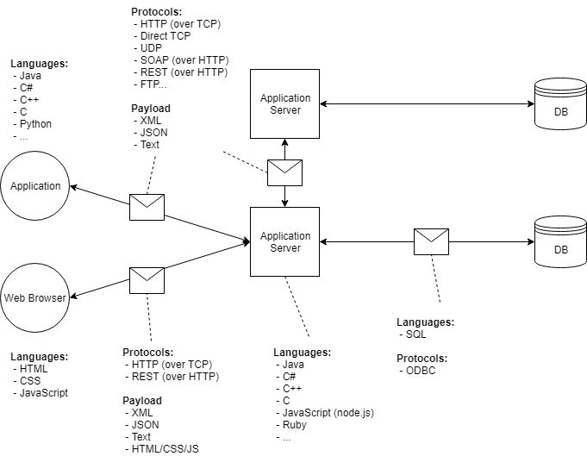
Client-Server-Database Architecture

Slide 5
Software Development Lifecycle [SDLC]
SDLC is a series of steps taken when creating new products.
General Steps:
Requirements Phase – Existing systems are evaluated to determine flaws or and/or gaps
Analysis Phase – New system requirements are defined.
Design Phase – Proposed system is planned and designed.
Development Phase – Software is built.
Testing Phase – Software is evaluated to ensure functionality.
Deployment and Maintenance – Product is delivered and ongoing upkeep is performed.
SDLC encompasses various methodologies, frameworks to help facilitate these phases and goals.

Slide 6
Terminology
Software – A set of instructions and data that communicate what a computer should do or how it should function.
Program – A type of software that is used to achieve a goal or perform a specific task.
Hardware – Physical components that a computer system requires to function.
Tool – A set of computer programs or software that are used by developers to create, maintain, debug, or support other applications and programs.
Technology Stack – The combination of programming languages, frameworks, and tools that developers use to build an application.
[Software] Framework (Tech Stack) – Utilities created to provide application-specific software.
Methodology – A broad category of development concepts and practices; which, when followed, should result in a particular goal.
Framework (SDLC) – A more detailed or specific implementation of a methodology.
User Story – Informal, general explanation of a software feature written from the perspective of the end user.

Slide 7
Collaboration
Git – A version control tool used to facilitate safer filesharing and collaboration between individuals and teams.
Agile – A popular SDLC methodology which favors flexibility and iteration throughout the development of an application.
Scrum – An implementation of the Agile methodology that divides work into discrete phases.
Kanban – An implementation of the Agile methodology that relies on transparency and communication through visual representations of work progress.
Scrumban – A combination of Scrum and Kanban frameworks, combining Scrum ceremonies and sprints with Kanban visual representations.

Slide 8
Agile
A methodology for following the SDLC
Agile is a mentality or philosophy, not a specific set of actions you take
An approach based on iterative development, where requirements and solutions evolve through the collaboration of cross-functional teams.
Four core Values
Individuals and Interactions over Processes and Tools
Working Software over Comprehensive Documentation
Customer Collaboration over Contract Negotiation
Responding to Change over Following a Plan.

Slide 9
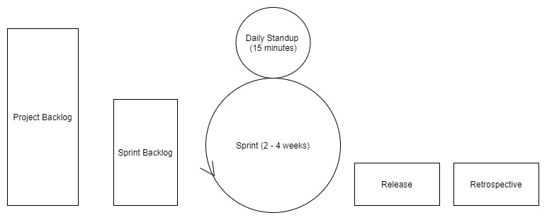
Scrum
Arguably the simplest Agile framework.
Uses certain ceremonies, led by a Scrum Master, to facilitate the organization and completion of work.
Scrum Master – Individual who ensures that a team is following Scrum practices.

Slide 10
Scrum Ceremonies
Sprint – A two-to-four-week timeline for established the completion of work.
Sprint Planning Meeting – Initial planning meeting to determine what work will be completed and the timeframe for completing that work.
Daily Standup – Short (10-15 minute) meetings at the start of each workday to discuss work completed yesterday and today’s plan and any blockers.
Blockers – Issues that prevent work from continuing, specifically issues that are out of that developer’s hands.
Sprint Review – A meeting that occurs at the end of each sprint that showcases accomplishments during that sprint.
Sprint Retrospective – A meeting that occurs after product deployment to discuss what went well during the sprint, what didn’t go well to improve work moving forward. Additionally, any unaccomplished tasks are placed into project backlog.

Slide 11
Scrum Advantages and Disadvantages
Advantages
Daily standups allow for quick identification of any setbacks a team is experiencing and development of quicker solutions through collaboration.
Shorter sprints allow for more constant releases, which can incorporate client feedback more easily throughout development process and adjust project requirements as needed.
Disadvantages
The Fluid nature of Agile brings a level of uncertainty, as deadlines and list of requirements are never known fully during project outset.
Feature creep is very common due to fluidity as well.
Scrum ceremonies require full team engagement in order to properly function.

Slide 12
Kanban
A popular Agile framework that requires real-time communication of capacity and full transparency of work.
Work items are visually represented on a Kanban board, allowing all team members to see the state of every piece of work at any time.
Kanban boards – The hallmark trait of the Kanban framework. There are no firm requirements for the number of columns on the board, but there should generally be at least one column per SDLC phase.
Tools include - Trello, Monday, Asana
Kanban cards – Visual representations of a single user story or work item which are placed in a column or a Kanban board.

Slide 13
Kanban Advantages and Disadvantages
Advantages
Event-driven, removing even the small pressure of sprint deadlines found in scrum.
Allows for specialization/more clearly defined roles.
i.e. “testing specialist”.
Kanban boards can always take new client requirements and is persistent throughout releases.
Allows the entire team to view the current state and progress of the project.
Disadvantages
Kanban boards can potentially grow to become unnecessarily complex and difficult to understand/navigate.
Kanban also requires high level of commitment from the team and active management of board.
An out-of-date board can potentially hurt the team because developers might work on the same tasks or leave work incomplete as the project is not accurately pictured.
The framework does not include a timing element, which can result in an even more extreme version of feature creep with constant release delays.

Slide 14
Other methodologies – Waterfall
Waterfall – A methodology that uses a rigid structure to complete the development of software.
Waterfall uses a straightforward model where software processes follow a linear pattern. To advance in stages a prior stage must be completed in full.
Stages are not returned to or repeated until the current work is completed in full and maintenance has started.
Also known as plan-driven model.
Waterfall is best for strict deadlines or for small teams.
i.e. government projects.

