Slide 1
The Rise of Agentic Software Engineering
Beyond Autocomplete: The Evolution of Autonomous Development
February 17, 2026 | Prolific Blog
Notes:
Welcome everyone. Today we are diving into a massive shift in the tech world: the transition from simple AI coding assistants to fully autonomous agentic software engineering. We've all used tools like GitHub Copilot, but what happens when the AI stops just suggesting lines of code and starts managing the entire development lifecycle? In this session, we'll explore how these agents are reshaping the industry, the architectural foundations making it possible, and the new challenges of governance and security in an AI-driven world.

Slide 2
01
The Evolution of Software Development
From Copilots to Autonomous Agents
Notes:
To understand where we're going, we first need to look at where we've been. Chapter one explores the limitations of our current tools and the emergence of multi-step reasoning that defines the new 'agentic' era. We are moving from passive code completion to systems that can actually think through a problem.

Slide 3
Limitations of First-Gen AI
•
Narrow operational scope
•
Lack of architectural context
•
No conception of testing or deployment
•
High cognitive burden for integration
Notes:
Building on that history, let's look at why first-gen tools like the original Copilot hit a wall. While they were great at finishing a function, they were 'myopic'—they couldn't see the broader project architecture. This meant developers often had to fix AI code that was syntactically correct but structurally wrong. Ultimately, the human still had to do all the heavy lifting of integration and maintenance.

Slide 4
“
Agentic AI is characterized by asynchronous, event-driven, and goal-driven execution models.
— AWS Prescriptive Guidance
Notes:
This quote perfectly captures the shift we are seeing. Unlike the 'request-response' nature of early LLMs, agentic systems are goal-driven. They don't just wait for you to type; they proactively work toward a finished feature, handling background tasks and events without constant human prompting.

Slide 5
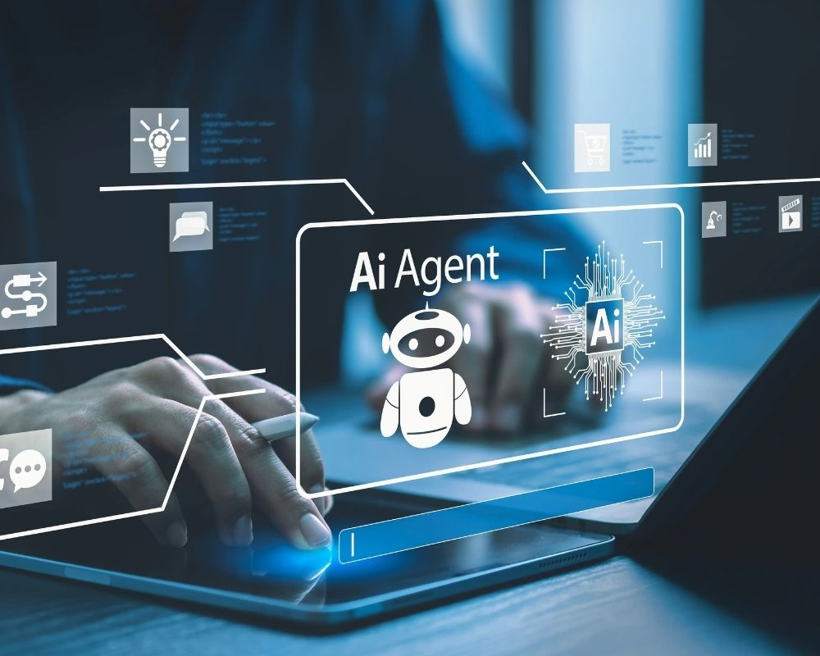
The Multi-Agent Orchestration
• Specialized roles for agents
• Continuous feedback loops
• Automated SDLC management
A developer orchestrating multiple AI agents through a centralized digital interface.
Notes:
Now, look at this visualization of the modern workflow. Instead of one AI chat box, we have a developer acting as an orchestrator. Systems like Fujitsu's platform use specialized agents—one for requirements, one for architecture, and one for testing—all working in a coordinated mesh to deliver software faster than ever before.

Slide 6
02
Architectural Foundations
Implementation Patterns and Benchmarks
Notes:
Transitioning from the 'what' to the 'how,' let's look at the technical architecture. How do these agents actually interact with our operating systems and how do we measure if they are actually any good at their jobs?

Slide 7
Native Integration & Security
•
Granular, context-aware permissions
•
Sandboxed execution environments
•
Multi-level rollback mechanisms
•
Native IDE and Tool integration
Notes:
Building on the need for deeper access, OpenAI's recent macOS integration shows us the blueprint. These agents aren't just in a browser; they have native access to file systems and build tools. To keep this safe, they use sophisticated sandboxing and 'least privilege' permissions, allowing them to run tests and manage git branches while keeping the host system secure.

Slide 8
Evaluating Autonomous Agents
•
SWE-bench: Real-world GitHub issues
•
DevBench: Repository-scale comprehension
•
Focus on long-term maintainability
•
Security and performance profiling
Notes:
Now let's talk about measurement. We can't just use old metrics like BLEU scores anymore. New benchmarks like SWE-bench force agents to solve real GitHub issues across multiple files. We're now looking at things like 'cyclomatic complexity' and 'architectural coherence' to see if the AI is writing code that humans can actually maintain long-term.

Slide 9
03
Governance and the Future
Security, Drift, and the Developer Experience
Notes:
In our final section, we have to address the risks. As we give agents more power, we face new threats like prompt injection and 'agentic drift.' We'll also look at how the role of the human developer is fundamentally changing.

Slide 10
Security in the Agentic Era
•
Prompt injection via data sources
•
Policy engines for agent boundaries
•
Mandatory human-in-the-loop checkpoints
•
Comprehensive audit logging
Notes:
Building on the security theme, the risks are evolving. Attackers can now use 'prompt injection' hidden in documentation to trick an agent into leaking credentials. To fight this, enterprises are building policy engines that act as guardrails, ensuring that high-impact changes—like database schema updates—always require a human thumb's up.

Slide 11
Sources & References
1. Comparing traditional AI to software agents and agentic AI
6. Fujitsu automates entire software development lifecycle with new AI .....
https://docs.aws.amazon.com/prescriptive-guidance/latest/age...
https://www.prnewswire.com/news-releases/fujitsu-automates-e...
2. a review of large language models as autonomous agents and tool ...
7. Multi AI Agent Framework - Fujitsu Research Portal
https://link.springer.com/article/10.1007/s10462-025-11471-9
https://en-documents.research.global.fujitsu.com/multi-ai-ag...
3. [PDF] Agentic SDLC in practice: the rise of autonomous software delive...
8. Fujitsu Unveils AI Agent Platform to Boost Healthcare Efficiency
https://www.pwc.com/m1/en/publications/2026/docs/future-of-s...
https://ai-techpark.com/fujitsu-unveils-ai-agent-platform-to...
4. An AI led SDLC: Building an End-to-End Agentic Software ...
9. Fujitsu: Multi-Agent Orchestration for Automated Sales Proposal ...
https://techcommunity.microsoft.com/blog/appsonazureblog/an-...
https://www.zenml.io/llmops-database/multi-agent-orchestrati...
5. OpenAI launches new macOS app for agentic coding - TechCrunch
10. Fujitsu launches AI platform to automate full software development ...
https://techcrunch.com/2026/02/02/openai-launches-new-macos-...
https://www.telecompaper.com/news/fujitsu-launches-ai-platfo...
Full article with all citations available on the blog
Notes:
For those who want to dig deeper, here are the primary sources for today's discussion. From the technical docs at AWS and Microsoft to the latest press releases from Fujitsu and OpenAI, these resources provide the full architectural details of the systems we've discussed.

Slide 12
The transition from AI copilots to autonomous agents shifts the developer's role from manual implementation to high-level orchestration and governance.
From Coder to Conductor
Like & Subscribe | Prolific Blog
Notes:
To wrap things up, we are moving from a world of writing code to a world of orchestrating intelligence. The most successful developers of the next decade won't just be the best at syntax; they'll be the best at guiding autonomous agents. Thanks for watching—make sure to subscribe for more deep dives into the future of engineering, and check out the full blog post in the description!

