Slide 1
The Open Source Reasoning Revolution
Understanding GPT-OSS and Gemma 3n
February 20, 2026 | Prolific Blog
Notes:
Welcome everyone. Today we are exploring a seismic shift in the artificial intelligence landscape: the rise of open-source reasoning models. For years, advanced logic and multi-step reasoning were locked behind the proprietary walls of companies like OpenAI and Google. But with the release of GPT-OSS and Gemma 3n, that era of exclusivity is officially over, and we're entering a new age of accessible, auditable, and local AI intelligence.

Slide 2
01
Chapter 1: The Dawn of Open Reasoning
Breaking the Proprietary Barrier
Notes:
To start, let's look at the emergence of these models and why they represent such a watershed moment. We'll dive into the architecture of GPT-OSS and how it manages to deliver enterprise-grade reasoning without the massive overhead of its predecessors.

Slide 3
What Makes These Models Different?
•
Chain-of-Thought (CoT) transparency
•
Visible and verifiable multi-step inferences
•
Sparse Mixture-of-Experts (MoE) architecture
•
Significant reduction in inference latency
Notes:
Building on the idea of transparency, what truly sets these models apart is their ability to show their work. Unlike previous models that relied on opaque pattern matching, GPT-OSS and Gemma 3n use Chain-of-Thought reasoning to decompose complex queries into logical steps. This isn't just a technical flex; it has real-world impact, like Spotify finding that users are four times more likely to click recommendations when they are accompanied by these AI-generated explanations.

Slide 4
“
The Dynamic Compositional Architecture (DCA) models the network as a directed acyclic graph of modular units.
— Nature Research (2025)
Notes:
Now let's look at the 'how' behind the efficiency. The Dynamic Compositional Architecture, or DCA, allows these models to act like a directed acyclic graph. This means the model can skip unnecessary operations based on how complex the task is, leading to a massive 40% reduction in inference latency. It’s about being smart with compute, not just throwing more parameters at the problem.

Slide 5
02
Chapter 2: Democratizing Deep Think
Running Advanced Reasoning Locally
Notes:
Moving from theory to practice, let's discuss the hardware and strategies required to actually run these models on your own infrastructure. This is where the democratization of AI truly happens—moving from expensive API calls to local control.

Slide 6
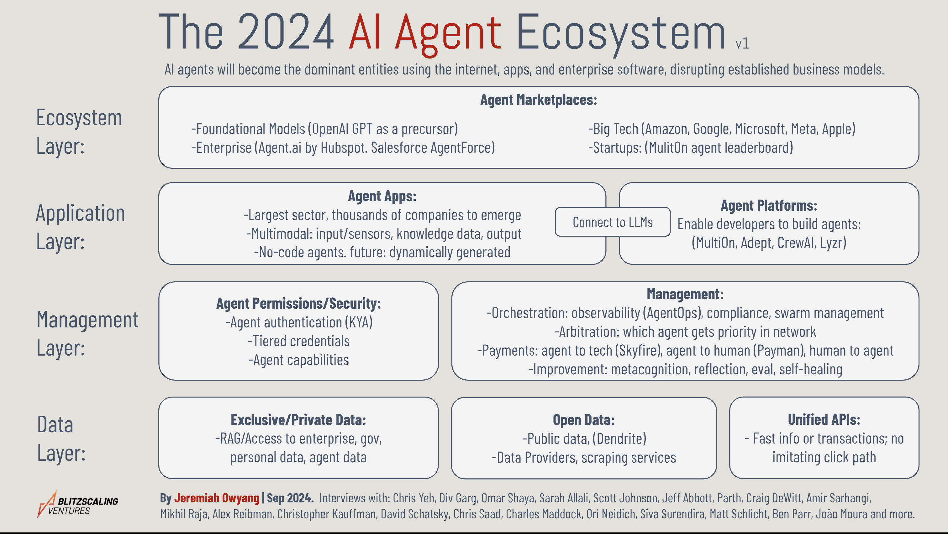
The AI Agent Ecosystem
• Data Layer: Private vs. Open Data
• Management Layer: Security and Orchestration
• Application Layer: Platforms and Apps
The 2024 AI Agent Ecosystem map illustrating the layers of innovation.
Notes:
As we see in this ecosystem map, reasoning models sit at the heart of the management and data layers. By running these locally, enterprises can keep their private data secure while using the orchestration layer to build complex agents. This map shows us that the reasoning model is the engine, but the ecosystem around it is what creates the value.

Slide 7
Hardware & Quantization
•
120B models now run on a single 80GB GPU
•
20B variants accessible on 16GB RAM
•
Post-training quantization delivers superior performance
•
30% memory usage reduction via dynamic adaptation
Notes:
Now let's talk about the hardware requirements. In 2026, the barrier to entry has plummeted. While the high-end 120B models still need an 80GB GPU for peak performance, the 20B versions can now run on a standard workstation with 16GB of RAM. The secret sauce here is quantization—reducing numerical precision to save memory without sacrificing the accuracy of the logic.

Slide 8
“
Quantizing models during the reinforcement learning training process has a negative effect on learning.
— NeurIPS (2025)
Notes:
Building on that technical optimization, it's important to note a key finding from recent research. You can't just quantize whenever you want. If you try to quantize during the reinforcement learning phase, the model actually struggles to learn. The best practice is post-training quantization or using QLoRA, which preserves that critical reasoning depth.

Slide 9
The Economics of Local AI
•
Break-even point typically reached in 6 months
•
Zero marginal cost for additional inference
•
Eliminates 'budget rationing' for developers
•
Enables domain-specific fine-tuning
Notes:
Let's look at the bottom line. Proprietary APIs are expensive, often costing thousands of dollars a month for high-volume users. By investing in local hardware, companies can hit a break-even point in just six months. More importantly, it changes the culture of innovation—developers don't have to ration their queries, leading to more experimentation and better final products.

Slide 10
03
Chapter 3: The Future of Open Reasoning
Research, Safety, and the Road Ahead
Notes:
Finally, let's look toward the horizon. The shift to open reasoning isn't just about saving money; it's fundamentally changing how AI research is conducted and what the next generation of models will look like.

Slide 11
Sources & References
1. [PDF] Distilling Probing and Reasoning Capabilities into Smaller ... -...
6. gpt-oss-120B (high) vs Gemma 3 1B Instruct
http://www.lrec-conf.org/proceedings/lrec-coling-2024/pdf/20...
https://artificialanalysis.ai/models/comparisons/gpt-oss-120...
2. [PDF] Distilling Reasoning Capabilities into Smaller Language Models
7. Is GPT-OSS Good? A Comprehensive Evaluation ...
https://aclanthology.org/2023.findings-acl.441.pdf
https://arxiv.org/html/2508.12461v1
3. The Impact of Quantization on Large Reasoning Model ... - NeurIPS
8. Top 10 Open-source Reasoning Models in 2026 - Clarifai
https://neurips.cc/virtual/2025/126555
https://www.clarifai.com/blog/top-10-open-source-reasoning-m...
4. Research on deep learning architecture optimization method for ...
9. CES 2026: The Rise of Reasoning AI Models
https://www.nature.com/articles/s41598-025-32015-9
https://www.digitalengineering247.com/article/ces-2026-the-r...
5. Comparative Analysis of Reasoning Capabilities in Foundation ...
10. Distilling Reasoning Ability from Large Language Models with ...
https://ieeexplore.ieee.org/iel8/10852419/10852420/10852449....
https://arxiv.org/abs/2404.09170
Full article with all citations available on the blog
Notes:
This presentation was built on a foundation of rigorous research. From Nature's work on architecture to NeurIPS's findings on quantization, these sources highlight the collaborative effort required to bring these models to the public. I encourage you to dive into these papers for a deeper technical understanding.

Slide 12
The emergence of open-weight reasoning models like GPT-OSS and Gemma 3n has broken the proprietary monopoly on advanced AI logic, enabling cost-effective, private, and customizable deployment for enterprises and researchers alike.
The Future is Open
Like & Subscribe | Prolific Blog
Notes:
In summary, the open-source reasoning revolution is here. We've moved from black-box APIs to transparent, local, and efficient models that anyone can use. If you want to stay at the cutting edge of this transition, make sure to like, subscribe, and check out the full blog post for the implementation guides. Thanks for watching!

