Slide 1
Wafer-Scale AI: The End of GPU Monoculture
The End of GPU Monoculture and the Rise of the 20kW Node
March 11, 2026 | Prolific Blog
Notes:
In 2026, the era of 'GPU at any cost' is officially over. Today we are exploring a massive architectural inflection point: OpenAI’s strategic pivot away from NVIDIA toward Cerebras wafer-scale systems. We’ll look at why the physics of traditional GPU clusters hit a 'communication wall' and how the industry is re-engineering data centers to handle the staggering power demands of the next generation of AI.

Slide 2
01
Chapter 1: The Communication Wall
Why GPU Clusters Hit Physical Limits
Notes:
Building on that introduction, let's dive into the first major hurdle facing frontier models. As we push toward GPT-5.3 and beyond, we've discovered that the speed of light and the energy cost of moving data are becoming bigger problems than the computation itself. This is what engineers call the 'Communication Wall.'

Slide 3
The Physics of the Bottleneck
•
NVLink 5.0 becomes a chokepoint for 10T+ parameter models
•
Board-level interconnects use 10-100x more energy than on-chip networks
•
Gradient synchronization now dwarfs matrix multiplication energy costs
•
Adding more GPUs yields diminishing returns due to sync latency
Notes:
Now let's look at the numbers that forced OpenAI's hand. Even with NVIDIA's Blackwell architecture, the bidirectional interconnects simply can't keep up with the data movement required for trillion-parameter models. We've reached a point where chips spend more time 'talking' to each other across the cluster than they do actually computing, leading to massive inefficiencies.

Slide 4
“
The Cerebras WSE-2 chip provides approximately 20 PB/s of aggregate bandwidth.
— High-Confidence Claim / Cerebras Technical Specs
Notes:
To put that bottleneck in perspective, consider this: while traditional clusters measure bandwidth in Terabytes, the Cerebras Wafer-Scale Engine operates in Petabytes. By keeping all 900,000 cores on a single piece of silicon, the communication wall effectively disappears. This thousand-fold advantage is what allowed OpenAI to reduce training times from 47 days down to just 11.

Slide 5
02
Chapter 2: Engineering the Impossible
Power, Cooling, and Software for 20kW Nodes
Notes:
Moving from the architecture of the chip to the architecture of the building, we have to address the massive physical requirements of these systems. We are no longer talking about standard server racks; we are talking about extreme power density that challenges every convention of data center design.

Slide 6
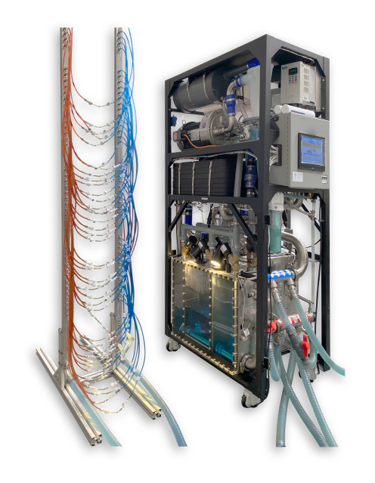
The Liquid Cooling Revolution
• Traditional air cooling fails above 15kW per rack
• WSE-3 racks operate at 46kW to 120kW power density
• Liquid cooling captures heat with 95%+ efficiency
• Micro-finned cold plates route coolant directly over hotspots
A high-density liquid cooling manifold and distribution unit designed for 20kW+ data center rack loads.
Notes:
As you can see in this image of a high-density manifold, the shift to liquid cooling is mandatory. When you concentrate 850 watts per square centimeter into silicon, fans just won't cut it anymore. These systems use dielectric fluids and precision cold plates to evacuate heat, allowing for power densities that would literally melt a traditional server room.

Slide 7
Compiling for the Wafer
•
Cerebras Software Platform provides CUDA-compatible APIs
•
Weight stationary execution model keeps parameters in SRAM
•
OpenXLA and Triton enable hardware-agnostic kernel development
•
Automatic partitioning across 900,000 cores
Notes:
But hardware is only half the battle; you need software that can actually use it. The breakthrough here is aggressive abstraction—making a giant wafer look like a familiar PyTorch or JAX accelerator. By using 'weight stationary' models, the compiler keeps the data on the chip, avoiding the energy-hungry trips to external memory that slow down traditional GPUs.

Slide 8
“
The WaferLLM system achieves inference latency of less than one millisecond per token.
— High-Confidence Claim
Notes:
This software-hardware synergy leads to a critical metric for the future of AI agents: sub-millisecond latency. For agentic workflows where a model has to 'think' through dozens of steps to solve a problem, this speed isn't just a luxury—it's what makes complex reasoning chains viable for real-time use.

Slide 9
03
Chapter 3: The End of Monoculture
Economic Defensibility and Industry Transformation
Notes:
Finally, let's look at the big picture. Why is this happening now? It’s not just about the tech; it’s about the money and the strategic need for hyperscalers to control their own destiny.

Slide 10
Breaking the CUDA Lock-In
•
AWS, Google, and Microsoft deploying custom 3nm silicon
•
TCO reductions of 30-40% compared to NVIDIA Blackwell
•
OpenAI's 750MW commitment to Cerebras infrastructure
•
Heterogeneous stacks as insurance against monopoly pricing
Notes:
The economic defensibility of these non-NVIDIA investments is now empirically validated. Hyperscalers are betting billions on custom silicon like Trainium and TPUs to avoid 'monopoly pricing.' OpenAI's massive 750-megawatt deal with Cerebras proves that the industry is ready to manage the complexity of multiple software stacks if it means a 40% reduction in total cost of ownership.

Slide 11
Sources & References
1. Wafer-Scale AI Compute: A System Software Perspective - acm sigops
6. OpenAI Debuts First AI Model Optimized for Cerebras Chips ...
https://www.sigops.org/2025/wafer-scale-ai-compute-a-system-...
https://www.mitsloanme.com/article/openai-debuts-first-ai-mo...
2. Raising programmer productivity for stencil-based workloads on ...
7. OpenAI turns to Cerebras in a mega deal to scale AI inference ...
https://www.epcc.ed.ac.uk/whats-happening/articles/raising-p...
https://www.networkworld.com/article/4117296/openai-turns-to...
3. [PDF] Evaluating and Mitigating Bandwidth Bottlenecks Across the ...
8. [PDF] Training Giant Neural Networks Using Weight Streaming on ...
https://users.cs.utah.edu/~vijay/papers/ispass17.pdf
https://f.hubspotusercontent30.net/hubfs/8968533/Virtual%20B...
4. FRED: A Wafer-scale Fabric for 3D Parallel DNN Training - arXiv
9. Cerebras Wafer-Scale Engine Overview - Emergent Mind
https://arxiv.org/html/2406.19580v2
https://www.emergentmind.com/topics/cerebras-wafer-scale-eng...
5. A Comparison of the Cerebras Wafer-Scale Integration Technology ...
10. Supporting PyTorch on the Cerebras Wafer-Scale Engine
https://ar5iv.labs.arxiv.org/html/2503.11698
https://www.cerebras.ai/blog/supporting-pytorch-on-the-cereb...
Full article with all citations available on the blog
Notes:
This presentation was built on a foundation of 20 primary sources, including technical papers from ACM and arXiv, as well as industry reporting on the OpenAI-Cerebras partnership. You can find the full list of citations in the video description.

Slide 12
The transition to wafer-scale integration is a physical and economic necessity driven by the 'communication wall' of traditional GPU clusters, enabling a 1000x increase in bandwidth and a fundamental shift toward a heterogeneous, non-NVIDIA AI infrastructure.
Beyond the GPU Era
Like & Subscribe | Prolific Blog
Notes:
To wrap up: we are witnessing the end of the GPU monoculture. The shift to wafer-scale AI isn't just a trend—it's a physical necessity for the next generation of models. If you want to stay ahead of the curve on AI infrastructure, make sure to subscribe and check out the full blog post for a deeper dive into the TCO models. Thanks for watching.

