Slide 1
Beyond the Wrapper
Why 2026 is the Year of Vertical AI Integration
March 06, 2026 | Prolific Blog
Notes:
Welcome everyone. Today we are diving into a massive shift in the tech landscape. In 2026, the 'gold rush' of simple AI apps is officially over, and a new era of deep, vertical integration has begun. We're going to explore why the 'wrapper' business model is dying and what it actually takes to build a defensible AI company in this consolidated market.

Slide 2
01
The Thin Wrapper Apocalypse
Why AI Startups Are Facing Their Reckoning
Notes:
Building on that opening, let's look at the first major chapter of this shift: The Thin Wrapper Apocalypse. We are seeing a brutal consolidation as companies built on simple API connections face extinction. This isn't just a market dip; it's a fundamental reckoning for how AI value is created and captured.

Slide 3
“
The industry doesn't have patience for that anymore. You have to build something that isn't just a wrapper.
— Google VP of Global Startups (February 2026)
Notes:
Now let's look at the catalyst for this change. In early 2026, Google's leadership sent shockwaves through the community by stating that the days of simple wrappers are over. This wasn't just a comment; it was a signal to investors that the era of funding companies with no proprietary technology has ended. Within weeks of this warning, we saw funding for these superficial applications contract sharply.

Slide 4
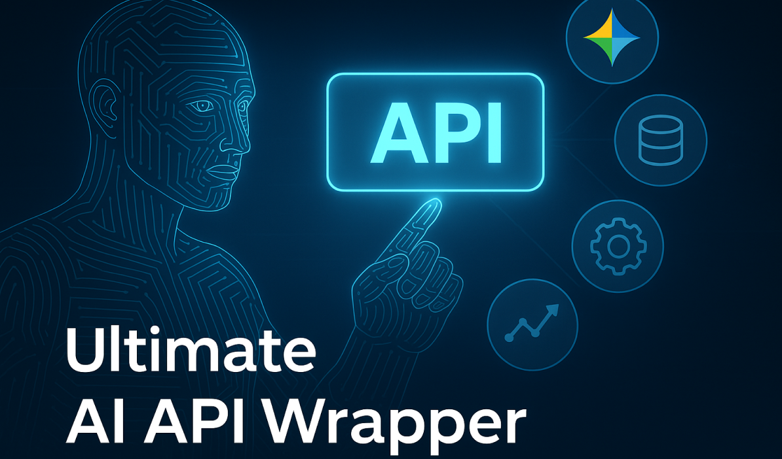
The Anatomy of a Dying Model
• Minimal preprocessing of user requests
• No proprietary training data
• Cosmetic features over technical depth
• Vulnerable to model provider updates
A conceptual illustration of an AI API wrapper interface.
Notes:
Moving on to the technical side, take a look at this illustration of a typical wrapper interface. These companies essentially 'reskin' capabilities that are available to anyone with an API key. Because they lack fine-tuned models or deep workflow integration, they have no defensible moat. When the underlying model provider like OpenAI or Google adds a new feature, these startups can be wiped out overnight.

Slide 5
The Economics of Commoditization
•
API prices dropped 70-80% in 18 months
•
Capability convergence across top models
•
Prompt engineering cannot be patented
•
Shift from 'AI-first' to 'AI-native' architectures
Notes:
Building on the technical vulnerability, the economics have also collapsed. As model providers slashed prices to compete, the margins for intermediaries evaporated. Furthermore, what we used to call 'prompt engineering' has become a basic skill rather than a specialized moat. To survive now, companies must be 'AI-native,' meaning their products are impossible to build without deep, multi-model integration.

Slide 6
02
Building Beyond the API
The Architecture of Vertical AI Integration
Notes:
So, if wrappers are dying, what is succeeding? Let's transition into the architecture of Vertical AI Integration. This is where AI moves from being a 'feature' to becoming the foundational infrastructure of enterprise systems. It's about deep, domain-specific engineering that base models simply cannot replicate.

Slide 7
Agentic AI Frameworks
•
Autonomous multi-step task execution
•
Integration with ERP and CRM systems
•
Persistent context management
•
Human-in-the-loop safety controls
Notes:
Now let's look at the core of this new architecture: Agentic AI. Unlike simple chatbots, agentic systems are capable of autonomous decision-making without constant human intervention. They don't just answer questions; they execute workflows across ERP and CRM systems. This requires a layered architecture that separates the intelligence layer from the business logic, allowing for updates without retraining the entire model.

Slide 8
“
Companies deploying fine-tuned models achieve 28.3% higher accuracy on domain-specific tasks compared to prompt-only approaches.
— Industry Performance Metrics 2026
Notes:
Building on the idea of deep integration, the data shows a massive performance gap. Fine-tuning is no longer optional for vertical applications. By investing in proprietary data pipelines and domain-specific training, companies are seeing nearly a 30% jump in accuracy. This level of precision is what enterprise customers now demand for mission-critical workflows like legal or healthcare.

Slide 9
03
Scaling Intelligence
Infrastructure Economics and the Path Forward
Notes:
Finally, let's discuss the money. The economics of AI have split into two divergent paths. Understanding whether you are scaling infrastructure or scaling intelligence is the most important strategic decision an AI founder can make in 2026.

Slide 10
The $30B Strategy Split
•
Infrastructure: Competing on computational density
•
Intelligence: Competing on task completion rates
•
Hardware providers investing in their own customers
•
Data center capacity needs reaching 122GW by 2030
Notes:
Now let's look at the divergence in the market. On one side, we have the infrastructure giants like OpenAI and Nvidia, who are betting billions on the computational substrate. On the other side, we have intelligence-focused startups. While the infrastructure game requires massive capital for data centers, the intelligence game is won through specialized accuracy and lower per-request costs through fine-tuning.

Slide 11
Sources & References
1. AI Trends for 2026 – Investor Discipline Supplants AI Valuation ...
6. Google VP warns that days for these AI startups are over; says
https://www.jdsupra.com/legalnews/ai-trends-for-2026-investo...
https://timesofindia.indiatimes.com/technology/tech-news/goo...
2. Agentic AI Frameworks for Building Autonomous AI Agents
7. Google VP warns AI wrapper startups may struggle to survive
https://www.digitalocean.com/community/tutorials/agentic-ai-...
https://www.techinasia.com/news/google-vp-warns-ai-wrapper-s...
3. LLM-based Agentic Reasoning Frameworks: A Survey from Methods ...
8. Google VP warns that two types of AI startups may not survive
https://arxiv.org/html/2508.17692v1
https://techcrunch.com/2026/02/21/google-vp-warns-that-two-t...
4. Prompt Engineering vs Fine Tuning: When to Use Each | Codecademy
9. Google Exec Warns AI Wrapper Startups Could Be in Trouble
https://www.codecademy.com/article/prompt-engineering-vs-fin...
https://www.pymnts.com/artificial-intelligence-2/2026/google...
5. The U.S. Is Betting the Economy on 'Scaling' AI
10. Agentic Large Language Models, a survey - arXiv.org
https://www.ineteconomics.org/perspectives/blog/the-u-s-is-b...
https://arxiv.org/html/2503.23037v3
Full article with all citations available on the blog
Notes:
Before we wrap up, I want to acknowledge the sources that made this deep dive possible. We've synthesized data from recent market warnings, technical surveys on agentic reasoning, and economic reports on the massive infrastructure investments currently shaping our world. You can find the full list of references in the video description.

Slide 12
Survival in the 2026 AI market requires moving beyond simple API wrappers to create deeply integrated vertical solutions that utilize custom agentic frameworks and domain-specific fine-tuning.
Building for the Next Era of AI
Like & Subscribe | Prolific Blog
Notes:
In summary, the era of the 'thin wrapper' is officially over. To survive the consolidation of 2026, you must build vertical solutions that are deeply embedded into the systems they serve. Focus on proprietary logic and domain-specific accuracy that base models can't match. If you found this breakdown valuable, please subscribe for more technical deep dives and check out the full blog post for the architectural diagrams. Thanks for watching!

