Slide 1
The 2026 Enterprise Agent Stack
Orchestrating OpenAI Frontier and Anthropic Plug-ins
February 27, 2026 | Prolific Blog
Notes:
Welcome to our deep dive into the 2026 Enterprise AI landscape. We've moved past the era of simple chatbots into a world of complex, federated agent systems. Today, we're going to explore how the industry's two biggest players—OpenAI and Anthropic—are being integrated into a single, unified stack. By the end of this session, you'll understand the architectural philosophies and technical standards driving the next generation of business automation.

Slide 2
01
The New AI Landscape
From Monolithic to Federated Systems
Notes:
To start, let's look at how we got here. Just two years ago, most companies picked one vendor and stuck with them. But as we'll see, that 'one-size-fits-all' approach has officially died in favor of a more flexible, multi-vendor reality.

Slide 3
The Evolution of Agent Systems
•
Transition from isolated islands to federated ecosystems
•
OpenAI Frontier for reasoning vs. Anthropic for regulation
•
Regulatory pressures demanding vendor-agnostic frameworks
•
The rise of standardized protocols like MCP
Notes:
Building on that transition, the shift accelerated in mid-2025 when it became clear that no single model could do everything. OpenAI's Frontier platform became the go-to for complex reasoning, while Anthropic's 'Constitutional AI' won over regulated industries like finance and healthcare. This forced organizations to manage both simultaneously, leading to the birth of federated agent systems. We also saw a massive push from regulators in the EU and US to avoid vendor lock-in, making interoperability a legal necessity.

Slide 4
“
Anthropic holds a 40% share of enterprise LLM spending, surpassing OpenAI's 27%.
— Anthropic - Company Analysis and Outlook Report (2026)
Notes:
Now let's look at some striking numbers that prove this shift. While OpenAI still dominates the consumer market, Anthropic has surged ahead in the enterprise sector. By August 2025, Anthropic's revenue run-rate hit $5 billion, largely because they focused on business-first features. This 40% market share highlights that enterprises are voting with their wallets for models that prioritize safety and enterprise-grade integration.

Slide 5
02
Engineering the Stack
Technical Implementation and Standards
Notes:
Now that we understand the 'why,' let's talk about the 'how.' Building a unified stack requires more than just API keys; it requires a new set of engineering standards. We're going to look at the protocols that allow these different agents to actually talk to each other.

Slide 6
The Model Context Protocol (MCP)
•
Model-agnostic client-server architecture
•
Uses JSON-RPC for secure tool invocation
•
Connects agents to Google Calendar, Notion, and Slack
•
Enables 'build once, use everywhere' tool integration
Notes:
A central piece of this puzzle is the Model Context Protocol, or MCP. Think of it as the universal translator for AI agents. It allows an agent to access your corporate data in Notion or your schedule in Google Calendar regardless of whether the underlying model is from Anthropic, OpenAI, or Google. By using a JSON-RPC interface, developers can build a tool once and have it work across every AI platform in their stack, drastically reducing development time.

Slide 7
Unified Corporate Workflows
•
Cross-system analysis via federated agents
•
Real-time schema mapping for heterogeneous data
•
Automated reconciliation of ERP and Jira data
•
80% autonomy in multi-step business workflows
Notes:
Building on those protocols, we are seeing the rise of unified workflows. In the past, finance and engineering data lived in separate silos. Today, federated agents can pull cost data from an ERP and correlate it with engineering velocity in Jira. We've seen cases where the monthly financial close was reduced from five days to just eight hours. These agents are now handling up to 80% of these complex workflows autonomously, only escalating to humans when they hit a true edge case.

Slide 8
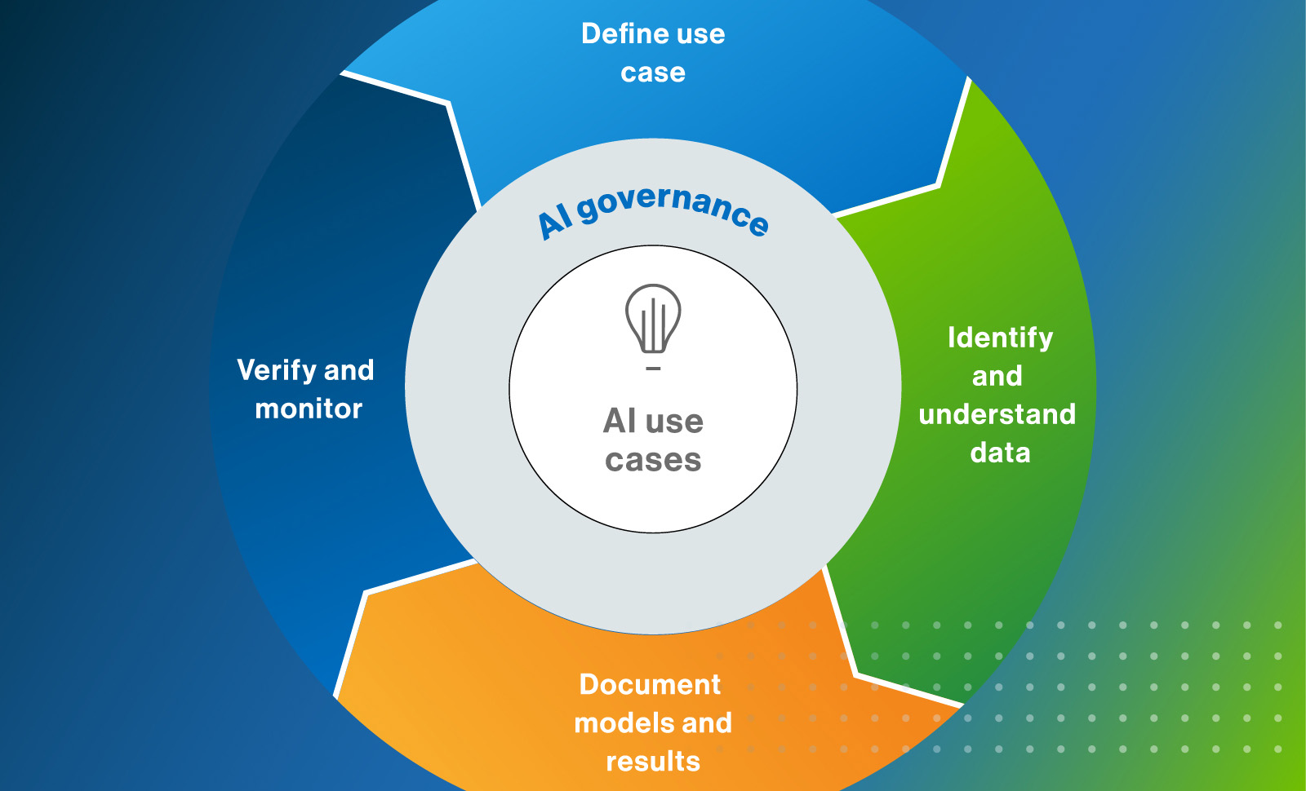
Governance and Security
• Centralized identity federation for agents
• Zero Trust governance for cross-platform actions
• Immutable audit records for compliance
• Behavioral analytics to detect lateral movement
A comprehensive AI governance framework illustrating the lifecycle of secure AI deployment.
Notes:
Now, let's look at the security layer shown in this diagram. In a multi-vendor environment, traditional security isn't enough. We need what's called the Agentic Trust Framework. This involves verifying the identity and behavior of every agent at every step. Because agents can now move between systems—like a Salesforce agent triggering a ServiceNow ticket—we must ensure they follow the principle of least privilege. This framework ensures that every action is documented and verified, creating a protective ring around your AI use cases.

Slide 9
03
Performance and Reliability
Benchmarking the Federated Stack
Notes:
Finally, we need to talk about performance. A federated stack is only useful if it's reliable. We're moving away from simple latency metrics and toward a more sophisticated understanding of how these agents behave under pressure.

Slide 10
New Metrics for Agent Success
•
Simulating 'conversation archetypes' for testing
•
Managing token limits and context windows
•
Loose coupling via messaging architectures
•
30% latency reduction in 6G semantic environments
Notes:
Now let's look at the metrics that actually matter. Traditional load testing fails with AI because response times can vary by 15 times for the same query. Instead, we now test 'conversation archetypes'—simulating real-world back-and-forth interactions. We're also seeing a shift toward messaging architectures that allow agents to work asynchronously. This loose coupling prevents a failure in one vendor's API from crashing your entire corporate workflow.

Slide 11
Sources & References
1. What is the Model Context Protocol (MCP)?
6. A Survey of Agent Interoperability Protocols: Model Context ... - arXi...
https://modelcontextprotocol.io/
https://arxiv.org/html/2505.02279v2
2. [PDF] Multi-Agent Collaboration via Evolving Orchestration - OpenRevie...
7. The Agentic Enterprise - The IT Architecture for the AI-Powered Future
https://openreview.net/pdf/9727f658d788c52f49f12ae4b230baf4c...
https://architect.salesforce.com/docs/architect/fundamentals...
3. Anthropic - Company Analysis and Outlook Report (2026)
8. The Agentic Trust Framework: Zero Trust Governance for AI Agents
https://www.deepresearchglobal.com/p/anthropic-company-analy...
https://cloudsecurityalliance.org/blog/2026/02/02/the-agenti...
4. OpenAI leads, Anthropic surges as enterprise AI shifts to multi-model ...
9. A NIST-Based Security Governance Framework for AI Agents
https://www.emarketer.com/content/openai-leads--anthropic-su...
https://techcommunity.microsoft.com/blog/microsoftdefendercl...
5. Enterprises prefer Anthropic's AI models over anyone ... - TechCrunch
10. NIST's AI Agent Standards Initiative - Jones Walker LLP
https://techcrunch.com/2025/07/31/enterprises-prefer-anthrop...
https://www.joneswalker.com/en/insights/blogs/ai-law-blog/ni...
Full article with all citations available on the blog
Notes:
For those of you who want to dive deeper into the technical specs, here are the primary sources we used for this presentation. I highly recommend checking out the official MCP documentation and the Cloud Security Alliance's blog on the Agentic Trust Framework. These documents provide the blueprints for the systems we've discussed today.

Slide 12
The enterprise AI standard has shifted from monolithic vendor lock-in to federated agent architectures orchestrated through open protocols like MCP, prioritizing interoperability and governance over single-model performance.
Start building your multi-vendor strategy today
Like & Subscribe | Prolific Blog
Notes:
In summary, the 2026 enterprise isn't defined by which model it uses, but by how well it orchestrates them. By adopting open protocols like MCP and focusing on a robust governance layer, you can build an AI stack that is flexible, secure, and high-performing. If you found this breakdown helpful, please like the video, subscribe to the channel, and check out the full blog post linked in the description. Thanks for watching!

