Slide 1
World Models in 3D Workflows
The Next Frontier for Generative AI
February 23, 2026 | Prolific Blog
Notes:
Welcome everyone. Today we are diving into a massive shift in the AI landscape: the transition from flat 2D images to fully realized 3D world models. While tools like DALL-E have amazed us, the industry is now moving toward spatial intelligence that understands depth, persistence, and physical reality. Let's explore how this evolution is redefining professional design and engineering.

Slide 2
01
The Evolution from 2D to 3D
Beyond Flat Image Synthesis
Notes:
To start, we need to understand why 2D diffusion models, as impressive as they are, aren't enough for professional 3D workflows. We are moving from pattern matching on pixels to true spatial reasoning. This section covers the architectural shift required to make AI understand the world as a three-dimensional space.

Slide 3
Limitations of 2D Diffusion
•
Lacks true geometric relationship between views
•
Inconsistent results when changing camera angles
•
Operates on pixel grids rather than 3D structures
•
Fails to maintain object permanence
Notes:
Building on the current state of AI, 2D diffusion models have a major 'consistency' problem. If you ask for the north side of a building and then the south side, a 2D model gives you two unrelated structures because it doesn't 'know' the building exists in 3D. This lack of spatial reasoning is a dealbreaker for industries like CAD, gaming, and autonomous vehicles where geometric precision is mandatory.

Slide 4
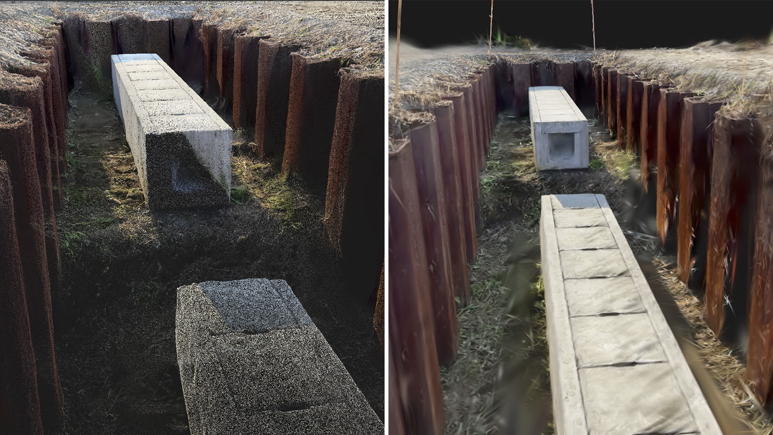
The Building Blocks of 3D
• NeRFs: Continuous volumetric representations
• Gaussian Splatting: Explicit 3D primitives
• Shift from point clouds to photorealistic renders
Point cloud reconstruction vs. photorealistic Gaussian Splatting render.
Notes:
Now, let's look at the actual tech making 3D AI possible. On the left of this image, you see a traditional, grainy point cloud, but on the right is a Gaussian Splatting render. While Neural Radiance Fields or NeRFs offer high quality, Gaussian Splatting has become a favorite for real-time work because it can hit over 90 frames per second. These technologies are the bridge between raw data and the interactive environments we need.

Slide 5
“
The transition from 2D visual perception to 3D spatial cognition represents a fundamental rethinking of how generative AI systems represent and reason about physical space.
— World Models in 3D Workflows Article
Notes:
It is important to emphasize that this isn't just about adding a third dimension to an image. As the article notes, we are moving toward 'spatial cognition.' A true world model understands that an object still exists even when it's behind a wall, and it understands how light and physics should behave as you move through a scene.

Slide 6
02
Industry Integration
World Labs, Autodesk, and Professional CAD
Notes:
Now that we understand the tech, let's look at how it's being used in the real world. The partnership between World Labs and Autodesk is a prime example of how generative AI is meeting professional engineering. This isn't just a research project; it's a $200 million investment into the future of design.

Slide 7
Bridging AI and Professional CAD
•
Neural representations meet parametric modeling
•
Rapid conceptual exploration without constraints
•
Bidirectional translation between AI and BREP data
•
Preserving manufacturing rigor in AI workflows
Notes:
Building on that partnership, the goal here is to combine the 'fluidity' of AI with the 'precision' of CAD. Designers can use World Labs to quickly generate 3D concepts from text, then translate those neural shapes into the exact parametric models needed for manufacturing. It solves the tension between early-stage creative freedom and late-stage engineering requirements.

Slide 8
The Simulation Revolution
•
Simulating complex physics (e.g., robots in debris)
•
Real-time collaborative virtual environments
•
Reduced iteration costs in Aero and Auto sectors
•
Data privacy: No sharing of proprietary design data
Notes:
Moving further into the lifecycle, world models are transforming Product Lifecycle Management or PLM. We can now simulate robots performing complex tasks in messy, real-world environments before a single physical prototype is built. Crucially, these partnerships are being built with strict data privacy, ensuring that sensitive proprietary designs aren't used to train public models.

Slide 9
03
Hardware Realities
The Infrastructure of 3D Inference
Notes:
All of this software innovation hits a very real wall: hardware. Running 3D world models requires massive computational power. In this final section, we'll look at the 'GPU wars' and the specialized silicon being built to handle the demands of spatial intelligence.

Slide 10
The GPU Architecture Wars
•
NVIDIA dominance via CUDA and Tensor cores
•
AMD's struggle with ecosystem maturity (ROCm)
•
High VRAM demands: 140GB+ for large world models
•
Rise of specialized neural rendering accelerators
Notes:
When we look at the hardware landscape, NVIDIA is currently the undisputed king because of the CUDA ecosystem. 3D world models are memory-hungry; a 70-billion parameter model can require 140GB of VRAM just for inference. While AMD has the raw power, the software stack for 3D AI is still catching up, leading to a surge in specialized chips designed specifically for volumetric rendering.

Slide 11
Sources & References
1. Diffusion models for 3D generation: A survey
6. SS4D: Native 4D Generative Model via Structured Spacetime Latents
https://www.sciopen.com/article/10.26599/CVM.2025.9450452
https://arxiv.org/html/2512.14284v1
2. 4D Latent World Model for Robot Planning | OpenReview
7. Diffusion Models in 3D Vision: A Survey - arXiv
https://openreview.net/forum?id=iB9qx28gv4
https://arxiv.org/html/2410.04738v2
3. NeurIPS Poster 4D-LRM: Large Space-Time Reconstruction Model ...
8. From 2D to 3D Cognition: A Brief Survey of General World Models
https://neurips.cc/virtual/2025/poster/120016
https://arxiv.org/html/2506.20134v1
4. Genie 3: A new frontier for world models
9. World Labs lands $1B, with $200M from Autodesk ... - Yahoo Finance
https://deepmind.google/blog/genie-3-a-new-frontier-for-worl...
https://finance.yahoo.com/news/world-labs-lands-200m-autodes...
5. [PDF] Next-scale Latent Prediction for Continuous Spatio-Temporal Worl...
10. World Labs lands $1B, with $200M from Autodesk, to ... - TechCrunch
https://openreview.net/pdf/ffd52fdf7b0675968b9cec1e5f82e24bf...
https://techcrunch.com/2026/02/18/world-labs-lands-200m-from...
Full article with all citations available on the blog
Notes:
For those who want to dive deeper into the technical papers or the business details, here are the primary sources used for this presentation. These include the latest surveys on 3D diffusion and the official announcements regarding the World Labs and Autodesk collaboration.

Slide 12
The transition from 2D diffusion to 3D world models represents a fundamental shift from pattern matching to spatial reasoning, enabling persistent, physically-consistent environments that will redefine professional CAD and simulation workflows.
Join the 3D Generative Revolution
Like & Subscribe | Prolific Blog
Notes:
To wrap up, the shift from 2D to 3D world models is the next great frontier for AI. It’s going to change how we design, build, and interact with the physical world. Thank you for watching! If you found this helpful, please like and subscribe, and let me know in the comments how you think spatial intelligence will impact your industry. See you in the next one!

