Slide 1
D4RT and the 4D Vision Frontier
Teaching AI Temporal-Spatial Awareness
February 19, 2026 | Prolific Blog
Notes:
Welcome everyone. Today we are diving into a massive breakthrough in how machines see the world: D4RT and the shift toward 4D vision. For decades, AI has been trapped in a 'frame-by-frame' mindset, but we are finally teaching neural networks to understand the continuous flow of time and space together. Let's explore how this temporal-spatial awareness is redefining the future of robotics and spatial AI.

Slide 2
01
The Evolution of Vision
From Static Frames to Spatiotemporal Understanding
Notes:
To understand where we're going, we first have to look at the limitations of where we've been. Traditional computer vision has essentially functioned like a high-speed slideshow. This section covers why that 'snapshot' approach is failing modern robotics and how Neural Radiance Fields provided the foundation for a better way.

Slide 3
The Limits of Traditional Vision
•
Temporal blindness in static algorithms
•
Disconnected sequences of still images
•
Dynamic objects treated as 'noise'
•
High computational burden of redundant processing
Notes:
Building on the history of vision, traditional systems suffer from what we call 'temporal blindness.' Because they process each frame independently, a robot has to 'rediscover' its environment every millisecond. This makes dynamic objects like walking pedestrians look like a series of unrelated detections, forcing engineers to use complex patches to maintain object identity.

Slide 4
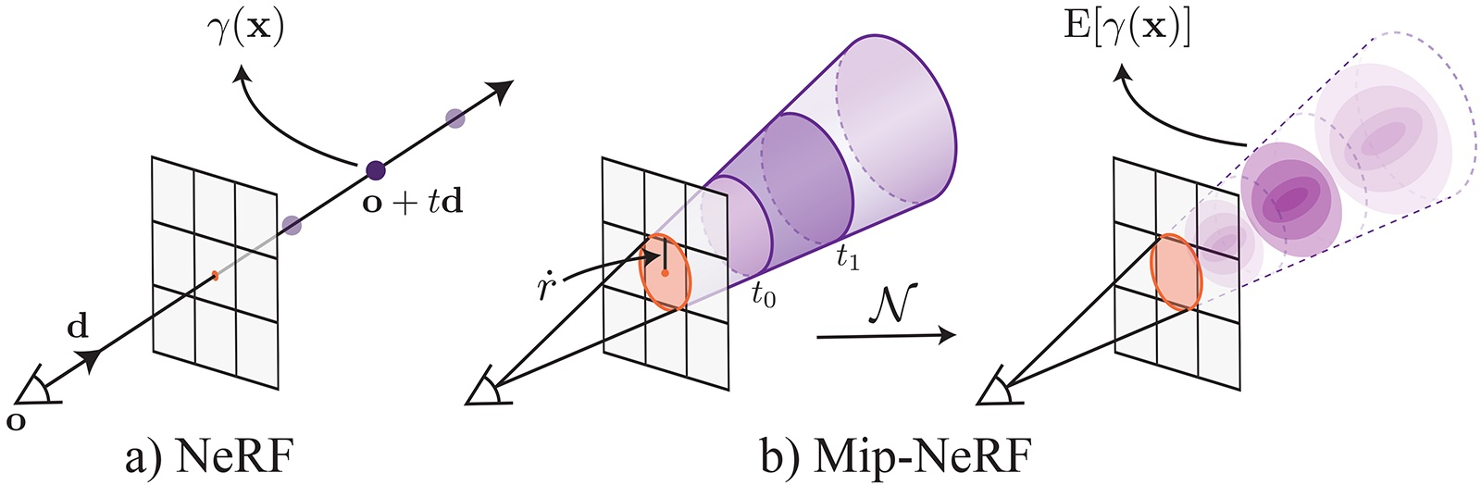
The NeRF Foundation
• Implicit surface reconstruction
• Continuous 5D coordinate functions
• Volumetric rendering vs. discrete meshes
• The bridge from 3D space to 4D spacetime
A comparison of ray casting in standard NeRF versus the conical frustums used in Mip-NeRF.
Notes:
Now, let's look at the technology that changed the game: Neural Radiance Fields, or NeRFs. As you can see in this diagram comparing standard NeRF to Mip-NeRF, we moved away from rigid pixels toward continuous volumetric rendering. This mathematical continuity is what allowed us to start thinking of time as just another dimension to be queried.

Slide 5
“
TiNeuVox completes training in 8 minutes with a storage cost of only 8-MB.
— D4RT Research Data
Notes:
Building on that spatial foundation, the efficiency gains have been staggering. Consider the TiNeuVox framework, which uses time-aware voxels. It can finish training in just eight minutes and fits into a tiny 8-megabyte footprint, proving that 4D awareness doesn't have to mean massive hardware requirements.

Slide 6
02
Architecture and Training
Integrating Temporal Dynamics
Notes:
So how does D4RT actually work under the hood? It's not just a faster NeRF; it's a fundamental architectural redesign. In this section, we'll look at how the system integrates temporal dynamics and the specific training methods used to keep everything consistent.

Slide 7
The D4RT Architecture
•
4D coordinate inputs (x, y, z, t)
•
Unified Transformer for global scene representation
•
Hierarchical temporal feature interpolation
•
Tiny coordinate deformation networks for motion
Notes:
Now let's look at the core architecture, where D4RT treats time as a first-class coordinate alongside X, Y, and Z. By using a unified Transformer, the system can look at an entire video clip at once rather than frame-by-frame. This allows it to understand both the flutter of a flag and the slow shift of shadows over a whole day.

Slide 8
Training for Consistency
•
Temporal consistency losses to prevent flickering
•
Time-reversal and speed-variation augmentation
•
Multi-scale temporal supervision
•
Learning physical priors like momentum
Notes:
Moving from architecture to training, the goal is to make motion look physically plausible. D4RT uses specialized loss functions that penalize 'flickering' or jerky movements. By training on video sequences with time-reversal and varying speeds, the network actually learns the 'physics' of how objects move through the world.

Slide 9
03
D4RT in Practice
Performance and Real-World Robotics
Notes:
Theory is great, but how does it perform in the real world? In this final section, we'll compare D4RT to traditional SLAM systems and look at how it's being used on actual robotic hardware today.

Slide 10
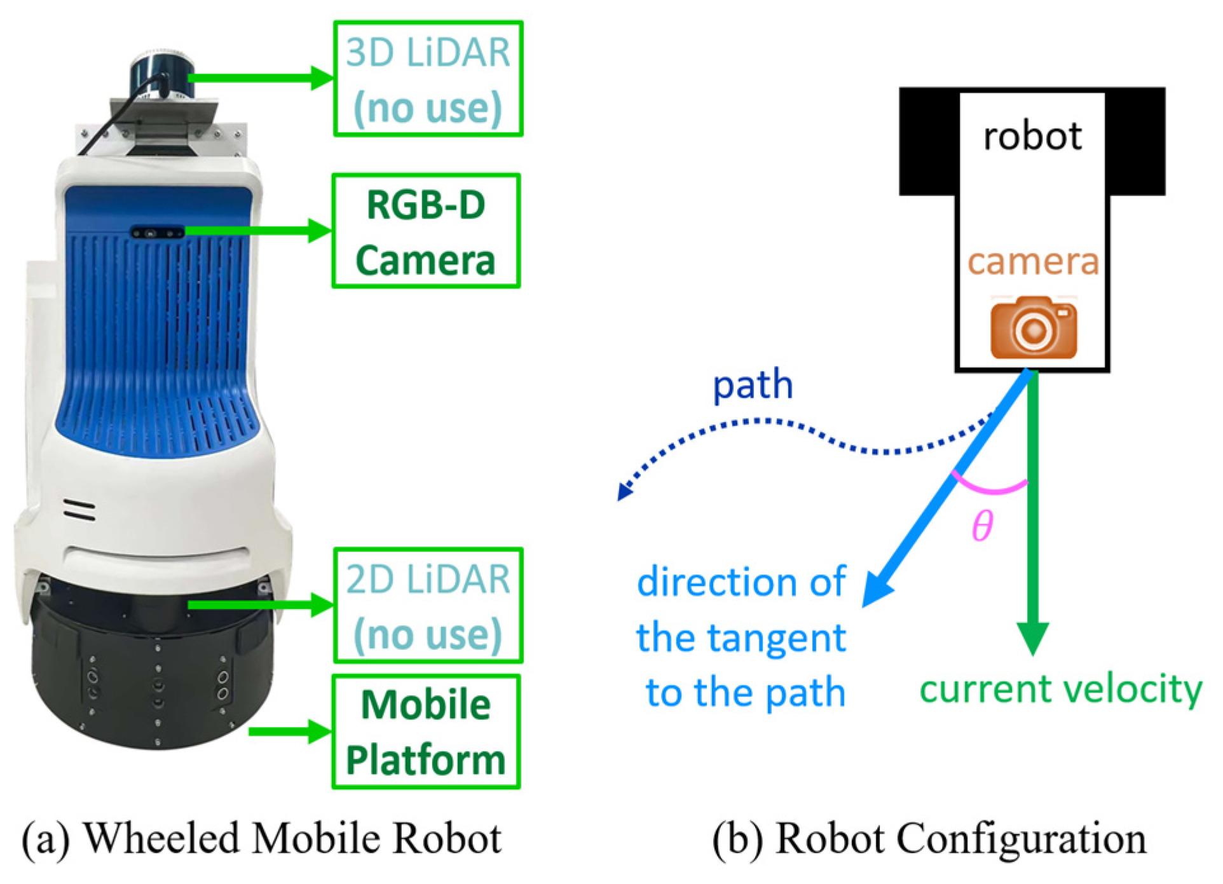
D4RT vs. Traditional SLAM
• 120x speedup over previous state-of-the-art
• Pose estimation at 200+ FPS
• Unified encoder-decoder Transformer
• Native handling of dynamic obstacles
A wheeled mobile robot platform using dynamic path planning.
Notes:
When we compare D4RT to traditional SLAM, the results are clear. As seen in this robotic navigation diagram, D4RT allows for much more fluid path planning. It achieves a 120x speedup over previous methods, processing a one-minute video in just five seconds, which is essential for robots moving in unpredictable environments.

Slide 11
Sources & References
1. “Fast Dynamic Radiance Fields with Time-Aware Neural ...
6. D4RT: Unified, Fast 4D Scene Reconstruction & Tracking
https://history.siggraph.org/learning/fast-dynamic-radiance-...
https://deepmind.google/blog/d4rt-teaching-ai-to-see-the-wor...
2. [PDF] Enhancing Autonomous Vehicle Perception with City-Scale NeRF ...
7. Temporal Interpolation Is All You Need for Dynamic Neural ... - arXiv
https://www.ecva.net/papers/eccv_2024/papers_ECCV/papers/099...
https://arxiv.org/abs/2302.09311
3. Temporal Interpolation Is All You Need for Dynamic Neural ... - CVPR
8. NeRFs in Robotics: A Survey - arXiv.org
https://cvpr.thecvf.com/virtual/2023/poster/21176
https://arxiv.org/html/2405.01333v2
4. [PDF] Temporal Interpolation Is All You Need for Dynamic Neural ...
9. D4RT: Efficient Dynamic 4D Reconstruction - Emergent Mind
https://openaccess.thecvf.com/content/CVPR2023/papers/Park_T...
https://www.emergentmind.com/papers/2512.08924
5. System Requirement — Open Edge Platform Documentation - Intel
10. Neural Radiance Field in Autonomous Driving: A Survey - arXiv.org
https://docs.openedgeplatform.intel.com/dev/edge-ai-suites/r...
https://arxiv.org/html/2404.13816v1
Full article with all citations available on the blog
Notes:
Building on this presentation, here are the primary sources that informed our deep dive. The work from DeepMind on D4RT and the TiNeuVox framework are particularly vital for anyone looking to implement these 4D voxel grids in their own AI projects.

Slide 12
D4RT shifts computer vision from frame-by-frame analysis to unified 4D spatiotemporal modeling, enabling 120x faster processing and native temporal awareness for real-time robotics.
Beyond the Static Frame
Like & Subscribe | Prolific Blog
Notes:
In summary, D4RT represents a massive leap toward machines that truly understand the flow of our world. By moving beyond static frames to unified 4D representations, we are unlocking a new era of predictive, reliable robotics. If you enjoyed this deep dive, make sure to subscribe for more AI breakthroughs and check out the full blog post linked below. Thanks for watching!

