Slide 1
Scaling AI Infrastructure: From Blackwell to Rubin GPUs
The Architectural Evolution of the Trillion-Parameter Era
February 21, 2026 | Prolific Blog
Notes:
Welcome everyone. Today we are diving into the massive shift occurring in AI compute as we move from NVIDIA's Blackwell architecture toward the upcoming Rubin GPUs. We're going to explore how silicon design, networking, and data center cooling are all being reinvented to support models with trillions of parameters. By the end of this session, you'll understand why the next two years represent the most significant infrastructure build-out in the history of computing.

Slide 2
01
Chapter 1: The Next Generation of AI Compute
Blackwell and Rubin Architectures
Notes:
To start, let's look at the silicon itself. The transition from Blackwell to Rubin isn't just a speed boost; it's a fundamental change in how GPUs are built. We are moving away from single-chip designs toward massive, multi-die systems that act as a single computational engine.

Slide 3
Blackwell: Breaking the 200 Billion Transistor Barrier
•
208 billion transistors in a dual-die design
•
10 TB/s high-bandwidth chip-to-chip interconnect
•
5th Gen Tensor Cores with native FP4 support
•
30X performance increase for GPT-MoE training
Notes:
Building on that architectural shift, Blackwell is NVIDIA's answer to the 'memory wall.' By using a dual-die approach, they've managed to pack 208 billion transistors into a single package that functions as one unit. This design allows for a staggering 30-fold increase in performance for Mixture-of-Experts models compared to the previous Hopper generation.

Slide 4
Rubin: 2026's Answer to Exascale AI
•
Next-gen NVLink for cluster-wide coherent memory
•
Dynamic precision scaling between FP16, INT8, and INT4
•
Enhanced sparsity acceleration for real-time inference
•
Optimized for multimodal vision-language models
Notes:
Looking ahead to 2026, the Rubin architecture takes things even further by focusing on cluster-level coherence. Instead of just scaling a single GPU, Rubin allows an entire rack to behave like one giant processor with a unified address space. It also introduces dynamic precision scaling, allowing the hardware to automatically switch between formats like INT4 and FP16 depending on the specific task the AI is performing.

Slide 5
02
Chapter 2: Building the Million-GPU Data Center
Infrastructure and Interconnect
Notes:
Now that we've covered the chips, we need to talk about the 'pipes' and 'power' that keep them running. Scaling to a million GPUs requires a total rethink of networking and thermal management.

Slide 6
“
The NVIDIA Spectrum-X Ethernet platform improves network performance by 1.6x and maintains 95% efficiency in deployments exceeding 100,000 GPUs.
— NVIDIA Technical Documentation
Notes:
One of the biggest hurdles in hyperscale AI is network congestion. Traditional Ethernet often sees its efficiency collapse under heavy AI workloads, but the Spectrum-X platform changes that. It uses adaptive routing to hit 95% efficiency even when you are connecting over 100,000 GPUs in a single cluster.

Slide 7
Thermal and Power Infrastructure
•
120kW+ rack densities make air cooling obsolete
•
GB200 NVL72 generates heat equivalent to 25 ovens
•
Direct liquid cooling provides 30% better power utilization
•
Water requirements projected to increase 170% by 2030
Notes:
As networking improves, power density is skyrocketing. We are now seeing racks that pull over 120 kilowatts, which is roughly ten times the density of a traditional server rack. At this level, air cooling simply doesn't work anymore, forcing a transition to direct liquid cooling to prevent the hardware from melting under its own computational load.

Slide 8
03
Chapter 3: The Future of AI Infrastructure
Economics, Environment, and Evolution
Notes:
Finally, let's look at the big picture. What does this massive build-out cost, and what is the impact on our planet?

Slide 9
The Economics of Hyperscale AI
•
100k GPU clusters cost over $4 billion in server CapEx
•
Individual GB200 NVL72 systems priced at ~$3 million
•
Electricity costs can exceed hardware investment in years
•
Rapid depreciation due to one-year release cycles
Notes:
The numbers here are staggering. Tech giants like Meta and Microsoft are spending tens of billions of dollars every quarter on this infrastructure. However, the hardware is only part of the cost; the electricity required to run a 100,000 GPU cluster can actually exceed the initial multi-billion dollar hardware investment within just a few years.

Slide 10
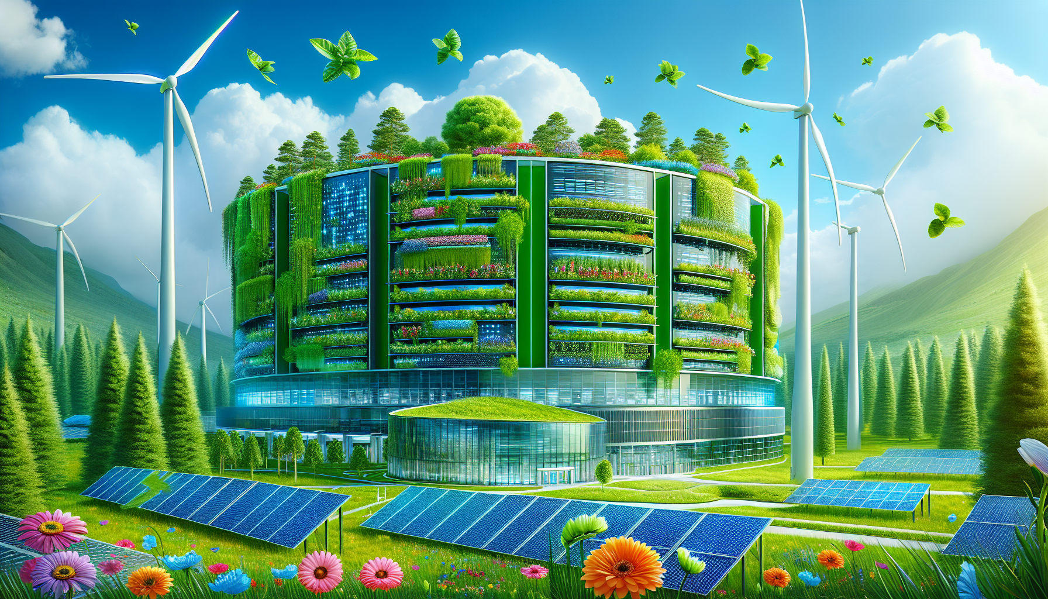
Environmental Impact and Sustainability
• AI facilities consuming power equivalent to small cities
• Microsoft restarting Three Mile Island nuclear plant
• Projected 123GW US data center demand by 2035
• Shift toward natural cooling in regions like Greenland
A futuristic, sustainable data center powered by integrated solar panels and wind turbines.
Notes:
This energy hunger is driving some radical solutions. As you can see in this conceptual design, the future of AI depends on integrating renewable energy directly into the data center footprint. We're already seeing this in the real world, with Microsoft literally restarting a nuclear power plant just to keep their AI services online.

Slide 11
Sources & References
1. The NVIDIA Spectrum Ethernet Platform - Networking
6. Can US infrastructure keep up with the AI economy? - Deloitte
https://www.nvidia.com/en-us/networking/products/ethernet/
https://www.deloitte.com/us/en/insights/industry/power-and-u...
2. Quartet: Native FP4 Training Can Be Optimal for Large ...
7. Nvidia Rubin revealed as Blackwell successor, powerful Vera CPU ...
https://neurips.cc/virtual/2025/poster/117521
https://www.tomshardware.com/pc-components/gpus/nvidia-rubin...
3. Introducing NVFP4 for Efficient and Accurate Low- ...
8. Next Gen Data Center CPU | NVIDIA Vera CPU
https://developer.nvidia.com/blog/introducing-nvfp4-for-effi...
https://www.nvidia.com/en-us/data-center/vera-cpu/
4. [PDF] Proposal - "802.3 Ethernet Interconnect for AI" Assessment - IEE...
9. FP4 Tensor Cores in Modern GPUs
https://www.ieee802.org/3/ad_hoc/ngrates/public/25_01/dambro...
https://www.emergentmind.com/topics/fp4-tensor-cores
5. [PDF] Supermicro NVIDIA GB200 NVL72 Datasheet
10. Tensor Cores: Versatility for HPC & AI
https://www.supermicro.com/datasheet/datasheet_SuperCluster_...
https://www.nvidia.com/en-us/data-center/tensor-cores/
Full article with all citations available on the blog
Notes:
For those who want to dive deeper into the technical specifications, I've compiled the primary sources used for this analysis. These include official NVIDIA whitepapers and independent infrastructure reports from Deloitte and the IEEE.

Slide 12
Scaling to trillion-parameter AI models requires a holistic evolution where silicon architecture (Blackwell/Rubin), networking (Spectrum-X), and thermal management (Liquid Cooling) function as a single, integrated system rather than independent components.
Stay Ahead of the AI Infrastructure Curve
Like & Subscribe | Prolific Blog
Notes:
In summary, the leap from Blackwell to Rubin represents a total transformation of the data center. From liquid cooling to unified memory fabrics, the way we build computers is changing forever. If you found this breakdown helpful, please hit the like button and subscribe for more technical deep dives. Thanks for watching, and I'll see you in the next one!

