Slide 1
Autonomous Agents as the New SaaS
Engineering for DSLMs and Data Contracts
March 08, 2026 | Prolific Blog
Notes:
Welcome everyone. Today we are exploring a fundamental shift in the software industry: the transition from human-centric dashboards to autonomous agent ecosystems. We're moving into an era where the primary consumer of your software isn't a person with a mouse, but an AI agent with an API key. Let's dive into how this changes everything from engineering to economics.

Slide 2
01
Chapter 1: The Paradigm Shift
From Dashboards to Autonomous Agents
Notes:
To start, we need to understand why the traditional SaaS model is under threat. We are witnessing the 'Death of the Dashboard' as AI agents take over the workflows that humans used to manage manually.

Slide 3
The Death of the Dashboard
•
Agents need APIs, not visual interfaces
•
Shift from human labor to machine execution
•
The rise of machine-readable manifests
•
Existential risk for dashboard-first architectures
Notes:
Building on that shift, think about the traditional enterprise dashboard. It was built for human eyes, but an AI agent finds it useless. Within just six months of the Model Context Protocol release, we saw over 22,000 tagged repositories on GitHub, signaling that developers are racing to build for machine consumers. If your core functionality is trapped behind a UI, you're essentially invisible to the next generation of automated workflows.

Slide 4
“
Within six months of the Model Context Protocol's release, over 22,000 MCP-tagged repositories were created on GitHub, yet fewer than 5% contain functional server implementations.
— Industry Analysis, 2026
Notes:
Now, look at this striking statistic. While the interest in agentic protocols like MCP is massive, the actual implementation is lagging. This represents a huge opportunity for engineers who can move beyond the 'hype' and actually build functional, agent-ready server implementations.

Slide 5
The New Economics of SaaS
•
Per-seat pricing fails with AI agents
•
Infrastructure costs growing 4x faster than revenue
•
Token-based billing as an intermediate step
•
The ultimate goal: Outcome-based pricing
Notes:
Transitioning from architecture to money, the per-seat model is effectively broken. A single agent can do the work of 20 people but only counts as one 'seat,' while consuming thousands of times more compute. We are moving toward token-based or outcome-based models where you pay for the problem solved, not the number of people logged in.

Slide 6
02
Chapter 2: Engineering the Interface
DSLMs and Data Contracts
Notes:
Now that we've established the 'why,' let's talk about the 'how.' Engineering for agents requires a much higher level of precision than engineering for humans.

Slide 7
Domain Specific Language Models (DSLMs)
•
General LLMs lack vertical API precision
•
DSLMs offer lower latency and lower cost
•
Hybrid architecture: DSLM + RAG
•
Muscle memory for domain-specific edge cases
Notes:
Moving into the model layer, general-purpose LLMs are often too 'broad' for specific technical tasks. By fine-tuning smaller, domain-specific models, we get better reliability and lower costs. A 7-billion parameter model focused entirely on your specific API will consistently outperform a massive generalist model when it comes to executing complex, error-free transactions.

Slide 8
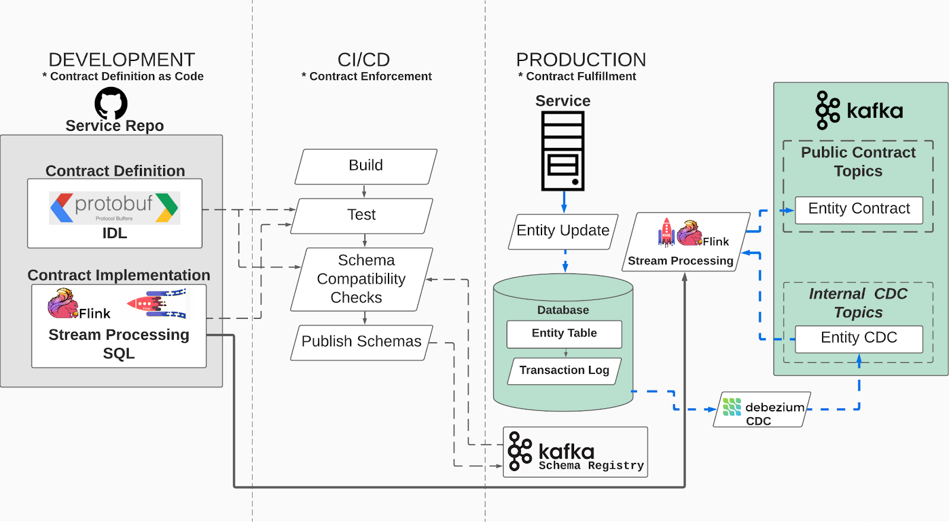
Hardening the Interface
• Deterministic interfaces for AI consumers
• Explicit schemas (OpenAPI, JSON Schema)
• Runtime and static validation layers
• Semantic versioning to prevent cascading failures
The lifecycle of a data contract from IDL to production fulfillment.
Notes:
Building on the model's intelligence, we need to provide it with rigid guardrails. As you can see in this architectural diagram, a data contract must be enforced from the development stage all the way through production. Because AI agents are non-deterministic, the interfaces they touch must be absolutely deterministic to prevent catastrophic system failures.

Slide 9
03
Chapter 3: Governance and Security
Securing the Agentic Future
Notes:
Finally, we have to address the risks. When agents act autonomously, who is responsible, and how do we control their access?

Slide 10
IAM for Autonomous Entities
•
Capability-based access control
•
Temporal and contextual permissions
•
Traceable delegation graphs
•
Revocable authority for non-human actors
Notes:
Now let's look at Identity and Access Management. Traditional RBAC is failing because agents don't have biometrics or passwords. We need a system of 'delegated authority' where agents carry cryptographically verifiable tokens that expire by default. If an agent is negotiating a million-dollar deal at 3 AM, we need to know exactly who authorized it and be able to revoke that power instantly.

Slide 11
Sources & References
1. Making REST APIs Agent-Ready: From OpenAPI to Model Context ...
6. IAM Framework: Master User Access Complexity - Okta
https://arxiv.org/html/2507.16044v2
https://www.okta.com/identity-101/identity-and-access-manage...
2. Digital technologies and data-driven delay management process for ...
7. What Is Identity and Access Management (IAM)? - Palo Alto Networks
https://www.frontiersin.org/journals/built-environment/artic...
https://www.paloaltonetworks.com/cyberpedia/what-is-identity...
3. Reducing hallucinations in LLM agents with a verified semantic ...
8. Top Advantages of Small Language Models in Vertical Domains - 36氪
https://aws.amazon.com/blogs/machine-learning/reducing-hallu...
https://eu.36kr.com/en/p/3538376336530306
4. [PDF] Developer's Guide to AI-Ready APIs - Postman
9. Stop AI Agent Hallucinations: 4 Essential Techniques
https://voyager.postman.com/pdf/developers-guide-to-ai-ready...
https://dev.to/aws/stop-ai-agent-hallucinations-4-essential-...
5. AI agents behave like users, but don't follow the same rules
10. AI Hallucination: Causes and Consequences Explained - CX Today
https://www.helpnetsecurity.com/2026/02/09/securing-autonomo...
https://www.cxtoday.com/customer-analytics-intelligence/ai-h...
Full article with all citations available on the blog
Notes:
For those who want to dive deeper into the technical specs, here are the primary sources we've referenced. I highly recommend checking out the MCP whitepaper and the latest research on agent-ready REST APIs.

Slide 12
The future of SaaS lies in replacing human-centric dashboards with agent-ready APIs, powered by domain-specific models and protected by strict, machine-readable data contracts.
Adapt or Be Bypassed
Like & Subscribe | Prolific Blog
Notes:
To wrap up, the shift from dashboards to agents isn't just a trend—it's a complete re-engineering of the SaaS industry. If you want your software to remain relevant, you must start building for machine consumers today. Thanks for watching! Make sure to subscribe for more deep dives into the future of engineering, and check out the full blog post in the description.

