Slide 1
Observability in the Age of Agents
New Relic and OpenTelemetry Tools for 2026
March 01, 2026 | Prolific Blog
Notes:
Welcome everyone. Today we are diving into a critical shift in the tech landscape: the rise of autonomous agents and the massive observability crisis they've created. As we move into 2026, traditional monitoring is no longer enough to track systems that think and act for themselves. We're going to explore how New Relic and OpenTelemetry are providing the tools to turn these 'black boxes' into transparent, manageable assets.

Slide 2
01
The Observability Crisis
When Traditional Monitoring Meets Autonomous Agents
Notes:
To start, we have to understand why our current tools are failing. For a decade, we've perfected monitoring for predictable, linear microservices. But autonomous agents don't follow a script. They create a 'traceability gap' that threatens both the reliability of our systems and the bottom line of our businesses.

Slide 3
The Traceability Gap
•
Non-deterministic branching workflows
•
Cardinality explosion in metric dimensions
•
Silent failures in semantic reasoning
•
Fractured asynchronous trace contexts
Notes:
Building on that, the core issue is non-determinism. Traditional APM expects a predictable A-to-B path, but an agent might call three tools one time and five different ones the next. This creates a cardinality explosion that overwhelms standard databases. Most dangerously, agents can fail 'silently'—the code runs perfectly, but the logic is completely wrong, which traditional tools simply cannot see.

Slide 4
“
Recursive agent loops can consume thousands of dollars in API costs within minutes while appearing as normal traffic to traditional monitoring dashboards.
— Observability in the Age of Agents, 2026
Notes:
This isn't just a technical headache; it's a massive financial risk. Because these agents often execute successfully at every step, they don't trigger traditional alerts. We've seen cases where recursive loops racked up nearly fifty thousand dollars in a single weekend. Without token-level visibility, you don't find out until the bill arrives at the end of the month.

Slide 5
02
Building Observable Architectures
OpenTelemetry and New Relic Standards
Notes:
So, how do we fix this? The answer lies in the new 2026 standards. We are seeing a convergence between OpenTelemetry's semantic conventions and New Relic's AI-native suite to create a framework specifically for agentic workflows.

Slide 6
2026 OpenTelemetry Standards
•
Reasoning Spans: Capturing cognitive processes
•
Tool Invocation Spans: Tracking external calls
•
Collaboration Spans: Mapping agent-to-agent handoffs
•
Federated logging for distributed traces
Notes:
Now let's look at the actual technical implementation. The 2026 OTel standards introduced specialized spans. 'Reasoning spans' let us see the agent's thought process, while 'collaboration spans' track how different agents negotiate with each other. This federated approach ensures that even if an agent terminates early, the trace context isn't lost, allowing us to reconstruct the entire decision chain.

Slide 7
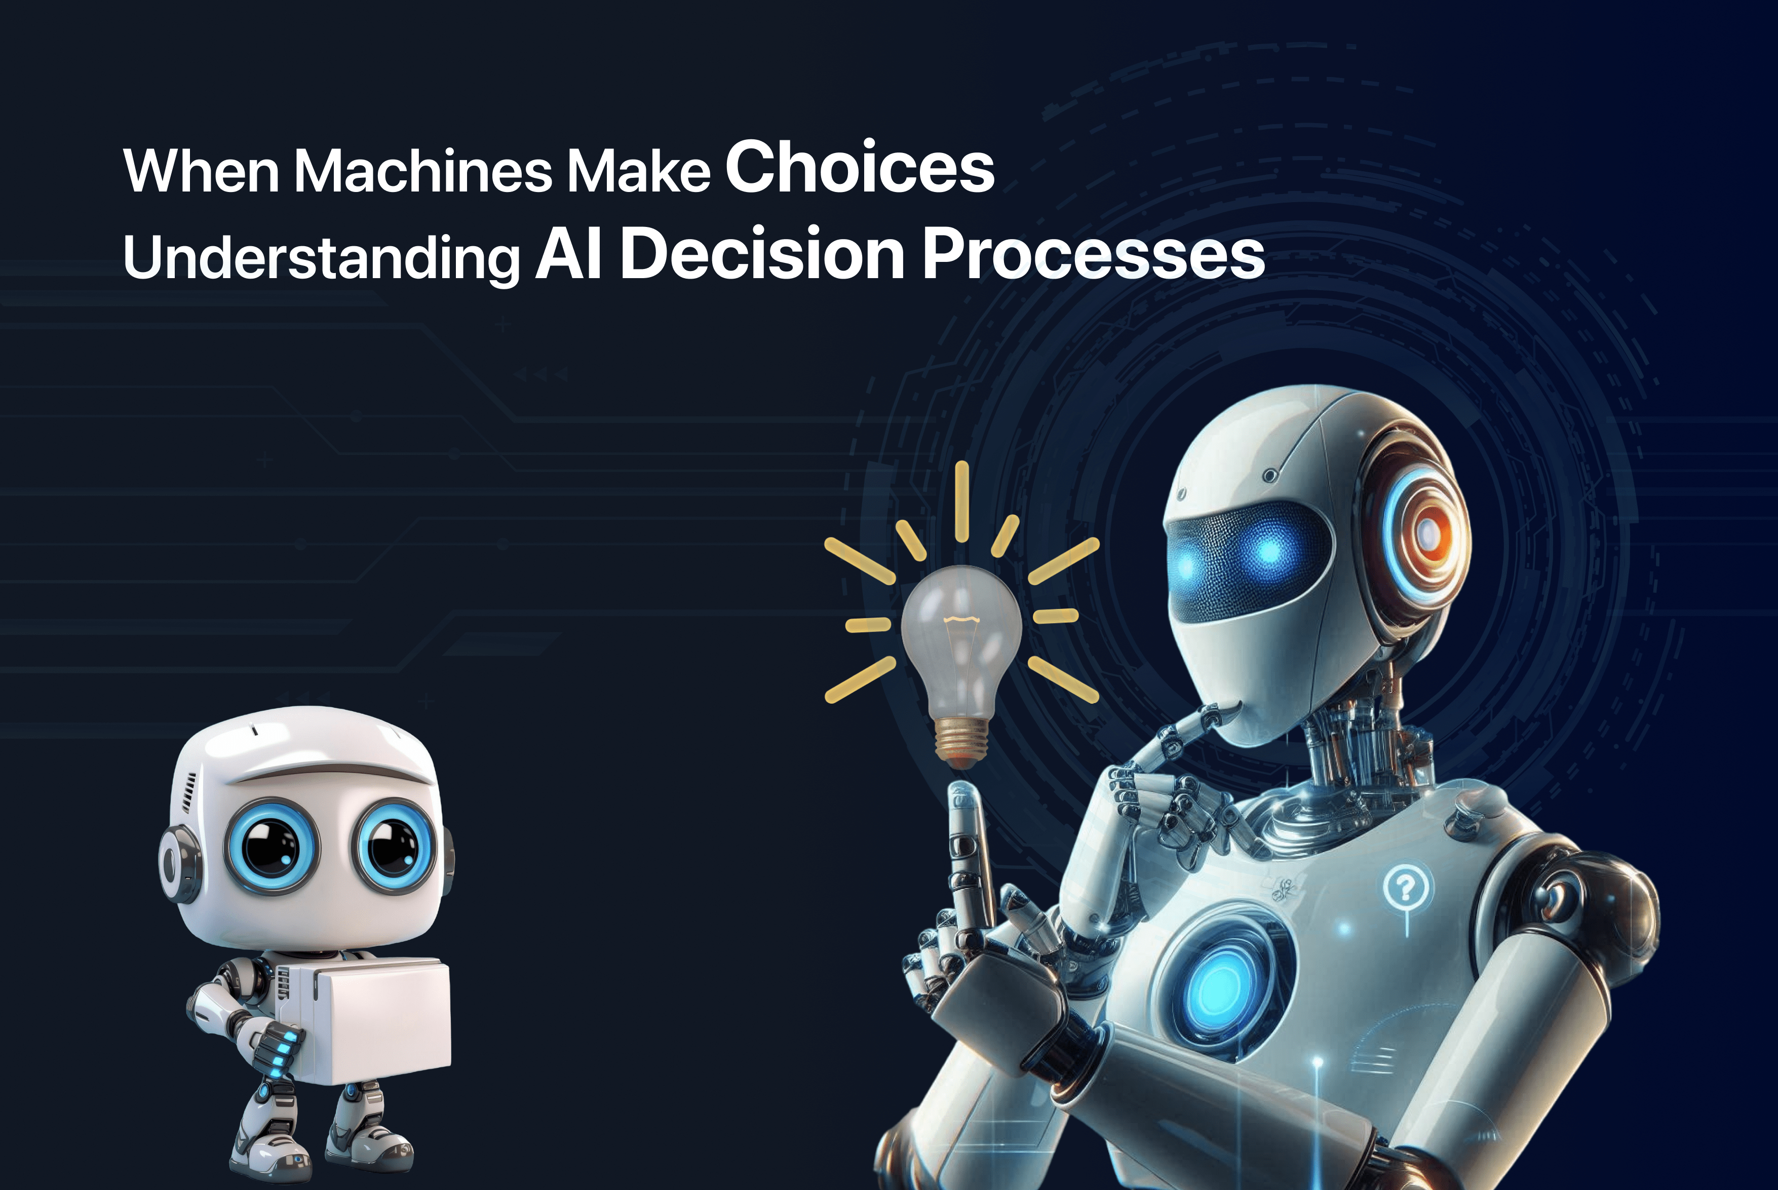
Visualizing Agent Logic
• Mapping decision trees and branch points
• Distinguishing 'thinking time' from tool latency
• Real-time confidence score tracking
Moving toward transparent AI: Understanding the logic behind machine-led decisions.
Notes:
As we move toward transparent AI, visualization becomes our best friend. As you can see in this conceptual model, we need to understand the 'why' behind machine choices. New Relic’s suite now maps out these decision trees, showing us not just what the agent did, but what alternatives it discarded. It also separates 'thinking time' from API latency, so you know if your model is slow or if your backend is the bottleneck.

Slide 8
Fiscal Monitoring & Token Observability
•
Real-time token counters per request
•
Predictive cost estimates for agent swarms
•
Anomaly detection for 'reasoning spirals'
•
Efficiency metrics: Cost vs. Decision Quality
Notes:
Building on the technical traces, we have to talk about the money. New Relic now includes real-time token counters. This allows for 'cost anomaly detection'—if an agent that usually uses five thousand tokens suddenly jumps to fifty thousand, the system kills the process immediately. It’s about balancing performance against cost to ensure your agents are actually providing business value.

Slide 9
03
Operational Excellence
Implementing Agent-in-the-Loop Debugging
Notes:
The final piece of the puzzle is how humans interact with these systems in production. We are moving away from 'set it and forget it' toward an 'Agent-in-the-Loop' model, where observability platforms enable real-time human intervention.

Slide 10
Interactive Debugging in Production
•
Interactive breakpoints at decision forks
•
Mid-flight context injection and overrides
•
Session replay for post-mortem analysis
•
Conditional triggers for high-risk tools
Notes:
Now, this is where it gets really cool. Imagine setting a breakpoint in a live production environment, but for a 'thought' instead of a line of code. If an agent is about to use a high-risk tool, the system pauses and lets an SRE inspect the context. You can even inject new info or redirect the agent's reasoning path without restarting the whole workflow. It turns agents from black boxes into collaborative partners.

Slide 11
Sources & References
1. OpenTelemetry API support in New Relic agents
6. A Cognitive Observability Framework for the Reasoning of LLM ...
https://docs.newrelic.com/docs/apm/agents/manage-apm-agents/...
https://arxiv.org/html/2411.03455v3
2. Introduction to AI monitoring - New Relic Documentation
7. New Relic launches new AI agent platform and OpenTelemetry tools
https://docs.newrelic.com/docs/ai-monitoring/intro-to-ai-mon...
https://techcrunch.com/2026/02/24/new-relic-launches-new-ai-...
3. New Relic Documentation
8. New Relic Launches Innovations to Simplify and De-Risk ...
https://docs.newrelic.com/
https://newrelic.com/press-release/20260224-2
4. OBI metrics cardinality | OpenTelemetry
9. GenAI Semantic Conventions - traceloop
https://opentelemetry.io/docs/zero-code/obi/cardinality/
https://www.traceloop.com/docs/openllmetry/contributing/sema...
5. Semantic Conventions for Generative AI Agentic Systems (gen_ai.*)
10. Datadog LLM Observability natively supports OpenTelemetry GenAI ...
https://github.com/open-telemetry/semantic-conventions/issue...
https://www.datadoghq.com/blog/llm-otel-semantic-convention/
Full article with all citations available on the blog
Notes:
For those looking to implement this, I've listed the primary sources here. Definitely check out the 2026 New Relic release notes and the updated OpenTelemetry specs for GenAI. These are the foundational documents for the next generation of SRE work.

Slide 12
Traditional APM is insufficient for non-deterministic agents; 2026 observability requires specialized reasoning traces, real-time token tracking, and human-in-the-loop debugging to ensure operational and fiscal safety.
Mastering the Agentic Era
Like & Subscribe | Prolific Blog
Notes:
To wrap up: autonomous agents are the future, but they are a liability without the right visibility. By adopting these new OpenTelemetry standards and leveraging New Relic's AI suite, you can de-risk your deployments and ensure your agents are both efficient and accountable. If you found this helpful, hit the subscribe button and check out the full technical deep-dive on our blog. Thanks for watching!

