Slide 1
Nature Redux
Cleaning up our ecosystem, one plant at a time

Slide 2
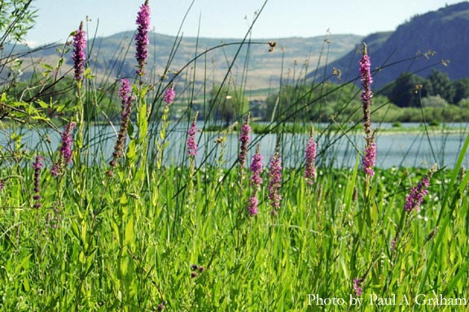
Goal
Target invasive species
Connect with other’s who care
Crowd funding environmental sustainability

Slide 3
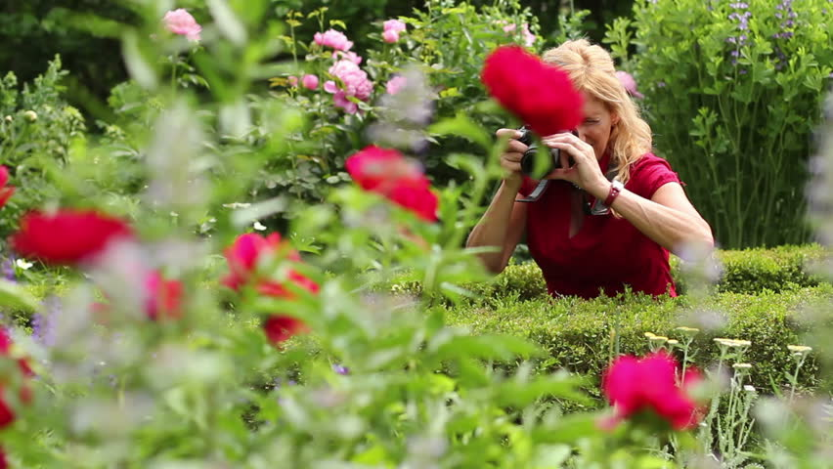
How It Works
User learns about these plants and how to identify and remove them
User uploads reports of invasive plant sightings(where, when, what) via 2 ways:
Hunting for them on social media where unknowing people post them
Seeing them in real life and taking a picture

Slide 4
How It Works
Pictures are taken and analyzed by volunteers
If identified as an invasive species, a report will be posted
Successful Reports will grant the repartee reputation.

Slide 5
How It Works
The user can choose if they want to take care of this report and go to the tagged place to clean up
The user cleans it up, takes a finished picture, and reports that it is cleaned up through the app

Slide 6

Future Innovations
Internal incentive (Cut of ad revenue, “Internet pts”, etc)
Google maps implementation (Pretty Pictures!!!)

Slide 7
Implementation
Park administration can serve as “default” moderators, and use data to maintain sites.
Economics – App will be developed under GPLv2/LGPLv3 copyleft licensing and be developed with free software principles. Once enough people frequent, Google AdSe
Sustainability: Raspberry Pi 2+ (running CentOS 7/Apache/MariaDB) and an internet connection (~$90)
Cost of development: 3 pizzas and beer

