Slide 1

Why adp dealer services chose Angularjs
Brian Garofola

Slide 2
ADP Dealer services
A division of Automatic Data Processing (ADP)
Provide technology to help automotive dealers do business
51% of all US automotive transactions touch an ADP system
Front to back – sales & CRM to finance & insurance to accounting
Publish over 12,000 auto dealer websites
Support digital marketing and online advertising for 11 manufacturers include GM and Volkswagen
Provide an IP telephony solution with over 250k phones deployed
Operate in over 100 countries
Why yes, since you asked, we’re hiring. Visit http://adp-jobs.com

Slide 3

About me
Notes:
-Engineering director at ADP responsible for Core Services and Continuous Delivery of a large, green field application
-Prior to ADP, owned a startup focused on IP video solutions
-Polyglot programmer with experience in C#, Java, JavaScript, Perl, Objective-C, and others

Slide 4
SINGLE PAGE APP ARCHITECTURE
Large-scale, greenfield initiative - ~100 engineers at full tilt
Service oriented architecture – autonomous business components (ABC’s)
Composition – data, service, or user interface – we favor UI
Single page application is a complete app in HTML, CSS, and JavaScript
a single ‘page’ request
Templates on the client
Highly dynamic

Slide 5
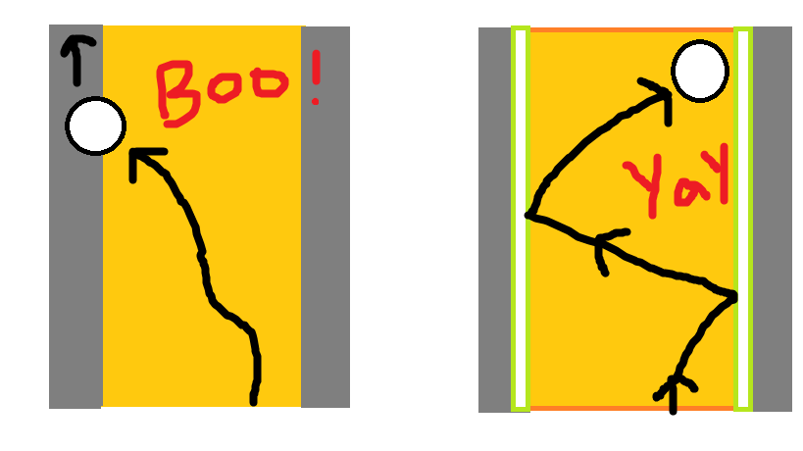
Bowling with bumpers
Notes:
-Always been easy to not adhere to good engineering principles when using JavaScript
-on a large scale, enterprise application, we needed a way to allow engineers autonomy, but not color outside of the lines
-library vs framework
-you call a library, can abstract and swap them out, typically serve a narrow purpose
-develop into a framework, it is weaved throughout your application, harder to migrate away from (Spring is an example)
-CanJS & KnockoutJS are libraries
-EmberJS is an extremely opinionated framework
-Angular is a framework, not so opinionated
-you can use it on just part of a page
-directory structure is not defined for you
-conventions exist for stereotypes such as Controller, Service, etc

Slide 6


Black magic & chicken wings
+
Notes:
-Tell story about the first time Elbrader used this term
-Angular does a lot of magic behind the scenes – promises, data binding, template interpolation, location/deep linking, logging
-Bottom line: Less code – easier to test & more maintainable

Slide 7
REASONS WE CHOSE ANGULARJS
Data Binding | Directives
Dependency Injection | Testability

Slide 8
Data binding
Glue that binds the model with the view
Changes to the model are immediately reflected in the view, and vice versa
Decouple your application layers
Model is the source of truth
Less code -
Easier to test & More maintainable

Slide 9
directives
Ability to teach HTML new tricks with custom DSL’s
Create reusable components
Separation of directive template from code enables testability
Less code -
Easier to test & More maintainable

Slide 10
Dependency Injection
Don’t call us, we’ll call you
Mock dependencies for fast, clean unit tests
Reduce unnecessary, boilerplate object construction code
Less code -
Easier to test & More maintainable

Slide 11
Testability
A built-in framework to mock modules
Provides a test runner (Karma)
Dependency injection creates the seams for mocks, spies
Built-in support for mocking HTTP back-ends
Less code -
Easier to test & More maintainable

Slide 12
grunt
Grunt is a task runner for JavaScript, akin to Maven for Java
Enables a smooth developer workflow
Runs on NodeJS
Common tasks for unit testing, linting, concatenation, minification, LESS/SASS compilation, template caching, and running a local dev server
Less code -
Easier to test & More maintainable

Slide 13
ADVICE
Check out the videos on AngularJS YouTube page at http://youtube.com/angularjs
Watch John Lindquist’s videos at http://egghead.io
Use Grunt – clone angular-grunt-seed project from Srinivas Kusunam (architect @ ADP DS) at http://github.com/skusunam/angular-grunt-seed
Test, test, test – use Jasmine for BDD at https://github.com/pivotal/jasmine/
$provide - Understand Providers, Services, Factories, Values, Constants, etc
Fight the urge to manipulate the DOM (with jQuery)
Get involved and contribute

