Slide 1
APAS-VERUS: AI Paired Proof Engineering Techniques and Experience
Brian G. Milnes briangmilnes@gmail.com
Experience, Results and Techniques in building
Algorithms Parallel and Sequential by Acar and Blelloch
in Rust
and then proving it in Verus.
Or What Can We Prove Today and for How Much?
And Can Proof In-The-Large Save Computer Security?
https://github.com/briangmilnes/{APAS-VERUS,APAS-AI}

Slide 2
Outline of the talk
Its a pleasure to speak here at the Topos Institute.
My Background
Algorithms Parallel and Sequential (APAS)
Rust - The Good, The Bad and the Ugly
APAS-AI - AI Paired Programming APAS in Rust
Verus - Proving Rust

Slide 3
Outline of the talk
APAS-VERUS - AI Paired Proving APAS in Verus
Rusticate and Veracity - Software Engineering AI Paired Proving
Software Engineering in AI Paired Proving
CPR$ - how to measure costs and my costs
How Bad is Our Computer Security?
How much Proof do we need to save computer security?
Review of the Talk
Questions

Slide 4
Background
B.Sc. Applied Math (Computer Science), Carnegie Mellon
2 years of AI PL development (Carnegie Group), my first startup.
7 years of (symbolic) AI Research (Soar Group, CMU CS)
2 years of PL research (Fox Group, CMU CS) aimed at making type safe languages work in systems and networking.
Founding member of Lycos - systems, performance, ran operations
Early Amazon - systems, performance, operations
M.Sc. Computer Science, University of Washington
Early Zillow - 6th engineer, ran operations, systems, performance
A general love of proving programs with Rocq, F* and now Verus.

Slide 5
Algorithms Parallel and Sequential (APAS)
I chose to implement: Algorithms Parallel and Sequential (APAS) in Verus.
Umut Acar and Guy Blelloch 2022
121 algorithms!
81 of which can be parallel.
740 concepts.
Not only is it a great textbook but it proved with very few changes needed!
A few months ago Zach Tatlock was on a call with Sandia National labs.
They said: “You can’t prove algorithms like that!”
He pointed them to APAS-VERUS and my linkedin racked up 1200 views.

Slide 6
Rust - The Good
20 year old PL
Fast compilation, code.
Industrial acceptance: AWS, Google, Huawei, Microsoft, and Mozilla.
Linux Kernel now uses it!
Linear typing plus borrowing! No GC!
Clear mutability, algebraic data types.
Slicing! with ownership and borrow.
Their ‘cargo’ package system works rather well.
No objects for modularity! Good.

Slide 7
Rust - The Bad
No GC! Circular structures require GC and why not have it!
No regions, just lifetime with end of scope deallocation which is slower.
Translating C to Rust is hard to get it into linear logic + borrowing.
However, you can (and I have) rewritten algorithms with a free list (that are right).
Macros, with typing checked at use, which is not so good.
Rust terminology is random.

Slide 8
Rust - Typeclasses are a weak module
You get basic module with pub/pub(crate) and no-pub.
You get typeclasses which MUST be implemented at type.
The Rustaceans have decided that unless their module implements a typeclass at multiple types, they won’t use it.
So reading Rust is every bit as scattered as reading C.
Verus is now doing this also, but I ABUSE the notation to put all the specs together in APAS-VERUS for readability.
You may pine for ML modules!

Slide 9
Rust - The Ugly — Equality and Ordering
Property | PartialEq | Eq | PartialOrd | Ord
Reflexive | NO! | req | NO! on leq | yes
Symmetric | req | req
Transitive | req | req | req | req
Antisymmetric |  |  | req | req
Total |  |  |  | req
Consistent w/ ==

Slide 10
Rust - The ‘unsafe’ State
In theory Rust marks unsafe code with ‘unsafe’ and allows ptr arithmetic and other unsafe operations only inside this.
In practice Rust allows at least 10 unsafe operations in ‘safe’ code.
The most mind boggling attitude is that basic data structures can be considered ‘safe’ and LOSE YOUR DATA.
Vec, VecDeque and BinaryHeap amongst others.
To emphasize this I wrote ‘Rust Seal’ which did a lazy repair on these cases for a few percent costs on Rust’s own benchmarks.
https://github.com/briangmilnes/RustSeal
It is RATHER hard to prove your algorithm if it’s allowed to drop all your data.

Slide 11
Rust - the State of the Semantics
Rust jumped ahead of any languages formal semantics with linear semantics of ownership, borrowing and re-borrowing.
They felt this was required for low-level systems and it is nice and fast.
But that left us with formal semantics now playing catch-up.
And we almost have:
Timany, Amin, et al. “A logical approach to type soundness.” Journal of the ACM 71.6 (2024): 1-75.
Jung, Ralf, et al. “RustBelt: Securing the foundations of the Rust programming language.” 45th ACM POPL 2018
Hance, Travis, et al. “VerusBelt: A Semantic Foundation for Verus’s Proof-Oriented Extensions to the Rust Type System.” PLDI (2026): 1962-1986.

Slide 12
APAS-AI - AI Programming APAS in Rust
APAS-AI is a nearly complete, idiomatic Rust implementation of the algorithms from Acar and Blelloch.
Sequential and parallel variants throughout.
Timeline: 347 commits over 88 calendar days (Aug–Oct 2025).
59 days of active development; 8 residual commits in November.
I knew no AI paired programming when I started.
I knew no Rust when I started.
My AI had to teach it to me, which was harder than I thought as of the 94 terms used in the Rust language and docs, only 4 are real PL terms!

Slide 13
APAS-AI - AI Paired Programming APAS in Rust
Scale:
42 chapters
238 source files
45,485 source LOC.
Tests:
246 files
55,223 LOC
3,923 test functions
Tests are now so cheap and automated, I generally don’t count them.
Benchmarks: 171 files, 13,890 LOC, 360 benchmark functions

Slide 14
Verus: Verified Rust
Verus is a tool for formally verifying Rust, developed at MSFT Research, VMware Research and Carnegie Mellon University.
Team: Andrea Lattuada, Travis Hance, Chris Hawblitzel, Jay Lorch, Matthias Brun, Chanhee Park, Yi Zhou, Jon Howell, Bryan Parno.
Goals: bring machine-checked proof to systems software written in Rust.
Goals: tight integration with the programming language.
Goals: easier faster proof.

Slide 15
Key Verus Publications
“Verus: Verifying Rust Programs using Linear Ghost Types” Lattuada, Hance, Cho, Brun, Subasinghe, Zhou, Howell, Parno, Hawblitzel
“Verus: A Practical Foundation for Systems Verification” Lattuada, Hance, Bosamiya, Brun, Cho, LeBlanc, Srinivasan, Achermann, Chajed, Hawblitzel, Howell, Lorch, Padon, Parno
“Verifying Concurrent Systems Code” Travis Hance — PhD Thesis, Carnegie Mellon University, 2024

Slide 16
Verus
Specifications are written in a pure First Order Logic.
Spec functions, forall/exists, arithmetic, sets, sequences.
Undecidable.
Z3 SMT handles linear arithmetic, arrays, and quantified formulas, but quantifier instantiation requires explicit trigger annotations.
Z3 is NOT building certified proofs for Verus (but cvc5 might be coming).
Wraps existing Rust code: spec / proof / requires / ensures on fns
Linear Logic + Borrowing from the Rust type system, which rustc checks.
The TCB then is Verus+Z3+Rust+Libs, which is easily = 2 M LOC.

Slide 17
Views and the Libraries
A View maps an executable Rust type to a math ghost type:
“Vec views as Seq”, “HashSet views as Set”.
Specs are written over the view; exec code manipulates the real type.
vstd is Verus’s standard library — specs for Vec, Seq, Set,
Map, Multiset, arithmetic, common lemmas, Fns …
Ghost types live only in the verifier

Slide 18
UnDirGraphStEph — Data Struct + View
#[verifier::reject_recursive_types(V)] pub struct UnDirGraphStEph<V: StT + Hash> { pub V: SetStEph<V>, pub E: SetStEph<Edge<V>>, } impl<V: StT + Hash> View for UnDirGraphStEph<V> { type V = GraphView<<V as View>::V>; open spec fn view(&self) -> Self::V { GraphView { V: self.V@, A: self.E@ } } }

Slide 19
UnDirGraphStEph — Trait
pub trait UnDirGraphStEphTrait<V: StT + Hash>: View<V = GraphView<<V as View>::V>> + Sized { open spec fn spec_neighborhood(&self, v: V::V) -> Set<V::V> recommends spec_graphview_wf(self@), self@.V.contains(v) { Set::new(|w| self@.A.contains((v,w)) || self@.A.contains((w,v))) } fn neighborhood(&self, v: &V) -> (nbrs: SetStEph<V>) requires spec_graphview_wf(self@), self@.V.contains(v@), ... ensures nbrs@ == self.spec_neighborhood(v@), nbrs@ <= self@.V; }

Slide 20
UnDirGraphStEph — Impl:
fn neighborhood(&self, v: &V) -> (nbrs: SetStEph<V>) { let mut nbrs: SetStEph<V> = SetStEph::empty(); let mut it = self.E.iter(); let ghost edges_seq = it@.1; loop invariant nbrs@ == Set::new(|w| exists |i| 0 <= i < it@.0 && /* edges_seq[i] hits v on either side */ ...), decreases edges_seq.len() - it@.0, { match it.next() { None => { proof { /* set-equality lemmas */ } return nbrs; } Some(e) => { /* if feq(&e.0,v) insert e.1; sym. */ ... } } } }

Slide 21
Wrapping Rust — Declaring an external type
Four specification constructs are used to give specs to Rust stdlib.
A proxy struct that introduces a spec for a foreign type.
The proxy struct name is conventionally ExTypeName.
#[verifier::external_type_specification] pub struct ExVec<T>(Vec<T>);

Slide 22
Wrapping Rust — Declaring an external function/method
A proxy function with the same signature as the foreign function, carrying the requires/ensures.
#[verifier::external_fn_specification] pub fn ex_vec_push<T>(v: &mut Vec<T>, value: T) requires v@.len() < usize::MAX, ensures v@ == old(v)@.push(value), { v.push(value) }

Slide 23
Wrapping Rust — Declaring an external fun
Add a View and specs to a foreign type.
#[verifier::external_type_specification] pub struct ExHashMap<K, V>(HashMap<K, V>); impl<K,V> View for ExHashMap<K,V> { type V = Map<K::V, V::V>; spec fn view(&self) -> Map<K::V, V::V>;}

Slide 24
Wrapping Rust — external_trait_specification
Adds a spec to a foreign trait without modifying it:
#[verifier::external_trait_specification] pub trait ExClone: Sized { type ExternalTraitSpecificationFor: core::clone::Clone; fn clone(&self) -> Self; }
The proxy trait name is Ex<TraitName> by convention.
Add requires/ensures to the method to give it a full spec.
Limitation: no generics.

Slide 25
Tokenized State Machines — Hance, CMU 2024
Problem: Rust’s ownership types handle sequential aliasing well but cannot express distributed protocol state across threads.
Answer: A Tokenized State Machine defines protocol state as fields with sharding strategies (variable, map, count, storage_option…).
Transitions and an inductive invariant are proved once, globally.
Verus auto-generates ghost token types and exchange functions
This has now been generalized to partial commutative monoids.

Slide 26
APAS-VERUS - AI Paired Proving APAS in Verus
Goal: formally verify all algorithms in Acar and Blelloch
Every algorithm gets a machine-checked proof
no admitted lemmas,
no hand-waving in production code.
44 chapters, 262 algorithm files, upto 4 variants per algorithm: StEph (sequential mutable), StPer (sequential persistent), MtEph (parallel mutable), MtPer (parallel persistent).
Minimal use of Rust std.
But as you’ll see I had to write some axioms and admit a class of functions.

Slide 27
APAS-VERUS - AI Paired Proving APAS in Verus
26 vstdplus library modules, mostly making Views.
29 standards documents encoding project proof conventions,
Verification is the primary goal.
Runtime tests (RTT) and proof-time tests (PTT) are secondary, but still terribly useful.
They both still catch errors and instruct the AI.

Slide 28
APAS-VERUS — Quantitatives
Scale: 44 chapters, 262 files, 186,223 src LOC (not counting comments).
With vstdplus, standards, RTT, PTT: 275,014 total LOC.
Built in 160 days, 2,596 commits, 8 agents, 281 agent-round reports.
Verification: 5,674 verified proof obligations, 0 errors.

Slide 29
APAS-VERUS: Full Validation Cost (2026-04-12)
Elapsed: 210s on a 12 core notebook
rust_verify RSS: 10,278 MB (~10 GB)
Z3 RSS: 6,874 MB (~6.7 GB)
rust_verify CPU: 216s
Z3 CPU: 265s
But I have had Z3 jump up to as much as 28 GB when I write bad proofs.
Somewhere in it I suspect there is a novel formal verification of some algorithm.

Slide 30
APAS-VERUS — Quantitatives
Holes: started at 238 (R20), now 0 but it’s out of date with Verus.
Largest chapter is the forest: Chap37 - AVL trees, BST variants - 20,319 src LOC.
2 × more source code to verify than APAS-AI needed to implement.
Start: 2025-11-03
End : 2026-04-12
Duration: approximately 150 calendar days

Slide 31
APAS-VERUS -
Spec 32,868 (21%)
Proof 42,251 (27%)
Exec 67,883 (44%)
Rust 12,206 (8%) plain Rust (outside Verus!)
The “rust” 8% is code outside Verus! — Debug impls, macros, cfg, etc.
All proof to exec: 75,119 / 67,883 = 110%.

Slide 32
APAS-VERUS: The Pain Points
When I started Verus, iterators for collections took quite some time.
Generics and Equality was the second big pain point.
I still have full equality axioms for generic types.
Closures took a good bit of work.
Ordering was and is still difficult, it made my UnionFind consume up to 28GB in Z3.
Verus is so fast, even with bloated AI proofs, I didn’t profile much until I was in the last few chapters.
I simply made validate isolate by chapters.
Verus is moving quickly and most of these pain points have been addressed.

Slide 33
AutoCLRS
AutoCLRS is Swamy et al. and AIs implementation: “Introduction to Algorithms, 4th ed” 2022
by Thomas H. Cormen, Charles E. Leiserson, Ronald L. Rivest, and Clifford Stein in F*/Pulse.
RISE MSR blog (2026-03-06) says the initial 10K lines came “very quickly” and then “about a month of nudging” to reach 100K LOC.
Nikhil Swamy with thanks to Gabriel Ebner, Lef Ioannidis, Guido Martinez, Matthai Philipose and Tahina Ramananandro.
They have a dependent type theory but prove about 12 times slower which they work around nicely with incremental and parallel proofs through a server.
They did a formal specification of algorithmic complexity with step counting.

Slide 34
Rusticate and Veracity- Software Engineering AI Paired Proving
I first built a toolset call Rusticate for APAS-AI.
Everything one can do in programmatic SE, I try and do in programmatic SE.
Then Veracity, a suite of 22+ tools for analyzing, reviewing, and fixing Verus codebases.
Review tools:
proof holes (assume, external_body, admit),
style enforcement (21 rules, auto-reorder),
with spec strength classification fed to AI,
veracity-count-loc (spec/proof/exec breakdown),
chapter-cleanliness-status
string-hacking detector, function inventory, etc.
One of the best is veracity-minimize-proofs
Heck, I had to run the string hacking detector on the string hacking detector.

Slide 35
Veracity- Software Engineering AI Paired Proving
Search: veracity-search — type directed search over vstd
VERUS by type signature, finding lemmas before writing new ones.
“Specifications as Search Keys for Software Libraries” Eugene J. Rollins and Jeannette M. Wing
Written for my sins of asking why does Verus vstd not have X? when it did!
Even more useful for my AIs’s seriously disturbing sinning.
This allowed me to download ALL known Verus (git VerusCodebases) and have my AI search them in 1.2 seconds!

Slide 36
APAS-VERUS - Complexity
APAS states complexity and informally proves many of them for some algorithms.
So I wrote a programmatic tool to find and list mismatches.
Then I had Claude Opus do it’s analysis and compare every function with the textbook’s.
This found 16 faults in parallel algorithms.

Slide 37
APAS-VERUS: Experiments
Agents often say “Verus Can’t Do That”
I said “Make an experiment!”
Quantitatives:
168 experiment files
21,476 lines of code (not counted in the totals)
Topics span: Clone, Arc, RwLock, TSM, closures, iterators, generics, float, bitvector, PartialEq, Copy, async, hash tables, parallel algorithms, ghost types, Send/Sync, collect, and sorting.
168 experiments, 107 successes, 61 Verus limits.

Slide 38
APAS-VERUS Standards
I finally built a set of coding standards in Verus rust files and in comments.
Agents read all standards before every task (~6,200 lines, ~54K tokens)
Violations are mostly AI checked except where an extensive code styling can get things.
Quantitatives:
29 standard files
6,911 lines total
Doing this earlier would have really sped things up.

Slide 39
Taking Claude to CS classes
In order to make Claude opus-4.8 work, I had to take it to CS classes.
https://github.com/briangmilnes/ComputAItionalThinking
ala Wing CACM Vol. 49 num 3, 2006
I described computational thinking and the agent’s roles.
I had my agent read and generate vocabulary over about 30 open classes.

Slide 40
Taking Claude to SE process
I eventually settled into a semi-formal SE style and taught it to my AIs
In medicine: GRASE (Medical Acronym) - Generally Recognized as Safe and Effective
In SE: GRASE - Git Recording Agentic Software Engineering
https://github.com/briangmilnes/GRASE
Agents are now hiding more and more of their thinking, even encrypting their messages to subagents.
GRASE pushes them into fixed plans, reports, logging and analyses which gives you more understanding and control.

Slide 41
Veracity: AIs Write Redundant Proofs
AI proof agents produce many correct but bloated proofs.
So I wrote a proof minimizer: veracity-minimize-proofs.
It tests each assert and proof block individually: removes it, re-verify, comment it out if it is not needed and it does not increase time or memory.
One assert in Chap43 OrderedTableMtEph saved:
104 s of Z3 CPU
up to 89 MB of Z3 RSS per verify run.
Eight removals Z3 RSS dropped by 57%.
105 minutes of running the minimizer bought many hours of validation drop.

Slide 42
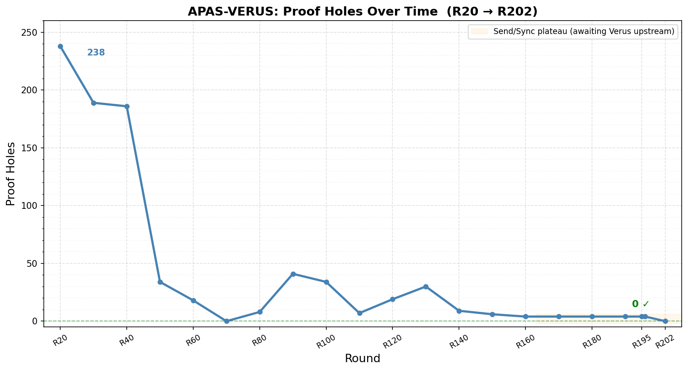
Proof Holes Over Time — R20 to R201

Slide 43
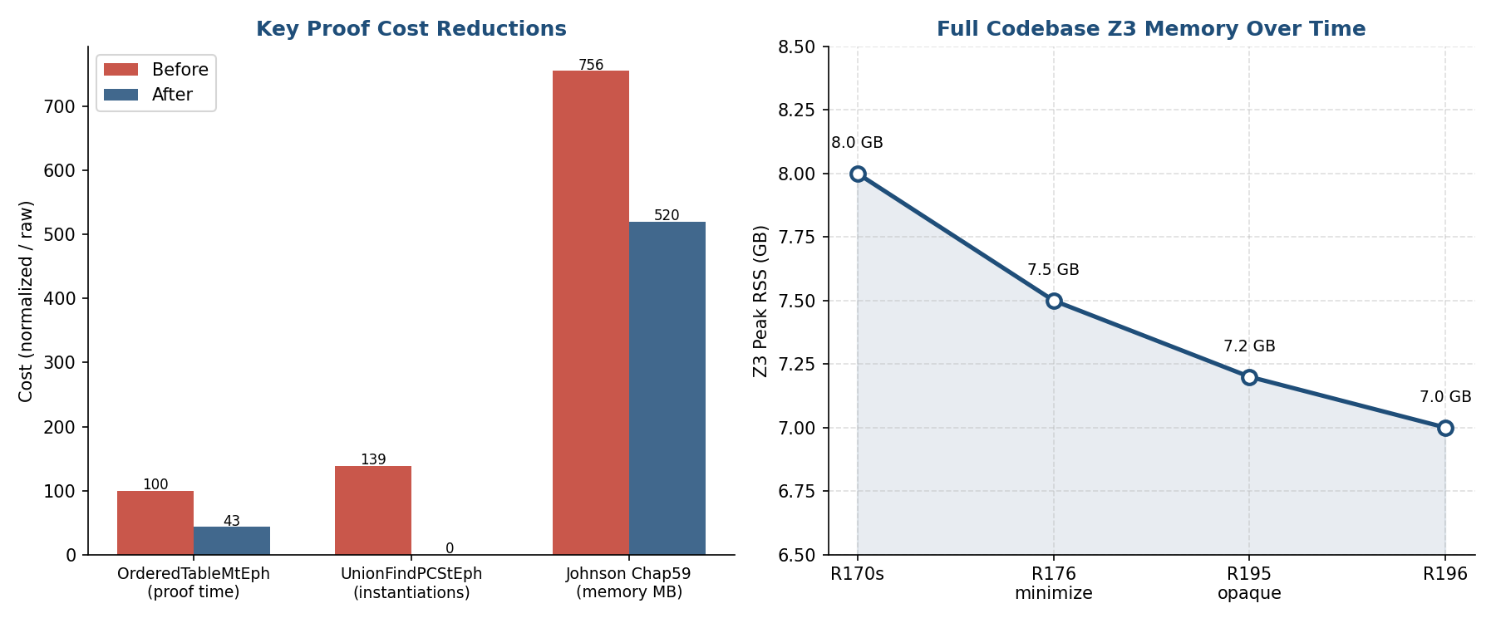
Proof Time and Memory — Key Reductions

Slide 44
Proof Time and Memory — Key Reductions
Five techiniques were used to optimize
minimize-proofs
profiling
splitting specs and applying them just where they are needed
opaque - to hide a definition within the module
private spec - to hide a definition across modules
OrderedTableMtEph: −57% proof time after minimize-proofs (R176).
UnionFindPCStEph: 139K Z3 instantiations → 0 after opaque pattern used in a required module.
Johnson Chap59: 756 MB → 520 MB (−31%) memory reduction.

Slide 45
CPR$ — Three Numbers and One Ratio
# | Sym | Name | Measures
1 | C | Cost of Code | $ to produce executable code
2 | P | Cost of Proof | $ to produce specs and proofs
3 | C+P | Total | Full bill for the verified artifact
4 | R | Review Ratio | Fraction of deliverable a proofgrammer must read (LOC0R excluded)

Slide 46
Proofgrammer/AI Costs
Programmer rate: $375,000/yr (senior + 50% loading)
Real AI spend: < $7,000 across the whole effort
Derived –ai-costs: $4.886/hr × 1,760 = $8,599/yr
AI split by task-hours:
21.6% APAS-AI ($1,512)
78.4% APAS-VERUS ($5,488)

Slide 47
Proofgrammer/AI Costs
# | Project | Hours | KLOC | KLoEC | KLOPC2R | KLOC0R
1 | APAS-AI | 309 | 31.8 | 31.8 | — | —
2 | APAS-VERUS | 1,123 | 166.4 | 56.5 | 47.8 | 95.9
3 | Combined | 1,432 | 198.2 | 88.3 | 47.8 | 95.9

Slide 48
CPR$ — Combined Result
# | Quantity | Value
1 | C — Cost of Code | $150,723
2 | P — Cost of Proof | $161,594
3 | LOP/LOC | 1.08
4 | C + P — Total | $312,317
5 | $ / KLines | $1,877
6 | C / KLOE | $2,665
7 | P / KLOP | $6,305
8 | R — Review Ratio | ~33.3%

Slide 49
Head-to-Head — seL4 (2009) vs APAS-VERUS — 22.5 py base
# | Quantity | seL4 (pre-AI) | APAS-VERUS | Ratio
1 | Person-years | 22.5 | 0.64 | seL4 ~35×
2 | Hours | 46,800 | 1,123 | seL4 ~42×
3 | KLOE | 10 | ~ 57 | Verus ~5.7×
4 | KLOP | 480 | ~ 110 | seL4 ~4.4×
5 | KLOP / KLOE | 48 | ~ 1.9 | seL4 ~25×
6 | KLines / hour | 0.0105 | 0.148 | Verus ~14×
7 | $ / KLOE | $ 843,750 | ~ $ 4,300 | seL4 ~196×
8 | $ / KLOP | $ 17,578 | ~ $ 2,225 | seL4 ~7.9×
9 | C + P total | $ 8,437,500 | $ 244,840 | seL4 ~34.5×

Slide 50
R
LOPC2R = Lines of proven code 2 review
LOPC0R = Lines of proven code not to review
R = LOPC2R / (LOPC2R + LOC0R)
47,828 / 143,736 = 0.332749 = 33.2749 %
R — Review Ratio ~33.3%

Slide 51
Software Engineering in AI Paired Proving- Problems
What is the limiting factor now? Code Review!
But really Spec Review when you prove.
What can we do to simplify code review?
Modularity - traits/impls in Verus.
TOC - This organizes the boilerplate to make reading easier.
Proof - I really just read the specs. If they’re right the code is right!
Tests - are hugely useful when you don’t trust your coding team.
Formatting - rust formatting has been adopted in Verus. It is very low density.

Slide 52
Quantitative SE: What Rust Cargos use in std.
I downloaded the 1036 most downloaded Rust projects, 3636 crates.
Top 1000 projects, 3636 crates.
48 data types fully support 100%.
79 modules fully support 99%.
1733 methods fully support 99%.
14,317 total fn definitions in std/core/alloc in Rust
4,965 pub fn definitions in std/core/alloc in Rust
But how many of those private functions do we need? I don’t know.

Slide 53
Compare Rust Libs to APAS-VERUS?
APAS-VERUS: -6,401 exec functions total, -4,911 with proofs
But APAS-VERUS has {Mt,St}x{Per,Eph}
So it is much more like 2000 distinct functions.
And I wrote this in 160 days while learning Verus.
At least 30 of those days were understanding and working around pain points.

Slide 54
How bad is our computer security?
Linux kernel team publishes 432 CVEs in two days 22 July 2026
Linux can’t handle this with their current process.
How many are really human verified not AI new CVE injections?
What happens when they try and make 432 changes one by one?

Slide 55
Mythos Audit Rust vs Firefox
# | Metric | Rust (Compiler/Std) | Firefox (Entire Codebase)
1 | Codebase Size | ~4,500 KLOC | ~40,000 KLOC
2 | Mythos Bugs Found | 189 | 271
3 | Vulnerability Density | 0.0420 bugs/KLOC | 0.0068 bugs/KLOC
4 | Ratio | 6.18 | 1

Slide 56
How much Proof do we need to save computer security?
As a spreadsheet style thought experiment, I collected examplars of proven/required systems and their LOP and LOC.
And put a $2000/KLOC to generate Rust LOC in it and $2000-8000/KLOP at 110% scaling.
What do we rewrite? Prove?

Slide 57
The Exemplars
One measured system per artifact — bold = carries a machine-checked proof
Semantics — Rocq · CoqQFBV · cake_lpr · Iris · RustBelt
PL — CompCert · CompCertELF · CakeML GC
Std Library — Rust core · VST malloc · CakeML basis · HACL*
OS boot — U-Boot · DICE*
OS core — Atmosphere · Asterinas · Linux net/ · FSCQ
OS devices — Linux drivers · Pancake i.MX8 NIC · SeKVM · Vigor/Klint
Utilities & Apps — Unbound · chrony · BusyBox · Suricata · nginx · Redis · SQLite
Distributed — CapybaraKV · S3 ShardStore · Verdi raft · FoundationDB ·
POP - Verus (vstd) · cvc5

Slide 58
Cost of Proving ‘Everything’ You Need for Security
Section | Unproven | Proven | Proofs | Total
1 Semantics | 3,000 | 228 | 252 | 3,480
2 PL | 8,173 | 178 | 206 | 8,557
3 Std Library | 1,178 | 148 | 135 | 1,461
4 OS | 1,594 | 19 | 107 | 1,720
5 Utilities | 879 | 0 | 0 | 879
6 Application Stack | 579 | 0 | 0 | 579
7 Distributed Svcs | 3,283 | 24 | 47 | 3,354
8 Proof of Programs | 500 | 2 | 38 | 540
Total | 19,186 | 599 | 785 | 20,570

Slide 59
Cost of Proving ‘Everything’ You Need for Security
$2,000/KLOC to write · 1.1 proof lines per line · $2,200/KLOP to prove
20,570 KLOC · $90.9M · 3.0% example proven today
Estimated cost of Total KLOC - $41,140,000
Estimated cost of Total Proven KLOC - $49,779,400
Estimated Total Cost - $90,919,400

Slide 60
The Enemies of Proven Code
Proven Formal Semantics - we are getting close.
Code bloat: Rust’s Libs are a great example!
Will AIs just brute force the security problems?
Programmers: will they accept proof?
Features - how much is enough?
The Innovator’s Dilemma - would MSFT, Amazon, … do this?
Complexity: how much can we really specify?
Going type safe we get about 70% bug reduction.
Is FOL enough?
Proving code, do we get 90%? 95% Is that enough?

Slide 61
Review of the Talk
We’ve talked about:
APAS, Rust, APAS’s implementation in Rust.
My Quantitative SE approach in Rusticate and Veracity.
SE in AI paired proving
CPR$ What does it really cost to write proven systems?
How bad is our computer security?
And how much Proof do we need to save computer security?

Slide 62
Questions
I’d like to know who is proving math in the audience?
Is it foundational proof?
Which agents are working well for you, which are not?
Is anyone proving algorithms in Lean?
Is anyone proving programs?
Is anyone proving PL semantics?
What happens when you use a generative style like F*/Pulse vs a close to the PL style?

