Slide 1
Application Security
Race conditions and other exposition
Notes:
I signed up to talk about race conditions and I'm going to talk specifically about race conditions, but I also want to weave a theme of how ridiculously easy it is to accidentally introduce a security vulnerability into your code.

Slide 2
Race condition example
Source: Effective Java, 2nd Edition, Item 39
Notes:
So let’s see an example
(switch to IntelliJ)
So there’s an example of a race condition. Any one of us could have written or CRed that code. And it’s not even necessarily wrong at the time; you might not even intend for the code to run in a multithreaded environment when you originally write it.

Slide 3
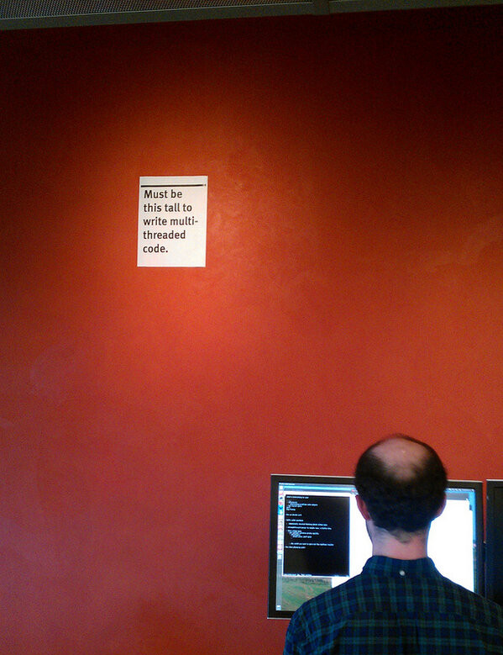
Notes:
So yeah, multithreaded is hard, to noone’s surprise. But it’s a good example number one of how difficult it can be to spot potential race conditions.

Slide 4
Live demo

Slide 5
Remarks
Knight Capital – $460 million
Primedice – $1 million
Notes:
https://en.wikipedia.org/wiki/Knight_Capital_Group
https://medium.com/@Stunna/breaking-the-house-63f1021a3e6d
The purpose of these examples, and my purpose here today, is to scare you. One silly little mistake can compromise our security, and can sink a company. And the really scary part is that it’s not sufficient to write clean, working code. Vulnerabilities can lurk in the best, most heavily-tested code. You can’t just think on the level of “correctness” – you have to also be aware of all of the major security vulnerabilities and think about all of them when you work on sensitive code.
I encourage you to slow down, take as much time as you need to fully understand the implications of a change before you commit it or approve it in CR, and to watch talks and read articles on your own time to improve your understanding of these issues.

