Slide 1
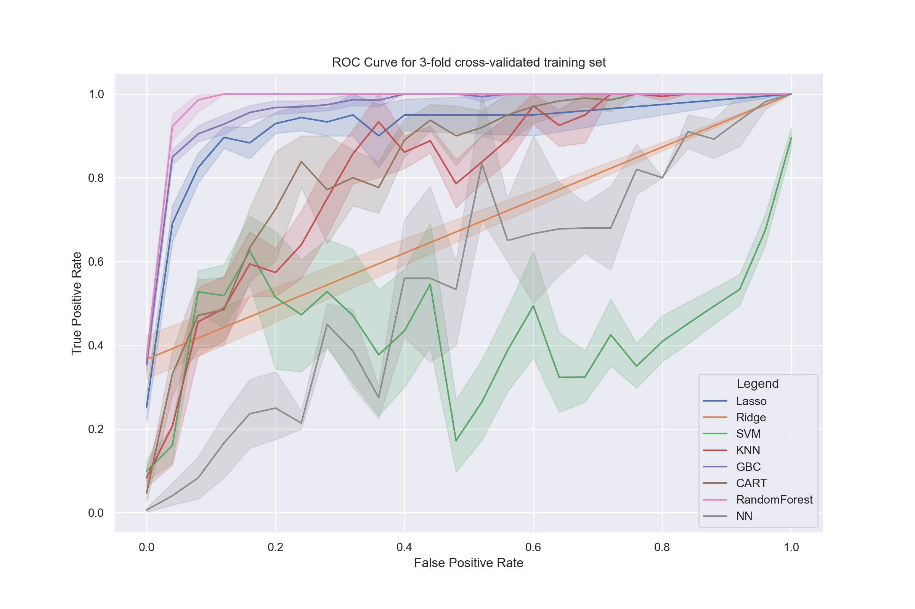
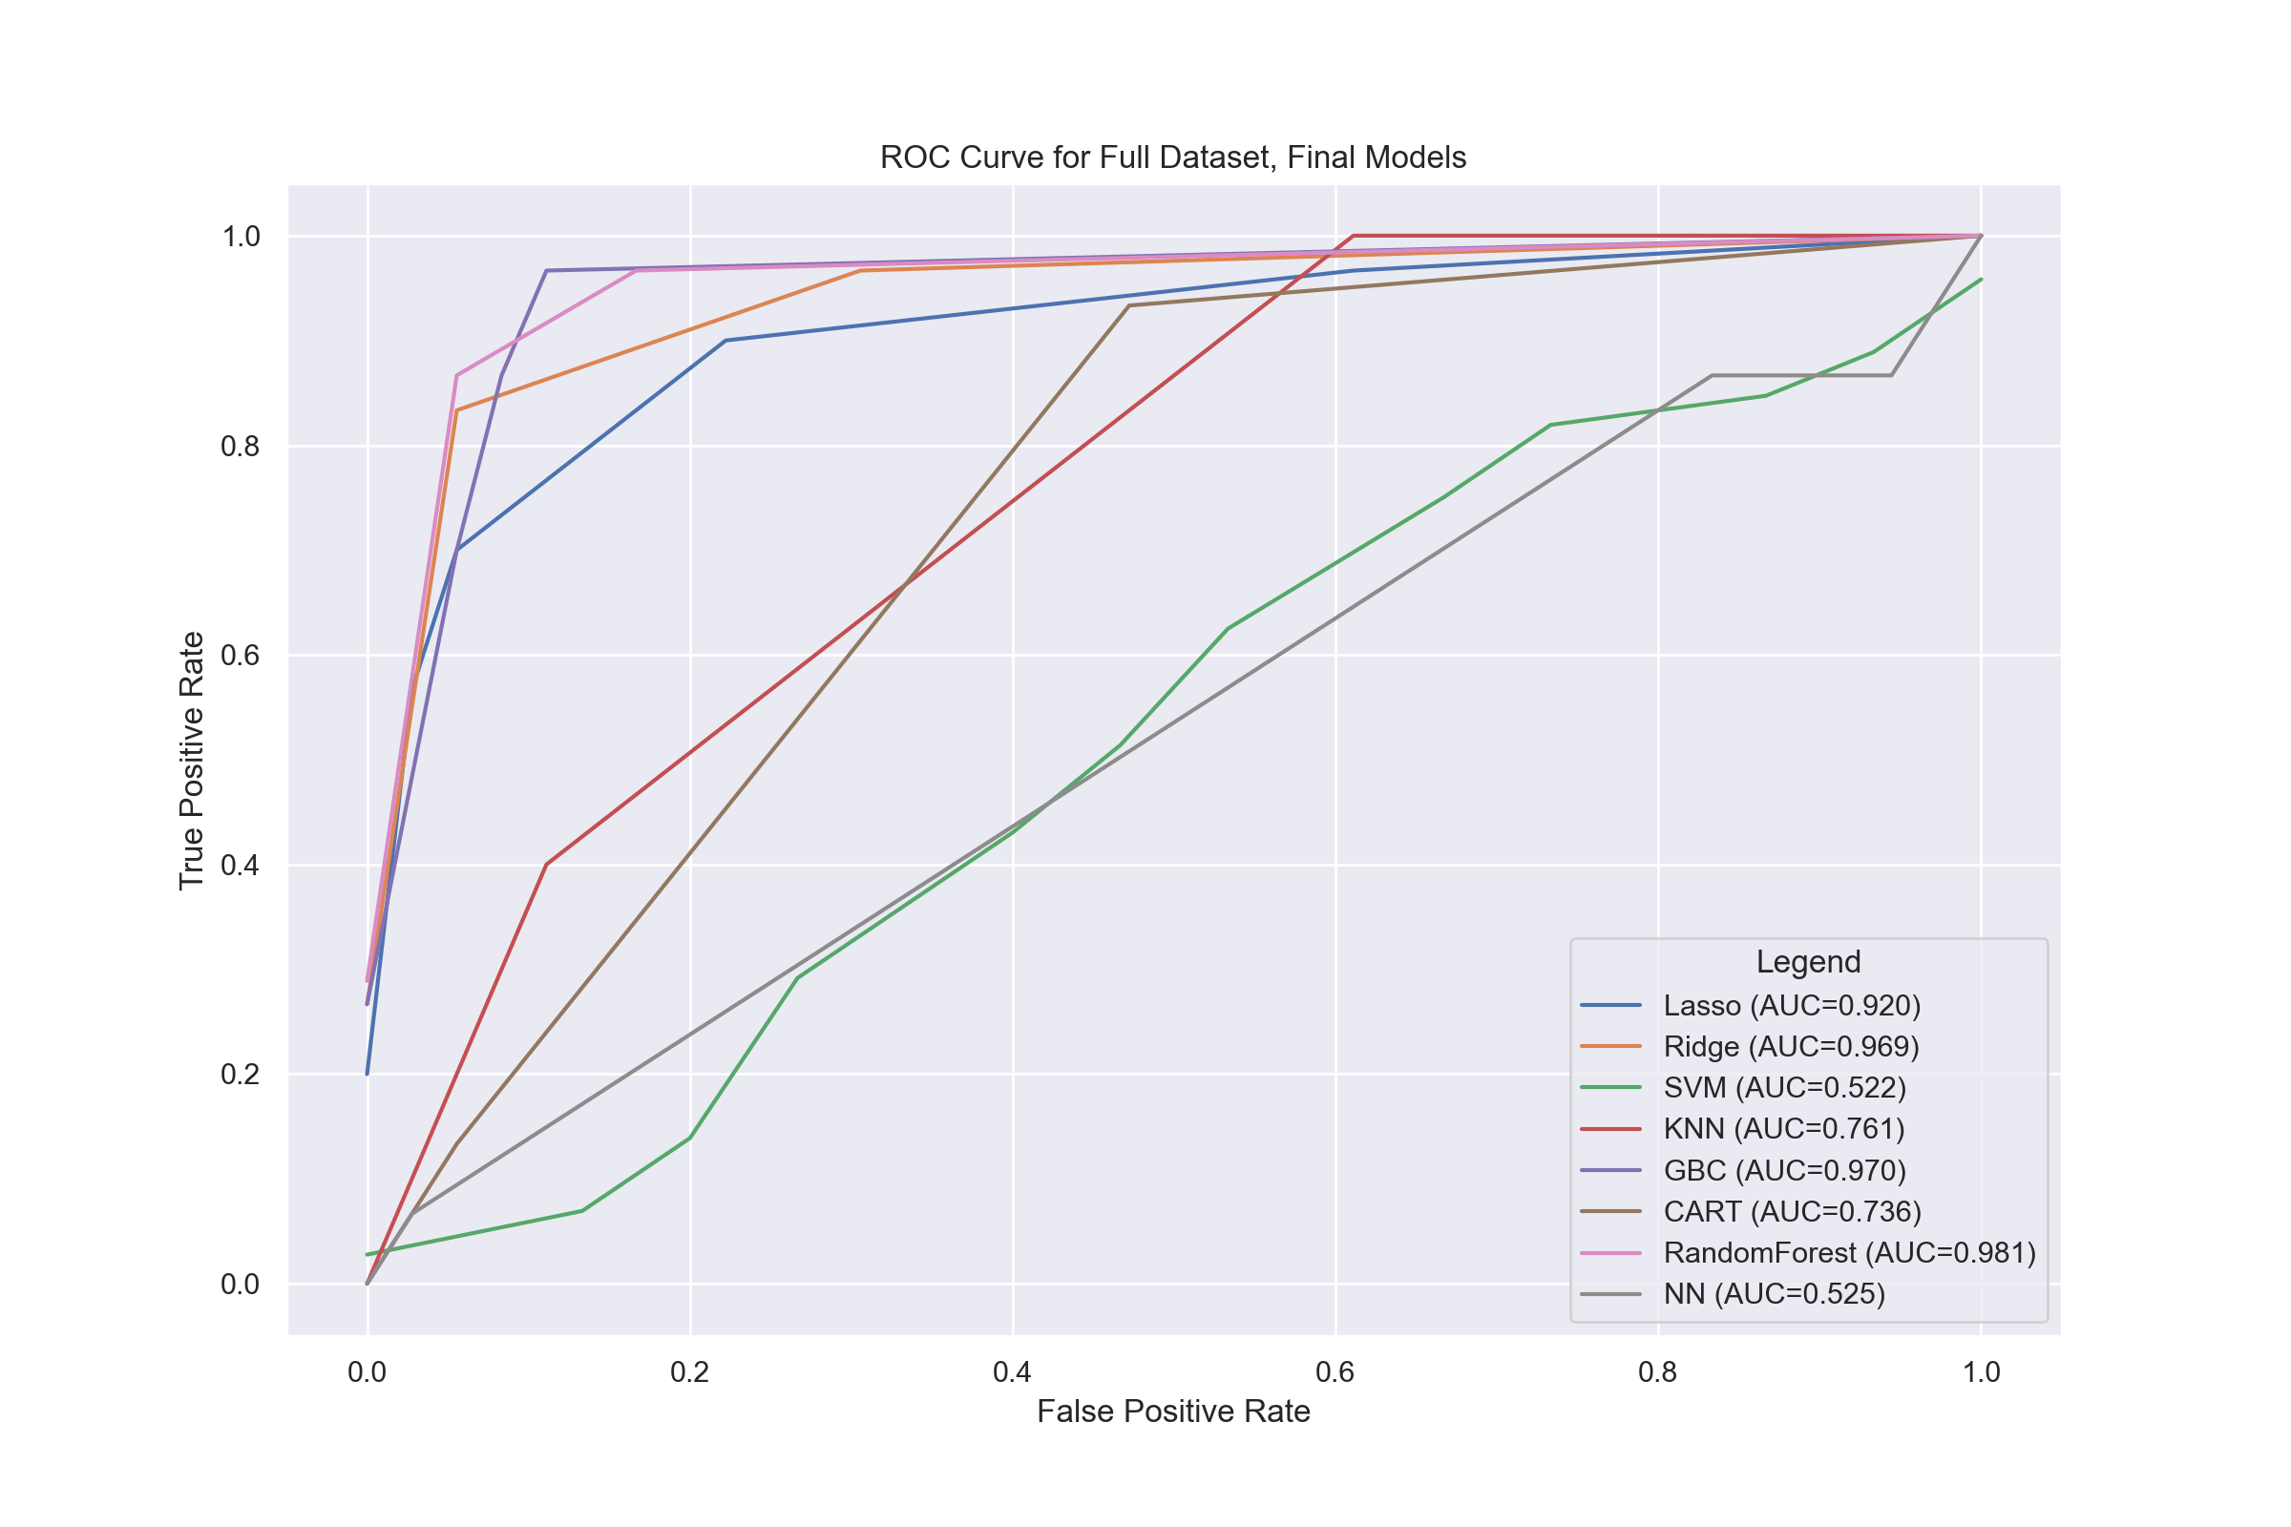
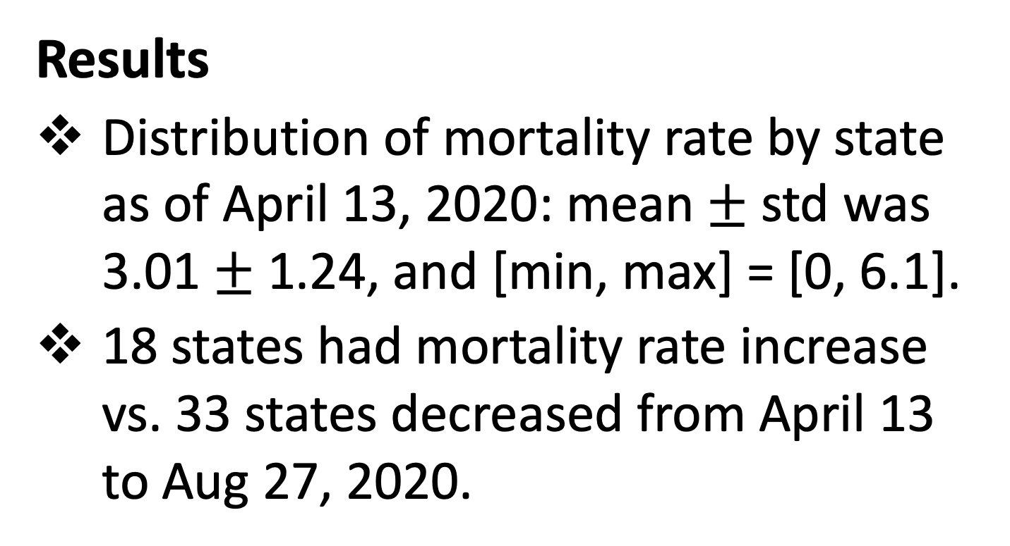
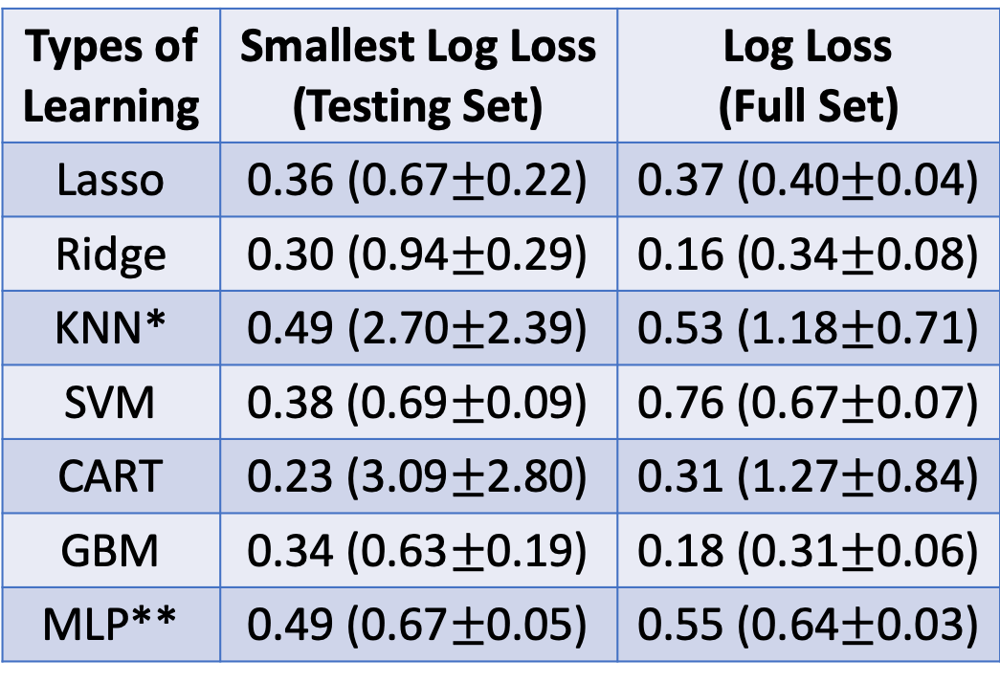
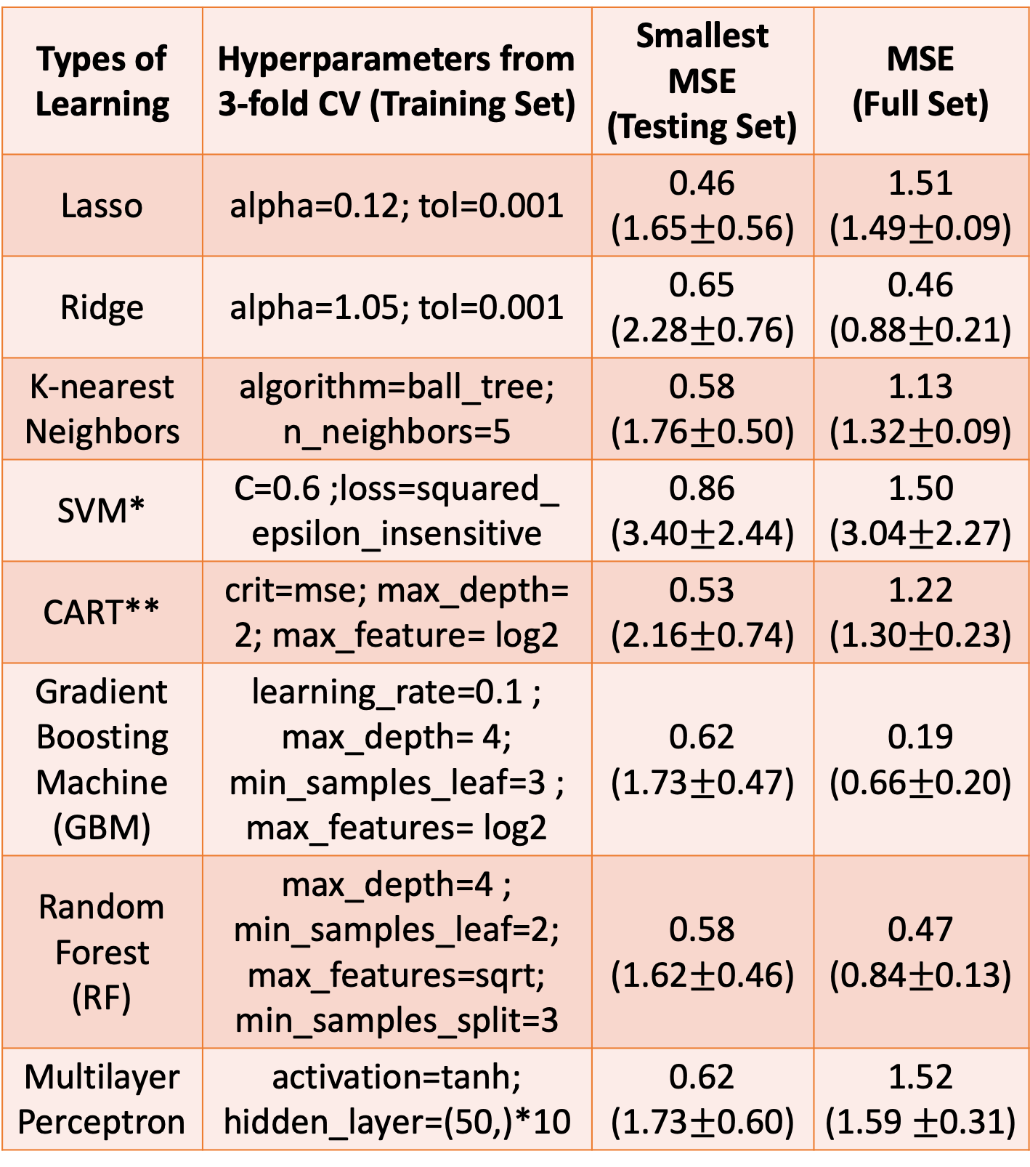
Introduction
Machine Learning (ML): an artificial intelligence technique that can be used to design and train software algorithms to learn from and act on data¹.
Supervised Learning: in ML, a class of systems and algorithms that determine a predictive model using data points with known outputs².
COVID-19: a severe public health event that impacts globally
Up to April 13, 2020, the total number of the confirmed cases was 576,774, and the mortality rate was 4.05%, national-wise³.
Up to Aug 27, 2020, the national mortality rate still remained 3.09%, and the aggregated number of the confirmed infections was 5.80 million, in accordance with CDC guidelines as of April 14³.
Objectives
to use supervised learning algorithms to identify key social-economic behavioral healthcare risks that may impact COVID-19 mortality and mortality change.
Design a supervised learning workflow that leverages and compares 8 types of supervised learning algorithms.
To help identify target patients and inform treatment and prevention.
The Behavioral Risk Factors Surveillance System (BRFSS) Prevalence Data 2018⁴: 19 domains covering demographics, health-related risk behaviors, chronic health conditions, and use of preventive services
The US County Health Rankings & Roadmaps 2020⁵: health factors, such as length and quality of life, health behaviors, clinical care, social economic factors, and physical environment
The US Hospital Capacity of 2020⁶: state-level hospital bed occupancy rate and ICU bed occupancy rate
Table 1. Models in Predicting Mortality Rate
Comparing a diverse set of models (8 types) allows to avoid making assumptions about data
Tree-based models and Ridge regression work well with sparse data
Types of Learning | Hyperparameters from 3-fold CV (Training Set) | Smallest MSE (Testing Set) | MSE (Full Set)
Lasso | alpha=0.12; tol=0.001 | 0.46 (1.65$±$0.56) | 1.51 (1.49$±$0.09)
Ridge | alpha=1.05; tol=0.001 | 0.65 (2.28$±$0.76) | 0.46 (0.88$±$0.21)
K-nearest Neighbors | algorithm=ball_tree; n_neighbors=5 | 0.58 (1.76$±$0.50) | 1.13 (1.32$±$0.09)
SVM* | C=0.6 ;loss=squared_ epsilon_insensitive | 0.86 (3.40$±$2.44) | 1.50 (3.04$±$2.27)
CART** | crit=mse; max_depth= 2; max_feature= log2 | 0.53 (2.16$±$0.74) | 1.22 (1.30$±$0.23)
Gradient Boosting Machine (GBM) | learning_rate=0.1 ; max_depth= 4; min_samples_leaf=3 ; max_features= log2 | 0.62 (1.73$±$0.47) | 0.19 (0.66$±$0.20)
Random Forest (RF) | max_depth=4 ; min_samples_leaf=2; max_features=sqrt; min_samples_split=3 | 0.58 (1.62$±$0.46) | 0.47 (0.84$±$0.13)
Multilayer Perceptron | activation=tanh; hidden_layer=(50,)*10 | 0.62 (1.73$±$0.60) | 1.52 (1.59 $±$0.31)
Table 2. Models in Predicting Mortality Change
Types of Learning | Smallest Log Loss (Testing Set) | Log Loss (Full Set)
Lasso | 0.36 (0.67$±$0.22) | 0.37 (0.40$±$0.04)
Ridge | 0.30 (0.94$±$0.29) | 0.16 (0.34$±$0.08)
KNN* | 0.49 (2.70$±$2.39) | 0.53 (1.18$±$0.71)
SVM | 0.38 (0.69$±$0.09) | 0.76 (0.67$±$0.07)
CART | 0.23 (3.09$±$2.80) | 0.31 (1.27$±$0.84)
GBM | 0.34 (0.63$±$0.19) | 0.18 (0.31$±$0.06)
MLP** | 0.49 (0.67$±$0.05) | 0.55 (0.64$±$0.03)
*K-nearest neighbors
**Multilayer Perceptron (a type of Neural Network)
Methods
Measurements
Mortality rate of COVID-19 by state as of April 13, 2020, and as of Aug 27, 2020
https://github.com/CSSEGISandData/COVID-19/tree/master/csse_covid_19_data, operated by the Johns Hopkins University Center for Systems Science and Engineering (JHU CSSE)
A binary outcome was derived as mortality rate increase vs. decrease as of Aug 27 since April 13.
A total of 242 social-economic, behavioral healthcare risks: from nationally representative surveys.
the data have been aggregated at the state level, appearing as % of the state population, and reflecting the risks prior to the outbreak.
Supervised Learning Strategy
300 random splits of training and testing sets with 70:30 (36 vs. 15 states);
at each split, training/testing pair run by 8 types of learning algorithms
Train: 3-fold CV to determine optimal hyperparameters
Test: external validation
Each of 8 types of algorithms yielded an optimal model that gave the smallest test error of all splits
Full validation: apply the optimal model of each type to all 51-state data and yield full test error;
Final model leveraged external and full validation;
Permutation importance to determine key risks.
*Support Vector Machine. **Classification and Regression Tree
8 Key risks were identified to impact mortality rate, 10 to mortality change, by permutation importance.
Fig 3. ROCs of 8 types of algorithms for training (left) and full validation (right) procedures.
Reference
U.S. Food & Drug Administration, Artificial intelligence and machine learning in software as a medical device, https://www.fda.gov/medical-devices/.
Hastie T, Tibshirani R, Friedman J, The Elements of Statistical Learning: Data Mining, Inference, and Prediction, 2nd ed, 12th printing. New York, NY, Springer, 2017.
Centers for Disease Control and Prevention: https://www.cdc.gov/coronavirus/2019-ncov/cases-updates/cases-in-us.html
CDC BRFSS: https://www.cdc.gov/brfss/
https://www.countyhealthrankings.org/
Harvard Global Health Institute: https://globalepidemics.org/hospital-capacity/
Yehia B.R., et.al.:https://jamanetwork.com/journals/
jamanetworkopen/article-abstract/2769387
Fig 2. Partial dependence of top 2 features from RF. The mortality rates of the states with >50% of population had severe housing cost burden and veterans < 50% of the population were much higher than other states.
Results
Distribution of mortality rate by state as of April 13, 2020: mean$±$ std was 3.01 $±$ 1.24, and [min, max] = [0, 6.1].
18 states had mortality rate increase vs. 33 states decreased from April 13 to Aug 27, 2020.
Conclusions
Social-economic, behavioral and healthcare factors were collected prior to the pandemic, and can serve as potential social causes to mortality rate and mortality change by COVID-19. The key risks identified were consistent with others findings with traditional methods⁷ .
Acknowledgements
*Matthew Ye was a college intern at Translational Medicine & Global Biometrics and Data Sciences Divisions, Bristol Myers Squibb. The work was supported by the organizations of his internship, and thanks for the support.
Fig 1. Histogram of mortality rates of 51 states as of April 13, 2020.

