Slide 1
MR_MasterMind
Dana zarowsky
Joel hills
Brian Hampson

Slide 2
Game Design Objectives
HoloLens experience
Start with cognitive services - breadth rather than depth
Design simple game around selected capabilities
Must scale to fit time

Slide 3
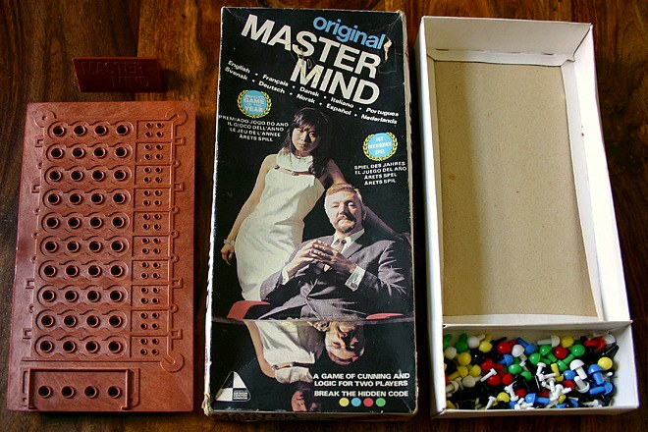
MR_MasterMind
Simple HoloLens game (ended up switching to MR)
Cognitive Services
Language - Language Understanding (LUIS)
Speech
- Text to Speech
- Speaker Recognition
Azure file storage – multi-user, submit solution

Slide 4
Demo

Slide 5
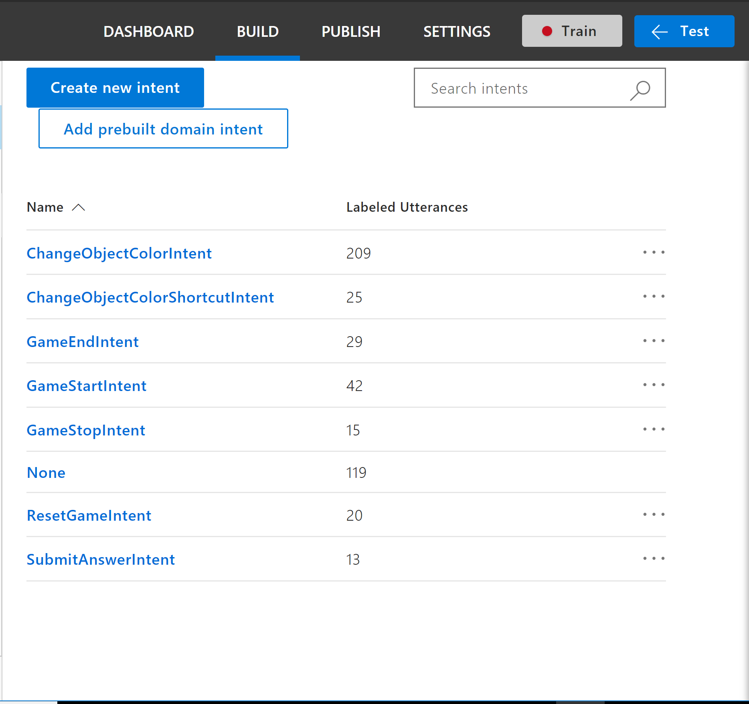
Language Unserstanding (LUIS)
Setup
Intents, Entities, and Utterances
Improvements
Learning

Slide 6
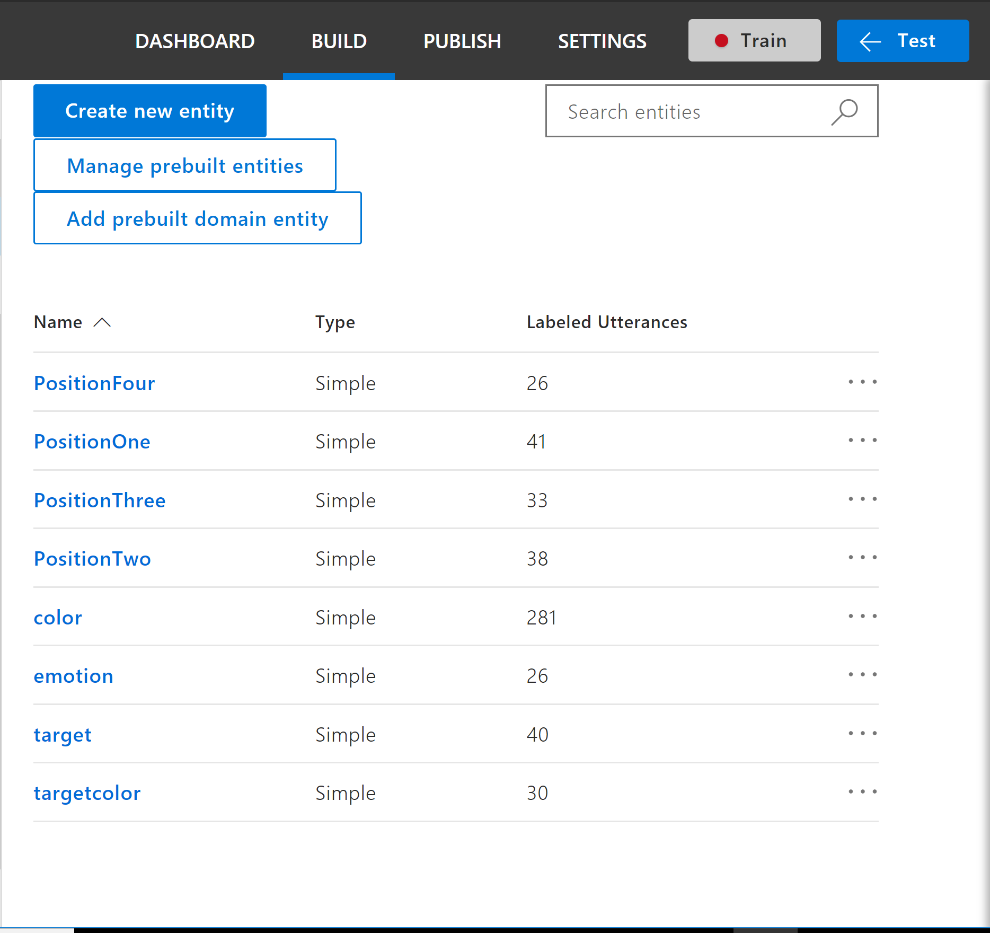
Language Unserstanding (LUIS)
Setup
Intents, Entities, and Utterances
Improvements
Learning

Slide 7
Challenges
Deployment and workflow
Build and deploy UWP with remote debugging – unnecessary!
Microphone HW and DictationRecognizer
Unknown default timeout 20s
Did not find solution for microphone HW issues
Investigate alternatives – speech to text?
LUIS
Training
Usability
Team skillsets

Slide 8
Learnings
MR setup, deployment, and workflow
Unity
Language understanding with LUIS

