Slide 1
Project Presentation LEND OR RENT
Brian Hsu
014337284
CMPE 277
2021 Spring Semester

Slide 2
What is LEND OR RENT?
A mobile app that provides a platform where users can rent things from other users or lend things to other users.
A win-win app for everyone!
- No need to buy new things, just rent → Renters save money
- Make extra income by lending things → Lenders earn money
- Less redundant products are produced → The environment benefits

Slide 3
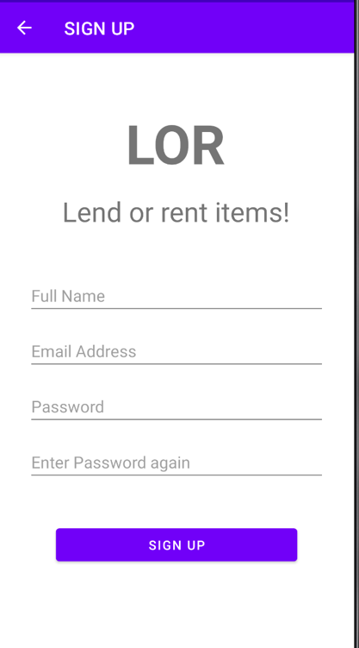
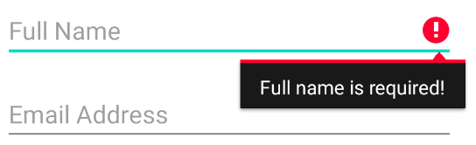
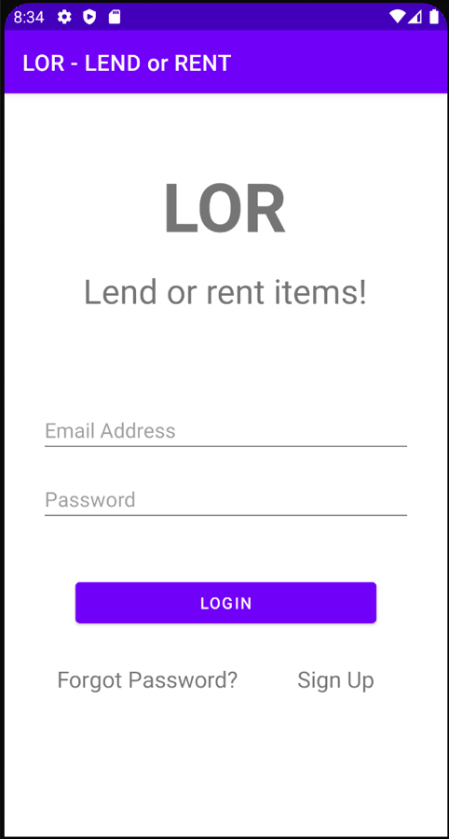
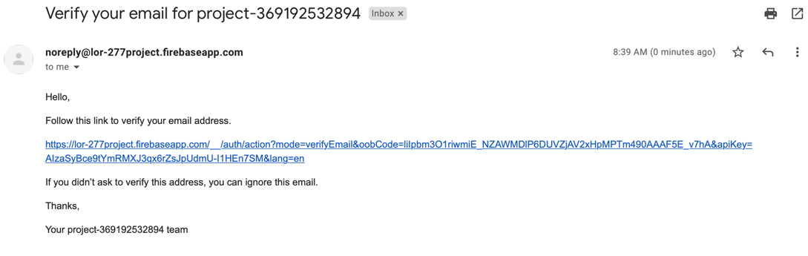
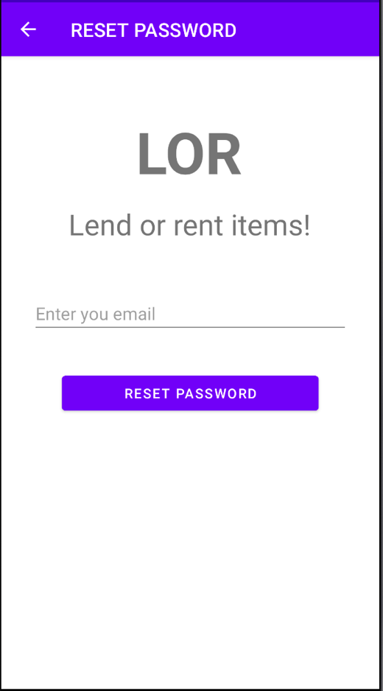
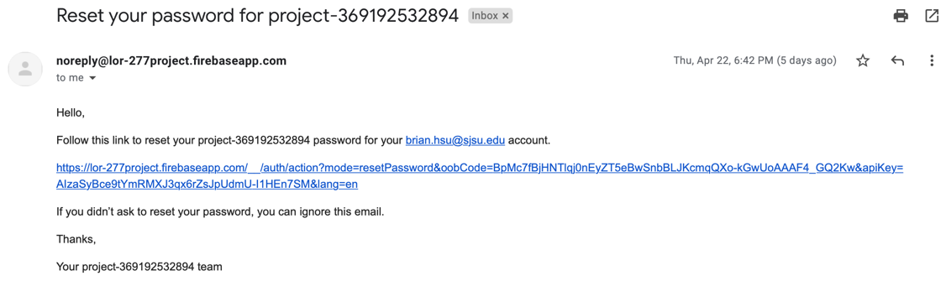
Login and Sign up
Need to fill in all fields, otherwise
Before login, go to email to verify account
Sign up
Enter email address and go to email to reset
your password
Forget password
Login Screen

Slide 4
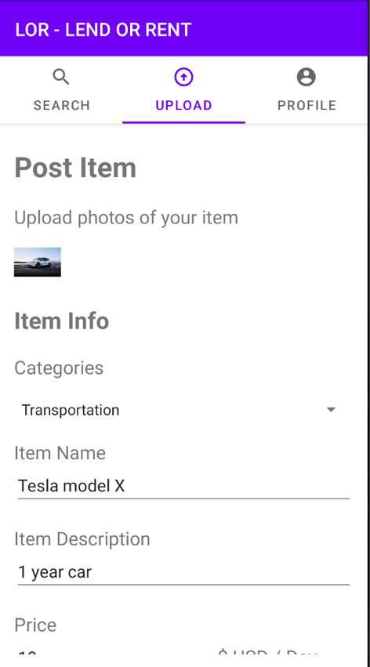
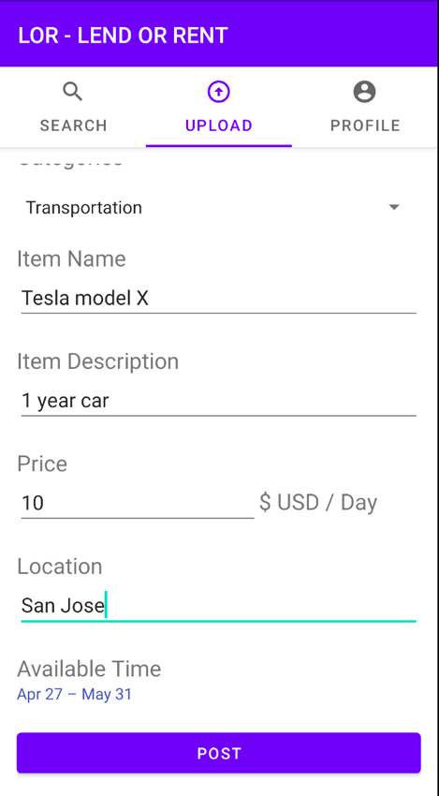
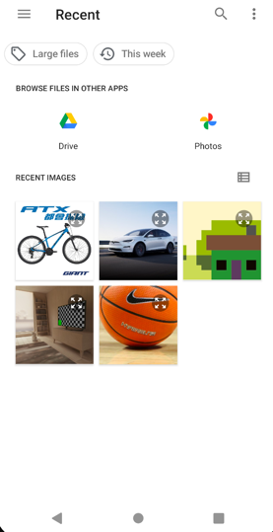
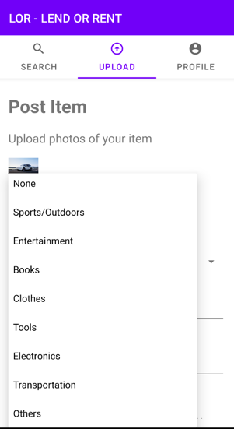
Post Item (Lending)
Step 1: Upload Photo
Step 2: Select the category
Post Item Screen

Slide 5
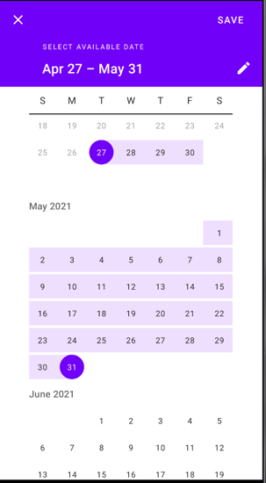
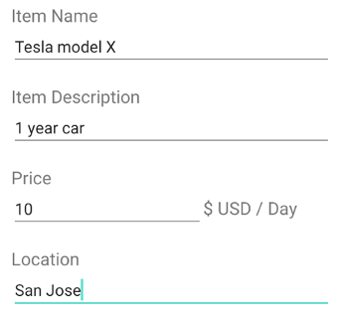
Post Item (Lending) Cont’d
Step 3: Enter the name,
description, price, location
Step 4: Choose the available date
Step 5: Click the Post button
Post!

Slide 6
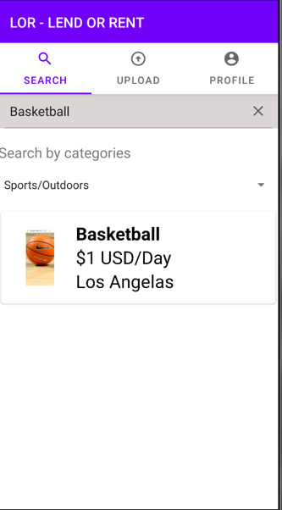
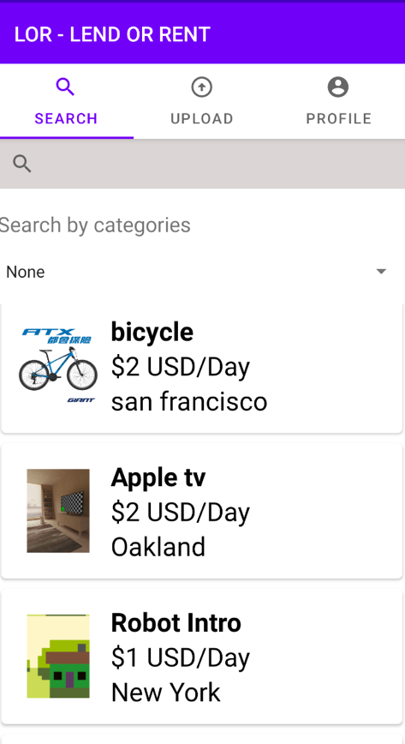
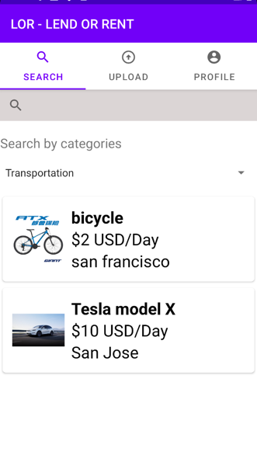
Search Items (Renting)
Enter the name of the item
in the search bar
Search by name
Search by category
Select a category in the
drop down menu
Search Items Screen

Slide 7
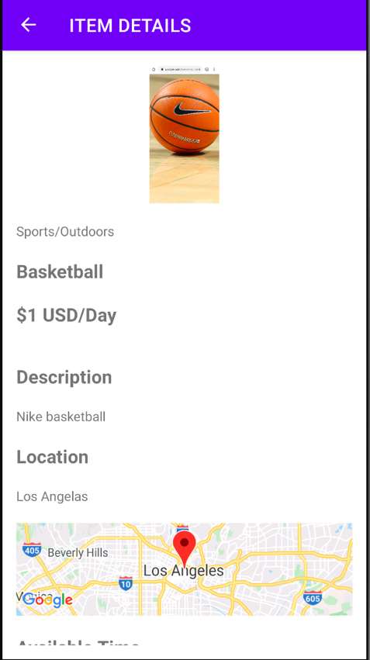
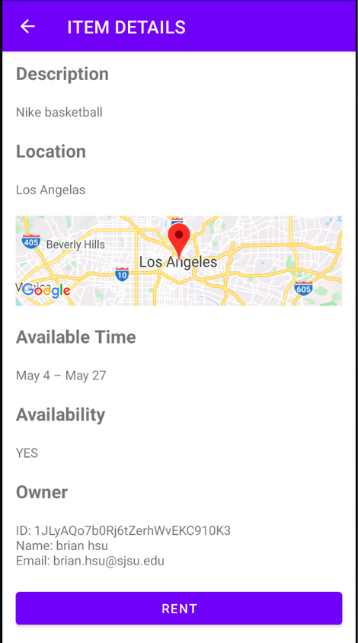
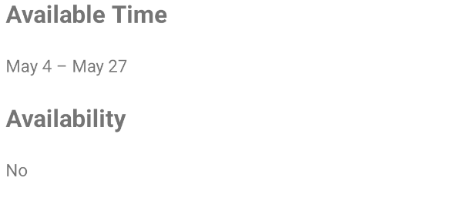

Search Items (Renting) Cont’d
In this screen user can see all the information of the item including the
Info of the owner of the item.
When a user click the RENT button, the availability of the item will
become “No” because one item can only be rented by one person at
a time.
If other users try to rent
Item Detail Screen

Slide 8
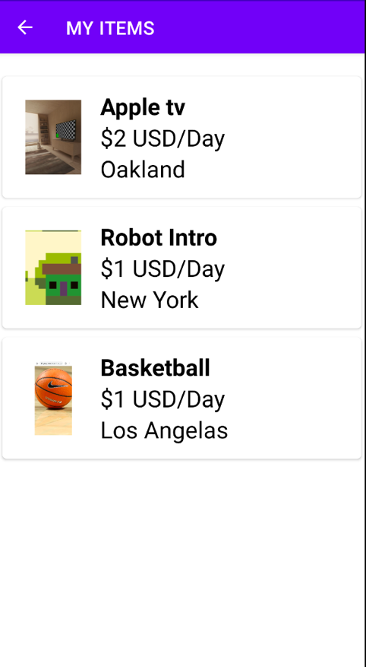
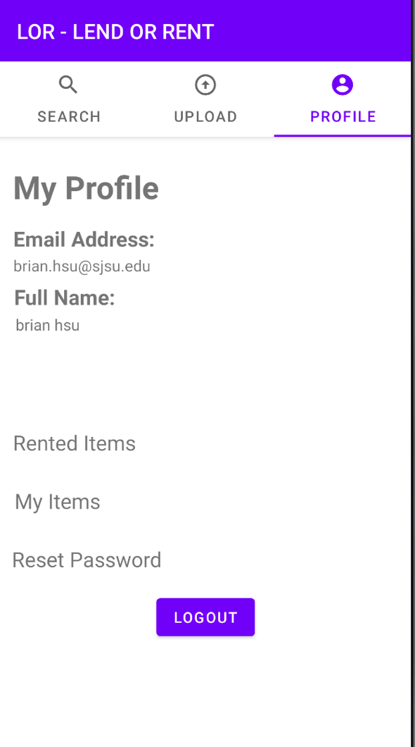
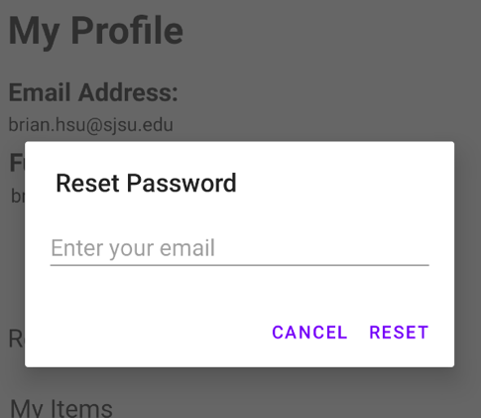
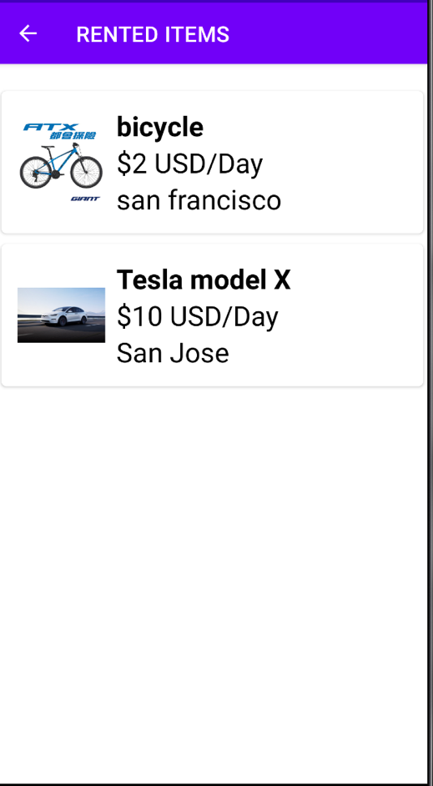
My Profile
My Items
Reset Password
Rented Items
My Profile Screen

Slide 9
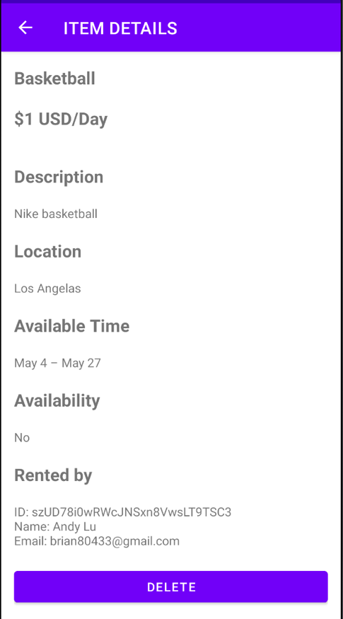
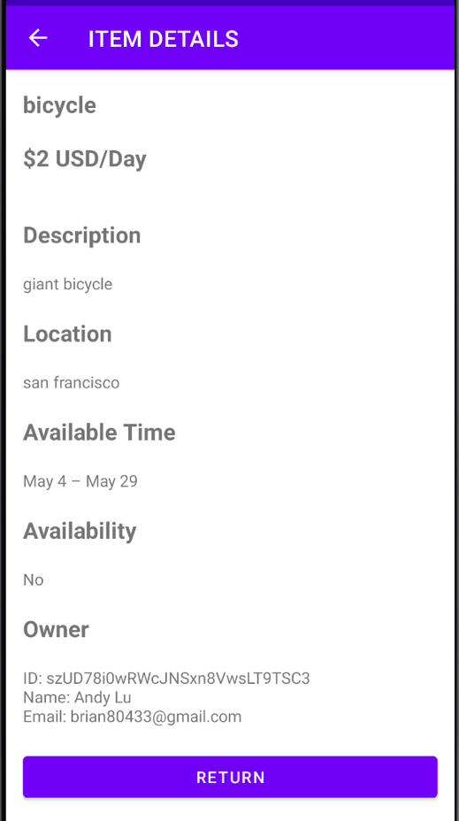

My Items & Rented Items Details
User can see who rented
his/her item
Click the RETURN button to
return the item to the owner
Click the DELETE button
if user wants to take his/her
Item off the platform
My Item Details Screen
Rented Item Details Screen
Availability back to “YES”

Slide 10
Thank you!
DEMO TIME

