Slide 1
Performance Evaluation: Accuracy Estimate for Classification and Regression
J.-S. Roger Jang (張智星)
jang@mirlab.org
http://mirlab.org/jang
MIR Lab, CSIE Dept.
National Taiwan University
2023/9/28

Slide 2
Introduction to Performance Evaluation
Performance evaluation
An objective procedure to derive the performance index (or figure of merit) of a given model for classification or regression
Importance
For comparing two models’ performance
For extracting useful features
For determining a model’s complexity
For AutoML
效度

Slide 3
Typical Performance Indices
Classification
Accuracy: ↗（望大）
Top-K accuracy
Recognition rate : ↗
Error rate: ↘
EER (equal error rate) for binary classification
Precision, recall, f-measure: ↗
AUROC (area under ROC): ↗
AUPRC (area under PRC): ↗
Regression
RMSE (root mean squared error): ↘ （望小）
MAE (mean absolute error): ↘
Coefficient of determination (R²): ↗
There are many more PIs!

Slide 4
Synonyms
Sets of synonyms to be used interchangeably (since we are focusing on classification):
Classifiers, models
Recognition rate, accuracy
Training/validation, design-time
Test, run-time

Slide 5
Performance Indices for Classifiers
Performance indices of a classifier
Recognition rate
How to derive it objectively?
Computation load
Design-time computation (training and validation)
Run-time computation (test)
Our focus
Recognition rate and the procedures to derive it
The estimated accuracy depends on
Dataset partitioning
Model’s types and complexity
Quiz!

Slide 6
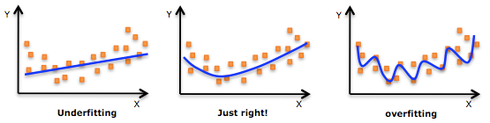
Underfitting and Overfitting
For regression
For classification
How to determine
the order of the
fitting polynomial?
How to determine
the complexity
of the classifier?

Slide 7
Canonical Dataset Partition: Concepts
Data partitioning: to make the best use of the dataset for both model construction & evaluation
Training set: For model construction
Validation set: For model evaluation & selection
Test set: For final model evaluation
Quiz!
Whole dataset
Training set
Validation set
Test set
For model
construction
For model
Evaluation & selection
For final model
evaluation
Disjoint!

Slide 8
Canonical Dataset Partition: Usage Scenarios
Your instructor wants you to develop a classifier using training set which should perform good on validation set. And, most likely, your instructor will finally check the results of your classifier on the test set, which he didn't share with you.
You can use historical data to create a stock predictor, where the data is partitioned into training set for model construction and validation set for model selection (to prevent overfitting). Then you can use future data as the test set (which won’t be available until the date comes) for evaluating the performance of your predictor.
Quiz!

Slide 9
Canonical Dataset Partition: Characteristics
Validation set is used for model selection, particularly for preventing overfitting.
Performance on validation set should be close to (or slightly higher than) the performance on test set
How to make do with a small dataset
Use cross validation (CV) on the training & validation sets to have a more reliable estimate of the accuracy.
Estimate the classifier’s performance based cross validation only; no further test set is used.

Slide 10
Simplified Dataset Partition: Training & Test
Data partitioning
Training set: For model construction
Test set: For model evaluation
Drawback
No validation set for model selection. Model is selected by the training error and it is likely to run into the risk of overfitting.
Whole dataset
Training set
Test set
For model
construction
For final model
evaluation
Disjoint!

Slide 11
Simplified Dataset Partition: Training & Validation
Data partitioning
Training set: For model construction
Validation set: For model evaluation & selection
Drawback
No test set for final model evaluation. Performance on validation set may also lead to overfitting.
Whole dataset
Training set
Validation set
For model
construction
For model
Evaluation & selection

Slide 12
Simplified Dataset Partition: Cross Validation
Data partitioning with cross validation (rotation)
Training set: For model construction
Validation set: For model evaluation & selection
Characteristics
Can obtain a more robust estimate of the model’s performance based on the average performance of the validation sets
Less likely to have dependency on dataset partitioning
Whole dataset
Training set & validation set
Use cross validation to rotate training and validation sets

Slide 13
Methods for Performance Evaluation
Typical methods to derive the recognition rate
Inside test (not desirable)
One-side holdout test
Two-side holdout test (two-fold cross validation)
M-fold cross validation
Leave-one-out cross validation
Ultimate goal
To find a just-right model for better prediction
No underfitting or overfitting
Reasonable computational time

Slide 14
Inside Test: Concept
Dataset partitioning
Use the whole dataset for training & evaluation
Recognition rate (RR)
Inside-test or resubstitution recognition rate

Slide 15
Inside Test: Characteristics
Characteristics
Too optimistic since RR tends to be higher
For instance, 1-NNC always has an RR of 100%!
Can be used as the upper bound of the true RR.
Potential reasons for low inside-test RR:
Bad features of the dataset
Bad method for model construction, such as
Bad results from neural network training
Bad results from k-means clustering

Slide 16
One-side Holdout Test: Concept
Dataset partitioning
Training set for model construction
Validation set for performance evaluation
Recognition rate
Inside-test RR
Outside-test RR

Slide 17
One-side Holdout Test: Characteristics
Characteristics
Highly affected by data partitioning
Usually Adopted when training (design-time) computation load is high (for instance, deep neural networks)

Slide 18
Two-side Holdout Test: Concept
Dataset partitioning
Training set for model construction
Validation set for performance evaluation
Role reversal

Slide 19
Two-side Holdout Test: Block Diagram
Two-side holdout test (two-fold cross-validation)
Dataset A
construction
Model A
evaluation
RRB➔A
Model B
evaluation
RRA➔B
Dataset B
construction
Outside test!

Slide 20
Two-sided Holdout Test: Characteristics
Characteristics
Better use of the dataset
Still highly affected by the partitioning
Suitable for models with high training (design-time) computation load

Slide 21
M-fold Cross Validation: Concept
Data partitioning
Partition the dataset into m folds
One fold for validation, the other folds for training
Repeat m times
Quiz!

Slide 22
M-fold Cross Validation: Block Diagram
construction
.
.
.
m
disjoint
sets
.
.
.
Model k
evaluation
.
.
.
Outside test!

Slide 23
M-fold Cross Validation: Characteristics
Characteristics
When m=2 ➔ Two-sided holdout test
When m=n ➔ Leave-one-out cross validation
The value of m depends on the computation load imposed by the selected model.

Slide 24
Stratified Partitioning for M-fold Cross Validation
Stratified partitioning
Each fold has the ratio of class sizes as close as possible to that of the original dataset.
Quiz!
Class 1
Class 2
Fold 1
Fold 2
Fold 3
Class size ratio = 2:3

Slide 25
Leave-one-out CV: Concept
Data partitioning
When m=n and D_{i} = (x_{i}, y_{i})
Quiz!

Slide 26
Leave-one-out CV: Block Diagram
Leave-one-out CV
construction
.
.
.
n
i/o
pairs
.
.
.
Either 0% or 100%!
Model k
evaluation
.
.
.
Outside test!

Slide 27
Leave-one-out CV: Characteristics
LOOCV (leave-one-out cross validation)
Strength: Best use of the dataset to derive a reliable accuracy estimate
Drawback: Perform model construction n times ➔ Slow!
To speed up the computation LOOCV
Construct a common part that is used repeatedly, such as
Global mean and covariance for QC or NBC
How to construct the final model after CV?
Use the selected model structure on the whole dataset (training set + validation set) to construct the final model, and then test it.
Quiz!

Slide 28
CV Applications
Feature selection in classification/regression
Model complexity determination
Order determination in polynomial fitting
Number of prototypes for VQ-based 1-NNC
…
Performance comparison among different models
Meta parameter tuning
Outlier detection (LOOCV in particular)
AutoML
…

Slide 29
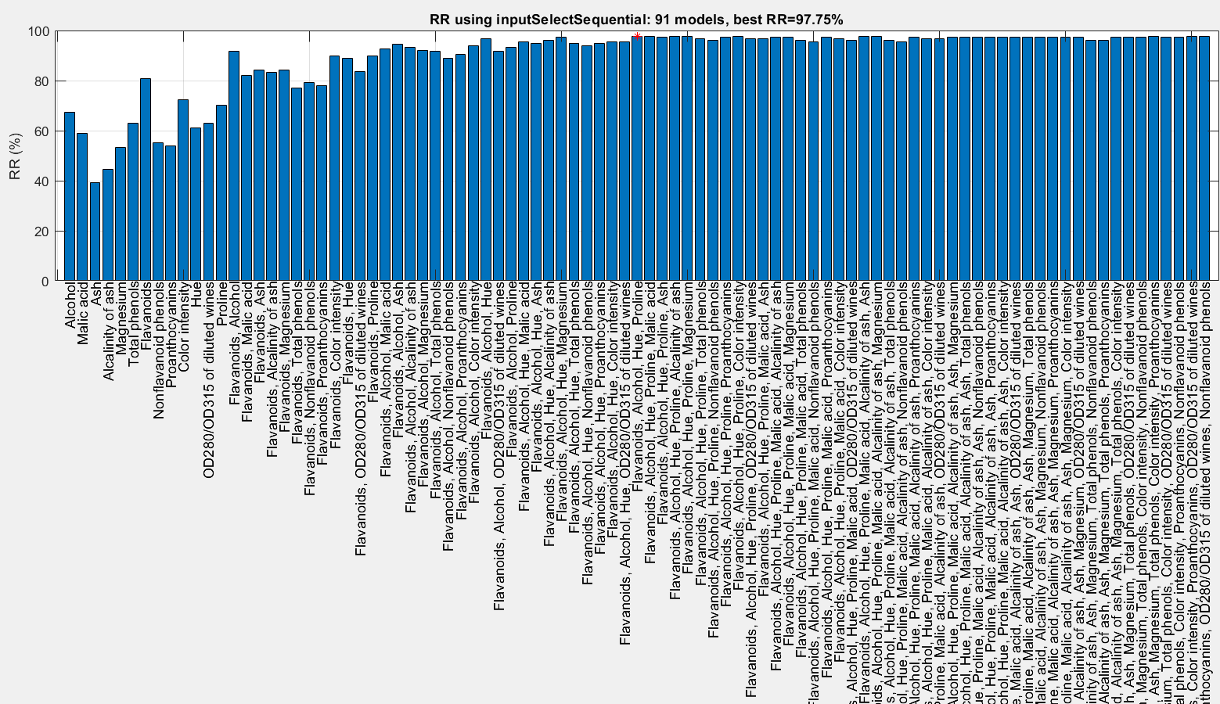
CV Example: Feature Selection
Wine dataset (13 features), naïve Bayes classifier, sequential forward selection, leave-one-out cross validation ➔ 97.75%

Slide 30
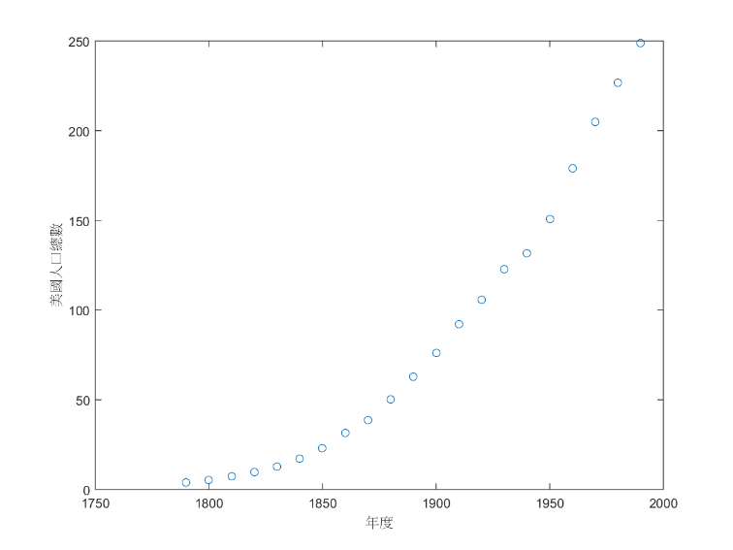
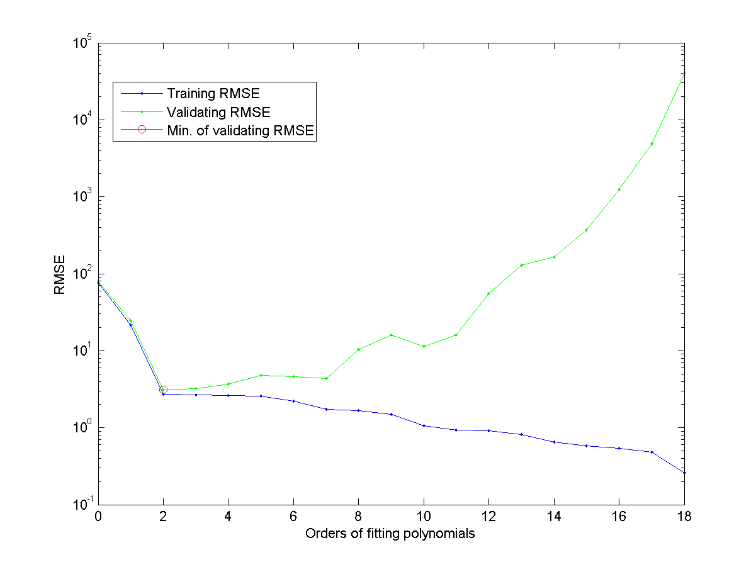
CV Example: Order Determination in Polynomial Fitting
Census dataset, polynomial on years, leave-one-out cross validation ➔ Best order = 2

Slide 31
Efficiency in LOOCV
How to speed up LOOCV in performance evaluation?
Common scenario
Construct a common model for all dataset
Update the model to remove the effect of an I/O pair
Use the I/O pair to evaluate the update model
Go back to step 1 until all I/O pairs are done.
The above scenario is applicable to the following classifiers:
K-nearest-neighbor classifiers
Naïve Bayes classifiers
Quadratic classifiers
SVM
…

Slide 32
Caveat of CV
Even with CV, overfitting is likely to happen when
Dataset is small.
Feature dimension is high.
Do not try to boost validation accuracy too much, or you are running the risk of indirectly training on the left-out data!
Example for using feature selection on a random dataset

Slide 33
Exercise: Computing Time for Cross Validation
Question: For a dataset of n input-output pairs, building a model using the set requires 2n seconds. And evaluating the model requires m seconds for m input-output pairs. Now we have a dataset of 100 input-output pairs, and we want to perform 10-fold cross validation on the set. Please answer the following questions.
What is the overall time required for performing 10-fold cross validation?
What is the overall time required for performing leave-one-out cross validation?
Answer
1,900 sec
19,900 sec

