Slide 1
Dynamic Programming
動態規劃
張智星 (Roger Jang)
jang@mirlab.org
http://mirlab.org/jang
多媒體資訊檢索實驗室
台灣大學 資訊工程系

Slide 2
Dynamic Programming
Dynamic Programming (DP)
  An effective method for finding the optimum solution to a multi-stage decision problem, based on the principal of optimality
Applications: NUMEROUS!
  Longest common subsequence, edit distance, matrix chain products, all-pair shortest distance, dynamic time warping, hidden Markov models, …
Quiz!

Slide 3
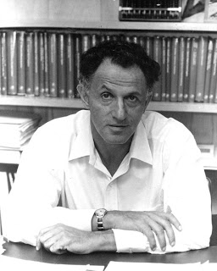
Principal of Optimality
Richard Bellman, 1952
  An optimal policy has the property that whatever the initial state and the initial decisions are, the remaining decisions must constitute an optimal policy with regard to the state resulting from the first decision.

Slide 4
Web Resources about DP
Recordings on the web
  MIT Open Course Ware

Slide 5
Problems Solvable by DP
Characteristics of problems solvable by DP
  Decomposition: The original problem can be expressed in terms of subproblems.
  Subproblem optimality: the global optimum value of a subproblem can be defined in terms of optimal subproblems of smaller sizes.
Quiz!

Slide 6
Three-step Formulas of DP
Quiz!
DP formulation involves 3 steps
  Define the optimum-value function for recursion
  Derive the recurrent formula of the optimum-value function, with boundary conditions
  Specify the answer to the original task in terms of the optimum-value function.

Slide 7
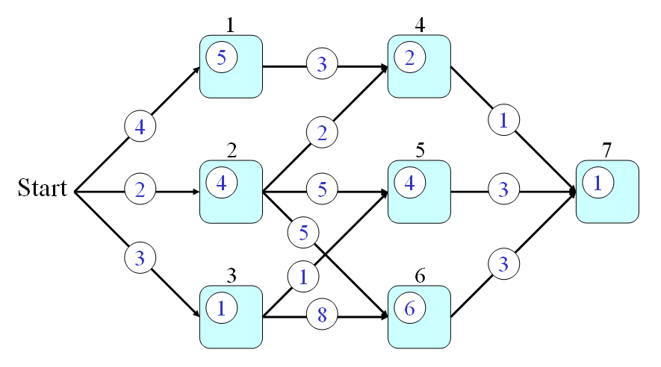
DP Example: Optimal Path Finding
Path finding in a feed-forward network
  p(a,b): transition cost
  q(a): state cost
Goal
  Find the optimal path from nodes 0 to 7 such that the total cost is minimized.
Node index
0
q(3)=1
p(3,6)=8

Slide 8
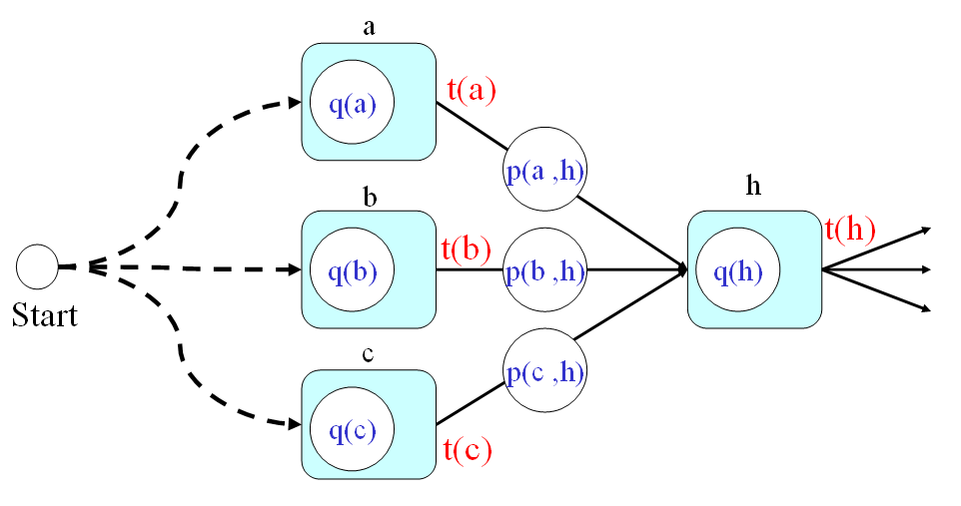
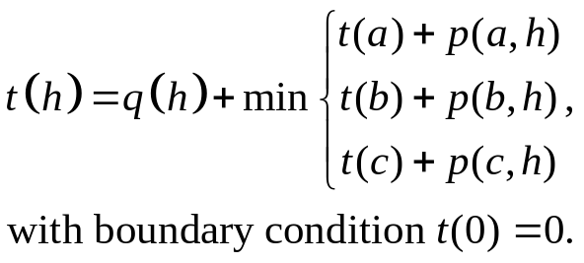
DP Example: Optimal Path Finding
Three steps in DP
  Optimum-value function t(h): the minimum cost from the start point (node 0) to node h.
  Recurrent formula
  Answer: t(7)
0
Optimum-value function
Last node

Slide 9
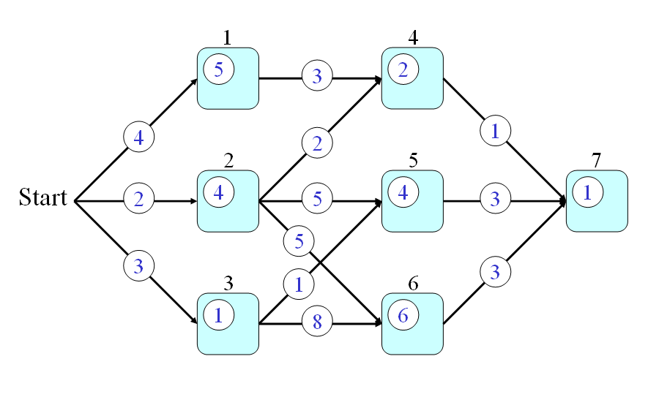
DP Example: Optimal Path Finding
Walkthrough of DP
  Flash
  Gif

Slide 10

Observations
Some observations based on this path finding example
  Once t(7) is found, t(k), k<7 is also found
  Multi-stage ➔ Layer-by-layer computation ➔ No loops in the graph
In fact
  Any DP problem can be visualized as this optimal path finding problem!

Slide 11
Principal of Optimality: Example
In terms of the min-cost path problem
  Any sub-path of the min-cost path should itself be a min-cost path given the starting and ending nodes
P ➔ Q
^Q ➔ ^P
Start
End
Q
P

Slide 12
Bottom-up Approach of DP
Usually bottom-up design of DP
  Start from the bottom (base cases)
  Solve small sub-problems
  Store solutions
  Reuse previous results for solving larger sub-problems
Usually it’s reduced to path finding via table filling!

Slide 13
Characteristics of DP
Some general characteristics of DP
  We need to store back-tracking information in order to identify the path efficiently.
  Once the optimal path is found, all the related sub-problems are also solved.
  DP can only find the optimal path. To find the second best, we need to resort to a more complicated n-best approach.
Quiz!

Slide 14
Comparison: Recursion, Divide & Conquer, DP
Recursion
  A problem of size n is solved by first solving a sub-problem of size n-1.
Divide & conquer
  A problem of size n is solved by first solving a sub-problem of size k and another of size n-k.
DP
  A problem of size n is solved by first solving all sub-problems of sizes k, where k < n.

