Slide 1
Basics about Random Variables
J.-S. Roger Jang (張智星)
MIR Lab, CSIE Dept.
National Taiwan University
jang@mirlab.org, http://mirlab.org/jang

Slide 2
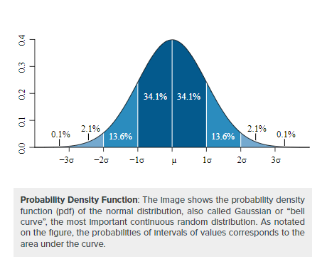
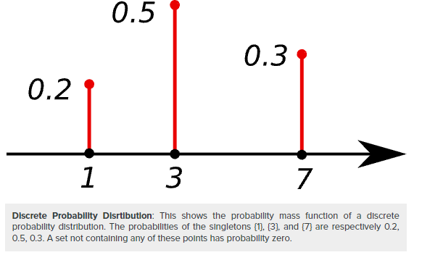
Math Background: Random Variables
Discrete
Continuous
https://courses.lumenlearning.com/boundless-statistics/chapter/discrete-random-variables/

Slide 3
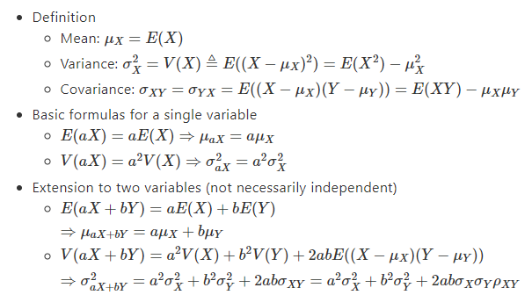
Linear Combination of Random Variables
Given two random variables X and Y
https://hackmd.io/@rogerjang/BJwCkf0LK, with exercise!

Slide 4
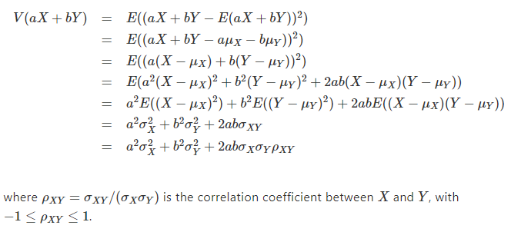
Proof of Variance after Combination
Proof of
https://hackmd.io/@rogerjang/BJwCkf0LK, with exercise!

