Slide 1
Internal Rate of Return (IRR) 內部報酬率
J.-S. Roger Jang (張智星)
MIR Lab, CSIE Dept.
National Taiwan University
jang@mirlab.org, http://mirlab.org/jang

Slide 2
Internal Rate of Return (IRR)
Definition
The rate at which an investment plan breaks even
Also known as
Effective interest rate
Annualized effective compounded return rate
年化報酬率
…
Application
Comparison of 2 investment plans
Quiz:
Definition of IRR in plain texts!
The term “internal” indicates it does not take
environmental factors (e.g., inflation) into consideration.

Slide 3
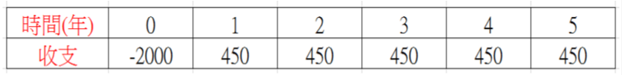
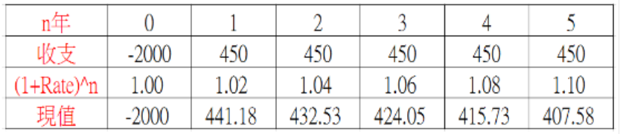
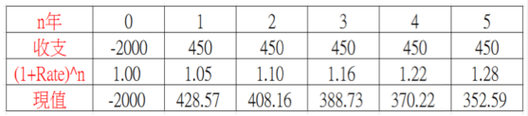
IRR Comparisons
Is this investment plan good? Profit=250?
Comparison with bank interest rate 2%
Comparison with bank interest rate 5%
What is the equivalent interest rate?
NPV: Net present value
➔ NPV=121.07
➔ NPV=-51.73

Slide 4


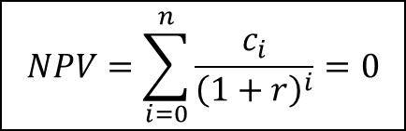




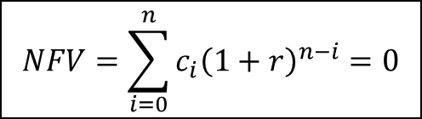

IRR Computation
Net present value (NPV) = 0
Net future value (NFV) = 0
$$NPV=\sum_{i=0}^{n}{\frac{c_{i}}{{\left(1+r\right)}^{i}}}=0$$
$$NFV=\sum_{i=0}^{n}{c_{i}{\left(1+r\right)}^{n−i}}=0$$
Cash flow on time line
Cash flow
at period i
$$c_{0}$$
$$c_{1}$$
$$c_{2}$$
$$c_{i}$$
$$c_{n}$$
Present value
at period 0
$$\frac{c_{i}}{{\left(1+r\right)}^{i}}$$
Future value
at period n
$$c_{i}{\left(1+r\right)}^{n−i}$$

Slide 5
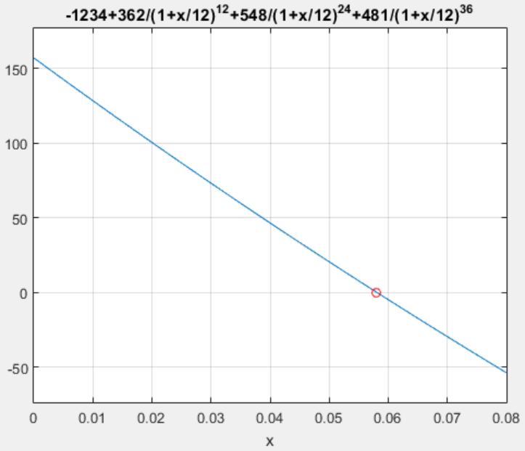




An IRR Example
Cash flow table
Equations
Yearly compounding
Monthly compounding
Year (i) | Cash flow (ci)
0 | -1234
1 | 362
2 | 548
3 | 481
$$−1234$$
$$362$$
$$548$$
$$481$$
$$NPV=−1234+\frac{362}{{\left(1+r\right)}^{1}}+\frac{548}{{\left(1+r\right)}^{2}}+\frac{481}{{\left(1+r\right)}^{3}}=0⇒r=5.96\%$$
$$NPV=−1234+\frac{362}{{\left(1+r/12\right)}^{12}}+\frac{548}{{\left(1+r/12\right)}^{24}}+\frac{481}{{\left(1+r/12\right)}^{36}}=0⇒r=5.80\%$$

Slide 6
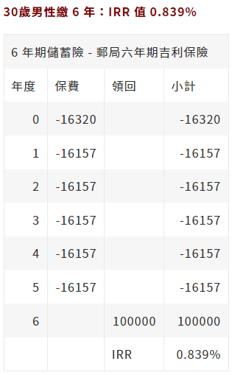
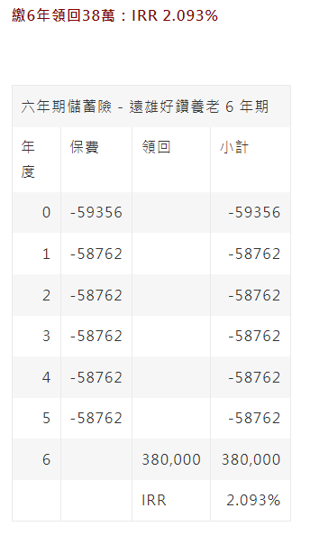
儲蓄險比較
郵局六年期吉利保險
遠雄好鑽養老保險
Based on
yearly compounding
Based on
yearly compounding
Notes:
goEulerNumber.m

Slide 7
投資方案比較
三種投資方案
方案一： 2年賺20% ➔ irr=9.54% (年複利) or 9.15% (月複利)
方案二： 5年賺50% ➔ irr=8.45% (年複利) or 8.14% (月複利)
方案三： 10年賺100% ➔ irr=7.18% (年複利) or 6.95% (月複利)
Exercise
Write a Python function to execute the above computation.
Notes:
Yearly compounding:
r=irrFind([-100 0 120], 12, 'year')*100
r=irrFind([-100 0 0 0 0 150], 12, 'year')*100
r=irrFind([-100 0 0 0 0 0 0 0 0 0 200], 12, 'year')*100
Monthly compounding:
r=irrFind([-100 0 120], 12, 'month')*100
r=irrFind([-100 0 0 0 0 150], 12, 'month')*100
r=irrFind([-100 0 0 0 0 0 0 0 0 0 200], 12, 'month')*100

Slide 8
References
IRR
綠角財經筆記 ⬅ A very good example of IRR
Wiki
儲蓄險比較
IRR值EXCEL教學：儲蓄險比較利潤請看IRR值算年利率，而非報酬率
六年儲蓄險台幣IRR分析-郵局六年期吉利保險(2012年)附DM
六年儲蓄險台幣 IRR 分析 -遠雄好鑽養老保險 (2012附DM)

