Slide 1
K-Nearest Neighbor Classifiers (KNNC)
J.-S. Roger Jang (張智星)
jang@mirlab.org
http://mirlab.org/jang
MIR Lab, CSIE Dept.
National Taiwan University
2022/8/14

Slide 2
Concept of KNNC
Concept: 近朱者赤、近墨者黑
Two Steps:
Find the first k nearest neighbors of a given point.
Determine the class of the given point by voting among k nearest neighbors.
Quiz!
: class-A point
: class-B point
: point with unknown class
Feature 2
3 nearest neighbors
➔ The point is classified as B via 3NNC.
Feature 1

Slide 3
Flowchart for KNNC
Flowchart of classification:
KNNC:
Feature
extraction
From raw data to features
Model
construction
Clustering (optional)
Model
evaluation
KNNC evaluation
on test dataset

Slide 4
Decision Boundary for 1NNC
Voronoi diagram: piecewise linear boundary
Quiz!
More about Voronoi diagrams

Slide 5
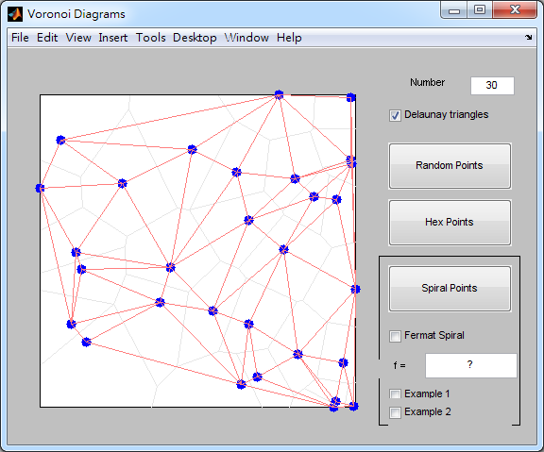
Demos by Cleve Moler
Cleve’s Demos of Delaunay triangles and Voronoi diagram
books/dcpr/example/cleve/vshow.m

Slide 6
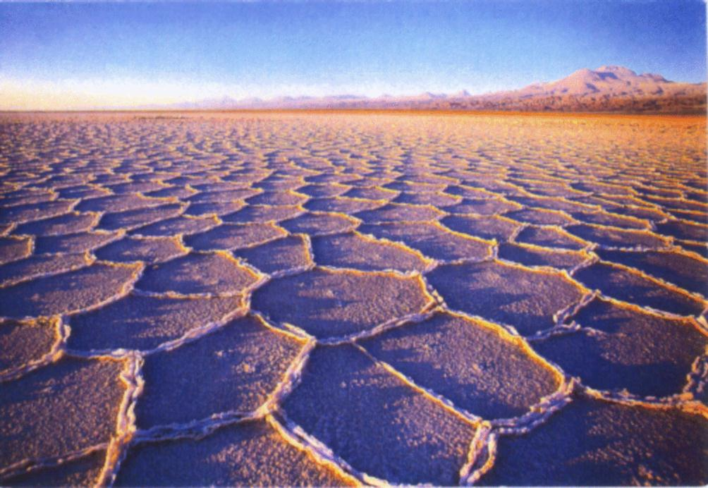
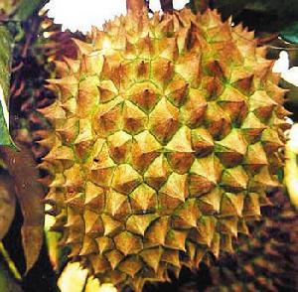
Natural Examples of Voronoi Diagrams (1/2)

Slide 7
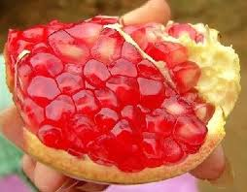
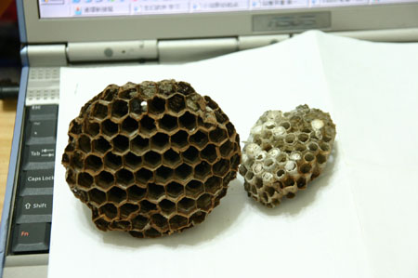
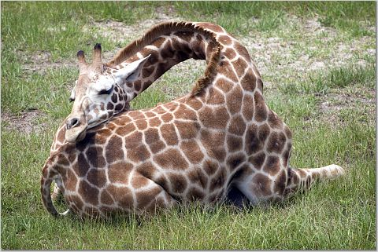
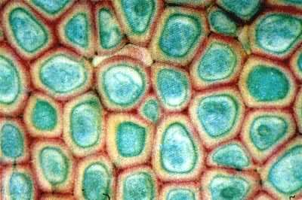
Natural Examples of Voronoi Diagrams (2/2)

Slide 8
Characteristics of KNNC
Strengths of KNNC
Intuitive
No computation for model construction
Weakness of KNNC
Massive computation required when dataset is big
No straightforward way
To determine the value of K
To rescale the dataset along each dimension
Quiz!

Slide 9

Preprocessing of Feature Normalization
Z normalization or z score
To have zero mean and unit variance along each feature
Range normalization
To have a specific range, such as [0, 1], along each feature
Quiz!
Let $x=\left[x_{1},x_{2},⋯,x_{n}\right] \text{be} \text{the} \text{values} \text{of} \text{a} \text{specific} \text{feature} \text{of} \text{a} \text{dataset}$
Z normalization: $${\hat{ x}}_{i}=\frac{x_{i}−μ}{σ},\text{with} μ \text{and} σ^{2} \text{being} \text{the} \text{sample} \text{mean} \\ \text{and} \text{sample} \text{variance} \text{of} x \text{respectively}$$
Range normalization: $${\hat{x}}_{i}=\frac{x_{i}−\min\left(x\right)}{\max\left(x\right)−\min\left(x\right)} \text{to} \text{have} \text{a} \text{range} \text{of} [\text{0, 1}]$$

Slide 10
Variants for KNNC
Many variants of KNNC:
Nearest prototype classification
Single prototype for each class ➔ Use “mean” or “average”
Several prototypes for each class ➔ Use “k-means clustering”
Distance-weighted votes
Edited nearest neighbor classification
k+k-nearest neighbor
Quiz!

Slide 11
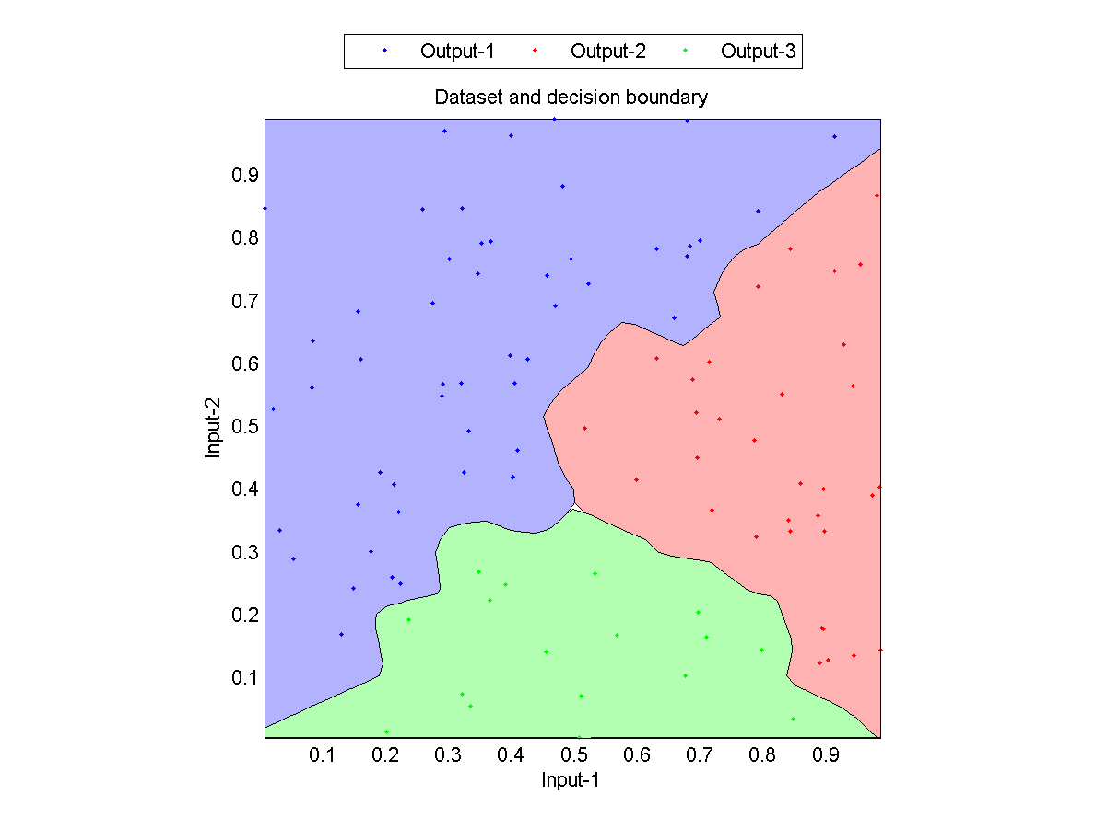
1NNC Decision Boundaries
1NNC Decision boundaries

Slide 12
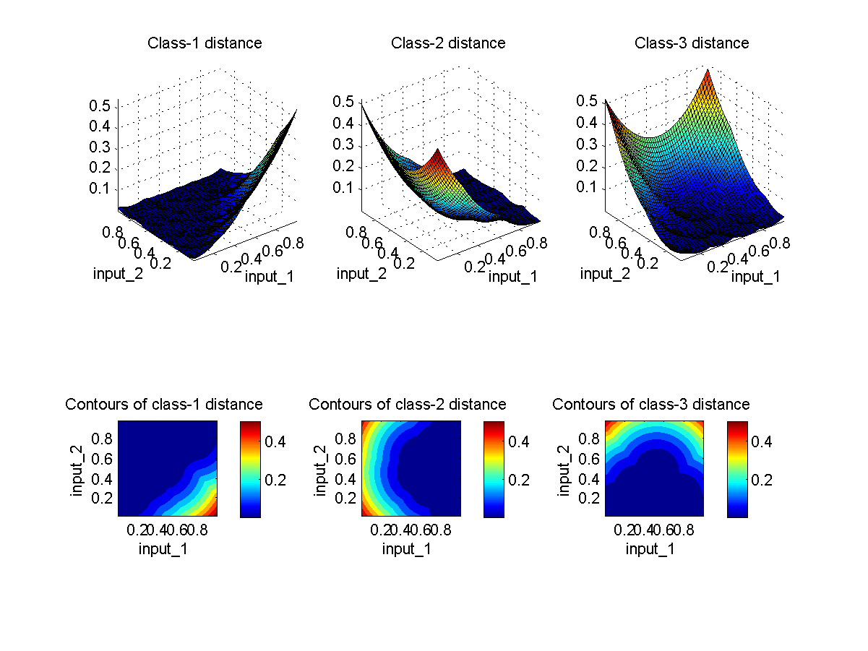
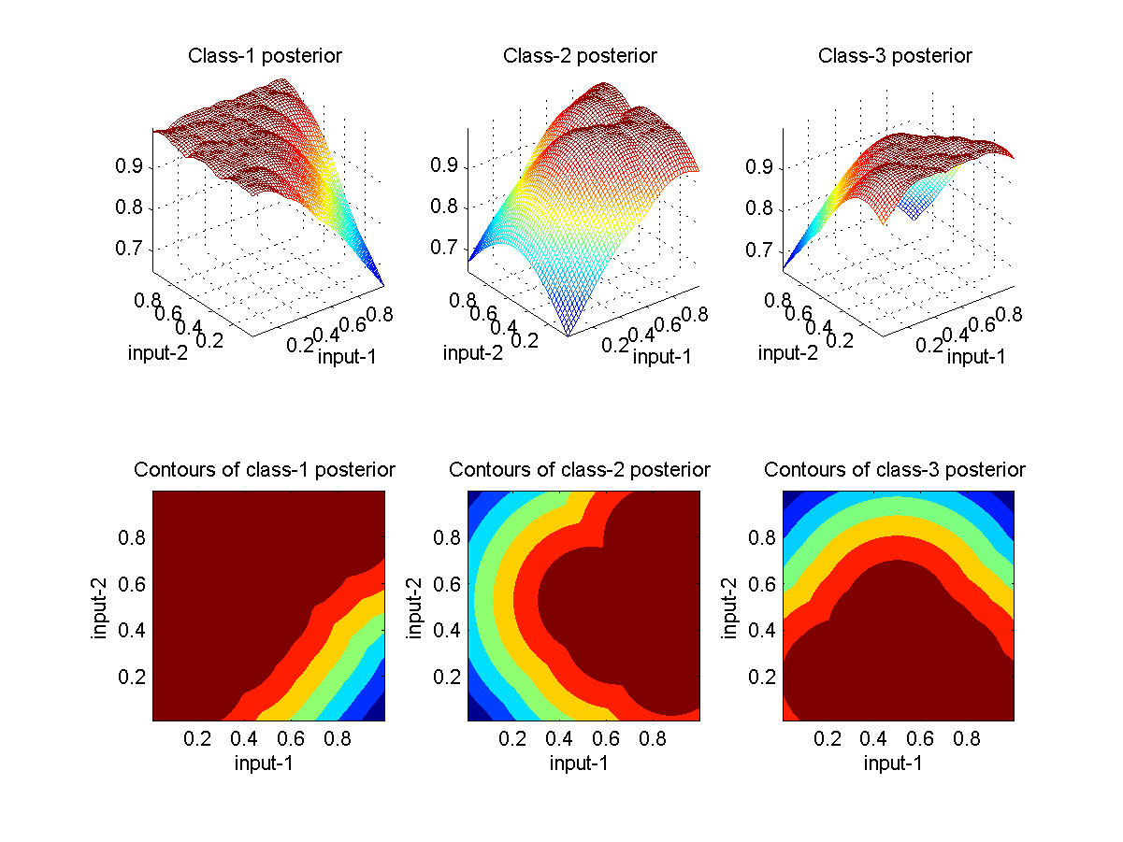
1NNC Distance/Posterior as Surfaces and Contours

Slide 13
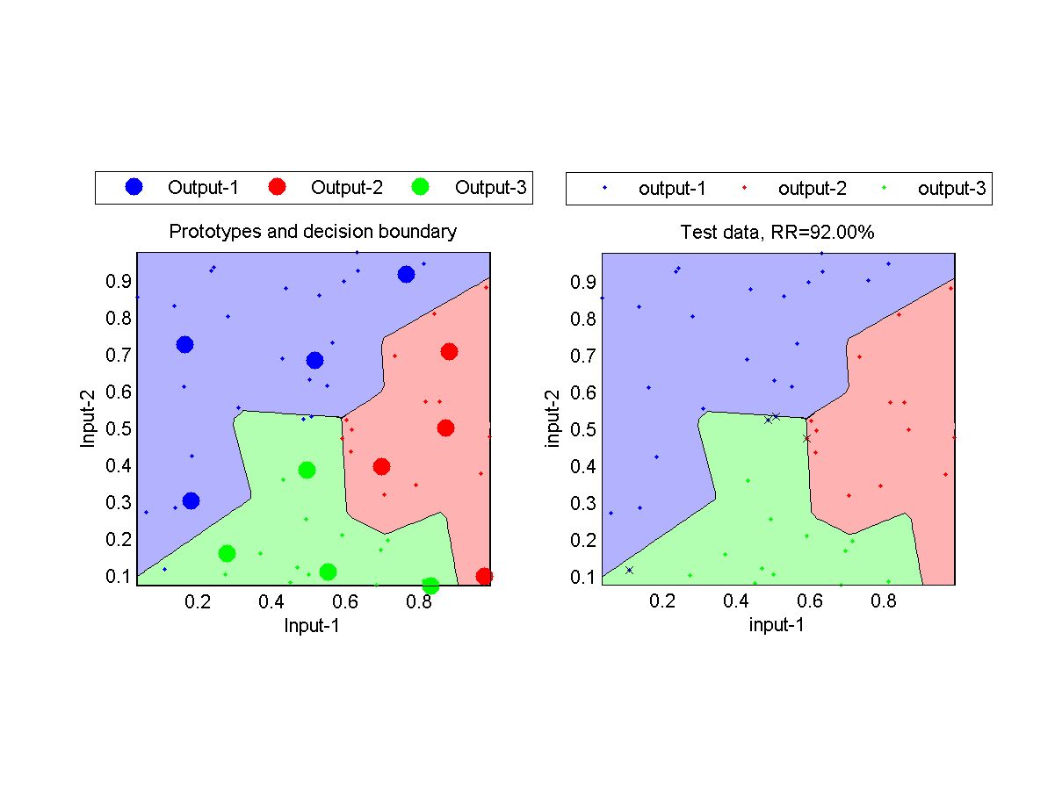
Using Prototypes in KNNC
No. of prototypes for each class is 4.

Slide 14
Decision Boundaries of Different Classifiers
Naive Bayes classifier
Quadratic classifier
1NNC classifier

Slide 15
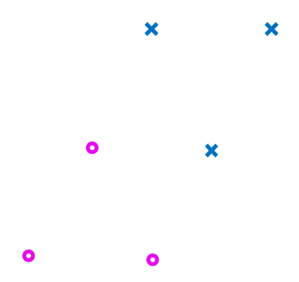
Exercise: KNNC Decision Boundary
Given 6 samples of two classes as shown below, plot the decision boundary based on KNNC with k=1.

Slide 16
Exercise: Nearest Prototype Classifier
If we want to use the nearest prototype classifier instead of KNNC, what methods be used to find the prototype(s) for each class in the following two cases?
When the number of prototype is 1 for each class.
When the number of prototype is more than 1 for each class.

