Slide 1
Sharpe Ratio 夏普率
J.-S. Roger Jang (張智星)
MIR Lab, CSIE Dept.
National Taiwan University
jang@mirlab.org, http://mirlab.org/jang

Slide 2

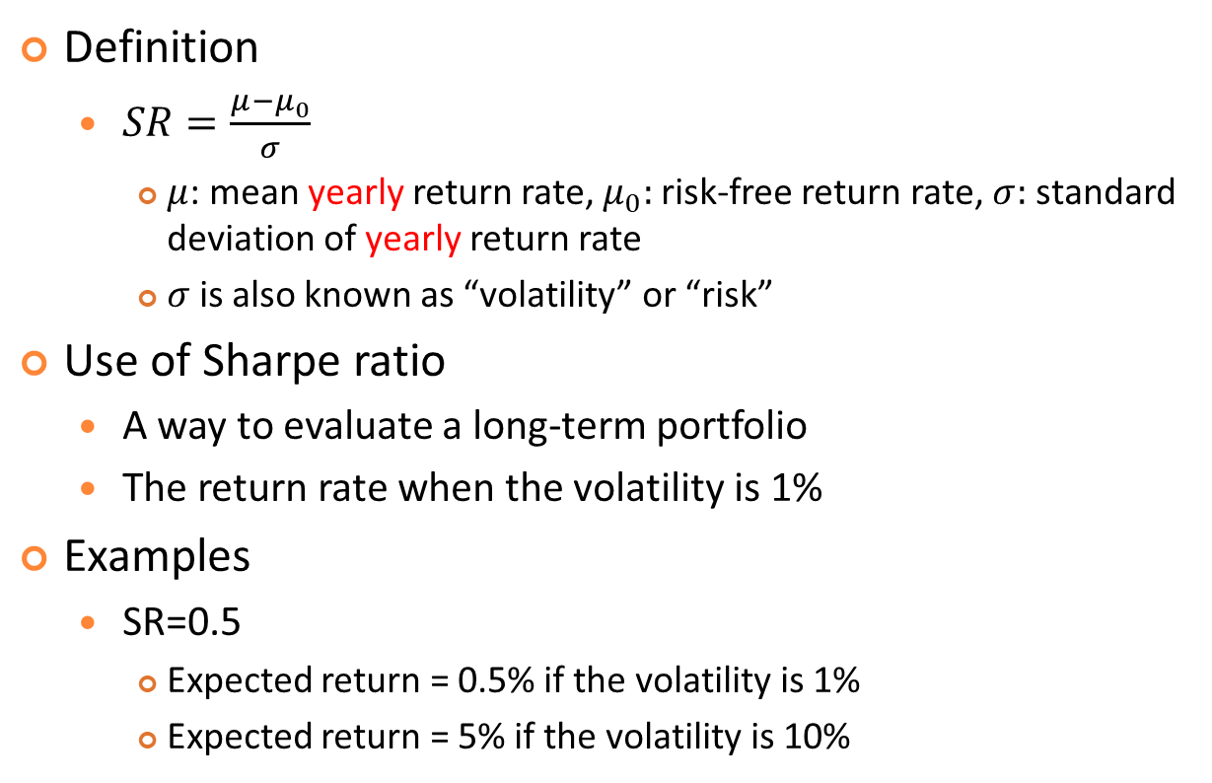

Sharpe Ratio (SR)
Definition
$SR=\frac{μ−μ_{0}}{σ}$
$μ$: mean yearly return rate, $μ_{0}:$risk-free return rate, $σ:$ standard deviation of yearly return rate
$σ$ is also known as “volatility” or “risk”
Use of Sharpe ratio
A way to evaluate a long-term portfolio
The return rate when the volatility is 1%
Examples
SR=0.5
Expected return = 0.5% if the volatility is 1%
Expected return = 5% if the volatility is 10%
Bank deposit interest rate
Assume $μ_{0}$ =0
Assume $μ_{0}$ =0

Slide 3
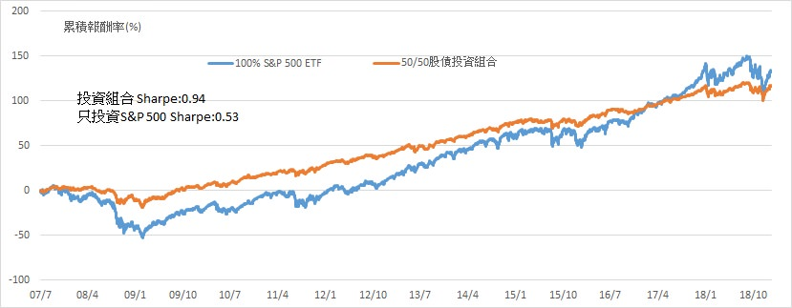
Examples of Sharpe Ratio
Comparison of Sharpe ratios of two portfolios
https://rich01.com/what-sharpe-ratio/

Slide 4
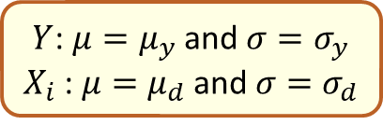
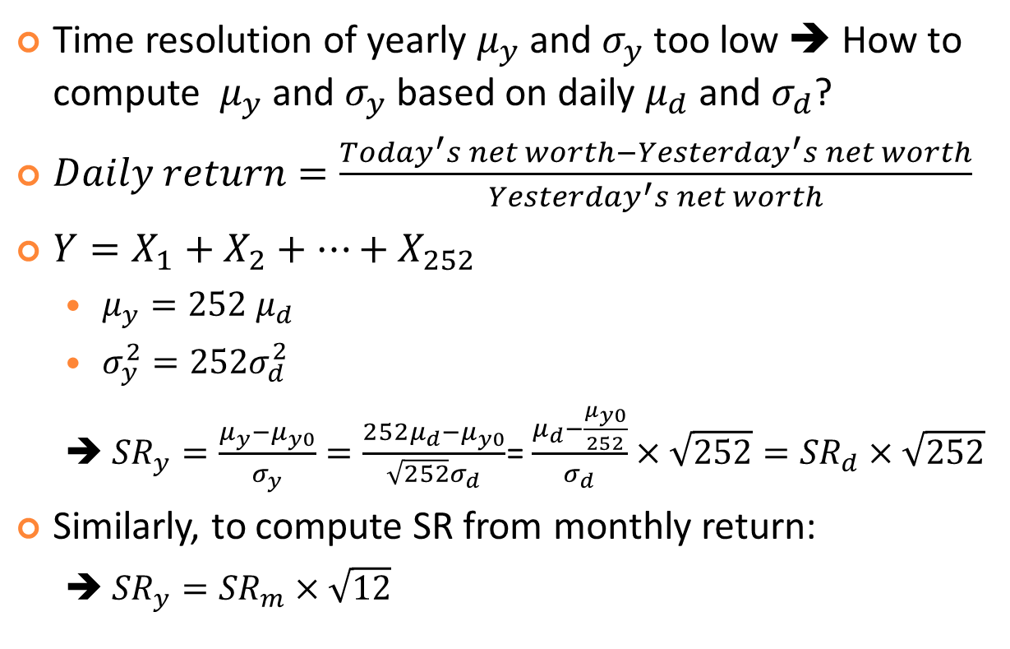
Compute SR from Daily Return
Time resolution of yearly $μ_{y}$ and $σ_{y}$ too low ➔ How to compute $μ_{y}$ and $σ_{y}$ based on daily $μ_{d}$ and $σ_{d}$?
$Daily return=\frac{Today^{′}s net worth−Yesterday^{′}s net worth}{Yesterday^{′}s net worth}$
$Y=X_{1}+X_{2}+…+$ $X_{252}$
$μ_{y}=252$ $μ_{d}$
$σ_{y}^{2}=252σ_{d}^{2}$
➔${SR}_{y}=\frac{μ_{y}−μ_{y0}}{σ_{y}}=\frac{{252μ}_{d}−μ_{y0}}{{\sqrt{252}σ}_{d}}$= $\frac{μ_{d}−\frac{μ_{y0}}{252}}{σ_{d}}×\sqrt{252}={SR}_{d}×\sqrt{252}$
Similarly, to compute SR from monthly return:
➔${SR}_{y}={SR}_{m}×\sqrt{12}$
252: Average trading days per year
$Y$: $μ=μ_{y}$ and $σ=σ_{y}$
$X_{i}$: ${μ=μ}_{d}$ and $σ=σ_{d}$
Source: https://www.realvantage.co/insights/what-is-sharpe-ratio/

Slide 5
Example
Assume the five days’ prices of a stock are [6 8 7 9 8] and the risk-free return is 1%, what is the corresponding Sharpe ratio?
Solution:
return=[2/6, -1/8, 2/7, -1/9];
mu=0.0957
sigma=0.2477
SR_{d} =(mu-0.01/252)/sigma=0.3863
SR_{y} =sqrt(252)* SR_{d}=6.1330

